Slide 2
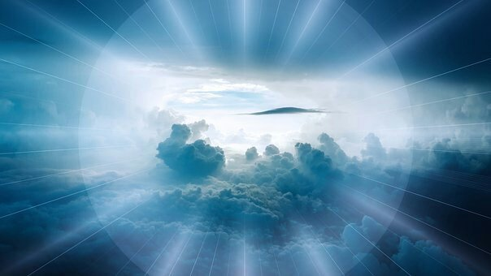
Life in God
Ron Bert
May 2, 2021
Notes:
Life with God is relying on Christ’s sacrifice for salvation

Slide 3
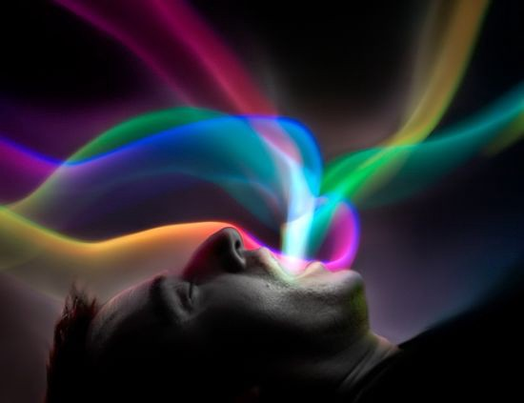
And the LORD God formed man of the dust of the ground, and breathed into his nostrils the breath of life; and man became a living being. — Genesis 2:7
the LORD God formed man
God
. .
living being
Notes:
God created man so that he could experience autonomous life to choose as he would.

Slide 4
"… for in Him we live and move and have our being, as also some of your own poets have said, 'For we are also His offspring.'" — Acts 17:28
we live
in Him we live
we live
we are also His offspring
His
. .
Notes:
Created by God, our eventual return to His presence is our destiny. As a Father evaluates a child, so too will God judge each of our hearts.

Slide 5
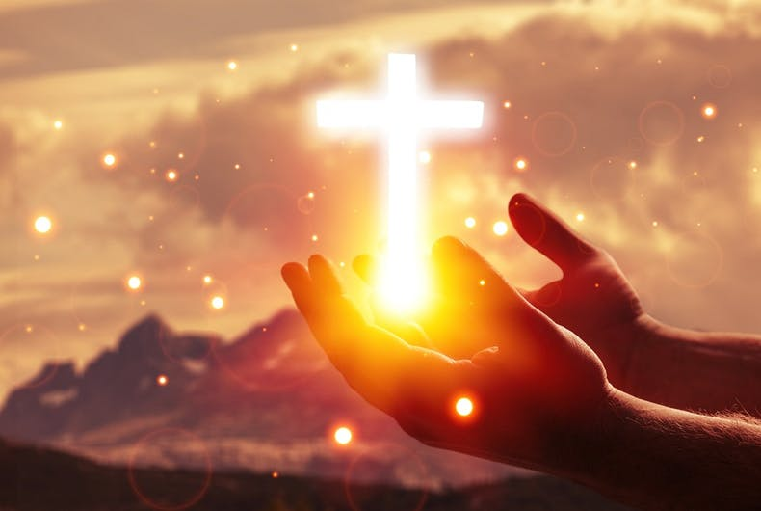
For none of us lives to himself, and no one dies to himself. For if we live, we live to the Lord; and if we die, we die to the Lord. Therefore, whether we live or die, we are the Lord's. — Romans 14:7-8
if we live
we live
. .
if we die
. .
we are the Lord's
the Lord's
. .
Notes:
Avoidance does not change the fact of what has always been, face to face with the truth.

Slide 6
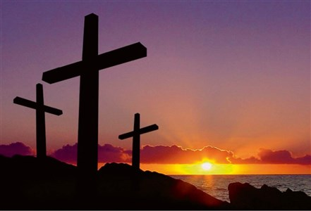
salvation
apart from sin for salvation
appear a second time
judgment
↑
who eagerly wait for Him
↑
appointed for men to die once
Christ was offered once
to bear the sins of many
And as it is appointed for men to die once, but after this the judgment, so Christ was offered once to bear the sins of many. To those who eagerly wait for Him He will appear a second time, apart from sin, for salvation. — Hebrews 9:27-28
appointed for men
die once
to die once
salvation
judgment
Christ was offered
Christ
once
to bear the sins of many
who eagerly wait for Him
appear a second time
apart from sin
for salvation
for salvation
. .
Christ
Christ
Notes:
The faithful have an eternal joy that is given upon His promise of salvation. It is God’s will that we find Him through knowing Jesus Christ as a breathless moment.

Slide 7
"Nor is there salvation in any other, for there is no other name under heaven given among men by which we must be saved." — Acts 4:12
salvation
no other name
. .
heaven given
we must be saved
must
. .
Notes:
Jesus Christ is the name above all names that will come to confront all. Generally, men do not like to be told what to do. God’s word is a final proclamation from His justice. Men have created many facsimile religions dismissing God and catering to the whims of particular sects, wherever they may be. It is God over man, not man over man.

Slide 8
"Most assuredly, I say to you, he who hears My word and believes in Him who sent Me has everlasting life, and shall not come into judgment, but has passed from death into life. — John 5:24
death in
hears
My word
to life
death into life
hears
believes
in
Him
believes
everlasting life
death into life
Notes:
To avoid the curse of condemnation, a soul must surrender to the truth God has brought. Eternal life is the promise for those that hear and adhere to His words. The door on the other side is larger than the one we all need to squeeze through.

Slide 9
Or do you not know that your body is the temple of the Holy Spirit who is in you, whom you have from God, and you are not your own? For you were bought at a price; therefore glorify God in your body and in your spirit, which are God’s. — 1st Corinthians 6:19-20
Spirit who is in you
in
. .
have from God
God
. .
glorify God in your body and in your spirit
glorify God
your body
and in your
in your body
spirit, which are God’s
spirit
Notes:
To see the truth begins a journey of emancipation into His light of love and peace ahead.

Slide 10
He who has the Son has life; he who does not have the Son of God does not have life. These things I have written to you who believe in the name of the Son of God, that you may know that you have eternal life, and that you may continue to believe in the name of the Son of God. — 1st John 5:12-13
has
life
has the Son
not
the Son
does not have life
life = has the Son
does not have life = has not the Son
eternal life to who believe in God
to
who
in
God
in the name of the Son of God
. .
know
eternal life
believe in
action
Notes:
Believing in God and His promise delivers a soul to know truth in all of its highest glory.

Slide 11
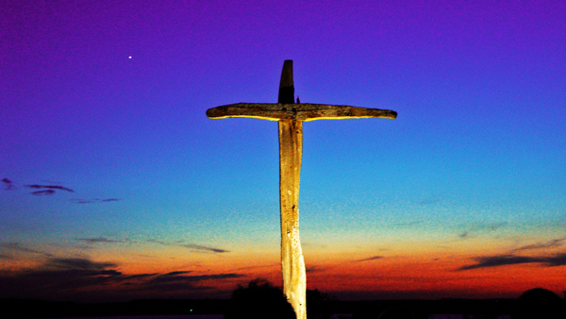
"He who believes in the Son has everlasting life; and he who does not believe the Son shall not see life, but the wrath of God abides on him." — John 3:36
in
believes in
believes in
everlasting life
everlasting life
everlasting life
does not believe
does not believe
not see life
wrath of God abides on him
wrath of God abides on him
Notes:
Anger is part of that which will eventually destroy all who are mired by its infectious results. Sadness often accompanies wrath. Jesus says it succinctly, life in Him or not.

Slide 12
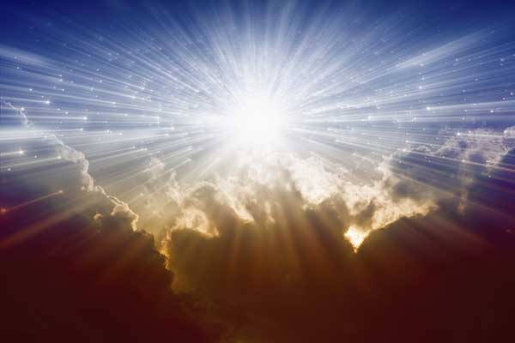
Then Jesus spoke to them again, saying, "I am the light of the world. He who follows Me shall not walk in darkness, but have the light of life." — John 8:12
Jesus
everlasting life
follow Me
follow
Me
light of life
. .
Notes:
To see God one has to come to the light of His truth. Just seeing God has no result unless one believes to the point of becoming a follower of His word.

Slide 13
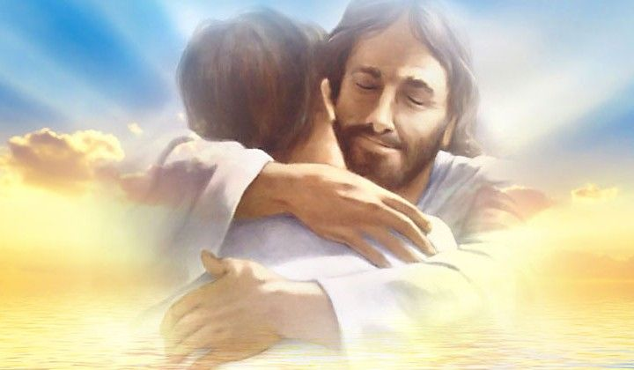
"He who loves his life will lose it, and he who hates his life in this world will keep it for eternal life. If anyone serves Me, let him follow Me; and where I am, there My servant will be also. If anyone serves Me, him My Father will honor." — John 12:25-26
life
life
keep it
life
. .
follow Me
My servant
. .
serves Me
. .
Notes:
Disappointments fill each heart where death devours loved ones. To be free of material bondage, eternity has to become the target.

Slide 14
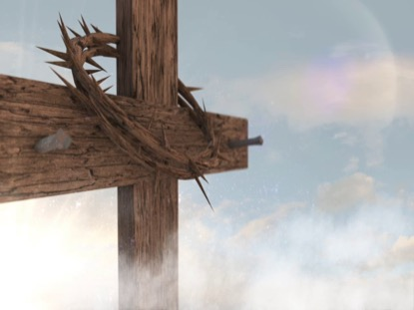
"And this is eternal life, that they may know You, the only true God, and Jesus Christ whom You have sent." — John 17:3
eternal life
eternal life
know the only true God
↓
and Jesus Christ
know
the only true God
and Jesus Christ
Jesus
Christ
Notes:
The Bible clearly states truth for all to know God, and His Son, through the Holy Spirit; a joyous union of His delivered truths. There are no facsimiles man can create to supersede this truth above all other truths or deceptions.

Slide 15
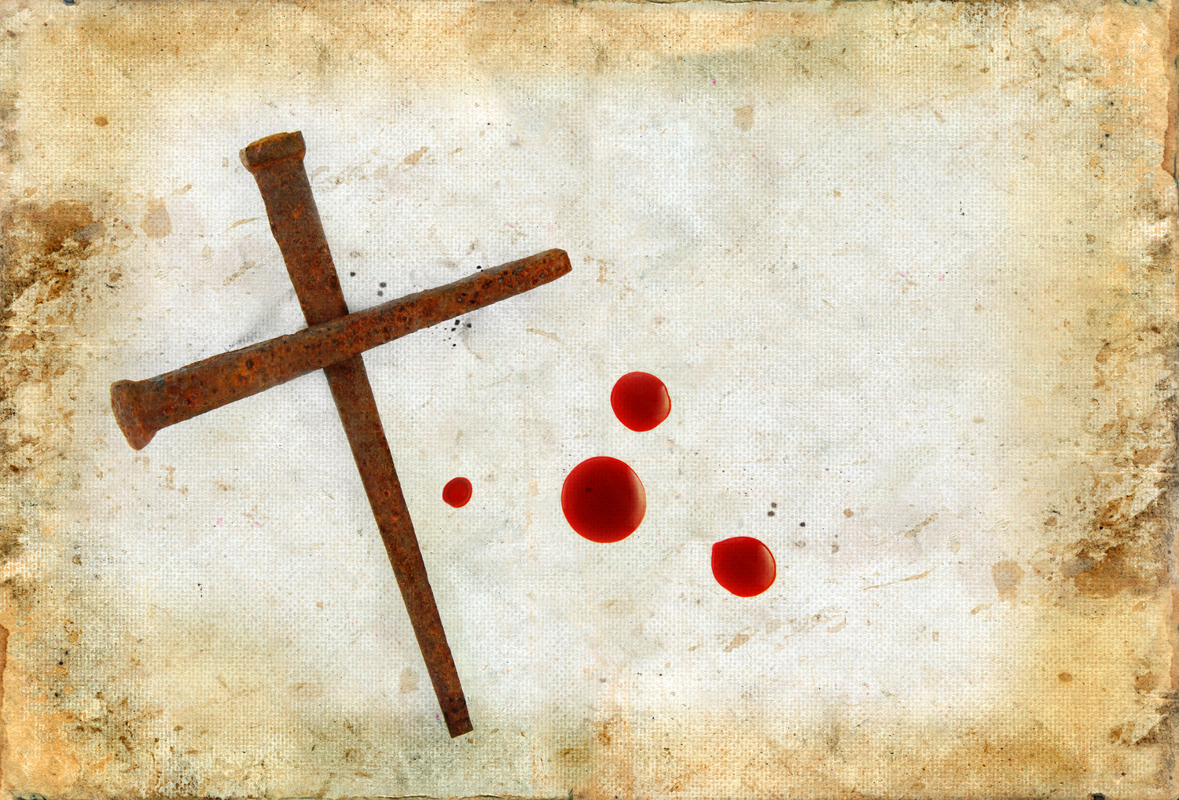
And truly Jesus did many other signs in the presence of His disciples, which are not written in this book; but these are written that you may believe that Jesus is the Christ, the Son of God, and that believing you may have life in His name. — John 20:30-31
Jesus
believe
believe
Christ
Son of God
. .
may have life
. .
Notes:
What a time to witness God Himself cry for our return. To carry the cross as Jesus did is the inspiration to climb on.

Slide 16
eternal life

Slide 17
And behold, a certain lawyer stood up and tested Him, saying, "Teacher, what shall I do to inherit eternal life?" He said to him, "What is written in the law? What is your reading of it?" — Luke 10:25-26
eternal life
eternal life?
eternal life?
Notes:
Skeptics and power mongering fools see not His grace offered through His mercy of forgiveness.

Slide 18
So he answered and said, "'You shall love the LORD your God with all your heart, with all your soul, with all your strength, and with all your mind,' and 'your neighbor as yourself.'" And He said to him, "You have answered rightly; do this and you will live." — Luke 10:27-28
→ love
the LORD your God
with all your heart
with all your soul
with all your strength
with all your mind
your neighbor as yourself
love
love
the LORD your God
with
all your heart
with all your soul
all
heart
with all your strength
with all
all
soul
your mind
your neighbor as
yourself
all
strength
all
mind
do this and you will live
do this and you will live
Notes:
What is simple for some is hard for others. Surrendering to God naturally produces more than can be said or explained: life’s pure essence.

Slide 19
Whoever denies the Son does not have the Father either; he who acknowledges the Son has the Father also. Therefore let that abide in you which you heard from the beginning. If what you heard from the beginning abides in you, you also will abide in the Son and in the Father. And this is the promise that He has promised us -- eternal life. — 1st John 2:23-25
in
in
righteousness
abide in the Son and in the Father
action
abide in
the Son and in the Father
the promise
the promise
- eternal life
eternal life
Notes:
To deny Jesus Christ, or exalt mere transitionary lying men, is to miss God’s own true message, to the follies of all that falls short.

Slide 20
For when you were slaves of sin, you were free in regard to righteousness. What fruit did you have then in the things of which you are now ashamed? For the end of those things is death. — Romans 6:20-21
righteousness
Sins
Notes:
Knowing truth has one or another result. Denial or acceptance. Death or life is the plan of choices in commitment. Pity to all who cannot care for family and or associations, no matter preference or position, for assisting in the eventual cause to know the truth of God. Hate cannot guide those who lack love.

Slide 21
But now having been set free from sin, and having become slaves of God, you have your fruit to holiness, and the end, everlasting life. For the wages of sin is death, but the gift of God is eternal life in Christ Jesus our Lord. — Romans 6:22-23
Christ Jesus
fruit to holiness
fruit to holiness
everlasting life
everlasting life
gift of
in
Christ Jesus
God is eternal life in Christ Jesus
Christ Jesus
our Lord
Notes:
Heaven is where the sands of time never run out. The end of the tunnel is where unending joy abounds.

Slide 22
"I am He who lives, and was dead, and behold, I am alive forevermore. Amen. And I have the keys of Hades and of Death." — Revelation 1:18
I am He who lives
Christ Jesus
the keys
. .
Notes:
The keys to life rest in the bosom of God's word through Christ Jesus.

Slide 23
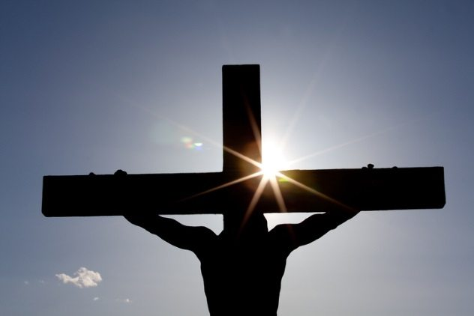
For the love of Christ compels us, because we judge thus: that if One died for all, then all died; and He died for all, that those who live should live no longer for themselves, but for Him who died for them and rose again. — 2nd Corinthians 5:14-15
love of Christ compels us
Christ
Christ
He died for all
. .
live
live
for Him
. .
Notes:
Christ died for all that He might save us from the evils we despise. His life exposed the truth God wills for the faithful to know.

Slide 24
… that if you confess with your mouth the Lord Jesus and believe in your heart that God has raised Him from the dead, you will be saved. — Romans 10:9
confess
confess
Lord Jesus
in
with Him
believe
in your heart
believe
saved
saved
Notes:
Confessing faith in His word is essential to hold a confident heart in Him.

Slide 25
with Him

Slide 26
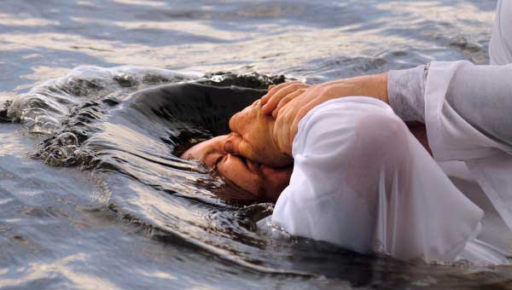
… buried with Him in baptism, in which you also were raised with Him through faith in the working of God, who raised Him from the dead. — Colossians 2:12
in
in baptism
. .
raised with Him through faith
with Him
raised with Him through faith
. .
in
in the working of God
For by grace you have been saved through faith, and that not of yourselves; it is the gift of God, … — Ephesians 2:8
. .
is the gift of God
. .
Notes:
Obedience is His reasonable command with such an eternal salvation.

Slide 27
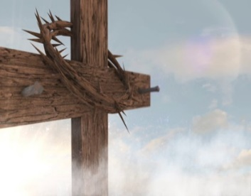
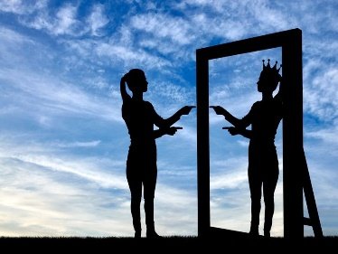
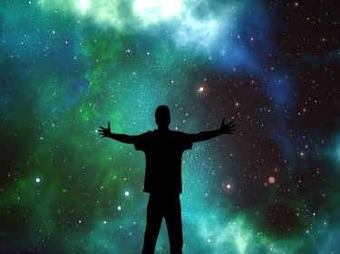
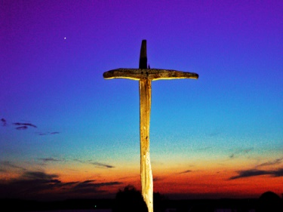
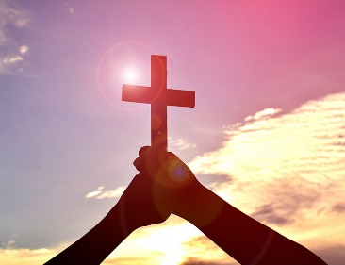

Slide 28
→ It is God that breathed life into mankind
→ Whether we live or die, we are the Lord’s
→ Men die once and after appear for judgment
→ God ordains Jesus only, through we must be saved
→ All we have has been given to us by God
→ Without Jesus, one has no life in God
→ Not believing in Jesus invites the wrath of God
→ Eternal life is knowing God and Jesus Christ
→ Loving God with one’s all & neighbor delivers life
→ God’s gift is eternal life in Christ Jesus
→ Jesus holds the keys to life and death for each of us
→ Believing Jesus rose from the dead is our faith
→ Baptism raises us from death to life/working of God
Life without God is impossible
Notes:
Life without God is impossible

Slide 30
Please visit http://www.RonBert.com to explore further
Ronald Bert Channel on
Notes:
Eternity never ends.

