Slide 2
KEEP
Ron Bert
February 16, 2020

Slide 3
All the paths of the LORD are mercy and truth, To such as keep His covenant and His testimonies. — Psalms 25:10
From Heaven
His covenant
promise
agreement
contract
His testimonies
confirmations
evidences
declarations
mercy and truth
keep
To such as keep
mercy and truth
To such as keep
His covenant
His testimonies
keep
Notes:
His testimonies and more importantly, His covenant now stands before us all. Do we see the mercy He extends by revealing the truth of good and evil, allowing us to choose one for the better or the ladder for the worst. It is a condition of temporary time where souls realize and decide who they will become.

Slide 4
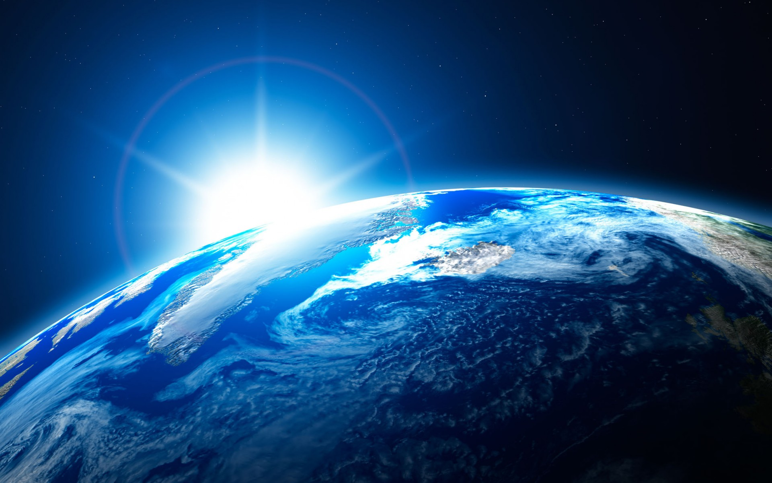
But the mercy of the LORD is from everlasting to everlasting On those who fear Him, And His righteousness to children's children, To such as keep His covenant, And to those who remember His commandments to do them. — Psalms 103:17-18
mercy
keep
To such as keep
keep
To such as keep
remember
His commandments
remember
His commandments
to do them
to do them
Notes:
Remembering the sure goodness God declares holds the strength of continuing family, and fortune all generations seek.

Slide 5
Keep your tongue from evil, And your lips from speaking deceit. — Psalms 34:13
keep
keep
Notes:
Single truths fill the word of God, instructing in what is best, for the decency He wills for His eternal creation.

Slide 6
That they may set their hope in God, And not forget the works of God, But keep His commandments; — Psalms 78:7
keep
hope
in God
not forget
. .
works of God
keep
commandments
Notes:
God has delivered life to know and to wonder. The way of God is not so far off touching all that is. Mortal faith is hoping for what is greater, adhering to His subjective call.

Slide 7
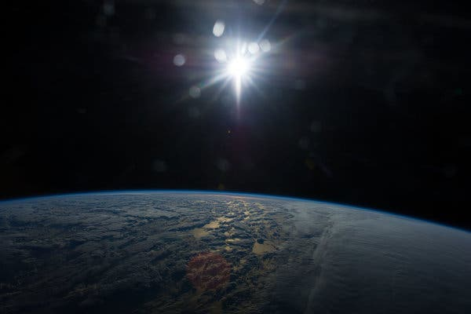
Blessed are those who keep His testimonies, Who seek Him with the whole heart! They also do no iniquity; They walk in His ways. You have commanded us To keep Your precepts diligently. Oh, that my ways were directed To keep Your statutes! — Psalms 119:2-5
keep
keep
keep
keep
seek
keep
seek
whole heart
. .
in
walk in His ways
. .
command
keep
command
keep
Notes:
His commands are a set of standards establishing what is best, and good, for the unity of life in His creation.

Slide 8
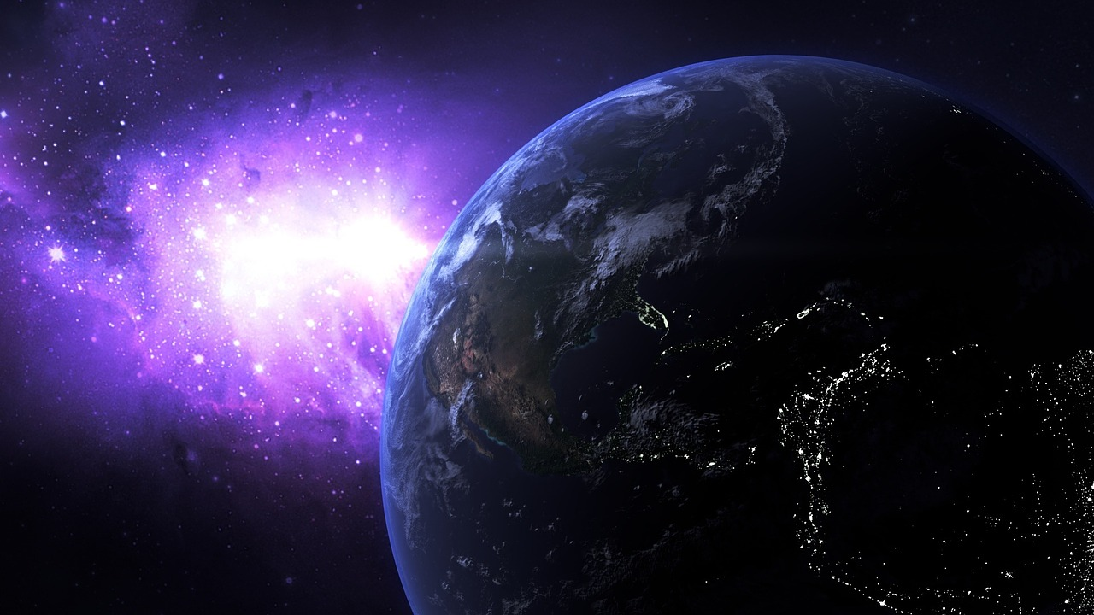
Redeem me from the oppression of man, That I may keep Your precepts. Make Your face shine upon Your servant, And teach me Your statutes. Rivers of water run down from my eyes, Because men do not keep Your law. — Psalms 119:134-136
Redeem me
Redeem me
keep
Truths
face shine
keep
teach
teach
do not
do not
keep
FAIL
Notes:
In the United States of America today, how many follow the teachings of the Bible, in which this country was founded, to protect those rights to worship in freedom's light under the truths of God? Hypocrites plague the corridors of blinded time where what was once sweet has become soured. As infants need instructions to survive, so too divine intervention is part of our spiritual rise back to God. Without God there is no survival.

Slide 9
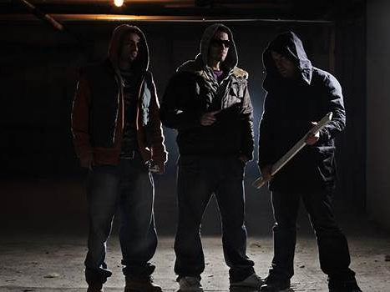
My son, do not walk in the way with them, keep your foot from their path; For their feet run to evil, And they make haste to shed blood. — Proverbs 1:15-16
keep
walk in
do not
in
walk in
keep
EVIL
Notes:
Running with thugs is like crud in the chest coughing on the self with no devotion to share. No matter the pain one says he or she has, the test of endurance is the mandate of God. One chooses to climb or descend in heart or heartlessness.

Slide 10
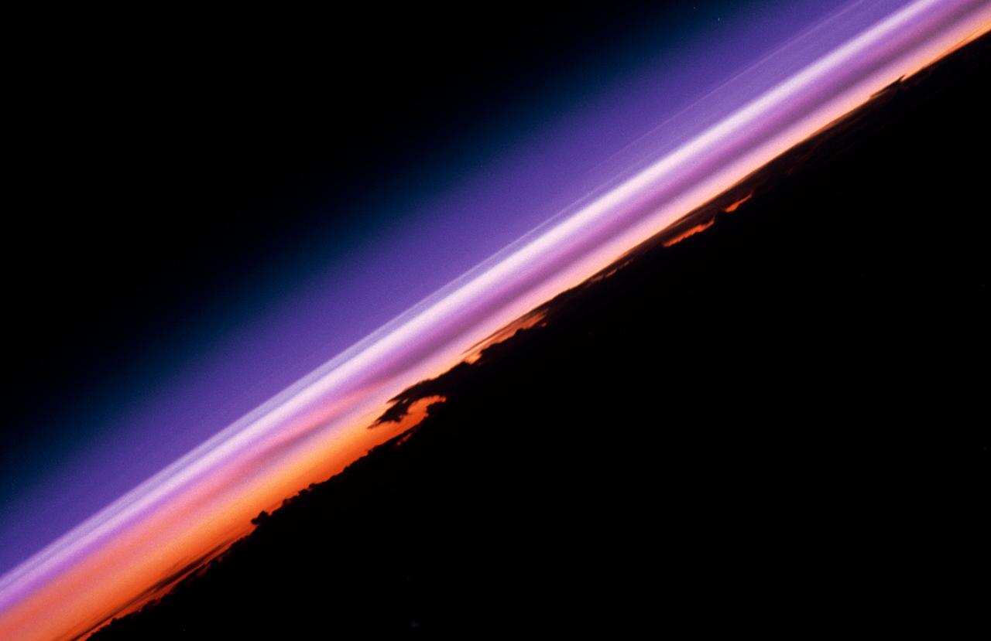
Discretion will preserve you; Understanding will keep you, To deliver you from the way of evil, From the man who speaks perverse things, From those who leave the paths of uprightness To walk in the ways of darkness; Who rejoice in doing evil, And delight in the perversity of the wicked; Whose ways are crooked, And who are devious in their paths; — Proverbs 2:11-15
Discretion
Discretion
Understanding
Understanding
keep
darkness
wicked
keep
devious
Notes:
The darkness of denying hearts, crooked in wickedness, will be revealed by the actions that destroy them. Looking to the shifting lies of man to absolve sin is not a substitute to what God has set in stone. Cool truth refreshes all who drink of it. Barren is the wasteland of lies where all are thirsty. Senseless water has no hold in the sand it disappears into. His light is the reservoir of eternal salvation.

Slide 11
To deliver you from the immoral woman, From the seductress who flatters with her words, Who forsakes the companion of her youth, And forgets the covenant of her God. For her house leads down to death, And her paths to the dead; None who go to her return, Nor do they regain the paths of life - So you may walk in the way of goodness, And keep to the paths of righteousness. — Proverbs 2:16-20
Discretion
Carefulness
Good judgment
Choice
Understanding
keep
in
walk in
walk in
goodness
keep
goodness
righteousness
righteousness
Notes:
Sorrow brings piercing chime's of weakness to be strong.

Slide 12
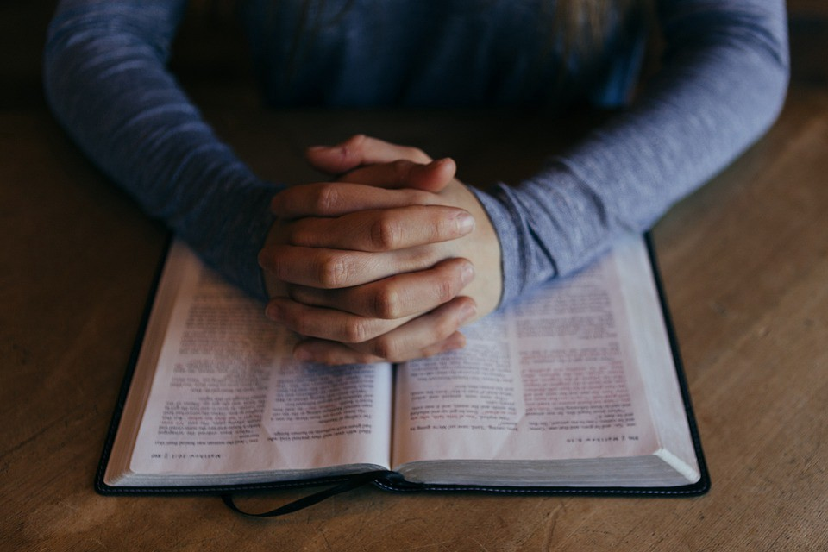
He also taught me, and said to me: "Let your heart retain my words; Keep my commands, and live. Get wisdom! Get understanding! Do not forget, nor turn away from the words of my mouth. Do not forsake her, and she will preserve you; Love her, and she will keep you. Wisdom is the principal thing; Therefore get wisdom. And in all your getting, get understanding." — Proverbs 4:4-7
keep
taught me
taught me
retain my words
retain my words
and live
and live
Do not forget
Do not forget
keep
keep
keep
keep
keep
Notes:
To achieve wisdom, memory of previous understandings must not be forgotten.

Slide 13
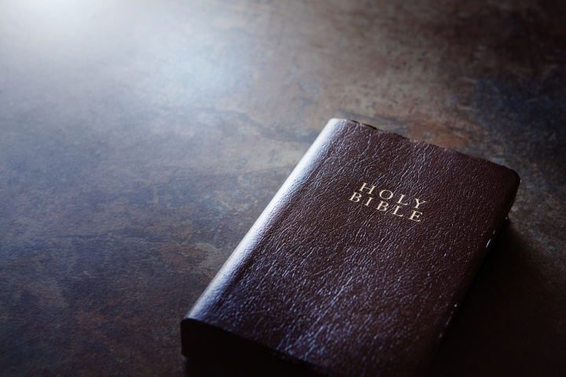
My son, keep your father's command, And do not forsake the law of your mother. Bind them continually upon your heart; Tie them around your neck. When you roam, they will lead you; When you sleep, they will keep you; And when you awake, they will speak with you. For the commandment is a lamp, And the law a light; Reproofs of instruction are the way of life, To keep you from the evil woman, From the flattering tongue of a seductress. — Proverbs 6:20-24
keep
keep
keep
light
instruction are the way of life
instruction are the way of life
keep
Notes:
Parents, too often dismissed, carry many horns of truth. The stubbornness of youth cannot see from above as it peers up from below. Love builds bonds that lights the paths ahead, and protects the soul from lies spewn among men. The greatest shield from a contemptuous life is the love we have for God and others.

Slide 14
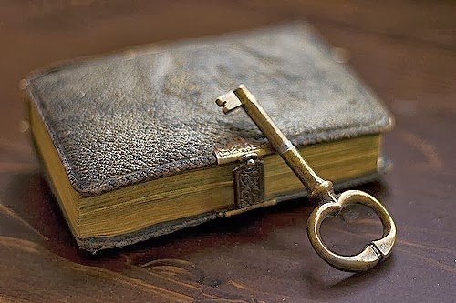
My son, keep my words, And treasure my commands within you. Keep my commands and live, And my law as the apple of your eye. Bind them on your fingers; Write them on the tablet of your heart. Say to wisdom, "You are my sister," And call understanding your nearest kin, That they may keep you from the immoral woman, From the seductress who flatters with her words. — Proverbs 7:1-5
. .
keep my words
treasure
keep
keep
keep
keep
keep
understanding
understanding
keep
keep
. .
keep you
Temptations
Notes:
The keys to the treasure house have been given to all. Come is the call to accept what has been freely given to live in the fullness He offers.

Slide 15
A time to gain, And a time to lose; A time to keep, And a time to throw away; A time to tear, And a time to sew; A time to keep silence, And a time to speak; — Ecclesiastes 3:6-7
time
time
time
time
time
time
keep
keep
time
time
time
time
time
time
time
keep
time
time
time
time
Notes:
Time is God’s creation that limits experiences to the pinpoint of the moment. Many hope for there, but God looks to see us here, for what we are, not illusions of distant desires. Contentment transcends the sky's highest plane.

Slide 16
Let us hear the conclusion of the whole matter: Fear God and keep His commandments, For this is man's all. For God will bring every work into judgment, Including every secret thing, Whether good or evil. — Ecclesiastes 12:13-14
God
keep
keep
man's all
God
man's all
keep
keep
Notes:
God is the watchful servant who will judge in the thunderous righteousness of His truth.

Slide 17
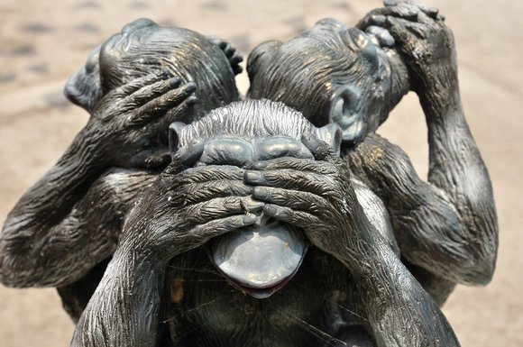
And He said, "Go, and tell this people: 'Keep on hearing, but do not understand; Keep on seeing, but do not perceive.'" — Isaiah 6:9
not speaking
not hearing
keep
keep
God
not seeing
do not understand
do not understand
keep
do not perceive
do not perceive
Notes:
Many remain in a state of denial that God is, and He is waiting to see who we become in thought and desire.

Slide 18
You will keep him in perfect peace, Whose mind is stayed on You, Because he trusts in You. — Isaiah 26:3
keep
in perfect
in perfect peace:
mind is stayed on You
Because he trusts in You
peace
mind is stayed on
You
Because he trusts in You
Notes:
Unyielding peace can only come to those who fully trust in His gifts and promises beyond the night where daylight never ends.

Slide 19
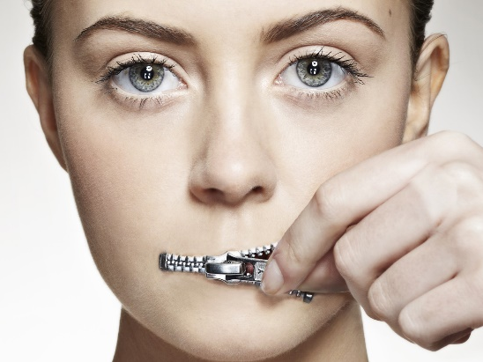
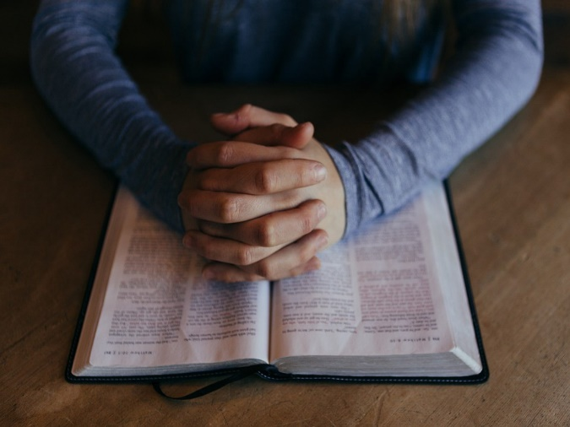
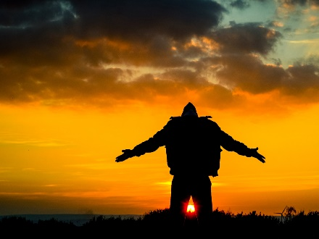
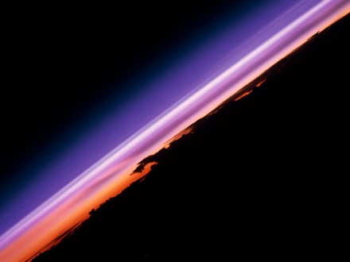

Slide 20
→ Mercy and truth come to those keeping His edicts
→ Keep from speaking deceitfully
→ Diligently keeping God’s word blesses one
→ Let not man’s oppressions keep from obeying God
→ Do not keep with evil doers
→ Understanding keeps a soul from the evil ways
→ Walk in ways of goodness & keep to righteousness
→ Keeping God’s commands causes one to live
→ His rules light the way keeping one from immorality
→ Times declare what one should keep and or speak
→ Fear God and keep His ways for this is man’s all
→ One can keep to things yet remain oblivious of God
→ Perfect peace comes by trust in God
Each step reveals the path forward
Notes:
Each step reveals the path forward

Slide 22
KEEP 2
Ron Bert
February 16, 2020

Slide 23
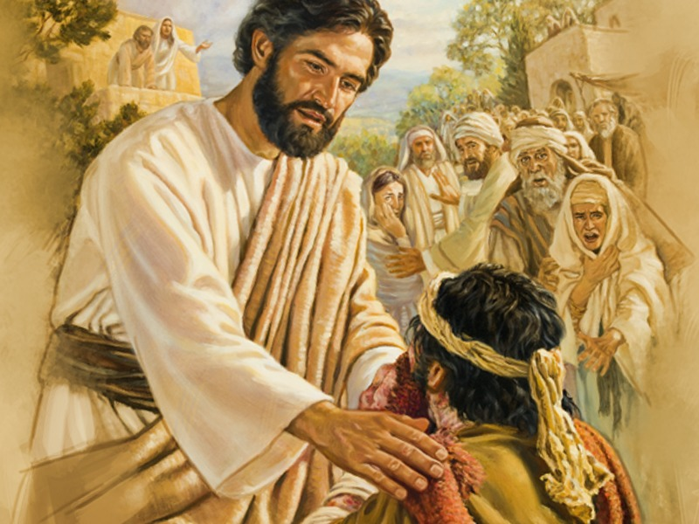
So He said to him, "Why do you call Me good? No one is good but One, that is, God. But if you want to enter into life, keep the commandments." — Matthew 19:17
God
keep
enter into life
enter into life
keep
commandments
Notes:
There is only One God who watches over the schisms of man.

Slide 24
He said to them, "All too well you reject the commandment of God, that you may keep your tradition." — Mark 7:9
reject
keep
keep
custom
practice
habit
belief
Notes:
Deception creeps in our world of shadows. To follow man is less than knowing God’s will as given in His word.

Slide 25
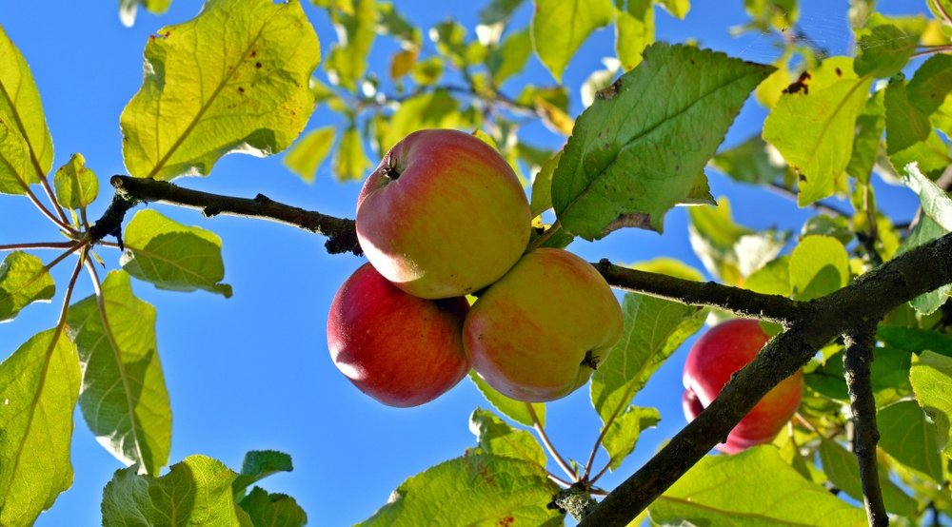
"But the ones that fell on the good ground are those who, having heard the word with a noble and good heart, keep it and bear fruit with patience." — Luke 8:15
heard the word
. .
keep it
keep it
keep
. .
bear fruit
Notes:
Seeking God is never-ending as He extends His eternal love. Past all hardships, to hear causes our souls to rise in the glory of knowing.

Slide 26
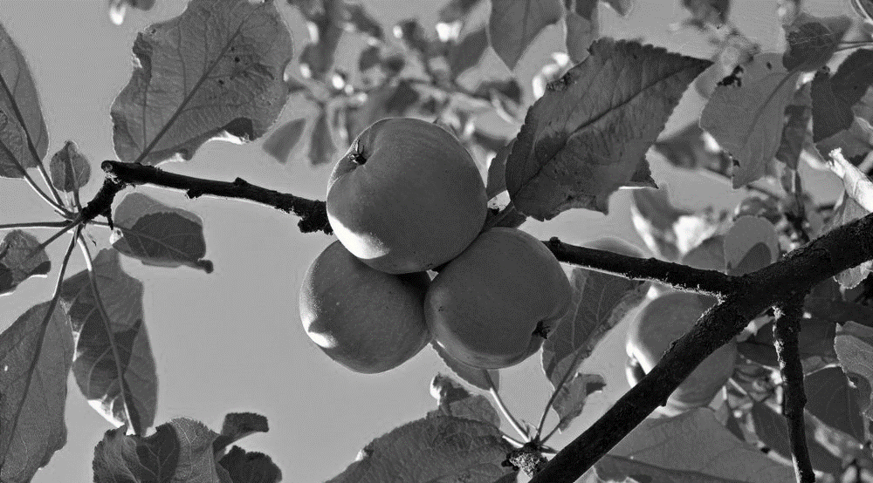
keep it
Notes:
Seeking God is never-ending as He extends His eternal love. Past all hardships, to hear causes our souls to rise in the glory of knowing.

Slide 27
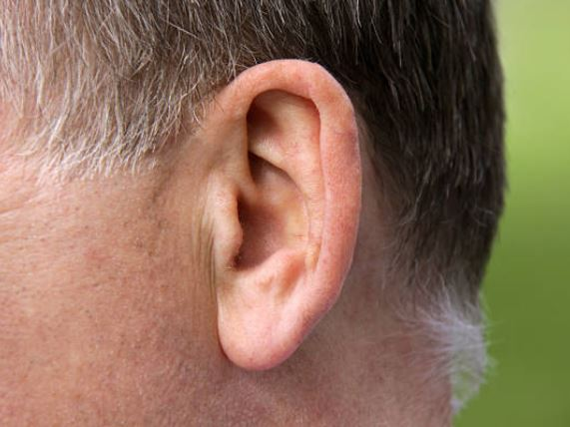
But He said, "More than that, blessed are those who hear the word of God and keep it!" — Luke 11:28
hear
keep it
keep it
Notes:
Noise brings life to sensation. To care is to want. Hearing is the cautious dilemma of knowing right from wrong. All need what is hard to do, to live under the righteous hand of God.

Slide 28
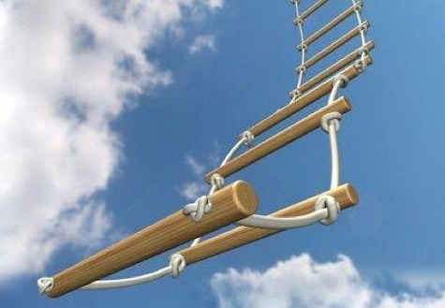
"He who loves his life will lose it, and he who hates his life in this world will keep it for eternal life." — John 12:25
Call
Greater than ourselves
hates his life
keep
for eternal life
keep it
for eternal life
keep
Notes:
To submit to God, in view of our sinful regrets, reaches to the summit of His own heart. Sacrifice to other’s needs elevates freedom’s depth past all distances.

Slide 29
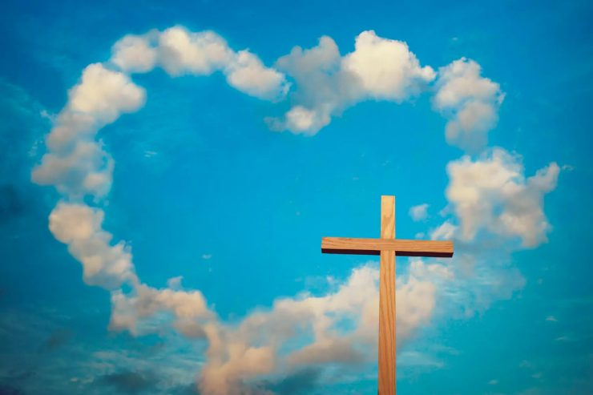
"If you love Me, keep My commandments." — John 14:15
keep
keep
keep
keep
Notes:
Love is the extent of acceptance.

Slide 30
Jesus answered and said to him, "If anyone loves Me, he will keep My word; and My Father will love him, and We will come to him and make Our home with him. He who does not love Me does not keep My words; and the word which you hear is not Mine but the Father's who sent Me." — John 14:23-24
keep
keep
My word
My word
keep
keep
My word
Notes:
As night is to day, dark is to light, and unsure is to sure, it will be love over hate that will judge each one of us.

Slide 31
Therefore let us keep the feast, not with old leaven, nor with the leaven of malice and wickedness, but with the unleavened bread of sincerity and truth. I wrote to you in my epistle not to keep company with sexually immoral people. — 1st Corinthians 5:8-9
keep
growth
nastiness
cruelty
meanness
hatred
humble
unleavened
keep
sincerity and truth
sincerity and truth
sincerity and truth
keep
Notes:
What is true cannot be changed, and habitual sinful pursuits void of regrets inherit death.

Slide 32
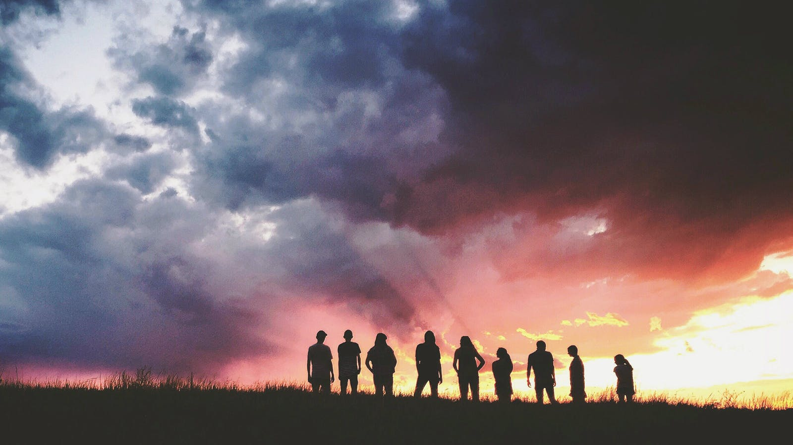
Yet I certainly did not mean with the sexually immoral people of this world, or with the covetous, or extortioners, or idolaters, since then you would need to go out of the world. But now I have written to you not to keep company with anyone named a brother, who is sexually immoral, or covetous, or an idolater, or a reviler, or a drunkard, or an extortioner --not even to eat with such a person. — 1st Corinthians 5:10-11
not to keep company
with anyone named
a brother who is:
● sexually immoral
● covetous
● an idolater
● a reviler
● a drunkard
● an extortioner
keep
keep
not to keep company
with
anyone named
a brother
who is
sexually
immoral
covetous
an idolater
a
reviler
a drunkard
an extortioner
Notes:
Climbing into the presence of good company builds characteristics of sharing and gentleness, uncharacteristic in a greedy and selfish world. Keeping godly associations pure is uplifting in an empty world of descending morals.

Slide 33
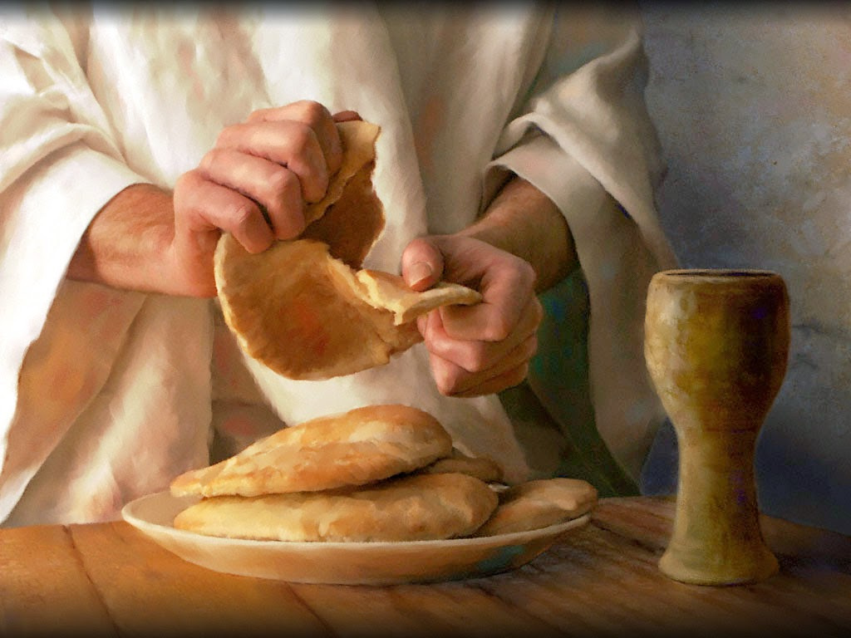
Now I praise you, brethren, that you remember me in all things and keep the traditions just as I delivered them to you. — 1st Corinthians 11:2
keep
remember me
remember me
keep the traditions
keep the traditions
keep
Notes:
To remember what God has delivered to uphold goodness should not be forgotten or dismissed to the simple disgust of machiavellianism.

Slide 34
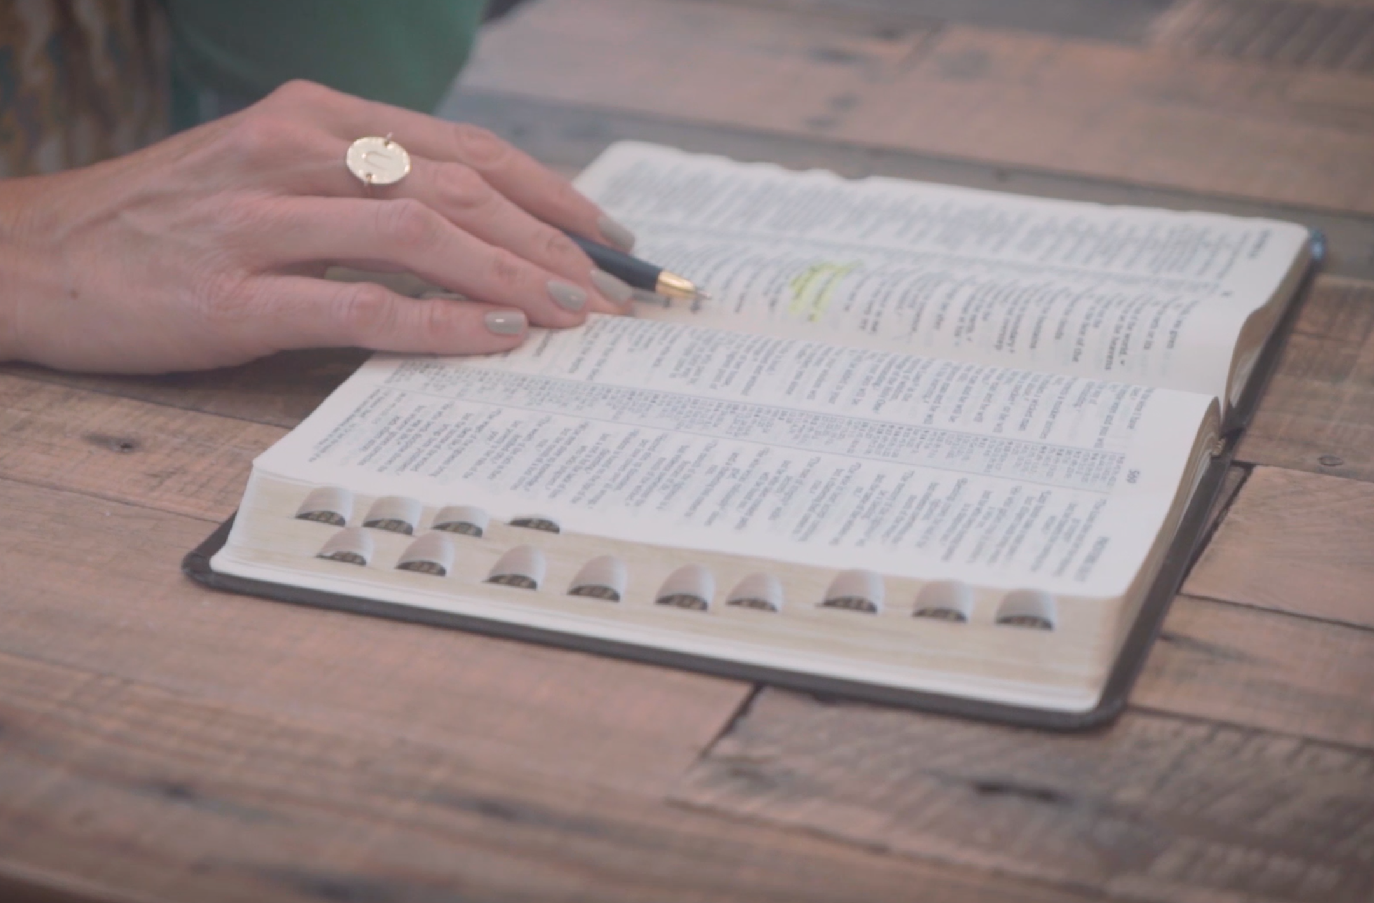
Let your women keep silent in the churches, for they are not permitted to speak; but they are to be submissive, as the law also says. — 1st Corinthians 14:34
keep
keep
Let a woman learn in silence with all submission. And I do not permit a woman to teach or to have authority over a man, but to be in silence. — 1st Timothy 2:11-12
Notes:
Godly traditions have the purpose to impose the greatest respect, for ourselves and God, in our worship of God.

Slide 35
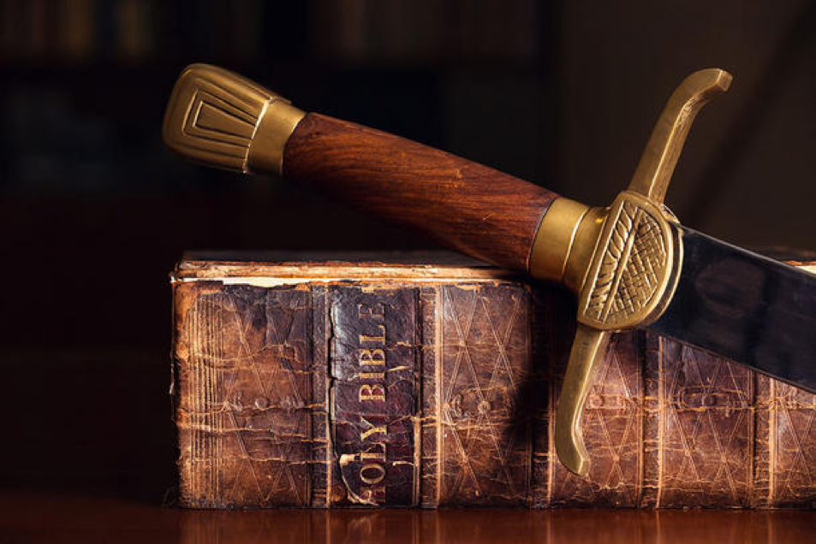
Fight the good fight of faith, lay hold on eternal life, to which you were also called and have confessed the good confession in the presence of many witnesses. I urge you in the sight of God who gives life to all things, and before Christ Jesus who witnessed the good confession before Pontius Pilate, … — 1st Timothy 6:12-13
lay hold
Fight the good fight of faith
. .
called
called
God
sight of God who gives life
God
good confession
Notes:
To weed through malarkey and win the battle of truth is no simple task without God’s own guidance.

Slide 36
… that you keep this commandment without spot, blameless until our Lord Jesus Christ's appearing, which He will manifest in His own time, He who is the blessed and only Potentate, the King of kings and Lord of lords, who alone has immortality, dwelling in unapproachable light, whom no man has seen or can see, to whom be honor and everlasting power. Amen. — 1st Timothy 6:14-16
keep
purpose
without spot
without spot
God
Faith
keep
Notes:
Tender is the shine brighter than light where God’s bosom is love for our lives. Dreams cannot contend with what is more than all visible.

Slide 37
Pure and undefiled religion before God and the Father is this: to visit orphans and widows in their trouble, and to keep oneself unspotted from the world. — James 1:27
keep
keep
keep
keep
unspotted
without spot
Notes:
Humble hearts able to shower love is where God takes notice.

Slide 38
keep
keep
His light
Notes:
Humble hearts able to shower love is where God takes notice.

Slide 39
keep
keep
faith
Notes:
Humble hearts able to shower love is where God takes notice.

Slide 40
Now by this we know that we know Him, if we keep His commandments. He who says, "I know Him," and does not keep His commandments, is a liar, and the truth is not in him. — 1st John 2:3-4
keep
keep
commandments
commandments
keep
commandments
Notes:
Obedience aligns with His will to observe truth.

Slide 41
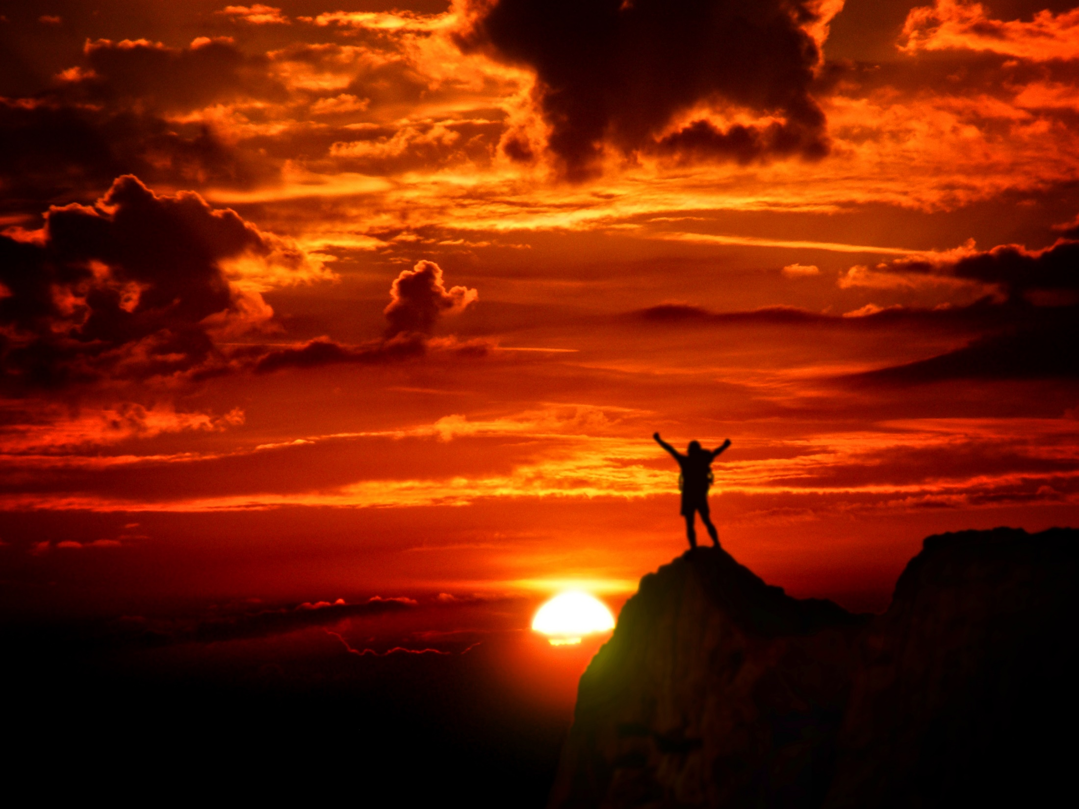
And whatever we ask we receive from Him, because we keep His commandments and do those things that are pleasing in His sight. — 1st John 3:22
keep
keep
keep
commandments
commandments
do
commandments
commandments
keep
in
pleasing in
pleasing in
commandments
commandments
Notes:
Do you keep what has been declared by heaven on earth?

Slide 42
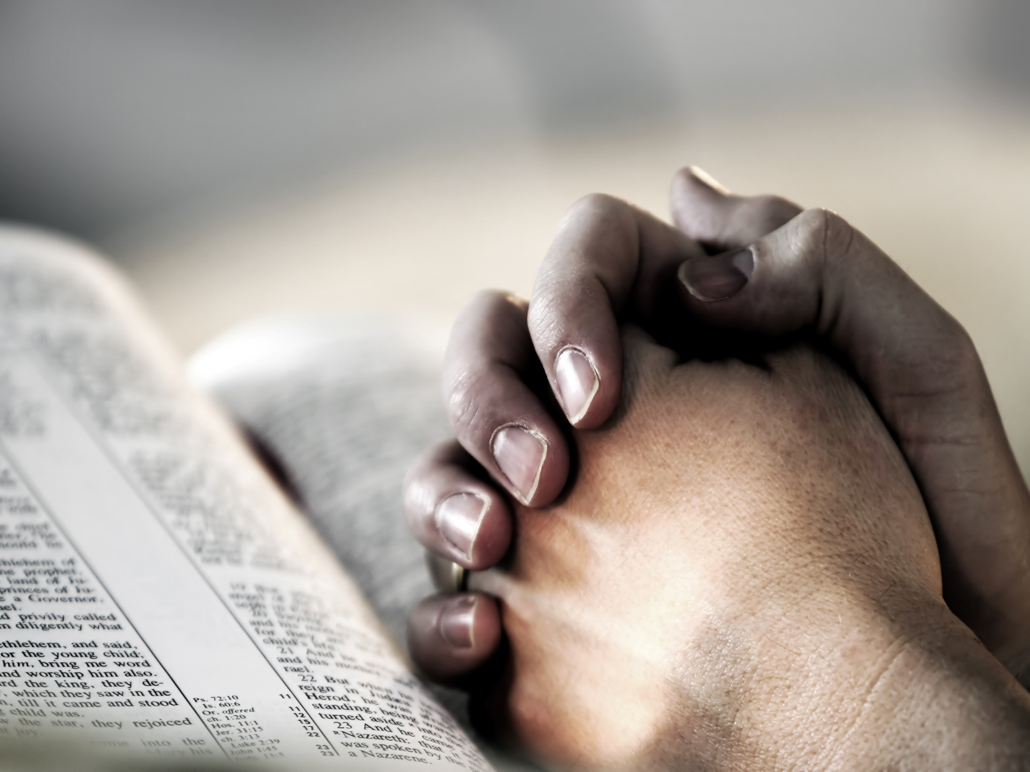
By this we know that we love the children of God, when we love God and keep His commandments. For this is the love of God, that we keep His commandments. And His commandments are not burdensome — 1st John 5:2-3
keep
commandments
keep
keep
commandments
commandments
easy
commandments
Notes:
Love is not a drudgingly static condition causing continuous sorrows, but dynamic in its’ rising moment surpassing all before. Each breath should deliver heightened appreciation for the grandness of breathlessness ahead.

Slide 43
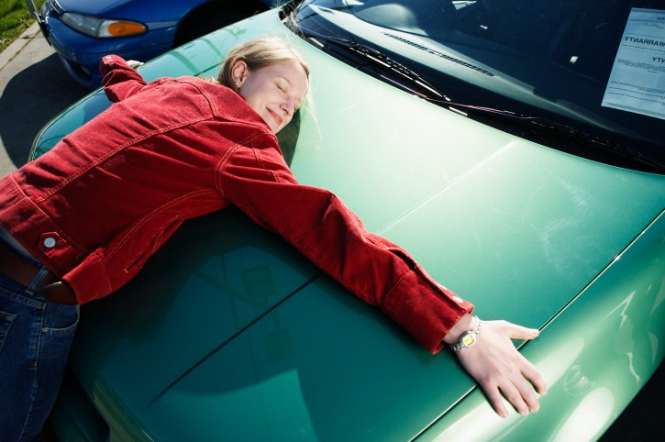
Little children, keep yourselves from idols. Amen. — 1st John 5:21
keep
keep
Notes:
Love of the material has no life in it. To love what is dead brings the same. To be full one must recognize the Creator over the creation.

Slide 44
But you, beloved, building yourselves up on your most holy faith, praying in the Holy Spirit, keep yourselves in the love of God, looking for the mercy of our Lord Jesus Christ unto eternal life. — Jude 1:20-21
in
in the Holy Spirit
faith
in the Holy Spirit
in
in the love of God
keep
in the love of God
keep
Notes:
If one’s true desire is to live eternally, what one is “in” to declares the outcome He will render, upon our return to His presence. Without love of God, hope has little effect.

Slide 45
Blessed is he who reads and those who hear the words of this prophecy, and keep those things which are written in it; for the time is near. — Revelation 1:3
Blessed
keep
keep
written in it
. .
Notes:
God has given His own heart, and life, naked before us all. Will we hear His call before time ceases and eternity begins?

Slide 46
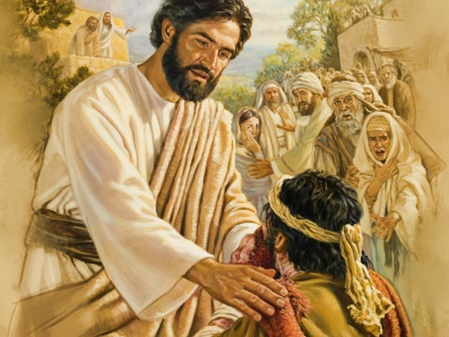
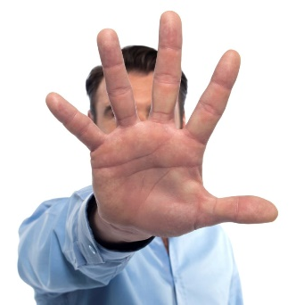
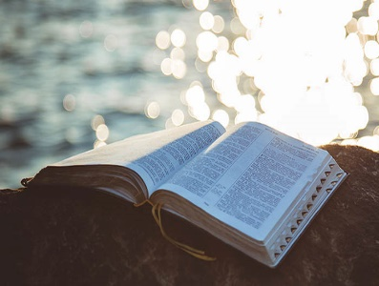
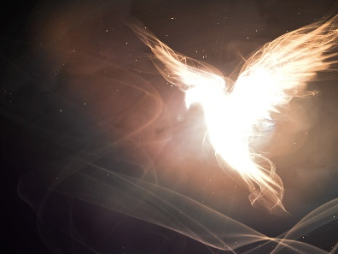
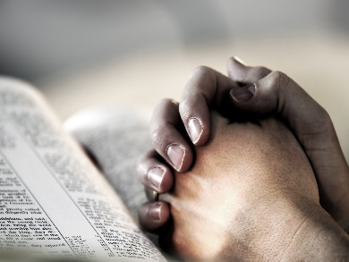
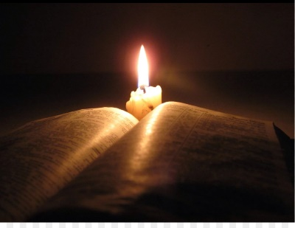
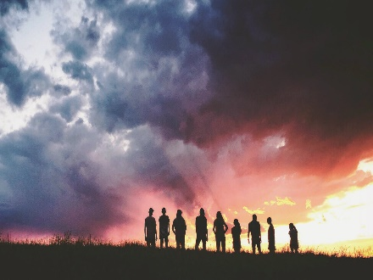

Slide 47
→ Those who desire eternal life keep to God’s word
→ People keep to traditions rejecting God’s commands
→ Blessed are those who hear the word and keep it
→ Eternal life is for those that love God over self
→ If you love God, keep His commandments
→ Keep to the principle of sincerity and truth
→ Keep to the traditions delivered by the Apostles
→ Let women keep silent and submissive in church
→ Keep oneself unspotted from the world
→ Only by seeking obedience can one know God
→ Keeping His commandments brings satisfaction
→ Keep from idols and worship of things
→ Blessed who read or hear and keep the word of God
Seeing truth is worthless unless regarded
Notes:
Seeing truth is worthless unless regarded

Slide 49
Please visit http://www.LoveFromGod.com to explore further
Ronald Bert Channel on
Notes:
Eternity never ends.

