Slide 1
Notes:
Darkness suffers with no place to hide.

Slide 2
Ron Bert
Common Situation
Assured Conclusion
INVISIBLE TEARS
January 17, 2016
Notes:
So many things touch a heart that the extent is virtually unfathomable. Hidden in the open is all that we are.

Slide 3
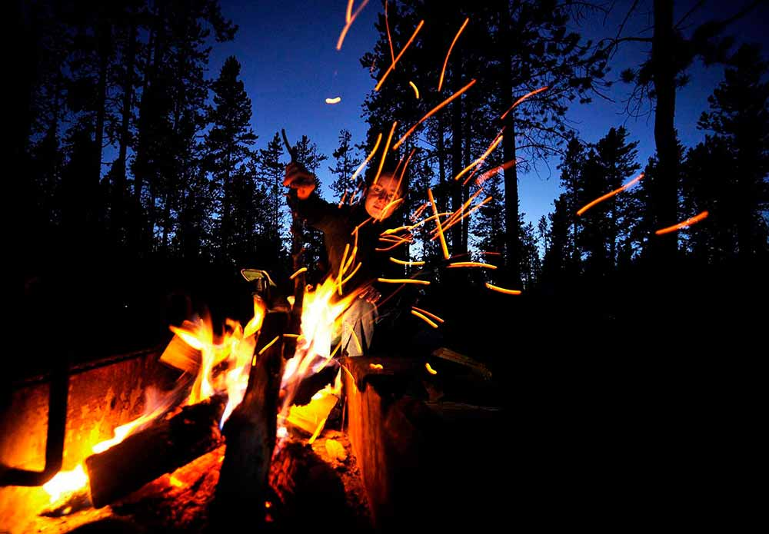
Yet man is born to trouble, As the sparks fly upward. — Job 5:7
born to trouble
Notes:
The fire of life sparks inconceivable rebellion if not tempered by the fear of God. Our break from God is a test of free souls to return or to revolt. In a realm of darkness, only His pure light of love is able to uncover us, as He calls for us to come out of the pit of conceit and self-deception.

Slide 4
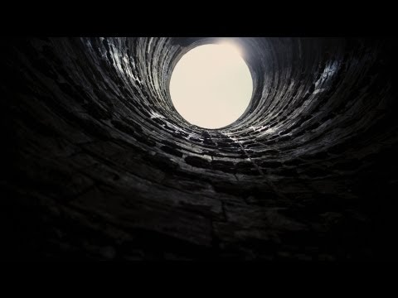
You have laid me in the lowest pit, In darkness, in the depths. — Psalm 88:6
For You will light my lamp; The LORD my God will enlighten my darkness. — Psalm 18:28
LORD my God
enlighten
enlighten
in
In darkness
in
darkness
in
Notes:
Inhumanity often plunges one into the despair of inequality. Without something higher than self, the decent is bottomless. A true question is what is one in to.

Slide 5
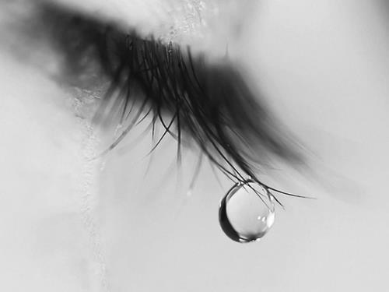
My tears have been my food day and night, While they continually say to me, "Where is your God?" — Psalm 42:3
Where is
your
God
You number my wanderings; Put my tears into Your bottle; Are they not in Your book? — Psalm 56:8
your
your
in
in Your book
in Your book
Notes:
Faith is always challenged under the weight of living. Gravity is literally a return to nothingness; suction into the darkness.

Slide 6
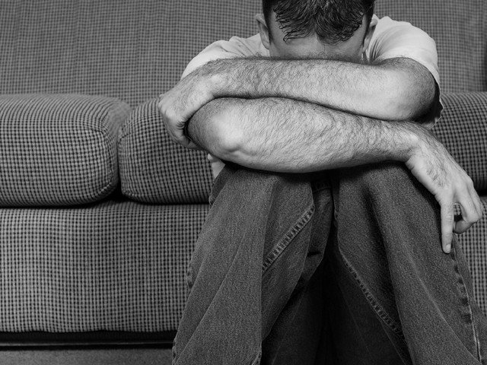
In those days men will seek death and will not find it; they will desire to die, and death will flee from them. — Revelation 9:6
In
seek death
In
not find it
desire
to die
Notes:
Anguish showers gloom empty of the enlightened carefree life. Suicidal thoughts lie on the brink of misery.

Slide 7
When I lie down, I say, 'When shall I arise, And the night be ended?' For I have had my fill of tossing till dawn. — Job 7:4
I am weary
I am weary with my groaning; All night I make my bed swim; I drench my couch with my tears. — Psalm 6:6
I have had my fill
Notes:
One’s thoughts brings about either longsuffering plagues or brilliant journeys.

Slide 8
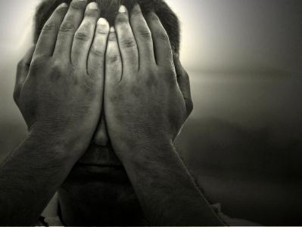
"In the morning you shall say, 'Oh, that it were evening!' And at evening you shall say, 'Oh, that it were morning!' because of the fear which terrifies your heart, and because of the sight which your eyes see." — Deuteronomy 28:67
fear
heart
eyes see
Notes:
Fear destroys peace.

Slide 9
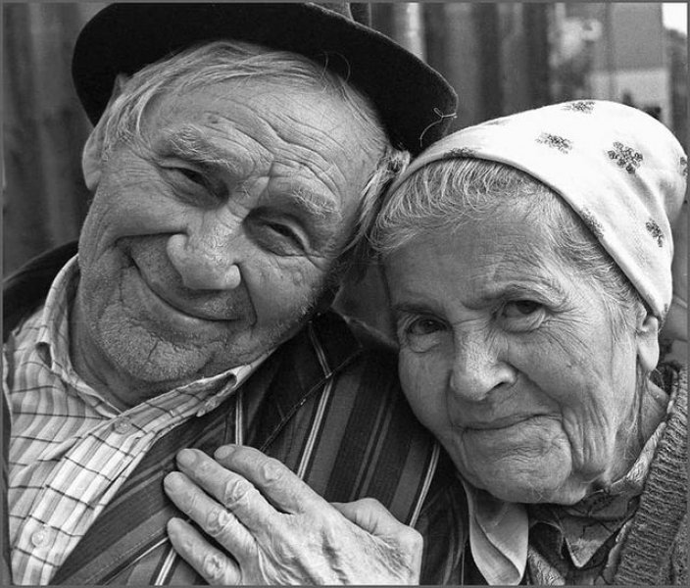
There is no fear in love; but perfect love casts out fear, because fear involves torment. But he who fears has not been made perfect in love. — 1st John 4:18
no fear in love
perfect
fear
fear
fear
love casts out fear
fear
involves torment
love
in
in
love
Notes:
Love transcends eternal dimensions.

Slide 10
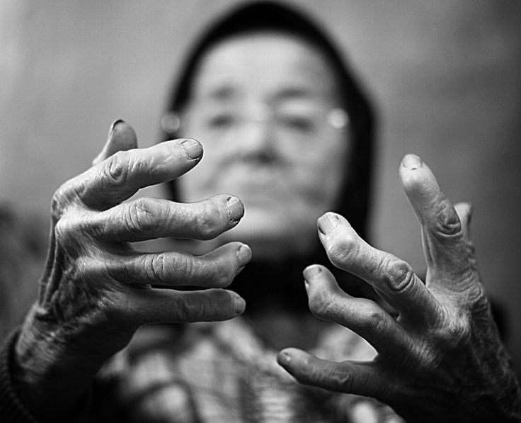
"Why is light given to him who is in misery, And life to the bitter of soul, Who long for death, but it does not come, And search for it more than hidden treasures;" — Job 3:20-21
in misery
in
long for death
Notes:
Misery holds no wealth.

Slide 11
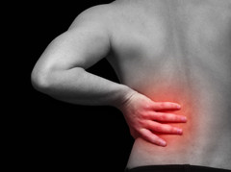
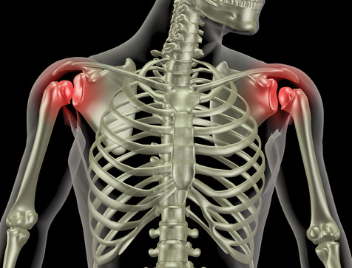
"Why is light given to him who is in misery, And life to the bitter of soul, Who long for death, but it does not come, And search for it more than hidden treasures;" — Job 3:20-21
in misery
in
The spirit of a man will sustain him in sickness, But who can bear a broken spirit? — Proverbs 18:14
long for death
A merry heart makes a cheerful countenance, But by sorrow of the heart the spirit is broken. — Proverbs 15:13
spirit
broken
spirit
Notes:
Pain has no shortage of flavors. Unspeakable heinous acts inflict more than vomiting pictures can display. Many live in sterile bubbles oblivious to the heart wrenching truths others cringe in. Hate knows no color.

Slide 12
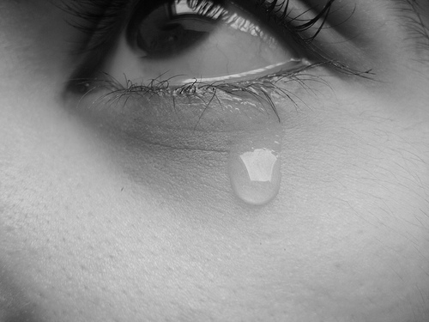
My friends scorn me; My eyes pour out tears to God. — Job 16:20
spirit
Disrespect
Ridicule
Rejection
Mockery
spirit
s
p
r
i
i
t
Sneering
scorn
Contempt
Disdain
Notes:
The world is filled with animosities whose bite is felt closest from those you know.

Slide 13
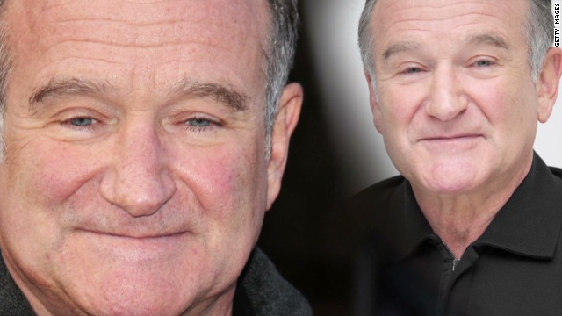
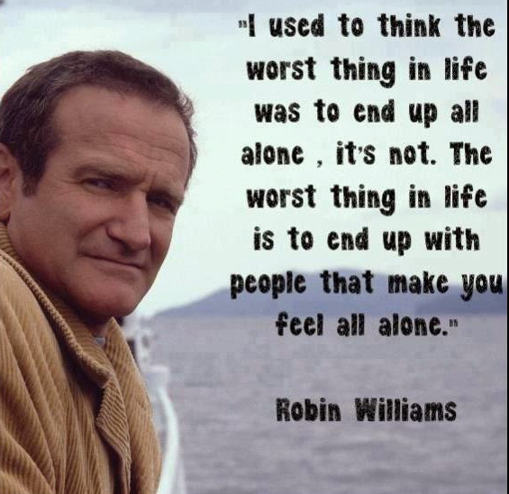
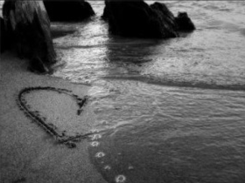
For the enemy has persecuted my soul; He has crushed my life to the ground; He has made me dwell in darkness, Like those who have long been dead. Therefore my spirit is overwhelmed within me; My heart within me is distressed. — Psalms 143:3- 4
crushed
crushed my life
in
in
overwhelmed
My heart within me is distressed
in
in
Notes:
Everyone is alone and without God, loneliness is a self inflicted disease. The faithless have no hope. With nothing to worship, one’s chasm develops into an annoyance with all. Self-serving has little understanding. One chooses Angel Island on the horizon, or Alcatraz approaches for those imprisoned in blindness. The worst thing in life is to live a life without accepting God.

Slide 14
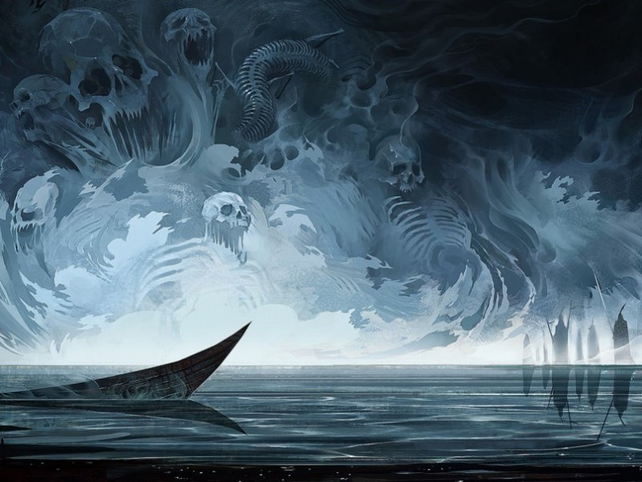
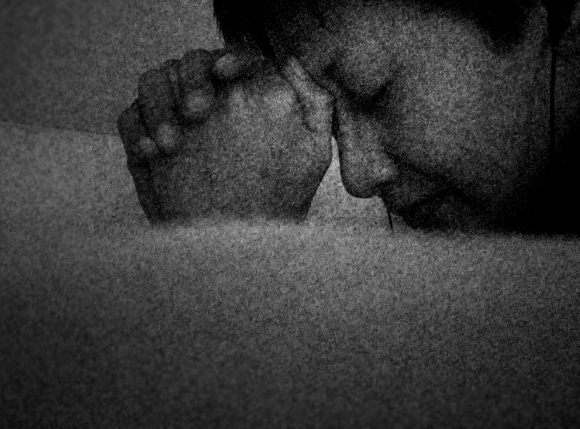
Woe
Misfortune
Distress
Grief
Horrific
Worry
Anxiety
The pains of death surrounded me, And the pangs of Sheol laid hold of me; I found trouble and sorrow. — Psalm 116:3
Unhappiness
Desperation
trouble and sorrow
Notes:
There is no escape from the pits that surround all flesh. Desperation can be a sinking boat filled with horrific worries of grief’s misfortune producing woes of distressing anxiety. Without relying on the eternalness of God the deepest of comforts goes missed.

Slide 15
Why are you cast down, O my soul? And why are you disquieted within me? Hope in God; For I shall yet praise Him, The help of my countenance and my God. — Psalm 42:11
Aspect
Expression
You are wearied in the length of your way; Yet you did not say, 'There is no hope.' You have found the life of your hand; Therefore you were not grieved. — Isaiah 57:10
Statement
Sorrow or Hope?
Personality
Characteristic
cast down
Demeanor
Qualities
in
Hope in God
. .
Air
in
you did not say
praise Him
help
hope
Presence
no hope
help
found
found
countenance
. .
countenance
of
life of your hand
Persona
Notes:
It is hope and faith in God that lifts a soul into the light of salvation. Apathy descends upon the hopeless. Grief is overwhelming without love. Purpose of heart directs life.

Slide 16
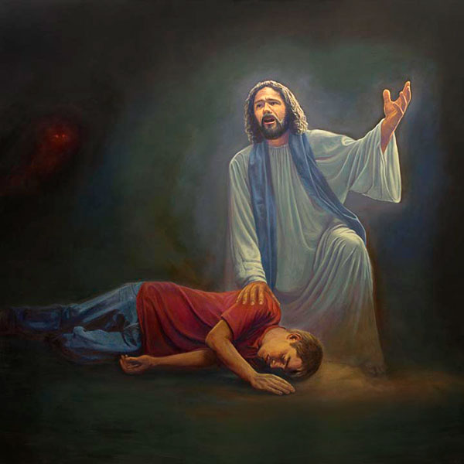
But I do not want you to be ignorant, brethren, concerning those who have fallen asleep, lest you sorrow as others who have no hope. — 1st Thessalonians 4:13
sorrow
no
hope
sorrow = no hope
Notes:
Sorrow dwells most prominently where there is no hope. The hopeless can be numb to love.

Slide 17
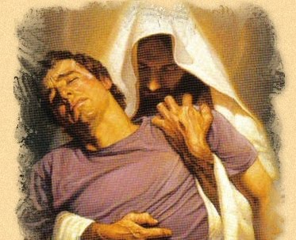
But I am poor and sorrowful; Let Your salvation, O God, set me up on high. — Psalm 69:29
Submit
Humble
Humble yourselves in the sight of the Lord, and He will lift you up. — James 4:10
in
in the
Lord
in
lift
Greater than self
Humble in the Lord = on high
sorrow = no hope
Ask
on high
Notes:
We all have miseries in our bosom that we are unable to hold alone. Death would consume us for lack of strength. Christ carries each one of us on the blood of His golden love.

Slide 18
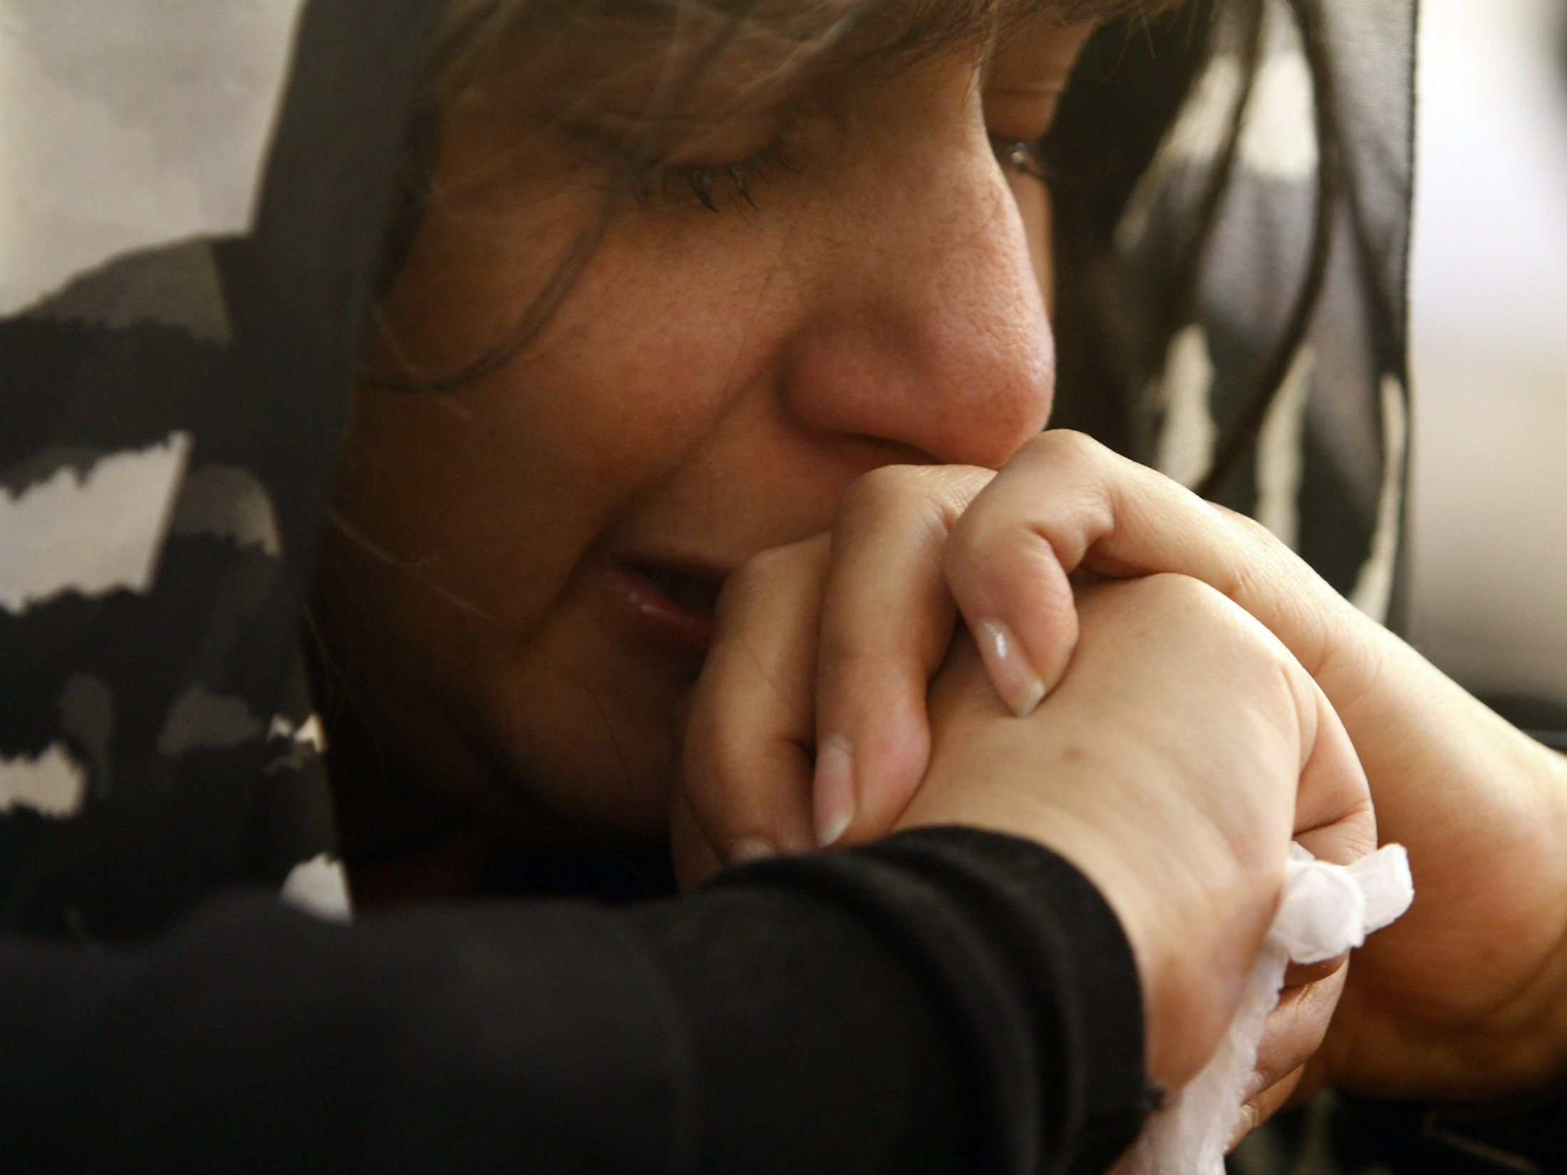
Better to go to the house of mourning Than to go to the house of feasting, For that is the end of all men; And the living will take it to heart. Sorrow is better than laughter, For by a sad countenance the heart is made better. The heart of the wise is in the house of mourning, But the heart of fools is in the house of mirth. — Ecclesiastes 7:2-4
mourning
end of all men
by a sad
Reflective humble heart
countenance
countenance the heart is made better
countenance
in
in
searching
in
in
carousing
Notes:
Sorrow deepens understanding and touches the marrow of one’s soul. Only pursuing limitless pleasure, oh dumb stumble to their own demise. God looks for a reflective humble heart.

Slide 19
For godly sorrow produces repentance leading to salvation, not to be regretted; but the sorrow of the world produces death. — 2nd Corinthians 7:10
T
e
s
t
i
n
g
T
e
t
i
n
g
T
e
i
n
g
T
e
T
e
s
t
God is
God is
us
wanting
leads to salvation
test
in
t
godly sorrow
godly sorrow = repentance
while
wanting
while not
having
repentance
sorrow of the world = death
not
sorrow
having
of the world
death
Notes:
To know or to cling only to the outward world, or the vapors of what can be seen, leaves one completely searching on near empty. God is greater than time. Times gone by remain in a dustless past where unreasonable stuck hearts decay. Life is solely in the present and unimpressed is impulse’s desperation ignoring this truth of wisdom’s light, whose source is God. To live in a gripeless moment is a challenge for all especially without knowing God’s own love calling for us to come. Self destruction comes from a lack of faith in His truth.

Slide 20
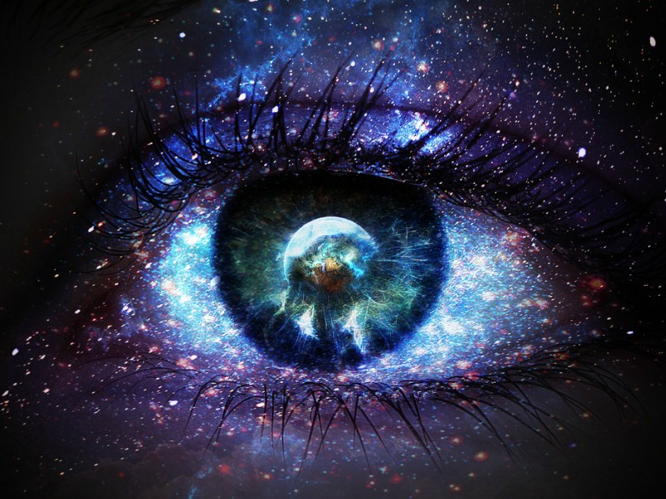
Blessed are the pure in heart, For they shall see God. — Matthew 5:8
Unto the upright there arises light in the darkness;
He is gracious, and full of compassion, and righteous. — Psalm 112:4
light
sad
in heart
Glad
sad
Glad
s
darkness
a
in heart
d
in
Care
a
l
G
d
Notes:
The purist of godly insight leads to vision beyond physical pain. Seeing God releases one’s spirit to rise above the mundane. True Faith is a matter of eternal choice beyond requiring convincing. Sad or glad, we are all one in Him. It is in His qualities of goodness that we are able to endure the darkness.

Slide 21
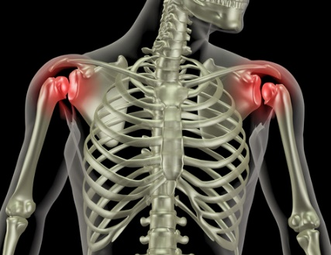
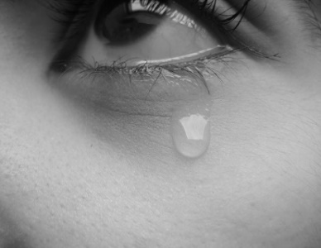
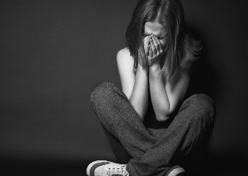
in heart

Slide 22
→ Born to trouble
→ Many long for death
→ There is no fear in love
→ Perfect love casts out fear
→ Fear involves torments
→ Sorrow of heart breaks the spirit
→ Sorrow can hold no hope
→ Hope in God and Praise Him – it heals the soul
→ Be humble in the Lord and He will lift you
→ Sadness makes a heart wiser
→ Godly sorrow produces repentance
→ Repentance leads to salvation knowing His Purity
→ Sorrow of the world leads to death
Our Sorrows Uncover Our Deepest Desires
in heart
in heart
Notes:
Faith is the ability to forge ahead in the face of human conflicts. Our sorrows uncover our deepest desires.

Slide 23
Notes:
Darkness renders nothing to offer.

Slide 24
Ron Bert
Common Situation
Assured Conclusion
PART 2
INVISIBLE TEARS
January 17, 2016
Notes:
It is the tears of our heart that reveals truth of self. What we cry for tells our tale.

Slide 25
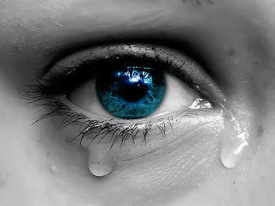
Weep not for the dead, nor bemoan him; Weep bitterly for him who goes away, For he shall return no more, Nor see his native country. — Jeremiah 22:10
Weep not for the dead
who goes away
away
who goes away
Notes:
Counter intuitive is what we mourn for, those gone before. God instructs us to rather mourn for those who do not know Him. Weep for the children whose quagmire is ignorance and home is called oblivion.

Slide 26
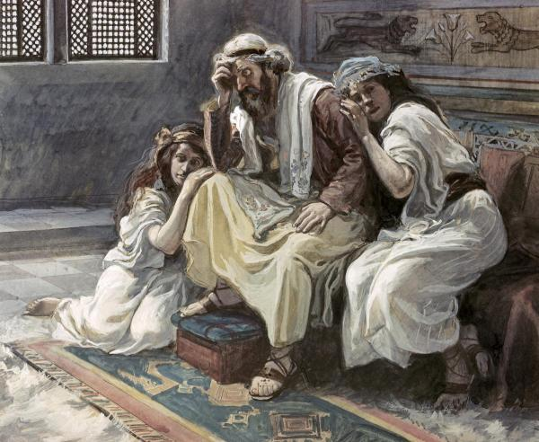
And he said, "While the child was alive, I fasted and wept; for I said, 'Who can tell whether the LORD will be gracious to me, that the child may live?' But now he is dead; why should I fast? Can I bring him back again? I shall go to him, but he shall not return to me." — 2nd Samuel 12:22-23
While
And he said, "While the child was alive, I fasted and wept; for I said, 'Who can tell whether the LORD will be gracious to me, that the child may live?' But now he is dead; why should I fast? Can I bring him back again? I shall go to him, but he shall not return to me." — 2nd Samuel 12:22-23
alive
wept
Life is for the living, not the dead.
now
dead
why should I
No reincarnation
Notes:
Truth shines above illusions. Life is for the living and this is where our concerns should be focused. No one can capture what is already done and long gone. We return to God where all judgment ends.

Slide 27
For in much wisdom is much grief, And he who increases knowledge increases sorrow. — Ecclesiastes 1:18
not good for a soul to be
not
Also it is not good for a soul to be without knowledge, And he sins who hastens with his feet. The foolishness of a man twists his way, And his heart frets against the LORD. — Proverbs 19:2-3
without knowledge
fool
man
man
,
frets against the LORD
the LORD
man curses man, not the LORD
in
u
in
ses
knowledge
c
r
Notes:
The wisest souls have the deepest insights in suffering. We are shadows in view of His eternal Light. Those most knowledgeable are often the most despised. Fools swim in hopeless turmoil loathing all. It is man that curses man, not God.

Slide 28
For I consider that the sufferings of this present time are not worthy to be compared with the glory which shall be revealed in us. — Romans 8:18
suffering
present time
Notes:
No matter intensity of affliction, brilliant timelessness will unfold for each who endure in Him.

Slide 29
For our light affliction, which is but for a moment, is working for us a far more exceeding and eternal weight of glory, while we do not look at the things which are seen, but at the things which are not seen. For the things which are seen are temporary, but the things which are not seen are eternal. — 2nd Corinthians 4:17-18
light affliction
suffering
our light affliction
for a moment
a moment
present time
for a moment
more
an
th
eternal
Notes:
God searches for our true character under wanting and how we respond to not having.

Slide 30
Behold, My servants shall sing for joy of heart, But you shall cry for sorrow of heart, And wail for grief of spirit. — Isaiah 65:14
servants
hope
eye on the prize
cry
sorrow of heart
wail
grief
of spirit
Notes:
Delight in ones hope is not diminished by those whose only outlook is misery. One either chants or squawks in the walk of life. Moreover, one’s eye is on the eternal prize of living or spirit is overwhelmed in fear for the onslaught of man.

Slide 31
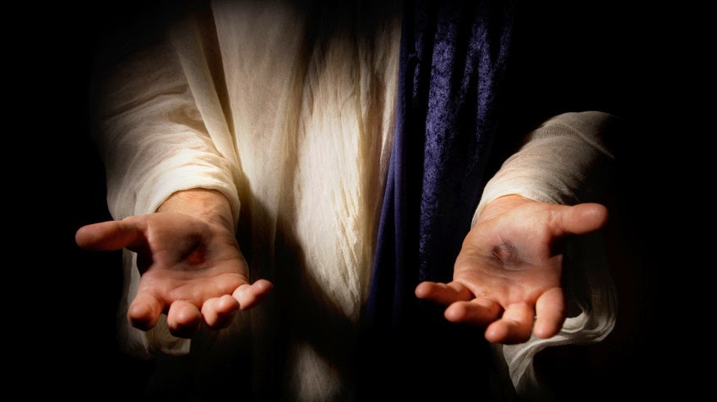
And we labor, working with our own hands. Being reviled, we bless; being persecuted, we endure; — 1st Corinthians 4:12
hands
endure
Notes:
As the despicable parade by audaciously, eternity emboldens our resolve. Finding hope gives our hands work to do.

Slide 32
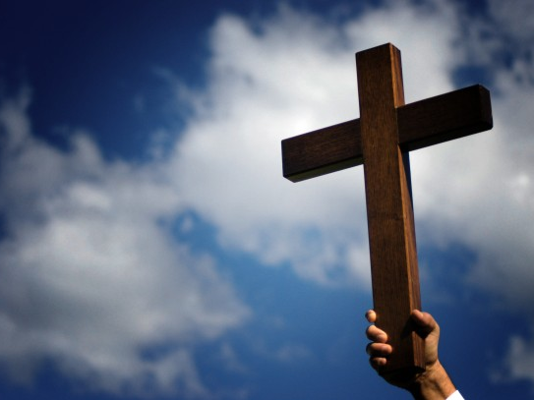
If we endure, We shall also reign with Him. If we deny Him, He also will deny us. — 2nd Timothy 2:12
endure
i
n
reign
reign
with Him
Him
with Him
Notes:
God is greater than man.

Slide 33
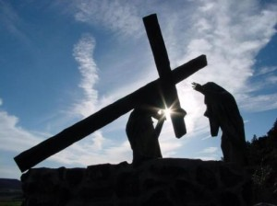
For to you it has been granted on behalf of Christ, not only to believe in Him, but also to suffer for His sake, … — Philippians 1:29
A
"And he who does not take his cross and follow after Me is not worthy of Me." — Matthew 10:38
i
s
l
ft
s
w
As we suffer He lifts us
e
e
in
believe in Him
in Him
u
s
suffer
in
H
Notes:
Faith is not a construct of conjecture doubting the authenticity that He is God. Suffering is an awakening to the approaching distant shore.

Slide 34
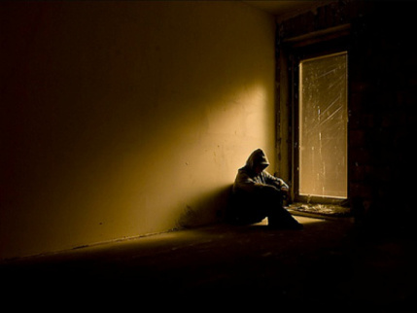
We are hard pressed on every side, yet not crushed; we are perplexed, but not in despair; persecuted, but not forsaken; struck down, but not destroyed - — 2nd Corinthians 4:8-9
not in
not in
Notes:
Things may not always be easy, but He promises that through our committed faith, we will rise above the bottom.

Slide 35
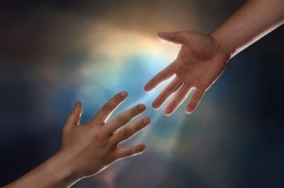
In God I have put my trust; I will not be afraid. What can man do to me? — Psalm 56:11
For whatever is born of God overcomes the world. And this is the victory that has overcome the world -- our faith. — 1st John 5:4
In
our faith
In
trust
Notes:
Again, it is God that lifts us to be greater than we are. A Faith in Trust overcomes temporary sufferings. Hope inspires our faith, trust matures it.

Slide 36
Is anyone among you suffering? Let him pray. Is anyone cheerful? Let him sing psalms. — James 5:13
"Hear my prayer, O LORD, And give ear to my cry; Do not be silent at my tears; For I am a stranger with You, A sojourner,
as all my fathers were."
— Psalm 39:12
pray
tears
I am
I am
trust
A sojourner
pray
A sojourner
our faith
Notes:
Our instructions from God are to pray and sing; to find solace in Him with our praise for Him. In this each one of us, utterly alone, finds that which cannot be given, by any other than God Himself, an inner sanctuary resting upon Him.

Slide 37
Those who sow in tears Shall reap in joy. — Psalm 126:5
tears
Those who sow in tears Shall reap in joy. — Psalm 126:5
Those who sow in tears Shall reap in joy. — Psalm 126:5
in
in
in
in
Blessed are you who hunger now, For you shall be filled. Blessed are you who weep now, For you shall laugh. — Luke 6:21
Blessed are the poor in spirit, For theirs is the kingdom of heaven. Blessed are those who mourn, For they shall be comforted. — Matthew 5:3-4
Needful for God
in
in
Repentful
Notes:
Those who extend to God, in view of heartache, develop in the ease of His love. Do we have a needful spirit for God repenting of wrong doings? Hardships may not cease, but His Glory of giving Grace settles the soul. A sign of his coming truth is revealed in many who in the midst of crying the hardest burst into laughter.

Slide 38
Be anxious for nothing, but in everything by prayer and supplication, with thanksgiving, let your requests be made known to God; and the peace of God, which surpasses all understanding, will guard your hearts and minds through Christ Jesus. — Philippians 4:6-7
in
prayer
in
thanksgiving
peace of God
peace of God
guard your hearts
through Christ Jesus
Christ Jesus
Notes:
For what is coming, offered to each, is greater than all the seas across time’s extent in space.

Slide 39
Finally, brethren, whatever things are true, whatever things are noble, whatever things are just, whatever things are pure, whatever things are lovely, whatever things are of good report, if there is any virtue and if there is anything praiseworthy -- meditate on these things. — Philippians 4:8
true
noble
just
pure
lovely
good report
virtue
anything
praiseworthy
meditate on
Notes:
His instructions for those in His light is to dwell upon all that embraces goodness. It is the candle of one’s true characters.

Slide 40
He will swallow up death forever, And the Lord GOD will wipe away tears from all faces; The rebuke of His people He will take away from all the earth; For the LORD has spoken. — Isaiah 25:8
swallow up
death
Lord GOD
the LORD
Notes:
And what is the price for eternity beyond misery? His sacrifice and a confessing genuine faith with an enduring giving heart of love rising above contempt. Eternity is in the very moment in which we live. To embrace or to despise.

Slide 41
Your sun shall no longer go down, Nor shall your moon withdraw itself; For the LORD will be your everlasting light, And the days of your mourning shall be ended. — Isaiah 60:20
LORD
the LORD
LORD
mourning shall be ended
mourning shall be ended
Notes:
This decaying universe is a staging ground for an eternal reward above the material.

Slide 42
LORD
Notes:
In a moment we will be changed in to something so magnificently penetrating, knowing that it is God, indescribable emanations, the source of our given life, by the will of His love, glories untold.

Slide 43
"And God will wipe away every tear from their eyes; there shall be no more death, nor sorrow, nor crying. There shall be no more pain, for the former things have passed away." — Revelation 21:4
God
w
God
God
waits
. .
death
sorrow
no more
death
sorrow
crying
crying
ai
t
s
pain
pain
Notes:
In a moment we will be changed in to something so magnificently penetrating, knowing that it is God, indescribable emanations, the source of our given life, by the will of His love, glories untold.

Slide 44
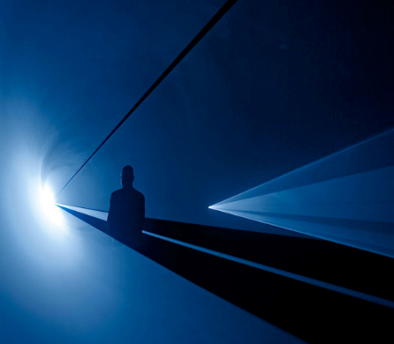
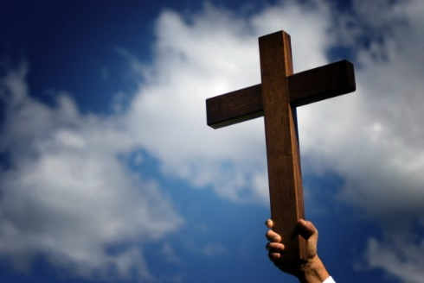
God
waits

Slide 45
→ Weep not for the dead but for those without a home
→ We will again see those found in God
→ Knowledge increases sorrows, yet it is good for a soul
→ Only a fool frets against God
→ All suffering falls short of the glory to be had in God
→ Who we are prepares us for what is to come
→ Servants of God are best able to endure suffering
→ Accepting His salvation is part of salvation
→ Believing in Jesus invites the criticism of the worldly
→ Trust in God protects us from the abuses of man
→ Faith knows we are of God, ponder on all that is good
→ Prayer & gratitude connects one to the peace of God
→ All suffering will cease upon His appearing
Through the truth of His Love His power lifts us to see
God
waits
Notes:
It is the way that it is. Through the truth of His Love His power lifts us to see. Put your hope on top of your sorrow, Not your sorrow on top of your hope.

Slide 46
Notes:
Oblivion has no answer as it is left alone in it’s own darkness.

Slide 47
Please visit http://www.RonBert.com to explore further
Ronald Bert Channel on
Notes:
Eternity never ends.

