Slide 1
Notes:
It is in His absence that we cannot see. Life seeks the light.

Slide 2
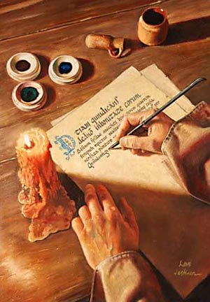
Ron Bert
April 24, 2016
Instrument
of Truth
Notes:
Either truth is or it is not. Truth is not a construct of uncertainty. Faith is an esoterical belief in what is yet to be, from an essence that which cannot be seen, and for us, it involves the unknown future; to reality that reaches out beyond us. Faith exists in the moment where time has positioned each one of us. Choices in what one believes leads to defining the truth of a soul. Are there certain instruments of truth?

Slide 3
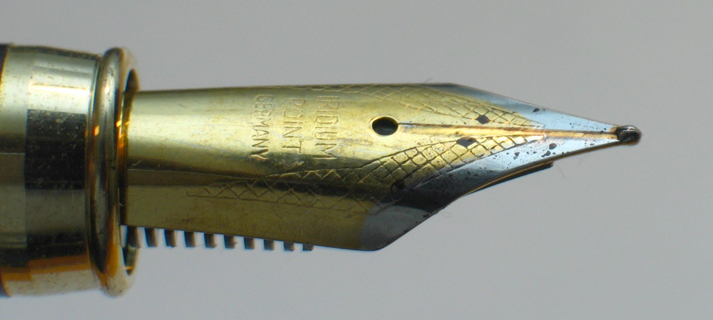
Notes:
It is said the pen is mightier than the sword. Words can have the power of truth as well as that of deception. Can the truth be erased; it certainly can be forgotten, even blurred, in the mind of man. The moment binds our spirit relinquishing all to inadequate experiences in the face of the fullness of all that is. In the challenged memories of man, can absolute truth change, or does its’ existence really matter? There are those that declare it as irrelevant and inconsequential to personal pursuits. Narrow visions of truth can be subjective short of the larger complete picture. As mere men, we must be careful not to belligerently dismiss greater truths as unreasonable. A simple truth is that it is all greater than we are. For God to be real, absolute truth is what establishes all reality upon His omnipotence. The only thing certain for those that prefer ambiguity is a lack of clarity.

Slide 4
Knowledge
CLARITY
Awareness
History
Science
Truth
In the
Light
Skills
Facts
Experience
Information
Understanding
Notes:
Our clarity of thought has been limited to that which is known. Knowledge for us is an accumulation of experiences across the ages of man. All thought falls short of what is or can be. To be open for truth, one has to see the insignificance of self in view of the unimaginable greatness of all that is.

Slide 5
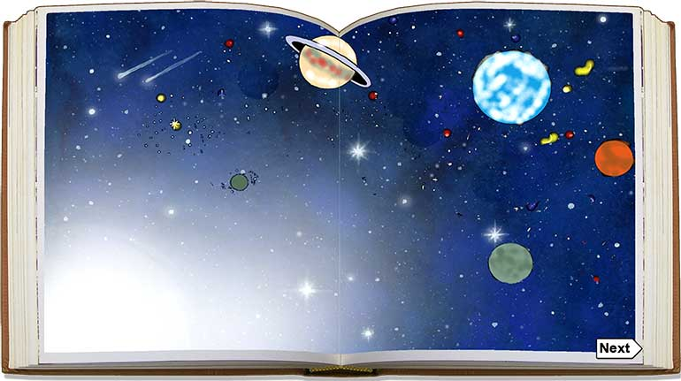
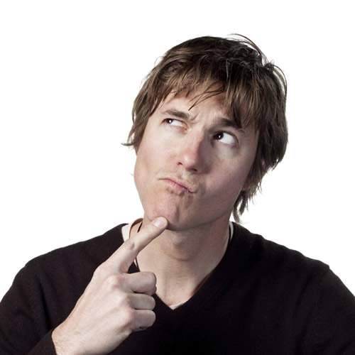
For Your mercy is great above the heavens, And Your truth reaches to the clouds. — Psalm 108:4
… always learning and never able to come to the knowledge of the truth. — 2nd Timothy 3:7
Everything We Don’t Know
Truth
We Don’t Know
Everything
=
Everything We Know
knowledge of the truth
Notes:
God’s absolute truth goes beyond what we can know. Even a lie is still part of the truth as it is an occurrence. Knowledge can never replace the value of understanding. It is not the desire of God to have His creation deceive itself. Since we cannot know absolute truth, God has endowed us with the revelation of His truths allowing us to see by faith in His Word. God has given us His truth to refute otherwise uncertain conjectures of man. It is His goodness in mercy that stretches down from heaven to retrieve all who would hear the call. In the midst of curious suffering, beyond what any of us are able to fully comprehend, what has been given to each of us is individual choice to be that we are as living in “I am.” God desires that salvation from tyranny may be grasped, by all that would seize it. It is reaching out beyond the moment to something holier than all that one could ever imagine to be, or become. Paradoxically, larger than life is in the moment. Faith is not something quantifiable. Faith is not taught, it is something believed. Scholars may claim power, but learning upon learning has no value without humble understanding. Finite rebellion has no place in praising His greater than infinite creation. God is in control, not that we are. What is more important, knowledge or truth? Life or death? Mere knowledge without essential understanding is void of the wisdom He calls out for in knowing His truths. He wants us to put it together in all honesty, through the gift of consciousness, where awareness becomes, to know that we are His created children.

Slide 6
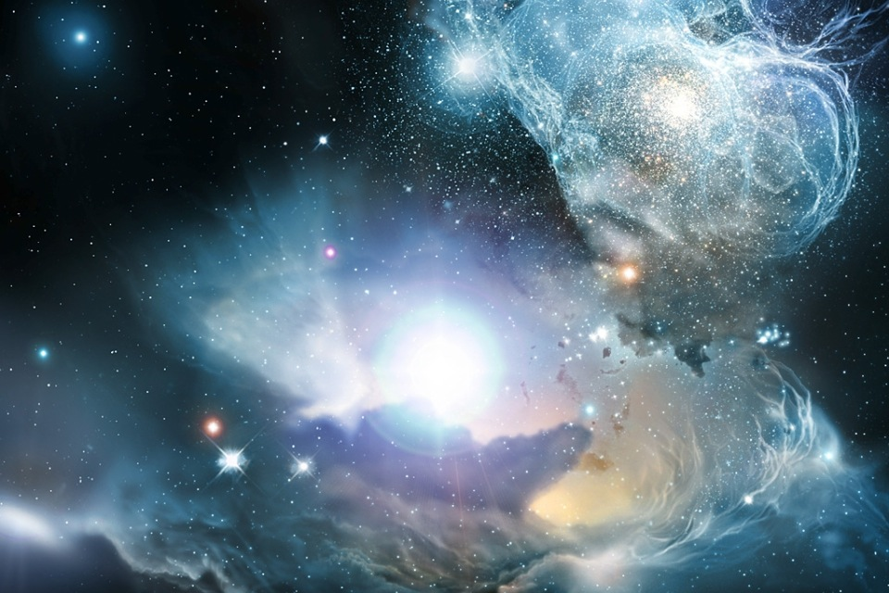
Great is the LORD, and greatly to be praised; And His greatness is unsearchable. — Psalm 145:3
LORD
is
LORD
is
"God is not a man, that He should lie, Nor a son of man, that He should repent. Has He said, and will He not do? Or has He spoken, and will He not make it good?" — Numbers 23:19
LORD
is
Forever, O LORD, Your word is settled in heaven. — Psalm 119:89
For the word of the LORD is right, And all His work is done in truth. — Psalm 33:4
LORD
LORD
is
truth
truth
Notes:
God has given the truth of creation to itself to freely become. It is by His generous love that this commencement has occurred for His living creatures to experience, on their own, as He does. The Lord Himself is the supreme instrument of truth. The light of the Lord touches each of us as we are open to the expanse. God has given the universe to itself to be real.

Slide 7
His greatness = unsearchable
=
God = not a man
=
Word = Settled in heaven
=
Right = Word of the LORD
=
Notes:
God has given the truth of creation to itself to freely become. It is by His generous love that this commencement has occurred for His living creatures to experience, on their own, as He does. The Lord Himself is the supreme instrument of truth. The light of the Lord touches each of us as we are open to the expanse. God has given the universe to itself to be real.

Slide 8
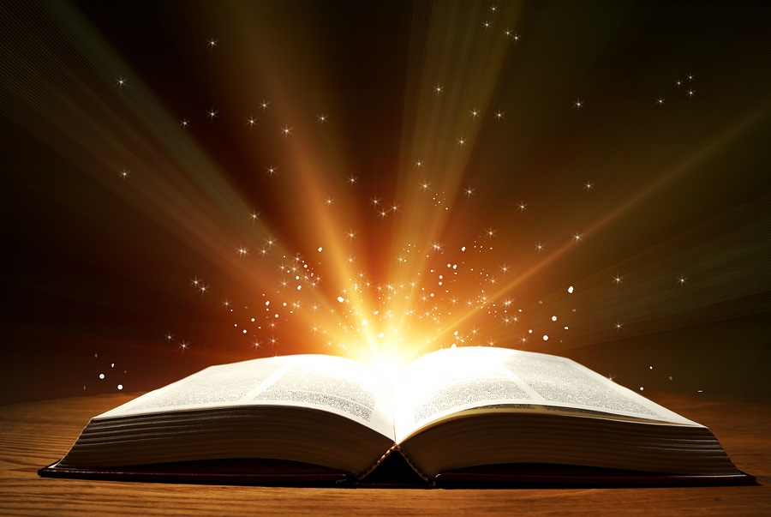
The entirety of Your word is truth, And every one of Your righteous judgments endures forever. — Psalm 119:160
=
For the LORD is good; His mercy is everlasting, And His truth endures to all generations. — Psalm 100:5
entirety of Your word is truth
LORD
word
truth
=
good
mercy
=
everlasting
truth
His truth endures
His truth endures
truth
truth
Notes:
It is His merciful word that allows us to soar in spirit beyond the confines that entrap us.

Slide 9
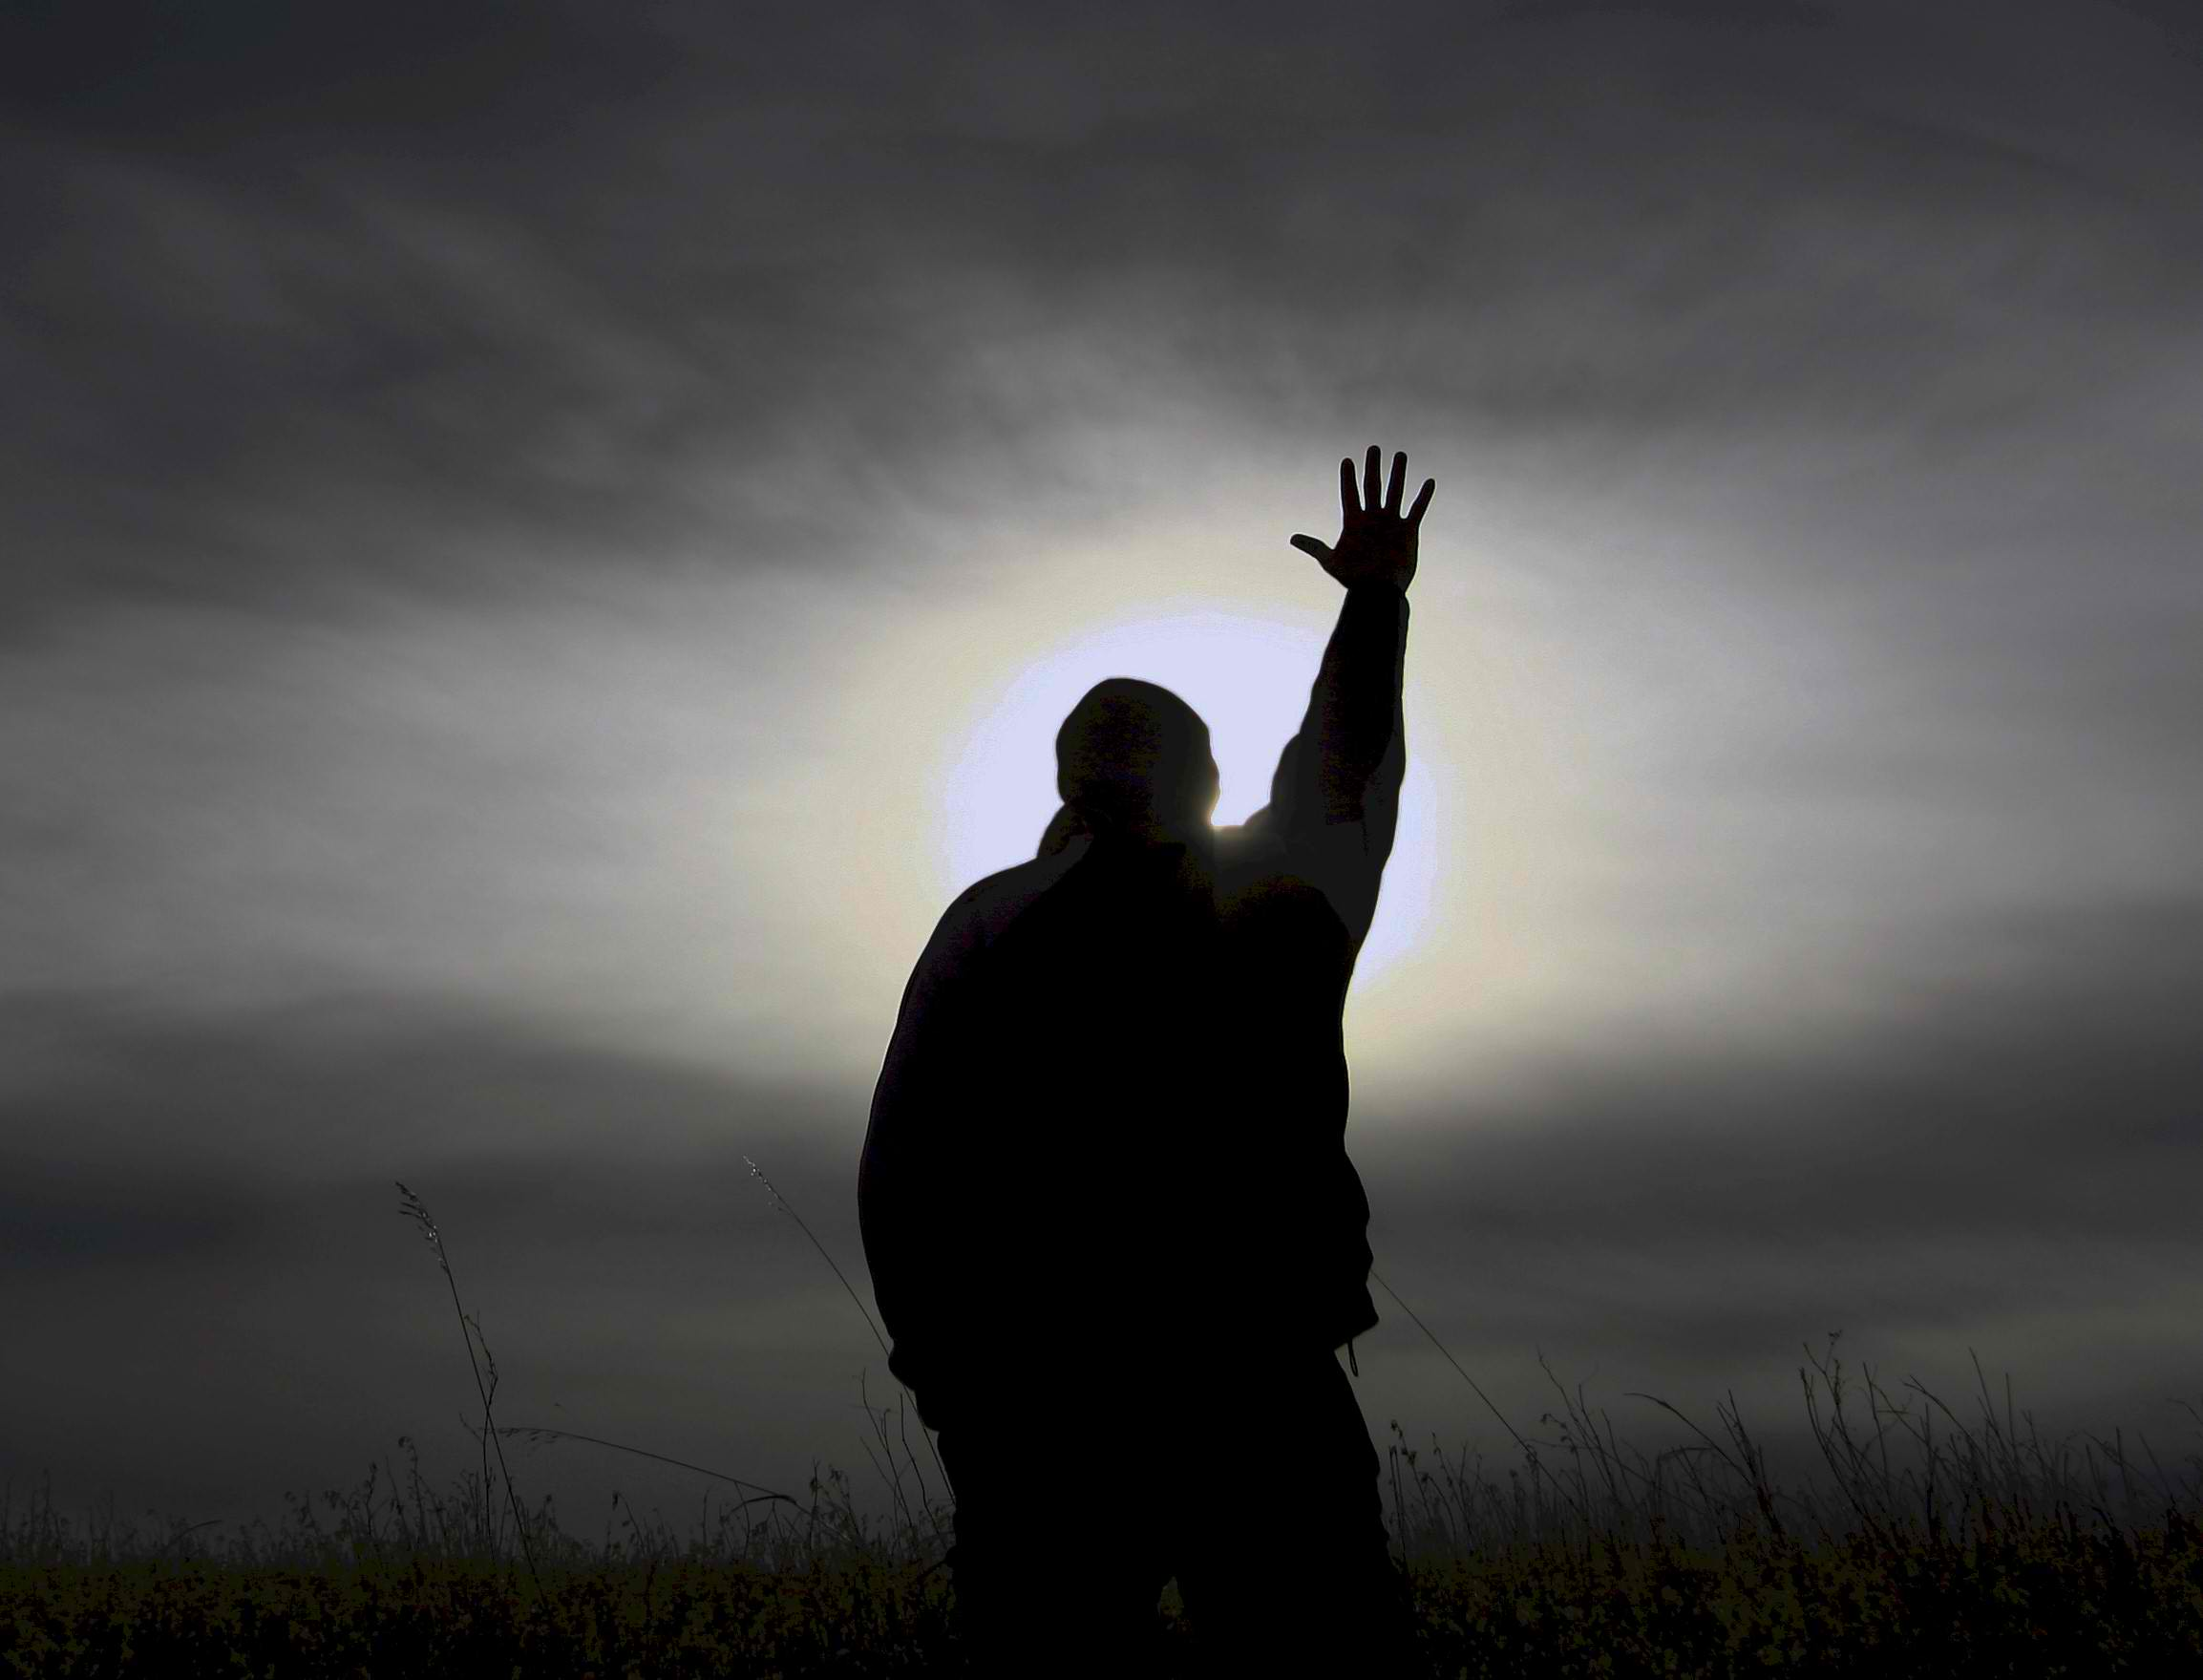
The LORD is near to all who call upon Him, To all who call upon Him in truth. — Psalm 145:18
truth
LORD
call upon Him
in
call upon Him
in
truth
Notes:
The call is to call upon Him in truth of heart. What higher ideal is that than to speak to God Himself?

Slide 10
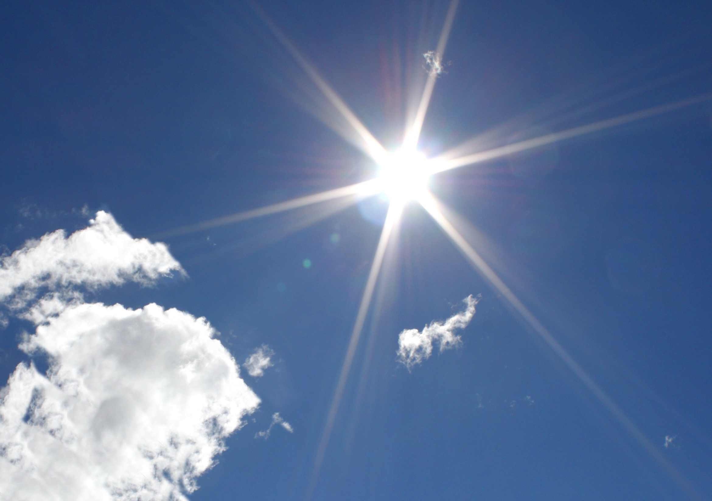
Buy the truth, and do not sell it, Also wisdom and instruction and understanding. — Proverbs 23:23
truth
truth
instruction
instruction
wisdom
wisdom
understanding
understanding
Notes:
To desire the truth is a higher calling that touches the sky. It brilliantly reaches out tickling the imagination to thirst for more. The desire for truth is a blessing upon the conscious and is a gift of God. Truth is influentially remembered as lies are simply forgotten; innate to our nature. Cherished is the strength of one’s presence over any misery in disgust. Man has cruelly perpetrated man, not God. Freedom to be is the consecration of life given by God. In His light, wisdom is obtained.

Slide 11
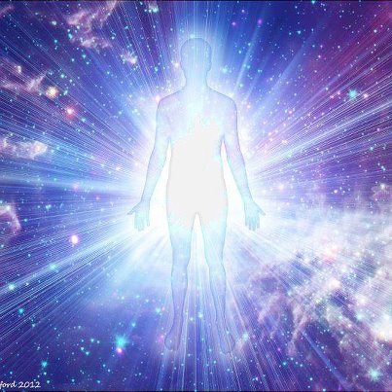
Behold, You desire truth in the inward parts, And in the hidden part You will make me to know wisdom. — Psalms 51:6
truth
inward
Notes:
It is from within where our souls become more than just a passing moment. In the depths of feeling thought, life is realized. God sees all that we are counting the heart beats of our breaths. What is it that we cherish? We fall naked before Him.

Slide 12
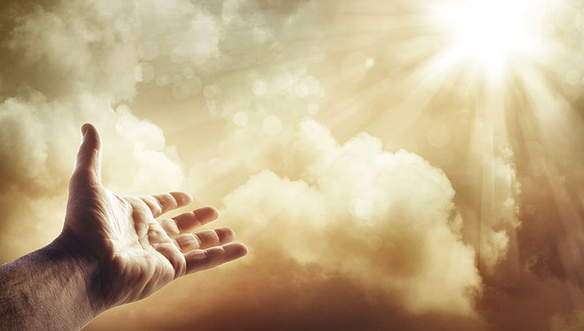
Oh, send out Your light and Your truth! Let them lead me; Let them bring me to Your holy hill And to Your tabernacle. — Psalm 43:3
Vault
Treasury
send out Your light
Chest
Your
truth
lead me
Source
lead me
Assurance
tabernacle
Shelter
Repository
Notes:
A good rule of thumb is to call out for His truth. Only in submission to His will in truth may we heartfully see. To be acceptable in His light, one must humbly call asking to come to Him. To His tabernacle where something valuable has always been, His holy loving light of life.

Slide 13
LORD, who may abide in Your tabernacle? Who may dwell in Your holy hill? He who walks uprightly, And works righteousness, And speaks the truth in his heart; — Psalms 15:1-2
And do not present your members as instruments of unrighteousness to sin, but present yourselves to God as being alive from the dead, and your members as instruments of righteousness to God. — Romans 6:13
And do not present your members as instruments of unrighteousness to sin, but present yourselves to God as being alive from the dead, and your members as instruments
of righteousness to
— Romans 6:13
tabernacle
He who speaks truth declares righteousness, But a false witness, deceit. — Proverbs 12:17
speaks truth
speaks truth
to
God
→
walks uprightly
walks uprightly
as instruments
→
righteousness
works righteousness
works righteousness
GOD
G
G
G
G
O
O
O
O
D
D
D
D
in
to
in
to God
→
to
speaks the truth in his heart
speaks the truth in his heart
Notes:
For one to embrace righteousness in the face of man and God, it is not only crucial, but essential, to speak the truth. Those that employ deception acquire death without question. Only a life grounded in goodness is able to see the sure riches of God and benefit one’s fellows. In truth, He calls for us to be instruments of righteousness, and we know that to be righteous, the truth must be an active part of us.

Slide 14
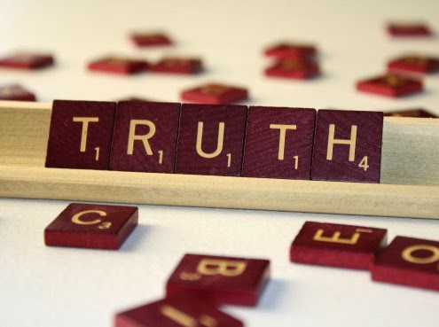
"But let your 'Yes' be 'Yes,' and your 'No,' 'No.' For whatever is more than these is from the evil one." — Matthew 5:37
Notes:
The universe holds to the commands of God and we, as individual parts, are called to be instruments of truth, in the very being that we are. To be included as a legitimate player, one has to abide by the rules. In truth, it is His creation, not ours. Deception comes by claiming that which is not, and in the case of all that would fall from His grace in superiority to Him, the farce of an unsubmitting soul living in denial, liars will die. The chains of our bondage are of the earth and not of heaven. Maybe is not an option in His coming judgment where absolute truth takes precedence.

Slide 15
"But he who does the truth comes to the light, that his deeds may be clearly seen, that they have been done in God." — John 3:21
truth
comes
… who desires all men to be saved and to come to the knowledge of the truth. — 1st Timothy 2:4
comes
to
God
to
come
come
to
to
God
"God is Spirit, and those who worship Him must worship in spirit and truth." — John 4:24
truth
truth
truth
truth
in
in
Notes:
The light of God is present in all moments. He waits to see if what we do is through Him, or is it something else foreign to His will unwilling to hold to the nature of goodness. God has subjected us in the futility of time temporarily, to reveal our true inner character of spirit. Truth is where the spin stops here. He asks for our presence in purity of heart. God is real and only accepts the same.

Slide 16
"And you shall know the truth, and the truth shall make you free." — John 8:32
truth
truth
Notes:
God has enough scriptures concerning truth to make us doubly sure about what He expects from His creation of life. The truth does not involve hidden double standards, but is straight forward in the light. For those that choose Him over self reap the rewards already. Great is His truth in truth.

Slide 17
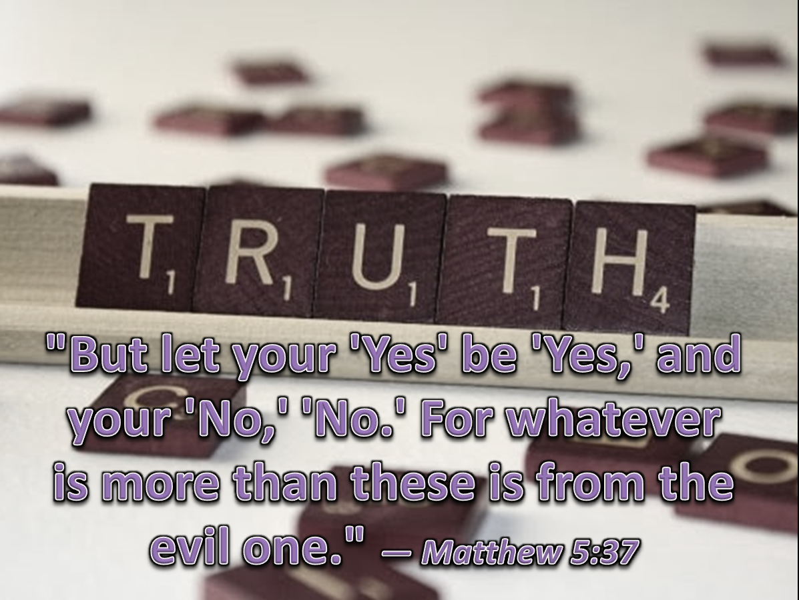
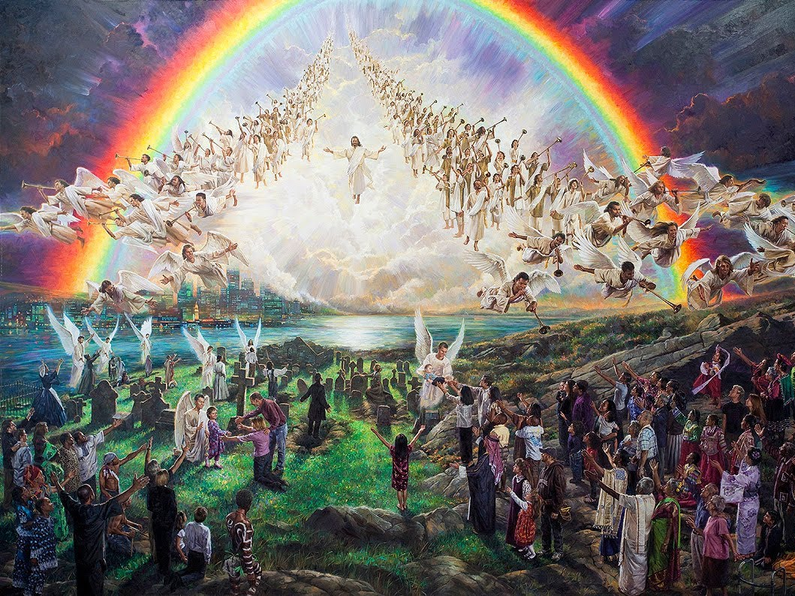
Jesus said to him, "I am the way, the truth, and the life. No one comes to the Father except through Me." — John 14:6
in you
truth
"... the Spirit of truth, whom the world cannot receive, because it neither sees Him nor knows Him; but you know Him, for He dwells with you and will be in you." — John 14:17
"... the Spirit of truth, whom the world cannot receive, because it neither sees Him nor knows Him; but you know Him, for He dwells with you and will be in you." — John 14:17
Spirit of truth
Spirit of truth
Spirit of truth
inward parts
Jesus said to him, "I am the way, the truth, and the life. No one comes to the Father except through Me." — John 14:6
Jesus
Jesus
the truth
the truth
in you
in you
Notes:
How grand that God Himself came to show us the way in truth through Christ. It is finding the spirit of truth within that separates the godly from the despicable. Honesty with self is a pillar of His kingdom. To deny Him and the light of truth He offers is the travesty of the ignorant and stubborn hearted. In truth, Jesus Christ is an instrument revealing God’s own truth. Unbeknownst to many, the Spirit of truth is with us all waiting upon each heart.

Slide 18
"But when the Helper comes, whom I shall send to you from the Father, the Spirit of truth who proceeds from the Father, He will testify of Me." — John 15:26
"However, when He, the Spirit of truth, has come, He will guide you into all truth; for He will not speak on His own authority, but whatever He hears He will speak; and He will tell you things to come. He will glorify Me, for He will take of what is Mine and declare it to you." — John 16:13-14
Spirit of truth
Spirit of truth
declare it to you
declare it to you
Notes:
The Spirit of God touches all, whether if acknowledged or not. His truth influences conscience of heart revealing the will of God among men. It has been declared true by God; His word for us to know. Jesus foretells the coming of His declarations, which we now have and find in the Bible.
His Spirit is witness to whether we are in His Spirit of eternal truth or not.

Slide 19
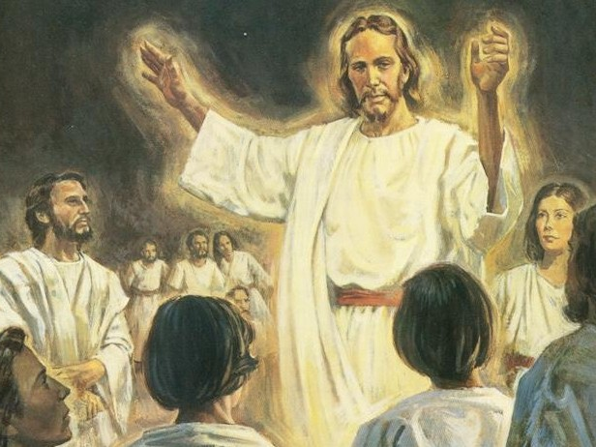
"Sanctify them by Your truth. Your word is truth. As You sent Me into the world, I also have sent them into the world. And for their sakes I sanctify Myself, that they also may be sanctified by the truth. I do not pray for these alone, but also for those who will believe in Me through their word;" — John 17:17-20
Your truth
"Sanctify them by Your truth. Your word is truth. As You sent Me into the world, I also have sent them into the world. And for their sakes I sanctify Myself, that they also may be sanctified by the truth. I do not pray for these alone, but also for those who will believe in Me through their word;" — John 17:17-20
Your word
Your word is truth
=
Your word is truth
believe in
Me through their word
Notes:
His sacrifice for all allows us to see from the inside where real truth resides. Knowing we are all part in one in Him is stronger than anything apart. No longer alone, we are with God Himself. God does not lie and to be in accordance with His word, one must believe it was He who brought His word together for us to know Him. He has declared this for us to know His sanctified truth of Spirit inspired by His life, and not just the result of mere writings from whimsical men. As of God, it is that it is, once delivered for all those that would believe.

Slide 20
And the Word became flesh and dwelt among us, and we beheld His glory, the glory as of the only begotten of the Father, full of grace and truth. — John 1:14
glory
glory
grace and truth
grace and truth
believe in Me through their word
Notes:
The Lord brings light to our darkness so that we can know truth. To behold the glory of His grace is truth in its’ purest openness. We all wait for corruption to end in view of His incorruption. God Himself has risen into our lives.

Slide 21
For this reason we also thank God without ceasing, because when you received the word of God which you heard from us, you welcomed it not as the word of men, but as it is in truth, the word of God, which also effectively works in you who believe. — 1st Thessalonians 2:13
thank God
received the word of God
thank God
heard from us
it is in truth
the word
of God
of God
works in you who believe
Notes:
Through the Spirit we are blessed to differentiate between His truth and mere simpleton concoctions of man. Fowl language and arrogance expose the intelligence of all fools. Thank the Lord for His inspired truth that makes the spirit soar in Him above all men. He is the fireworks of the heart.

Slide 22
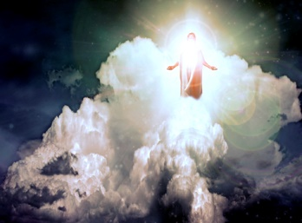
But You, O Lord, are a God full of compassion, and gracious, Longsuffering and abundant in mercy and truth. — Psalm 86:15
thank God
God
God
mercy and truth
Notes:
God has reached down to touch us with His gloriousness. We are not alone suffering in the pain of separation. As a Father waits for the return of his child, so God calls to His children.

Slide 23
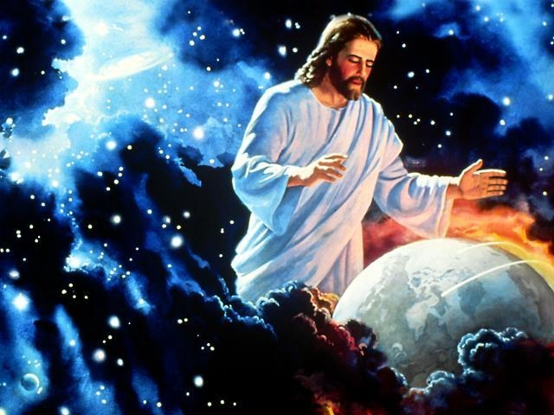
Mercy and truth have met together; Righteousness and peace have kissed. Truth shall spring out of the earth, And righteousness shall look down from heaven. — Psalms 85:10-11
mercy and truth
truth
heaven
Notes:
The truth of heaven has been revealed as God Himself has visited us. Unsurmountable peace extends to all those who rise in Him. It is by our example of faith that enlightens the angles and suppresses rebellion.

Slide 24
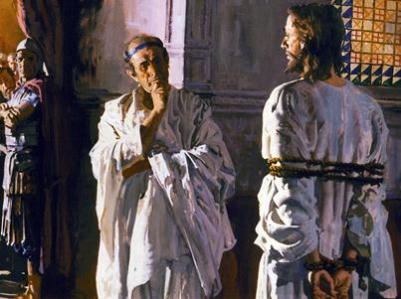
Pilate therefore said to Him, "Are You a king then?" Jesus answered, "You say rightly that I am a king. For this cause I was born, and for this cause I have come into the world, that I should bear witness to the truth. Everyone who is of the truth hears My voice." — John 18:37
Pilate
truth
truth
truth
Notes:
God never intended to leave us in the darkness without a way to return to His living truth in the light of His creation. For those that love Him, we hear the ring of heaven.

Slide 25
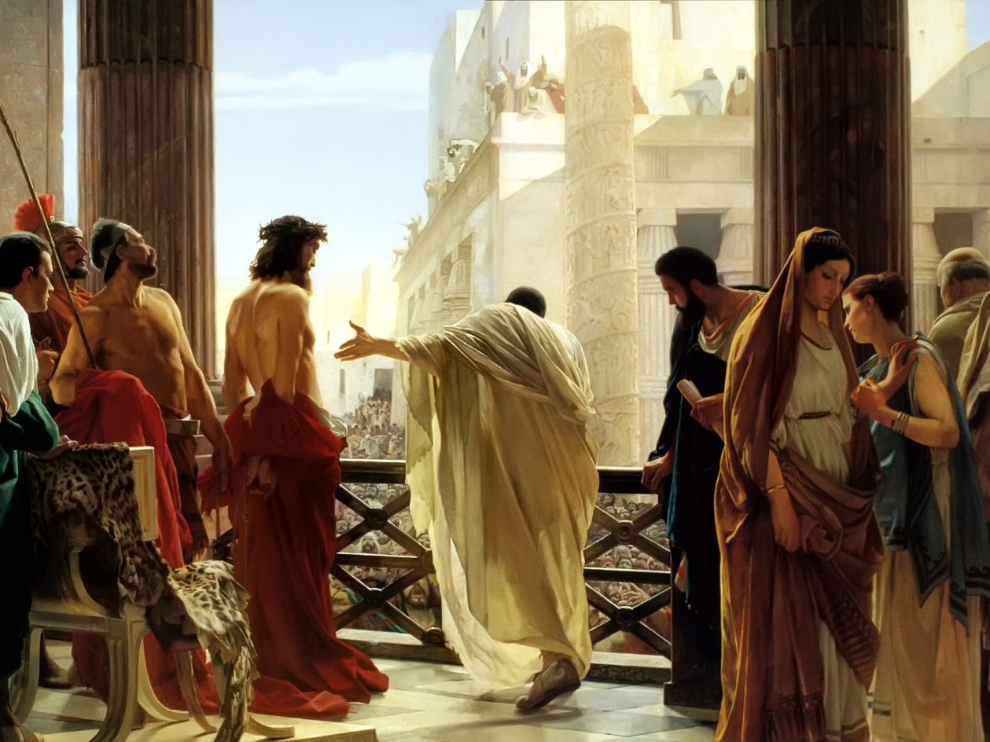
Pilate said to Him, "What is truth?" And when he had said this, he went out again to the Jews, and said to them, "I find no fault in Him at all." — John 18:38
Pilate
What is truth?
truth
=
What is truth?
Notes:
Torment plagues all liars. It takes courage to tell the truth and the reward is great with a peace that can come by no other means or way. Honor and integrity have no equal as they are the excellence of a soul. Rebellion comes from those who are threatened by authority and search for an escape with no reason other than spitefulness and or delusions of power. An impatient heart is a nasty heart. Look at all the arguments among men today, over truth, and how our unity breathlessly falls away from us. Division is the nature of man, to the shame of our children. Truth can be despicable when intermingled with oppression without compassion.

Slide 26
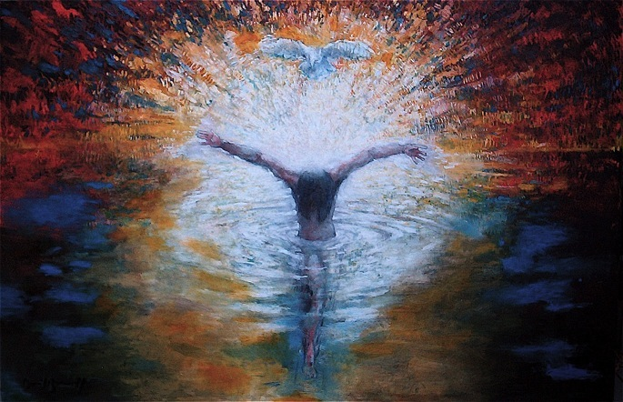
Who is he who overcomes the world, but he who believes that Jesus is the Son of God? This is He who came by water and blood --Jesus Christ; not only by water, but by water and blood. And it is the Spirit who bears witness, because the Spirit is truth. — 1st John 5:5-6
Baptism
Sacrifice
the Spirit is truth
truth
Notes:
To understand the Holy Spirit and our relationship in God, one must possess the quality of one of His greatest gifts to life, truth. And certainly, that of truth, over creations of self deception. To be immersed in God is to know His sacrifice of love is, so that life itself would be free to be free. The Holy Spirit is in us when we freely and truthfully stand in love of others.

Slide 27
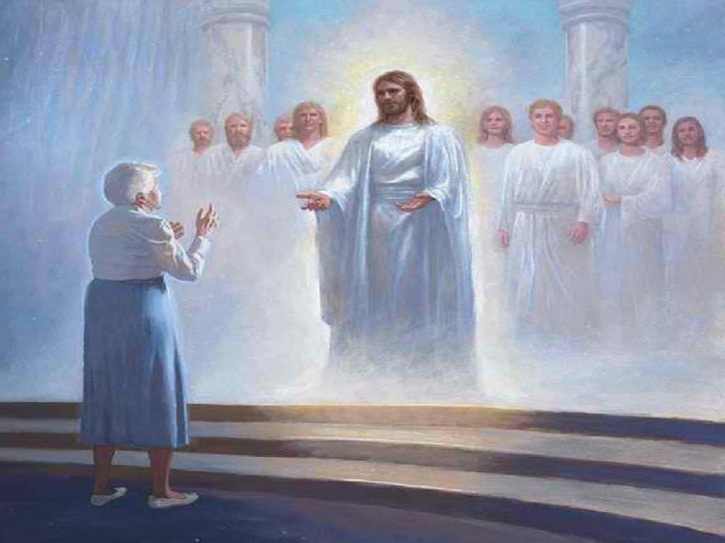
Of His own will He brought us forth by the word of truth, that we might be a kind of firstfruits of His creatures. — James 1:18
His own will
forth
forth by the word of truth
. .
His creatures
Notes:
God’s force is such that He calls for our return through the spirit of our lives. Our choice is our destiny, in Him or not. God takes no pleasure in the defiant that would spurn Him. He wills that we would be born in Him, adopted to an eternal inconceivable and irrevocable inheritance.

Slide 28
G
O
B
R
E
J
E
G
W
O
R
INDIVIDUALS
INSTRUMENT
INS
O
DIVINE
S
D
L
TRUTH
I
D
DU
U
A
US
S
TH
I
F
E
SP
R I T
Notes:
It is in realizing that God has given each of us life that the truth of His spirit is revealed. Jesus has sealed the terms of our salvation for all those that would fully accept Him. Repent and be immersed in Him. Stand as a breathing individual in God’s creation, knowing that His plan has eternal purpose. He is in fact the one that carries us all. We are of the rising dirt of the earth. We owe our lives to God, praise Him our Lord Jesus Christ and blessings untold will unfold.

Slide 29
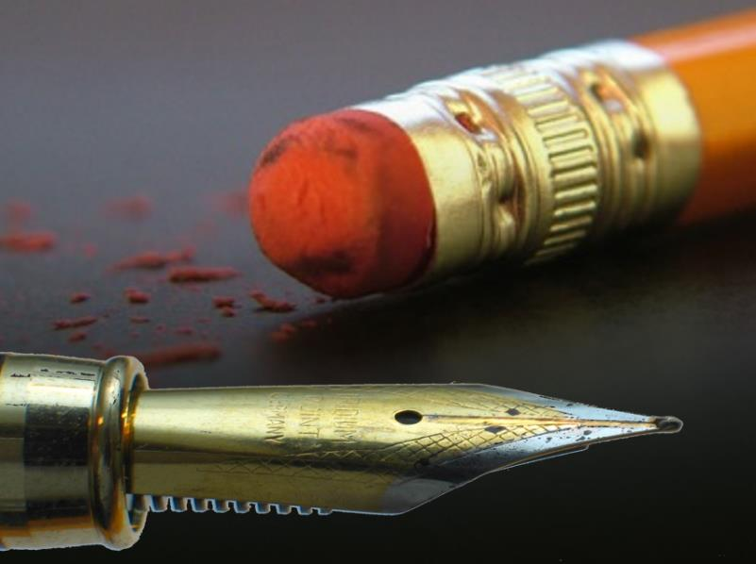
Notes:
In truth, have you immersed your spirit in Jesus and the life God would have for us? To accept Him lifts the soul beyond the mortal and strengthens the spirit deepening the soul.

Slide 30
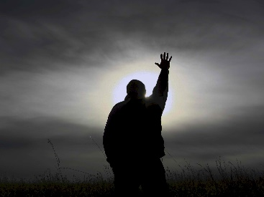
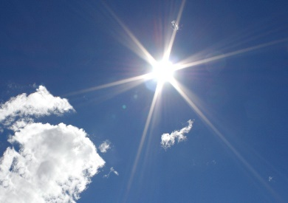
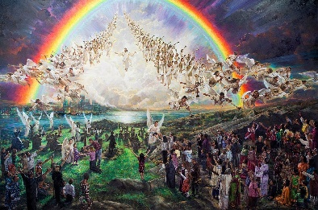
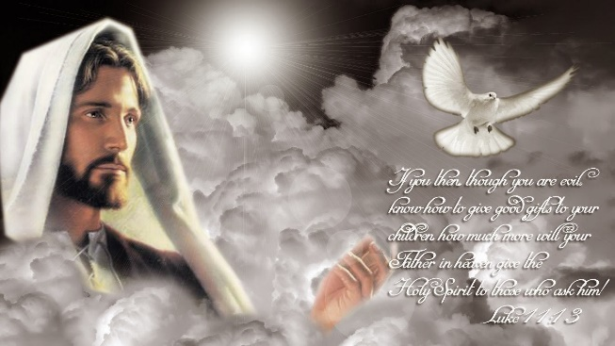
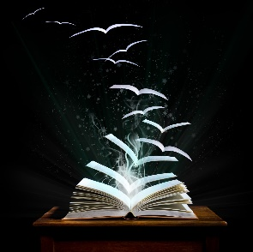
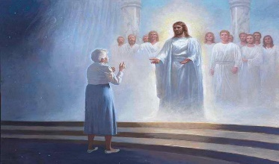
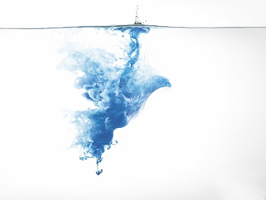

Slide 31
The Spirit of Truth is in our Hearts
→ God Himself is an instrument of truth
→ The Word of God is an instrument of truth
→ Jesus Christ is an instrument of truth
→ The Spirit is an instrument of truth
→ We are instruments of truth
Notes:
The Spirit of truth is in our hearts.

Slide 32
Notes:
Darkness holds no truth other than the absence of light. There is no heart in darkness.

Slide 33
Ron Bert
April 24, 2016
Part 2
Instrument
of Truth
Notes:
It is in the promises of His Word and declarations of goodness that we surely find the truth of God.

Slide 34
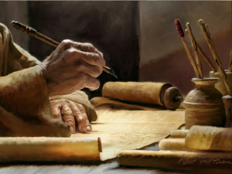
This will be written for the generation to come, That a people yet to be created may praise the LORD. For He looked down from the height of His sanctuary; From heaven the LORD viewed the earth, To hear the groaning of the prisoner, To release those appointed to death, … — Psalms 102:18-20
written for
praise Him
to come
a people
m
praise
LORD
LORD
written for a people to come
Hi
LORD
LORD
groaning
prisoner
release
release
prisoner groaning
death
death
Notes:
Above all His Grace extends Mercy to all those who genuinely and humbly cry out openly for Him in this most holy notion we bow to called truth. Remember, He is greater than the extinguishing of time. It is in truth, thoughts from His heart, that transcends all the generations. He gives to those whose cry is freedom.

Slide 35
"The glory of the LORD shall be revealed, And all flesh shall see it together; For the mouth of the LORD has spoken." — Isaiah 40:5
The voice said, "Cry out!" And he said, "What shall I cry?" "All flesh is grass, And all its loveliness is like the flower of the field. The grass withers, the flower fades, Because the breath of the LORD blows upon it; Surely the people are grass. The grass withers, the flower fades, But the word of our God stands forever." — Isaiah 40:6-8
LORD
glory of the LORD
glory of the LORD
all flesh shall see it
all flesh shall see it
time
LORD
fades
fades
word of our God stands forever
word
word of our God stands forever
Notes:
The Word of God is greater than any mere mortal man. It is His word that instructs us. It is God, through His timeless being, touching each generation with a call to come back in truth. Repeatedly, He explains our futile situation in view of a greater glory. Praise the Lord for the lesson found in grass. We die to live. Surely the breath of God is given by the times in which we live.

Slide 36
"I am the true vine, and My Father is the vinedresser." — John 15:1
"I am the vine, you are the branches. He who abides in Me, and I in him, bears much fruit; for without Me you can do nothing. If anyone does not abide in Me, he is cast out as a branch and is withered; and they gather them and throw them into the fire, and they are burned." — John 15:5-6
in
abides in Me
in
fruit
I in him
without Me you can do nothing
without Me you can do nothing
fire
fruit
I am
true
I am
fire
designer
Notes:
What is the truth of a flower? How did its’ seed come to be? Can words express the fire of fragrance’s color? Can the memory of love pierce the present without a knowing heart? Are sentient beings more than rising dust? God declares it is our choice to be part in Him or not as we question what, and who, we are. In truth, we are nothing without God.

Slide 37
Do not withhold Your tender mercies from me, O LORD; Let Your lovingkindness and Your truth continually preserve me. — Psalm 40:11
truth
fire
fruit
truth
preserve me
Notes:
The delicate beauty of life has no equal and we are ignorant to the enormity of its’ colors. Who can claim the source of life in its’ infinite perplexing wonders? We loudly and humbly need God so that we may survive our collapsing deaths in the flesh. It is in the flesh that the true nature of a soul is determined. His truth is such a special delicacy bringing surviving nectar as we precariously navigate unknown devouring portals. He promises permanency but not in this realm of finite impossibilities. He looks for that awakening change from self, to us. Unity is not found in the disunion of souls, and especially those mired contemptuously against one another, - the cancer of all fallen civilizations. Leadership is not leadership when it only divides the people and proves God’s own announcement that man is powerless to lead himself. Without the power of unyielding decency under His guidance (how God upholds the heavens), petty thoughts are lost in the crowd.

Slide 38
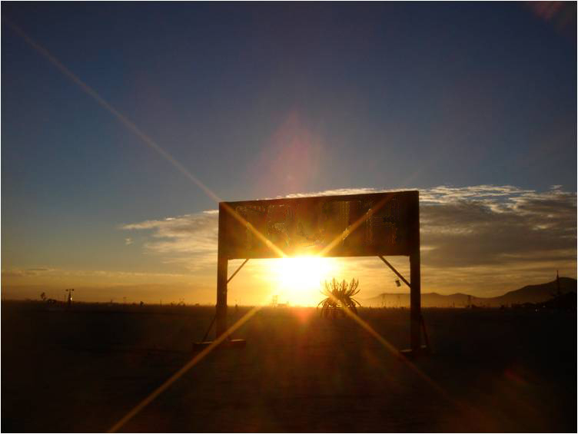
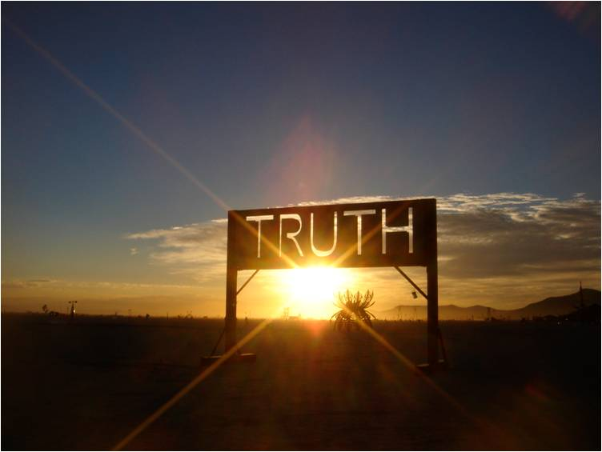
Lead me in Your truth and teach me, For You are the God of my salvation; On You I wait all the day. — Psalm 25:5
Lead me
Lead me
truth
Lead me
teach me
teach me
day
TRUST
truth
Notes:
Many things are attributed to being strengthened by the Word of God. Qualities of humbly asking for help to know better while maintaining the patience to work through any struggle, in hopeful view of what He has promised the faithful, eternal life. It is trust in the hereafter and Him. Disbelievers may say hogwash asking why we must wait, but truth is larger than human life. Claims of once your dead, your dead, wail out from cynics who plunder upon the material. It is more than just dust in the darkness. To be alive in Him is what He waits for. God is for the living, not the dead or the dying. A cemetery is not a place of worship and He proclaims that it should not be. This world is not our permanent home. Salvation is the cry of the marching faithful. Holy is the pureness of His sustaining light. In fact, His truth comes to light for all those that truly believe. It is not about squabbling religions of man, it is about the greatness of God’s own truth given to all men.

Slide 39
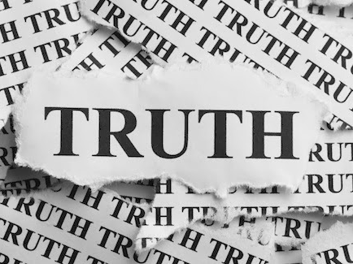
Be diligent to present yourself approved to GOD, a worker who does not need to be ashamed, rightly dividing the word of truth. — 2nd Timothy 2:15
present yourself
Be diligent to present yourself approved to GOD, a worker who does not need to be ashamed, rightly dividing the word of truth. — 2nd Timothy 2:15
present yourself
GOD
GOD
GOD
GOD
truth
Notes:
There is a lot of knowledge in the realm of man. God is instructing us to be careful in knowing right from wrong, in accordance with His will. Man’s anger denies the goodness of God by blaming God for the shortcomings of man and unspiritual people fail to fully acknowledge the curse of Satan’s own devouring death, as he is cast away into the darkness dragging his once omnipresent blessings with him. Man’s severance of God endorses lawlessness and joins in Satan’s own characteristic demise. In the exclusive isolated pursuit of man, God’s brilliance is lost. To examine His Word is to find God. There is a greater purpose than just mortal life in a universe of decay, and it is found in being living creatures of God. To find this on your own has no greater value.

Slide 40
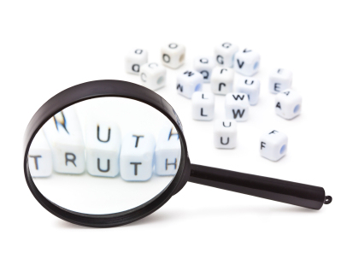
Test all things; hold fast what is good. Abstain from every form of evil. — 1st Thessalonians 5:21-22
1 .
2 .
3 .
Notes:
All is a mystery to be found and upon finding understanding, it leads one on the path to further exploration. Decisions to accept what is wholesome and reject that which is profane is where a good life resides. To accept God’s word embraces eternity.

Slide 41
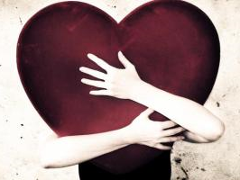
Let love be without hypocrisy. Abhor what is evil. Cling to what is good. — Romans 12:9
3
2
1
Let love be without hypocrisy
love
Abhor what is evil
Cling to
good
what is good
Notes:
In one’s deepest thoughts, love’s aspiration is to be simple and sure. He asks that we pursue goodness shunning the repulsiveness of evil. To achieve love in all its’ glory, one’s heart, mind, must rise, leave, even leap, from the bottom of its’ darkness. Approaching the light is not found in resting inside the darkness. Truth for us can be enigmatic in God’s innumerable gifts. Ours, given in wondering, reflects eternity. God is certainly not disguised with duplicity for this is a dish most often served by man. God calls for clean hearts in His light.

Slide 42
Let not mercy and truth forsake you; Bind them around your neck, Write them on the tablet of your heart, And so find favor and high esteem In the sight of God and man. — Proverbs 3:3-4
mercy
truth
Write
Write
heart
heart
Notes:
A passionate compassionate heart is regarded by all.

Slide 43
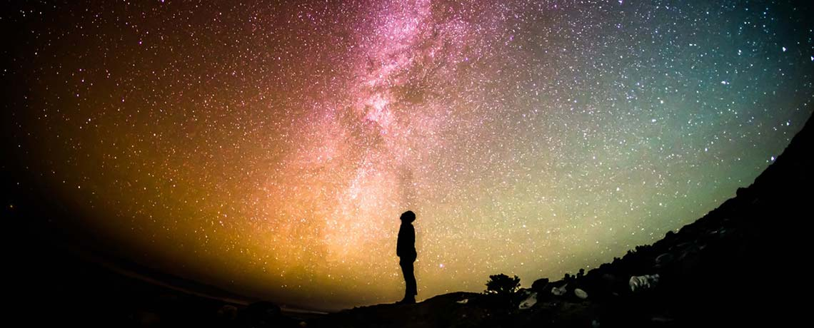
"Only fear the LORD, and serve Him in truth with all your heart; for consider what great things He has done for you." — 1st Samuel 12:24
truth
all your heart
in
in
Notes:
In regards to God’s creation, how can one not fall humbled in service to what has been given. Without gratefulness in awe of His wonders, one limits awareness. True paupers fail to look up from within. Rich are the poor in spirit for they know of such a greater need than all the earth could provide.

Slide 44
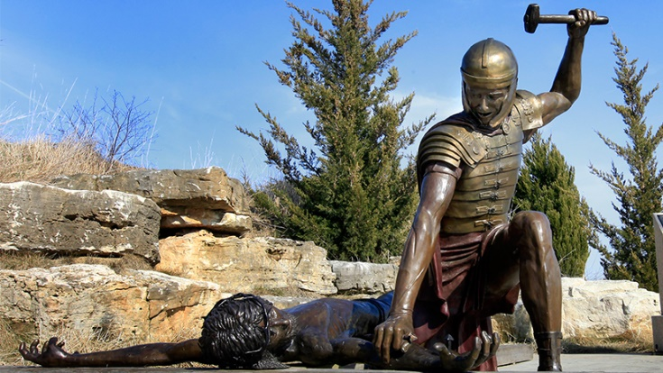
For the law was given through Moses, but grace and truth came through Jesus Christ. — John 1:17
grace and truth
Christ
through Jesus Christ
grace
truth
Notes:
God has no wish for death to reign in the suffering of separation mired in the inabilities of man. He has incorporated a plan where His grace redeems those who know Him; the loyal living in Him. It is not rocket science. A praising heart is a humble heart. It is in praising that heaven’s eternity draws near. Indescribable is the distant remembrance of the most familiar truth, God so dearly loves us that He did die for us. His gift of free life and love for us echoes across the heavens.

Slide 45
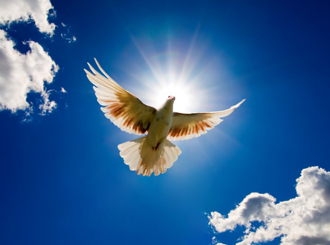
In Him you also trusted, after you heard the word of truth, the gospel of your salvation; in whom also, having believed, you were sealed with the Holy Spirit of promise, … — Ephesians 1:13
trust
trust
word of truth
believed
believed
sealed with the Holy Spirit
Notes:
By abiding in His word the Spirit of truth engages further assistance, within, as the promise of the inheritance consummates. Life eternally begins now. Truth is not something hidden.

Slide 46
If we say that we have fellowship with Him, and walk in darkness, we lie and do not practice the truth. But if we walk in the light as He is in the light, we have fellowship with one another, and the blood of Jesus Christ His Son cleanses us from all sin. If we say that we have no sin, we deceive ourselves, and the truth is not in us. — 1st John 1:6-8
we
a
do
practice
truth
in
light
is
the
of Jesus Christ
Notes:
There are those that only worship the ground before them. Unforgiving materialism void of spirit only invites the downtrodden greedy. Hypocrites abound as man’s hate for man is truly our greatest enemy. Divorce from others is not divorce from self. Sacrifice leads a soul’s sinless rising. All those who walk in His light bring a greater power to the whole glory, in mercy for one another. The sharing of love was intended by Him, for His children, and His deepest hope is now for our joy in Him to overtake our miseries for without.

Slide 47
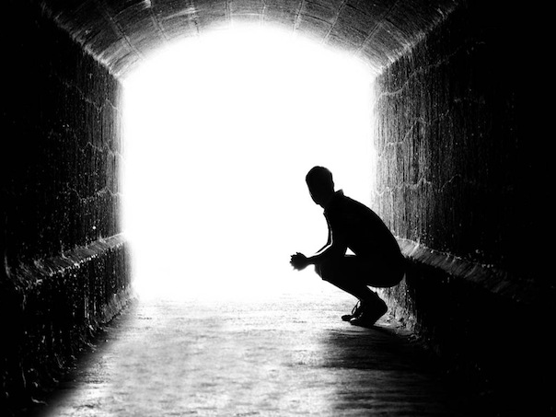
"For everyone practicing evil hates the light and does not come to the light, lest his deeds should be exposed. But he who does the truth comes to the light, that his deeds may be clearly seen, that they have been done in God." — John 3:20-21
who does
truth
comes to the light
deeds
ly
in God
Notes:
Darkness maintains a brazen lack of conscience. Truth blazes in the face of darkness. It takes courage to overcome any yanking tumultuous fears. Apathy has no friend in the bravery one must muster to survive. In struggles, while darkness glooms, the heart beats hard coughing to breathe. These are times that have consumed each of us. It can be a battle just to be. To see clearly with the clarity of an open heart, one must become free of the darkness that binds us; those clasping chains holding misery in our disgust. All good hearts hold regret. Accepting His forgiveness strengthens one’s resolve to be free and moves the spirit forward and upward.

Slide 48
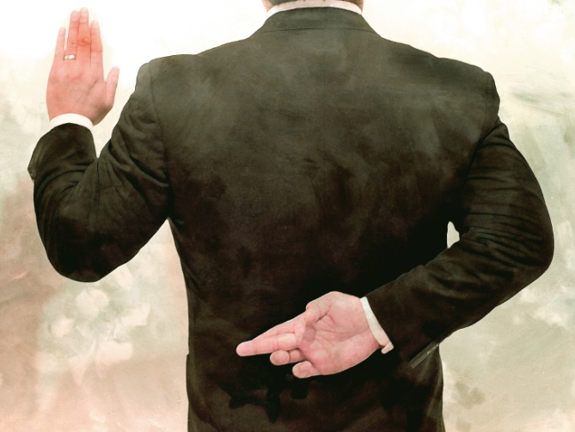
He who says, "I know Him," and does not keep His commandments, is a liar, and the truth is not in him. But whoever keeps His word, truly the love of God is perfected in him. By this we know that we are in Him. — 1st John 2:4-5
keeps His word
keeps His word
By this we know that we are in Him
Notes:
Truth is the gauge to whether one is in God or not. All liars have no pity. Alone, a lying heart murders the truth.

Slide 49
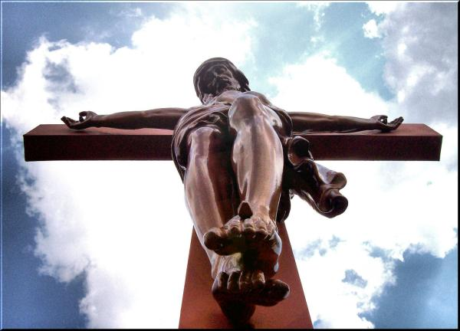
In mercy and truth Atonement is provided for iniquity; And by the fear of the LORD one departs from evil. — Proverbs 16:6
Punishment
Compensation
Propitiation
Atonement
Fee
Amends
Reinstatement
Reparation
Penance
Payment
Notes:
He came to lift all repenting hearts. Thank God, praise the Lord, for Christ carries our sins setting us free to move onward. This is the truth of His mercy, and astounding grace is found by all those loyal to Him. Brilliant is shy of His shining truth.

Slide 50
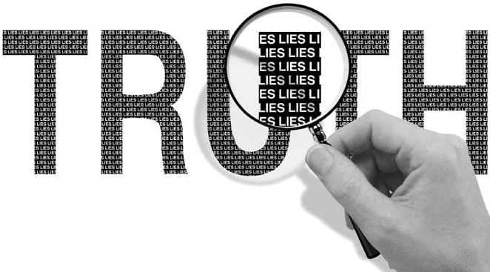
… and with all unrighteous deception among those who perish, because they did not receive the love of the truth, that they might be saved. And for this reason God will send them strong delusion, that they should believe the lie, that they all may be condemned who did not believe the truth but had pleasure in unrighteousness. — 2nd Thessalonians 2:10 -12
love of the truth
love of the truth
saved
condemned
who did not believe the truth
who did not believe the truth
Notes:
For the arrogant of heart, pointed in their determination, place self above God. In life they would mock truth buried in deception. These range from the insane knife cutting butchers, baby life torturing primadonnas, to the neurotics that rage across the roadways of all lands. Pray all those who hurt, God truly help us as evil surrounds the meek. The storm rages upon the remaining calm as nature herself is witness to the toxic onslaught of man’s atrocities.

Slide 51
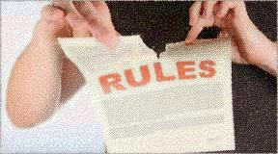
But this people has a defiant and rebellious heart; They have revolted and departed. — Jeremiah 5:23
defiant
defiant
rebellious
rebellious
departed
departed
Notes:
Evil has no conscience and pursues pleasure no matter the cost. Desperation finds hopeless rage in its’ breaking point.

Slide 52
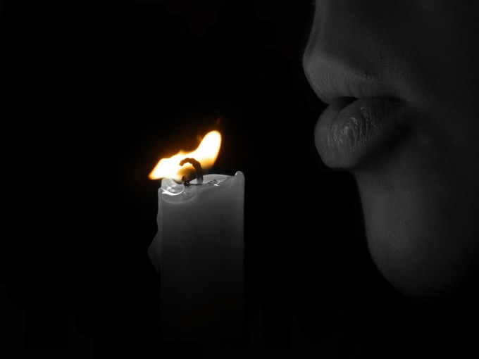
"There are those who rebel against the light; They do not know its ways Nor abide in its paths." — Job 24:13
truth
Notes:
It is said that the people perish where there is no truth. To find the light is to find God. Pity upon all whose death is in darkness.

Slide 53
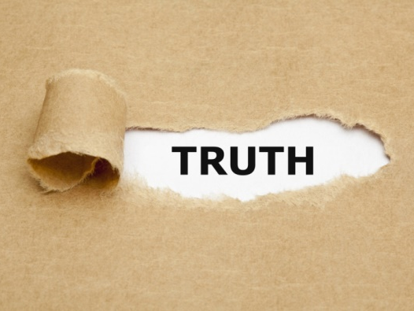
Have I therefore become your enemy because I tell you the truth? — Galatians 4:16
For we can do nothing against the truth, but for the truth. — 2nd Corinthians 13:8
truth
truth
truth
TRUTH
TRUTH
truth
Notes:
Like searching for a prize in a box of Cracker Jacks, one has to dig for the truth to uncover the treasure. In order to see the truth, one must tear back the lies that would deceive us. If there is no underlying guiding greater truth, how pitiable is all life. Hard truth can be painful, but it is the wall we all must climb. Many prefer the absence of His light, for the truth can be most uncomfortable for those deceived in the trickery of a lie. Comfort zones have been the death of many of souls. Truth remains over the masks of man.

Slide 54
The truthful lip shall be established forever, But a lying tongue is but for a moment. — Proverbs 12:19
truth
truth
Notes:
Truth is intermingled with love for how can one absolve one from the other and still maintain truth? What is impossible is impossible; inseparable. There is false truth. Hate is truth without merciful hope. Hate is void of timeless unity with roots often repressed in hidden fears. What nurtures a child raises a child. Lying cowards beget cowards of the same, and so to individually rise in the goodness of God’s own truth, a break from tradition must be mustered, for surely a clean brave heart can only be realized, in life's fullest form, if God is embraced. It is a lie that our state should be separate from the godly life. It is in greatest truth that when we separate God from our state that the despicable creep in, may it never be so, as it is. Truth maintains a fearless quality in knowing something greater is ahead. Mature spirits have peaceful praise for life superseding those immaturely caught up in the disgust of anxiety. Man’s affliction against man kills many who would be faithful in adopting finite scornful lies over His greater desire for the higher truths to upwell in us. To be deep is to be high. What is shallow will forever remain shallow. Lies descend to nothing while the truth eternally rises.

Slide 55
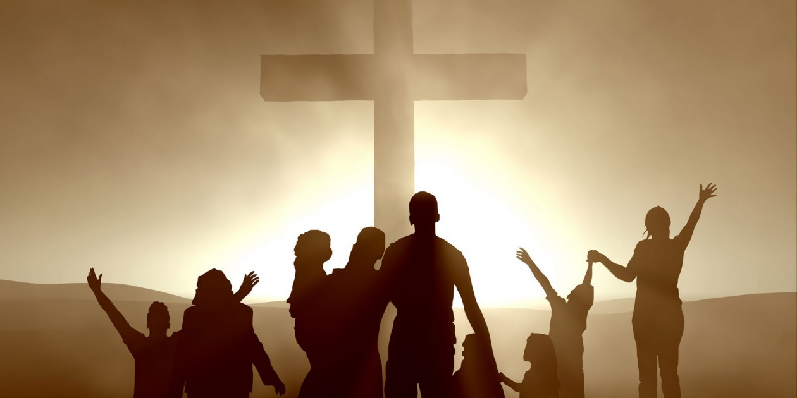
… but, speaking the truth in love, may grow up in all things into Him who is the head -- Christ -- — Ephesians 4:15
truth
love
grow up
grow up
Christ
Notes:
He has risen to show us how to rise, so be it! In truth, does our might of love reach out to uncover a greater light of truth?

Slide 56
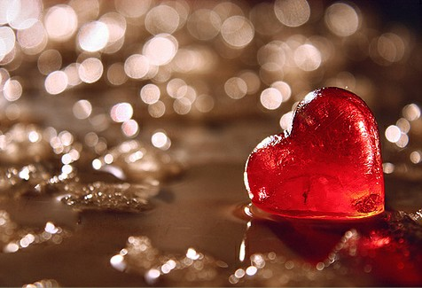
Love suffers long and is kind; love does not envy; love does not parade itself, is not puffed up; does not behave rudely, does not seek its own, is not provoked, thinks no evil; does not rejoice in iniquity, but rejoices in the truth; — 1st Corinthians 13:4-6
Love suffers long and is:
● kind
does not → envy
→ parade itself
→ behave rudely
→ seek its own
→ rejoice in iniquity
● not puffed up / provoked
● thinks no evil
● rejoices in the truth
Love
love
=
Love suffers long and is
Love
kind
does not
envy
parade itself
=
not puffed up
behave rudely
truth
seek its own
=
provoked
thinks no evil
rejoice in
rejoices in the truth
iniquity
truth
rejoices in the truth
rejoices in the truth
truth
Notes:
Love is over all.

Slide 57
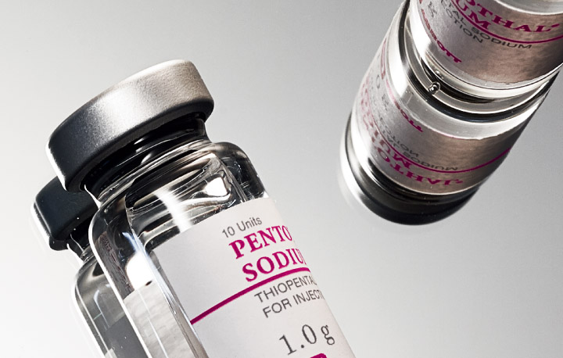
Therefore, putting away lying, "Let each one of you speak truth with his neighbor," for we are members of one another. — Ephesians 4:25
truth
speak truth
speak truth
Notes:
It is incredible that truth serum is required in such a trustless world as ours. No serum is required when one’s praise is to the source of all. Honest is the face of the noble.

Slide 58
(for the fruit of the Spirit is in all goodness, righteousness, and truth), — Ephesians 5:9
truth
goodness
righteous
Notes:
God is calling us out to be righteous in all goodness holding truth as precious.

Slide 59
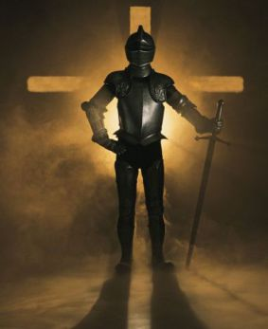
Stand therefore, having girded your waist with truth, having put on the breastplate of righteousness, and having shod your feet with the preparation of the gospel of peace; — Ephesians 6:14-15
Stand
with truth
truth
with truth
the gospel
truth
Notes:
To stand for and in the truth holds no greater honor. Truth prepares us to withstand attacks upon our conviction when lies assault our character. One can have zeal for a lie so truth is essential to be right in the eye of God. We are instructed to use the gospel of peace as a basis for the truth that we would believe. Lies suppress the people in ignorance holding us all in the bondage of corruption. He calls for us to put on the light of His truth in the face of darkness.

Slide 60
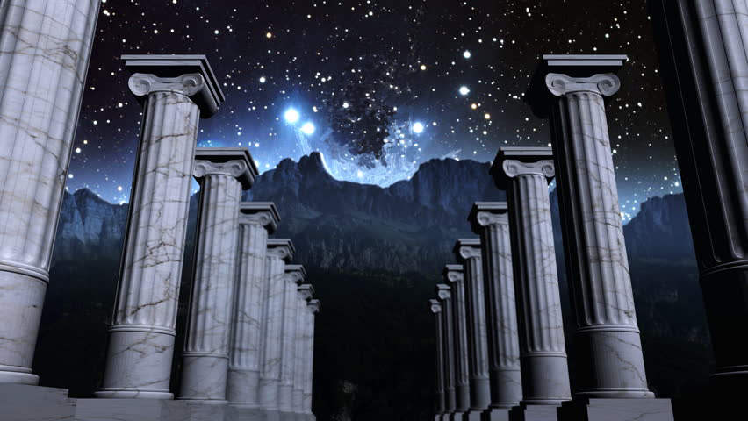
… but if I am delayed, I write so that you may know how you ought to conduct yourself in the house of God, which is the church of the living God, the pillar and ground of the truth. — 1st Timothy 3:15
I write
I write
may know
you may know how
you may know how
to conduct yourself
to conduct yourself
church of the living God
pillar
of the truth
truth
Notes:
Universally truth holds to the pillar of eternity. His truth remains as all falsehoods evaporate. His word thunderously enlightens the softness of our hearts.

Slide 61
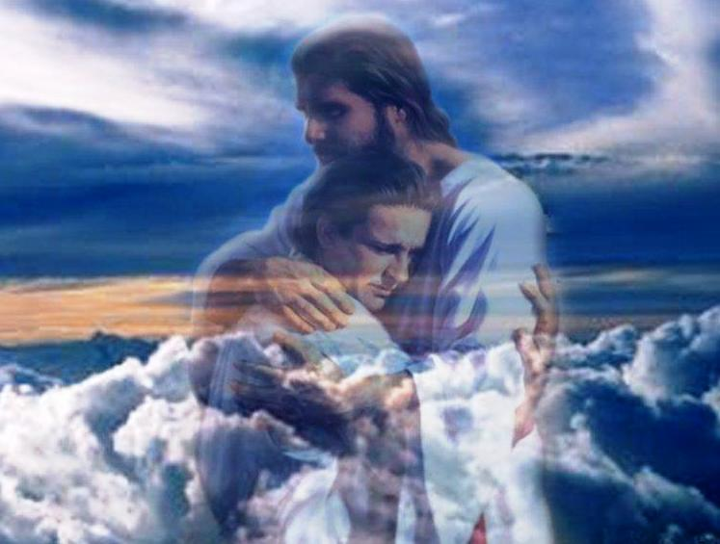
And we know that the Son of God has come and has given us an understanding, that we may know Him who is true; and we are in Him who is true, in His Son Jesus Christ. This is the true God and eternal life. — 1st John 5:20
know
may know
Him who is true
Him who is true
Him who is true
Him who is true
God
Notes:
To be held by God is to know Him.

Slide 62
We are of God. He who knows God hears us; he who is not of God does not hear us. By this we know the spirit of truth and the spirit of error. — 1st John 4:6
God
God
God
hear
w
t
o
spirit of truth = wants to hear God
spirit of error = does not hear God
God
t
God
does not hear
s
spirit of truth
an
spirit of error
God
Notes:
We reach for something yet unseen promised by God. It inspires us to be better than we are in compassion for others. As God proclaims, the spirit of truth is in Him, and to reject His reality is to adopt the spirit of error. Many claim to believe in God, but don’t care to talk about Him, either for fear or ignorance, or in todays political correctness, He has become taboo. Is God an opinion or a fact, and if opinions differ, does that change God? It does not, and His truth remains over the petty arguments of man. A society that does not talk about God is abandoned by God. Honest hearts transparent in His light beholds the epitome of truth itself.

Slide 63
My little children, let us not love in word or in tongue, but in deed and in truth. And by this we know that we are of the truth, and shall assure our hearts before Him. — 1st John 3:18 -19
in deed
shallow
in
in deed
in truth
truth
in
in truth
truth
truth
truth
assure our hearts before Him
Notes:
It is caring for others that we find ourselves in harmony with the fulfillment of spirit, that God created us for, expressly to enjoy in, and this is naturally innate to His creation. As a part to edify the whole, we find unity in Him.

Slide 64
I rejoiced greatly that I have found some of your children walking in truth, as we received commandment from the Father. — 2nd John 1:4
children
children
truth
walking in truth
truth
in
walking in truth
commandment
commandment
commandment
Notes:
Children pure in heart; it is often lost by those that turn from God. Children should be the fresh air of their parents inhalation; a welcomed rejoicing. And if we are reduced to children void of the truth, it results in the recklessness we now witness across this nation, and any nation that would abandon His teachings. Withholding God is to the demise of our children, crippling them as adults, and only perpetuates a mistrustful society of disgust and unhappiness.

Slide 65
For I rejoiced greatly when brethren came and testified of the truth that is in you, just as you walk in the truth. I have no greater joy than to hear that my children walk in truth. — 3rd John 1:3 - 4
truth
truth
truth
truth
no greater joy
no greater joy
walk in truth
in
walk in truth
Notes:
The Word, completed by the Apostles, established God’s truth in His desire that man know His will through His pronouncements of truth. Come to Him and find your greater self, an unpretentious soul in the whole of Him. Harmless as a dove but wise as a waiting serpent. Would ignorance serve us, and our self-indulgent children, better?

Slide 66
For if we sin willfully after we have received the knowledge of the truth, there no longer remains a sacrifice for sins, … — Hebrews 10:26
truth
For if we sin willfully after we have received the knowledge of the truth, there no longer remains a sacrifice for sins, … — Hebrews 10:26
no
no
sacrifice for sins
sacrifice for sins
Notes:
A sinful unrepentant life is one that has no restraints, anything goes. It is one immersed in the sole impulsive pleasures of the flesh, regardless of the consequences to those surrounding the perpetrator. It is lust unfulfilled void of generosity. In the mercy of Jesus’ life, His grace holds to those in pursuit of His redeeming force, abiding in the improvements of spirit God calls out for, in all that would be sinners. He carries the sins of those that do not turn from Him and His once delivered truths. Each true Christian is a mountain climber. It is asked, will you come or remain in your sins. To go on alone in a ditch, it is dreadful to think that there would be no sacrifice, to cover your disobedience, in the face of His judgment, especially with access into the goodness that is eternity waiting.

Slide 67
"But the cowardly, unbelieving, abominable, murderers, sexually immoral, sorcerers, idolaters, and all liars shall have their part in the lake which burns with fire and brimstone, which is the second death." — Revelation 21:8
all liars
all liars
second death
Notes:
For those that remain rebelliously alone, the second death is figuratively found in the dumping grounds of burning human garbage. More detrimentally, it is a place of separation from ongoing creation, and most predominately, separate from the living giving God. As polluted waste is purged, so will the destruction from the living occur for those that serve no one but self. There is no room in God’s kingdom for the selfish as they depart to the discarded. How alone is darkness with no life.

Slide 68
Word
d
h
e
a
r
t
Mercy
e
B
u
y
B
Word
e
W
Truth
o
u
r
d
d
y
.
p
worship
s
pure
pillar
Notes:
It will be unadulterated truth that will expose each soul for what we are, bare in His light.

Slide 69
… before the LORD. For He is coming, for He is coming to judge the earth. He shall judge the world with righteousness, And the peoples with His truth. — Psalm 96:13
He is coming to judge
. .
Word
with righteousness
. .
. .`
truth
with His truth
His
Notes:
So it is the Word in which we seek truth. Nothing is more valuable than the truth for its’ foundation builds on all that is noble. Truth serves a heart mercifully joining one with the divine. Our deeds are purely in the midst of our hearts as the pillar defining who we are. We need to keep our thoughts pure as it is in fact the pillar of our faith in the sight of God. Pray He preserves us from wicked temptations. May we be found worthy in the tower of His great living truth. More than what we think, it is about what we do.

Slide 71
→ Esteem mercy and truth as truth endures forever
→ Love rejoices in the truth
→ Truth is one of the fruits of the Spirit
→ A spirit of truth hears the word of God
→ In mercy & truth Atonement is provided for iniquity
→ Truth came through Jesus Christ
→ Speak the truth to one another
→ Our deeds expose the truth of our hearts
→ Serve the Lord in truth
→ Sinning willfully after receiving truth dooms a soul
→ One cannot go against the truth
→ The church of the living God is a pillar of truth
→ God will judge the world’s people in His truth
The Word of God is the Truth of God
Notes:
We stand on the shore of time waiting for His timeless appearing.

Slide 72
Notes:
Darkness has no cover.

Slide 73
Please visit http://www.RonBert.com to explore further
Ronald Bert Channel on
Notes:
Eternity never ends.

Slide 74
Notes:
We are blank without the truth.

