Slide 1
Notes:
Darkness succumbs to light.

Slide 2
Hope
Ron Bert
March 6, 2016
Notes:
Hope is the heart of mortal life. Some believe hope is something we reach for while faith is something we have. I would argue belief in the future is a hope. Faith asserts improvement in living, not only for destiny we seek, but the eventuality of where true life in a spirit of love belongs. It is a fine line to distinguish between faith and hope as not being synonymous.

Slide 3
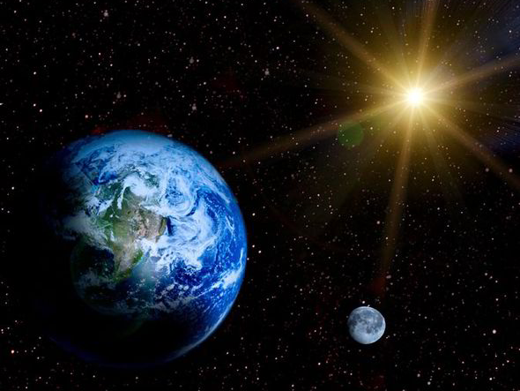
"God, who made the world and everything in it, since He is Lord of heaven and earth, does not dwell in temples made with hands. Nor is He worshiped with men's hands, as though He needed anything, since He gives to all life, breath, and all things." — Acts 17:24-25
Lord
Notes:
God commands the light over the darkness. In His light He gives independent life.

Slide 4
"And He has made from one blood every nation of men to dwell on all the face of the earth, and has determined their preappointed times and the boundaries of their dwellings, so that they should seek the Lord, in the hope that they might grope for Him and find Him, though He is not far from each one of us;" — Acts 17:26-27
seek
Lord
in
hope
the Lord
hope
. .
grope for Him
Notes:
His creation is such that He hopes we will find Him for the greatness that He is.

Slide 5
God
Notes:
His creation is such that He hopes we will find Him for the greatness that He is.

Slide 6
"… for in Him we live and move and have our being, as also some of your own poets have said, 'For we are also His offspring.' Therefore, since we are the offspring of God, we ought not to think that the Divine Nature is like gold or silver or stone, something shaped by art and man's devising." — Acts 17:28-29
in
in
Him we live
Him we live
offspring of God
God
Notes:
As offspring of God, our true nature is to reflect His righteous qualities. As for human nature in sin, more often than not, children rebel against their parents wishing autonomy from authority. It is clear that God wishes for us to regain our senses in our ability to obediently live in Him forever.

Slide 7
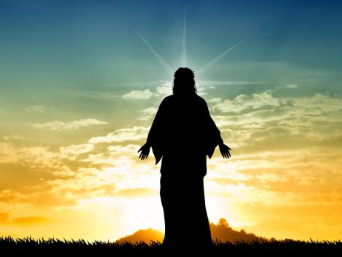
"Truly, these times of ignorance God overlooked, but now commands all men everywhere to repent, because He has appointed a day on which He will judge the world in righteousness by the Man whom He has ordained. He has given assurance of this to all by raising Him from the dead." — Acts 17:30-31
repent
repent
God
judge
God
judge
by the Man
by the Man
Jesus
assurance
by raising Him from the dead
Notes:
Time is such that it runs out. His call to eternal life is an awakening in hope of His truth.

Slide 8
For the earnest expectation of the creation eagerly waits for the revealing of the sons of God. For the creation was subjected to futility, not willingly, but because of Him who subjected it in hope; — Romans 8:19-20
For the earnest expectation of the creation eagerly waits for the revealing of the sons of God. For the creation was subjected to futility, not willingly, but because of Him who subjected it in hope; — Romans 8:19-20
creation
waits
revealing of the sons of God
revealing
revealing of the sons of God
creation
subjected
in hope
in
in hope
Notes:
True hope is a venue of return to the root of a single life in Him and His eternal existent creation. The silver lining to reality is that a revealing is coming, and especially for those that wait upon His ways. God wants to know what we hope for.

Slide 9
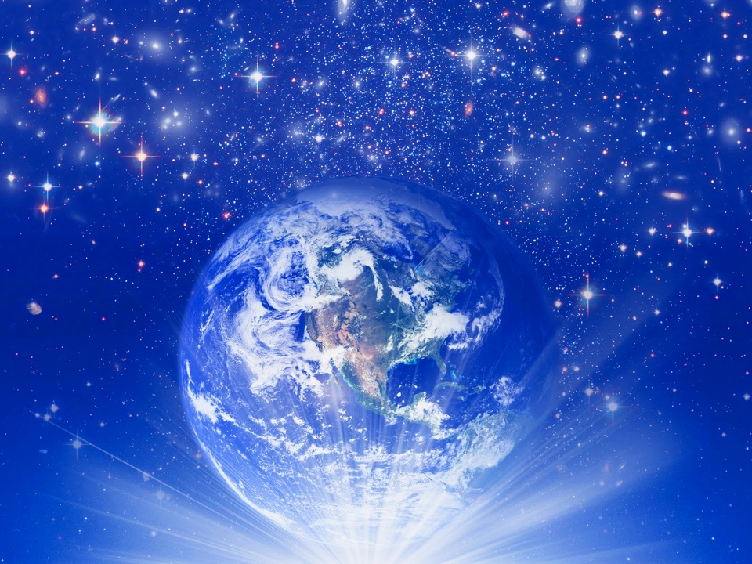
… because the creation itself also will be delivered from the bondage of corruption into the glorious liberty of the children of God. For we know that the whole creation groans and labors with birth pangs together until now. — Romans 8:21-22
will be delivered
from
will be delivered
bondage
liberty
glorious liberty
Notes:
Our individual risings await the telling of what life is to surely be.

Slide 10
Not only that, but we also who have the firstfruits of the Spirit, even we ourselves groan within ourselves, eagerly waiting for the adoption, the redemption of our body. — Romans 8:23
h
e
hope
the adoption
op
the adoption
of our body
of our body
Notes:
In the sorrow of captivity, we thirst for freedom beyond bondage.

Slide 11
For we were saved in this hope, but hope that is seen is not hope; for why does one still hope for what he sees? But if we hope for what we do not see, we eagerly wait for it with perseverance. — Romans 8: 24-25
in
hope
in
hope
hope
hope
hope
hope
hope
Notes:
Knowing He has come offering life itself is a gift of grace beyond compare.

Slide 12
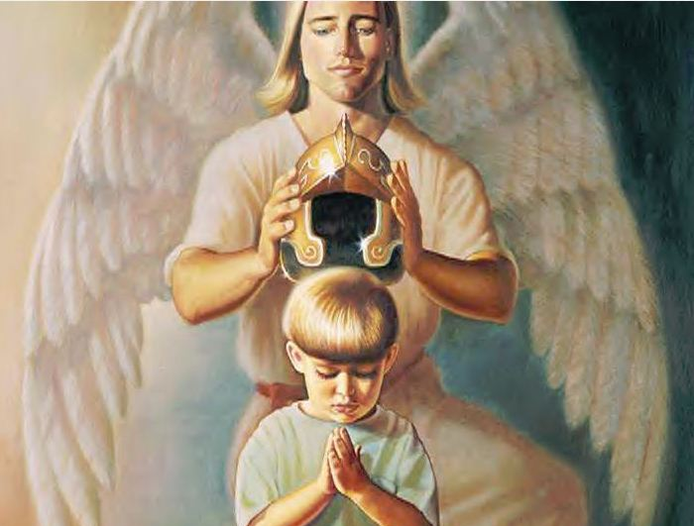
But let us who are of the day be sober, putting on the breastplate of faith and love, and as a helmet the hope of salvation. — 1st Thessalonians 5:8
faith
love
hope
Notes:
This conscious hope in Him distinguishes the faith of a soul. Our outward faith works hand in hand with our inner love whereas hope lifts them both. Concealed love is shown by actions supported by our hope.

Slide 13
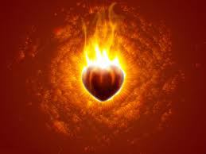
And not only that, but we also glory in tribulations, knowing that tribulation produces perseverance; and perseverance, character; and character, hope. Now hope does not disappoint, because the love of God has been poured out in our hearts by the Holy Spirit who was given to us. — Romans 5:3-5
endurance
God of hope
enduran e
tribulation
suff ring
suffering
suffering
e
tribulation
perseverance
perseverance
character
hope
hope
character
hope
of
hope
God
in
in our hearts
character
charact r
Holy Spirit
e
c
Notes:
Hope leads us through all suffering in view of His promise of love. Doesn't hope often passionately burn upon one’s heart? Without hope the light of the heart dims. It is God’s garden and He is cultivating life to live eternally with Him. Suffering deepening endurance developing character purifying hope is God’s fishing hook.

Slide 14
Now may the God of hope fill you with all joy and peace in believing, that you may abound in hope by the power of the Holy Spirit. — Romans 15:13
God of hope
hope
in
in
believing
in
in
hope
hope
Holy Spirit
Notes:
His call is to live with an increasing hope that does not fade. This is the belief that pounds upon a heart at peace in joy of Him.

Slide 15
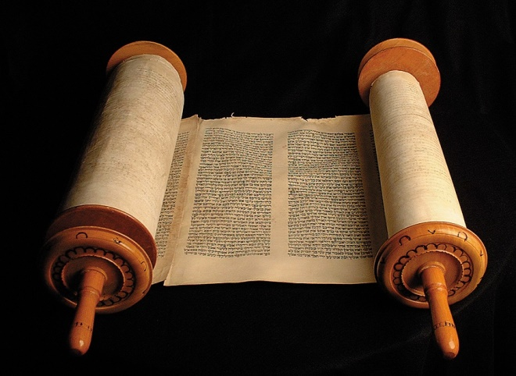
For whatever things were written before were written for our learning, that we through the patience and comfort of the Scriptures might have hope. — Romans 15:4
patience and comfort
patience and comfort
might have hope
hope
hope
might have hope
hope
Notes:
Dwelling upon His word edifies our hope. God left us a road map with deep treasures so as to find our free hearts in Him.

Slide 16
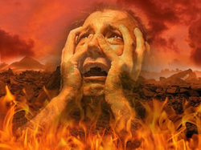
For Sheol cannot thank You, Death cannot praise You; Those who go down to the pit cannot hope for Your truth. — Isaiah 38:18
hope
hope
For what is the hope of the hypocrite, Though he may gain much, If God takes away his life? — Job 27:8
So are the paths of all who forget God; And the hope of the hypocrite shall perish, … — Job 8:13
hope
Notes:
Hypocrites hold to selfishness with at best false hopes.

Slide 17
hope
hope
hope
Notes:
Hypocrites hold to selfishness with at best false hopes.

Slide 18
The hope of the righteous will be gladness, But the expectation of the wicked will perish. — Proverbs 10:28
Hope
Anticipation
Expect
hope
expectation
Belief
Wish
Long
Desire
Suppose
Notes:
True hope lifts one joyously to the presence of God. What we longingly desire for in anticipation of our wishes supposes upon an expectant belief that our hopes will come true, and this is what lights our hearts.

Slide 19
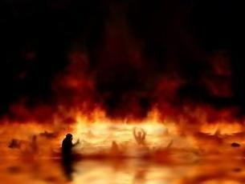
When a wicked man dies, his expectation will perish, And the hope of the unjust perishes. — Proverbs 11:7
wicked
expectation
hope
expectation
perish
hope
unjust
wicked unjust perish
Notes:
The end of all evil is to dangle in hopelessness.

Slide 20
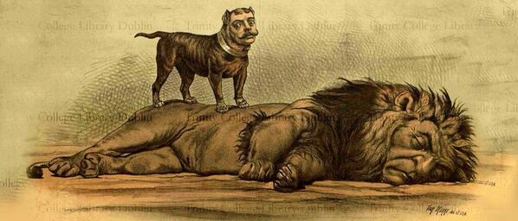
But for him who is joined to all the living there is hope, for a living dog is better than a dead lion. — Ecclesiastes 9:4
hope
living there is hope
living there is hope
Notes:
Life is where death is not.

Slide 21
But I will hope continually, And will praise You yet more and more. — Psalm 71:14
hope
continually
continually
Notes:
Praise for Him goes hand in hand with hope.

Slide 22
Uphold me according to Your word, that I may live; And do not let me be ashamed of my hope. — Psalm 119:116
Uphold
word
that I may live
that I may live
hope
Notes:
It is in knowing His word that strengthens a continuing life of hope.

Slide 23
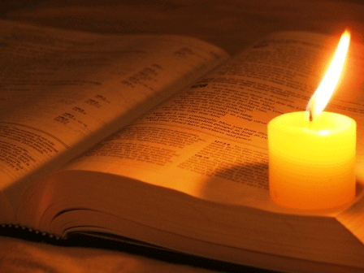
My soul faints for Your salvation, But I hope in Your word. — Psalm 119:81
Your word
I wait for the LORD, my soul waits, And in His word I do hope. — Psalm 130:5
My soul faints for Your salvation, But I hope in Your word. — Psalm 119:81
in
in
hope
His word
Notes:
Patience in coming salvation commands over those that would be rash. We were created to gasp for salvation; groping for Him settles a soul. Hope is the light of where we are going.

Slide 24
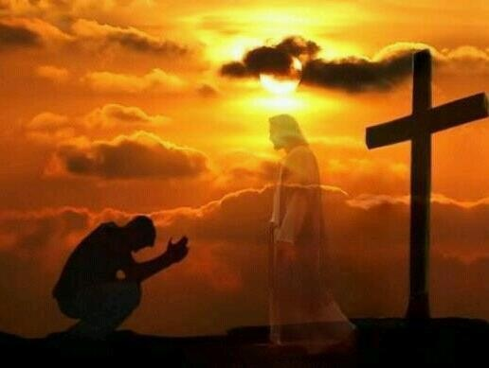
For in You, O LORD, I hope; You will hear, O Lord my God. — Psalm 38:15
hope
hope
in
hope
I hope
For in You, O LORD, I hope; You will hear, O Lord my God. — Psalm 38:15
For in You, O LORD, I hope; You will hear, O Lord my God. — Psalm 38:15
"And now, Lord, what do I wait for? My hope is in You." — Psalm 39:7
You
in
You
You
Notes:
Faith is trust for that which cannot be seen. For us hope is a languishing desire for more than we are.

Slide 25
Hope deferred makes the heart sick, But when the desire comes, it is a tree of life. — Proverbs 13:12
hope
tree of life
Notes:
Sorrows can hinder our hopes, yet the outcome remains.

Slide 26
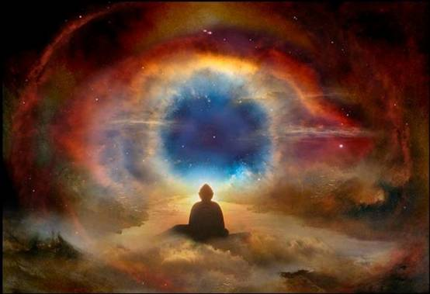
Behold, the eye of the LORD is on those who fear Him, On those who hope in His mercy, To deliver their soul from death, And to keep them alive in famine. — Psalm 33:18-19
eye of the LORD
on
who fear Him
eye of the LORD
↓
on who fear Him
hope in soul alive
His mercy
hope
in
hope in
soul
alive
Notes:
God watches each of us to see our resolve in what we are. His blessings wait for those uninhibited in hope of His truth.

Slide 27
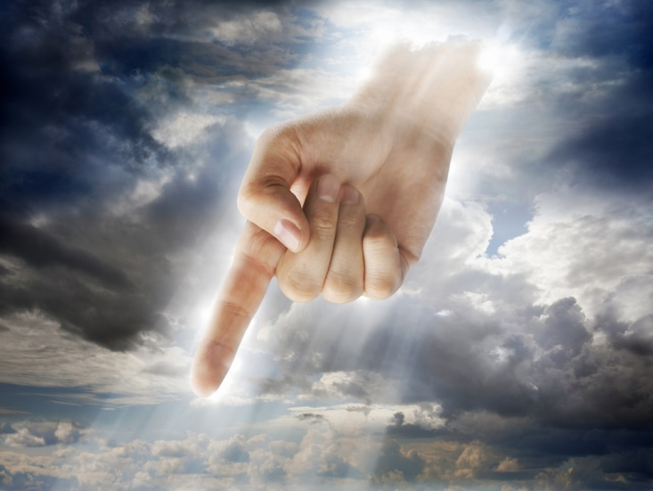
For I know the thoughts that I think toward you, says the LORD, thoughts of peace and not of evil, to give you a future and a hope. — Jeremiah 29:11
of peace
not of evil
hope
Notes:
The Lord’s will is to offer salvation to all that would have it. He offers hope that we will remain alive in Him. Hope is a key to His kingdom.

Slide 28
Be of good courage, And He shall strengthen your heart, All you who hope in the LORD. — Psalm 31:24
good courage
strengthen you
hope
in
in
Notes:
There comes a moment where hope must commit to the surety of His truth.

Slide 29
"Blessed is the man who trusts in the LORD, And whose hope is the LORD. For he shall be like a tree planted by the waters, Which spreads out its roots by the river, And will not fear when heat comes; But its leaf will be green, And will not be anxious in the year of drought, Nor will cease from yielding fruit." — Jeremiah 17:7-8
in
trusts
in
hope is the LORD
hope
hope is the LORD
not fear
not be anxious
will yield fruit
→
→
→
not fear
hope
not be anxious
will
yield
fruit
Notes:
It is when hope mingles in trust that fear is purged.

Slide 30
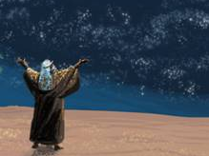
Happy is he who has the God of Jacob for his help, Whose hope is in the LORD his God, — Psalm 146:5
hope
in
in
Notes:
Grounded in happiness comes from a content hope in Him. The sands of time contain the wind of God’s own retrieving truths.

Slide 31
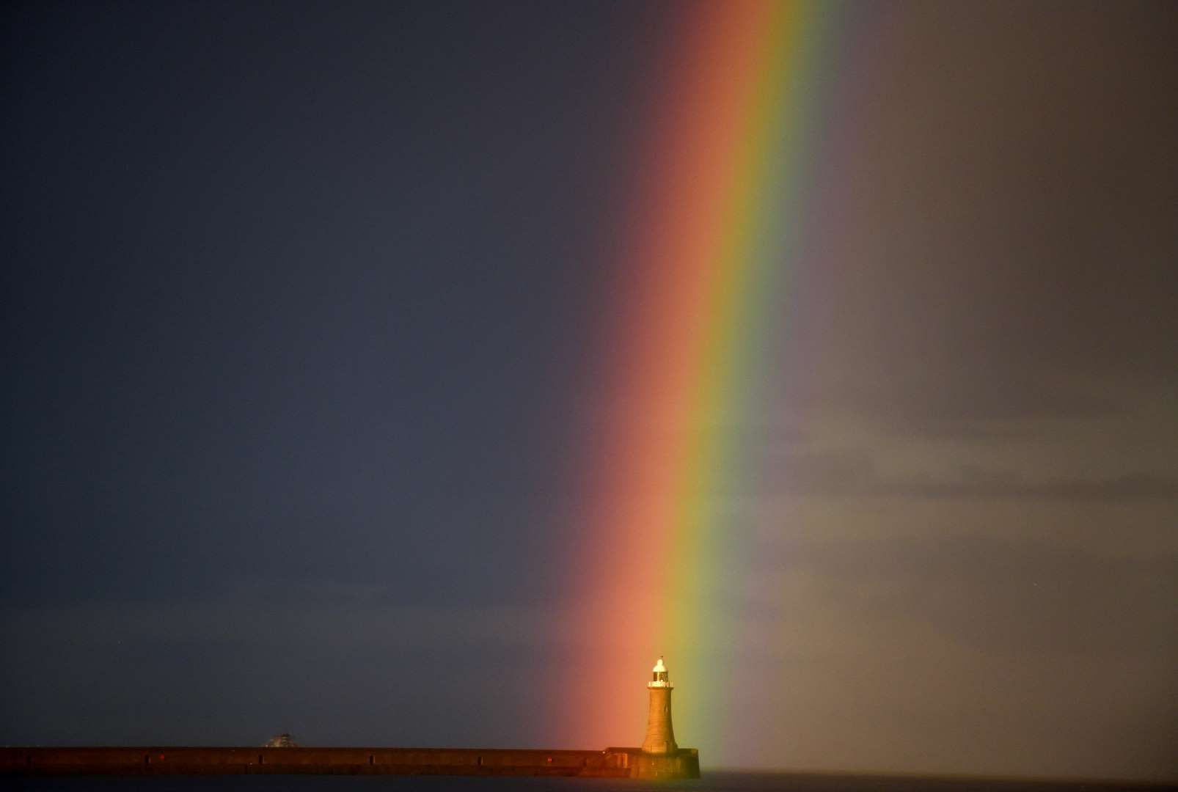
"The LORD is my portion," says my soul, "Therefore I hope in Him!" The LORD is good to those who wait for Him, To the soul who seeks Him. It is good that one should hope and wait quietly For the salvation of the LORD. — Lamentations 3:24 -26
"The LORD is my portion," says my soul, "Therefore I hope in Him!" The LORD is good to those who wait for Him, To the soul who seeks Him. It is good that one should hope and wait quietly For the salvation of the LORD. — Lamentations 3:24 -26
"The LORD is my portion," says my soul, "Therefore I hope in Him!" The LORD is good to those who wait for Him, To the soul who seeks Him. It is good that one should hope and wait quietly For the salvation of the LORD. — Lamentations 3:24 -26
in
in
wait
wait
seek
seek
faith
Now faith is the substance of things hoped for, the evidence of things not seen. — Hebrews 11:1
hope
wait quietly
wait quietly
things hoped for
things not seen
things not seen
Notes:
We all wait on a beach called time. The quintessence of what we are rests on who we are and what we seek. Waiting on the Lord has no measure for those that willingly wait. All the world is a fool in the Father’s light.

Slide 32
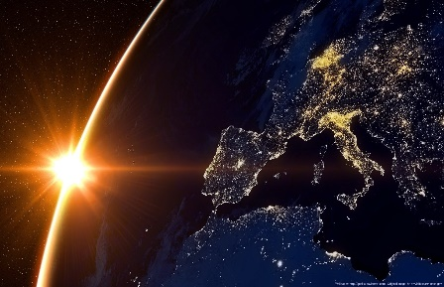
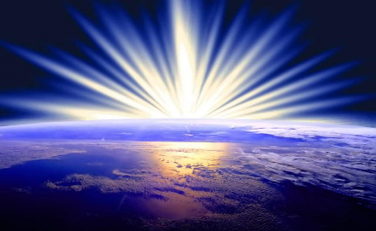
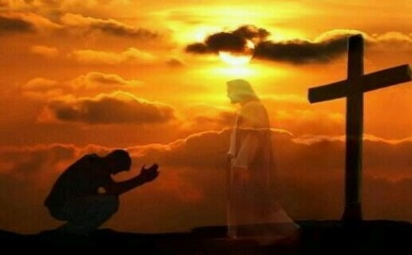
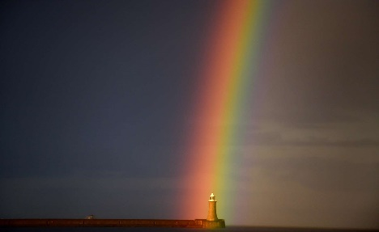

Slide 33
→ God hopes we want Him enough to find Him
→ God subjected creation to futility to expose hope
→ We are saved thru our stamina in an unseen hope
→ Hope is a cognitive act desiring salvation
→ Hope will not disappoint if patient thru troubles
→ Hope is a construct of the Holy Spirit’s power
→ The word of God assists in obtaining true hope
→ The hopes of the unjust will perish
→ Our hope should be based in believing in Him
→ The watchful Lord hopes we seek peace over evil
→ Courageous hope strengthens the heart
→ Hope mingled in trust delivers His sure calm
→ He desires we seek Him patiently in hope
Faith is Hope in the Promise of His Love
Notes:
We wait for the promise of His light.

Slide 34
Notes:
In His light we see.

Slide 35
Notes:
Darkness holds no promise.

Slide 36
Hope
PART 2
Ron Bert
March 6, 2016
Notes:
It is the shore of peace that our hope waits for.

Slide 37
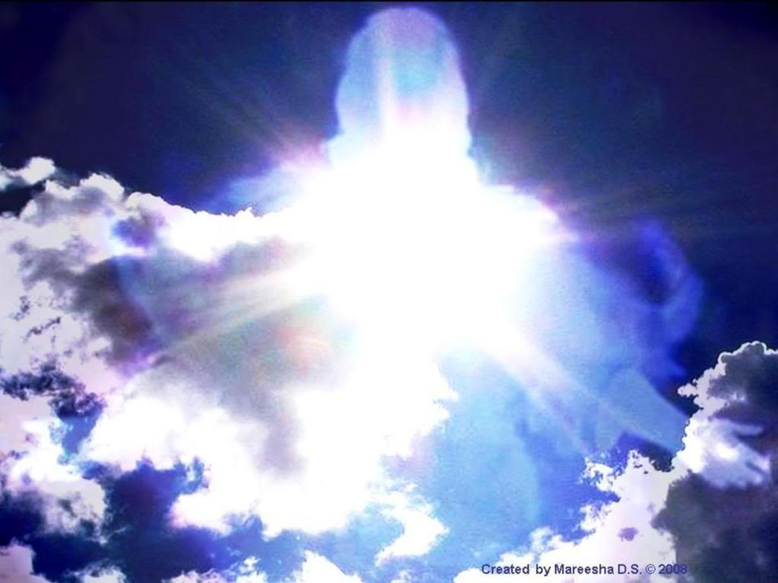
Blessed be the God and Father of our Lord Jesus Christ, who according to His abundant mercy has begotten us again to a living hope through the resurrection of Jesus Christ from the dead, — 1st Peter 1:3
a living
hope
through the resurrection
of
Jesus Christ
Notes:
Our living hope is one that embraces eternal life itself.

Slide 38
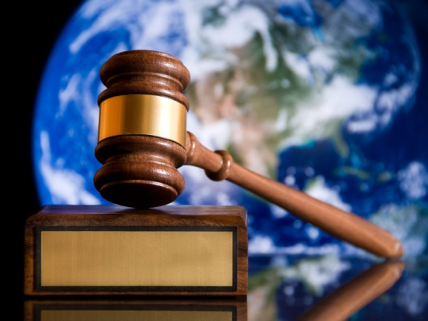
Yes, we had the sentence of death in ourselves, that we should not trust in ourselves but in God who raises the dead, who delivered us from so great a death, and does deliver us; in whom we trust that He will still deliver us, … — 2nd Corinthians 1:9-10
h
sentence of death
hope
e
in
in
in
ourselves
in
God
d
deliver
us
o
in
in
trust
trust
He will still deliver us
He will
He will still deliver us
He will
He will
He will
He will
He will
He will
He will
He will
He will
He will
Notes:
And to save us from death, He came to show us the way.

Slide 39
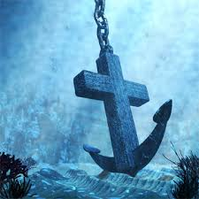
This hope we have as an anchor of the soul, both sure and steadfast, and which enters the Presence behind the veil, — Hebrews 6:19
hope
hope
anchor
Notes:
Clearly pure access to His eternal light is before us in the truth He offers. The question in each heart is, do you believe? The answer to the call is a faith with hope.

Slide 40
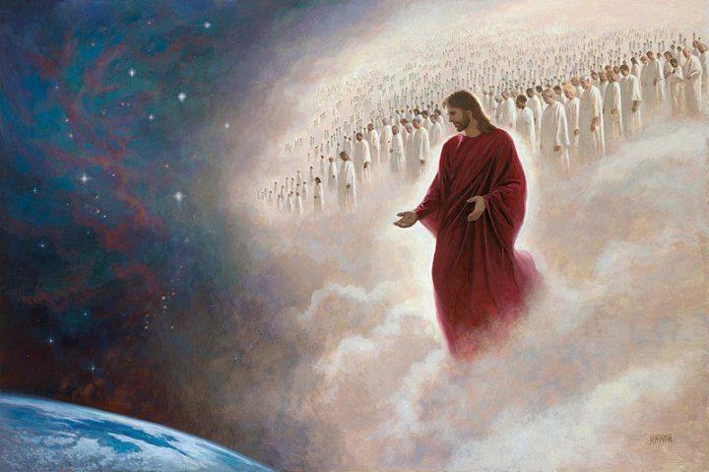
… looking for the blessed hope and glorious appearing of our great God and Savior Jesus Christ, — Titus 2:13
seeking
hope
Notes:
How wondrous it will be when our hope is realized in His appearing! He asks that we individually seek out His truth. A most personal work over simply being misled by man. It is a call and a quest for souls to find Him.

Slide 41
But if there is no resurrection of the dead, then Christ is not risen. And if Christ is not risen, then our preaching is empty and your faith is also empty. — 1st Corinthians 15:13-14
if no resurrection
of the dead
↓
Christ is not risen
preaching is empty
faith is empty
if
no resurrection
of
the dead
Christ is not risen
preaching is empty
faith
→
is
empty
→
Notes:
Skeptics will always scream, doubters will always doubt. What is empty remains empty.

Slide 42
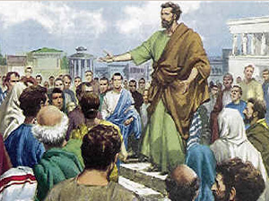
Yes, and we are found false witnesses of God, because we have testified of God that He raised up Christ, whom He did not raise up -- if in fact the dead do not rise. For if the dead do not rise, then Christ is not risen. — 1st Corinthians 15:15-16
if
if
if
Notes:
To believe or not to believe He has risen to prove His love confronts us all.

Slide 43
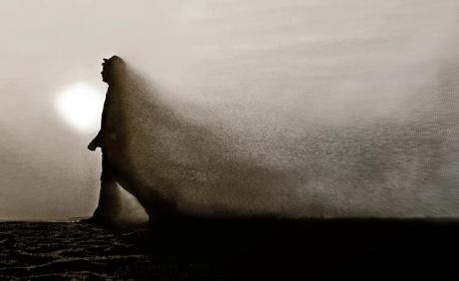
And if Christ is not risen, your faith is futile; you are still in your sins! Then also those who have fallen asleep in Christ have perished. If in this life only we have hope in Christ, we are of all men the most pitiable. — 1st Corinthians 15: 17-19
if
faith is futile
still in your
sins!
in
in
men the most pitiable
Notes:
If Jesus Christ is just a charlatan, no hope survives.

Slide 44
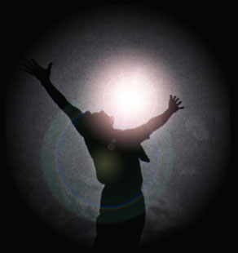
But now Christ is risen from the dead, and has become the firstfruits of those who have fallen asleep. For since by man came death, by Man also came the resurrection of the dead. For as in Adam all die, even so in Christ all shall be made alive. — 1st Corinthians 15:20 -22
N
E
S
I
in
in
R
flesh
in
in
Adam
die
Christ
spirit
Christ
alive
Notes:
But He has risen and this tells the tale of God’s redeeming force. It is the living hope He has given to us.

Slide 45
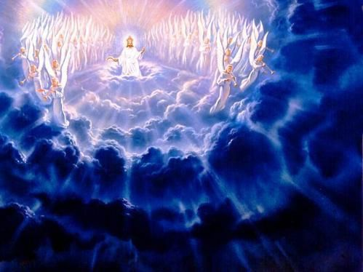
But each one in his own order: Christ the firstfruits, afterward those who are Christ's at His coming. Then comes the end, when He delivers the kingdom to God the Father, when He puts an end to all rule and all authority and power. For He must reign till He has put all enemies under His feet. The last enemy that will be destroyed is death. — 1st Corinthians 15:23-26
order
Christ
1
2
He delivers
He delivers
Notes:
It has been established that after the recovery of His loyal souls, death will end. God’s plan is time-honored to enable free souls to return ecstatically in Him. When all rule, authority, and power over others ends, it will be then that God truly will trust those whom remain.

Slide 46
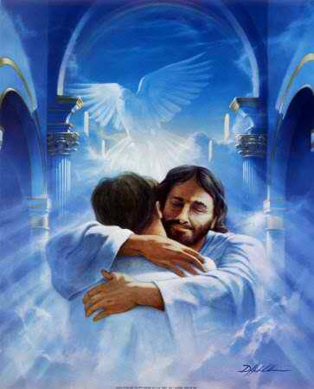
… but Christ as a Son over His own house, whose house we are if we hold fast the confidence and the rejoicing of the hope firm to the end. — Hebrews 3:6
hold fast
confidence
hope
firm
firm
Notes:
And it is by His will that individual lives have been set to be welcomed, for all those that remain righteous in Him. To know we are part of Him is one of God’s goals that we come to realize.

Slide 47
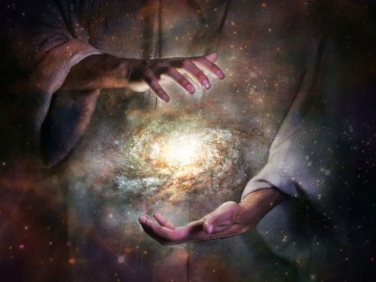
He indeed was foreordained before the foundation of the world, but was manifest in these last times for you who through Him believe in God, who raised Him from the dead and gave Him glory, so that your faith and hope are in God. — 1st Peter 1:20-21
u
s
t
m
believe in God
believe in God
believe in God
faith
hope
in God
Notes:
For His desire is that we know Him for all that He is. It is His promise of life that delivers our hope.

Slide 48
And we desire that each one of you show the same diligence to the full assurance of hope until the end, that you do not become sluggish, but imitate those who through faith and patience inherit the promises. — Hebrews 6:11-12
hope
through faith and patience inherit
the promises
Notes:
Struggles either refine commitment to endure or weaknesses expose what will forever remain barred. What we hope for is seriously looked at by God.

Slide 49
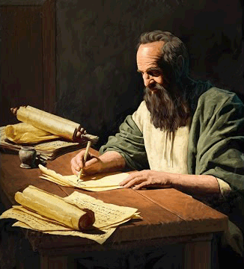
Paul, an apostle of Jesus Christ, by the commandment of God our Savior and the Lord Jesus Christ, our hope, — 1st Timothy 1:1
God our
Savior
the Lord Jesus Christ
our hope
hope
our hope
Notes:
To see the light is in fact hope in Him. He is our savior and hope unto eternal life. Hope for God is the highest of all hopes.

Slide 50
Paul, an apostle of Jesus Christ, by the commandment of God our Savior and the Lord Jesus Christ, our hope, — 1st Timothy 1:1
God our Savior
the Lord Jesus Christ
God our
Savior
the Lord Jesus Christ
our hope
hope
our hope

Slide 51
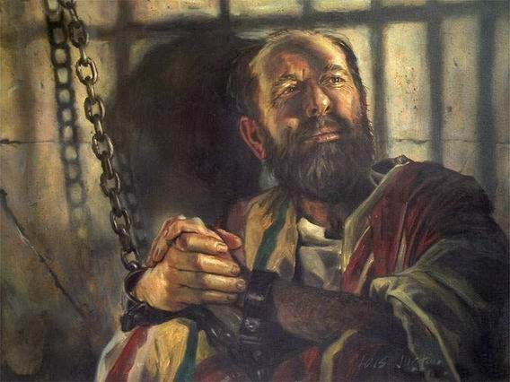
"And now I stand and am judged for the hope of the promise made by God to our fathers. To this promise our twelve tribes, earnestly serving God night and day, hope to attain. For this hope's sake, King Agrippa, I am accused by the Jews. Why should it be thought incredible by you that God raises the dead? " — Acts 26:6-8
hope
hope of the promise
hope of the promise
hope
hope
Notes:
This world does not care for the word of God because it removes authority from man.

Slide 52
Therefore gird up the loins of your mind, be sober, and rest your hope fully upon the grace that is to be brought to you at the revelation of Jesus Christ; — 1st Peter 1:13
Jesus Christ
Jesus Christ
hope
grace
grace
brought to you
brought to you
Jesus Christ
Notes:
To prepare for what we will become is larger than anyone can offer. Approaching grace is more than all the times in space that merely dwindle away. Our hope stands in the light.

Slide 53
Now may our Lord Jesus Christ Himself, and our God and Father, who has loved us and given us everlasting consolation and good hope by grace, comfort your hearts and establish you in every good word and work. — 2nd Thessalonians 2:16-17
hope
hope by grace
by
hope by grace
Notes:
Without love of God, how will grace be obtained?

Slide 54
hope

Slide 55
Therefore my heart rejoiced, and my tongue was glad; Moreover my flesh also will rest in hope. — Acts 2:26
hope
in
in
rest in hope
Notes:
It is in love of God that salvation rests upon her bosom. It is a fireous vision burning endlessly upon the heart.

Slide 56
… rejoicing in hope, patient in tribulation, continuing steadfastly in prayer; — Romans 12:12
in
hope
in
in
in
in
in
prayer
Notes:
What touches the sky lifts us beyond what has become broken down here.

Slide 57
Let us hold fast the confession of our hope without wavering, for He who promised is faithful. — Hebrews 10:23
firm
hold fast
hold fast
hope
Notes:
Only the strong maintain an exhilaration to what calls us to care. Hope is the freedom obtained in His love.

Slide 58
… remembering without ceasing your work of faith, labor of love, and patience of hope in our Lord Jesus Christ in the sight of our God and Father, … — 1st Thessalonians 1:3
work
faith
labor
love
work
labor
patience
hope
patience
Notes:
Spiritual meaning is held by a clam resolve over a reckless heart.

Slide 59
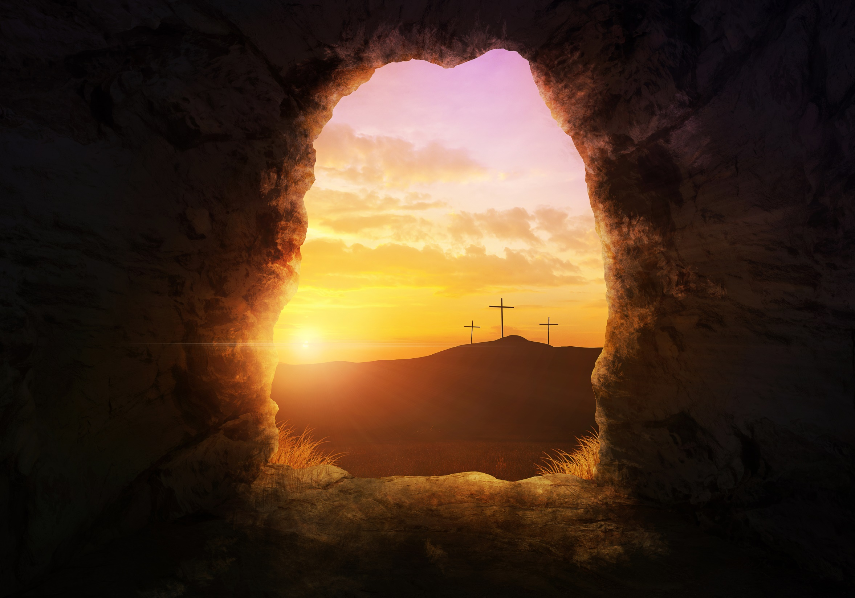
Therefore, having been justified by faith, we have peace with God through our Lord Jesus Christ, through whom also we have access by faith into this grace in which we stand, and rejoice in hope of the glory of God. — Romans 5:1-2
justified
justified by faith
peace with God
through Jesus Christ
↑
access by faith
into grace we stand
rejoice in hope
glory of God
by faith
peace with God
through
Jesus Christ
hope
in
into
grace
in
access by faith
in
we stand
in
rejoice in
hope
glory of God
Notes:
For those resolved in His ways, grace rewards our hope.

Slide 60
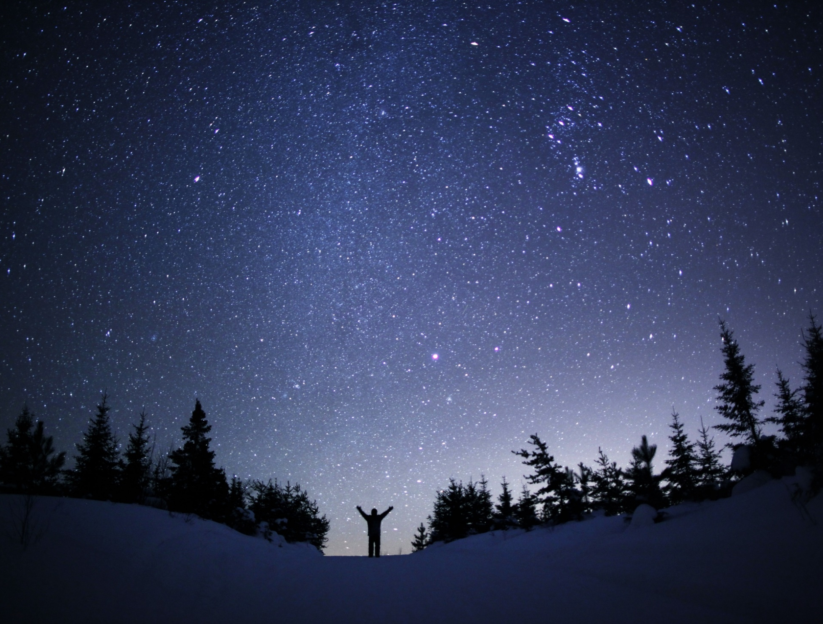
… that having been justified by His grace we should become heirs according to the hope of eternal life. — Titus 3:7
hope
hope
eternal life
eternal life
Notes:
Truly, our inheritance is to become children of God. There is no inheritance in a man left alone.

Slide 61
… the eyes of your understanding being enlightened; that you may know what is the hope of His calling, what are the riches of the glory of His inheritance in the saints, and what is the exceeding greatness of His power toward us who believe, according to the working of His mighty power … — Ephesians 1:18-19
hope
His calling
His calling
in
in
His power
His power
Notes:
To fully understand is to know His saving grace powers over all. This hope invites awareness to be in accord with His works. Our hope is to be reunited entirely in Him.

Slide 62
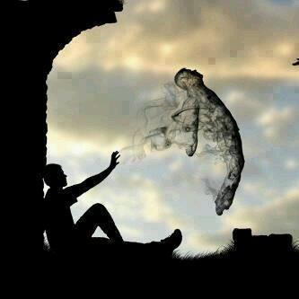
There is one body and one Spirit, just as you were called in one hope of your calling; — Ephesians 4:4
in
hope
in
one
Notes:
We are all born to ourselves. The calling of God is to find Him and to be justified by His ordained commands. There are false hopes of man where imagination replaces His word. Blowing yourself up in a crowded market does not bring the hope of a thousand virgins. Lust engulfs the weak. Judging others judges oneself in the condemnation of His coming wrath. If one cannot put contempt away, it will devour the soul at His revealing.

Slide 63
For we through the Spirit eagerly wait for the hope of righteousness by faith. — Galatians 5:5
hope
righteousness
righteousness
by faith
by faith
Notes:
In Him we find welcomed acceptance into His righteous sanctuary.

Slide 64
But sanctify the Lord God in your hearts, and always be ready to give a defense to everyone who asks you a reason for the hope that is in you, with meekness and fear; — 1st Peter 3:15
a reason
a reason
hope
in
in
Notes:
Our faith is in defense of our eternal given lives. His promise and resurrection awaits for each heart to respond.

Slide 65
… because of the hope which is laid up for you in heaven, of which you heard before in the word of the truth of the gospel, — Colossians 1:5
hope
in
in
in
in
word of the truth of the gospel
word of the truth of the gospel
Notes:
It is a destiny beyond time where flowers never die.

Slide 66
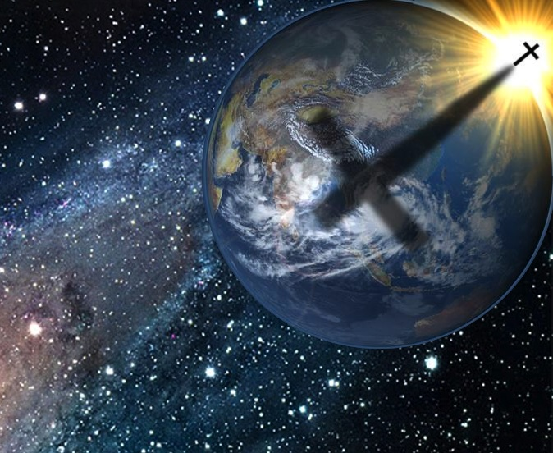
For surely there is a hereafter, And your hope will not be cut off. — Proverbs 23:18
surely
surely
hope
Notes:
For us that remain hopefully grateful, there will be no ending.

Slide 67
"I have hope in God, which they themselves also accept, that there will be a resurrection of the dead, both of the just and the unjust. — Acts 24:15
hope
in
in
hope in God
just
unjust
Notes:
It is certain that God will appear to each and every one of us. Our pursuits and actions will declare whether one soars into the light or falls into the abyss of darkness.

Slide 68
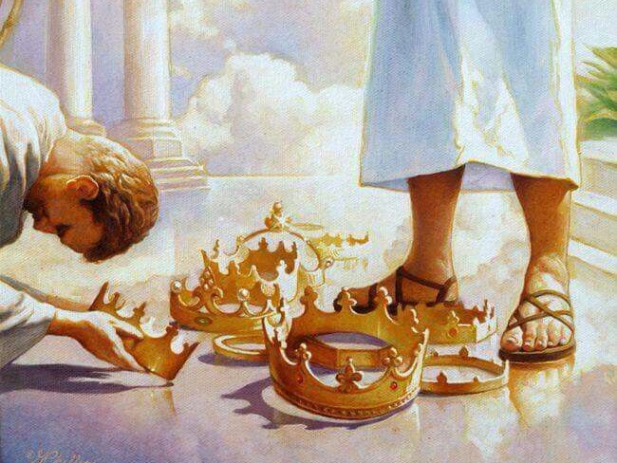
For what is our hope, or joy, or crown of rejoicing? Is it not even you in the presence of our Lord Jesus Christ at His coming? — 1st Thessalonians 2:19
Jesus Christ
in His presence
joy
↑
our hope
↖
crown of rejoicing
hope
our hope
joy
crown of rejoicing
hope
even you in the presence
in
. .
even you in the presence
in
presence
Jesus Christ
His
hope
Notes:
His kingdom holds all those that would gain the crown He gives. Hope is not exclusive to self. The kick is that we hope for each other in gaining eternal life.

Slide 69
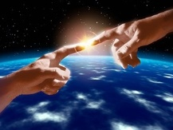
Beloved, now we are children of God; and it has not yet been revealed what we shall be, but we know that when He is revealed, we shall be like Him, for we shall see Him as He is. And everyone who has this hope in Him purifies himself, just as He is pure. — 1st John 3:2-3
He is pure
we shall see Him as He is
↓
we are children of God
↓
not revealed what we shall be
● when He is revealed
● we shall be like Him
hope in Him purifies
we are children
of God
not
revealed what we shall be
when He is revealed
hope
we shall be like Him
we shall
see Him as He is
hope
in
in
hope in Him purifies
He is pure
hope
Notes:
At His coming, those faithful will ignite upon His waves of light. Those concealed in doubt will not unfold before Him. By His power we are lifted into life. Hope is a wonderful thing and it helps us on our path in union with eternal life.

Slide 70
And now abide faith, hope, love, these three; but the greatest of these is love. — 1st Corinthians 13:13
faith
hope
love
Notes:
Hope is our climb in faith to be eternally joined with His love. Without hope faith is challenged to nurture the love that would inspire us. One should not trivialize what one hopes for, for it is hope that writes upon a believing heart. Misplaced hope can jeopardize our eternal lives in Him. Hope is our rudder to eternity.

Slide 71
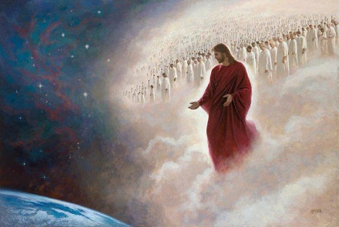
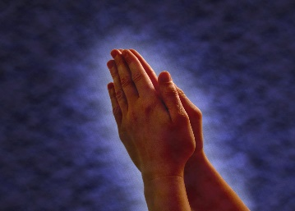
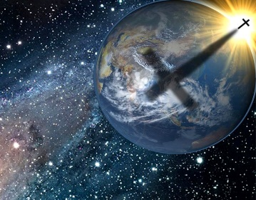
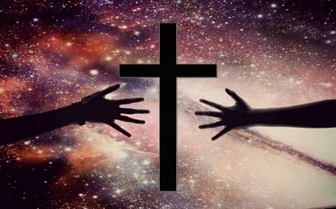

Slide 72
→ A Living hope comes by the resurrection of Christ
→ Our hope anchors to God’s promise of eternal life
→ Hope looks for the appearing of our God & Savior
→ Hope is a rejoicing of the soul in the glory of God
→ Christ appeared so our faith and hope are in God
→ Hope is an art of endurance to inherit the promise
→ God is our hope and Hope is of heaven
→ Our hope should rest in the grace to come
→ Hope includes a unwavering confession that He is
→ God hopes for our return thru His workings
→ There is one hope in Him which we are all called
→ Hope includes hope for all those hopeful in Him
→ Hope in Him purifies the soul
Hope is Treasure Ahead
Notes:
On the shores of our belief, He is. No man is an island apart from Him.

Slide 73
Notes:
Darkness can cover no wounds. The dead do not carry themselves.

Slide 74
Notes:
Hope is our light unto eternity.

Slide 75
Please visit http://LoveFromGod.com/hope.htm to explore further
Notes:
Eternity never ends.

Slide 76
Please visit http://www.RonBert.com to explore further
Ronald Bert Channel on
Notes:
Eternity never ends.

