Slide 2
Of the Heart
4
Ron Bert
April 2, 2023

Slide 3
By this we know love, because He laid down His life for us. And we also ought to lay down our lives for the brethren. But whoever has this world's goods, and sees his brother in need, and shuts up his heart from him, how does the love of God abide in him? — 1st John 3:16-17
He laid down His life for us
By this we know love
lay down your lives for the brethren
whoever has this world's goods
and sees his brother in need
shuts up his heart from him
how is the love of God in him?
By this we know love
He
↑
↖
↗
laid down His life for us
is
y
our lives for
lay down
the brethren
whoever has this
world's goods
and sees his brother
in need
shuts up his heart
from him
how
the love of
God
in him?

Slide 4
My little children, let us not love in word or in tongue, but in deed and in truth. And by this we know that we are of the truth, and shall assure our hearts before Him. For if our heart condemns us, God is greater than our heart, and knows all things. Beloved, if our heart does not condemn us, we have confidence toward God. — 1st John 3:19-21
let us not love in word or in tongue
but in deed and in truth
by this we know we are of the truth and shall assure our hearts before Him
in
in
let us not love in
in
deed
truth
word or in tongue
in
but in deed and
in truth
by this we know
we are of the truth
and shall assure
advance
comfort
confirm
declare
pledge
promise
assure
our hearts before Him
if our
heart
condemns us,
God is greater
if our heart condemns us, God is greater than our heart, and knows all things
if our heart does not condemn us we have confidence toward God
heart
heart
than our heart, and
heart
knows all things
if our heart does
not
condemn us
we have
confidence
toward God

Slide 5
For the word of God is living and powerful, and sharper than any two-edged sword, piercing even to the division of soul and spirit, and of joints and marrow, and is a discerner of the thoughts and intents of the heart. And there is no creature hidden from His sight, but all things are naked and open to the eyes of Him to whom we must give account. — Hebrews 4:12-13
=
the word of God is living
the word of God is living
powerful
sharper than any two-edged sword
piercing division of soul and spirit
and is a discerner of the thoughts
and intents of the heart
no creature is hidden from His sight
to Him whom we must give account
+
powerful
sharper than any two-
edged sword
piercing
+
division of soul and spirit
and is a discerner
of the thoughts
and intents of the
+
=
heart
is
no creature
hidden
heart
from His sight
to
=
Him
whom
we must give account
→

Slide 6
"Now the parable is this: The seed is the word of God. Those by the wayside are the ones who hear; then the devil comes and takes away the word out of their hearts, lest they should believe and be saved. But the ones on the rock are those who, when they hear, receive the word with joy; and these have no root, who believe for a while and in time of temptation fall away." — Luke 8:11-13
The seed is the word of God
by the wayside hear
then the word is out of their hearts
lest they should believe and be saved
on the rock hear
receive the word with joy
have no root, believe for a while
and in time of temptation fall away
is
The seed is the
word of God
↙
↓
↘
by the wayside
①
by the wayside
hear
by the wayside
hear
then the
word
out of their
hearts
lest they should believe and be
should
should
→
→
saved
on the rock
hear
receive the
on the rock
hear
②
on the rock
word with joy
have no root,
believe for a while
and in time of
temptation fall away

Slide 7
"Now the ones that fell among thorns are those who, when they have heard, go out and are choked with cares, riches, and pleasures of life, and bring no fruit to maturity. But the ones that fell on the good ground are those who, having heard the word with a noble and good heart, keep it and bear fruit with patience." — Luke 8:11-15
The seed is the word of God
by the wayside hear
then the word is out of their hearts
lest they should believe and be saved
on the rock hear
receive the word with joy
have no root, believe for a while
and in time of temptation fall away
↙
↓
↘
①
by the wayside
hear
by the wayside
ones that fell among thorns hear
go out and are choked with cares, riches, and pleasures of life
bring no fruit to maturity
ones on the good ground
having heard the word
with a noble and good heart
keep it and bear fruit with patience
ones that fell among thorns hear
go out and are choked with cares, riches, and pleasures of life
bring no fruit to maturity
ones on the good ground
having heard the word
with a noble and good heart
keep it and bear fruit with patience
fell among thorns
fell among thorns
hear
hear
ones that fell among thorns
Forgetful
Worldly
. .
fell among thorns
Dismiss
hear
→
→
go out and are choked with cares,
③
③
Temptations
Godly
bring
Shallow
riches, and pleasures of life
on the rock
hear
②
on the rock
no fruit to maturity
ones
The field is the world
good seeds are sons of the kingdom
tares are sons of the wicked one
The field is the world
good seeds are sons of the kingdom
tares are sons of the wicked one
"The field is the world, the good seeds are the sons of the kingdom, but the tares are the sons of the wicked one." — Matthew 13:38
The field is the world
good
on the good ground
on the good ground
on the good ground
. .
on the good ground
④
④
seeds are
sons of the kingdom
having heard the word
with a
heard
heard
noble and good heart
keep it and
tares are
sons of the
bear fruit with patience
keep it
keep it
. .
. .
wicked one

Slide 8
But if you have bitter envy and self-seeking in your hearts, do not boast and lie against the truth. This wisdom does not descend from above, but is earthly, sensual, demonic. For where envy and self-seeking exist, confusion and every evil thing are there. But the wisdom that is from above is first pure, then peaceable, gentle, willing to yield, full of mercy and good fruits, without partiality and without hypocrisy. Now the fruit of righteousness is sown in peace by those who make peace. — James 3:14-18
fruit of righteousness
fruit of righteousness is sown in peace
wisdom is first pure, then peaceable, gentle, willing to yield, full of mercy and good fruits, without partiality and without hypocrisy
if bitter envy and self-seeking in your hearts
do not boast and lie against the truth
This wisdom does not descend from above
is earthly, sensual, demonic
where envy and self-seeking exist
confusion and every evil thing are there
if
bitter envy and self-seeking in
your hearts
do not boast and lie against the
truth
This wisdom does not descend from
above
is earthly, sensual, demonic
where envy and self-seeking exist
confusion
and every evil thing are there
wisdom
→
do not boast and lie against the truth
←
is first pure, then peaceable,
↓
gentle,
willing to yield, full of mercy and good
fruits,
without partiality and without hypocrisy
fruit of righteousness is sown in peace
↙
↘

Slide 9
A sound heart is life to the body, But envy is rottenness to the bones. — Proverbs 14:30
A sound heart is life to the body
envy is rottenness to the bones
heart
=
A sound heart is life to the body
heart
envy is rottenness to the
bones
=

Slide 10
He also taught me, and said to me: "Let your heart retain my words; Keep my commands, and live. — Proverbs 4:4
live
taught:
Let your heart retain my words Keep my commands
taught
:
Let your heart retain my
heart
words
Keep my commands
remember
live

Slide 11
Flee also youthful lusts; but pursue righteousness, faith, love, peace with those who call on the Lord out of a pure heart. But avoid foolish and ignorant disputes, knowing that they generate strife. And a servant of the Lord must not quarrel but be gentle to all, able to teach, patient, in humility correcting those who are in opposition, if God perhaps will grant them repentance, so that they may know the truth, and that they may come to their senses and escape the snare of the devil, having been taken captive by him to do his will. — 2nd Timothy 2:22-26
pursue righteousness; faith, love, peace
with who call on the Lord out of a pure heart
Flee youthful lusts and foolish ignorant disputes
knowing they generate strife
a servant of the Lord
must not quarrel but be gentle to all
able to teach, patient, in humility
correcting who are in opposition
perhaps know truth and come to their senses
God grant them repentance to escape the devil
;
pursue righteousness
Flee
youthful lusts
pure heart
faith, love, peace
. .
with
who call on the Lord
out of a pure heart
foolish
and
Flee
ignorant disputes
knowing
they generate
strife
a servant of the Lord
must not quarrel
but be gentle to all
able to teach, patient, in
a servant
humility
correcting
who are in opposition
God
perhaps
grant them repentance
know
truth
and
come to their senses
escape
to
the devil
know truth
→
. .
←

Slide 12
"If you do well, will you not be accepted? And if you do not do well, sin lies at the door. And its desire is for you, but you should rule over it." — Genesis 4:7
If you do well
will you not be accepted?
And if you do not do well
sin lies at the door
And its desire is for you
but you should rule over it
If you do well
will you not be
↓
accepted?
And if you do not do
well
sin lies at the door
And its
desire is for you
but you should
↘
rule over it
↖
↑
↗
rule over it

Slide 13
Therefore submit to God. Resist the devil and he will flee from you. Draw near to God and He will draw near to you. Cleanse your hands, you sinners; and purify your hearts, you double-minded. — James 4:7-8
submit to God
Draw near to God
and He will draw near to you
Resist the devil; he will flee from you
Cleanse your hands, you sinners
purify your hearts
you double-minded
→
Resist
submit to God
←
the devil
he will flee from
born again
you
Draw near to God
and He will
draw near to you
Cleanse your
hands, you sinners
↓
;
purify
your hearts
you double-minded

Slide 14
Since you have purified your souls in obeying the truth through the Spirit in sincere love of the brethren, love one another fervently with a pure heart, having been born again, not of corruptible seed but incorruptible, through the word of God which lives and abides forever, because "All flesh is as grass, And all the glory of man as the flower of the grass. The grass withers, And its flower falls away, But the word of the LORD endures forever." Now this is the word which by the gospel was preached to you. — 1st Peter 1:22 -25
having been born again
not of corruptible seed but incorruptible
through the word of God which abides forever
in obeying the truth through the Spirit
in sincere love of the brethren
you have purified your soul
love one another fervently with a pure heart
this is the word of the LORD preached to you
you have purified your soul
in obeying the
truth through the Spirit
in sincere love of the
brethren
love one another fervently with a pure
↓
having been born again
not of corruptible
heart
born again
in
seed but incorruptible
through the word of God
in
which
abides forever
↓
↙
↘
of the LORD
pure heart
one another
. .
this is the word
↑
↑
↑
↑
↑
↑
↑
preached to you
=

Slide 15
one another

Slide 16
"A new commandment I give to you, that you love one another; as I have loved you, that you also love one another. By this all will know that you are My disciples, if you have love for one another." — John 13:34 - 35
as I have loved you
I give you a new commandment
that you love one another
if you have love for one another
all will know you are My disciples
new commandment
I give
one
you
a
another
another
as I have loved you
↓
one another
that you
love one
sincere faith
all will know
↙
↘
you are My disciples
if
one
you have love for one
another
another
aware
know
know
Notes:
To be of God, love must be the scepter of one’s heart.

Slide 17
Now the purpose of the commandment is love from a pure heart, from a good conscience, and from sincere faith, from which some, having strayed, have turned aside to idle talk, desiring to be teachers of the law, understanding neither what they say nor the things which they affirm. — 1st Timothy 1:5-7
purpose of the commandment
the purpose of the
the purpose of the commandment is love from a pure heart, from a good conscience, from sincere faith
some have strayed
turned aside to idle talk
desiring to be teachers of the law understanding neither what they say nor the things which they affirm
=
commandment
from a
is love
is love from a
from a pure heart
love from a
love from a
purpose of the commandment
is love
● from a pure heart
● from a good conscience
● from sincere faith
→
from a
from sincere faith
good conscience
good conscience,
pure heart,
pure heart
pure heart
↓
from sincere faith
e
sincere faith
some
hav
strayed
turned
→
←
aside to idle talk
desiring to be
teachers of the law
understanding
neither what they
say nor the things
which they affirm
Notes:
Love is the only way to obtain genuine life.

Slide 18
And He said, "What comes out of a man, that defiles a man. For from within, out of the heart of men, proceed evil thoughts, adulteries, fornications, murders, thefts, covetousness, wickedness, deceit, lewdness, an evil eye, blasphemy, pride, foolishness. All these evil things come from within and defile a man." — Mark 7:20-23
What comes out of a
What comes out of a man
that defiles a man
What comes out of a man
that defiles a man
man
that defiles a man
from
from within
out of the heart of men proceed
● evil thoughts
● adulteries
● fornications
● murders
● thefts
● covetousness
● wickedness
from within
out of the heart of men proceed
● evil thoughts
● adulteries
● fornications
● murders
● thefts
● covetousness
● wickedness
● evil thoughts
● adulteries
● fornications
● murders
● thefts
● blasphemies
● false witness
out of the heart of men
within
. .
. .
proceed
evil thoughts
adulteries
● deceit
● lewdness
● an evil eye
● blasphemy
● pride
● foolishness
● deceit
● lewdness
● an evil eye
● blasphemy
● pride
● foolishness
fornications
murders
thefts
covetousness
wickedness
deceit
"For out of the heart proceed evil thoughts, murders, adulteries, fornications, thefts, false witness, blasphemies." – Matthew 15:19
out of
the heart
evil
lewdness
an evil eye
blasphemy
out of
the heart
out of
the heart
thoughts
murders
adulteries
pride
foolishness
fornications
thefts
false witness
blasphemies

Slide 19
… having their understanding darkened, being alienated from the life of God, because of the ignorance that is in them, because of the blindness of their heart; who, being past feeling, have given themselves over to lewdness, to work all uncleanness with greediness. — Ephesians 4:18-19
alienated from the life of God
their understanding darkened
of the ignorance in them
of blindness of their heart
who past feeling work all
uncleanness with greediness
given to lewdness
their understanding
darkened
alienated from
↓
the life of God
of the
ignorance
in them
of
blindness of their heart
who
past feeling
given
to lewdness
→
past feeling
←
. .
work all
uncleanness with
greediness

Slide 20
They devise iniquities: "We have perfected a shrewd scheme." Both the inward thought and the heart of man are deep. — Psalms 64:6
the inward thought and the heart
of man are deep
They devise iniquities:
"perfected shrewd schemes"
They devise iniquities:
"
perfected
shrewd scheme
s
"
↓
the inward thought and the heart
of man are deep

Slide 21
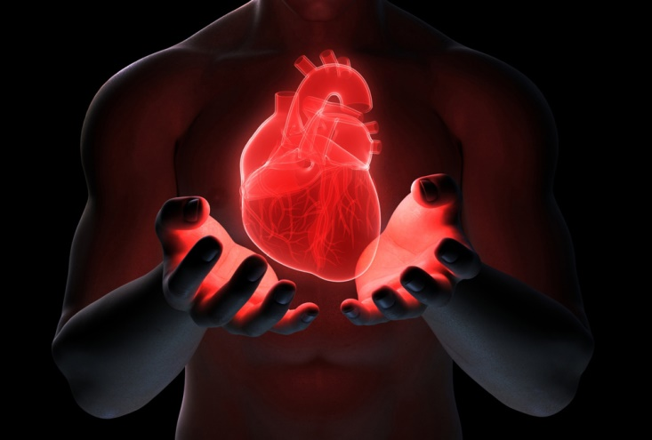
Thus says the LORD: "Cursed is the man who trusts in man And makes flesh his strength, Whose heart departs from the LORD." — Jeremiah 17:5
G
O
D
TRUST
TRUTH
TR TH
HEART
SPIRIT
f
strength
l
e
s
h
heart departs
heart departs
Notes:
The bottom line is what a heart is to itself. One can only know who one is and if not in accord with the divine calling of God Himself, oblivious despicable pursuits can lead to a soul's destruction over eternal life in Him. No crime is greater than departing from what is real beyond all that we can know. If God is not greater, then something less has been fallen in to.

Slide 22
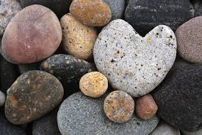
"The heart is deceitful above all things, And desperately wicked; Who can know it? I, the LORD, search the heart, I test the mind, Even to give every man according to his ways, According to the fruit of his doings. — Jeremiah 17:9-10
above all things
The heart is deceitful
And desperately wicked
Who can know it?
I, the LORD, search the heart
I test the mind
to give every man according to
his ways; the fruit of his doings
The heart is deceitful
above all
things
And desperately wicked
;
Who can know it?
I, the LORD,
G
O
D
search the heart
I test the mind
to give every man according
to
his ways
the fruit
↙
↘
of his doings
Do
the fruit of his doings

Slide 23
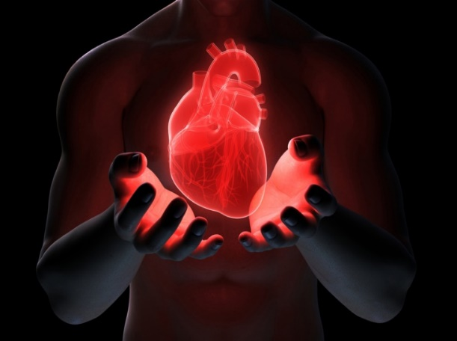

Slide 24
→ Not helping one another is what condemns a heart
→ God’s truths pierces the spirit to heal the soul
→ Patience in belief settles the spirit of good soul
→ Envy & self-seeking destroys any peace of heart
→ Righteousness, faith, and love deliver a pure heart
→ Sin is a battle of conscience one should rule over
→ Submitting to God cleanses a heart from hypocrisy
→ Obeying truth lifts a heart out of the corruptible
→ Love for one another is a highest of calls from God
→ Love from a pure heart is Gods own call for us to be
→ Each soul produces heartfelt shine; dark or light
→ Cold blind ignorance darkens a heart from truth
→ A wicked heart’s fruits will find abrupt judgment
God desires to reach each heart with His truths
Notes:
God desires to reach each heart with His truths

Slide 26
Of the Heart
5
Ron Bert
April 30, 2023

Slide 27
"Take heed to yourselves, lest your heart be deceived, and you turn aside and serve other gods and worship them, … — Deuteronomy 11:16
lest your heart be deceived
Take heed to yourselves
and you turn aside and
serve and worship other gods
heart
Take heed to yourselves
lest your
↙
↘
heart be deceived
and you turn
→
←
aside and
serve
other gods
and
↘
↙
worship
turn

Slide 28
"But take heed to yourselves, lest your hearts be weighed down with carousing, drunkenness, and cares of this life, and that Day come on you unexpectedly. For it will come as a snare on all those who dwell on the face of the whole earth. "Watch therefore, and pray always that you may be counted worthy to escape all these things that will come to pass, and to stand before the Son of Man." — Luke 21:34-36
take heed to yourselves
lest your
Watch to stand before the Son of Man
take heed to yourselves
lest your hearts weighed down
with
● carousing
● drunkenness
● cares of this life
pray you may be counted worthy
to escape that unexpected snare Day
hearts
weighed down
with
carousing
↓
drunkenness
cares of this life
take heed
. .
that
Day
you
unexpected
snare
on all
. .
Watch
pray
may be counted worthy
to escape
pray
to stand before the Son of Man

Slide 29
They do not consider in their hearts That I remember all their wickedness; Now their own deeds have surrounded them; They are before My face. — Hosea 7:2
consider in heart
I remember all their wickedness
their own deeds surround them
They are before My face
in
↙
↘
consider in
→
heart
I remember all their
←
wickedness
↓
their own deeds
surround
them
They are
↑
before My face
↖
↗

Slide 30
Now the Pharisees, who were lovers of money, also heard all these things, and they derided Him. And He said to them, "You are those who justify yourselves before men, but God knows your hearts. For what is highly esteemed among men is an abomination in the sight of God. — Luke 16:14-15
who were lovers of money
derided Him and the things He said
God knows your hearts
You are those who justify
yourselves before men
what is highly esteemed among men is an abomination in the sight of God
who were
$ ₿ € ¥ ₣ ₽ ₭ £ ₮ ¢ ₼ ฿ ₯ ₱ ₤ ₻ ₾ ₴ ₲ ₰ ₿ $
lovers of money
derided
mocked
knocked
rejected
despised
slammed
ridiculed
things
and the
derided
↘
Him
He said
You
↓
yourselves
are those who justify
exalt
before men
God knows your
↙
↘
hearts
what is highly esteemed
among men
is an abomination in
the sight of God

Slide 31
For the love of money is a root of all kinds of evil, for which some have strayed from the faith in their greediness, and pierced themselves through with many sorrows. — 1st Timothy 6:10
love of money
is
a root of all kinds of evil
some have strayed from the faith in their greediness and pierced themselves through with sorrows
love of money
is
a root of
=
all kinds of evil
some
have strayed from the faith
in
their greediness
and pierced
the faith
→
themselves through with
←
greediness
pierced
in
sorrows
sorrows

Slide 32
O Jerusalem, wash your heart from wickedness, That you may be saved. How long shall your evil thoughts lodge within you? — Jeremiah 4:14
That you may be saved
wash your heart from wickedness
How long shall
evil thoughts be in you?
↓
wash your heart
from wickedness
That you may
be saved
How long shall
be
evil
thoughts
in you?
in

Slide 33
"Repent therefore of this your wickedness, and pray God if perhaps the thought of your heart may be forgiven you." — Acts 8:22
Repent of your wickedness
pray God if perhaps
the thought of your heart
may be forgiven you
Repent
of
your
wickedness
↓
pray God if
perhaps
the thought of your
pray
pray
heart
may be forgiven you

Slide 34
Those who are of a perverse heart are an abomination to the LORD, But the blameless in their ways are His delight. – Proverbs 11:20
Who
has a haughty look
a proud heart
secretly slanders his neighbor
Him I will;
● destroy
● not endure
Murderous Plots
Disobedient
Wicked
Mean
Hateful
Rebellious
Cheaters
Vicious
Liars
perverse heart
. .
↓
Whoever secretly slanders his neighbor, Him I will destroy; The one who has a haughty look and a proud heart, Him I will not endure. – Psalm 101:5
secretly slanders his
Who
abomination to
LORD
smear
tarnish
defame
insult
slur
belittle
backbite
vilify
perverse heart is abomination to LORD
blameless in their ways is His delight
slanders
=
blameless in their ways
;
neighbor
Him I will
destroy
His delight
is
is
has a haughty
in
ways
=
look
a proud heart
not endure
Notes:
Heartless without compassion, perverted souls will find no solace in His ways.

Slide 35
Before destruction the heart of a man is haughty, And before honor is humility. — Proverbs 18:12
the heart of a man
before honor is humility
Before destruction is haughty
↙
↘
Before destruction
the heart of a
=
man
is haughty
before honor
is humility
=

Slide 36
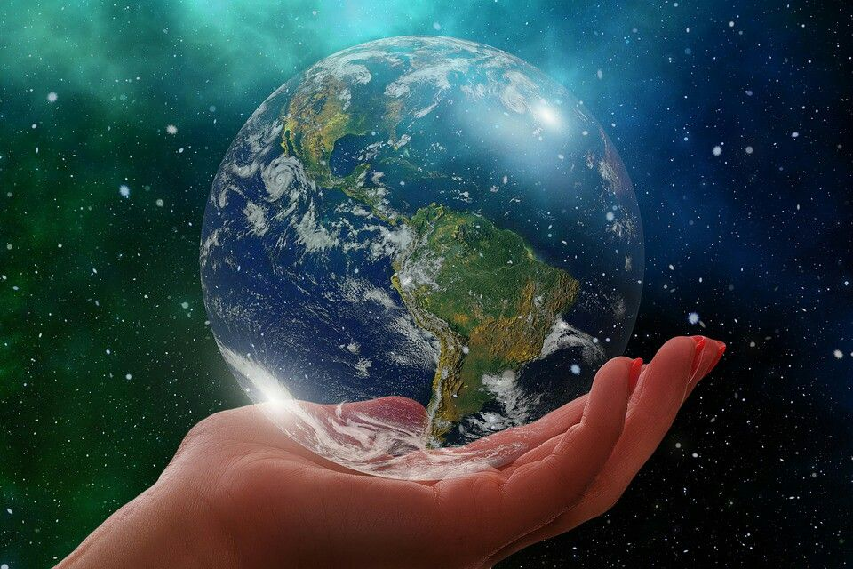
"But when his heart was lifted up, and his spirit was hardened in pride, he was deposed from his kingly throne, and they took his glory from him." — Daniel 5:20
when his heart was lifted up
and his spirit was hardened in pride
when his heart was lifted up
and his spirit was hardened in pride
All the inhabitants of the earth are reputed as nothing; He does according to His will in the army of heaven And among the inhabitants of the earth. No one can restrain His hand Or say to Him, "What have You done?" — Daniel 4:35
when his heart
in
in
. .
. .
was lifted up
and his
if anyone thinks himself
to be something
when he is nothing
he deceives himself
if anyone thinks himself
to be something
when he is nothing
he deceives himself
For if anyone thinks himself to be something, when he is nothing, he deceives himself. — Galatians 6:3
if anyone thinks himself
spirit was hardened
to be something
when he is
in pride
he was
nothing
he deceives himself
deposed from his
throne
and
they took his glory
he was deposed from his throne
and they took his glory from him
he was deposed from his throne
and they took his glory from him
from him

Slide 37
All the inhabitants of the earth are reputed as nothing; He does according to His will in the army of heaven And among the inhabitants of the earth. No one can restrain His hand Or say to Him, "What have You done?" — Daniel 4:35
All the inhabitants of the earth
are reputed as nothing;
He does according to His will
in the army of heaven And among the inhabitants of the earth
No one can restrain His hand Or
say to Him, "What have You done?"
All the inhabitants of the earth
reputed
thought
believed
supposed
presumed
considered
regarded
deemed
are reputed as nothing;
He does
according to His will
in the army
He
His
of heaven And among
the
inhabitants of the earth
No one
can restrain His hand
Or
say
to
Him, "What have You done?"
His
Him
You

Slide 38
If anyone among you thinks he is religious, and does not bridle his tongue but deceives his own heart, this one's religion is useless. Pure and undefiled religion before God and the Father is this: to visit orphans and widows in their trouble, and to keep oneself unspotted from the world. — James 1:26-27
?
think you are religious
and do not bridle your tongue
you deceive your own heart
one's religion is useless
Pure and undefiled religion
before God and the Father is this:
to visit orphans and widows
in their trouble
to keep oneself unspotted
from the world
you
think
you
you
you
religious
and do
not bridle
r
a
r
heart
heart
tongue
deceive
own heart
one's religion is useless
Pure and
re
←
care
undefiled religion
before God and the
Father is this:
to visit orphans and
to
widows
in their trouble
to keep
oneself unspotted
from the world
to

Slide 39
"But as for those whose hearts follow the desire for their detestable things and their abominations, I will recompense their deeds on their own heads," says the Lord GOD. — Ezekiel 11:21
for
whose hearts follow
desire for detestable things and their abominations
I GOD will recompense their deeds on their own heads
for
heart
whose hearts
heart
follow
desire for
detestable things
and their
heart
abominations
abominations
I
will recompense
their
deeds on their own heads
abominations
deeds
GOD
deeds

Slide 40
"Therefore I will judge you, O house of Israel, every one according to his ways," says the Lord GOD. "Repent, and turn from all your transgressions, so that iniquity will not be your ruin. Cast away from you all the transgressions which you have committed, and get yourselves a new heart and a new spirit." — Ezekiel 18:30-31
I will judge you says the Lord GOD
every one according to his ways
Repent, and turn
from all your transgressions
so that iniquity will not be your ruin
Cast away all your transgressions
get a new heart and a new spirit
I will judge you
↙
every one according to his
ways
says the Lord GOD
Repent,
↙
↘
and turn
transgressions
turn
from all your transgressions
→
Repent
turn
Repent
so that iniquity will not be your ruin
Cast away
all
transgressions
get
your
a new
heart and a new spirit
heart
→
←

Slide 41
Now the Spirit expressly says that in latter times some will depart from the faith, giving heed to deceiving spirits and doctrines of demons, speaking lies in hypocrisy, having their own conscience seared with a hot iron, forbidding to marry, and commanding to abstain from foods which God created to be received with thanksgiving by those who believe and know the truth. — 1st Timothy 4:1-3
in latter times some will depart the faith
● giving heed to deceiving spirits
● doctrines of demons
● speaking lies in hypocrisy
● having their conscience seared
● forbidding to marry
● commanding to abstain from foods
God created us to be thankful
by who believe and know the truth
in
the faith
in
latter times some will depart
the
faith
giving heed to deceiving spirits
doctrines of demons
speaking lies in
lies
hypocrisy
having their
conscience
ful
seared
forbidding to
marry
commanding to abstain from
foods
God created
to be
thank
by
s
who believe
→
←
and know the truth
u
believe
know the truth
believe
. .

Slide 42
Now I urge you, brethren, note those who cause divisions and offenses, contrary to the doctrine which you learned, and avoid them. For those who are such do not serve our Lord Jesus Christ, but their own belly, and by smooth words and flattering speech deceive the hearts of the simple. — Romans 16:17-18
note those who: avoid them
cause divisions and offenses
contrary to doctrine you learned
those do not serve Jesus Christ
but their own belly
by smooth words
and flattering speech
deceive the hearts of the simple
note
→
those who:
cause divisions and
→
offenses
contrary to
doctrine
↓
you learned
avoid them
Jesus Christ
those
do not serve
↓
Jesus Christ
but their own
belly
by smooth words
and
flattering speech
deceive the hearts
↓
of the simple

Slide 43
Therefore do not be unwise, but understand what the will of the Lord is. And do not be drunk with wine, in which is dissipation; but be filled with the Spirit, speaking to one another in psalms and hymns and spiritual songs, singing and making melody in your heart to the Lord, giving thanks always for all things to God the Father in the name of our Lord Jesus Christ, submitting to one another in the fear of God. — Ephesians 5:17-21
let the peace of God rule in your
in
do not be unwise
peace of God
let the peace of God rule in your hearts
called in one body to be thankful
the word of Christ dwell in you richly in all wisdom, teaching and admonishing
in psalms and hymns and spiritual songs singing with grace in your hearts to God
whatever you do in word or deed, do all in the name of the Lord Jesus, giving thanks to God the Father through Him
And let the peace of God rule in your hearts, to which also you were called in one body; and be thankful. Let the word of Christ dwell in you richly in all wisdom, teaching and admonishing one another in psalms and hymns and spiritual songs, singing with grace in your hearts to the Lord. And whatever you do in word or deed, do all in the name of the Lord Jesus, giving thanks to God the Father through Him. — Colossians 3:15-17
do not be unwise
do not be unwise
understand what the will of the Lord is
do not be drunk with wine
be filled with the Spirit
in psalms and hymns and spiritual songs singing and making melody in your heart
to the Lord God, giving thanks always
submitting to one another in fear of God
do not be unwise
understand what the will of the Lord is
do not be drunk with wine
be filled with the Spirit
in psalms and hymns and spiritual songs singing and making melody in your heart
to the Lord God, giving thanks always
submitting to one another in fear of God
hearts
to
↓
called in
understand what the will of the Lord is
=
understand
=
understand
one body
in
be thankful
the word
do not be drunk with wine
Christ
in
of Christ dwell in you richly
be filled with the Spirit
in all
delusions
in
delusions
wisdom, teaching and admonishing
in psalms and
↓
↓
↓
in psalms and hymns and
hymns and spiritual songs
singing and
in
spiritual songs
singing with grace in your
making melody in your heart
to the Lord
,
truths
in
truths
sayings
in
sayings
in
hearts to
whatever you do
giving thanks always
God
↖
↑
↗
in
in
in word or deed, do all
in the name of
in
→
→
←
Lord God
←
Lord God
thanks to God the
the Lord Jesus, giving
God
in
submitting to one another in
Lord Jesus
in
in
→
fear of God
←
Father through Him
thanks to God the Father through Him

Slide 44
… not with eyeservice, as men -pleasers, but as bondservants of Christ, doing the will of God from the heart, with goodwill doing service, as to the Lord, and not to men, … — Ephesians 6:6-7
as bondservants of Christ
doing the will of God from the heart
with goodwill doing service
as to the Lord, and not to men
not with eyeservice
as men - pleasers
Christ
not with eyeservice
as men -
as bondservants
pleasers
↓
of Christ
doing the will of God
→
service
←
service
from the heart
with goodwill
doing service
as to the Lord, and
↓
not to men

Slide 45
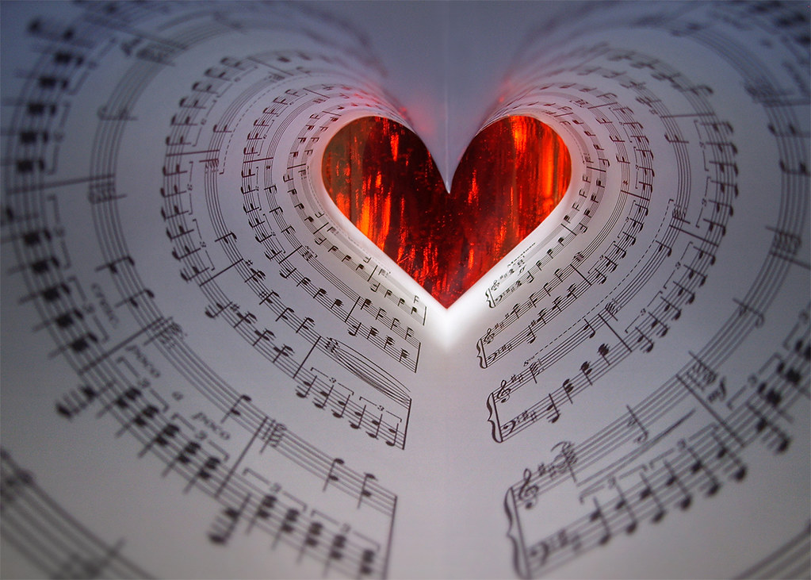
until the Lord comes
judge nothing before the time
God will bring to light
the hidden things of darkness and reveal the counsels of the hearts
each one's praise
will come from God
Therefore judge nothing before the time, until the Lord comes, who will both bring to light the hidden things of darkness and reveal the counsels of the hearts. Then each one's praise will come from God. — 1st Corinthians 4:5
judge nothing before
until the Lord comes
the time
↓
will
bring to light
the
God
hidden things of darkness and
reveal
hearts
reveal the counsels of the hearts
↑
will come
each one's praise
↙
↘
from God
God
God

Slide 46
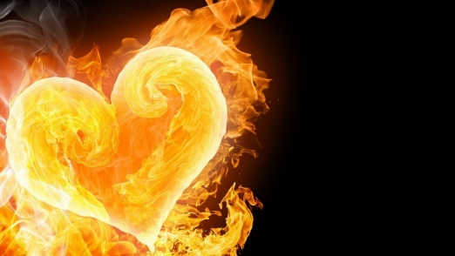
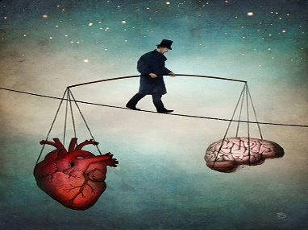

Slide 47
→ Take heed to not have heavy hearts of earthly cares
→ Do not forget God remembers all wicked acts
→ God knows all hearts in how and what they desire
→ The love of money pierces a heart of sorrows
→ Prayer is essential in requesting His forgiveness
→ Perverse secretive hearts are an abomination
→ Proud/haughty have no inheritance in God’s realm
→ Hardened hearts hold the disease of arrogance
→ Repent, cast away, and turn from one’s sins
→ Evils will remain in the times of unfaithful deceit
→ Watch, corrupt desires will corrupt simple hearts
→ Do all in thankfulness through the peace of God
→ God’s judgment will praise those in His light
The heart is a light given by God to shine

Slide 49
Of the Heart
6
Ron Bert
May 28, 2023

Slide 50
"Now, therefore," says the LORD, "Turn to Me with all your heart, With fasting, with weeping, and with mourning. So rend your heart, and not your garments; Return to the LORD your God, For He is gracious and merciful, Slow to anger, and of great kindness; And He relents from doing harm." — Joel 2:12-13
Return says the LORD
Turn to Me with all your heart
rend your heart, not your garments
the LORD your God is;
● gracious and merciful
● Slow to anger
● of great kindness
● relents from doing harm
says the LORD
↓
Turn to Me with all your heart
with all your
rend
shred
tear
split
rip
inside
outside
rend your heart,
not your garments
Return
the
LORD your God
is
gracious
●
and merciful
Slow to anger
of
●
great kindness
;
relents from
●
doing harm
●

Slide 51
For thus says the High and Lofty One Who inhabits eternity, whose name is Holy: "I dwell in the high and holy place, With him who has a contrite and humble spirit, To revive the spirit of the humble, And to revive the heart of the contrite ones. — Isaiah 57:15
→
anxiety
peace
says the High and Lofty One
Who inhabits eternity
whose name is Holy:
I dwell With him who has
a contrite and humble spirit
To revive the spirit of the humble And to revive the heart
of the contrite ones
lost
says the High and Lofty
found
hopeless
hopeful
One
love
whose
Who inhabits eternity
peace
mortality
name is Holy:
I dwell
immortality
hate
love
immortality
With him who has
revive
trust
truth
happiness
a contrite and humble spirit
To
lies
truth
death
life
hopeful
revive the spirit of the humble
revive
revive the spirit
. .
And to revive the heart
of the
found
distrust
revive the heart
trust
revive
. .
contrite ones
life
sorrow
happiness
Notes:
fear confidence
judgment forgiveness
unbelief belief

Slide 52
The LORD is near to those who have a broken heart, And saves such as have a contrite spirit. — Psalms 34:18
=
The LORD is near
to those who have a broken heart
And saves such as have
a contrite spirit
↙
↘
The LORD is near
to those who
have a broken heart
And saves
such as have
a contrite spirit
contrite
apologetic
remorseful
repentant
penitent
regretful
ashamed
sorry

Slide 53
The refining pot is for silver and the furnace for gold, But the LORD tests the hearts. — Proverbs 17:3
Mankind’s creative abilities
The refining pot is for silver
the furnace for gold
But the LORD tests the hearts
The refining pot is for silver
the furnace for gold
But the LORD
tests the hearts
He looks for noble spirits

Slide 54
Say to those who are fearful-hearted, "Be strong, do not fear! Behold, your God will come with vengeance, With the recompense of God; He will come and save you." — Isaiah 35:4
Say to who are fearful-hearted
Be strong, do not fear!
God will come with vengeance
With the recompense of God
He will come and save you
Say to
who are fearful-
↙
↘
hearted
Be strong, do not fear!
God will come with
vengeance
With the recompense
→
←
of God
He will come and
recompense
compensation
restoration
restitution
return
reward
save you

Slide 55
Say to who are fearful-hearted
Be strong, do not fear!
God will come with vengeance
With the recompense of God
He will come and save you
↙
↘
words
→
with
←
compensation

Slide 56
"You shall love the LORD your God with all your heart, with all your soul, and with all your strength. And these words which I command you today shall be in your heart." — Deuteronomy 6:5-6
You shall love the LORD your God
with all your heart
with all your soul
with all your strength
these words shall be in your heart
You shall
. .
You shall love the LORD your God
with all your heart
with all your
all your heart
→
all your heart
with all your
soul
with all your strength
→
with all your
these words
words
→
with all your
shall be in
your heart
in

Slide 57
'And you shall love the LORD your God with all your heart, with all your soul, with all your mind, and with all your strength.' This is the first commandment. — Mark 12:30
you shall love the LORD your God
with all your heart
with all your soul
with all your mind
with all your strength
This is the first commandment
you shall
. .
you shall love the LORD your
→
with all your
heart
with all your heart
God
all your heart
with all
heart
→
with all your
your soul
with all your mind
→
with all your
with all your strength
This is the
→
with all your
first commandment
=

Slide 58
"But from there you will seek the LORD your God, and you will find Him if you seek Him with all your heart and with all your soul." — Deuteronomy 4:29
seek the LORD your God
you will find Him if you seek Him ● with all your heart
● with all your soul
seek the
↘
you will find
LORD your God
heart
heart
Him if you seek Him
with all your
with all your
heart
with all your soul
with all your

Slide 59
Then you will call upon Me and go and pray to Me, and I will listen to you. And you will seek Me and find Me, when you search for Me with all your heart. — Jeremiah 29:12-13
call upon Me
go and pray to Me
I will listen to you
you will seek Me and find Me
when you search for Me
with all your heart
↖
call upon Me
go
pray
pray
and pray to Me
I will listen to
you
you will seek Me and find
Me
when you search for Me
with
all your heart
→
with all your

Slide 60
Let the words of my mouth and the meditation of my heart Be acceptable in Your sight, O LORD, my strength and my Redeemer. — Psalms 19:14
Let
the words of my mouth
the meditation of my heart
Be acceptable in Your sight
O LORD
● my strength
● my Redeemer
the words of my mouth
Let
↓
the meditation of my heart
Be
acceptable in Your sight
O LORD
in
my strength
↓
my Redeemer
Abba
Father
O LORD

Slide 61
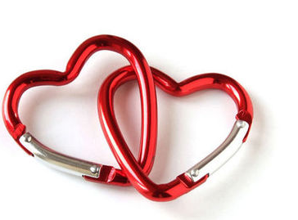
Let not mercy and truth forsake you; Bind them around your neck, Write them on the tablet of your heart, … — Proverbs 3:3
Let not
mercy and truth forsake you
Bind them around your neck
Write them on the tablet
of your heart
↘
↓
Let not
mercy and truth forsake
you
Bind them around your neck
↙
↓
↘
Write them on the tablet
of
your heart

Slide 62
You are our epistle written in our hearts, known and read by all men; clearly you are an epistle of Christ, ministered by us, written not with ink but by the Spirit of the living God, not on tablets of stone but on tablets of flesh, that is, of the heart. — 2nd Corinthians 3:2-3
message
heart
dispatch
letter
Christ’s
epistle
in
Christ’s epistle written in our hearts
known and read by all men;
written not with ink
but by the Spirit of the living God
not on tablets of stone
but on tablets of the heart
epistle written in our
↘
s
hearts
known and read by all
read
men;
↓
Christ
written
,
heart
not with ink
but by the Spirit of
the living God
not on tablets of
stone
but on tablets
of the heart
heart

Slide 63
"This is the covenant that I will make with them after those days, says the LORD: I will put My laws into their hearts, and in their minds I will write them," then He adds, "Their sins and their lawless deeds I will remember no more." — Hebrews 10:16-17
the covenant that I make
says the LORD:
I will put My laws into their hearts
in their minds I will write them
Their sins and their lawless deeds
I will remember no more
the covenant that I
. .
make
says the LORD:
I will put My laws
into their hearts
in their
. .
heart
into
→
in
minds I will write them
. .
Their sins and their lawless
Forgiveness
deeds
I will remember no more
. .

Slide 64
For I am not ashamed of the gospel of Christ, for it is the power of God to salvation for everyone who believes, for the Jew first and also for the Greek. For in it the righteousness of God is revealed from faith to faith; as it is written, "The just shall live by faith." For the wrath of God is revealed from heaven against all ungodliness and unrighteousness of men, who suppress the truth in unrighteousness, because what may be known of God is manifest in them, for God has shown it to them. — Romans 1:16-19
=
power of God
Christ
. .
the gospel of Christ
the gospel of Christ is the power of God
to salvation for everyone who believes
in it the righteousness of God is revealed
"The just shall live by faith"
the wrath of God is revealed from heaven against all ungodliness and unrighteousness
of men, who suppress the truth
in unrighteousness
God has shown it to them
↙
to salvation for
is the power of God
everyone who believes
in it the righteousness
in
of God is revealed
"The just shall live by faith"
the
wrath of God is revealed from heaven against
wrath of God
all ungodliness and unrighteousness
of men,
who suppress the truth
in unrighteousness
→
in
God has shown it
to them

Slide 65
But the righteousness of faith speaks in this way, "Do not say in your heart, 'Who will ascend into heaven?'" (that is, to bring Christ down from above) or," 'Who will descend into the abyss?'" (that is, to bring Christ up from the dead). — Romans 10:6-7
the righteousness of faith
speaks in this way
Do not say in your heart
the righteousness of faith
in
speaks in this way
Do not say in
↓
your heart
'Who will
ascend into
in
heaven?'
↙
↘
'Who will
Hope over
Judgment
'Who will ascend into heaven?'
'Who will descend into the abyss?'
descend into
the abyss?'
in
Faith in Christ

Slide 66
But what does it say? "The word is near you, in your mouth and in your heart" (that is, the word of faith which we preach): that if you confess with your mouth the Lord Jesus and believe in your heart that God has raised Him from the dead, you will be saved. For with the heart one believes unto righteousness, and with the mouth confession is made unto salvation. — Romans 10:8-10
righteousness of faith says:
The word of faith preached is near you in your mouth and in your heart
if you confess with your mouth
the Lord Jesus and believe in your heart that God has raised Him from the dead you will be saved
with the heart
one believes unto righteousness
say
The word
is near
s
you
in your mouth and in your heart
word of faith
. .
of faith
d
of faith
heart
in
mouth
in
preach
:
if you confess with your
e
mouth
the Lord Jesus and believe in
Lord Jesus
in
heart
your heart
that God has raised Him from
raised
resurrection
the dead
raised
you will be saved
→
righteousness
heart
one believes unto righteousness
with the

Slide 67
For if we would judge ourselves, we would not be judged. — 1st Corinthians 11:31
if
we would judge ourselves
we would not be judged
we would judge ourselves
if
review
reckon
assess
gauge
critic
→
judge
we would not be judged
→
Notes:
De 30:19 "I call heaven and earth as witnesses today against you, that I have set before you life and death, blessing and cursing; therefore choose life, that both you and your descendants may live;

Slide 68
But God be thanked that though you were slaves of sin, yet you obeyed from the heart that form of doctrine to which you were delivered. — Romans 6:17
God be thanked
though you were slaves of sin
you obeyed from the heart
doctrine which you were delivered
↑
God be thanked
though
↖
↗
you were slaves of sin
you
obeyed from the heart
↓
obeyed
heart
doctrine
which you were
delivered
↙
↘
doctrine
delivered

Slide 69
As for every man to whom God has given riches and wealth, and given him power to eat of it, to receive his heritage and rejoice in his labor-this is the gift of God. For he will not dwell unduly on the days of his life, because God keeps him busy with the joy of his heart. — Ecclesiastes 5:19-20
this is the gift of God
every man to whom God has
● given riches and wealth
● given him power to eat of it
● to receive his heritage
● rejoice in his labor
God keeps him busy
with the joy of his heart
→
every man to whom God
has
given riches and wealth
↙
to
given him power to eat of it
given
rejoice in
receive his heritage
in
given
his labor
this is the gift of God
receive
↘
he will not dwell unduly in his life
he will
not dwell
unduly
rejoice
in
his life
God keeps
↙
wrongly
improperly
excessively
desperately
unfairly
unduly
him busy
with the joy of his heart
joy of his heart
heart
. .

Slide 70
Then Philip said, "If you believe with all your heart, you may." And he answered and said, "I believe that Jesus Christ is the Son of God." — Acts 8:37
you may
If you believe with all your heart
I believe that Jesus Christ
is the Son of God
If you believe
↙
↘
with all your heart
you may
heart
with all your
I believe that Jesus Christ
is
Jesus Christ
the Son of God
=

Slide 71
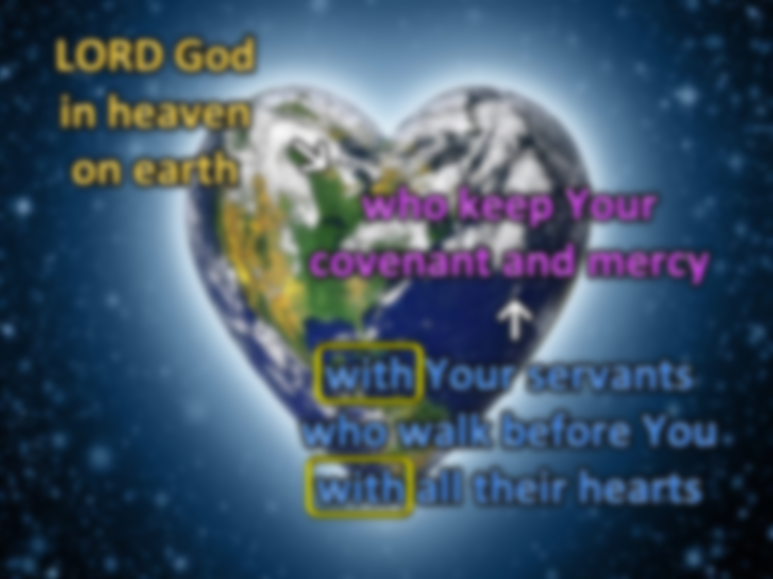
… and he said: "LORD God of Israel, there is no God in heaven or on earth like You, who keep Your covenant and mercy with Your servants who walk before You with all their hearts." — 2nd Chronicles 6:14
LORD God in heaven on earth
LORD God
↘
in heaven
who keep Your covenant and mercy
with Your servants who walk before You with all their hearts
on earth
who keep
Your
covenant and mercy
with
↓
mercy
Your servants
who walk before
servants
You
with all their hearts
walk
humbly
all their hearts
justly/truth
Notes:
Mic 6:8 He has shown you, O man, what is good; And what does the LORD require of you But to do justly, To love mercy, And to walk humbly with your God?

Slide 72
"Peace I leave with you, My peace I give to you; not as the world gives do I give to you. Let not your heart be troubled, neither let it be afraid." — John 14:27
Peace I leave with you
not as the world gives
do I give to you
Let not your heart be troubled neither let it be afraid
Peace I leave with you
↙
↘
not as
the world gives
do I give to you
Let not your heart be troubled
↑
neither let it be afraid
. .

Slide 73
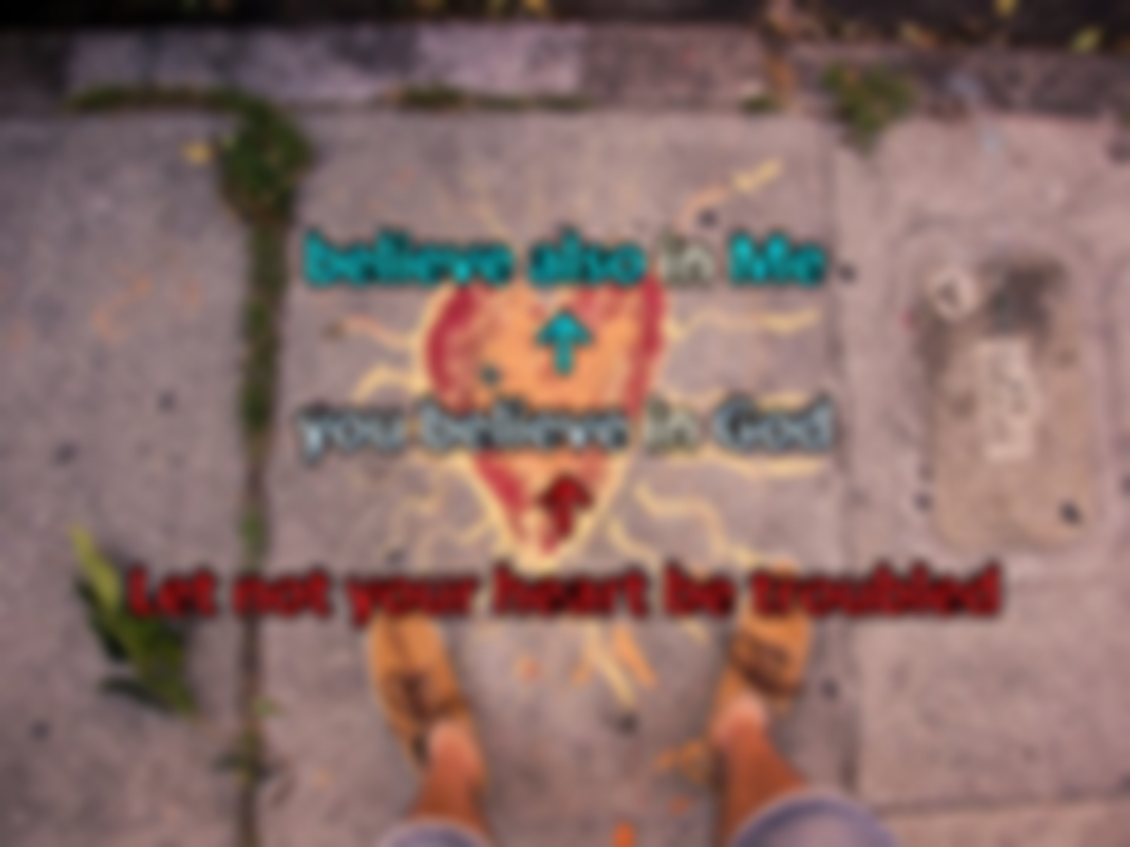
"Let not your heart be troubled; you believe in God, believe also in Me. — John 14:1
believe also in Me
you believe in God
Let not your heart be troubled
in
in
Let not your heart be
↑
troubled
you believe in
in
in
God
believe also in Me
↑

Slide 74
"Therefore take heart, men, for I believe God that it will be just as it was told me." — Acts 27:25
take heart
believe God that it will
be just as it was told
take heart
↙
↓
↘
believe God that it will
be just
as it was told

Slide 75
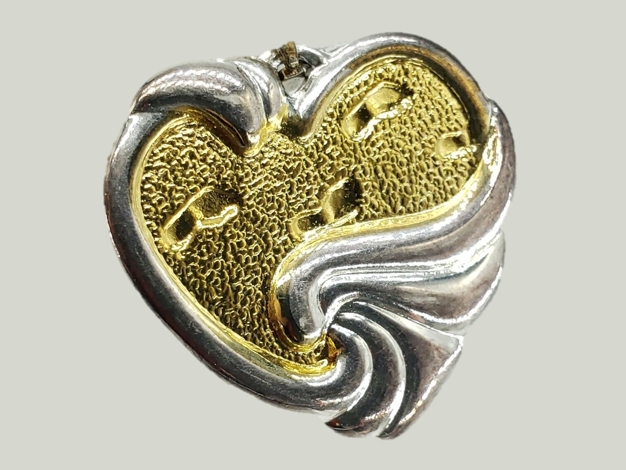
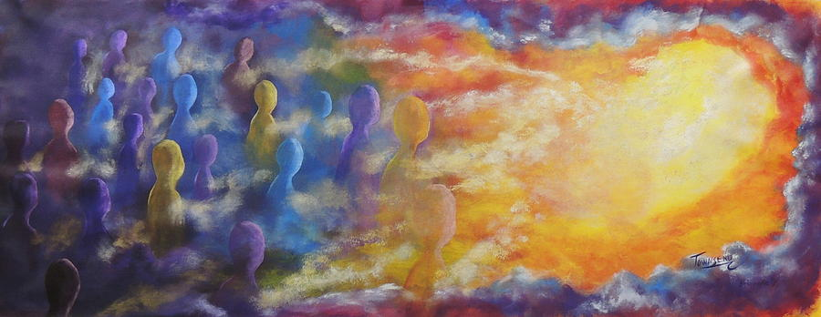
But above all these things put on love, which is the bond of perfection. — Colossians 3:14
above all these things
put on
love is the bond of perfection
above all these things
put
on
love
→
is the bond of
perfection
=

Slide 77
→ God desires our inward heart over outward masks
→ God dwells with all humble spirits who mourn
→ Our revival is where faith conquers all
→ Fear is short of faith, and in His strong promises
→ Absolute love for God describes the top of character
→ God hears all hearts who honestly seek Him
→ Mercy and truth are the high waters of a heart
→ God’s salvation plan forgives obedient hearts
→ Call for higher faith in Christ over judging others
→ Deliverance comes by earnestly following His word
→ Joyfully busy is God’s gift to all genuine hearts
→ Peace is the greatest rest He gives to all believers
→ Faith is confidence in the eventual outcome
Heaven holds the heart of God for the faithful

Slide 79
Please visit http://www.RonBert.com to explore further
Ronald Bert Channel on
Notes:
Eternity never ends.

