Slide 1
Notes:
Darkness extends where nothing grows.

Slide 2
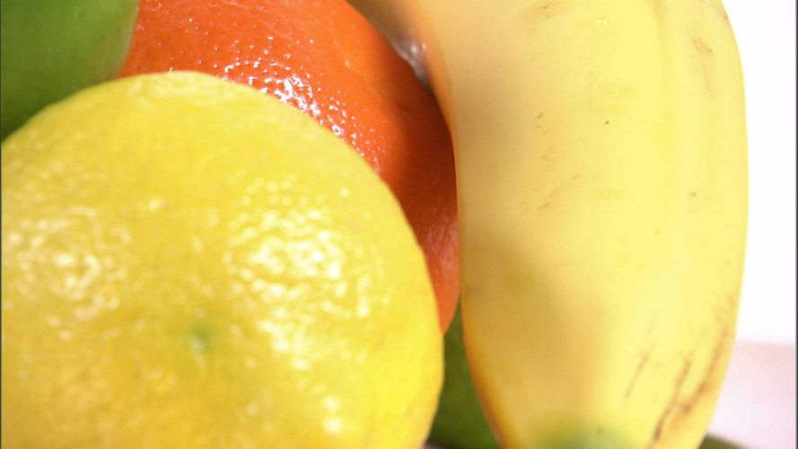
FRUITS
Ron Bert
July 16, 2017
Notes:
In the fruit of His Spirit we are made alive.

Slide 3
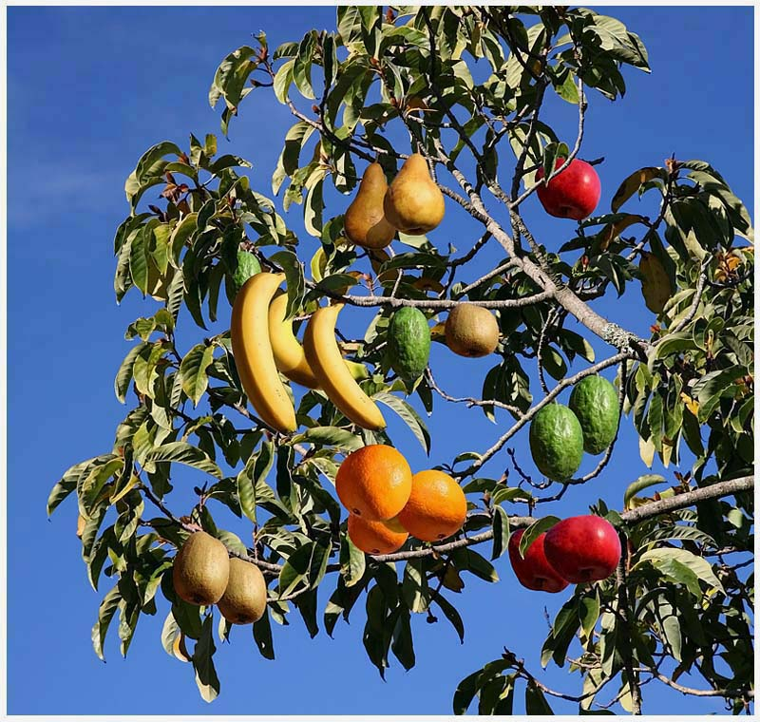
"You will know them by their fruits. Do men gather grapes from thornbushes or figs from thistles? Even so, every good tree bears good fruit, but a bad tree bears bad fruit. A good tree cannot bear bad fruit, nor can a bad tree bear good fruit." — Matthew 7:16-18
"You will know them by their fruits. Do men gather grapes from thornbushes or figs from thistles? Even so, every good tree bears good fruit, but a bad tree bears bad fruit. A good tree cannot bear bad fruit, nor can a bad tree bear good fruit." — Matthew 7:16-18
fruits
bear good fruits
bear
good
Notes:
Many types of fruit exist in the kingdom of His glory.

Slide 4
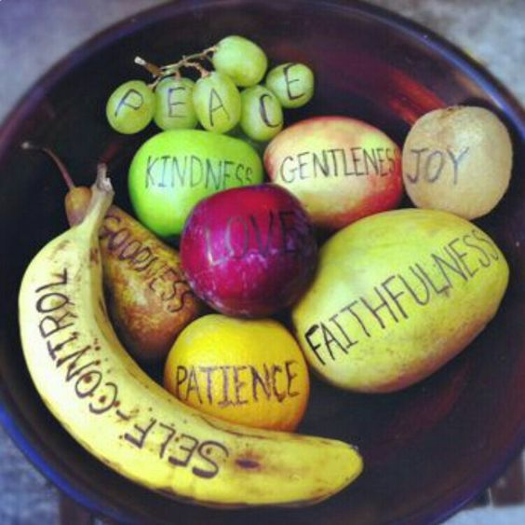
"Therefore bear fruits worthy of repentance, …" — Matthew 3:8
bear
bear good fruits
bear
fruits
fruits
Notes:
Bearing good fruits is to His glory and benefits are for all involved. In bowl of life, as happiness mixes with sadness, what our heart remains true to rises to the sustenance that we are. Do we share goodness growing in all we eat?

Slide 5
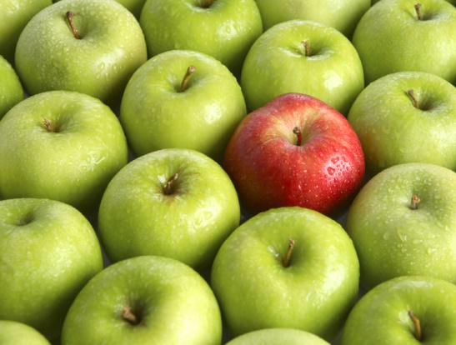
"Every tree that does not bear good fruit is cut down and thrown into the fire. Therefore by their fruits you will know them." — Matthew 7:19-20
bear
fruit
fruit
fruits
Notes:
Poor choices in life lead to destruction without regard for His ways. Belief in God with obedience stands out against decadent social norms.

Slide 6
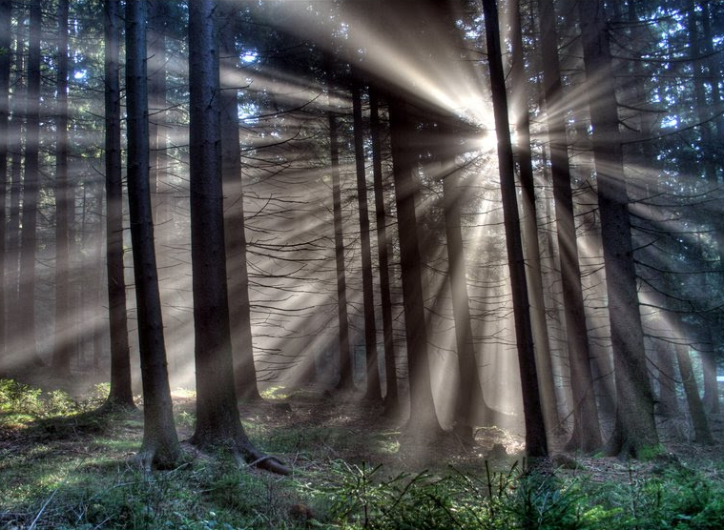
For you were once darkness, but now you are light in the Lord. Walk as children of light (for the fruit of the Spirit is in all goodness, righteousness, and truth), finding out what is acceptable to the Lord. — Ephesians 5:8-10
fruit of Spirit
fruit
children of light
of
● all goodness
● righteousness
● truth
Spirit
all goodness
righteousness
truth
Notes:
He calls to us as children of light whereas He demands we care for His truth, and in goodness apply righteousness to our lives.

Slide 7
And have no fellowship with the unfruitful works of darkness, but rather expose them. For it is shameful even to speak of those things which are done by them in secret. — Ephesians 5:11-12
fruit
unfruitful works of darkness
. .
expose them
. .
Notes:
Darkness goes beyond despicable and should be revealed as it is darkness. By not holding darkness accountable it only invades the light where the peaceful abide.

Slide 8
And have no fellowship with the unfruitful works of darkness, but rather expose them. For it is shameful even to speak of those things which are done by them in secret. — Ephesians 5:11-12
fruit
fruit
in
secret
in
gossip
deception
Notes:
Darkness goes beyond despicable and should be revealed as it is darkness. By not holding darkness accountable it only invades the light where the peaceful abide.

Slide 9
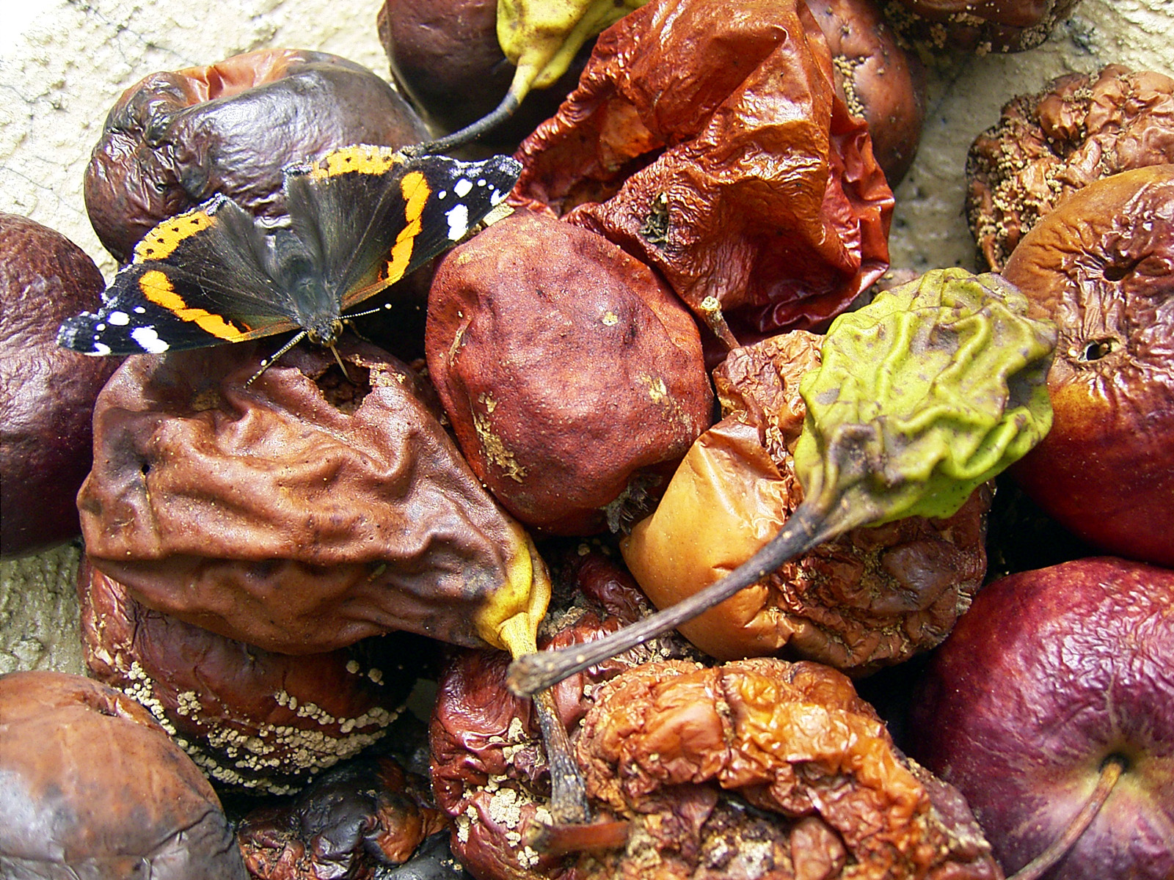
For when you were slaves of sin, you were free in regard to righteousness. What fruit did you have then in the things of which you are now ashamed? For the end of those things is death. — Romans 6:20-21
slaves of sin
slaves of sin
X
fruit
righteousness
fruit
death
Notes:
The putrid remains surrounding us all. Without noticing God’s call to righteousness, one’s shame has no mercy.

Slide 10
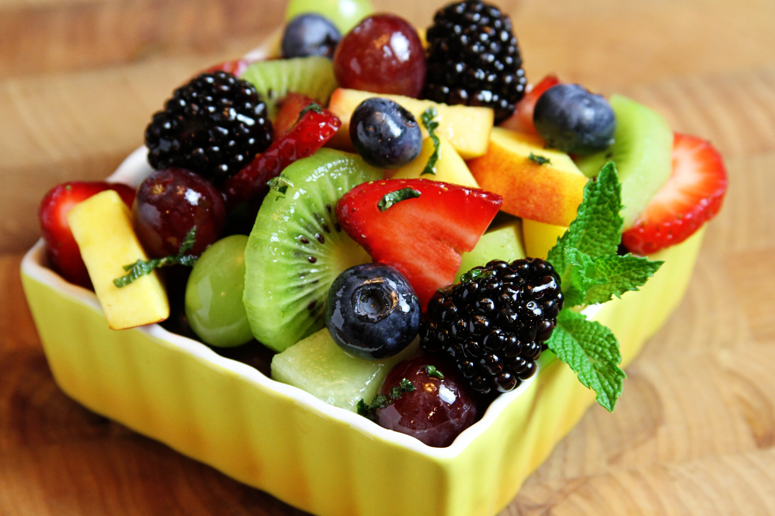
But now having been set free from sin, and having become slaves of God, you have your fruit to holiness, and the end, everlasting life. For the wages of sin is death, but the gift of God is eternal life in Christ Jesus our Lord. — Romans 6:22-23
fruit
fruit
fruit
death
fruit
in
eternal life
Notes:
To seek Him out sets one free from the bondage of death’s onslaught. The fruit we choose defines who we are.

Slide 11
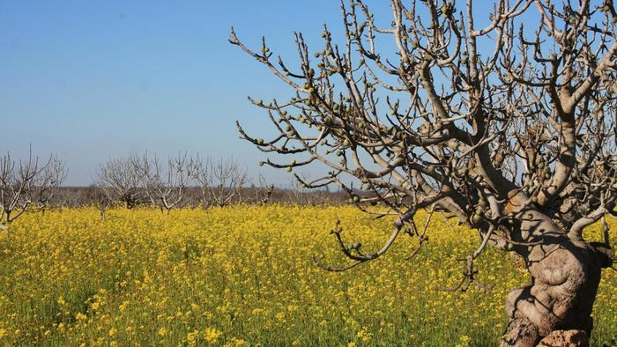
He also spoke this parable: "A certain man had a fig tree planted in his vineyard, and he came seeking fruit on it and found none. Then he said to the keeper of his vineyard, 'Look, for three years I have come seeking fruit on this fig tree and find none. Cut it down; why does it use up the ground?'" — Luke 13:6-7
fruit
fruit
fruit
judgment
Notes:
Many of those who have disgust for the godly have not yet realized His glory to come. The Lord waits watching to see who desires Him as His Word has clearly been delivered.

Slide 12
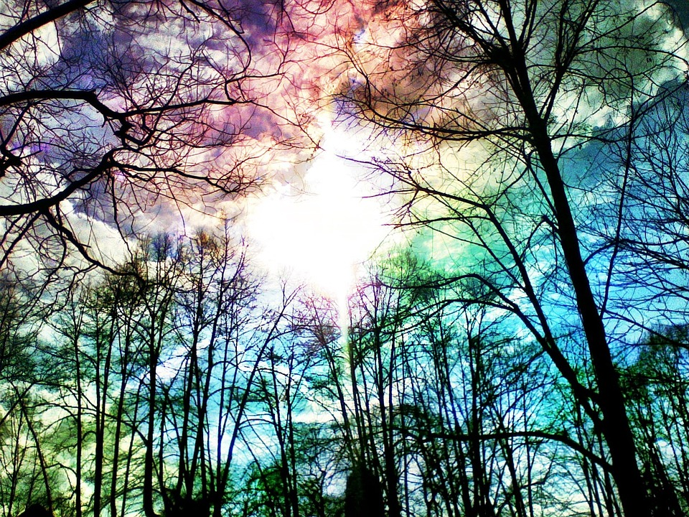
"But he answered and said to him, 'Sir, let it alone this year also, until I dig around it and fertilize it. And if it bears fruit, well. But if not, after that you can cut it down.' " — Luke 13:8-9
patience
fruit
teach
fruit
Notes:
He is saying, “Wait until the light of God might change it to bear fruit.” The seed code: Each of us is a seed yet to be born blossoming into His kingdom. It is what type of fertilizer we choose to be surrounded in that reveals if we come to maturity or remain stagnant, even to the detrimental point of remaining permanently dormant. There comes a point that a seed looses its’ ability to germinate. Pray God cold hearts turn back to His warming light.

Slide 13
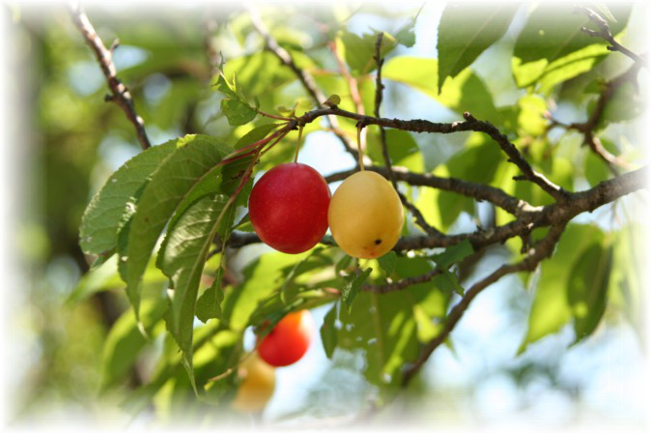
"Either make the tree good and its fruit good, or else make the tree bad and its fruit bad; for a tree is known by its fruit. Brood of vipers! How can you, being evil, speak good things? For out of the abundance of the heart the mouth speaks." — Matthew 12:33-34
fruit good
fruit bad
heart
fruit
abundance of the heart
heart
abundance of the heart
Notes:
The light of the heart forces character as it nurtures goodness or spews badness.

Slide 14
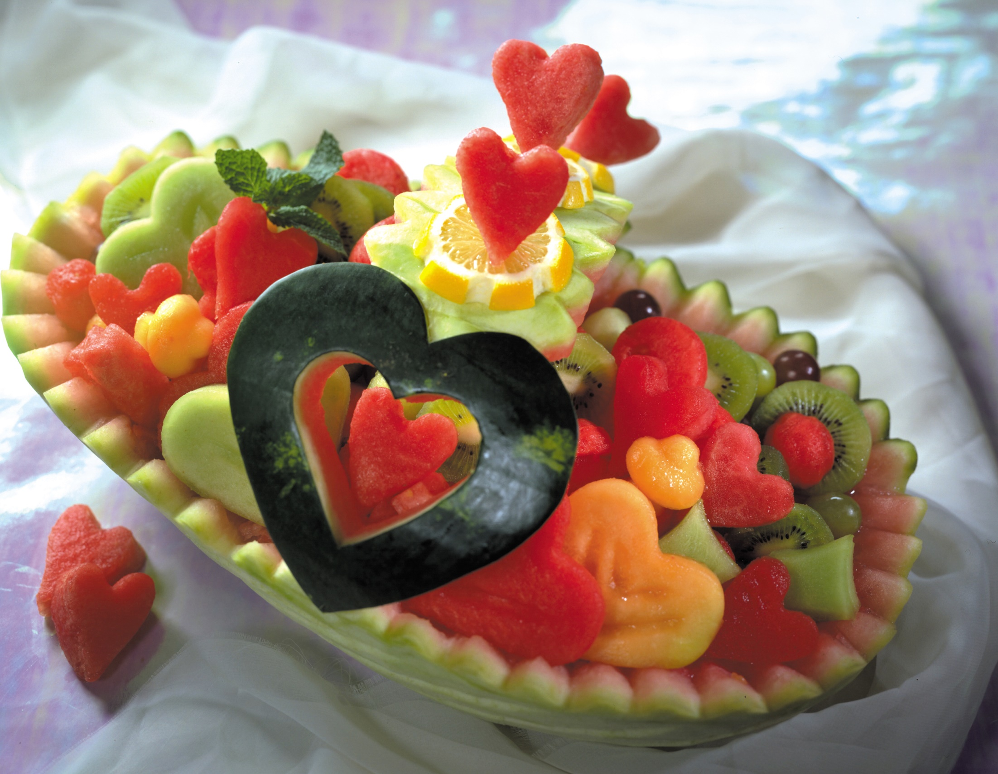
"A good man out of the good treasure of his heart brings forth good things, and an evil man out of the evil treasure brings forth evil things." — Matthew 12:35
d
s
heart
e
seed
e
Notes:
The seed in the heart of man uncovers one’s true character. He calls for seeds to bring forth rather than continuing as hidden. Let your light shine is His message for life.

Slide 15
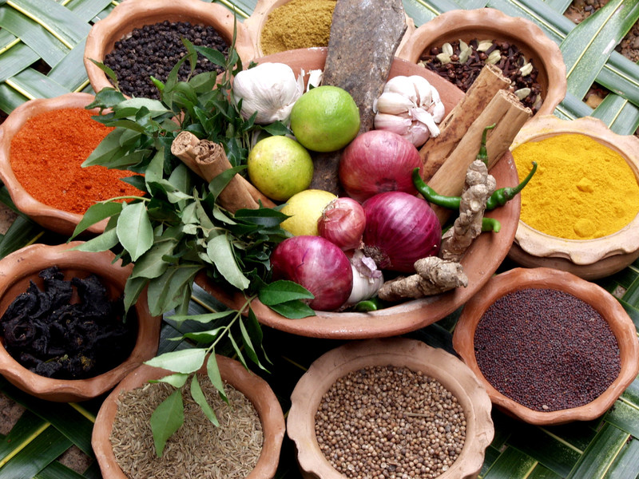
Then God said, "Let the earth bring forth grass, the herb that yields seed, and the fruit tree that yields fruit according to its kind, whose seed is in itself, on the earth"; and it was so. — Genesis 1:11
gentleness
jealousies
truth
dissensions
contentions
self-control
selfishness
goodness
faithfulness
idolatry
murders
peace
uncleanness
righteousness
wrath
drunkenness
sorcery
seed
seed
seed
seed is in itself
in
seed is in itself
envy
seed
joy
lewdness
heresies
kindness
hatred
adultery
longsuffering
love
fornication
Notes:
There are many seeds but in each is identity to remain whole. Good seed is not the same as bad seed, and blessed are those that know the difference. Without knowledge, the fruits of wisdom have no blossom. One must choose carefully in order to keep weeds at a distance in cultivating knowledge. We are gardeners of our own lives.

Slide 16
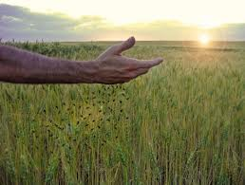
"Now the parable is this: The seed is the word of God." — Luke 8:11
… having been born again, not of corruptible seed but incorruptible, through the word of God which lives and abides forever, … — 1st Peter 1:23
. .
word of God
word of God
seed
word of God
. .
word of God
Notes:
It is what we as individuals immerse ourselves into that defines who we are. The word of God instills moral fiber while other written or pictorial materials may tear from that decency.

Slide 17
word of God
the word
the word
Notes:
It is what we as individuals immerse ourselves into that defines who we are. The word of God instills moral fiber while other written or pictorial materials may tear from that decency.

Slide 18
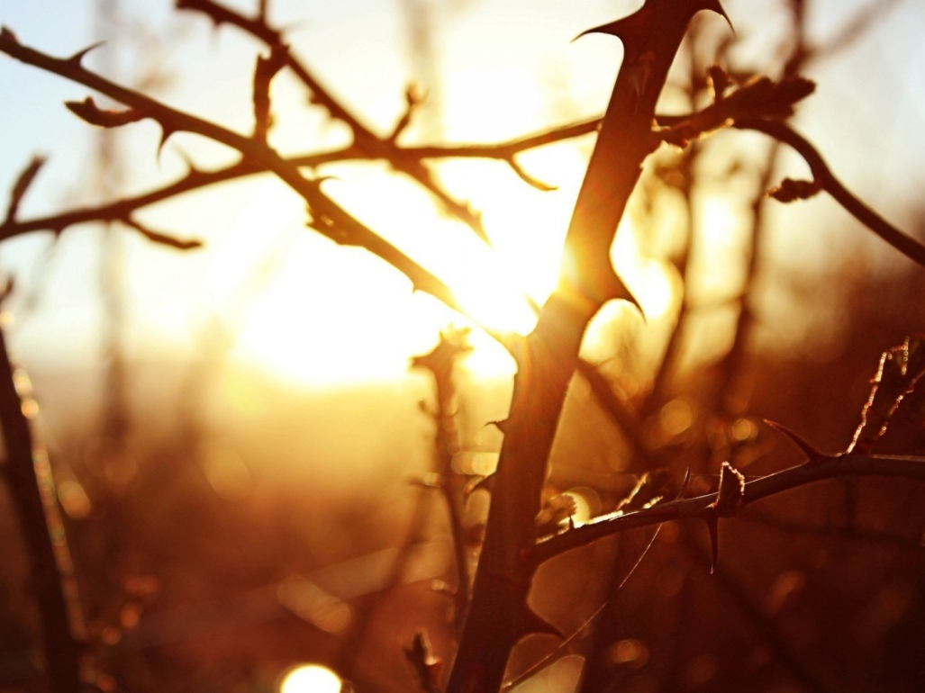
"Now the ones that fell among thorns are those who, when they have heard, go out and are choked with cares, riches, and pleasures of life, and bring no fruit to maturity. But the ones that fell on the good ground are those who, having heard the word with a noble and good heart, keep it and bear fruit with patience." — Luke 8:14-15
patience
"Now the ones that fell among thorns are those who, when they have heard, go out and are choked with cares, riches, and pleasures of life, and bring no fruit to maturity. But the ones that fell on the good ground are those who, having heard the word with a noble and good heart, keep it and bear fruit with patience." — Luke 8:14-15
"Now the ones that fell among thorns are those who, when they have heard, go out and are choked with cares, riches, and pleasures of life, and bring no fruit to maturity. But the ones that fell on the good ground are those who, having heard the word with a noble and good heart, keep it and bear fruit with patience." — Luke 8:14-15
heard
heard
heard
heard
the word
the word
the word
→
keep it
heart
patience
Notes:
Each of us that approaches His mercy, and grace, helps one navigate through the thorns of life. Unfortunate for us all, and our children, is that we are within a spiritual drought, a devouring famine for the lack of knowledge in God’s Word. Without God hearts splinter into loosing the love we were meant to have.

Slide 19
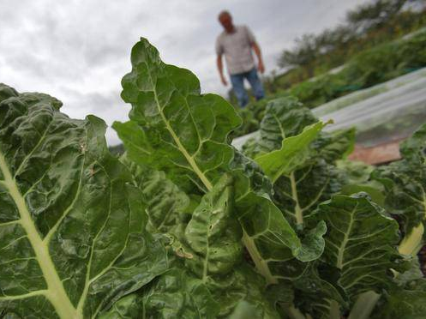
Therefore be patient, brethren, until the coming of the Lord. See how the farmer waits for the precious fruit of the earth, waiting patiently for it until it receives the early and latter rain. You also be patient. Establish your hearts, for the coming of the Lord is at hand. Do not grumble against one another, brethren, lest you be condemned. Behold, the Judge is standing at the door! — James 5:7-9
patience
be patient
be patient
fruit
hearts
Establish your hearts
fruit
Do not
Do not
grumble against one another
X
grumble
grumble against one another
Notes:
Time is truly relative as we endlessly meet our master and creator. Often ignored is His very presence waiting on the door of each heart.

Slide 20
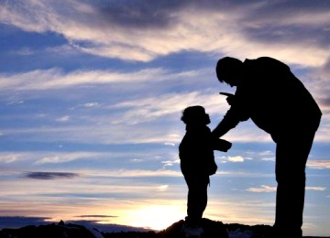
Now no chastening seems to be joyful for the present, but painful; nevertheless, afterward it yields the peaceable fruit of righteousness to those who have been trained by it. — Hebrews 12:11
peace
fruit
peace
trained
trained
Notes:
Peace is something worked for. Welcoming correction only refines and hones the soul to better arrive where peace has no end.

Slide 21
Now the fruit of righteousness is sown in peace by those who make peace. — James 3:18
fruit
fruit
peace
peace
Notes:
He rewards the seeking diligent with fruits of peace, in love, where joy remains untouched by the defiled.

Slide 22
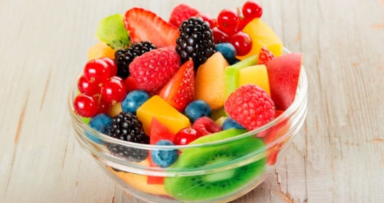
But the fruit of the Spirit is love, joy, peace, longsuffering, kindness, goodness, faithfulness, gentleness, self-control. Against such there is no law. And those who are Christ's have crucified the flesh with its passions and desires. — Galatians 5:22-24
fruit
fruit of the Spirit
love,
joy, peace
longsuffering
● love, joy, peace
● longsuffering
● kindness
● goodness
● faithfulness
● gentleness
● self-control
love
kindness
goodness
faithfulness
longsuffering
gentleness
self-control
kindness
goodness
faith
self-control
Notes:
And so it comes to the fruits we choose that declares our destination. To pursue Spirit over that of the flesh has eternal treasure in the garden of His light. May our bowls eternally be filled in Him.

Slide 23
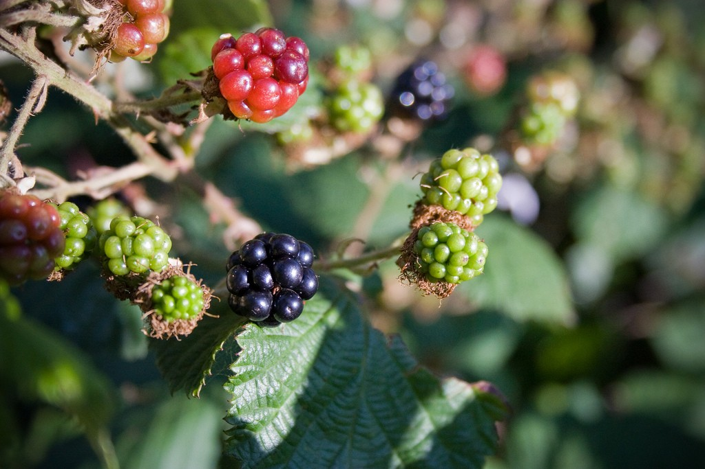
faith
self-control
perseverance
godliness
kindness
love
Notes:
And so it comes to the fruits we choose that declares our destination. To pursue Spirit over that of the flesh has eternal treasure in the garden of His light. May our bowls eternally be filled in Him.

Slide 24
But also for this very reason, giving all diligence, add to your faith virtue, to virtue knowledge, to knowledge self-control, to self-control perseverance, to perseverance godliness, to godliness brotherly kindness, and to brotherly kindness love. For if these things are yours and abound, you will be neither barren nor unfruitful in the knowledge of our Lord Jesus Christ. — 2nd Peter 1:5-8
add
add
additudes
love
godliness
brotherly kindness
perseverance
self-control
knowledge
virtue
faith
add
faith
i
tu
love
faith
virtue
knowledge
brotherly kindness
godliness
self-control
self-control
self-control
perseverance
perseverance
godliness
perseverance
godliness
d
es
kindness
brotherly kindness
virtue
knowledge
love
love
faith
unfruitful
unfruitful
Notes:
As we grow as Christians, we integrate those things that strengthen our character bringing us closer to His divine nature, as instructed.

Slide 25
love
LOVE
G
B
godliness
brotherly kindness
S
P
self-control
perseverance
V
K
virtue
knowledge
FAITH
faith
Notes:
Many of the fruits of Spirit work in concert with each other. To relinquish or ignore any one part can compromise the effectiveness of them all. To fall short is not to stand tall.

Slide 27
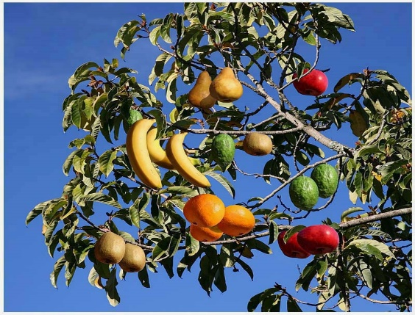

Slide 28
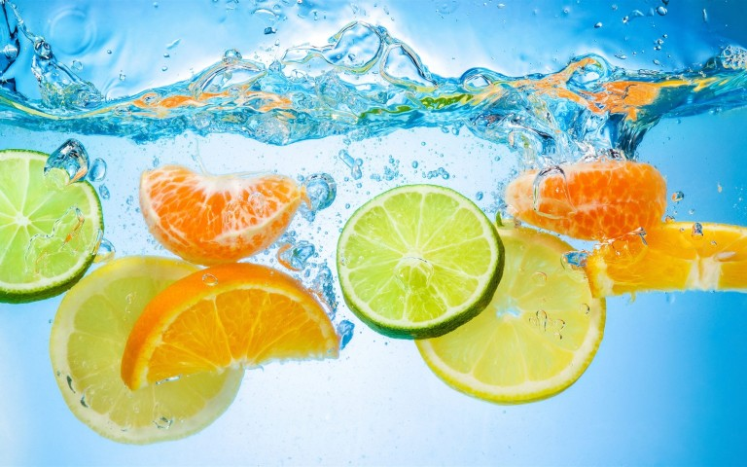
→ You will know them by their fruits
→ Bear fruits worthy of repentance; evil will be burned
→ Fruit/Spirit is in all goodness, righteousness, & truth
→ No fellowship with the unfruitful works of darkness
→ Fruit of holiness brings everlasting life
→ Be patient for fruit to develop after being fertilized
→ Of the abundance of the heart the mouth speaks
→ Fruit grows whose seed is in itself
→ Noble and good hearts keep the word and bear fruit
→ Chastening yields peaceable fruit of righteousness
→ Fruit of righteousness is peace
→ Fruit/Spirit - love, joy, peace, longsuffering, kindness
- goodness, faithfulness, gentleness, self-control
Good fruits
shine forth from
godly spirits
Notes:
Good fruits shine forth from godly spirits.

Slide 29
Notes:
Darkness has no place to go.

Slide 30
FRUITS
2
Ron Bert
July 16, 2017
Notes:
The fruit of life is best in accordance with HIS WILL.

Slide 31
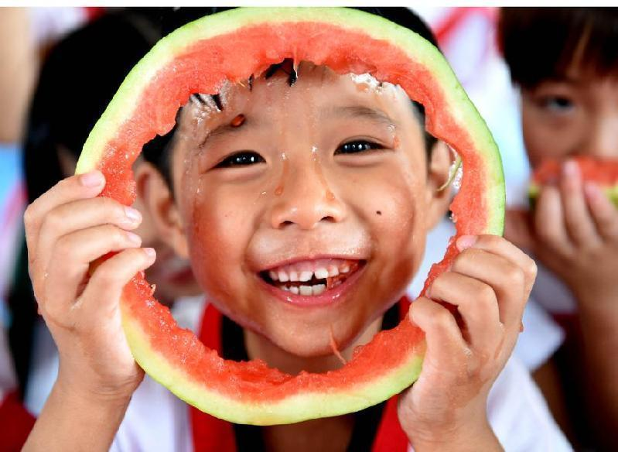
Death and life are in the power of the tongue, And those who love it will eat its fruit. — Proverbs 18:21
lips
fruit
Notes:
To be innocent of condemnation one’s words must be wisely placed. The reckless have no permanent home other than anguish.

Slide 32
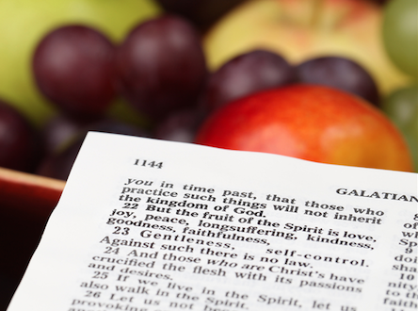
Preach the word! Be ready in season and out of season. Convince, rebuke, exhort, with all longsuffering and teaching. — 2nd Timothy 4:2
fruit
fruit
Preach the word
Be ready
. .
. .
fruit
fruit
longsuffering
teaching
longsuffering
teaching
Notes:
Fruits come in all colors such as in speaking. Producing fruit utters the oracles of God always being ready, with longsuffering, in the glory of teaching His ways.

Slide 33
Counsel is mine, and sound wisdom; I am understanding, I have strength. By me kings reign, And rulers decree justice. By me princes rule, and nobles, All the judges of the earth. — Proverbs 8:14-16
wisdom
fruits
understanding
fruit
fruit
fruit
fruit
wisdom
BAD
GOOD
Notes:
The fruit of wisdom has an accumulation of many diverse attributes with the single source being that of God Himself.

Slide 34
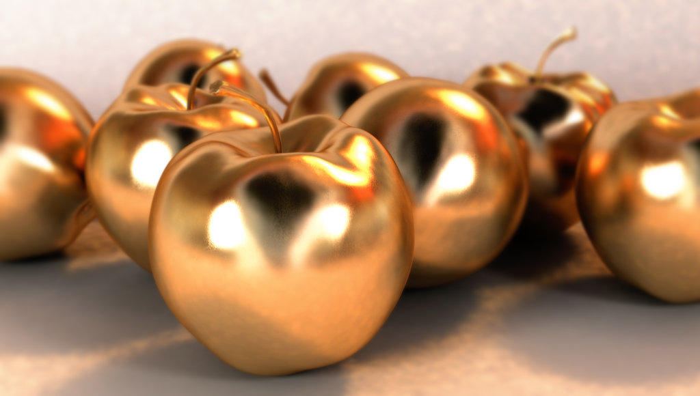
I love those who love me, And those who seek me diligently will find me. Riches and honor are with me, Enduring riches and righteousness. My fruit is better than gold, yes, than fine gold, And my revenue than choice silver. — Proverbs 8:17-19
love
spirit
justice
fruit
fruit
better
better
truth
than fine gold
honor
than fine gold
wisdom
righteousness
Notes:
Where does good fruit dwell? It is the treasure of the heart.

Slide 35
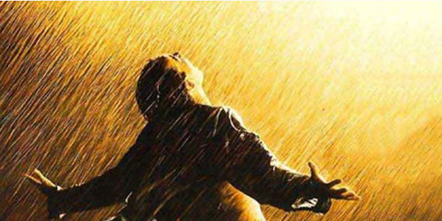
I traverse the way of righteousness, In the midst of the paths of justice, That I may cause those who love me to inherit wealth, That I may fill their treasuries. — Proverbs 8:20-21
wisdom from above:
① pure
② peaceable
③ gentle
④ willing to yield
⑤ full of mercy and good fruits
⑥ without partiality
⑦ without hypocrisy
But the wisdom that is from above is first pure, then peaceable, gentle, willing to yield, full of mercy and good fruits, without partiality and without hypocrisy. — James 3:17
wisdom
e
from above
pure
d
peaceable
gentle
willing to yield
filled
fruit
full of mercy and good fruits
without partiality
without
fill
hypocrisy
Notes:
Good fruits of spirit are welcomed in the heart of all men.

Slide 36
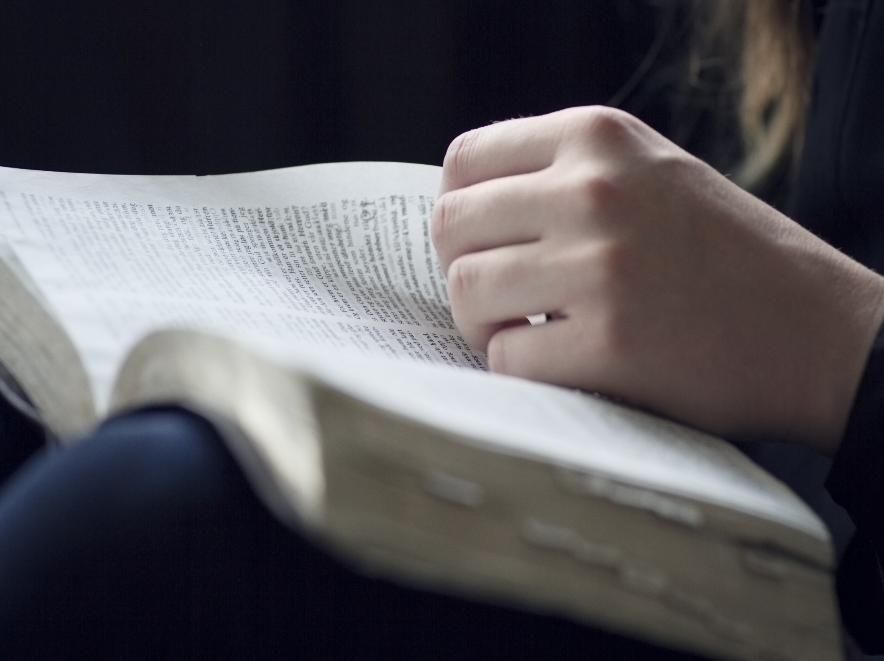
Those who are planted in the house of the LORD Shall flourish in the courts of our God. They shall still bear fruit in old age; They shall be fresh and flourishing, To declare that the LORD is upright; He is my rock, and there is no unrighteousness in Him. — Psalms 92:13-15
planted
in
planted
planted
still bear fruit in old age
fruit
still bear fruit in old age
filled
fruit
Notes:
Habits define the soul. What one is planted in renders either strength or weakness in days of trouble. To be sure is in the priceless moment we live.

Slide 37
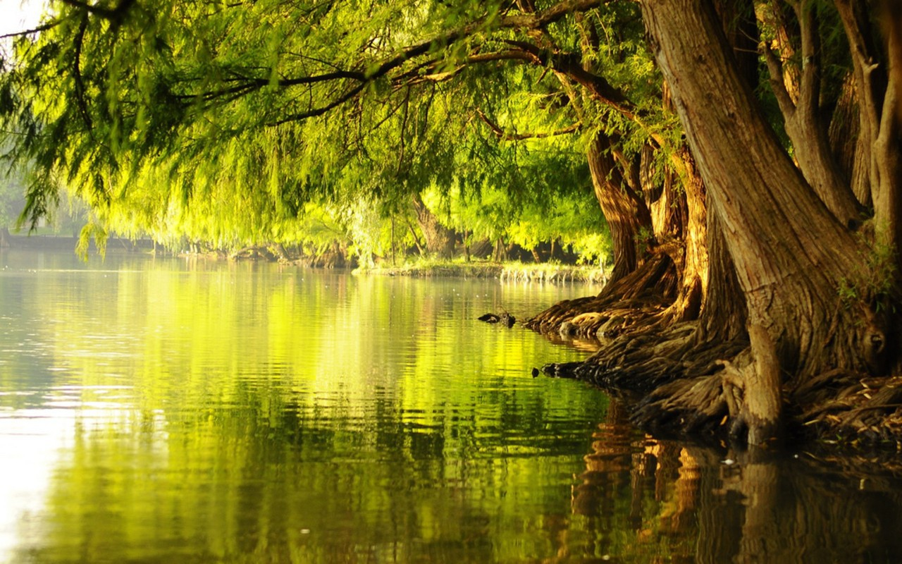
For he shall be like a tree planted by the waters, Which spreads out its roots by the river, And will not fear when heat comes; But its leaf will be green, And will not be anxious in the year of drought, Nor will cease from yielding fruit. — Jeremiah 17:8
planted
For he shall be like a tree planted by the waters, Which spreads out its roots by the river, And will not fear when heat comes; But its leaf will be green, And will not be anxious in the year of drought, Nor will cease from yielding fruit. — Jeremiah 17:8
For he shall be like a tree planted by the waters, Which spreads out its roots by the river, And will not fear when heat comes; But its leaf will be green, And will not be anxious in the year of drought, Nor will cease from yielding fruit. — Jeremiah 17:8
He shall be like a tree Planted by the rivers of water, That brings forth its fruit in its season, Whose leaf also shall not wither; And whatever he does shall prosper. — Psalms 1:3
will not be
will not be
fruit
anxious
anxious
fruit
Notes:
Fruit is developed by which nutrients the roots consume, and whether the ground is fertile or barren. If one finds that parched wasteland underfoot, run and or come to better ground, in Him, is His call. If employed, time is made available to heal the spirit saving the soul no matter the external conditions. Accepting His love has enormous effects.

Slide 38
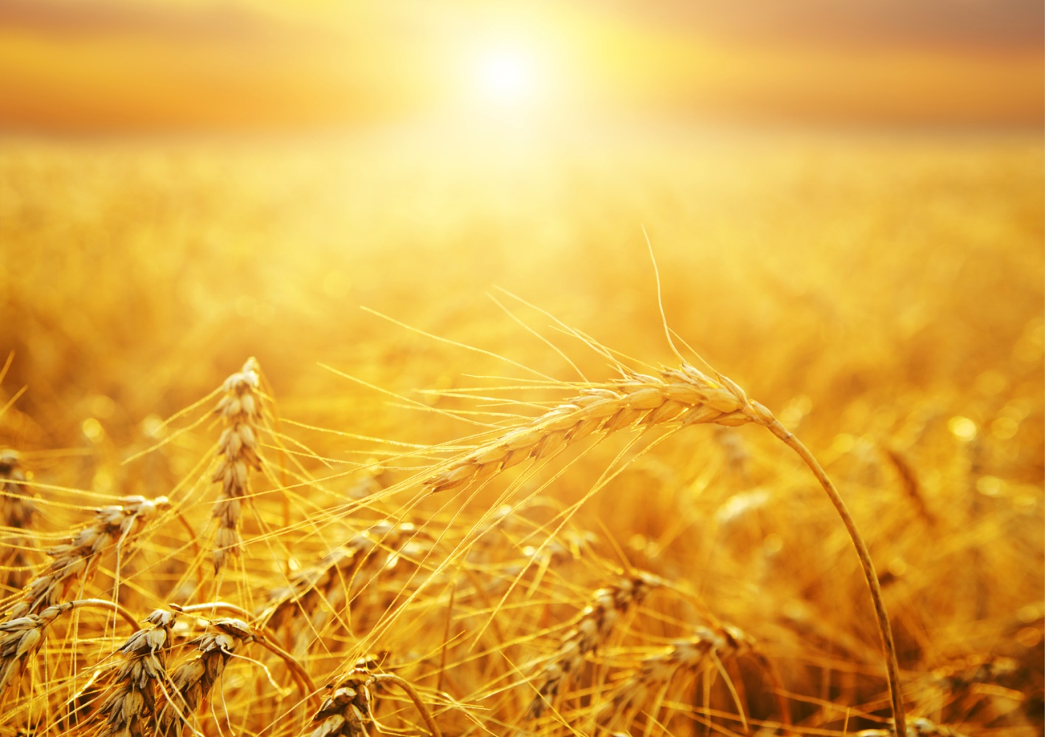
"Do you not say, 'There are still four months and then comes the harvest'? Behold, I say to you, lift up your eyes and look at the fields, for they are already white for harvest! And he who reaps receives wages, and gathers fruit for eternal life, that both he who sows and he who reaps may rejoice together." — John 4:35-36
reap
reap
gathers fruit for eternal life
fruit
gathers fruit for eternal life
sows
rejoice together
reaps
Notes:
As sowing leads to reaping, one must be present at the harvest to partake in that reaping. We are called to reap upon that which has already been sown.

Slide 39
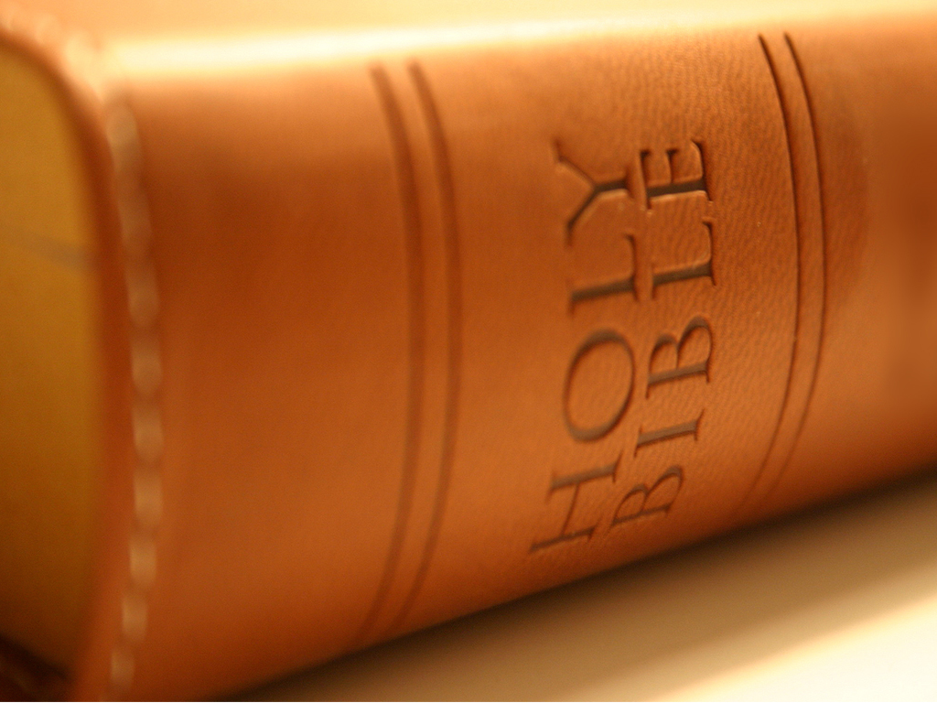
"For in this the saying is true: 'One sows and another reaps.' I sent you to reap that for which you have not labored; others have labored, and you have entered into their labors." — John 4:37-38
reap
Christ Jesus our Lord
into their labors
into their labors
Christ Jesus our Lord
Notes:
God put in place those things previously sown for us to be able to reap the rewards which are currently offered to His children.

Slide 40
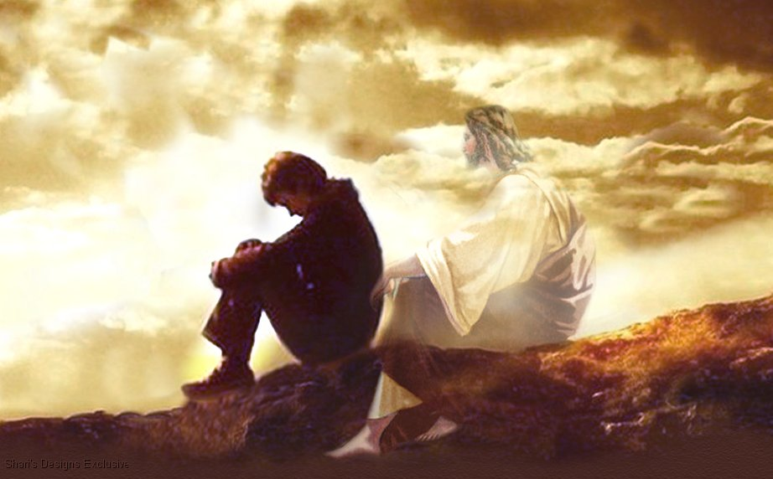
For the wages of sin is death, but the gift of God is eternal life in Christ Jesus our Lord. — Romans 6:23
death
"For I have no pleasure in the death of one who dies," says the Lord GOD. "Therefore turn and live!" — Ezekiel 18:32
Christ Jesus our Lord
in
turn and live
death
Notes:
Christ sacrificed His life so we could have access to eternal life. His field is planted across the four corners of time.

Slide 41
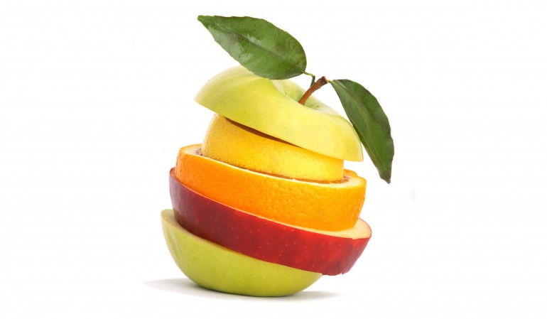
Therefore, my brethren, you also have become dead to the law through the body of Christ, that you may be married to another -- to Him who was raised from the dead, that we should bear fruit to God. For when we were in the flesh, the sinful passions which were aroused by the law were at work in our members to bear fruit to death. — Romans 7:4-5
to Him
flesh
bear fruit to God
in
bear fruit to God
flesh
sinful passions
sinful passions
bear fruit to death
death
bear fruit to death
Notes:
Do you hang on the flesh more than bearing the fruits God calls out for? The balance in life comes by that which blesses higher over that which consumes lower.

Slide 42
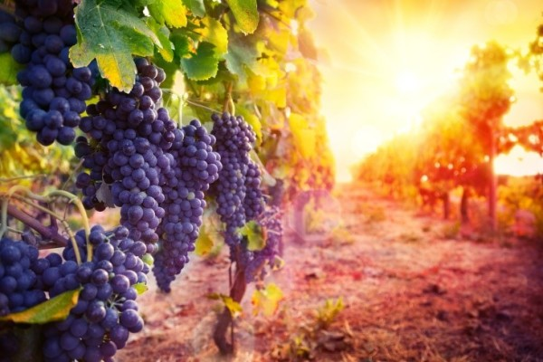
Do not be deceived, God is not mocked; for whatever a man sows, that he will also reap. For he who sows to his flesh will of the flesh reap corruption, but he who sows to the Spirit will of the Spirit reap everlasting life. And let us not grow weary while doing good, for in due season we shall reap if we do not lose heart. — Galatians 6:7-9
flesh
flesh
flesh
sows to
sows to
the
sows to
sows to of the Spirit
the Spirit = reap everlasting life
Spirit
=
Spirit
Spirit
Spirit
of the Spirit
reap
everlasting life
Notes:
The spirit is deeper than the flesh. If the flesh is made to dominate the spirit, higher qualities such as mercy are inactive. God watches to see who will control the flesh through the spirit.

Slide 43
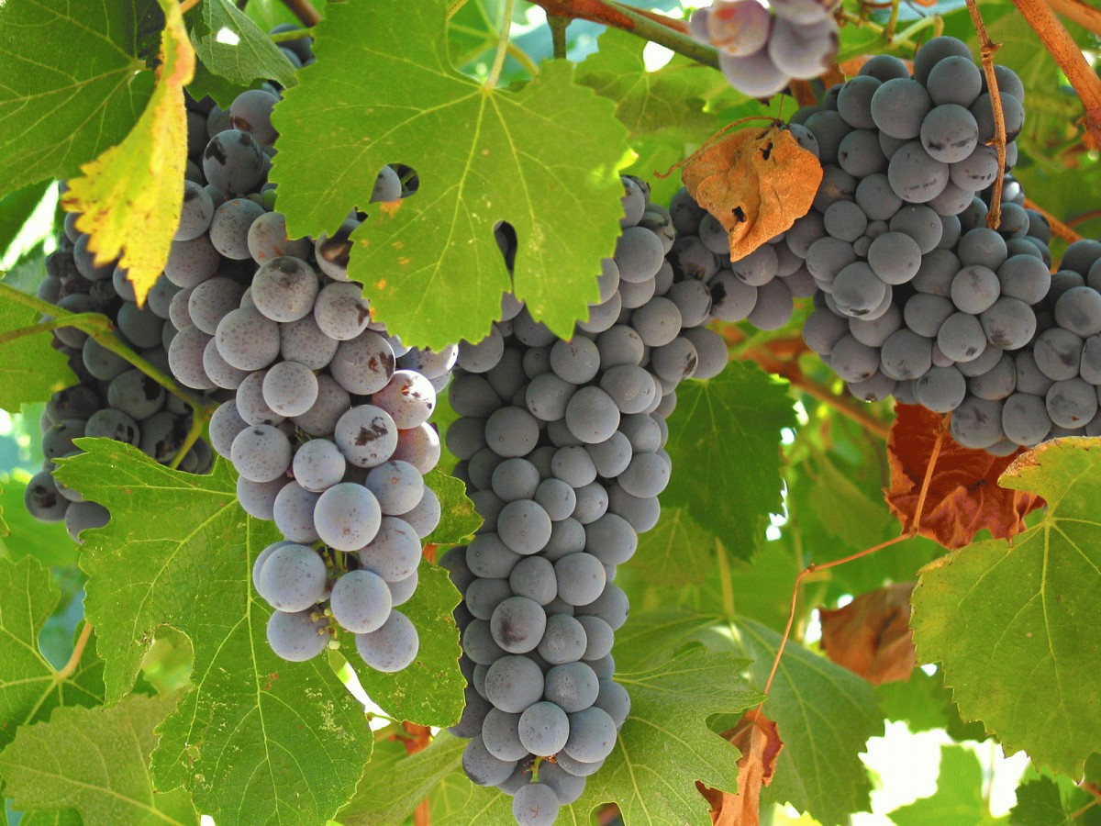
"I am the true vine, and My Father is the vinedresser. Every branch in Me that does not bear fruit He takes away; and every branch that bears fruit He prunes, that it may bear more fruit. You are already clean because of the word which I have spoken to you." — John 15:1-3
fruit
fruit
fruit
fruit
Notes:
Without knowledge of His word, one’s eternal security is precariously perched in jeopardy of being cast off. Jesus is the gardener nurturing that which grows back to Him.

Slide 44
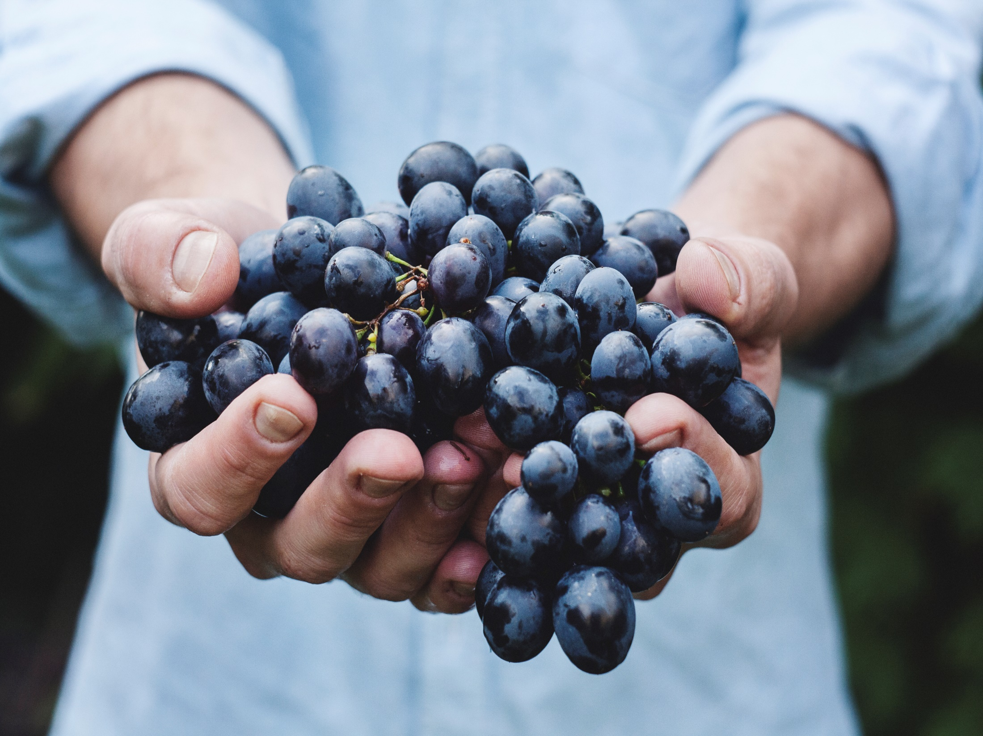
"Abide in Me, and I in you. As the branch cannot bear fruit of itself, unless it abides in the vine, neither can you, unless you abide in Me. I am the vine, you are the branches. He who abides in Me, and I in him, bears much fruit; for without Me you can do nothing." — John 15:4-5
fruit
abide
abide
without Me you can do nothing
without Me you can do nothing
Notes:
Do we carry the fruit Jesus would have us to have? Through Him good fruit abounds. While God remains in our proximity, we have the opportunity to be redeemed. Without acknowledging what He has seriously done for us, giving us life, our very existence is at risk.

Slide 45
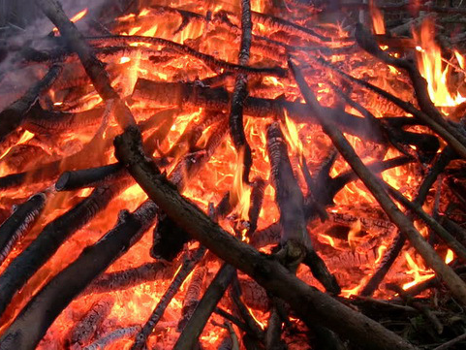
"If anyone does not abide in Me, he is cast out as a branch and is withered; and they gather them and throw them into the fire, and they are burned. If you abide in Me, and My words abide in you, you will ask what you desire, and it shall be done for you." — John 15:6-7
abide
disobedience
abide
abide
in
abide
in
in Me
My words abide in you
in Me
My words abide in you
obedience
Notes:
Destruction is assured for those that deny His redeeming presence and apathetically produce nothing and or undesirable fruits of wickedness.

Slide 46
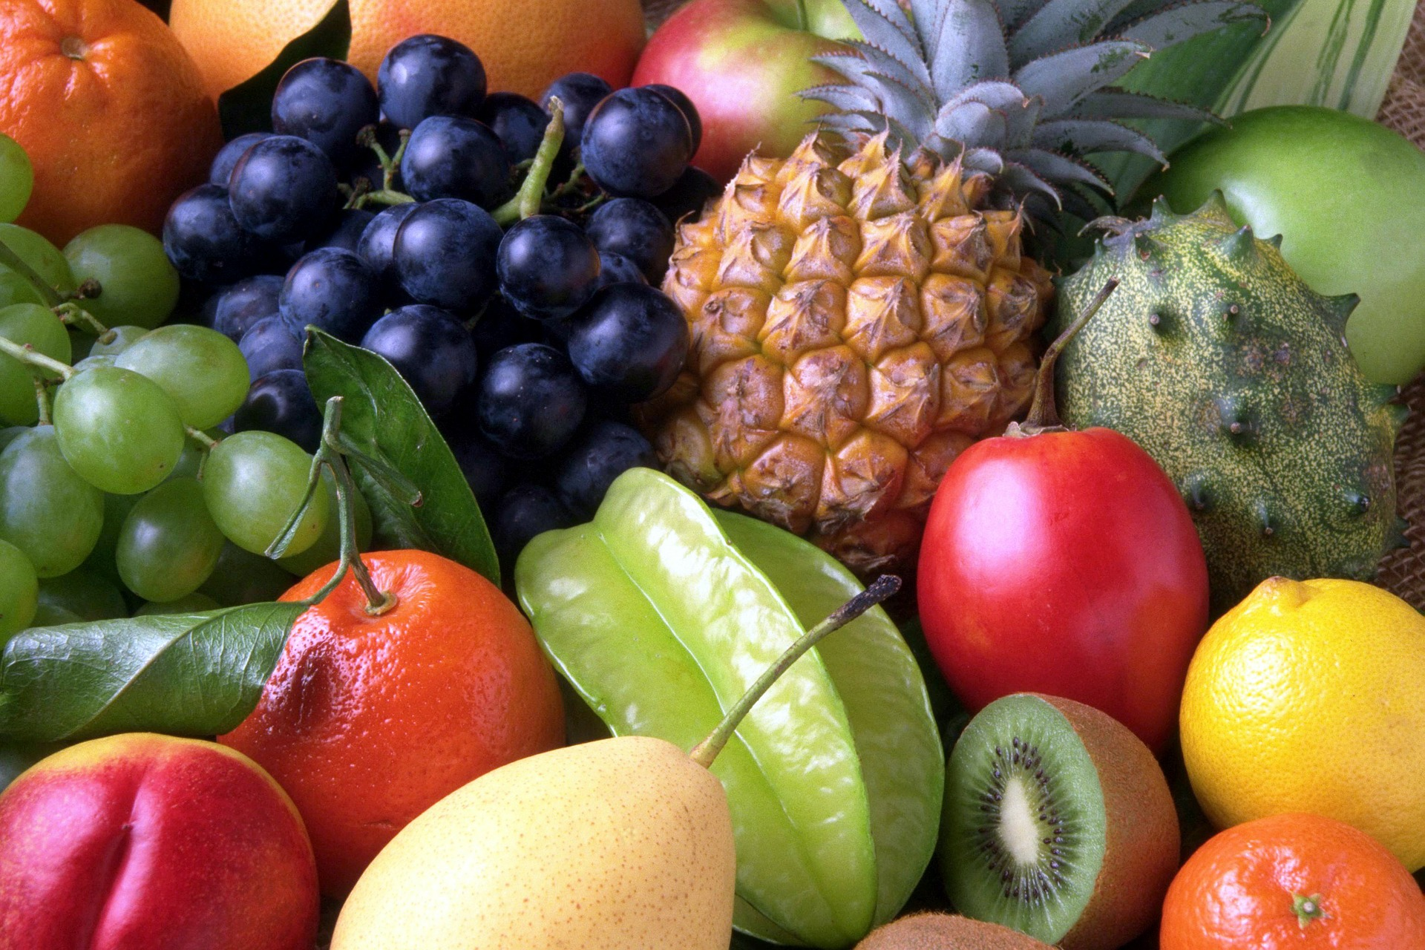
"By this My Father is glorified, that you bear much fruit; so you will be My disciples." — John 15:8
glorified
bear much fruit
fruit
bear much fruit
learn
learn
And let our people also learn to maintain good works, to meet urgent needs, that they may not be unfruitful. — Titus 3:14
fruit
fruit
Notes:
Fruit has its’ sweetest array when it arises plentiful in Him.
.

Slide 47
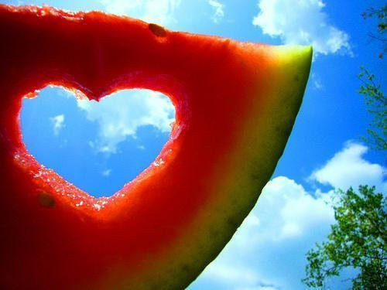
And this I pray, that your love may abound still more and more in knowledge and all discernment, that you may approve the things that are excellent, that you may be sincere and without offense till the day of Christ, being filled with the fruits of righteousness which are by Jesus Christ, to the glory and praise of God. — Philippians 1:9-11
your love
abound
in
knowledge
and all discernment
in
● your love abound in knowledge
and all discernment
● approve things that are excellent
● be sincere and without offense
● filled with fruits of righteousness
… that you may walk worthy of the Lord, fully pleasing Him, being fruitful in every good work and increasing in the knowledge of God; — Colossians 1:10
approve
things that are
approve
approve
excellent
be sincere
and without offense
increasing
increasing
filled with
fruits of
fruit
righteousness
Notes:
It is clear what the Lord wants for us to be in. It is our honorable pursuit to obtain the best results possible in His ways where glory shines.

Slide 48
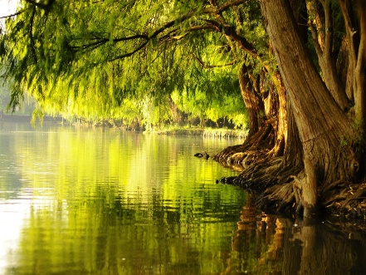
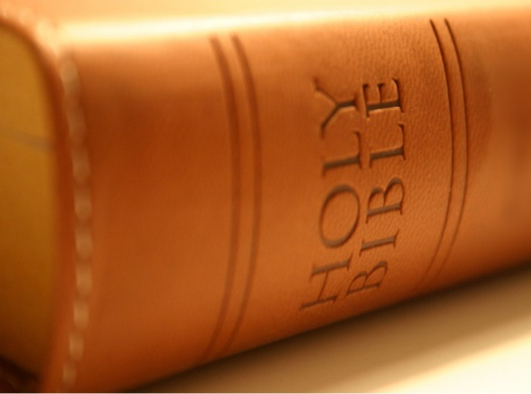
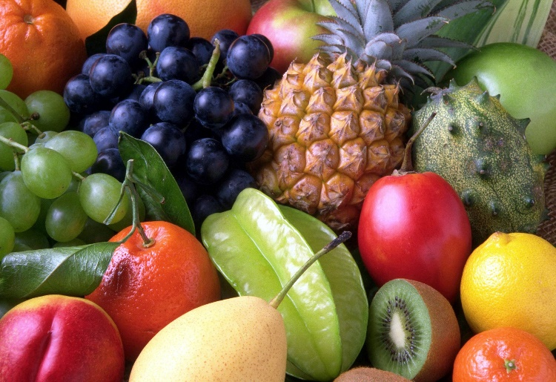
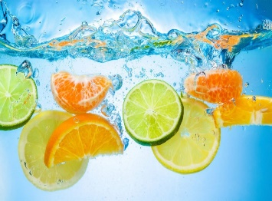

Slide 49
→ Death and life comes by the fruit one speaks
→ Be ready with all longsuffering and teaching
→ Wisdom is of the most precious of fruits
→ Planted in the house of the LORD endures the ages
→ No drought can halt righteous fruit
→ The righteous bring forth fruit in its season
→ The harvest is here as we reap the labors of others
→ We should bear fruit to God
→ Whatever a man sows, that he will also reap
→ Without God one can do nothing
→ Those not abiding in Him will be cast out
→ God is glorified by our fruits of righteousness
→ Be filled with fruits of righteousness by Jesus Christ
His fruit
is in all
that is good
Notes:
His fruit is in all that is good.

Slide 50
Notes:
Darkness is the destination where evil resides.

Slide 51
Please visit http://www.LoveFromGod.com to explore further
Ronald Bert Channel on
Notes:
Eternity never ends.

