Slide 2
Forgiven
Ron Bert
December 29, 2019

Slide 3
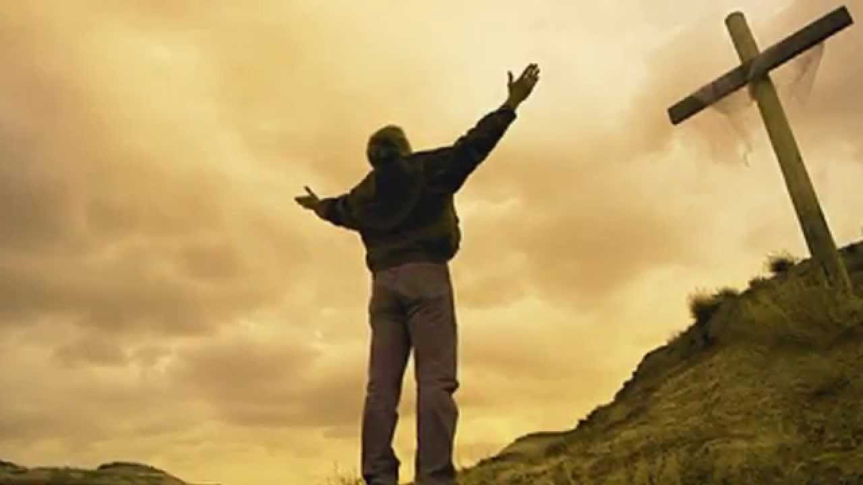
Let all bitterness, wrath, anger, clamor, and evil speaking be put away from you, with all malice. And be kind to one another, tenderhearted, forgiving one another, just as God in Christ forgave you. — Ephesians 4:31-32
Let all bitterness, wrath, anger, clamor, and evil speaking be put away from you, with all malice. And be kind to one another, tenderhearted, forgiving one another, just as God in Christ forgave you. — Ephesians 4:31-32
forgave
forgiving one
another
forgave

Slide 4
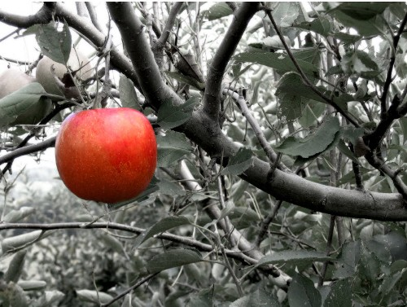
"Give us day by day our daily bread. And forgive us our sins, For we also forgive everyone who is indebted to us. And do not lead us into temptation, But deliver us from the evil one." — Luke 11: 3-4
Ask
forgive
us
forgave
forgave
SIN
forgave
forgive
everyone
deliver us
deliver us
Notes:
Surely we hope to be delivered from this tortuous existence where temptation and death overwhelms the lot of us. He asks for forgiving hearts as a prerequisite to His grace of truth.

Slide 5
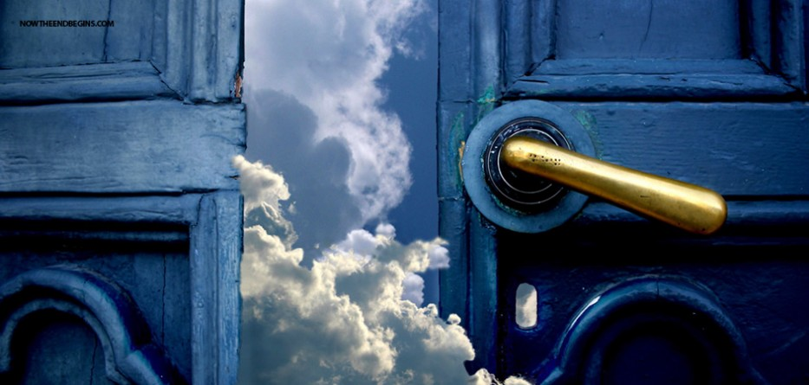
Give us this day our daily bread. And forgive us our debts, As we forgive our debtors. And do not lead us into temptation, But deliver us from the evil one. For Yours is the kingdom and the power and the glory forever. Amen. — Matthew 6:11-13
deliver us
Yours is the kingdom
power and the glory forever

Slide 6
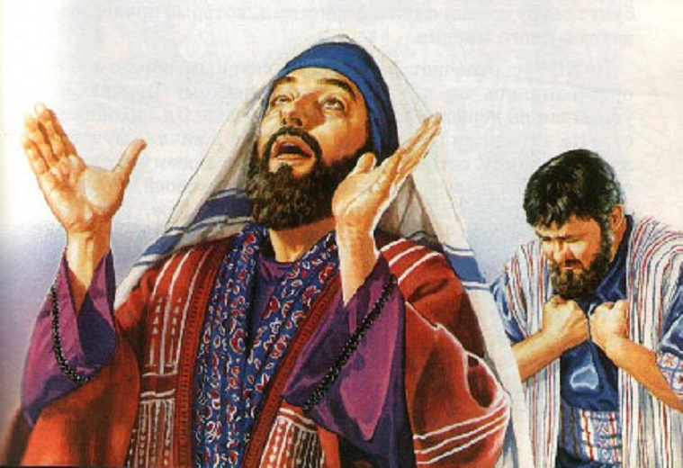
"And whenever you stand praying, if you have anything against anyone, forgive him, that your Father in heaven may also forgive you your trespasses. But if you do not forgive, neither will your Father in heaven forgive your trespasses." — Mark 11:25-26
forgive him
heaven
if you do not forgive
X
Notes:
If our deepest desire is to get to heaven it will not be done if we hold grudges against those around us. How big is our hope of heaven for if we fail to forgive we will be left to the coldness where we reside.

Slide 7
"Therefore if you bring your gift to the altar, and there remember that your brother has something against you, leave your gift there before the altar, and go your way. First be reconciled to your brother, and then come and offer your gift." — Matthew 5:23-24
Love
your gift
settled
submissive
resolved
be reconciled
Love
your gift
Notes:
True forgiveness is love without compromise. Pure in the sight of God is His children who see Him above any and all arguments of men. People and family may forever hate you, it is when you fester on returning the ugliness that God will not accept your sacrifice of shallow love. The greatest gift one can hold is love.

Slide 8
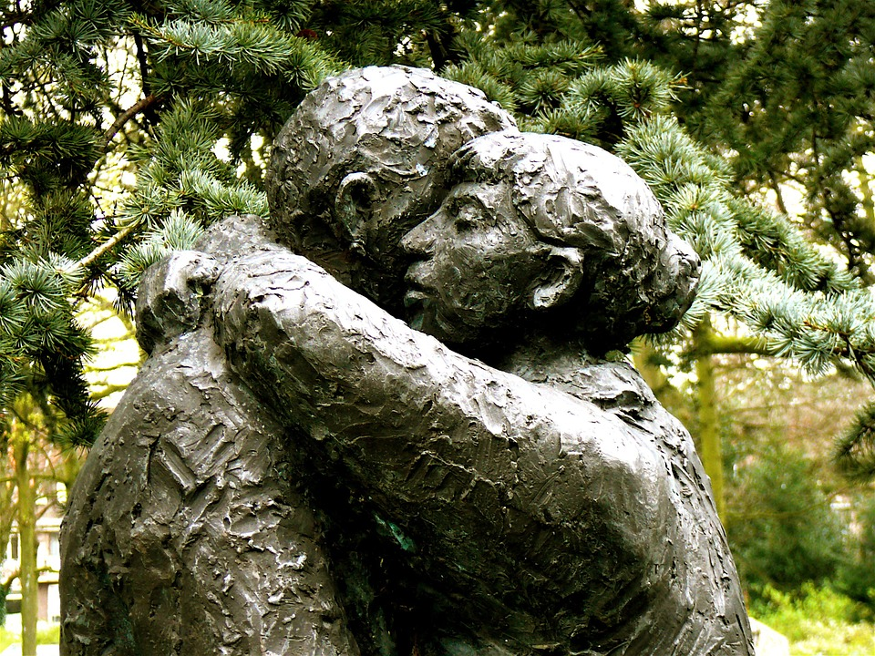
"For if you forgive men their trespasses, your heavenly Father will also forgive you. But if you do not forgive men their trespasses, neither will your Father forgive your trespasses." — Matthew 6:14-15
forgive
forgive
forgive
forgive
forgive
forgive
forgive
forgive
forgive

Slide 9
Then Peter came to Him and said, "Lord, how often shall my brother sin against me, and I forgive him? Up to seven times? Jesus said to him, "I do not say to you, up to seven times, but up to seventy times seven." — Matthew 18:21-22
forgive
seven times
seven times
7 x 70 = 490

Slide 10
"Take heed to yourselves. If your brother sins against you, rebuke him; and if he repents, forgive him. And if he sins against you seven times in a day, and seven times in a day returns to you, saying, 'I repent,' you shall forgive him." And the apostles said to the Lord, "Increase our faith." — Luke 17:3-5
Take heed
seven times
n
forgive
forgiven
improve
Increase

Slide 11
"Therefore be merciful, just as your Father also is merciful. Judge not, and you shall not be judged. Condemn not, and you shall not be condemned. Forgive, and you will be forgiven." — Luke 6:36-37
Father
forgiven
Condemn not
forgiven
forgiven
forgiven
one

Slide 12
forgiven
Father
one
forgiven

Slide 13
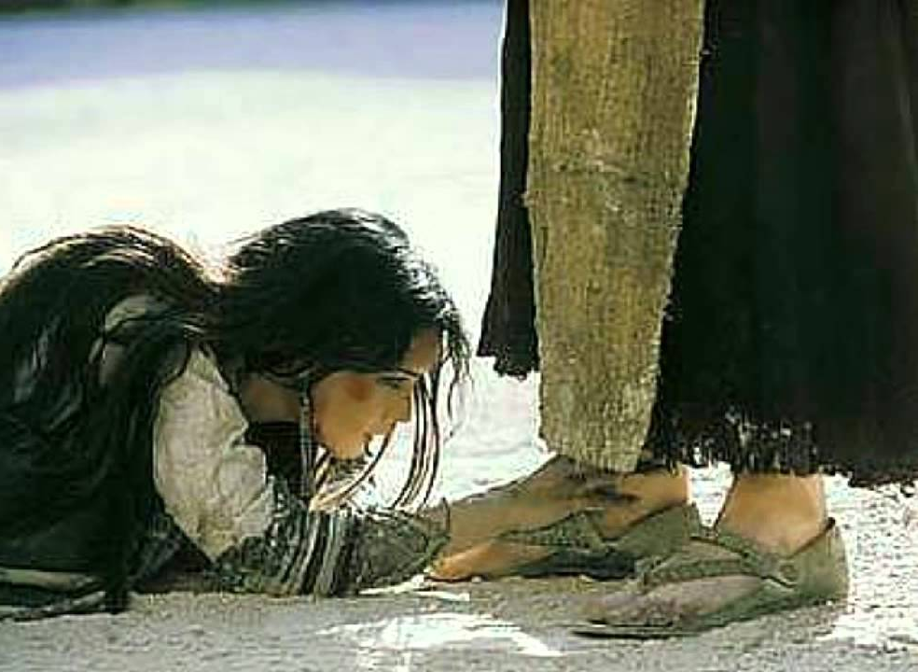
"Therefore I say to you, her sins, which are many, are forgiven, for she loved much. But to whom little is forgiven, the same loves little." — Luke 7:47
forgiven
who
little
forgive
s
forgiven
loves little
is selfish
who loves little forgives little
Notes:
People that are unable to forgive generally are those who love little, more contemptuous than not, normally critical of all others.

Slide 14
This punishment which was inflicted by the majority is sufficient for such a man, so that, on the contrary, you ought rather to forgive and comfort him, lest perhaps such a one be swallowed up with too much sorrow. Therefore I urge you to reaffirm your love to him. — 2nd Corinthians 2:6-8
forgive and comfort
too much sorrow
Grudge ≠ Forgiveness
Notes:
A grudge does not equal forgiveness which sets a soul free to believe in God without hindrance.

Slide 15
Therefore, as the elect of God, holy and beloved, put on tender mercies, kindness, humility, meekness, longsuffering; bearing with one another, and forgiving one another, if anyone has a complaint against another; even as Christ forgave you, so you also must do. But above all these things put on love, which is the bond of perfection. And let the peace of God rule in your hearts, to which also you were called in one body; and be thankful. — Colossians 3:12-15
as the called elect of God — put on:
• tender mercies
• kindness
• humility
• meekness
• longsuffering
• love
→ bearing with and forgiving one another
→ let the peace of God rule in your hearts
→ be thankful
as the
elect of God
put on
tender mercies
kindness
humility
meekness
longsuffering
bearing
with
and forgiving
one
another
love
let the peace of God rule in your
hearts
peace of God rule
called
be thankful
be thankful
—

Slide 16
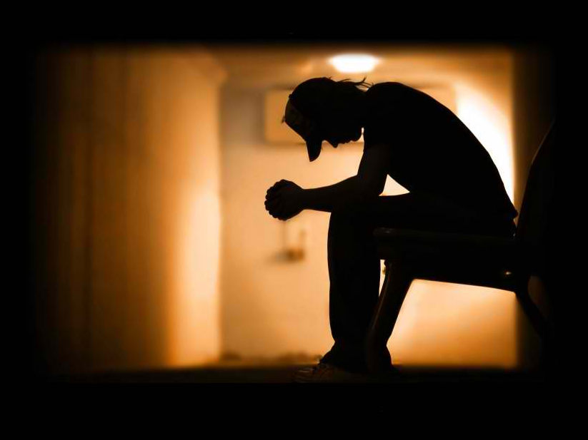
Confess your trespasses to one another, and pray for one another, that you may be healed. The effective, fervent prayer of a righteous man avails much. — James 5:16
Confess
honest
pray
pray
pray
pray

Slide 17
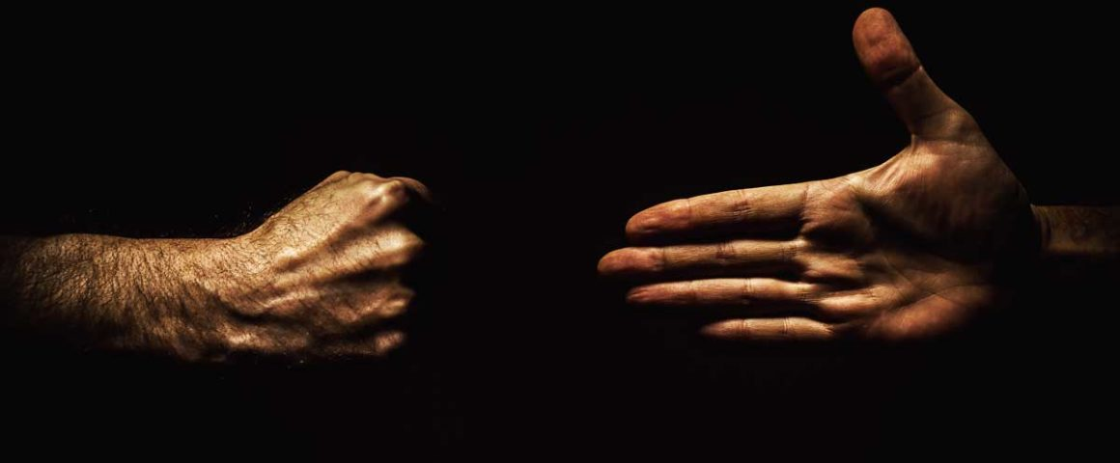
"But I say to you who hear: Love your enemies, do good to those who hate you, bless those who curse you, and pray for those who spitefully use you." — Luke 6:27-28
Love
do good
bless
pray
pray

Slide 18
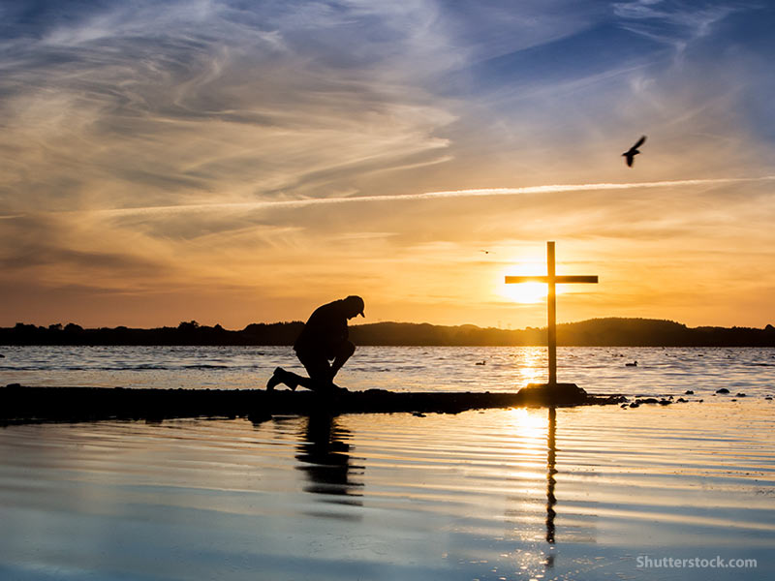
And you, being dead in your trespasses and the uncircumcision of your flesh, He has made alive together with Him, having forgiven you all trespasses, having wiped out the handwriting of requirements that was against us, which was contrary to us. And He has taken it out of the way, having nailed it to the cross. — Colossians 2:13-14
Gentiles
alive
forgiven
nailed it to
the cross
Notes:
We are alive and the more so when we understand the blessing of His forgiveness.

Slide 19
… for all have sinned and fall short of the glory of God, being justified freely by His grace through the redemption that is in Christ Jesus, whom God set forth as a propitiation by His blood, through faith, to demonstrate His righteousness, because in His forbearance God had passed over the sins that were previously committed, to demonstrate at the present time His righteousness, that He might be just and the justifier of the one who has faith in Jesus. — Romans 3:23-26
justified freely by
His grace
His grace
His grace
His blood
His forbearance
His righteousness
His grace
in
Christ Jesus
God
His blood
His blood
His righteousness
His forbearance
God
be just
in
Jesus
who has faith in Jesus

Slide 20
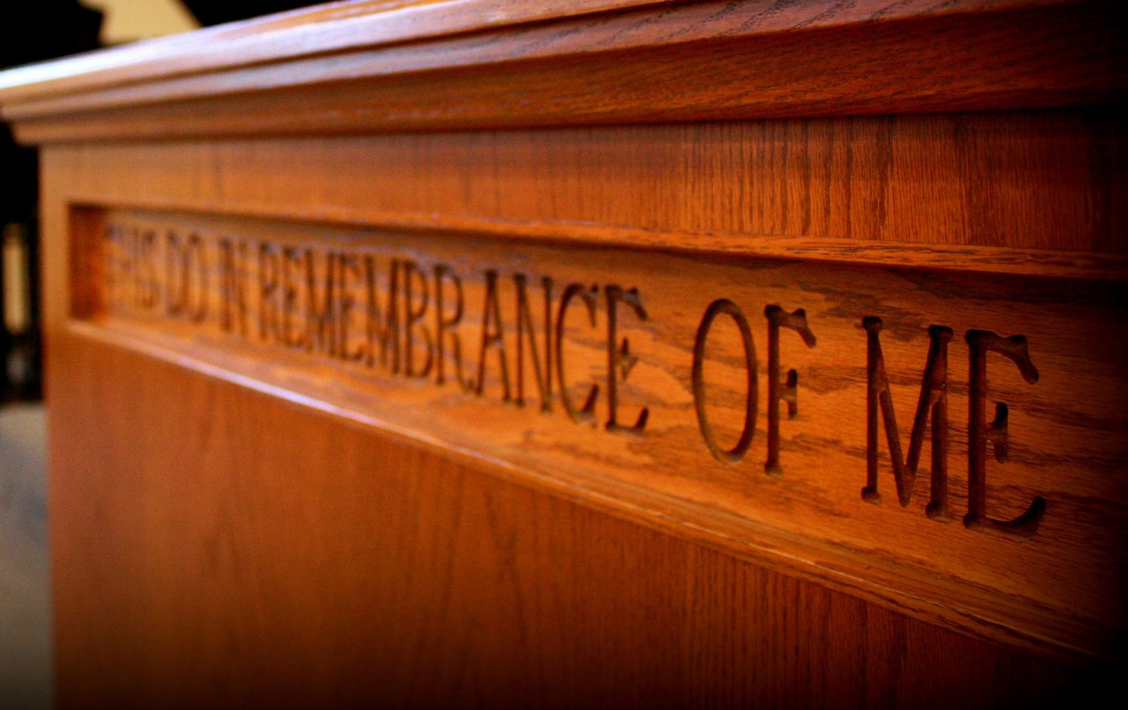
In Him we have redemption through His blood, the forgiveness of sins, according to the riches of His grace which He made to abound toward us in all wisdom and prudence, having made known to us the mystery of His will, according to His good pleasure which He purposed in Himself, that in the dispensation of the fullness of the times He might gather together in one all things in Christ, both which are in heaven and which are on earth -- in Him. — Ephesians 1:7-10
In
In Him
His blood
forgiveness of sins
His grace
His will
His grace
His blood
His good pleasure
His will
His good
pleasure
purposed in Himself
in
in Him
Notes:
We fall away from God when we forget Him, whereas He never forgets us. His coming to earth in the flesh achieved His purpose in hoping more of His creation of souls would not forget but yield to that which created all.

Slide 21
If we say that we have no sin, we deceive ourselves, and the truth is not in us. If we confess our sins, He is faithful and just to forgive us our sins and to cleanse us from all unrighteousness. If we say that we have not sinned, we make Him a liar, and His word is not in us. — 1st John 1:8-10
sin
sins
sins
sins
sin
Notes:
Sin has a lot to do with our forgiveness, and our ability to allow His word to change our life in pursuit of the goodness He calls forth from His creation.

Slide 22
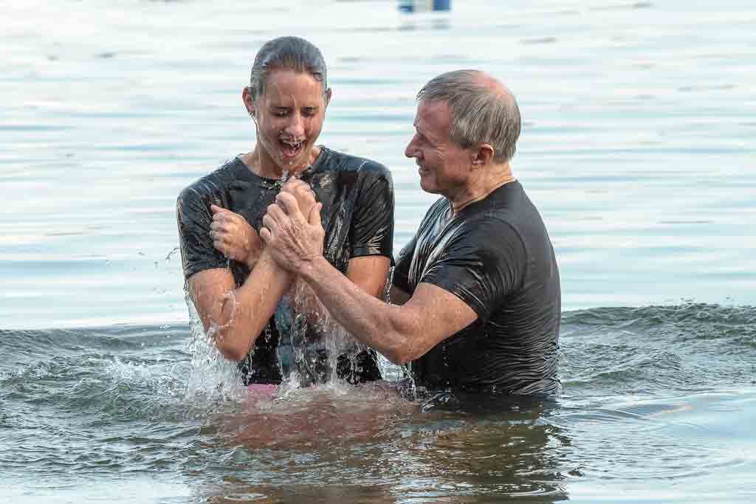
Then Peter said to them, "Repent, and let every one of you be baptized in the name of Jesus Christ for the remission of sins; and you shall receive the gift of the Holy Spirit. — Acts 2:38
forgiveness
remission of sins
sins
sins

Slide 23
"To Him all the prophets witness that, through His name, whoever believes in Him will receive remission of sins." — Acts 10:43
. .
. .
sins

Slide 25
… that if you confess with your mouth the Lord Jesus and believe in your heart that God has raised Him from the dead, you will be saved. — Romans 10:9
Lord Jesus
in
heart
. .
PEACE
saved heart
saved
Notes:
Spiritual change is that which belief builds confidence upon. Return on investment swells up from the heart reaching out past earth and time in Him. It is learning to fly on His wing.

Slide 26
"I, even I, am He who blots out your transgressions for My own sake; And I will not remember your sins." — Isaiah 43:25
sins
sins
not remember your sins
Notes:
The biggest part of God’s forgiveness is to acknowledge that we need Him to forgive us. Only the humble can follow forward into His kingdom. It is God that forgives sins and no other.

Slide 27
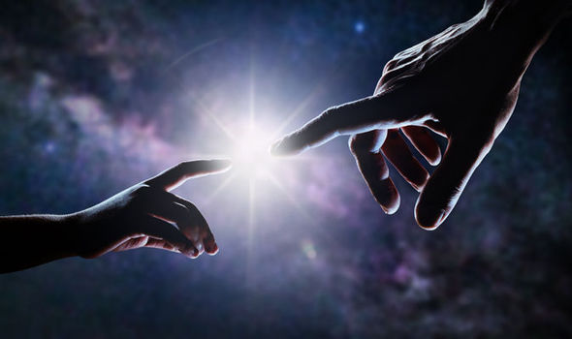
"Repent therefore and be converted, that your sins may be blotted out, so that times of refreshing may come from the presence of the Lord, …" — Acts 3:19
Repent
. .
sins
. .
. .

Slide 28
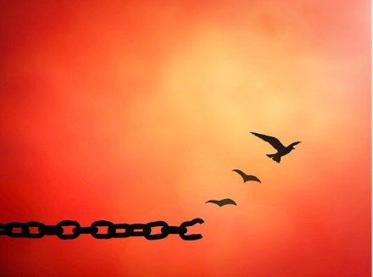
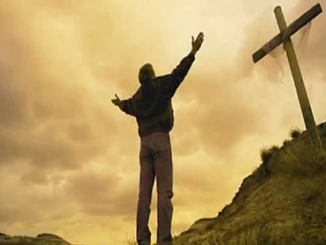
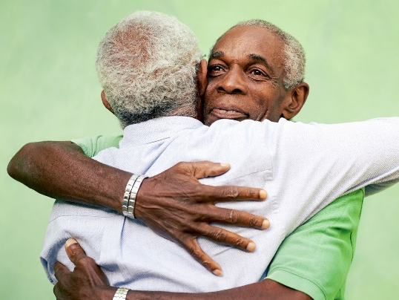
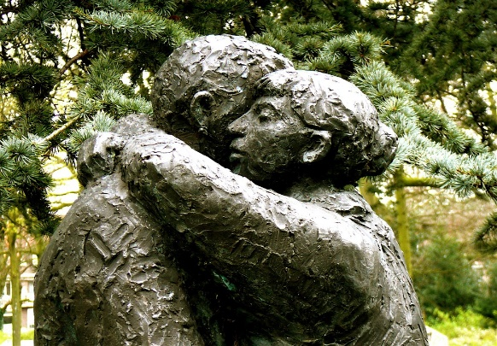
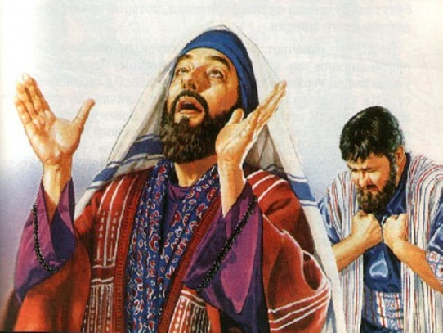
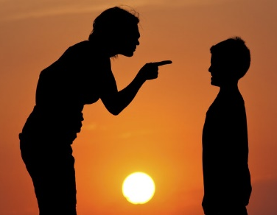

Slide 29
→ God in Christ offers forgiveness to all soft hearted
→ Pray for forgiveness to those who wrong us
→ Without a forgiving heart, God will not forgive you
→ Forgiveness is a process that never should end
→ Faith is a course of an improvement upon His word
→ Those who love little find hollow unforgiving hearts
→ Brow beating a sinner serves not their recovery
→ Loving minds are crucial in setting a soul free in Him
→ We are made alive in God through His forgiveness
→ God justifies those who have faith in Jesus
→ Truth is found in confessing our sins to God
→ Admitting Jesus has been raised holds salvation
→ Repentance is key for sins to be forgiven
To forgive is to regain the sense of love
Notes:
To forgive is to regain the sense of love.

Slide 31
Please visit http://www.LoveFromGod.com to explore further
Ronald Bert Channel on
Notes:
Eternity never ends.

