Slide 1
Notes:
Darkness has no notice.

Slide 2
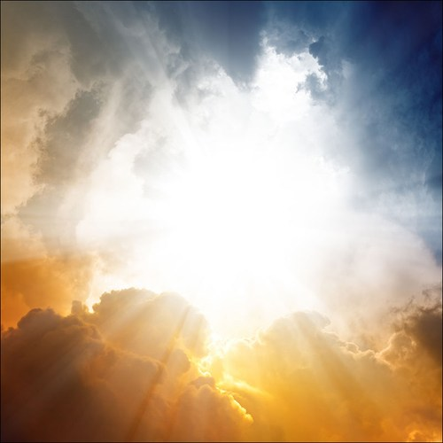
The Fear of The Lord
Ron Bert
May 27, 2018
Notes:
Respect for God regards His notice to be upright. The Lord patiently hopes arrogance subsides.

Slide 3
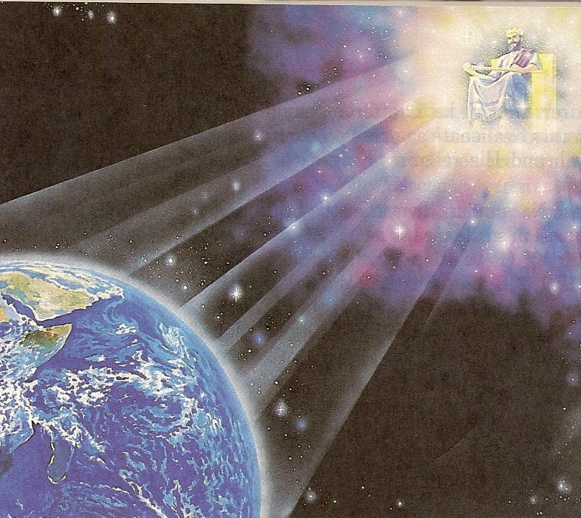
Thus says the LORD: "Heaven is My throne, And earth is My footstool. Where is the house that you will build Me? And where is the place of My rest? For all those things My hand has made, And all those things exist," Says the LORD. "But on this one will I look: On him who is poor and of a contrite spirit, And who trembles at My word." — Isaiah 66:1-2
My word
Says the LORD
I look
contrite spirit
trembles at
My word
My word
Notes:
The Lord looks to see who fears Him as it is a sign of honoring Him. Fearing His Word is a sign of respect in accepting Him as true.

Slide 4
My son, if you receive my words, And treasure my commands within you, So that you incline your ear to wisdom, And apply your heart to understanding; Yes, if you cry out for discernment, And lift up your voice for understanding, … — Proverbs 2:1-3
receive
My word
treasure my commands
treasure
within you
treasure
wisdom
Notes:
A mortal lifetime is shy in coming to all that we can be. It is however a ground level that we all must rise from. Will the luster of our soul come to understand a living brilliance through God? We all reach out for wisdom and thereby insecurities are purged. Fear lies in the bed of the blind. Wisdom is not readily retrieved from searching through outside knowledge, it is naturally known from within. True wisdom is written by God on a pleading heart.

Slide 5
If you seek her as silver, And search for her as for hidden treasures; Then you will understand the fear of the LORD, And find the knowledge of God. For the LORD gives wisdom; From His mouth come knowledge and understanding; — Proverbs 2:4-6
fear of the LORD
treasure
understand
fear
fear of the LORD
find
knowledge
the LORD gives
wisdom
Notes:
The Lord is there for each of us, if we gain understanding, in what He has given. Relationship comes by diligently seeking Him through His Word in prayer. This fear of God in intermingled with great awe and unending love which stretches timelessly across the heart of one’s devotion. God tells us to understand fear through knowledge which will deliver His generous wisdom and shield of strength.

Slide 6
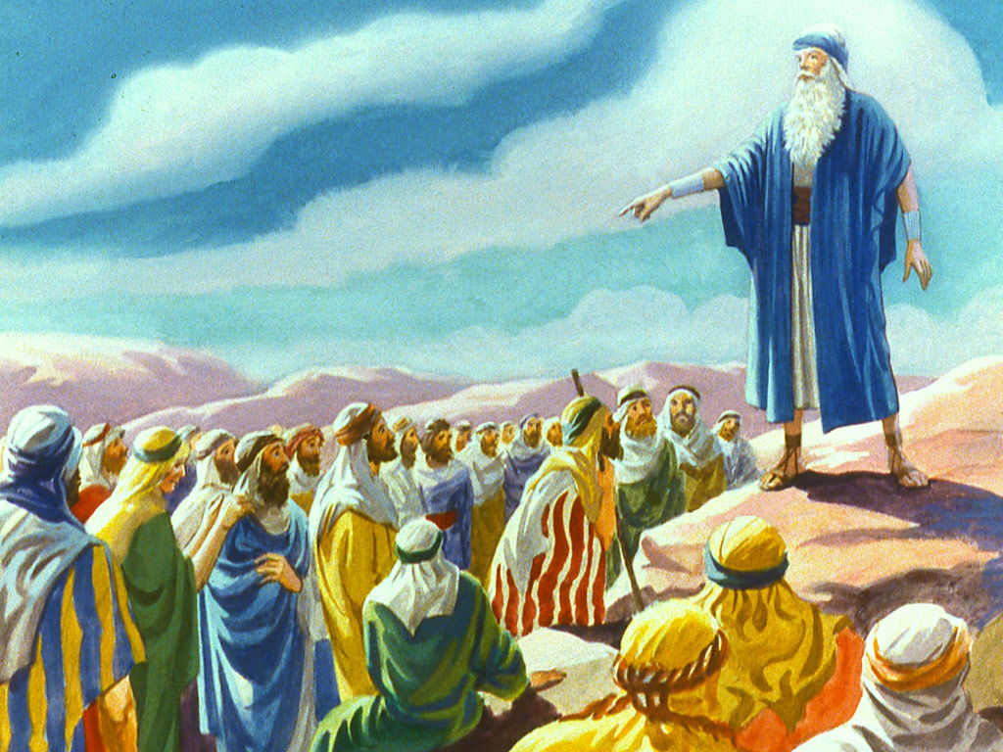
And Moses said to the people, "Do not fear; for God has come to test you, and that His fear may be before you, so that you may not sin." — Exodus 20:20
fear of the LORD
fear
fear
fear
test
before you
not sin
Notes:
Respect for the Lord is a test to see if we will commit, and to admit, that He is. He is attempting to teach us to not ignore Him, over preferring instead rebellious sinful ways.

Slide 7
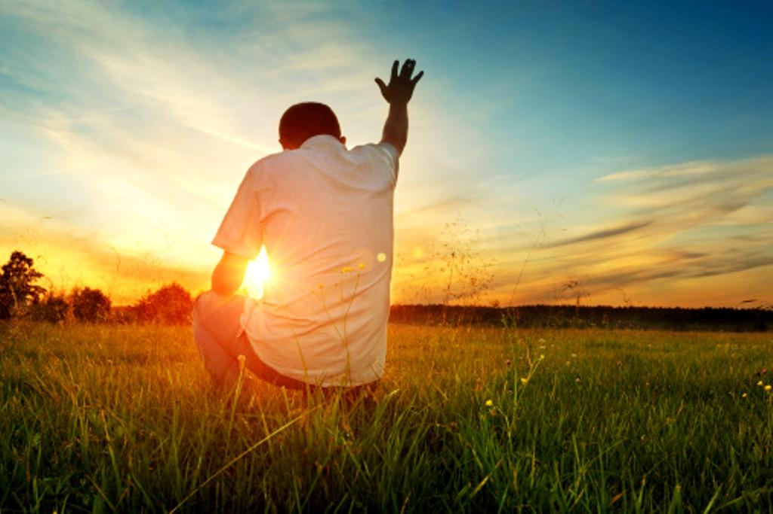
"Now therefore, fear the LORD, serve Him in sincerity and in truth, and put away the gods which your fathers served on the other side of the River and in Egypt. Serve the LORD!" — Joshua 24:14
fear the LORD
fear
in
in
serve Him in sincerity and in truth
fear
Notes:
He looks for hearts of sincerity, in truth, regarding Him and His pronounced Word. In life one battles either serving self or God. May our extremes draw us closer to Him rather than excusing the sins we battle.

Slide 8
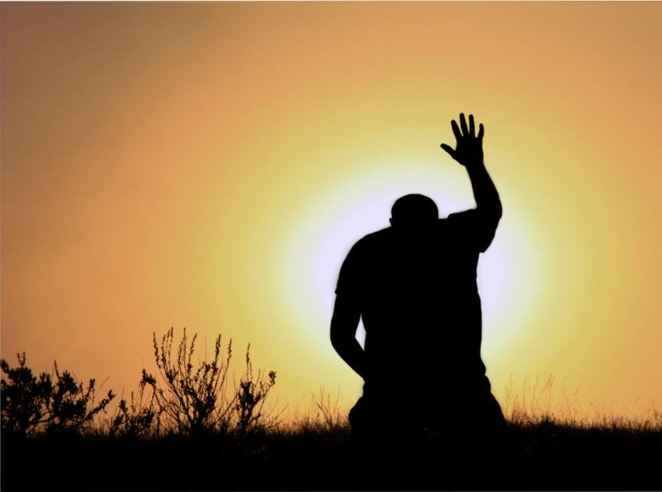
God is greatly to be feared in the assembly of the saints, And to be held in reverence by all those around Him. — Psalms 89:7
God
fear
fear
God
Notes:
God is Holy and should be regarded as such with every breath.

Slide 9
'Therefore you shall not oppress one another, but you shall fear your God; for I am the LORD your God.' — Leviticus 25:17
fear the LORD your God
not oppress
fear
your God
the LORD
God
Notes:
Mankind’s desire for possessions and others has led him away from the Holy ordinances of decency.

Slide 10
"And now, Israel, what does the LORD your God require of you, but to fear the LORD your God, to walk in all His ways and to love Him, to serve the LORD your God with all your heart and with all your soul, and to keep the commandments of the LORD and His statutes which I command you today for your good?" — Deuteronomy 10:12-13
to
to
fear the LORD your God
to walk in all
to
to
His ways
to love Him
to serve
fear the LORD
to
the LORD
with
all
your
● to fear the LORD your God
● to walk in all His ways
● to love Him
● to serve the LORD with your all
● to keep His commandments
fear the LORD
to
to
keep
commandments
His
Notes:
As the Lord’s people He requires us to be loyal to His ways. He commands for us to keep, to the best of our abilities, those things He has declared, in the ways we should be. Sacrifice is a sign of obedience over the selfish desires swelling from the heart of man. Mercy dwells among all mature. To excuse sin is to deny God. Though God has the power to destroy us, His love is greater hoping we embrace His shield of grace. Submitting to God is what all need TO do.

Slide 11
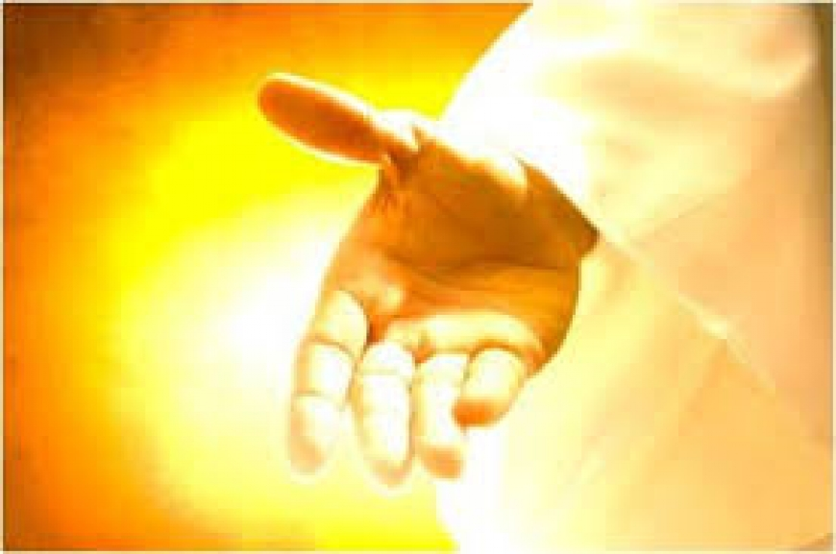
"Only fear the LORD, and serve Him in truth with all your heart; for consider what great things He has done for you." — 1st Samuel 12:24
fear the LORD
LORD
in
LORD
consider
done for you
Notes:
In view of His majesty how can one not openly serve Him? He is offering each of us salvation into the goodness that He is.

Slide 12
Praise the LORD! Blessed is the man who fears the LORD, Who delights greatly in His commandments. — Psalms 112:1
fear
in
m
LORD
LORD
LORD
LORD
fear Him
Blessed is every one who fears the LORD, Who walks in His ways. — Psalms 128:1
in
Hi
Notes:
Blessings come from acknowledging Him and following His ways. If you want a blessing, come to the LORD and He will heal your heart.

Slide 13
And His mercy is on those who fear Him From generation to generation. — Luke 1:50
The LORD takes pleasure in those who fear Him, In those who hope in His mercy. — Psalms 147:11
fear Him
fear Him
mercy
fear Him
fear Him
Notes:
Mercy is a high ideal offered to all those who love Him. Hope for mercy co-mingles with our fear of God.

Slide 14
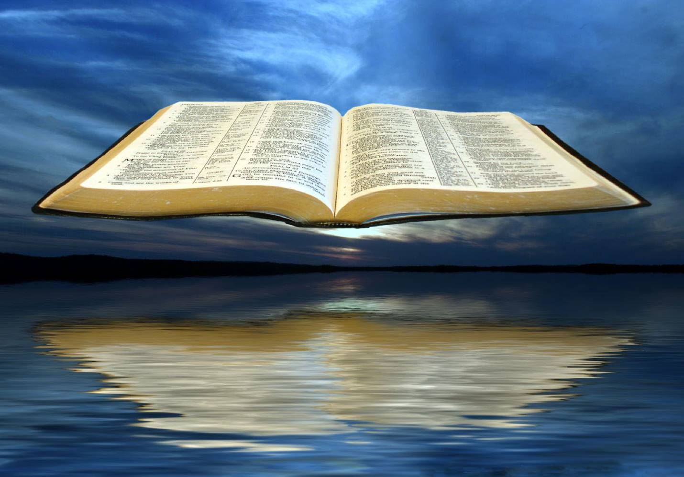
But the mercy of the LORD is from everlasting to everlasting On those who fear Him, And His righteousness to children's children, To such as keep His covenant, And to those who remember His commandments to do them. — Psalms 103:17-18
fear
fear
fear Him
keep
remember
do them
Notes:
Mercy is conditional in that He expects one to follow His will imaging the goodness He has shown us, and keeping to His Word. Do we choose to purposely forget what we do not want to know? Civilizations have done this throughout time. When His knowledge is forgotten, destruction looms over the horizon.

Slide 15
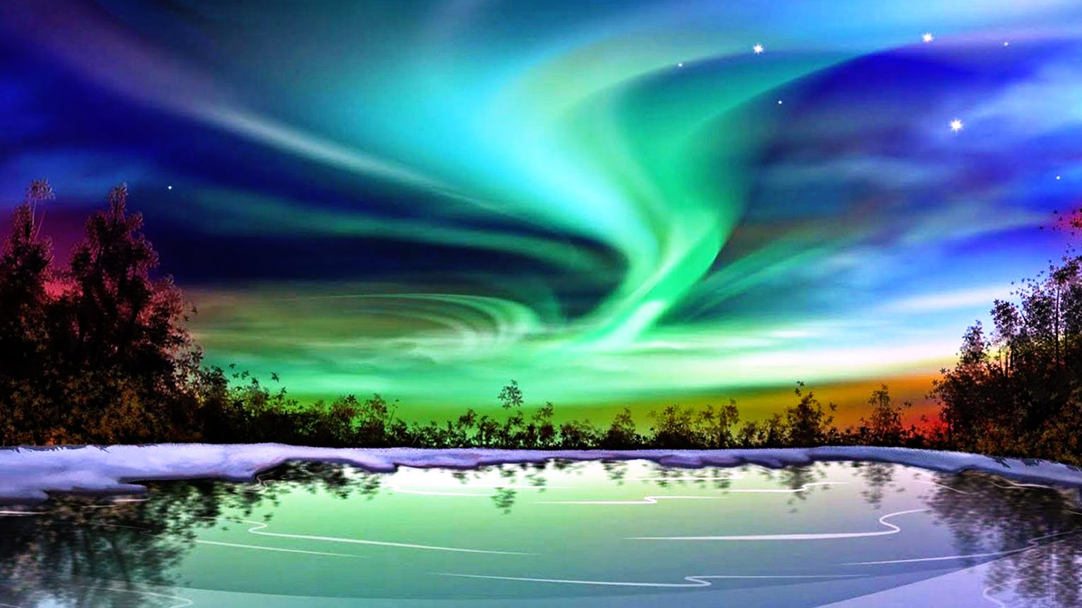
"Now therefore, let the fear of the LORD be upon you; take care and do it, for there is no iniquity with the LORD our God, no partiality, nor taking of bribes." — 2nd Chronicles 19:7
therefore
fear of
fear
"Now therefore, let the fear of the LORD be upon you; take care and do it, for there is no iniquity with the LORD our God, no partiality, nor taking of bribes." — 2nd Chronicles 19:7
the LORD
be upon you
do it
for
Holy
just
pure
Notes:
It is a command of God that fear of His greatness be upon us. Respect has the quality of honoring that which is reverenced. The Lord is Pure and Holy and waits for our response to His call, to acknowledge Him and humbly return.

Slide 16
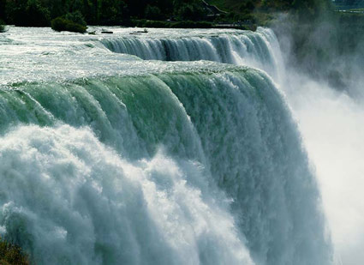
The fear of the LORD is clean, enduring forever; The judgments of the LORD are true and righteous altogether. — Psalms 19:9
fear of the LORD
the LORD
fear
fear the LORD
LORD
Notes:
By the visible great power of God, in His creation alone, demands tremendous regard beyond measure. If one chooses not to believe in God, do not lie against the truth in what has come to be, as Jesus said, believe because of the works done, which are miraculous by any standard.

Slide 17
Let all the earth fear the LORD; Let all the inhabitants of the world stand in awe of Him. — Psalms 33:8
fear the LORD
LORD
awe
in
Notes:
Many people are just in to the earth and what it can offer, disregarding the Lord who holds all. This world is His staging ground for harvesting seeds that blossom in to His kingdom of glory.

Slide 18
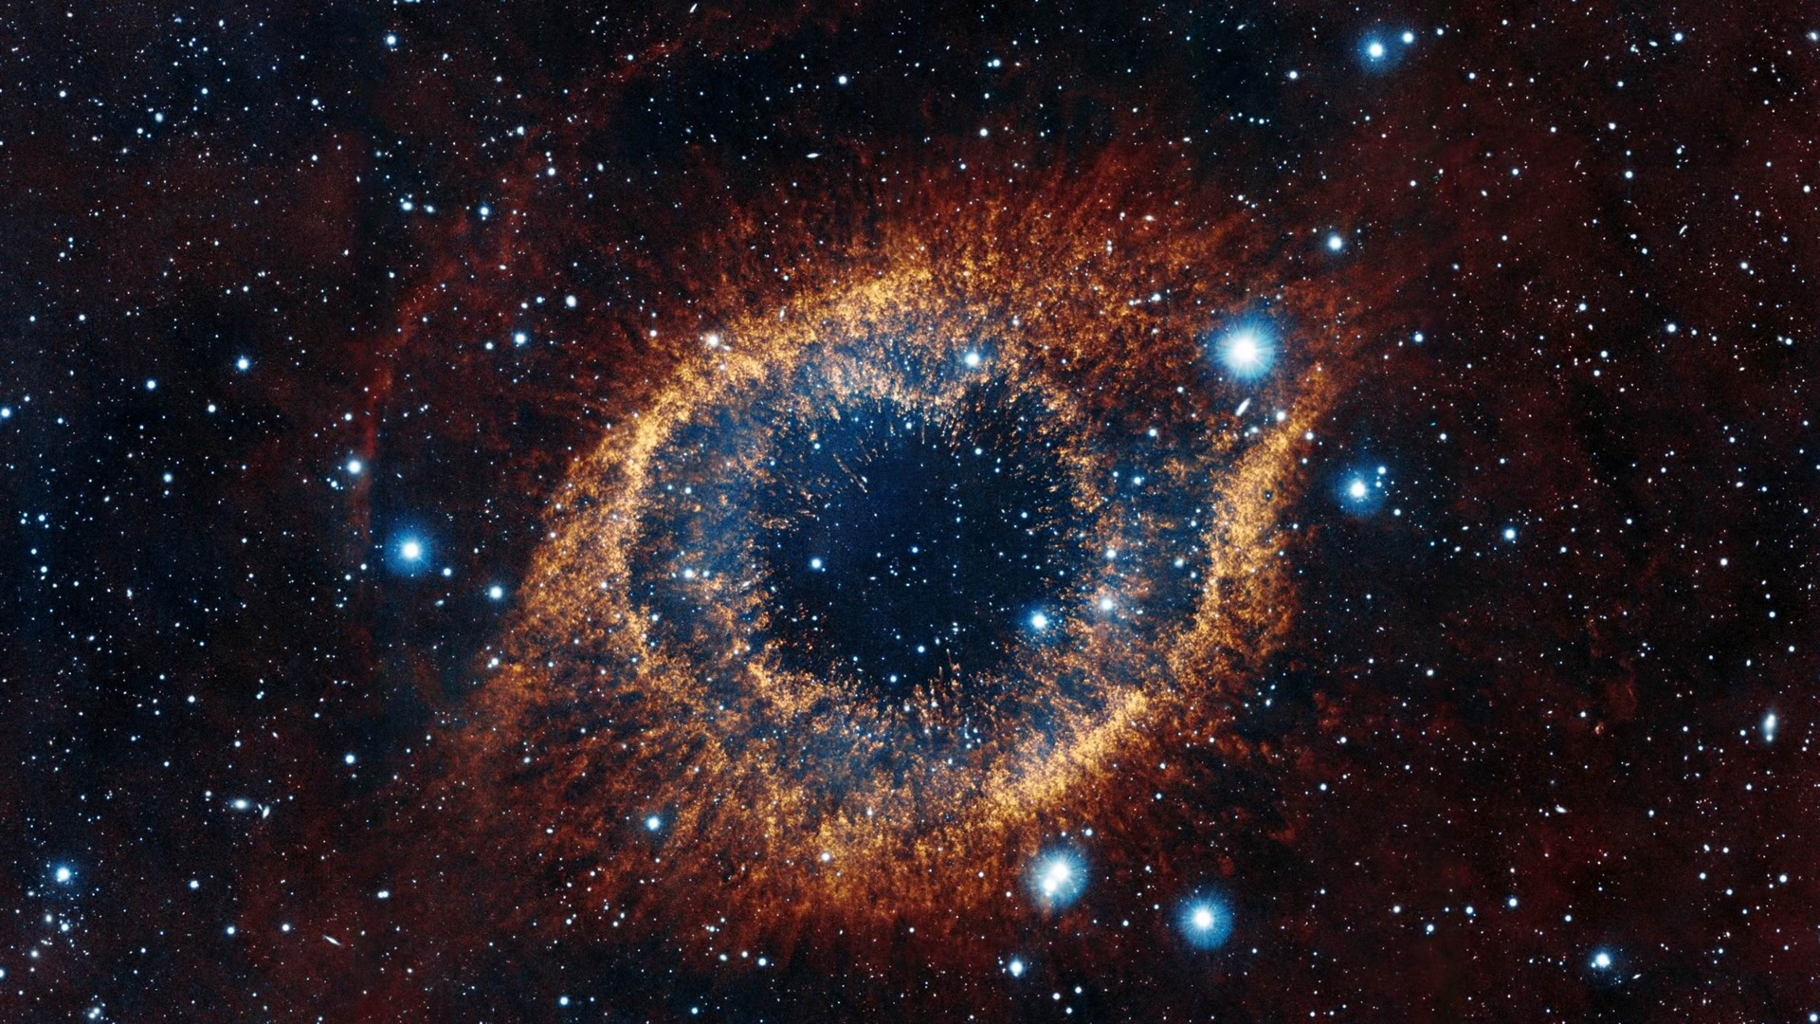
Behold, the eye of the LORD is on those who fear Him, On those who hope in His mercy, … — Psalms 33:18
LORD
the LORD
fear
fear
hope
in
His mercy
Notes:
God is not telling us just to fear Him but to include hope as part of our salvation thoughts of heart. Fear and regard for Him is only part of the depth He offers for souls that love Him. A deepening spirit rises to touch eternity.

Slide 19
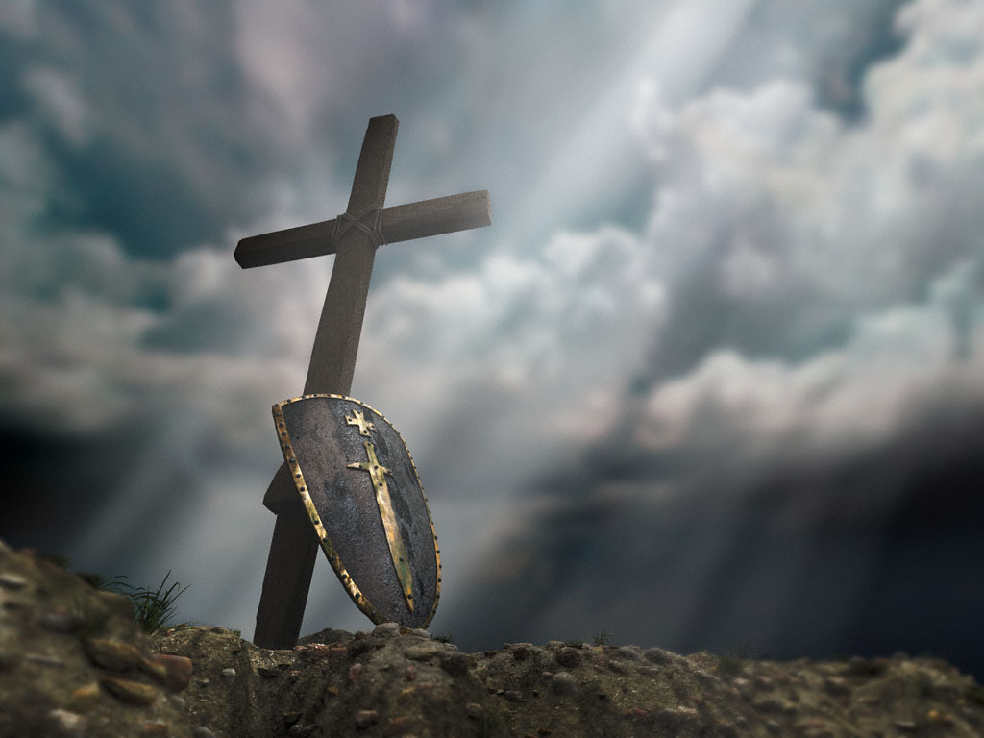
You who fear the LORD, trust in the LORD; He is their help and their shield. — Psalms 115:11
fear the LORD
LORD
trust
in
LORD
Notes:
The Bible is more a medical book than anything else. It instructs us what to be “in” to so as to achieve peace inside spiritual fulfillment, and the healing calm from the outside tortures of the flesh.

Slide 20
The fear of the LORD is the beginning of knowledge, But fools despise wisdom and instruction — Proverbs 1:7
fear of the LORD
LORD
beginning of knowledge
knowledge
Notes:
One may not realize it but consciousness is a gift of God. Through our awakening from the infant state, knowledge is given by God, and by understanding His presence, life in His kingdom is established.

Slide 21
Because they hated knowledge And did not choose the fear of the LORD, … — Proverbs 1:29
They spend their days in wealth, And in a moment go down to the grave. Yet they say to God, 'Depart from us, For we do not desire the knowledge of Your ways. — Job 21:13-14
wisdom
knowledge
For in much wisdom is much grief, And he who increases knowledge increases sorrow. — Ecclesiastes 1:18
Also it is not good for a soul to be without knowledge, And he sins who hastens with his feet. — Proverbs 19:2
fear of the LORD
wisdom
Notes:
One has to wonder if the world is not just filled with so many stumbling fools. Ignorance is bliss is not what the Bible tells us. We are told wisdom increases sorrows and who welcomes this? Knowledge is an unavoidable purse whose weight increases over time. It is declared that grief (pain) is an escalator in mortal life. Under this curse, without God, how can one bear up? We are told to pursue knowledge and that in this pursuit, suffering will most certainly ensue. It is easier to avoid the responsibility of acquiring knowledge with the already stated natural effects. Strong spirits are called for in this empire of despair. No matter, knowledge refines the sharpness of thought. The weak do not welcome the suffering that makes one stronger. No one genuinely wants grief but for by it, the heart is humbled, and healed from falling from His grace, if patience is employed for love’s sake. Better to leave the world crippled than to stand proud as oblivion consumes life. Grief is a prelude to death, a warning call from God. The purpose of grief is to draw us closer to God.

Slide 22
"And to man He said, 'Behold, the fear of the LORD, that is wisdom, And to depart from evil is understanding.'" — Job 28:28
fear of the LORD
wisdom
depart from evil
Notes:
Choices define character. Many have chosen to dismiss His will, declaring birth defects or deviant attributes as an excuse, absolving one from accountability to Him. We are all told not to be deceived, and the immoral have no regard for His will as they reject His knowledge brazenly, in the face of His judgment to come. His repeated message is to turn back to Him, and His ways over the flesh, and it is a test in desire for Him over self. One cannot truly obtain the wealth of wisdom if sin is not reckoned as evil and purposely purged.

Slide 23
Do not be wise in your own eyes; Fear the LORD and depart from evil. — Proverbs 3:7
LORD
LORD
depart from evil
Notes:
When we see only ourselves we miss the greatness of all else. How short the shallow when they stand higher than God. Emphasis on self as a finite mortal lord lacks humble awareness of His eternal presence.

Slide 24
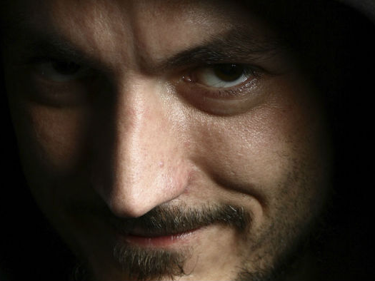
The fear of the LORD is to hate evil; Pride and arrogance and the evil way And the perverse mouth I hate. — Proverbs 8:13
LORD
fear of the LORD
hate evil
fear of the LORD
Notes:
God calls us to not only depart from evil but to hate its’ very existence. Evil is the misery we all endure as we wait to arrive at eternities door. Even for those that believe in God, if there is not fear or regard for His ways, one’s faith is void of the works He calls out for in us, in loving dedication to Him. Fearfully we all fall short requiring the gift of His grace.

Slide 25
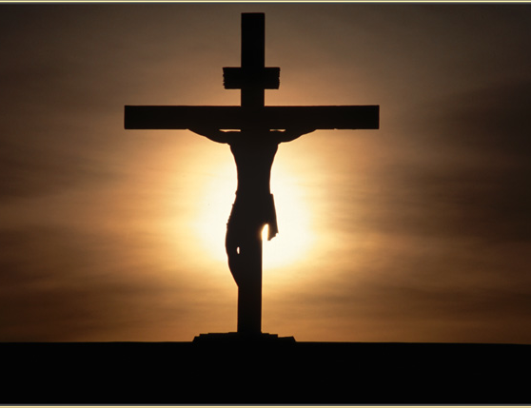
F
E
A
R
Atonement is provided for
LORD
L
I
F
E
In mercy and truth Atonement is provided for iniquity; And by the fear of the LORD one departs from evil. — Proverbs 16:6
LORD
Atonement is
provided for
iniquity
LORD
LORD
fear of the LORD
Notes:
Christ bore the burden of all of our iniquities so as to be able to present us back to God redeemed. This redemption is found, and had, in abiding in what God has called us out to be in, in Him. One should fear that sins are not forgiven, with death as the final result, without His conditional mercy offered through grace. It remains conditional for us in that He demands we come humbly and repentfuly to Him seeking His ways. In this reconciliation, we should hold Jesus as more valuable than gold, for the life He sacrificed so we might ably live.

Slide 26
→ God looks for the contrite who tremble at His word
→ In wisdom one understands the fear of the LORD
→ Fear of God is a test in not sinning
→ Fear the LORD serving Him in sincerity and in truth
→ Fear the LORD, to walk in all His ways & to love Him
→ Blessed are who fear the LORD & walk in His ways
→ Fearing Him and hoping in His mercy pleases God
→ Let the fear of the LORD be upon you
→ The fear of the LORD is clean when trust is applied
→ The eye of the LORD is on those who fear Him
→ The fear of the LORD is the beginning of knowledge
→ The fear of the LORD is to hate evil
→ By the fear of the LORD one departs from evil
Peace is upon those who trust God in fear
Notes:
Peace is upon those who trust God in fear.

Slide 27
Notes:
Darkness holds no shadow of doubt.

Slide 28
The Fear of The Lord
2
Ron Bert
June 10, 2018
Notes:
Fearing the Lord is to regard Him as a Father.

Slide 29
'They shall be My people, and I will be their God; then I will give them one heart and one way, that they may fear Me forever, for the good of them and their children after them. And I will make an everlasting covenant with them, that I will not turn away from doing them good; but I will put My fear in their hearts so that they will not depart from Me.' — Jeremiah 32:38-40
God
one way
fear
of
fear of God
I will put My fear
fear
in
In their hearts
Notes:
In the depths of Godly fear comes the highest love.

Slide 30
The fear of the LORD prolongs days, But the years of the wicked will be shortened. — Proverbs 10:27
fear of the LORD
fear of God
fear of the LORD
Notes:
Time is not a luxury for the mortal. Without exercising knowledge in Him, empty voids fill the loneliness as the years evaporate to meaningless. If one’s anchor is found in the earth, it only leaves a taste of dust. Fear is a result of being trapped in time.

Slide 31
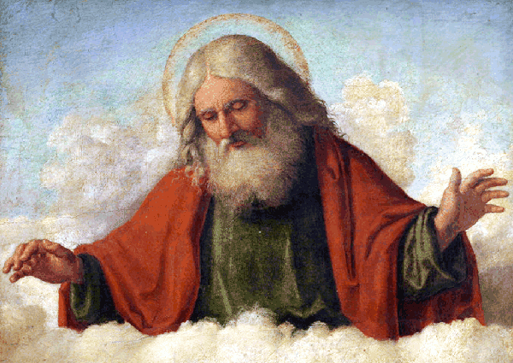
The fear of the LORD is the beginning of wisdom; A good understanding have all those who do His commandments. His praise endures forever. — Psalms 111:10
fear of the LORD
fear of the LORD
wisdom
understanding
do
do His commandments
Notes:
Competence in all aspects of life depends on a keen understanding of the ways of God. One cannot be wise without the ordinances of God buried in one’s bosom.

Slide 32
"The fear of the LORD is the beginning of wisdom, And the knowledge of the Holy One is understanding." — Proverbs 9:10
"The fear of the LORD is the beginning of wisdom, And the knowledge of the Holy One is understanding." — Proverbs 9:10
fear of the LORD
fear of the LORD
beginning of wisdom
Jesus
Notes:
By not believing in God denies one access to all higher order conditions of existence, including spiritual illumination in the current state. The fear of the Lord gives us something truly larger than life, the substance of life itself.

Slide 33
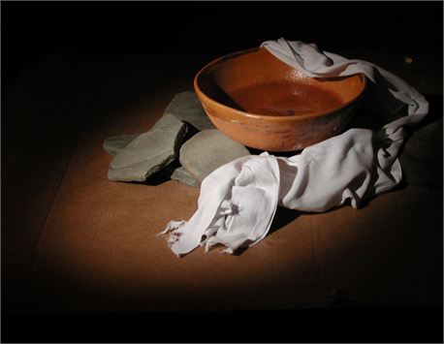
The fear of the LORD is the instruction of wisdom, And before honor is humility. — Proverbs 15:33
fear of the LORD
fear of the LORD
humility
Notes:
For understanding to be had in its’ fullest realization, truth must be incorporated as the essential foundation. Lies lead to ditches where the blind claim sight. We are all blind and only by His insights are we able to spiritually stand.

Slide 34
In the fear of the LORD there is strong confidence, And His children will have a place of refuge. — Proverbs 14:26
fear of the LORD
fear of the LORD
strong confidence
safety
Notes:
It is the fear of God that makes us safe, not our surrounding situations or conditions.

Slide 35
The fear of the LORD is a fountain of life, To turn one away from the snares of death. — Proverbs 14:27
fear of the LORD
life
away from
fear of the LORD
death
Notes:
By the fear of the Lord life overcomes death to those who believe and act on their faith. Holy belief is not something one shamefully hides in a closet. The shameless pervert His true calling, to enter through Him, adhering to the temporary mask of fleshliness.

Slide 36
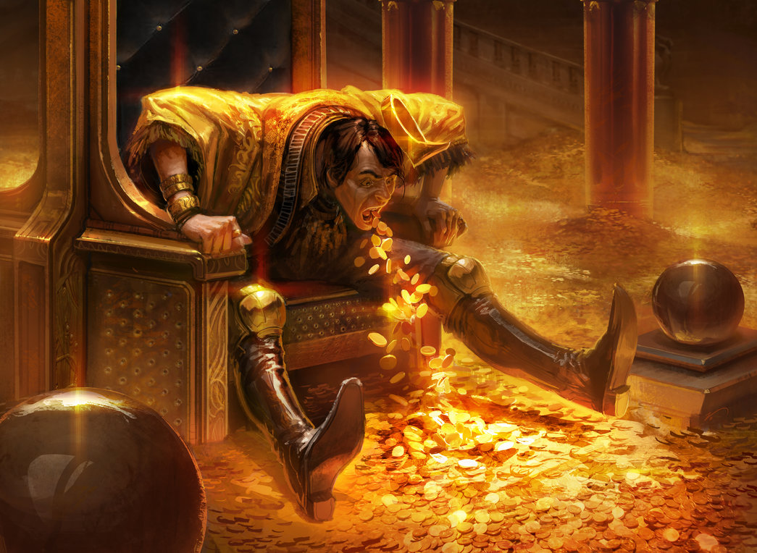
Better is a little with the fear of the LORD, Than great treasure with trouble. — Proverbs 15:16
fear of the LORD
fear of the LORD
trouble
Notes:
Coughing on the flesh, and consumption of things, cannot compare to the release the Spirit gives in salvations promise. Without the fear of the Lord one can only spin on troubles. The benefits the Lord delivers has no comparison. The entire wealth of God’s treasuries opens to all faithful.

Slide 37
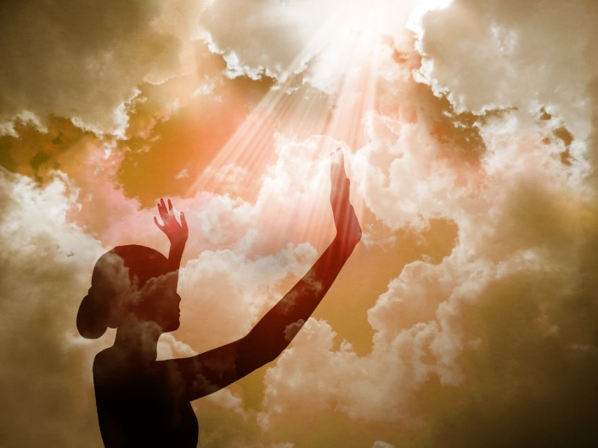
The fear of the LORD leads to life, And he who has it will abide in satisfaction; He will not be visited with evil. — Proverbs 19:23
fear of the LORD
leads to life
fear
the LORD
fear the LORD
Notes:
The bond in connecting with God draws a depth of peace surpassing the confines of this world.

Slide 38
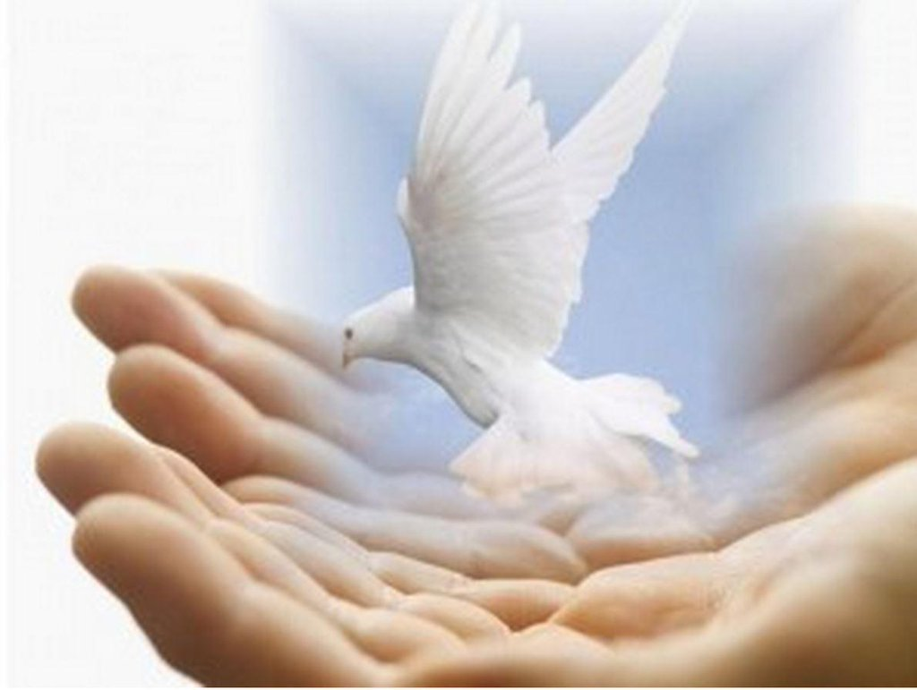
He will fulfill the desire of those who fear Him; He also will hear their cry and save them. — Psalms 145:19
fear Him
fear Him
fear the LORD
Oh, fear the LORD, you His saints! There is no want to those who fear Him. — Psalms 34:9
fear Him
fear Him
Notes:
A great blessing to be satisfied in the Lord through fear of His awesomeness.

Slide 39
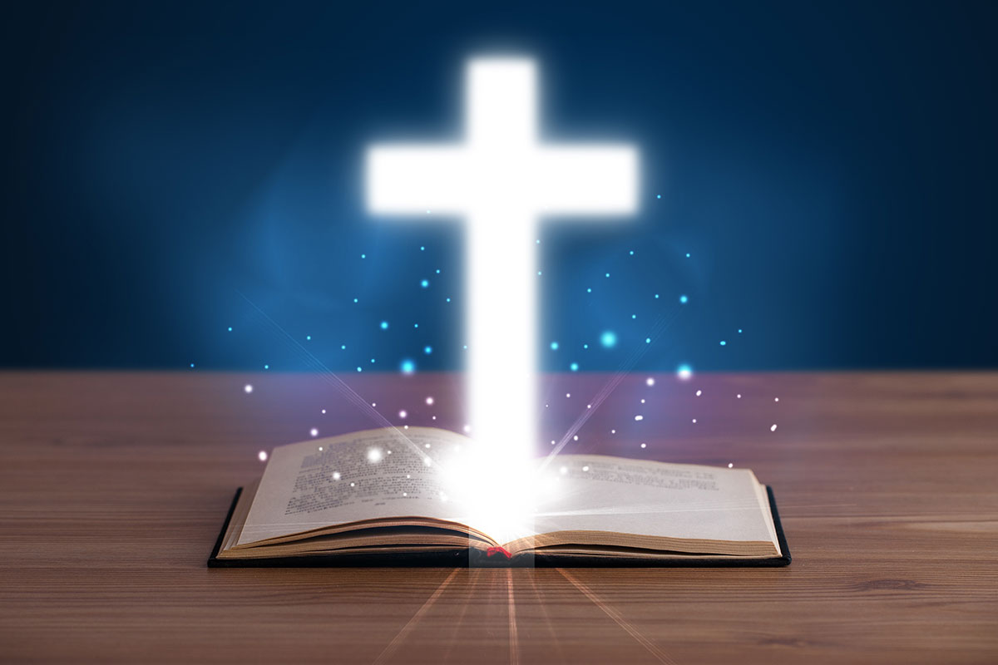
The secret of the LORD is with those who fear Him, And He will show them His covenant. — Psalms 25:14
fear of the LORD
of the LORD
fear Him
fear
those who fear Him
He will show them His covenant
Notes:
The Lord holds the floodgates of wisdom, reserved for those thirsty for Him. He fills those who fear His reservoir of forever.

Slide 40
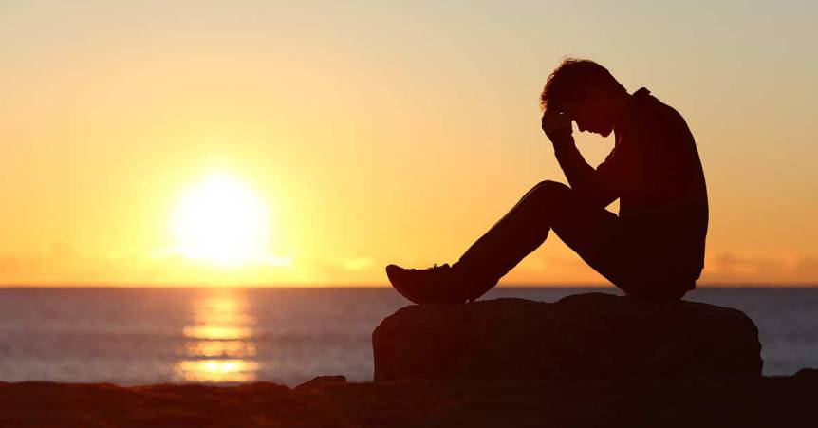
By humility and the fear of the LORD Are riches and honor and life. — Proverbs 22:4
humility
fear of the LORD
riches & honor
LIFE
fear of the LORD
Notes:
Honor and riches rise from within where true life is had. Love of God, family, and country are noble qualities that diminish to the detriment of all as civilizations fall away from God.

Slide 41
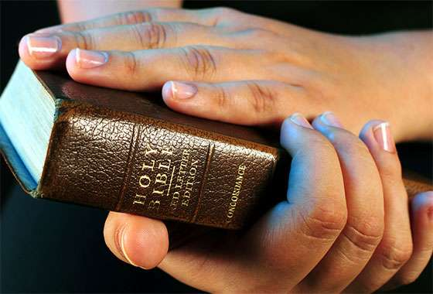
Do not let your heart envy sinners, But be zealous for the fear of the LORD all the day; — Proverbs 23:17
Do not
envy
fear
envy
be zealous
fear of the LORD
fear
all
Notes:
The fear of God is extremely healthy, refreshing the spirit with a focus on all things higher. The fear and or regard for His Word brings one in to the best mental state one can achieve. Do not envy, be thankful. Applying these God given principles is a quest spanning an entire lifetime. Fear is an intricate part of a larger set of values. His desire is that we find a deepest peace in love where we are.

Slide 42
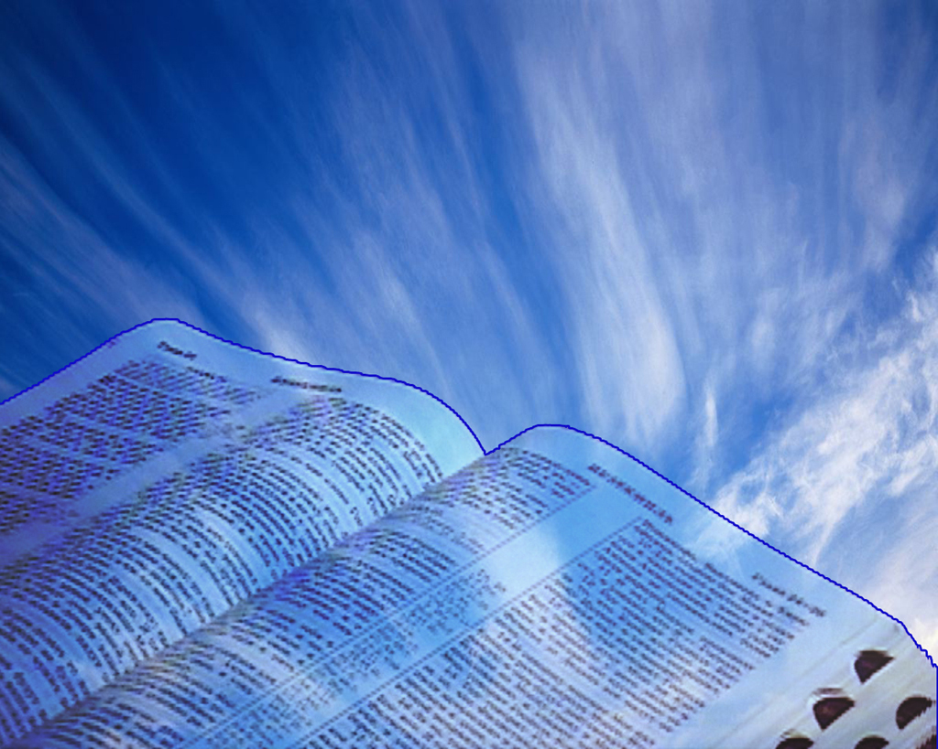
The fear of man brings a snare, But whoever trusts in the LORD shall be safe. — Proverbs 29:25
fear
trust
safe
fear
Notes:
Sadness afflicts all mankind and only by trusting in God are we able to shed these oppressive shackles.

Slide 43
Therefore, having these promises, beloved, let us cleanse ourselves from all filthiness of the flesh and spirit, perfecting holiness in the fear of God. — 2nd Corinthians 7:1
cleanse
fear of God
fear
fear of God
Notes:
In view of the promise He has made upon our return, is it so much to follow what He asks of us?

Slide 44
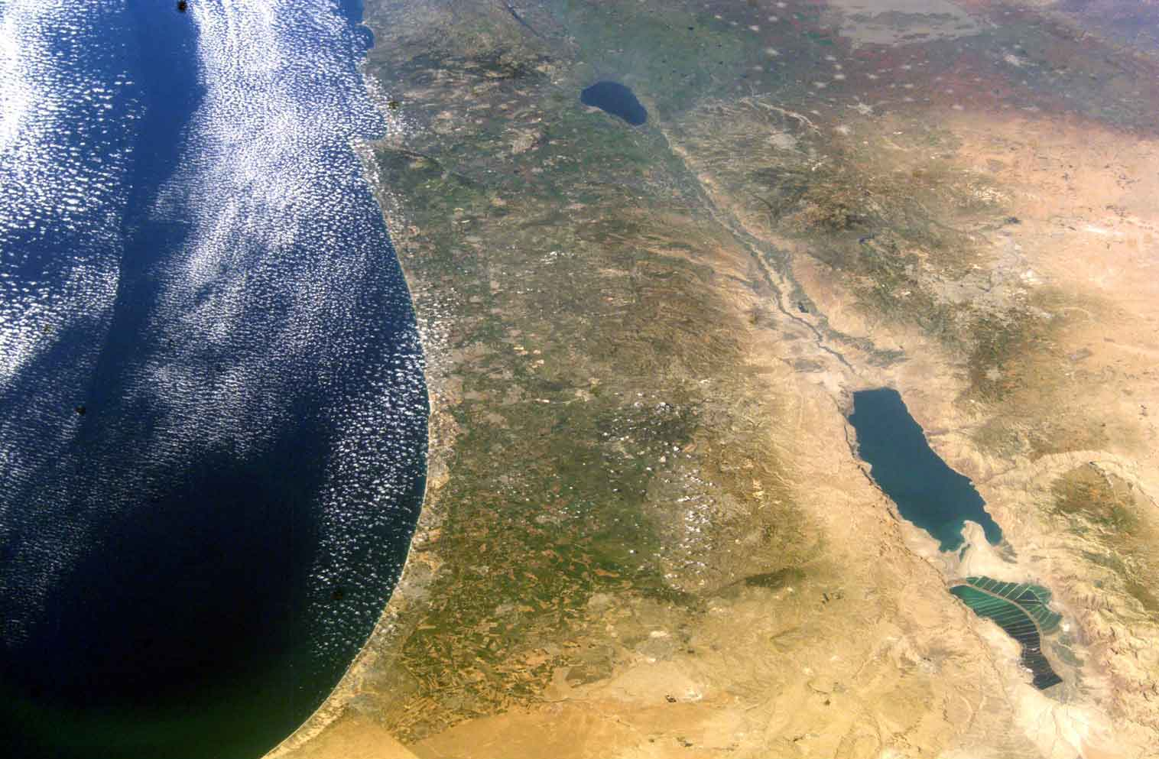
Then the churches throughout all Judea, Galilee, and Samaria had peace and were edified. And walking in the fear of the Lord and in the comfort of the Holy Spirit, they were multiplied. — Acts 9:31
Capernaum●
SYRIA
Sea of Galilee
Haifa●
●Nazareth
●Caesarea
Jordan
JORDAN
Judea
Galilee
and
Samaria
●Tel Aviv
fear
●Jericho
●Jerusalem
fear of God
in
fear of the Lord
fear
fear and comfort
Bethlehem●
Mediterranean Sea
Dead Sea
in
comfort
Salida ●
ISRAEL
●Gaza
Masada●
EGYPT
Notes:
In fear of Him we are comforted by the notion we are in service to Him. May it be so when we see Him for who He is.

Slide 45
"But in every nation whoever fears Him and works righteousness is accepted by Him." — Acts 10:35
fear
fear
works
righteousness
Notes:
God is looking for righteousness over despicableness and fits of anger. Peace is a byproduct of true belief in God.

Slide 46
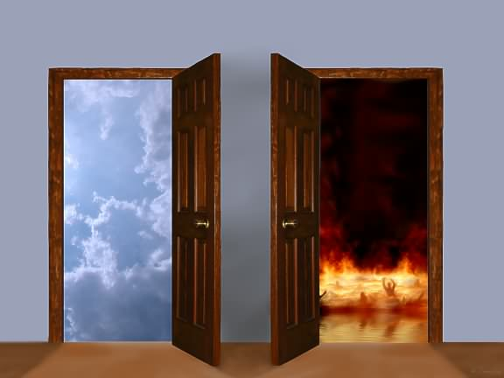
"And do not fear those who kill the body but cannot kill the soul. But rather fear Him who is able to destroy both soul and body in hell." — Matthew 10:28
fear
soul
and
body
fear
fear
soul
and
body
Notes:
Proper regard is to be doubly fearful of not achieving heaven bound graces. To ignore the fear of God, in His great glory, denies eternal life and renders hell’s abyss.

Slide 47
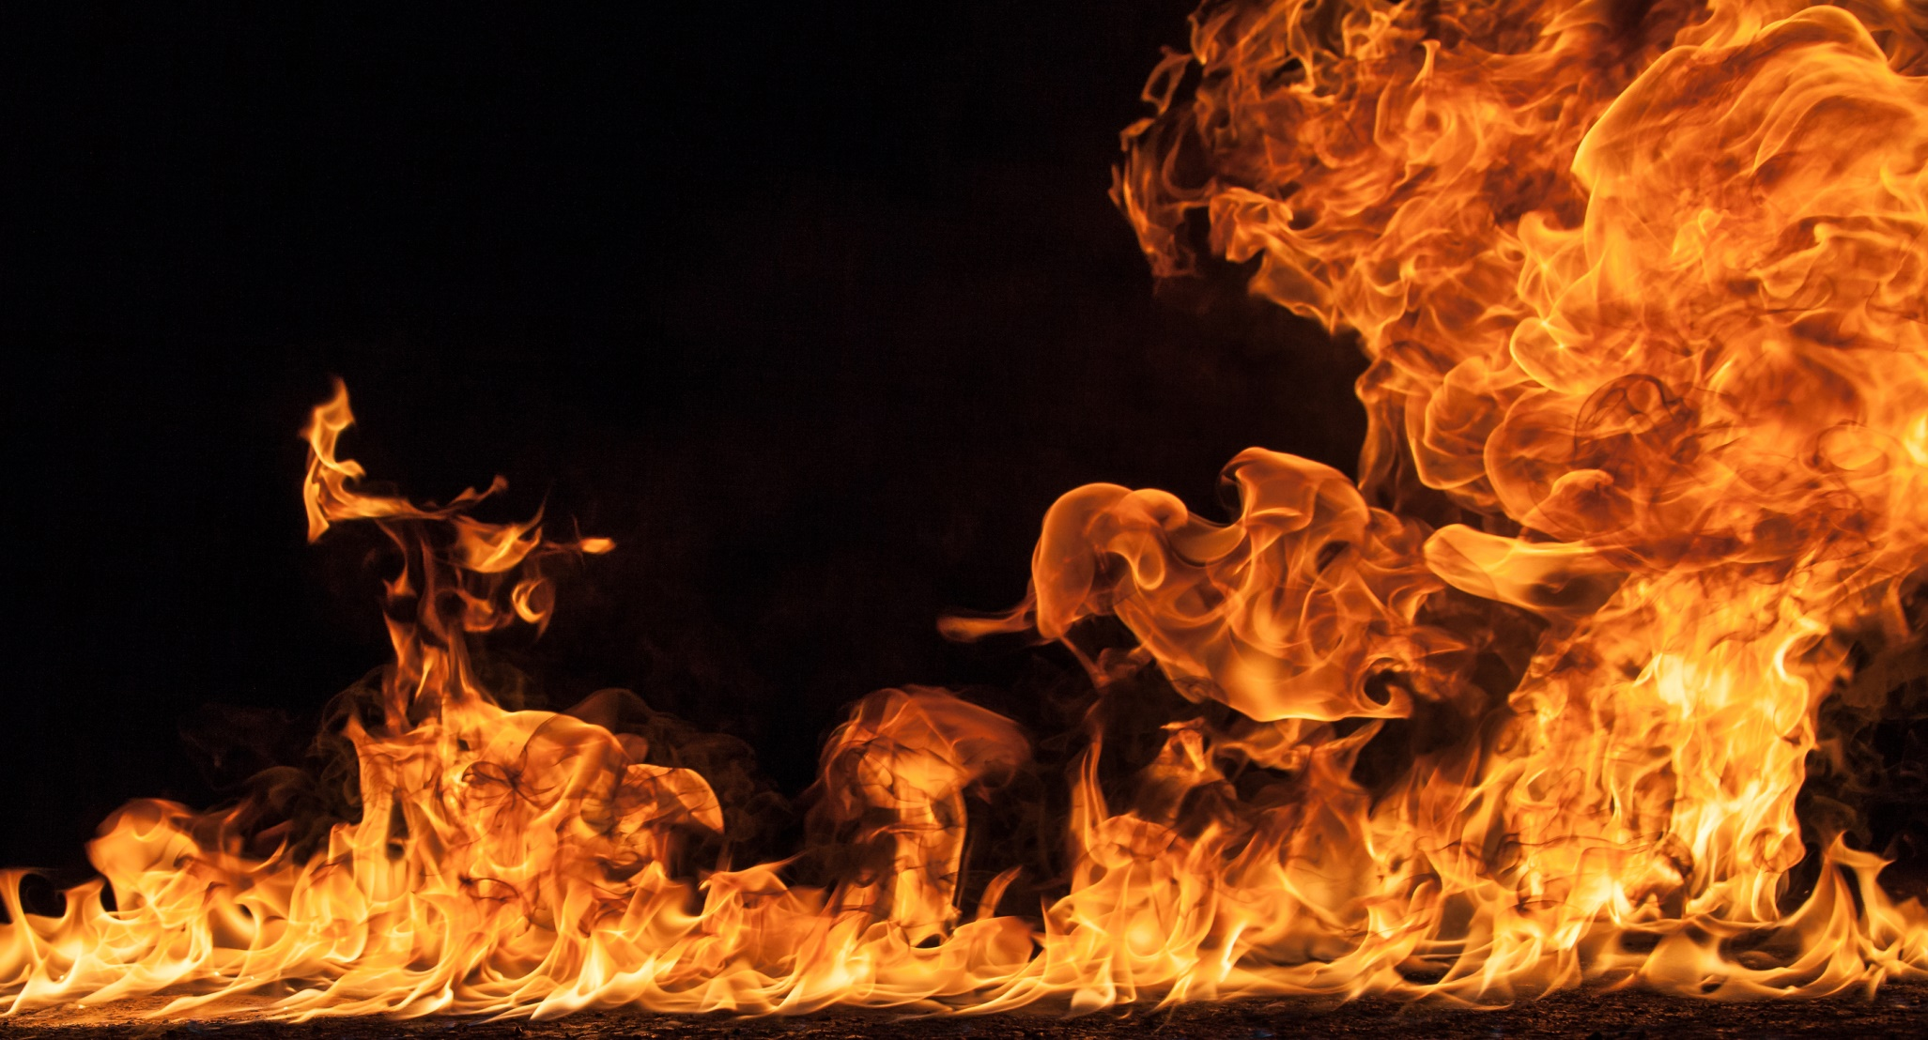
For if we sin willfully after we have received the knowledge of the truth, there no longer remains a sacrifice for sins, but a certain fearful expectation of judgment, and fiery indignation which will devour the adversaries. — Hebrews 10:26-27
hope
h
e
fearful expectation of judgment
fear
p
o
fear
Notes:
Fury has no equal in its’ rising heat of heart. Denying one’s love and devotion back to God is devastating. His fury brews for those rejecting His Fatherly love.

Slide 48
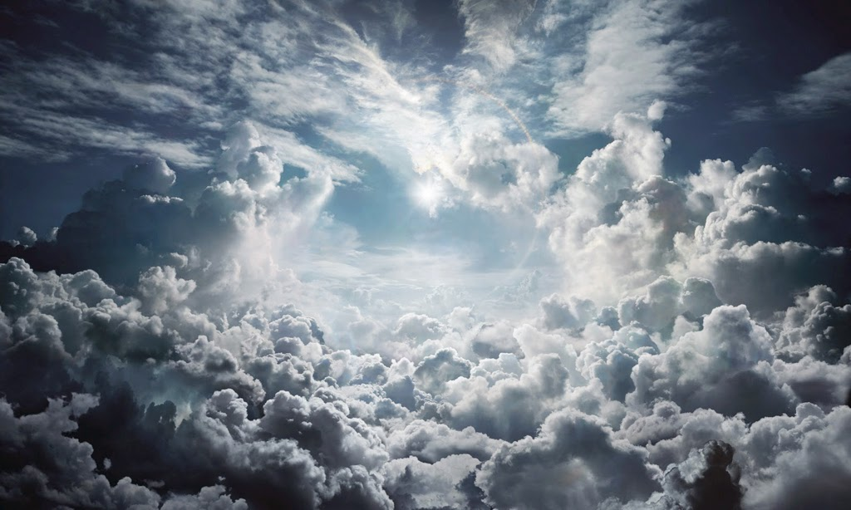
Therefore, since we are receiving a kingdom which cannot be shaken, let us have grace, by which we may serve God acceptably with reverence and godly fear. For our God is a consuming fire. — Hebrews 12:28-29
hope
l
o
v
e
fear
e
v
godly fear
fear
l
o
Notes:
One needs to find, and secure, service in regard to His nature, having compassion on all.

Slide 49
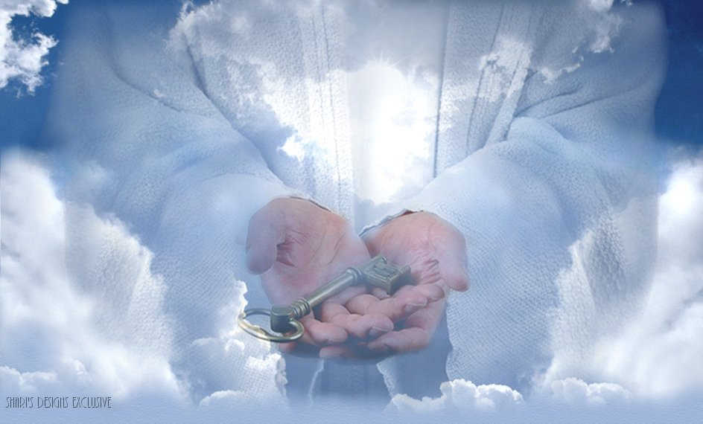
It is a fearful thing to fall into the hands of the living God. — Hebrews 10:31
call
fear
all
c
Notes:
The Bible is instructing us to be wise and prepare for that moment of rejoicing over regret for not being ready. To gain that key opening eternity, one has to accept His given word and apply these numerous noble values, to the best of ones abilities, with whatever powers one might have. We are all prisoners with no excuse as He offers to unlock us from bondage. God does not debate as He waits.

Slide 50
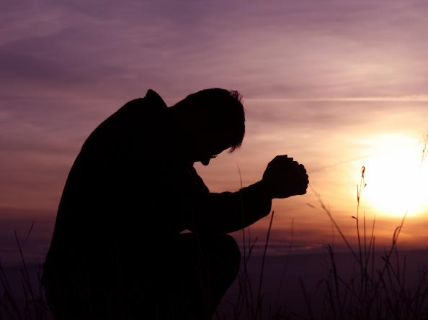
And if you call on the Father, who without partiality judges according to each one's work, conduct yourselves throughout the time of your stay here in fear; — 1st Peter 1:17
call
conduct
test
fear
fear
Notes:
Fear of God is commitment to God by which true ageless understanding comes. In fear of Him our conduct grows for the better and our heart’s love enlarges.

Slide 51
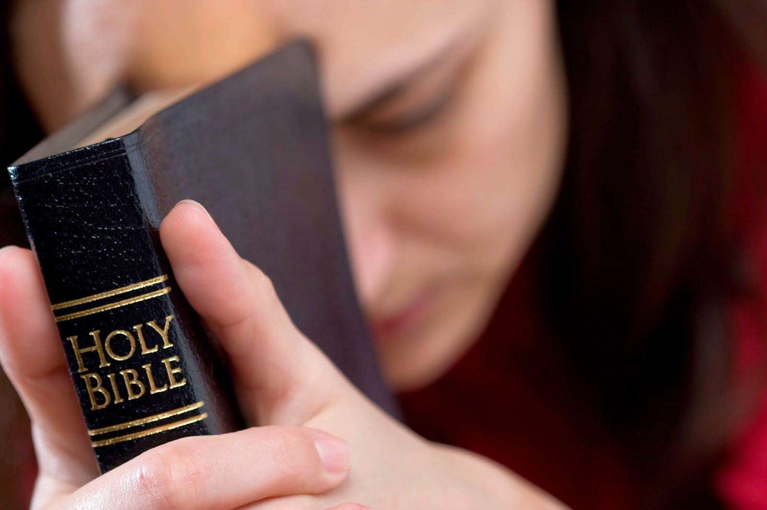
Therefore, my beloved, as you have always obeyed, not as in my presence only, but now much more in my absence, work out your own salvation with fear and trembling; — Philippians 2:12
Therefore, my beloved, as you have always obeyed, not as in my presence only, but now much more in my absence, work out your own salvation with fear and trembling; — Philippians 2:12
fear
Notes:
Our relationship is one most personal and individual.

Slide 52
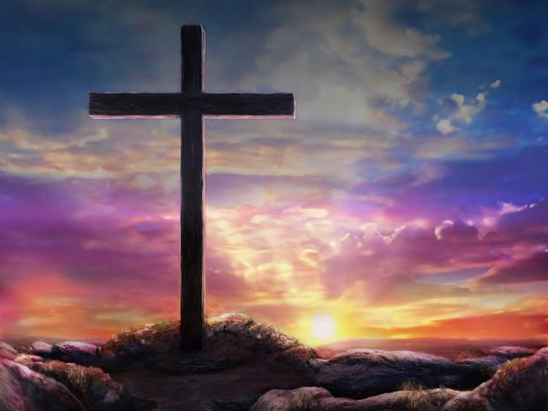
Honor all people. Love the brotherhood. Fear GOD. Honor the king. — 1st Peter 2:17
F
E
A
R
G
LORD
D
LORD
L
I
F
E
Honor all people. Love the brotherhood. Fear . Honor the king. — 1st Peter 2:17
G
O
D
Notes:
Without His truth, even the simplest of eternal pleasures are made impossible. His sacrifice has set us free to know God and ourselves; in the mirror of creation He reflects these truths to those that would have Him. Blessed are those that have the true character of God in their spirit. Fear, love, and honor, this is what hones all of His saints.

Slide 53
→ The fear of the LORD is the beginning of wisdom
→ The fear of the LORD is the instruction of wisdom
→ In the fear of the LORD there is strong confidence
→ The fear of the LORD is a fountain of life
→ The fear of the LORD leads to life prolonging days
→ Whom fear God, He will show them His covenant
→ The fear of the LORD are riches and honor and life
→ Seeing His promises we must perfect holiness in fear
→ Walk in fear of the Lord comforted by the Holy Spirit
→ Fear Him who is able to destroy both soul and body
→ Willfully sinning = a fearful expectation of judgment
→ Serve God acceptably with reverence & godly fear
→ Work out your own salvation with fear & trembling
Fearing the LORD honors Him for
all that He is
Notes:
Fear of the Lord respects Him in deserving love. Fearing the LORD honors Him for all that He is.

Slide 54
Notes:
Anguish evaporates into the darkness.

Slide 55
Please visit http://www.LoveFromGod.com to explore further
Ronald Bert Channel on
Notes:
Eternity never ends.

