Slide 2
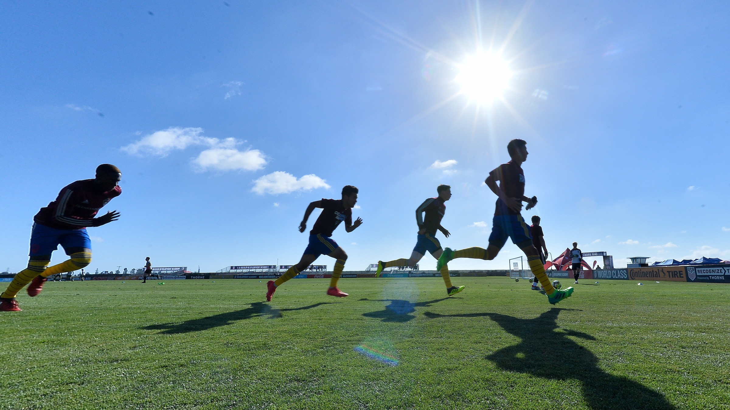
Do Not Become Weary
Ron Bert
March 8, 2020

Slide 3
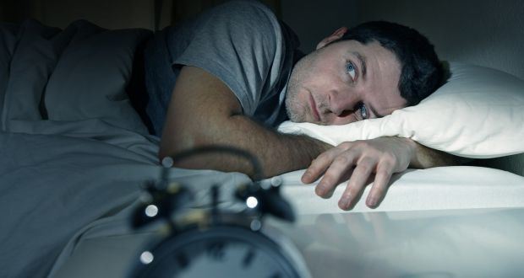
I am weary with my groaning; All night I make my bed swim; I drench my couch with my tears. My eye wastes away because of grief; It grows old because of all my enemies. — Psalms 6:6-7
I am weary
I am weary
grief
grief
my enemies
my enemies
Notes:
Sorrow cannot help but draw weariness to a soul. Enemies steal peace when not put to rest. It is perceived enemies that prohibit strength of spirit and deny victory over conquering evil.

Slide 4
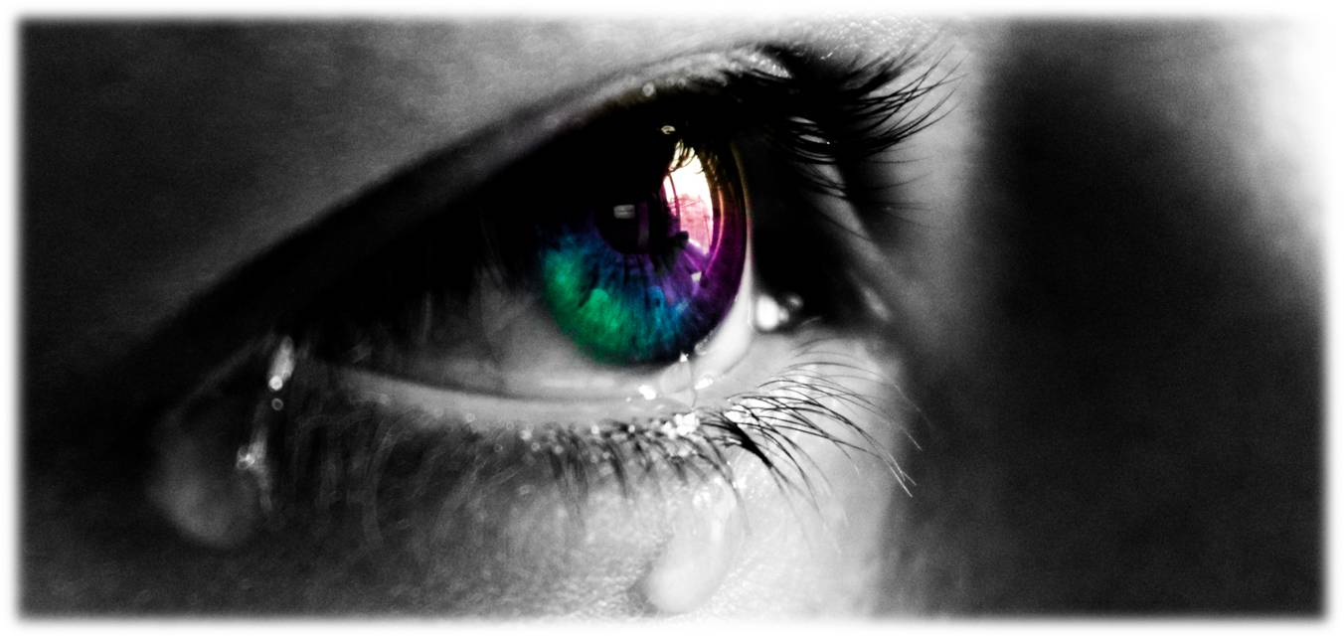
I am weary with my crying; My throat is dry; My eyes fail while I wait for my God. Those who hate me without a cause Are more than the hairs of my head; They are mighty who would destroy me, Being my enemies wrongfully; Though I have stolen nothing, I still must restore it. — Psalms 69:3-4
I am weary
Those who hate
Those who hate
not
enemies wrongfully
enemies wrongfully
not
Notes:
Sorrow’s most dreadful result is in the collapse of spirit. For those void of sorrow, only incensed with anger and or hate, they violate all those who still have sense of conscience. Many times people tend to imagine things or events that are not there, nor have they even been. Paranoia inflicts the disease of self-destruction. Many choose enemies for whose names they know not, spiritual imprisonment to say the least, prejudice.

Slide 5
not

Slide 6
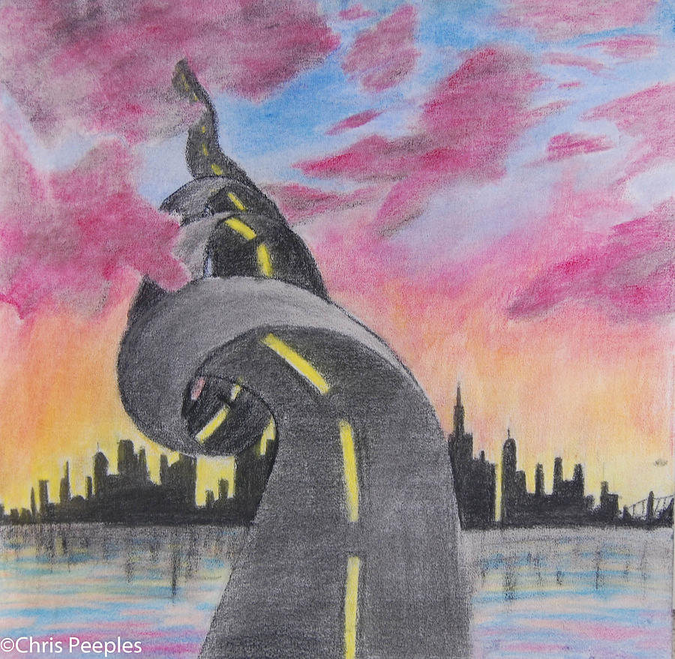
The labor of fools wearies them, For they do not even know how to go to the city! — Ecclesiastes 10:15
not
not
know
not
know
not
Notes:
If heaven is to be our eventual home, would it not be important to know how to return to this highest of sanctuaries? Surely an innate quality in human experience is to find the way home.

Slide 7
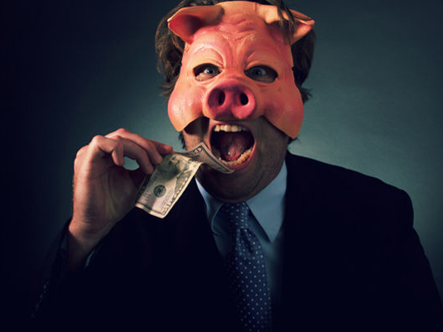
Do not overwork to be rich; Because of your own understanding, cease! — Proverbs 23:4
Do not overwork to be rich; Because of your own understanding, cease! — Proverbs 23:4
not
X
Notes:
Understanding is a main component of any situation, for sanity to prevail. Common sense can be elusive when arrogance and greed spin their tortures on the innocent. Understanding higher truths is more than the earth could ever deliver. To die to the self is to discover the powers of God Himself.

Slide 8
My flesh and my heart fail; But God is the strength of my heart and my portion forever. — Psalms 73:26
My flesh and my heart fail
My flesh and my heart fail
Notes:
Each of us ages to the next moment. Blessed are those who are able to bypass the most heinous afflictions, maintaining faith in God Almighty.

Slide 9
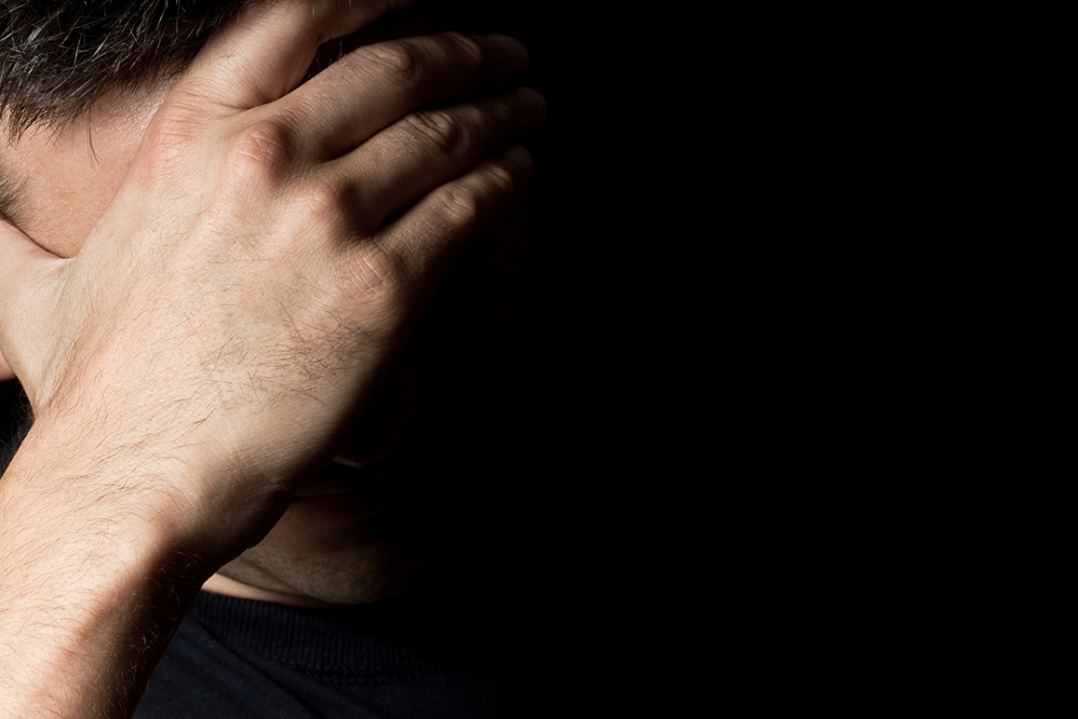
"But now it comes upon you, and you are weary; It touches you, and you are troubled. Is not your reverence your confidence? And the integrity of your ways your hope? Remember now, who ever perished being innocent? Or where were the upright ever cut off?" — Job 4:5-7
But now
But now
you are weary
you are weary
troubled
troubled
confidence?
confidence?
hope
integrity
hope
innocent
upright
Notes:
Thoughts can assist or destroy peace of mind. If one loses purpose, then life can be challenged without hope. Hope is essential when climbing toward the dreams ahead. Our confidence is shored up with honest upright hearts. Heartbreakers generally are callous souls self-absorbed and preoccupied with endless anxiety. To be free of judgment, and with pure care for others, has no comparable sweetness. Many times we can miss the good qualities we possess when we overly condemn ourselves for shortcomings or stumbling's that have occurred. Again, focus on what one has to advance one’s spirit.

Slide 10
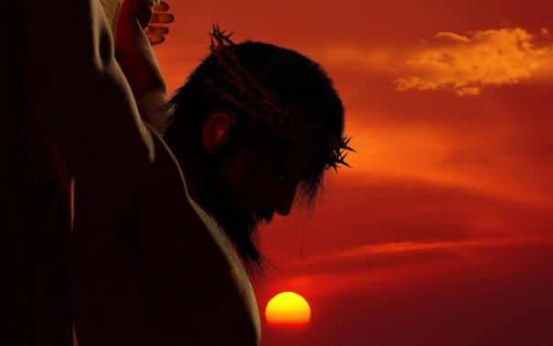
And not only that, but we also glory in tribulations, knowing that tribulation produces perseverance; and perseverance, character; and character, hope. Now hope does not disappoint, because the love of God has been poured out in our hearts by the Holy Spirit who was given to us. For when we were still without strength, in due time Christ died for the ungodly. — Romans 5:3-6
tribulations
perseverance
hope
character
hope
hope
character
love of God
poured out
Holy Spirit
love of God
poured
out
Holy Spirit
perseverance
Christ died
Christ
Christ died
tribulations
for the ungodly
for the ungodly
Notes:
When it is said, “No pain, no gain,” it is pain that exposes the true mettle of character, and heights of our hope.

Slide 11
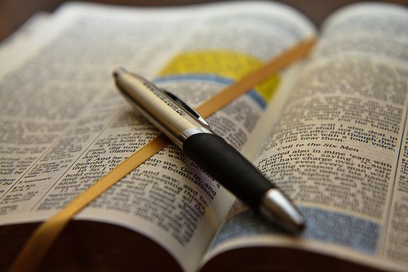
"I know your works, your labor, your patience, and that you cannot bear those who are evil. And you have tested those who say they are apostles and are not, and have found them liars; and you have persevered and have patience, and have labored for My name's sake and have not become weary." — Revelation 2:2-3
patience
persevered and have patience
. .
have not become weary
Notes:
God knows at once our rejoicings and miseries. He watches to see what we will choose; be it goodness over evil’s plotting.

Slide 12
perseverance

Slide 13
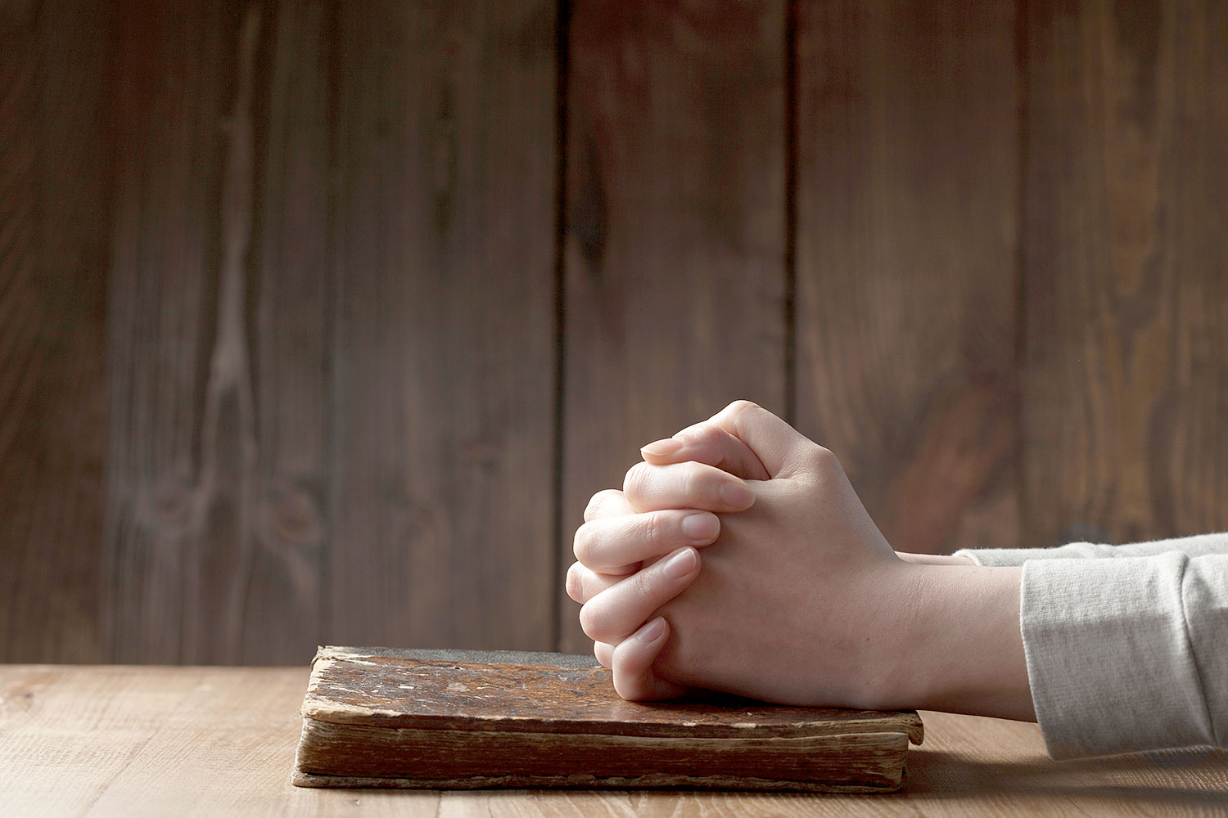
Indeed we count them blessed who endure. You have heard of the perseverance of Job and seen the end intended by the Lord -- that the Lord is very compassionate and merciful. — James 5:11
blessed
blessed
endure
who endure
who endure
perseverance
endure
Notes:
Blessings beyond measure are imbedded in all hearts devoted to the pursuit of His word. In this life, none receive the unleased reservoir ahead, in store for all who believe without doubting.

Slide 14
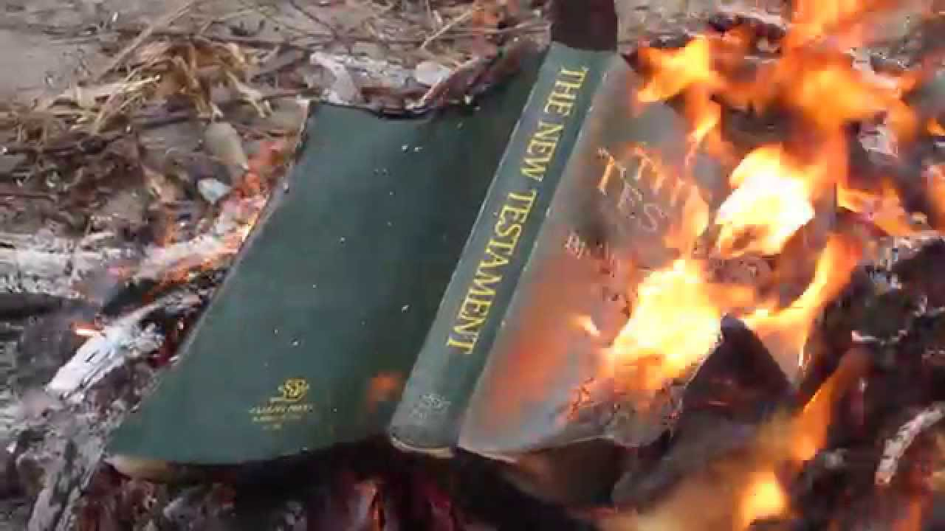
"And you will be hated by all for My name's sake. But he who endures to the end will be saved." — Matthew 10:22
endure
endures to the end will be saved
endures to the end will be saved
Notes:
Many hurtfully reject the good news God shares with all. His characteristic name cannot be changed. As man hates man, no excuse will exonerate one from His unending truths.

Slide 15
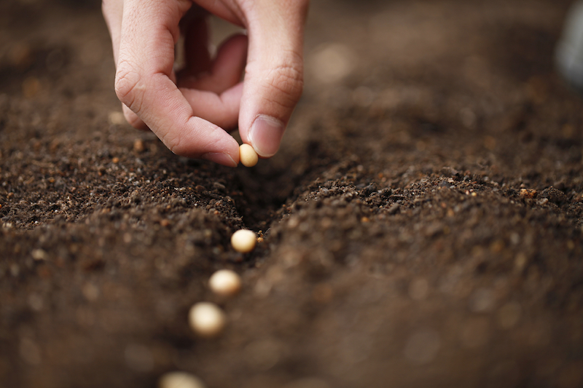
And let us not grow weary while doing good, for in due season we shall reap if we do not lose heart. Therefore, as we have opportunity, let us do good to all, especially to those who are of the household of faith. — Galatians 6:9-10
not grow weary
not grow weary
do not lose heart
do not lose heart
do not lose heart
do not lose heart
do good
do good
Notes:
Sure belief cannot abandon the truths given by heaven. Faith involves the unity of sharing love in His ways over our shortcomings of falling from His Holy Grace.

Slide 16
Therefore, since we have this ministry, as we have received mercy, we do not lose heart. — 2nd Corinthians 4:1
do not lose heart
do not lose heart
Notes:
In the tower He has dropped before us, our hearts can fly back to Him.

Slide 17
For all things are for your sakes, that grace, having spread through the many, may cause thanksgiving to abound to the glory of God. Therefore we do not lose heart. Even though our outward man is perishing, yet the inward man is being renewed day by day. — 2nd Corinthians 4:15-16
For all things are for your sakes
that grace
. .
cause thanksgiving
. .
do not lose heart
inward man
Notes:
Every beach has a wave of hope for more. In all thanksgiving glory is shone when faith is larger than our fears.

Slide 18
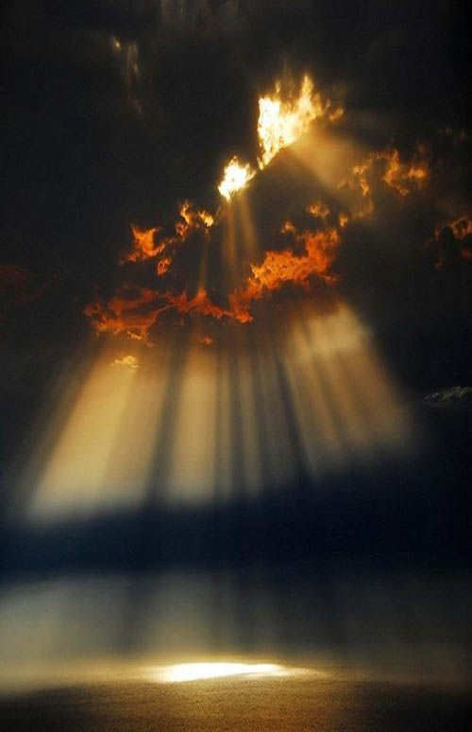
For our light affliction, which is but for a moment, is working for us a far more exceeding and eternal weight of glory, while we do not look at the things which are seen, but at the things which are not seen. For the things which are seen are temporary, but the things which are not seen are eternal. — 2nd Corinthians 4:17-18
For our light affliction
eternal weight of
. .
glory
glory
which are seen
which are seen
Notes:
The greatest of all that is, comes after each soul renders their deeds under the sun. No one can condemn another as each will receive judgment alone. Many love family and friends who choose self over a higher creator source. Reasons are left for God to judge, but knowing truth is the best part of caring for His justice of I am. Honesty delivers courage in the shadows of fear.

Slide 19
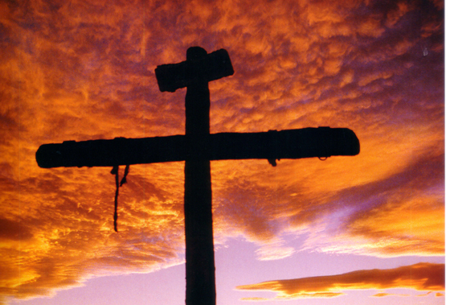
For consider Him who endured such hostility from sinners against Himself, lest you become weary and discouraged in your souls. You have not yet resisted to bloodshed, striving against sin. — Hebrews 12:3-4
consider Him who endured
consider Him who endured
HATE
which are seen
striving against sin
striving against sin
Notes:
Christ showed all by resisting evil, while unjust prices were stolen, that truth measures higher than lies.

Slide 20
"Come to Me, all you who labor and are heavy laden, and I will give you rest. Take My yoke upon you and learn from Me, for I am gentle and lowly in heart, and you will find rest for your souls. For My yoke is easy and My burden is light." — Matthew 11:28-30
Come to Me
Come to Me
learn from Me
learn from Me
in
heart
heart
in heart
find rest
find rest
Notes:
What is easy comes when loneliness no longer plagues a soul under His care.

Slide 21
Then He spoke a parable to them, that men always ought to pray and not lose heart, … — Luke 18:1
pray
heart
not lose heart
not lose heart
Notes:
Hearts all beat with one eternal wish, to never die.

Slide 22
But as for you, brethren, do not grow weary in doing good. — 2nd Thessalonians 3:13
do not grow weary in doing good
do not grow weary in doing good
Notes:
As sickles shear the crops, so too, our resolve to produce what is good gives us our name.

Slide 23
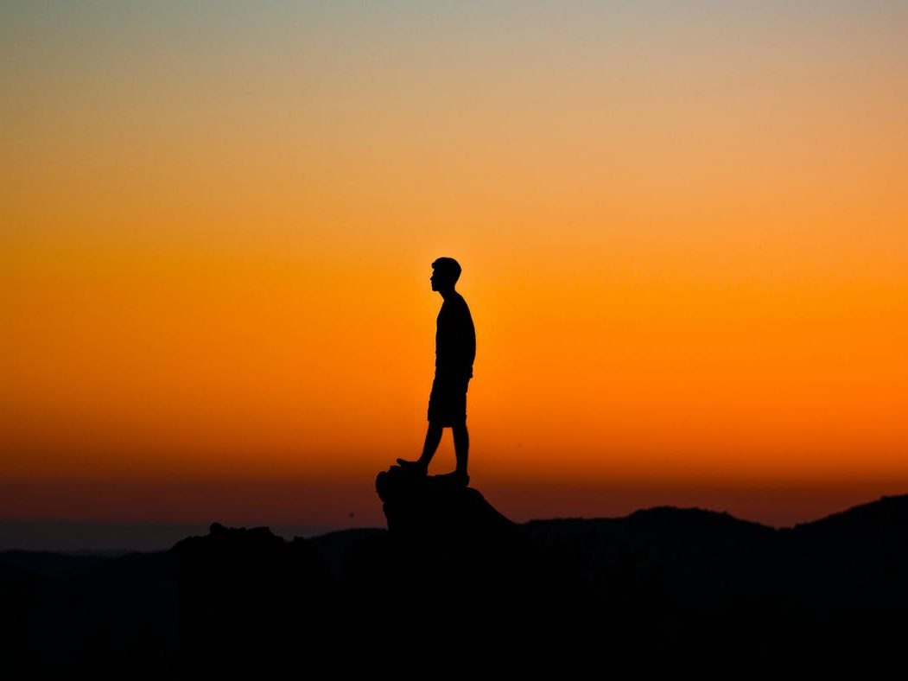
"Be strong and of good courage, do not fear nor be afraid of them; for the LORD your God, He is the One who goes with you. He will not leave you nor forsake you." — Deuteronomy 31:6
For a righteous man may fall seven times And rise again, But the wicked shall fall by calamity. — Proverbs 24:16
rise again
rise again
LORD
LORD your God
LORD your God
not leave you nor forsake you
LORD
Notes:
In all the spears that come upon us, we wait for this higher excellence of glory, in His light, where no words are needed. Is the LORD the Rock one stands on or falls upon? Righteous hearts rise to the occasion enduring all fires for the glorious insight ahead. It is the weak the exit the door to recovery, and sink into the frozen gaspless tears of living. Pity parties hold no strength of character.

Slide 24
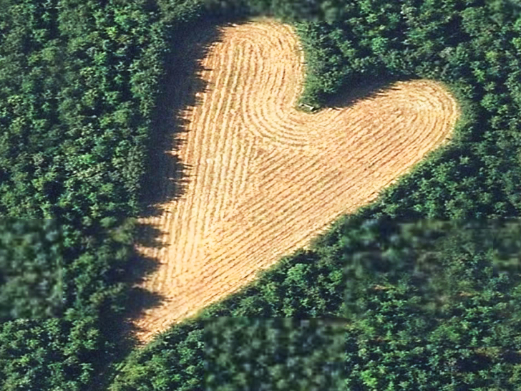
Therefore be patient, brethren, until the coming of the LORD. See how the farmer waits for the precious fruit of the earth, waiting patiently for it until it receives the early and latter rain. You also be patient. Establish your hearts, for the coming of the LORD is at hand. — James 5:7-8
be patient
. .
Establish your hearts
. .
LORD
coming of the LORD is at hand
Notes:
Hearts melt in hope of a return to love without measure. The LORD’s presence will be upon each of us in a breathless moment as our hearts will bare all.

Slide 25
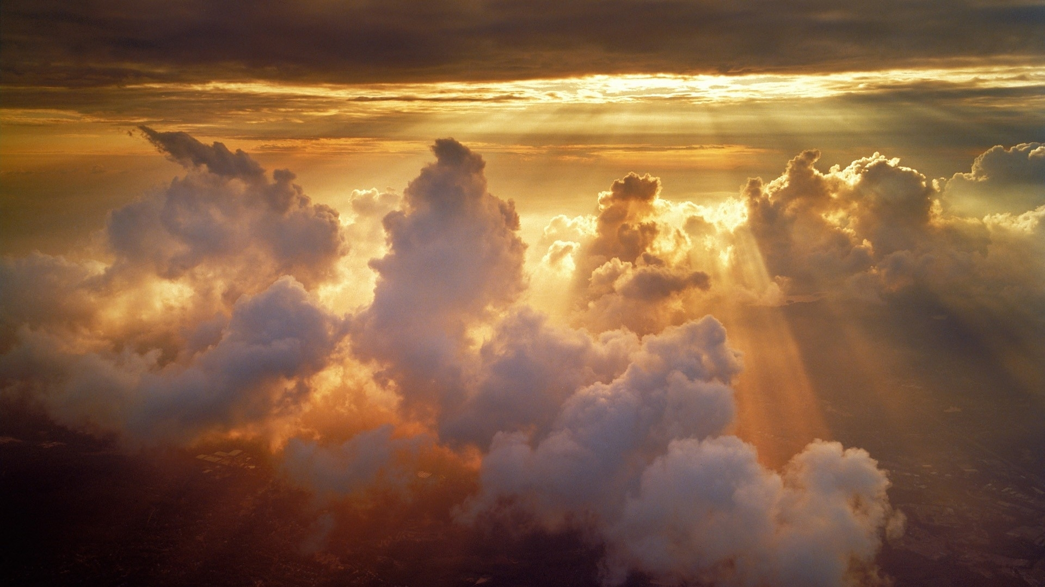
Blessed be the God and Father of our Lord Jesus Christ, who according to His abundant mercy has begotten us again to a living hope through the resurrection of Jesus Christ from the dead, to an inheritance incorruptible and undefiled and that does not fade away, reserved in heaven for you, who are kept by the power of God through faith for salvation ready to be revealed in the last time. — 1st Peter 1:3-5
reserved in heaven for you
↑
inheritance incorruptible
↑
resurrection of Jesus Christ
↑
kept by the power of God
through faith for salvation
↑
a living hope
↑
a living hope
↑
resurrection
of Jesus Christ
inheritance incorruptible
↑
does not fade away
reserved in
. .
heaven for you
kept by the power
↑
of God
through faith for salvation
revealed in the last time
Notes:
It is simple for a child to have careless wonder. What God keeps is a return to this innocence above all violations.

Slide 26
In this you greatly rejoice, though now for a little while, if need be, you have been grieved by various trials, that the genuineness of your faith, being much more precious than gold that perishes, though it is tested by fire, may be found to praise, honor, and glory at the revelation of Jesus Christ, whom having not seen you love. Though now you do not see Him, yet believing, you rejoice with joy inexpressible and full of glory, receiving the end of your faith -- the salvation of your souls. — 1st Peter 1:6-9
for a little while
for a little while
grieved by various trials
grieved by various trials
Notes:
As sparks ignite more upon the winds of time, joy of heart fires inextinguishable faith.

Slide 27
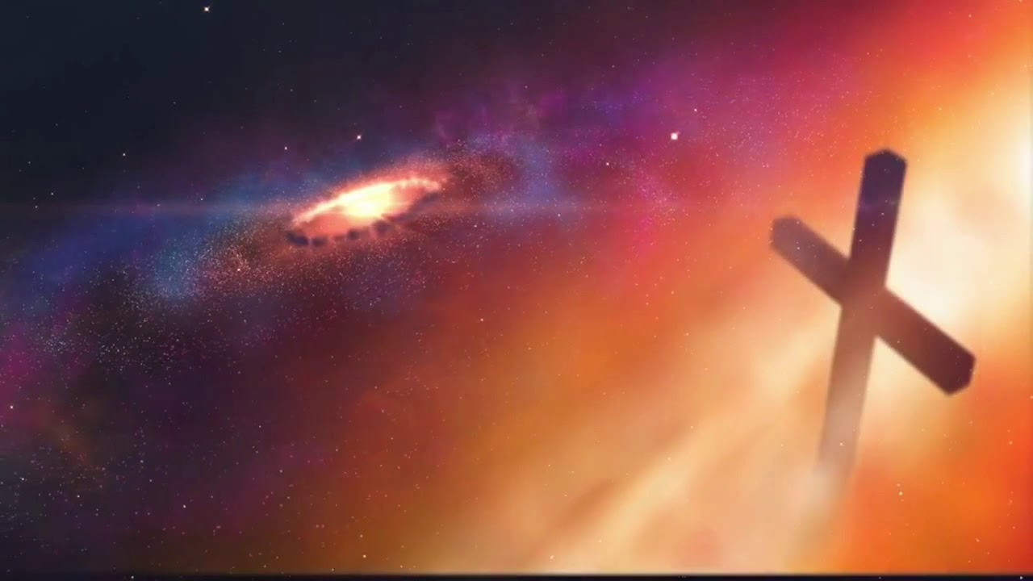
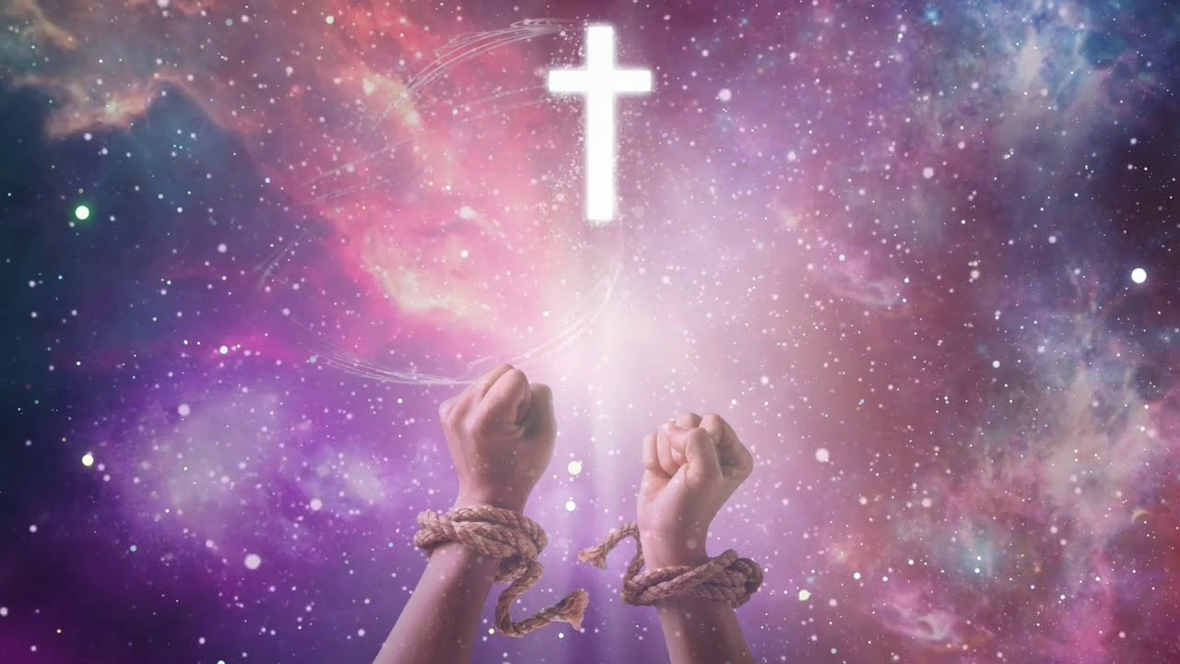
"These things I have spoken to you, that in Me you may have peace. In the world you will have tribulation; but be of good cheer, I have overcome the world." — John 16:33
I have overcome the world
. .
Notes:
When life comes at one, as it does, faith is the upholding crutch when calamities arrive. And they arrive, if not already, most certainly, as afflictions touch us all.

Slide 28
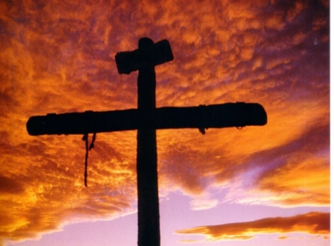
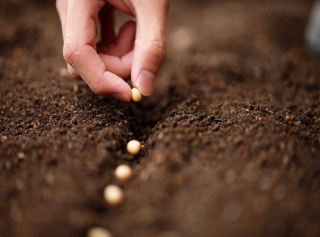
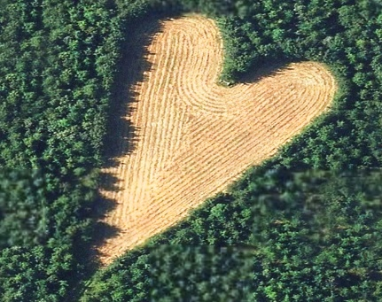
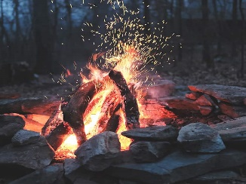
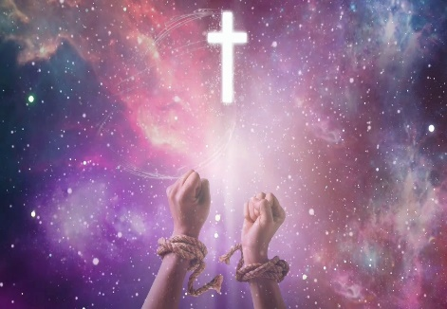
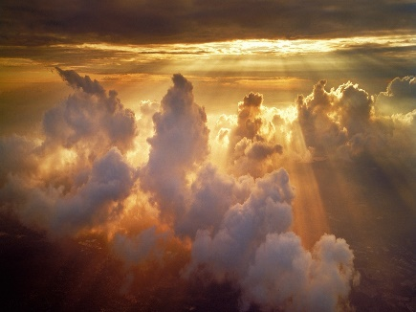

Slide 29
→ Weariness and grief arrive because of enemies
→ Not all woes, real or imagined, are justified in truth
→ Overworking for earthly riches curbs understanding
→ Tribulations hone our character enhancing hope
→ Endurance’s farthest reach is a labor of love
→ Hearts bond eternally in the ongoing of doing good
→ The inner soul is renewed with thanksgiving in Him
→ In but a moment we all will arrive at God’s doorstep
→ Be reminded of Christ’s sufferings to strengthen us
→ The promises of God lift us past the tallest of woes
→ God remains even if we fear lacking confidence
→ God’s mercy offers salvation through faith in Christ
→ Overcoming worldliness is key to peace of mind
God’s rewards do surpass all imaginable
Notes:
God’s rewards do surpass all imaginable.

Slide 31
Please visit http://www.LoveFromGod.com to explore further
Ronald Bert Channel on
Notes:
Eternity never ends.

