Slide 1
Notes:
Darkness surrenders to gloom.

Slide 2
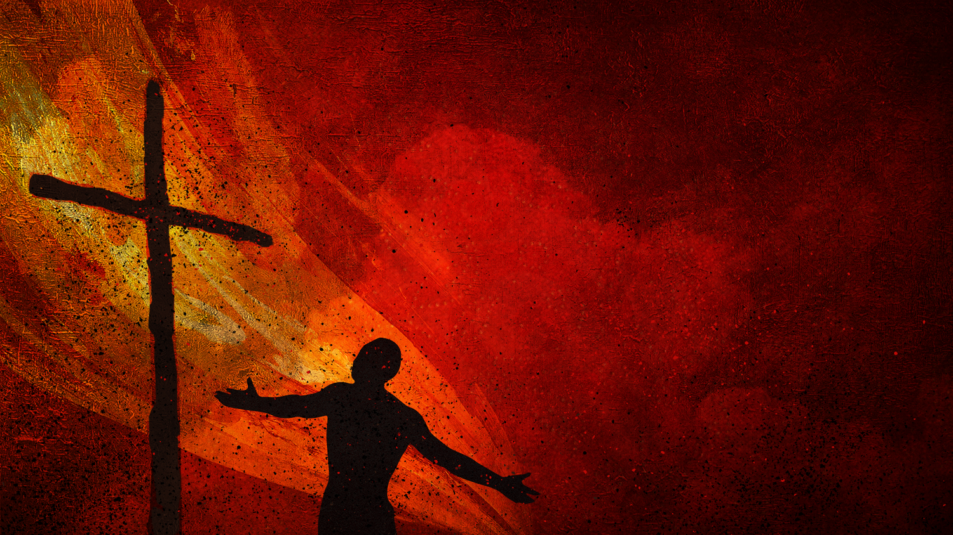
DISCIPLES
Ron Bert
October 15, 2017
Notes:
He calls us to be disciples, that is students, with increasing understanding, on our climb in Him. Without His knowledge we are crippled in knowing God’s will for us. To be a disciple one must possess the desire to acquire His truths. Disciples care for one another in honor of Him.

Slide 3
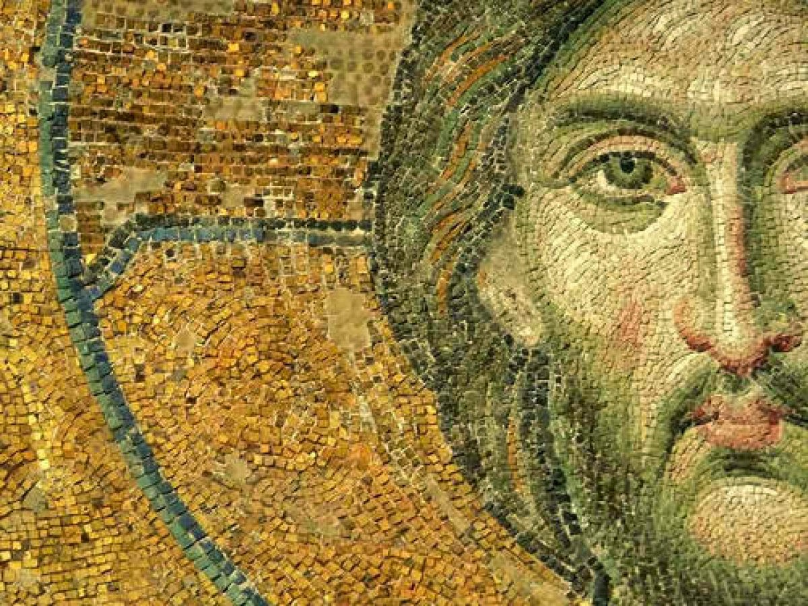
"If anyone comes to Me and does not hate his father and mother, wife and children, brothers and sisters, yes, and his own life also, he cannot be My disciple." — Luke 14:26
comes to Me
comes to Me
GOD
Love More
Love More
Authority
Nurturing
Companionship
Camaraderie
Sympathy
Reliance
disciple
cannot be My disciple
disciple
cannot be My disciple
Notes:
It is about putting God above all things including family and self, which in turn then improves all relationships. Many of us can recall weeping over the fears for our parents own death, as youths. With time, rebellion over control inevitably leads to resentment, and those frustrations are encountered by many as they grow toward adulthood. Disgust over one’s own behavior is a sign of repentance and increases the deepening matrimonial bonds all are challenged with. To come to Christ is to humbly and honestly surrender your heart to Him past all of one’s past failings. His is the success of all living. God above all does not want us to deceive ourselves, but to live in honesty with self and others.

Slide 4
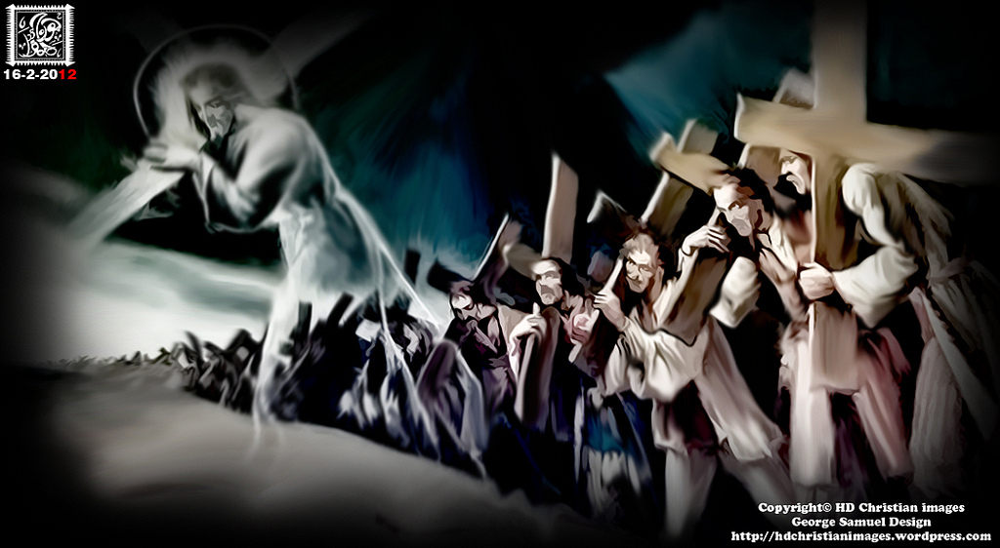
"And whoever does not bear his cross and come after Me cannot be My disciple." — Luke 14:27
seek
come after Me
come after Me
disciple
disciple
Notes:
What life has delivered, to each of us, is unique, yet we all have this in common, suffering. It is natural to desire an escape from pain, but in how we do it defines the character of our spirit. We all have seen many famous financial wealthy individuals unable to bear the weight of their miseries; substance abuses mask passing out (escaping) from reality. In Christ He lifts us past those impossible heart aching weights, none can carry, as His eternal light puts the temporary in perspective. The love He renders is an easy yoke in its’ simple lifting truth. To seek Him is to pray to Him.

Slide 5
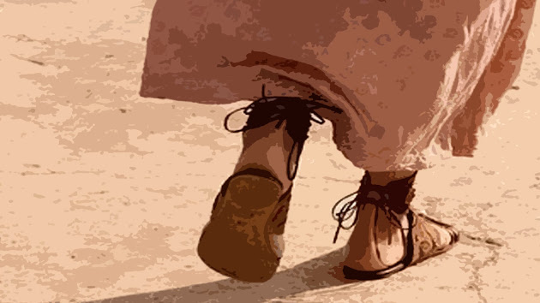
"So likewise, whoever of you does not forsake all that he has cannot be My disciple." — Luke 14:33
disciple
desire
forsake all
forsake all
disciple
Notes:
It is a question of desire. Are things and the lust for them more valuable than one single breath of life? Purpose is what tracks our paths in life. And this life, if it is only a shell to impulsively satisfy, is one missing the sense something eternally much more? Each step at times can be grueling, in view of the losses life exposes, which brings about an almost universal, in common, pain that needles all of our hearts; deaths door.

Slide 6
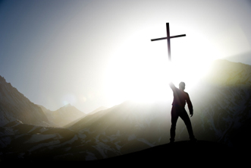
Then Jesus said to His disciples, "If anyone desires to come after Me, let him deny himself, and take up his cross, and follow Me. For whoever desires to save his life will lose it, but whoever loses his life for My sake will find it." — Matthew 16:24-25
disciple
desires to come after Me
desires to come after Me
deny himself
follow Me
follow Me
desires
desires
find
Notes:
To find Christ in the bottom of one’s heart allows Him to be that foundation, the rock that lifts the whole world and more. Truly, without surrendering to Him there is no pleasure in carrying death all alone, whereas He turns the other side of the coin to life over death. To find Christ is to find that which is greater than the world.

Slide 7
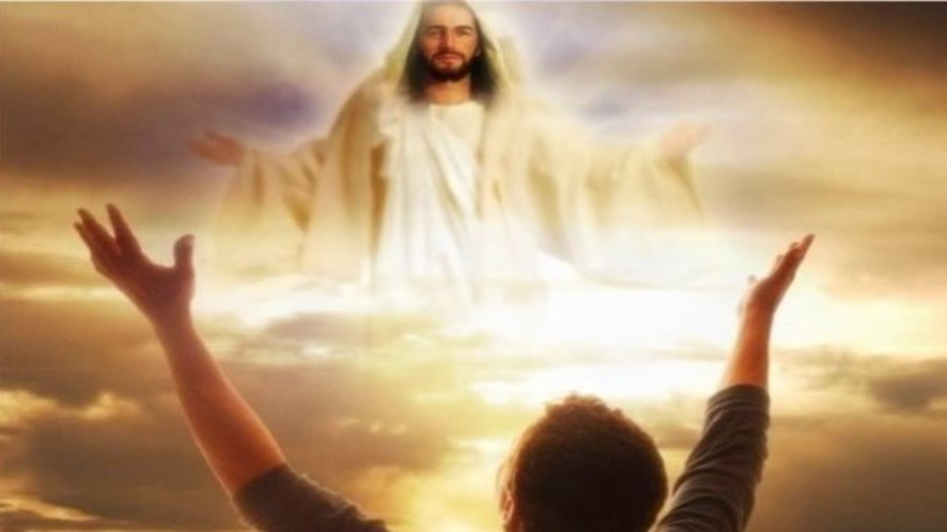
And those who are Christ's have crucified the flesh with its passions and desires. — Galatians 5:24
crucified
desires
crucified
Notes:
If lusting desires remain in the lower carnal, without a maturing to spiritual contemplations, the shallow remains over the depth a true soul was created to know. The heights of heaven are higher than the bowels of the earth where mortal life originates. One cannot come to God unless all desires for earthly considerations are secondary.

Slide 8
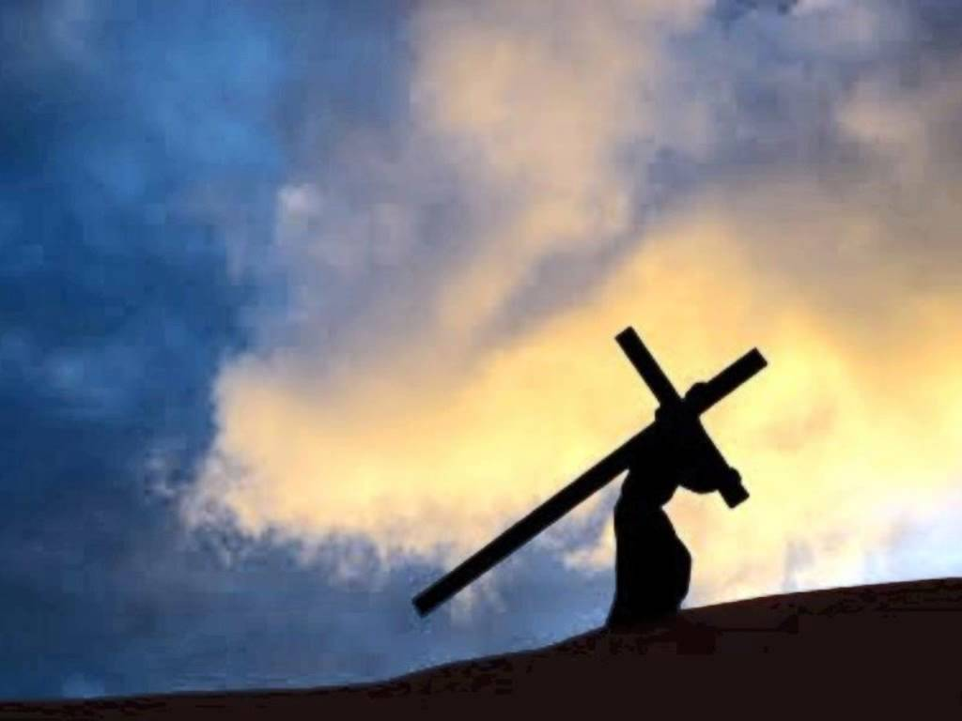
Then He said to them all, "If anyone desires to come after Me, let him deny himself, and take up his cross daily, and follow Me. — Luke 9:23
up
daily
follow Me
daily
crucified
Notes:
In finding purpose in following Christ, it becomes an upward path, even though each of us bears that baggage that hinders us from plowing on. Purpose never loses sight of that destination and so it is daily in our lives as true Christians. An unceasing awareness.

Slide 9
Then Jesus said to those Jews who believed Him, If you abide in My word, you are My disciples indeed. And you shall know the truth, and the truth shall make you free." — John 8:31-32
in
abide in
abide in
My word
disciple
disciples
disciple
TRUTH
disciples
Notes:
Are you looking through the window of a disciple? Disciples peer though His word to achieve clarity of thought. Abiding in it is to accept and tolerate what has been commanded. Striving to be better is hard work with rewards of spirit. Let us not blame God for what man devises in lies against Him or in diluting His significance.

Slide 10
"A new commandment I give to you, that you love one another; as I have loved you, that you also love one another. By this all will know that you are My disciples, if you have love for one another." — John 13:34-35
love
love
love
love
you are My disciples
disciples
you are My disciples
if you have love
if
love
if you have love
Notes:
In love there is no contempt. Sorrow too often evolves into anger where delusions ruin a pure heart from knowing the simplest of truths; His love for us. When love supports a heart, its’ bottom is not left helpless to bear agony alone. Thank God His Spirit rest upon us all, believers and unbelievers alike. He bears the load as we arrive.

Slide 11
Therefore be imitators of God as dear children. And walk in love, as Christ also has loved us and given Himself for us, an offering and a sacrifice to God for a sweet - smelling aroma. — Ephesians 5:1-2
be imitators of God
be imitators of God
child
in
walk in love
walk in love
Christ
love
Christ
Christ
Notes:
That innocence of childhood lost is where God wants us to return with wisdom intact. Gleaming in the rainbows of life's approach are the dreams of children. The innocence of childlike love is a light floating far above the heights of the sky. Life is a choice to embrace it, life, over death, as Christ said, let the dead bury the dead. Life is for the living, and best had, enjoying real deepest love over impulsive selfish desires. When it becomes more about others the blossom of truth opens. We must open our hearts and love one another, for without this we know not God but only self delusions. True life is learning how to die to live.

Slide 12
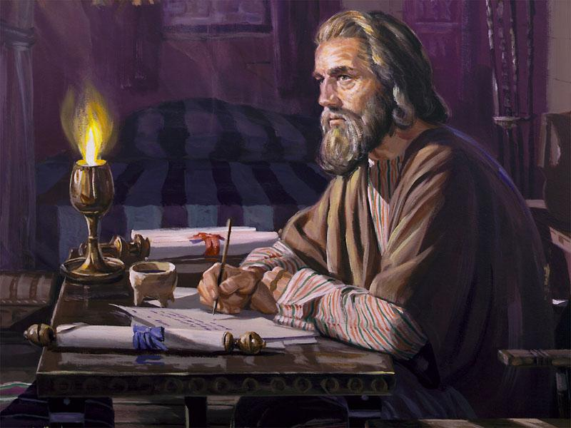
Imitate me, just as I also imitate Christ. — 1st Corinthians 11:1
Christ
Notes:
Those examples in His Word lead us to know how to be for the best we can be.

Slide 13
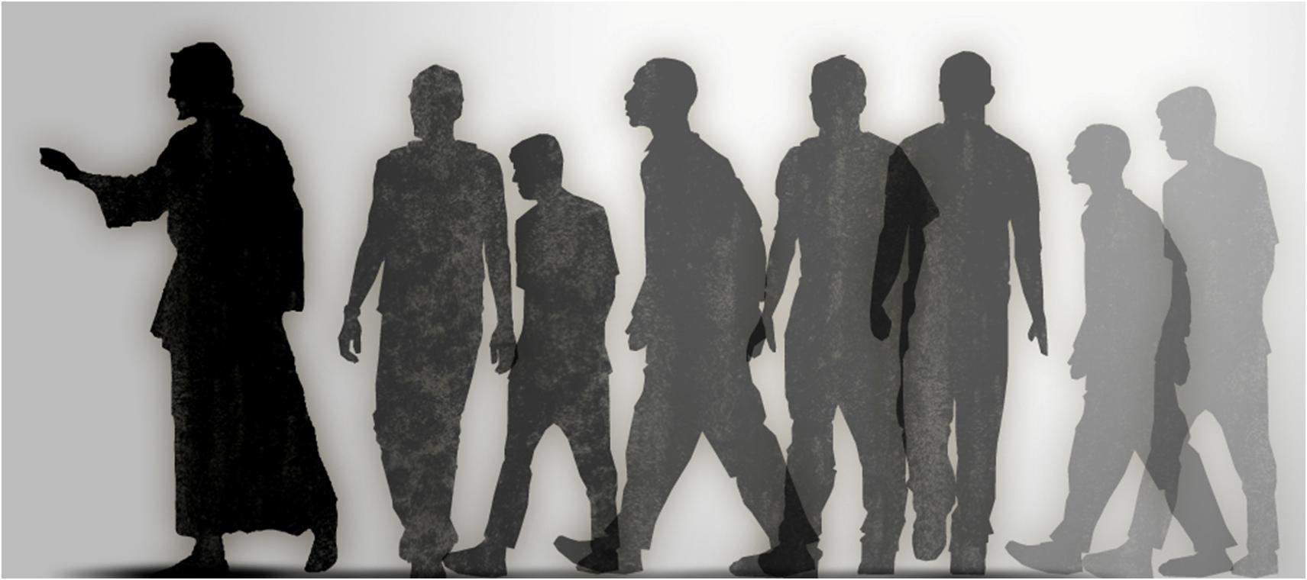
"A disciple is not above his teacher, nor a servant above his master. It is enough for a disciple that he be like his teacher, and a servant like his master. If they have called the master of the house Beelzebub, how much more will they call those of his household!" — Matthew 10:24-25
master
a disciple
a disciple
be like his teacher
be like his teacher
master
Notes:
What one seeks is what one learns. To practice evil is to not return, to the goodness He calls out for, in all of our actions. To know His heart of truth sets true eternal freedom upon a soul. A disciple has a life in pursuit of worship in Him, and not simply disregarding that which can be an inconvenient nuance. One regards the commands He demands. Blatant disregard for His truth is what crushes peoples and decays civilizations from prospering. Is division a blessing? It is not, but holds the seed of Satan’s desire for the destruction of souls. Is God the master or something devised in an isolated deceived heart? Hate is something done all alone though in crowds we all gather.

Slide 14
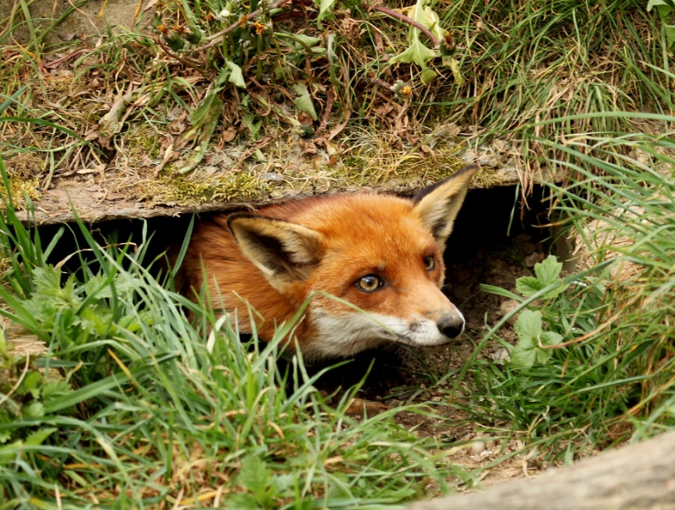
Now it happened as they journeyed on the road, that someone said to Him, "Lord, I will follow You wherever You go." And Jesus said to him, "Foxes have holes and birds of the air have nests, but the Son of Man has nowhere to lay His head." — Luke 9:57-58
I will follow You
I will follow You
Jesus
Jesus
but
but
Notes:
Do you really follow Jesus? Bags of wind are a dime a dozen.

Slide 15
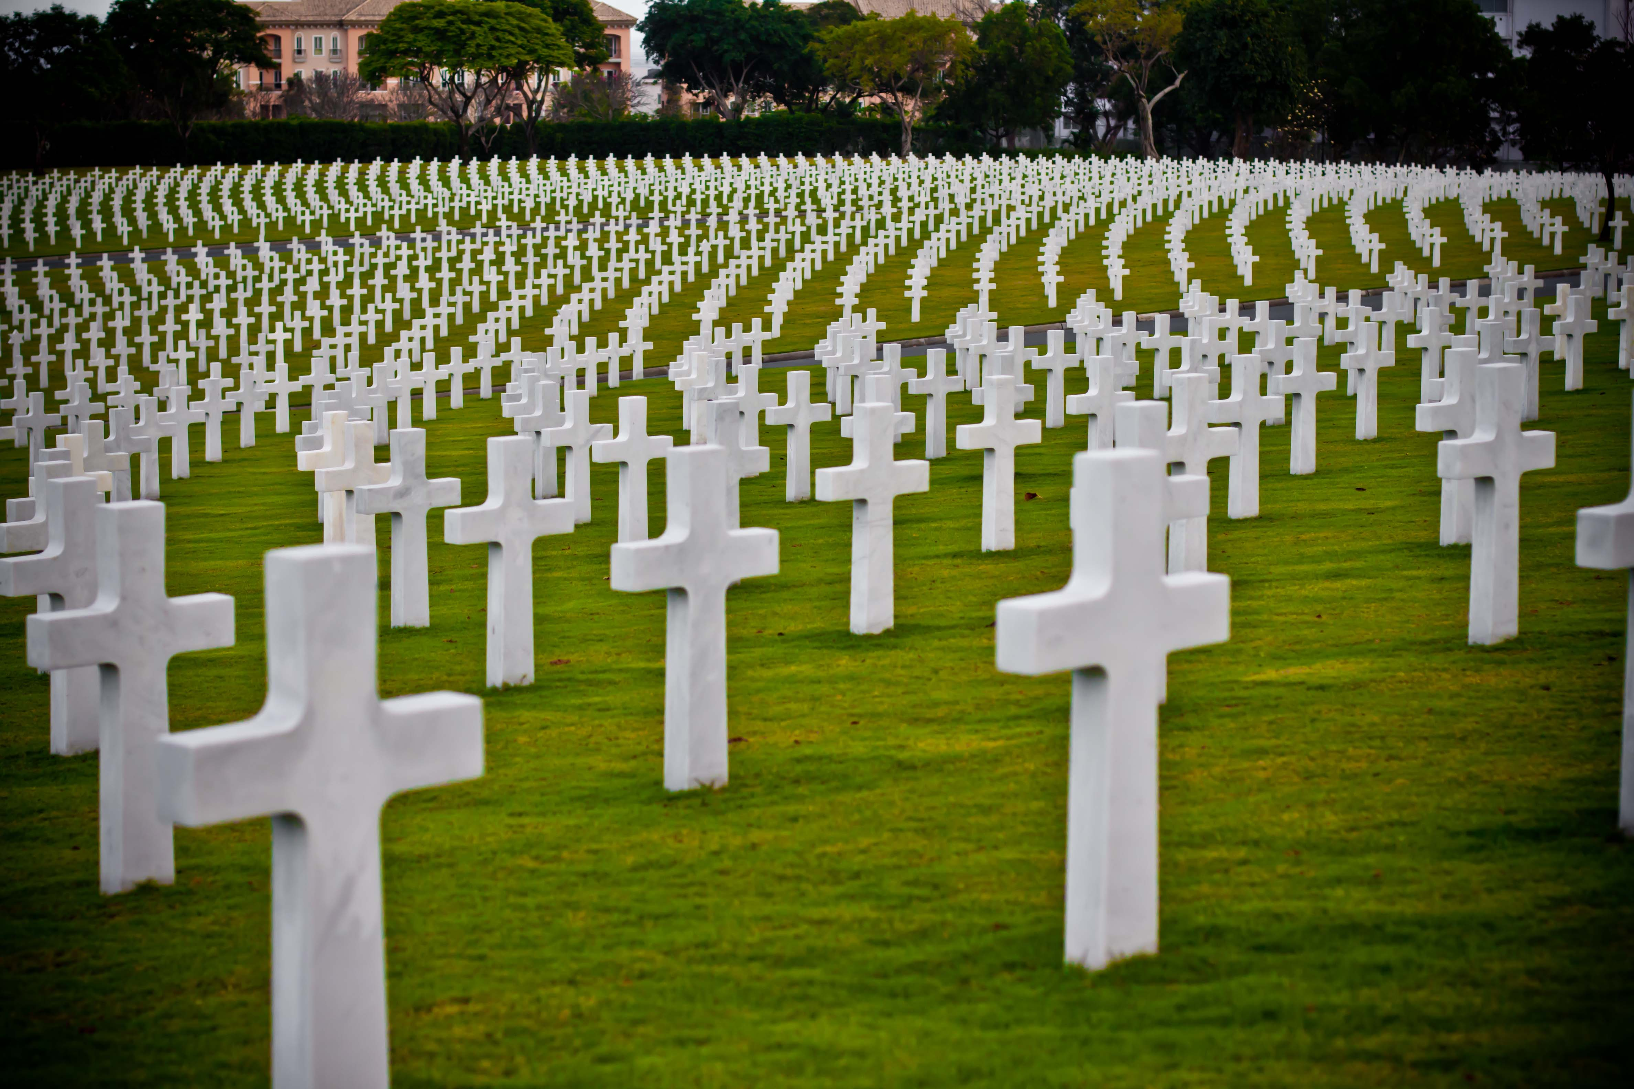
Then He said to another, "Follow Me." But he said, "Lord, let me first go and bury my father." Jesus said to him, "Let the dead bury their own dead, but you go and preach the kingdom of God." — Luke 9:59-60
X
Follow Me
But
Follow Me
Jesus
Jesus
go
seek
live
preach
preach
Notes:
The dead can not go anywhere. We are called to live in His light announcing His kingdom of life, not death. “Woe is me” has destroyed an innumerable count. He calls us to be fearless in His delivered living truths. Many search for the living in the cemeteries of their mind.

Slide 16
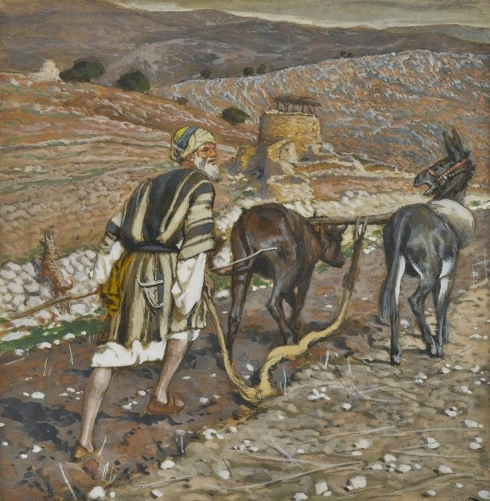
And another also said, "Lord, I will follow You, but let me first go and bid them farewell who are at my house." But Jesus said to him, "No one, having put his hand to the plow, and looking back, is fit for the kingdom of God." — Luke 9:61-62
"But they all with one accord began to make excuses. The first said to him, 'I have bought a piece of ground, and I must go and see it. I ask you to have me excused.' And another said, 'I have bought five yoke of oxen, and I am going to test them. I ask you to have me excused.' Still another said, 'I have married a wife, and therefore I cannot come.' " — Luke 14:18-20
excuses
excuses
I will
I will
X
but
follow You
. .
PROPERTY
Jesus
No
No one looking back is fit for God
BUSINESS
one
looking back
is fit for
God
FAMILY
Notes:
In order to love as God would have us to live is to look forward releasing the past. Misery and agony live in the past, where a greater love always lives ahead. God wants us to be optimistic in our approach to heaven. Lack of resolve leads to excuses skirting responsibility to worship the Creator.

Slide 17
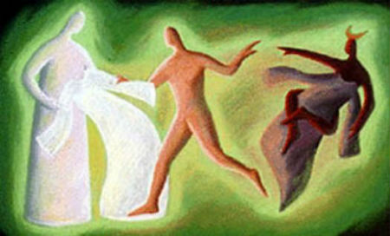
"No one can serve two masters; for either he will hate the one and love the other, or else he will be loyal to the one and despise the other. You cannot serve God and mammon." — Matthew 6:24
?
serve
serve
serve God
serve God
Notes:
To serve God one has to lose the desires for the world and embrace the Spirit.

Slide 18
"If anyone serves Me, let him follow Me; and where I am, there My servant will be also. If anyone serves Me, him My Father will honor." — John 12:26
disciple
serve
follow
follow
servant
serves Me
serves Me
Notes:
A disciple is one who follows as a servant.

Slide 19
"By this My Father is glorified, that you bear much fruit; so you will be My disciples. As the Father loved Me, I also have loved you; abide in My love. If you keep My commandments, you will abide in My love, just as I have kept My Father's commandments and abide in His love." — John 15:8-10
disciple
commandment
in
If you keep
abide in My love
abide in My love
commandment
in
commandment
in
Notes:
It is a commandment to keep His commandments.

Slide 20
Now the purpose of the commandment is love from a pure heart, from a good conscience, and from sincere faith, … — 1st Timothy 1:5
purpose of the commandment
purpose of the
PEACE
love from a pure heart
from a good conscience
from sincere faith
commandment
love from a pure
heart
TRANQUILITY
→
from a good conscience
→
DEVOTION
from sincere faith
Notes:
To arrive in Him is where a sincere faith cleanses the conscience in the purity of thought.

Slide 21
And Jesus came and spoke to them, saying, "All authority has been given to Me in heaven and on earth. Go therefore and make disciples of all the nations, baptizing them in the name of the Father and of the Son and of the Holy Spirit, teaching them to observe all things that I have commanded you; and lo, I am with you always, even to the end of the age." Amen. — Matthew 28:18-20
the Father
the Son and
the Holy Spirit
make disciples
make disciples
the Father
the Son and
the Holy Spirit
teach
observe all things
observe all things
teach
follow
commanded you
commanded you
Notes:
Jesus Himself calls out for all to become disciples, and upon our understanding of His message, of salvation, to actively surrender to Him immersed in His truth. The promise of eternity should be a welcoming event.

Slide 22
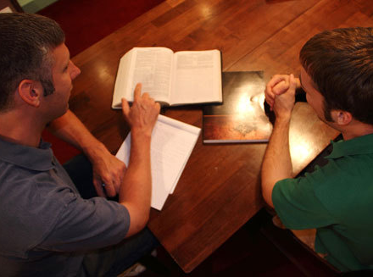
And the things that you have heard from me among many witnesses, commit these to faithful men who will be able to teach others also. — 2nd Timothy 2:2
commit
commit
teach others also
teach
teach others also
Notes:
Many loyal have come before, where an enormous amount of sacrifices have made His word available, to all. These sacrifices are where man does not oppress man, and cruelty does not deny a quest for honest living. The message of God is life, not death.

Slide 23
For to this you were called, because Christ also suffered for us, leaving us an example, that you should follow His steps: — 1st Peter 2:21
Christ
an example
an example
follow His steps
follow His steps
Notes:
Follow in a life living for God.

Slide 24
And they continued steadfastly in the apostles' doctrine and fellowship, in the breaking of bread, and in prayers. — Acts 2:42
E
I P L E
I S C I P L E
L E
C I P L E
P L E
S C I P L E
D I S C I P L E
D I S C I P L E
DEDICATED
INTEGRITY
STUDENT
COURAGE
INDIVIDUAL
PERSEVERANCE
LOVE
EXALT
. .
continued steadfastly
in
in
in
Notes:
To be a disciple one must remain steadfast in what His Word has taught with all one’s might.

Slide 25
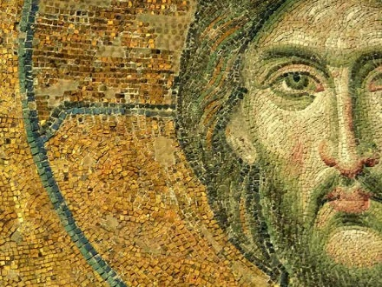
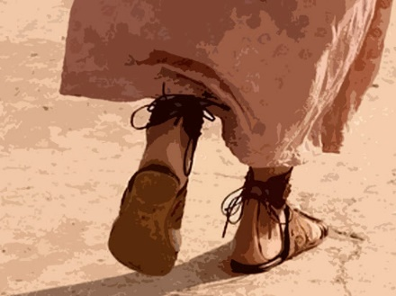
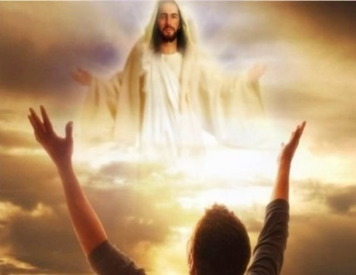
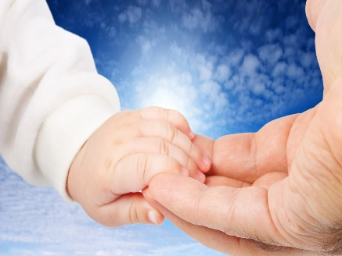
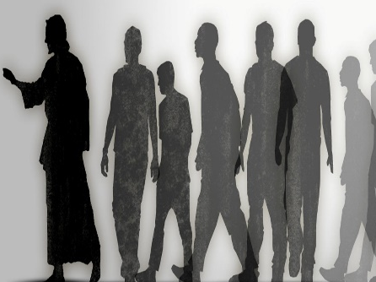
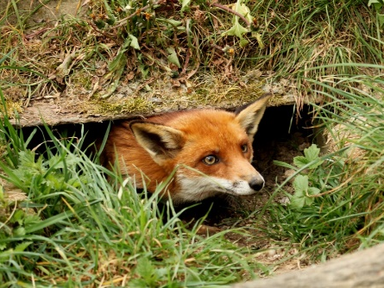

Slide 26
→ One must be ready to abandon all for Christ
→ One must bear one’s cross & come after Christ
→ Whoever does not forsake all cannot be My disciple
→ Whoever loses his life for My sake will find it
→ Disciples crucify the flesh with its passions/desires
→ If you abide in My word, you are My disciples
→ All will know you are My disciples if you have love
→ Be imitators of God as dear children & walk in love
→ No one looking back is fit for the kingdom of God
→ No one can serve two masters
→ If anyone serves Me, let him follow Me in honor
→ To glorify God bear much fruit as My disciples
→ Go make disciples of all the nations, baptizing them
Disciples follow the ways of God
Notes:
Disciples follow the ways of God.

Slide 27
Notes:
Darkness has no anchor.

Slide 28
Please visit http://www.RonBert.com/disciple.htm to explore further
Ronald Bert Channel on
Notes:
Eternity never ends.

