Slide 1
Notes:
In the absence of light, darkness has no smell.

Slide 2
Destiny will be what we seek
Ron Bert
October 6, 2019
Notes:
Seeking is a personal quest for that which one desires to obtain.

Slide 3
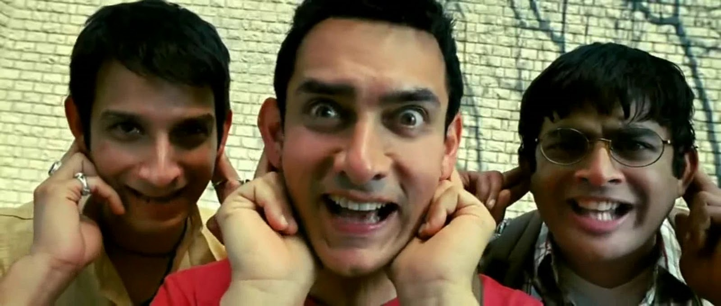
"How long, you simple ones, will you love simplicity? For scorners delight in their scorning, And fools hate knowledge." — Proverbs 1:22
fools
hate knowledge
Notes:
Many choose to live on impulse, either buried in a desperate moment or just personifying an outrageous presence, on to the next episode. These types of people care little for others as the plow or rip into both those near and far from them.

Slide 4
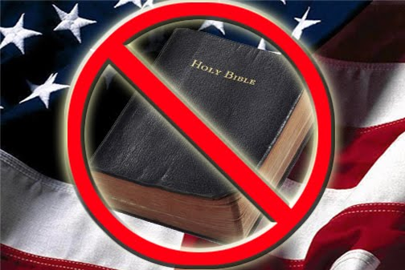
Salvation is far from the wicked, For they do not seek Your statutes. — Psalms 119:155
. .
fa
i
th
. .
Notes:
Unnoticed for many is they are dismissing God by ignoring what He has announced for humanity to know. By not caring to become familiar with His knowledge exposes a character of a self seeking, over a thankful submissive soul regarding that which is larger than all.

Slide 5
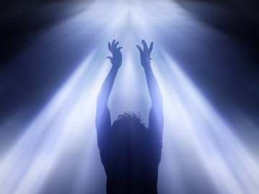
But without faith it is impossible to please Him, for he who comes to God must believe that He is, and that He is a rewarder of those who diligently seek Him. — Hebrews 11:6
God rewards those who seek Him
hope
faith
s
strength
I love those who love me, And those who seek me diligently will find me. — Proverbs 8:17
"But seek the kingdom of God, and all these things shall be added to you." — Luke 12:31
God
peace
seek
reward
those
will find me
seek Him
who
love
Notes:
Spiritual depths have no equal in the turmoil's of living. Strength of God comes by accepting His grace delivering peace through hope upwelling from mutual love. One has to be sober minded to carry a real relationship with God.

Slide 6
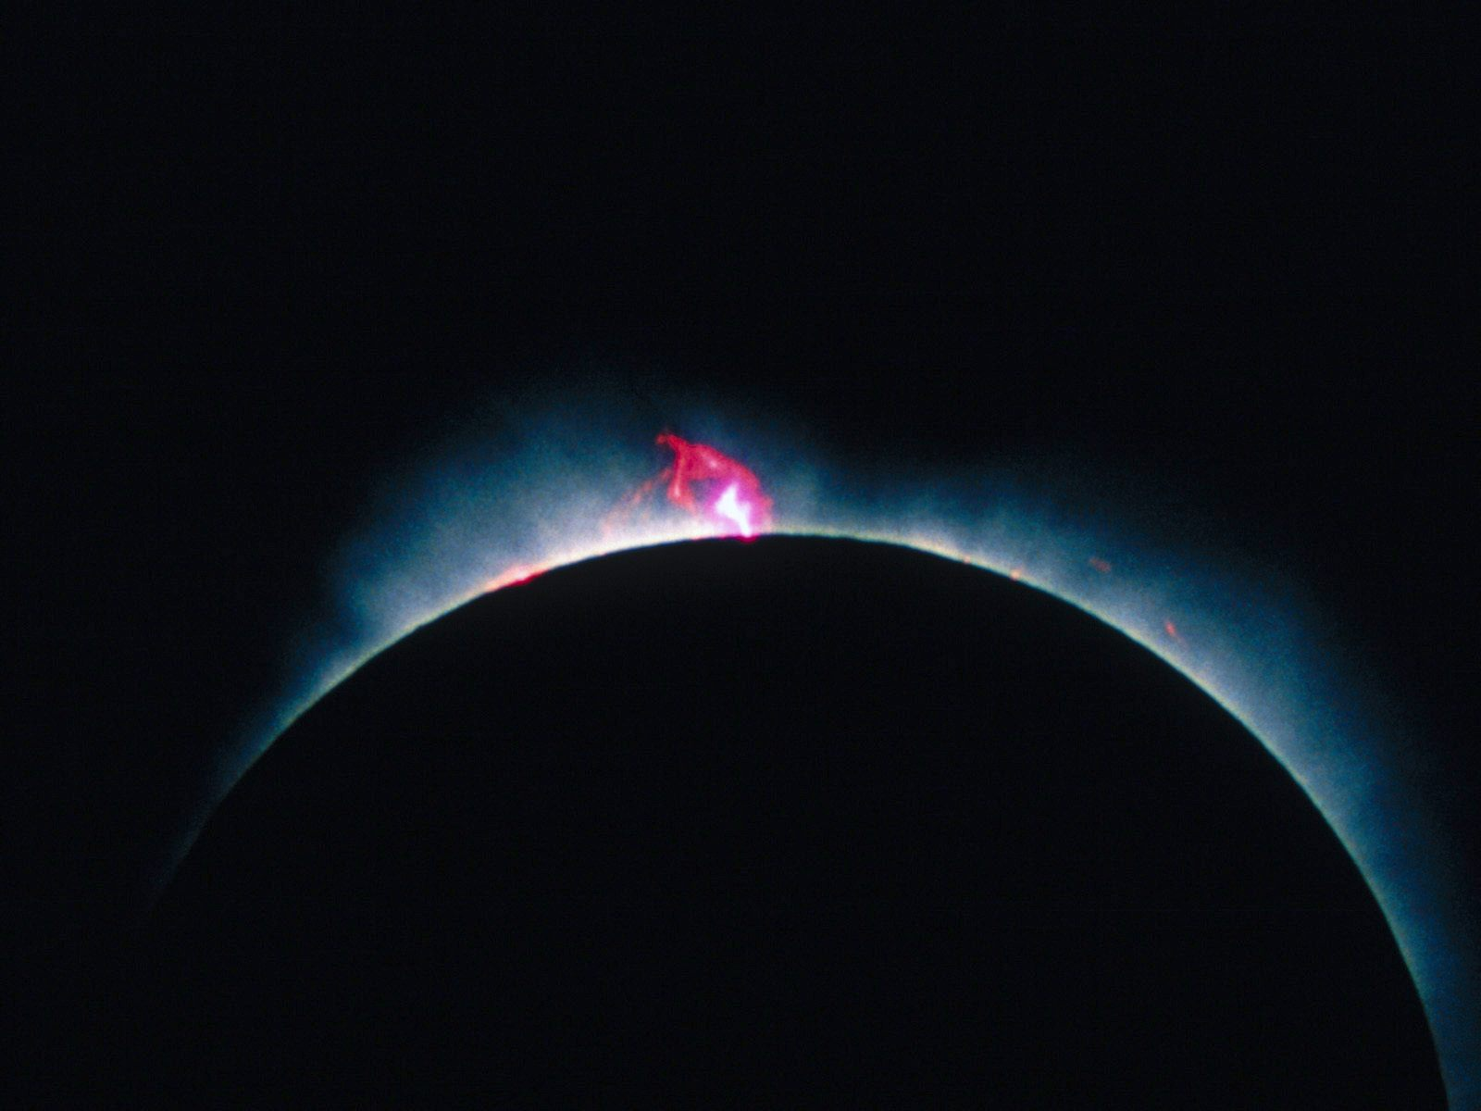
Depart from evil and do good; Seek peace and pursue it. — Psalm 34:14
2nd John
Judges
Joshua
1st John
Ruth
Deuteronomy
3rd John
2nd Peter
Numbers
1st & 2nd Samuel
Jude
1st Peter
Leviticus
Obadiah
Revelation
1st Corinthians
1st & 2nd Kings
Exodus
Amos
Jonah
James
2nd Corinthians
1st & 2nd Chronicles
Romans
Genesis
Joel
Galatians
Micah
Hebrews
Ezra
"Is not My word like a fire?"
"Is not My word like a fire?"
Hosea
Ephesians
Nehemiah
Daniel
Nahum
Philemon
Matthew
Malachi
Acts
Esther
Philippians
Habakkuk
Ezekiel
Titus
Zechariah
Mark
John
Job
Lamentations
Zephaniah
2nd Timothy
Colossians
Luke
Psalms
Haggai
Jeremiah
1st Timothy
Proverbs
1st Thessalonians
Isaiah
Ecclesiastes
2nd Thessalonians
Song of Solomon
Notes:
Only each humble heart can admit to how much one has examined His word concerning His presence among us. Sixty six books, 39 in the Old Testament and 27 in the New are open for review. To miss the Lord is to undermine the deepest reasons for living.

Slide 7
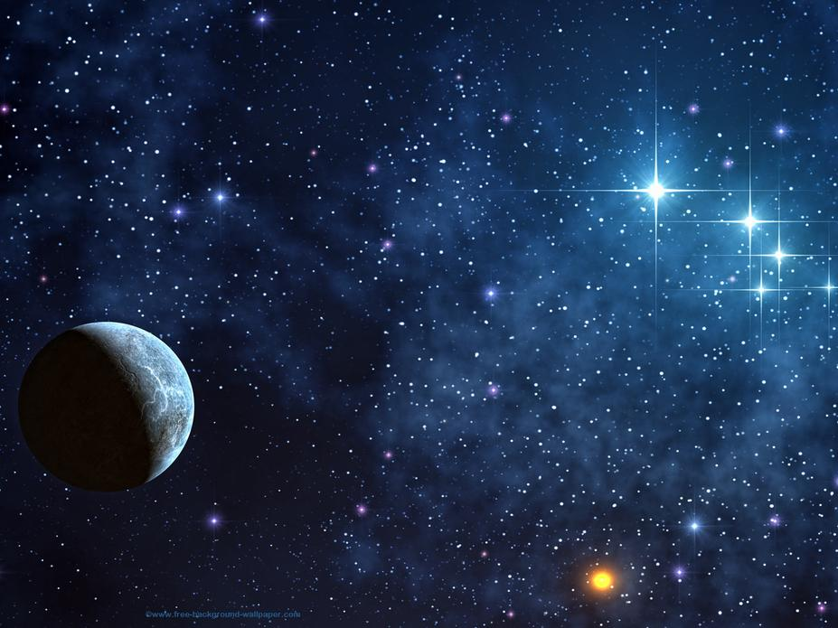
"I call heaven and earth as witnesses today against you, that I have set before you life and death, blessing and cursing; therefore choose life, that both you and your descendants may live;" — Deuteronomy 30:19
heaven and earth
living
witnesses
life
death
blessing
cursing
dying
Notes:
Each of us are presented with choices enabling the blessing of thankful living or merely rendered to the damnation of cursing in the midst of wishing death in a blind stupor. Our isolated rage tells the tale if it suppresses an openness to love. As witness is God in Heaven and all those who we would encounter during our stay upon this spatial orb called earth.

Slide 8
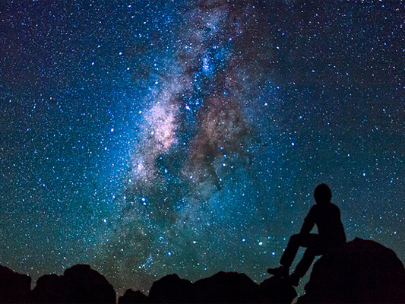
"As for you, my son Solomon, know the God of your father, and serve Him with a loyal heart and with a willing mind; for the LORD searches all hearts and understands all the intent of the thoughts. If you seek Him, He will be found by you; but if you forsake Him, He will cast you off forever." — 1st Chronicles 28:9
seek the LORD
you will find Him
LORD
ind
f
the LORD
understand
seek
Evil men do not understand justice, But those who seek the LORD understand all. — Proverbs 28:5
will
you
Him
Notes:
Clearly His message contains the path of return to something greater than can be written. By genuinely seeking Him, He unbiasedly promises to lift a heart into knowing. How eager is again the choice we choose to pursue. One only interested in the next beer and or faceless sex reduces to shallow extremism. True spiritual depth rises past the desire to possess the material. Do you seek the Eternal Lord in your deepest parts or is it something more shallow involving just the passing's of the earth?

Slide 9
He has shown you, O man, what is good; And what does the LORD require of you But to do justly, To love mercy, And to walk humbly with your God? — Micah 6:8
LORD
do justly
love mercy
walk humbly
Notes:
The evidence is overabundant in God reaching out for our return. It manifests in all that we perceive. The material is a test to find the heart of what we seek. Is it only for the selfish self or does nobility play notice?

Slide 10
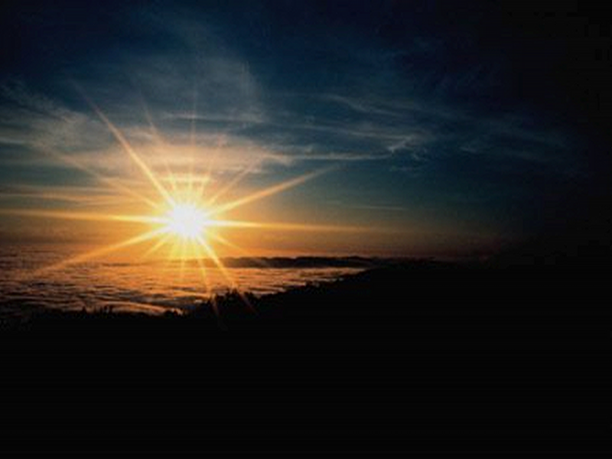
To Obey To Heed Do Justly Love Mercy Broken Spirit Contrite Heart Righteousness Knowledge of God
Regretful
For thus says the High and Lofty One Who inhabits eternity, whose name is Holy: "I dwell in the high and holy place, With him who has a contrite and humble spirit, To revive the spirit of the humble, And to revive the heart of the contrite ones. — Isaiah 57:15
For thus says the High and Lofty One Who inhabits eternity, whose name is Holy: "I dwell in the high and holy place, With him who has a contrite and humble spirit, To revive the spirit of the humble, And to revive the heart of the contrite ones. — Isaiah 57:15
For thus says the High and Lofty One Who inhabits eternity, whose name is Holy: "I dwell in the high and holy place, With him who has a contrite and humble spirit, To revive the spirit of the humble, And to revive the heart of the contrite ones. — Isaiah 57:15
Sorry
To Obey
To Heed
Do Justly
Remorseful
Apologetic
Love Mercy
With him
Broken Spirit
Contrite Heart
Ashamed
contrite
Righteousness
Knowledge of God
Penitent
Humbled
Feeling guilty
Notes:
October 2019 turned off Hidden
His life paid the price to engage us all in a personal relationship with the true One and Only Living Lord God. For those that return, the quality of listening takes action. God is with the soul that humbly falls before Him. He calls and commands we seek His will.

Slide 11
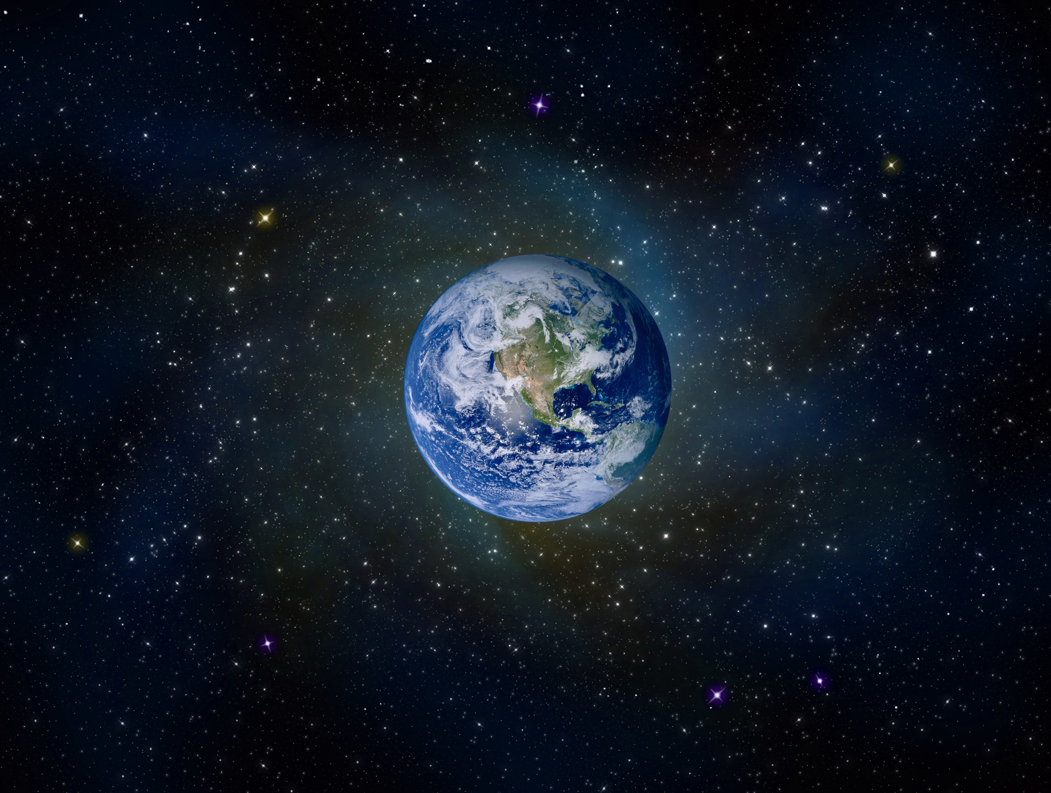
For this reason we also, since the day we heard it, do not cease to pray for you, and to ask that you may be filled with the knowledge of His will in all wisdom and spiritual understanding; that you may walk worthy of the Lord, fully pleasing Him, being fruitful in every good work and increasing in the knowledge of God; — Colossians 1:9-10
For this reason we also, since the day we heard it, do not cease to pray for you, and to ask that you may be filled with the knowledge of His will in all wisdom and spiritual understanding; that you may walk worthy of the Lord, fully pleasing Him, being fruitful in every good work and increasing in the knowledge of God; — Colossians 1:9-10
For this reason we also, since the day we heard it, do not cease to pray for you, and to ask that you may be filled with the knowledge of His will in all wisdom and spiritual understanding; that you may walk worthy of the Lord, fully pleasing Him, being fruitful in every good work and increasing in the knowledge of God; — Colossians 1:9-10
For this reason we also, since the day we heard it, do not cease to pray for you, and to ask that you may be filled with the knowledge of His will in all wisdom and spiritual understanding; that you may walk worthy of the Lord, fully pleasing Him, being fruitful in every good work and increasing in the knowledge of God; – Colossians 1:9-10
h
o
e
p
knowledge
His will
wisdom
understanding
Notes:
His gifts are delivered in the subtleties of living. It is His will that we find Him on our own as independent sentient creatures. How close we become with Him is directly related to the effort we put forth.

Slide 12
… that the God of our Lord Jesus Christ, the Father of glory, may give to you the spirit of wisdom and revelation in the knowledge of Him, the eyes of your understanding being enlightened; that you may know what is the hope of His calling, what are the riches of the glory of His inheritance in the saints, — Ephesians 1:17-18
… that the God of our Lord Jesus Christ, the Father of glory, may give to you the spirit of wisdom and revelation in the knowledge of Him, the eyes of your understanding being enlightened; that you may know what is the hope of His calling, what are the riches of the glory of His inheritance in the saints, — Ephesians 1:17-18
hope
hope
Father of
Father of
wisdom
wisdom
glory
glory
spirit
spirit
understanding
understanding
of wisdom and revelation
of wisdom and revelation
in the
wisdom
in the
wisdom
knowledge
knowledge
knowledge of Him
knowledge of Him
understanding
understanding
in
understanding
understanding
knowledge
knowledge
enlightened
enlightened
know
know
the hope of His calling
the hope of His calling
know the hope
hope
hope
the glory
the glory
of His inheritance
of His inheritance
Notes:
How could we hope not to have knowledge releasing the understanding of His true wisdom?

Slide 13
'Ah, Lord GOD! Behold, You have made the heavens and the earth by Your great power and outstretched arm. There is nothing too hard for You.' — Jeremiah 32:17
hope
In Him was life, and the life was the light of men. — John 1:4
in
wisdom
understanding
light
And so we have the prophetic word confirmed, which you do well to heed as a light that shines in a dark place, until the day dawns and the morning star rises in your hearts; — 2nd Peter 1:19
knowledge
Unto the upright there arises light in the darkness; He is gracious, and full of compassion, and righteous. — Psalms 112:4
arises light
light that shines
light
a light that shines
in a dark place, until the day dawns and the morning star rises in your hearts; — 2nd Peter 1:19
He
gracious
full of
Rewards of God
Fruits of Spirit
compassion
righteous
CHRIST
in
He = in His Image
Notes:
For those that embrace His ways, an eternal light comes to heart. The fires of eternity cannot be extinguished for in them is no darkness where we will come to dwell in His light. He calls for us to rise back to Him. He exposes Himself so that we may know how to be in conduct and godliness. Graciousness and to be full of compassion and righteousness is to partake in the fruit of the spirit as well as embrace these qualities as a reward from God.

Slide 14
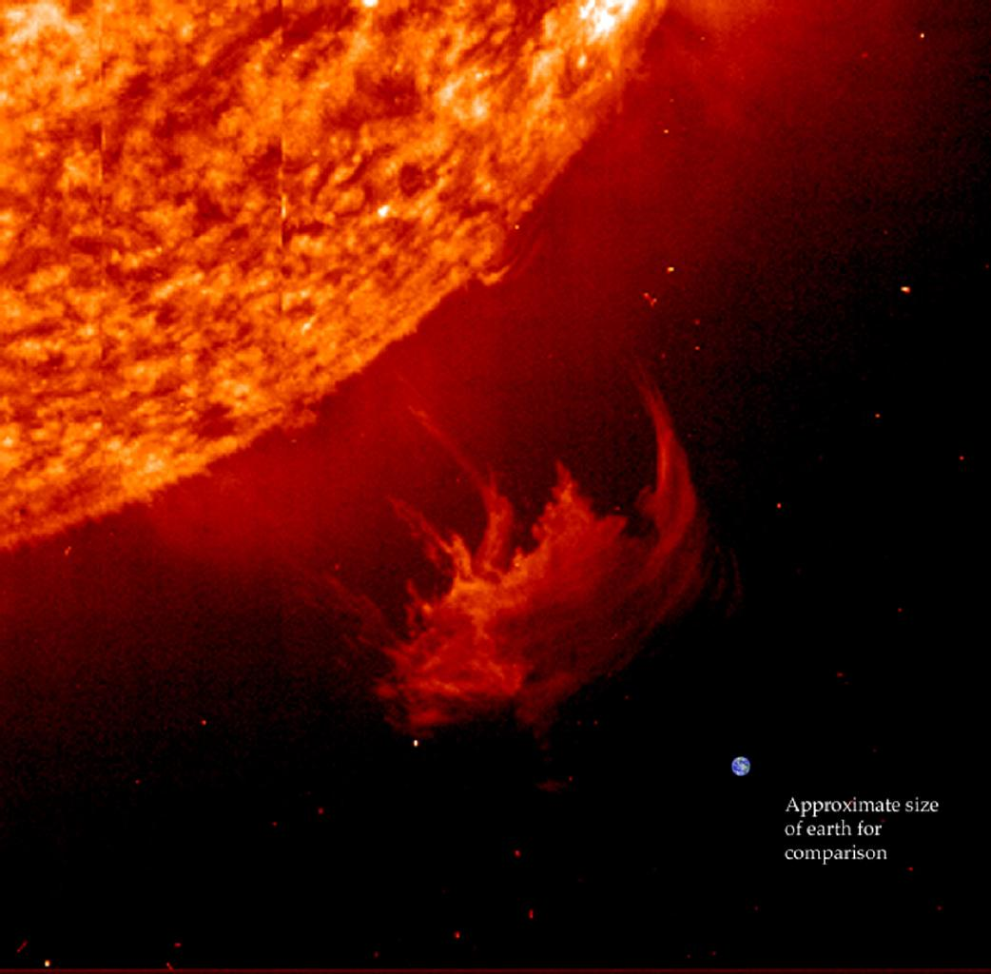
Therefore, since all these things will be dissolved, what manner of persons ought you to be in holy conduct and godliness, looking for and hastening the coming of the day of God, because of which the heavens will be dissolved, being on fire, and the elements will melt with fervent heat? — 2nd Peter 3:11-12
day of the Lord
But the day of the Lord will come as a thief in the night, in which the heavens will pass away with a great noise, and the elements will melt with fervent heat; both the earth and the works that are in it will be burned up — 2nd Peter 3:10
light that shines
manner of persons
holy conduct and godliness
Seek the LORD
Seek
Seek the LORD, all you meek of the earth, Who have upheld His justice. Seek righteousness, seek humility. It may be that you will be hidden In the day of the LORD'S anger. — Zephaniah 2:3
day of God
Seek righteousness
Seek
seek humility
seek
He stretches out the north over empty space; He hangs the earth on nothing. — Job 26:7
Approximate
size of earth for comparison
Notes:
A single coronal mass ejection (CME) could quickly extinguish life on earth if it were the will of God. One of His creations is that He hangs matter on the edge of nothing. His power to create is immeasurable. Time itself simultaneously reacts in space as it continually separates; quite a magnificent displaying of velocities structure and all due to and of His ingenious enigmatic will. Surely His presence extends well past knowledge upholding reality itself. His touch spreads to the edge of eternity.

Slide 15
Love does no harm to a neighbor; therefore love is the fulfillment of the law. — Romans 13:10
Let no one seek his own, but each one the other's well-being. — 1st Corinthians 10:24
Let no one seek his own, but each one the other's well-being. — 1st Corinthians 10:24
Love does no harm to a neighbor; therefore love is the fulfillment of the law. — Romans 13:10
manner of persons
If then you were raised with Christ, seek those things which are above, where Christ is, sitting at the right hand of God.
— Colossians 3:1
If then you were raised with Christ, seek those things which are above, where Christ is, sitting at the right hand of God.
— Colossians 3:1
Notes:
October 2019 turned off Hidden
The key to living is loving.

Slide 16
the judgment
day of visitation
Hebrews 9:27
Beloved, now we are children of God; and it has not yet been revealed what we shall be, but we know that when He is revealed, we shall be like Him, for we shall see Him as He is. - 1st John 3:2
Beloved, now we are children of God; and it has not yet been revealed what we shall be, but we know that when He is revealed, we shall be like Him, for we shall see Him as He is. - 1st John 3:2
See that you do not refuse Him who speaks. For if they did not escape who refused Him who spoke on earth, much more shall we not escape if we turn away from Him who speaks from heaven, … - Hebrews 12:25
See that you do not refuse Him who speaks. For if they did not escape who refused Him who spoke on earth, much more shall we not escape if we turn away from Him who speaks from heaven, … - Hebrews 12:25
John 6:40 John 12:48
THAT
DAY
THE
END
end of the age
2nd Peter 3:12
see Him
Proverbs 16:4
Luke 21:33-36
Job 21:30
Matthew 24:13
day of God
Matthew 13:49-50
2nd Peter 3:10
day of the Lord
Love
Love has been perfected among us in this: that we may have boldness in the day of judgment; because as He is, so are we in this world. – 1st John 4:17
Love has been perfected among us in this: that we may have boldness in the day of judgment; because as He is, so are we in this world. – 1st John 4:17
boldness
1st Peter 2:12
day of doom
1st John 4:17
day of wrath
day of judgment
last day
Notes:
October 2019 turned off Hidden
A situation is coming for all that transcends time itself. It will be an accounting with that supreme of all fateful awakening occurrences. It will define life over death unveiling all secrets. It will be soberly plain as justice is true for each soul before Him. May the gravity of this event find one prepared as its finality is eternal.

Slide 17
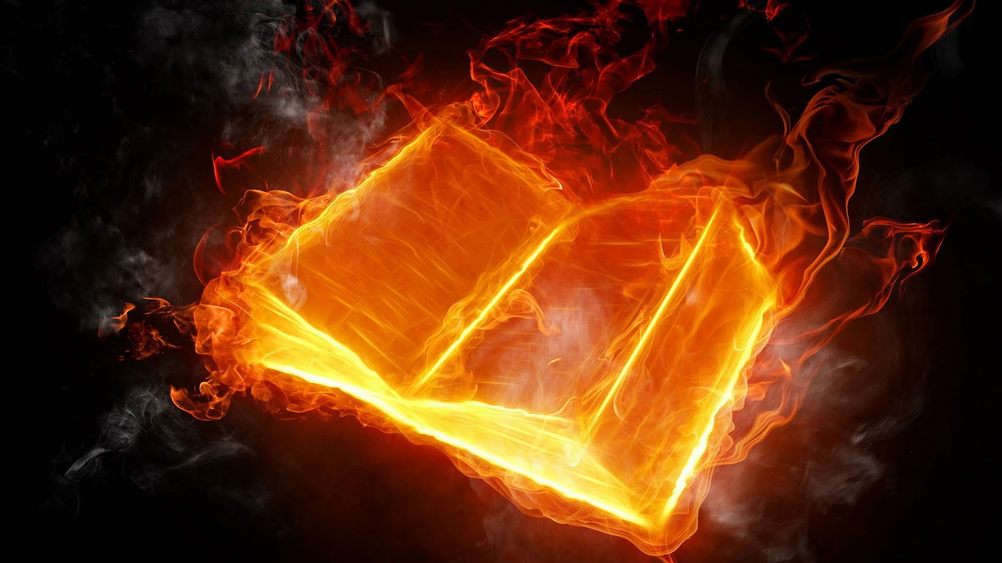
Blessed is he who reads and those who hear the words of this prophecy, and keep those things which are written in it; for the time is near. — Revelation 1:3
Blessed
is
read
reads
hear
hear
NEARS
NEARS
HEARS
READS
KEEPS
reads + hear + keep = Blessed
keep
keep
in
time is near
Notes:
It is in His word saints find sanctuary that no weapon can destroy. The message has always been that time is near, for each of us, one breath close.

Slide 18
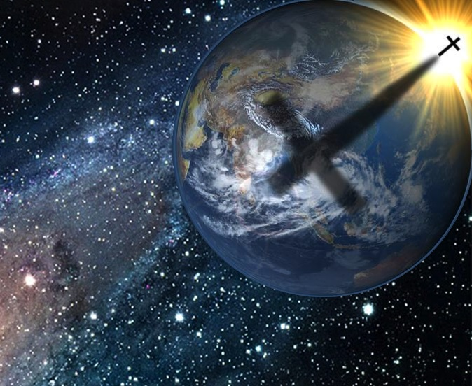
→ Fools hate knowledge
→ The wicked miss salvation with no desire for His law
→ God rewards those who diligently seek Him
→ His word is a torch that pierces through all delusions
→ We all face a decision to live or to die
→ God can be found if one seeks Him
→ God is with the humble bestowing a lifting spirit
→ Must do justly, love mercy, & walk humbly with God
→ Filled with and growing in the knowledge of His will
→ Know the hope of His call & riches of His inheritance
→ For the upright, God brings light in the darkness
→ Consider what manner of person you ought to be
→ To live is to love and here stands the law of God
We will be judged
by what we seek
Notes:
We will be judged by what we seek. In His eternal light justice prevails where all rejoice.

Slide 20
Notes:
Darkness resides where all has been stripped bare.

Slide 21
Please visit http://www.LoveFromGod.com/destiny.htm to explore further
Ronald Bert Channel on
Notes:
Eternity never ends.

