Slide 2
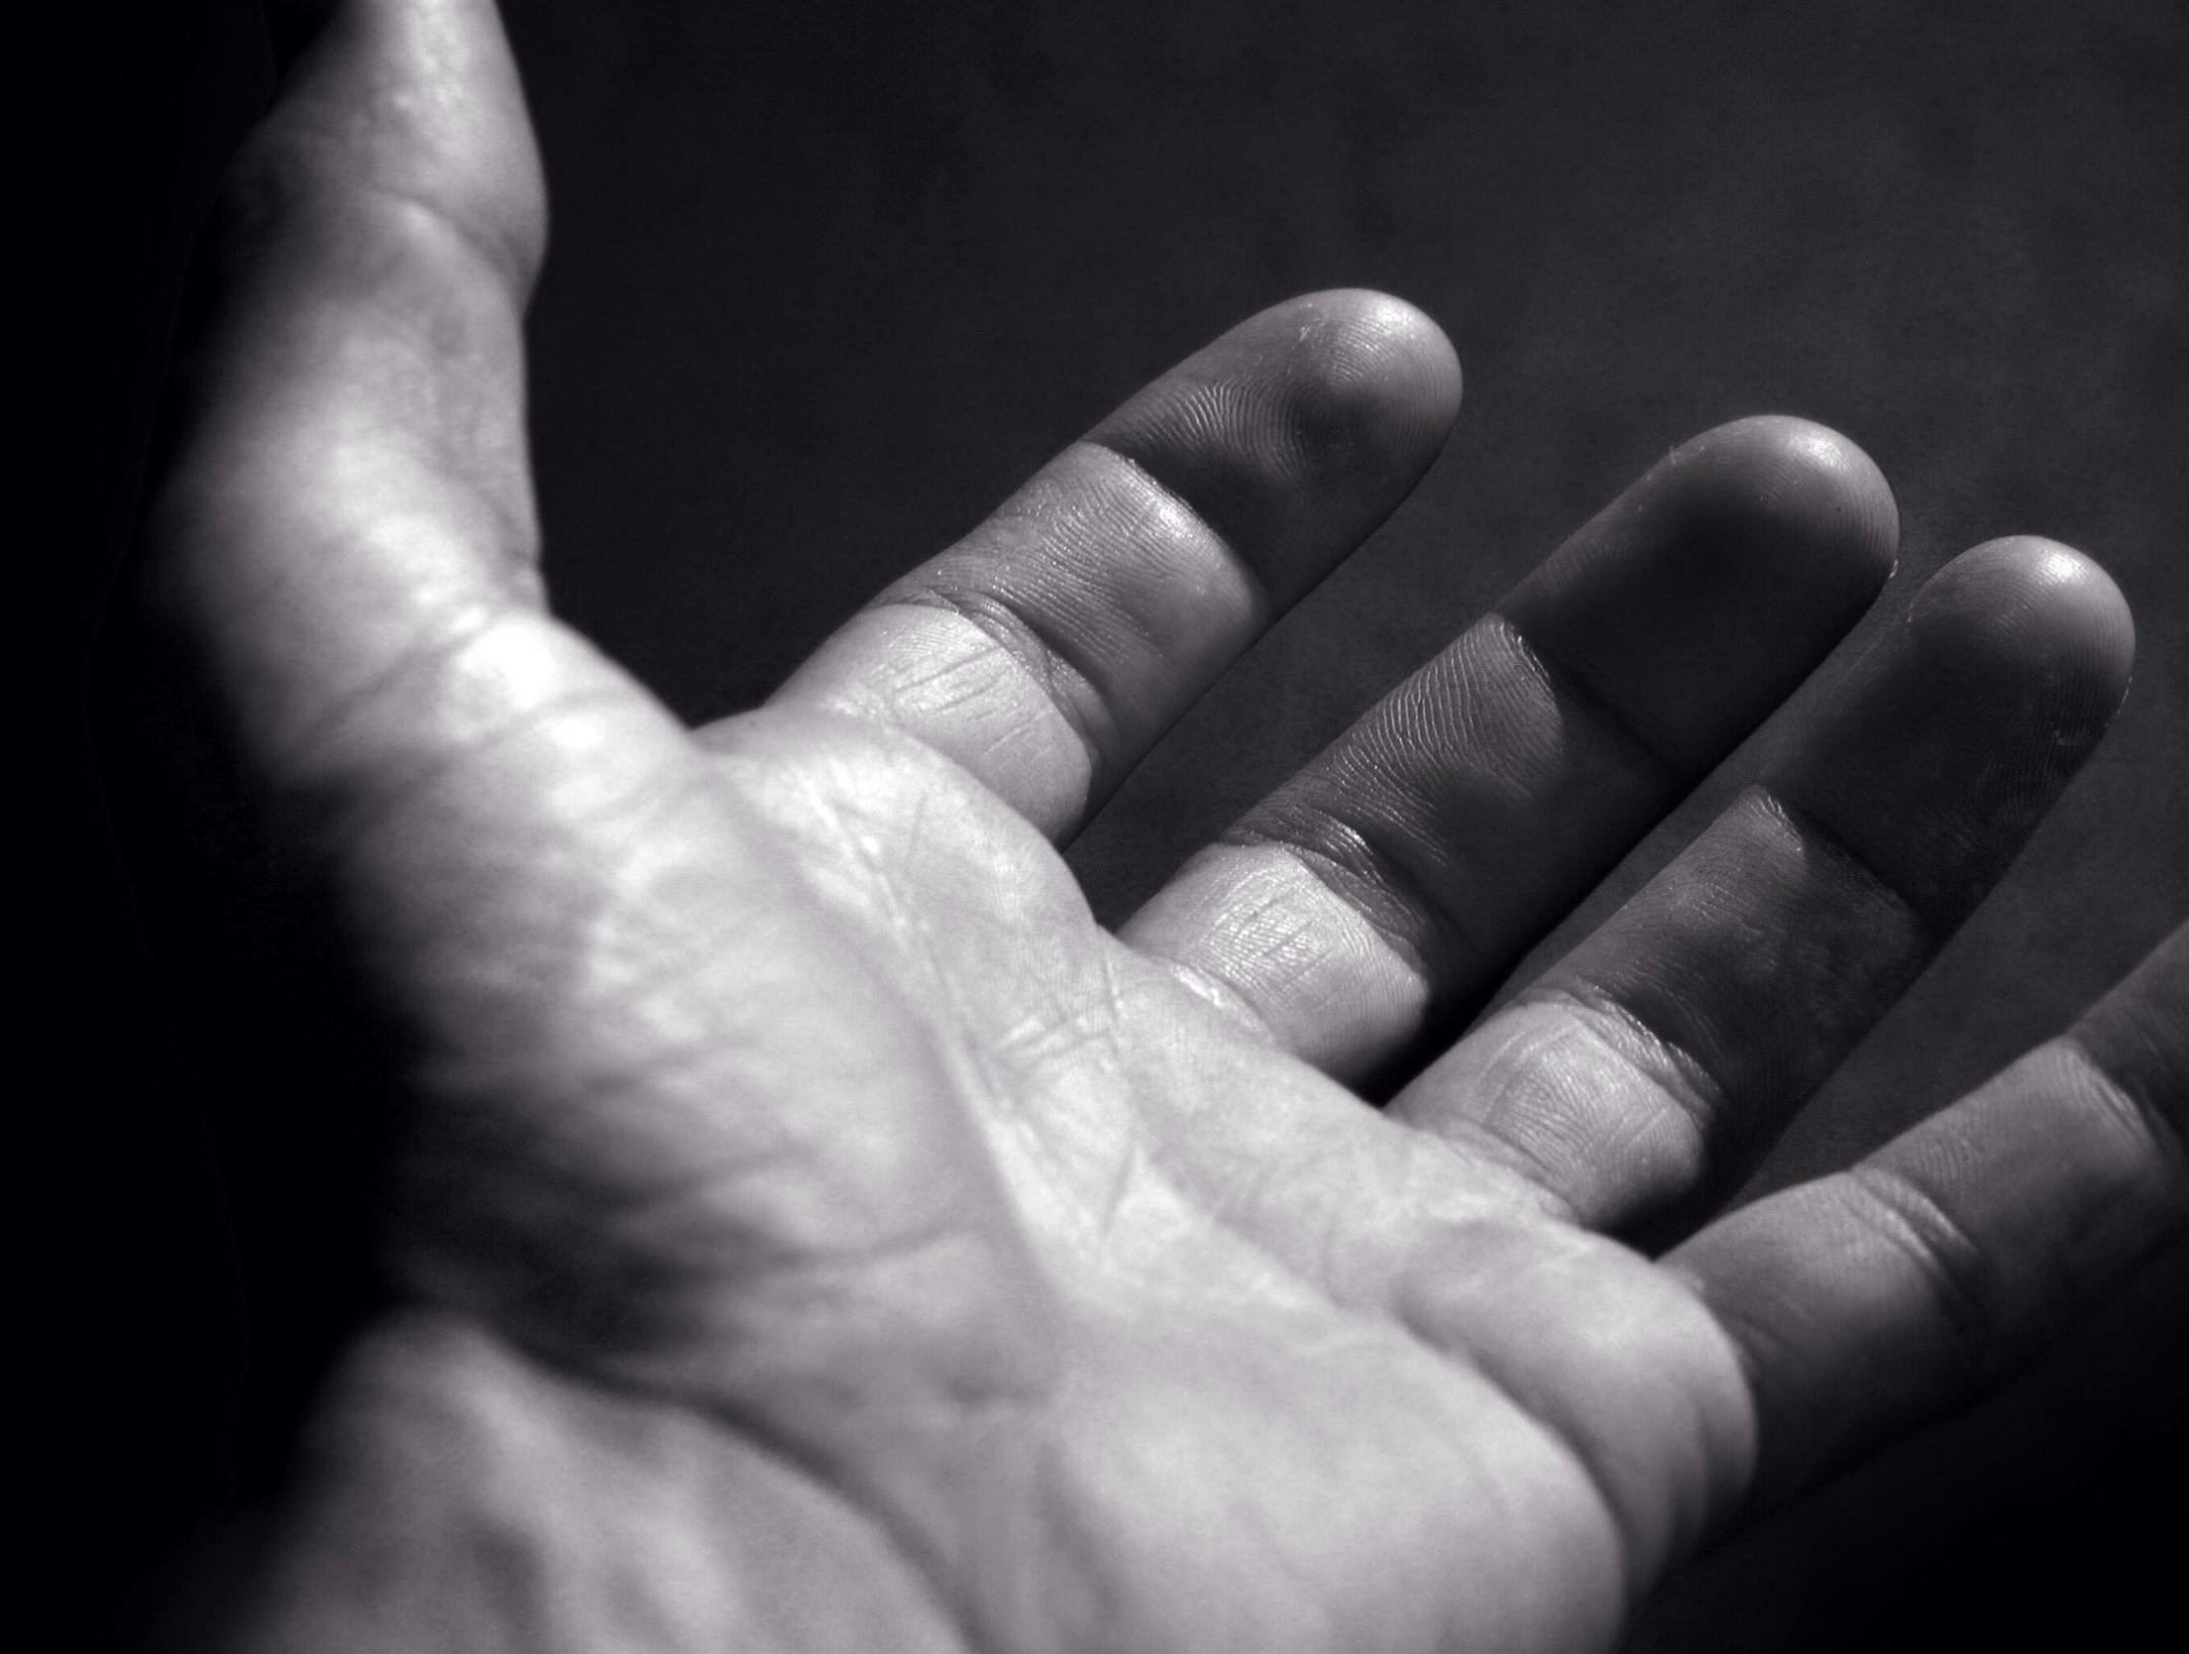
Desire
Ron Bert
August 25, 2019

Slide 3
Delight yourself also in the LORD, And He shall give you the desires of your heart. Commit your way to the LORD, Trust also in Him, And He shall bring it to pass. — Psalms 37:4-5
joy
in
LORD
desire
desire
Commit your way
Trust

Slide 4
Lord, all my desire is before You; And my sighing is not hidden from You. — Psalms 38:9
faith
desire
f
r
e
a
desire
sighing
not hidden

Slide 5
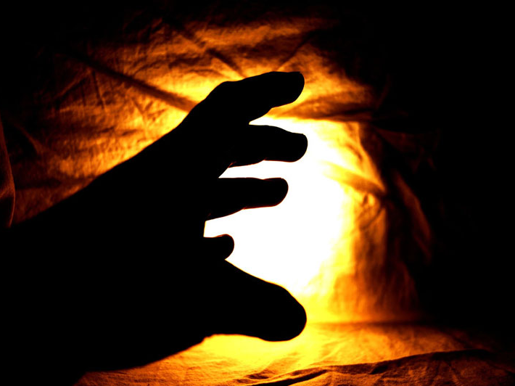
The fear of the wicked will come upon him, And the desire of the righteous will be granted. — Proverbs 10:24
desire
fear of the wicked
desire
righteous
granted

Slide 6
Whatever my eyes desired I did not keep from them. I did not withhold my heart from any pleasure, For my heart rejoiced in all my labor; And this was my reward from all my labor. — Ecclesiastes 2:10
desire
desire
For my heart
Without God all is vanity

Slide 7
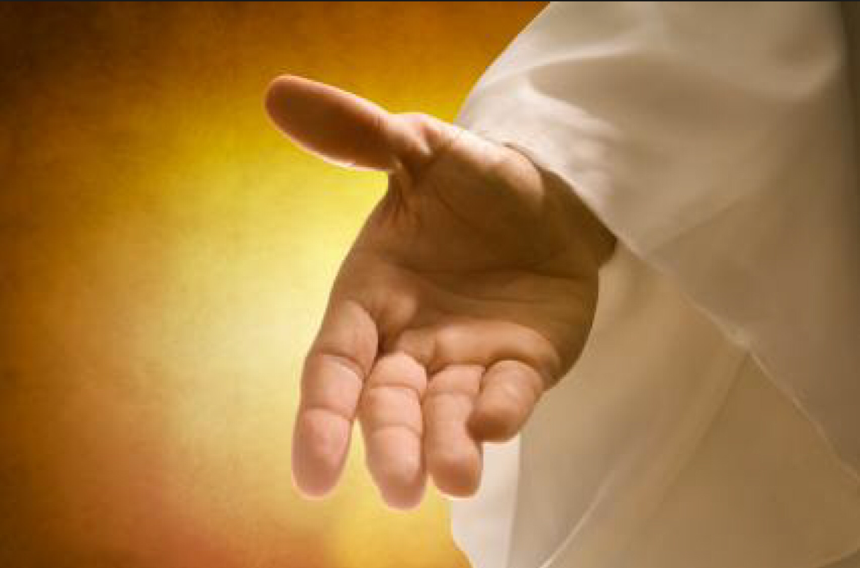
You open Your hand And satisfy the desire of every living thing. The LORD is righteous in all His ways, Gracious in all His works. The LORD is near to all who call upon Him, To all who call upon Him in truth. He will fulfill the desire of those who fear Him; He also will hear their cry and save them. — Psalms 145:16-19
satisfy
desire
desire
satisfy
fulfill
near
call
in
who call upon Him in truth
fulfill
desire

Slide 8
A desire accomplished is sweet to the soul, But it is an abomination to fools to depart from evil. — Proverbs 13:19
desire
accomplished is sweet
desire
HOPE
abomination
fool
depart
evil
fool
abomination
depart
evil
X

Slide 9
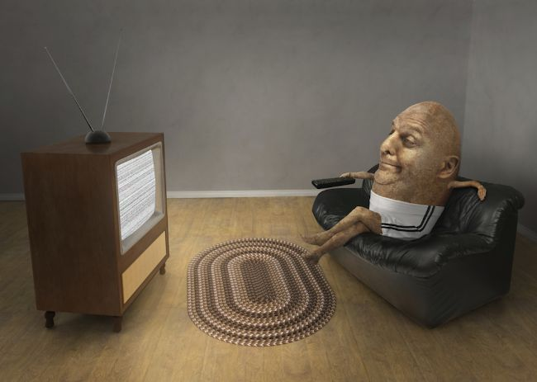
The desire of the lazy man kills him, For his hands refuse to labor. — Proverbs 21:25
desire
desire
nothing
hands refuse to labor
hand

Slide 10
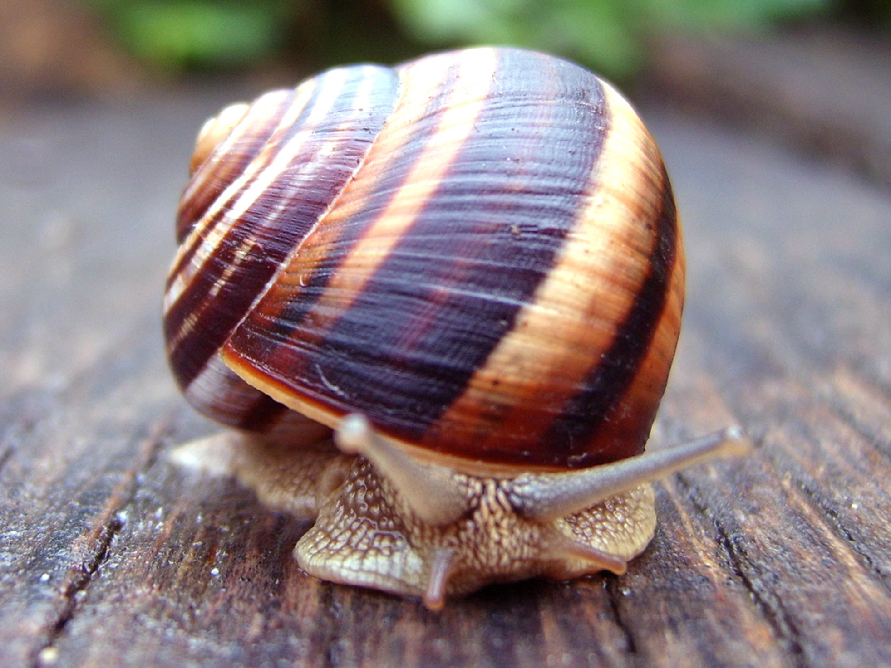
The soul of a lazy man desires, and has nothing; But the soul of the diligent shall be made rich. — Proverbs 13:4
diligent soul is rich
lazy man
i
s
desire
desire
has nothing
lazy man
has nothing
soul
nothing
diligent
rich
conscientious
hardworking
meticulous
attentive
thorough

Slide 11
Do not be envious of evil men, Nor desire to be with them; For their heart devises violence, And their lips talk of troublemaking. — Proverbs 24:1-2
evil men
evil men
violence
troublemaking
desire
violence
troublemaking
desire

Slide 12
For what more has the wise man than the fool? What does the poor man have, Who knows how to walk before the living? Better is the sight of the eyes than the wandering of desire. This also is vanity and grasping for the wind. — Ecclesiastes 6:8-9
G
O
D
Better
desire
vison of purpose
carelessness
desire

Slide 13
Hope deferred makes the heart sick, But when the desire comes, it is a tree of life. — Proverbs 13:12
desire
patience
desire
joy

Slide 14
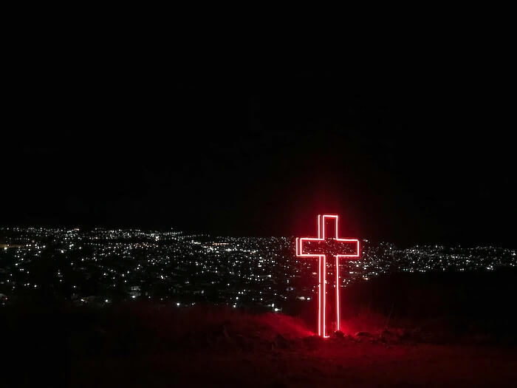
Pursue love, and desire spiritual gifts, but especially that you may prophesy. — 1st Corinthians 14:1
desire
desire spiritual gifts
desire

Slide 15
This is a faithful saying: If a man desires the position of a bishop, he desires a good work. — 1st Timothy 3:1
desire
good work
desire

Slide 16
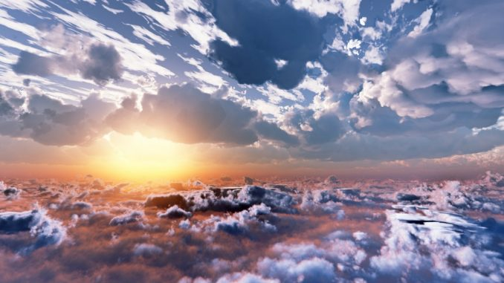
For I am hard pressed between the two, having a desire to depart and be with Christ, which is far better. — Philippians 1:23
desire
desire
be with Christ
Christ

Slide 17
But now they desire a better, that is, a heavenly country. Therefore God is not ashamed to be called their God, for He has prepared a city for them. — Hebrews11:16
desire
better
heavenly country
heaven
heaven

Slide 18
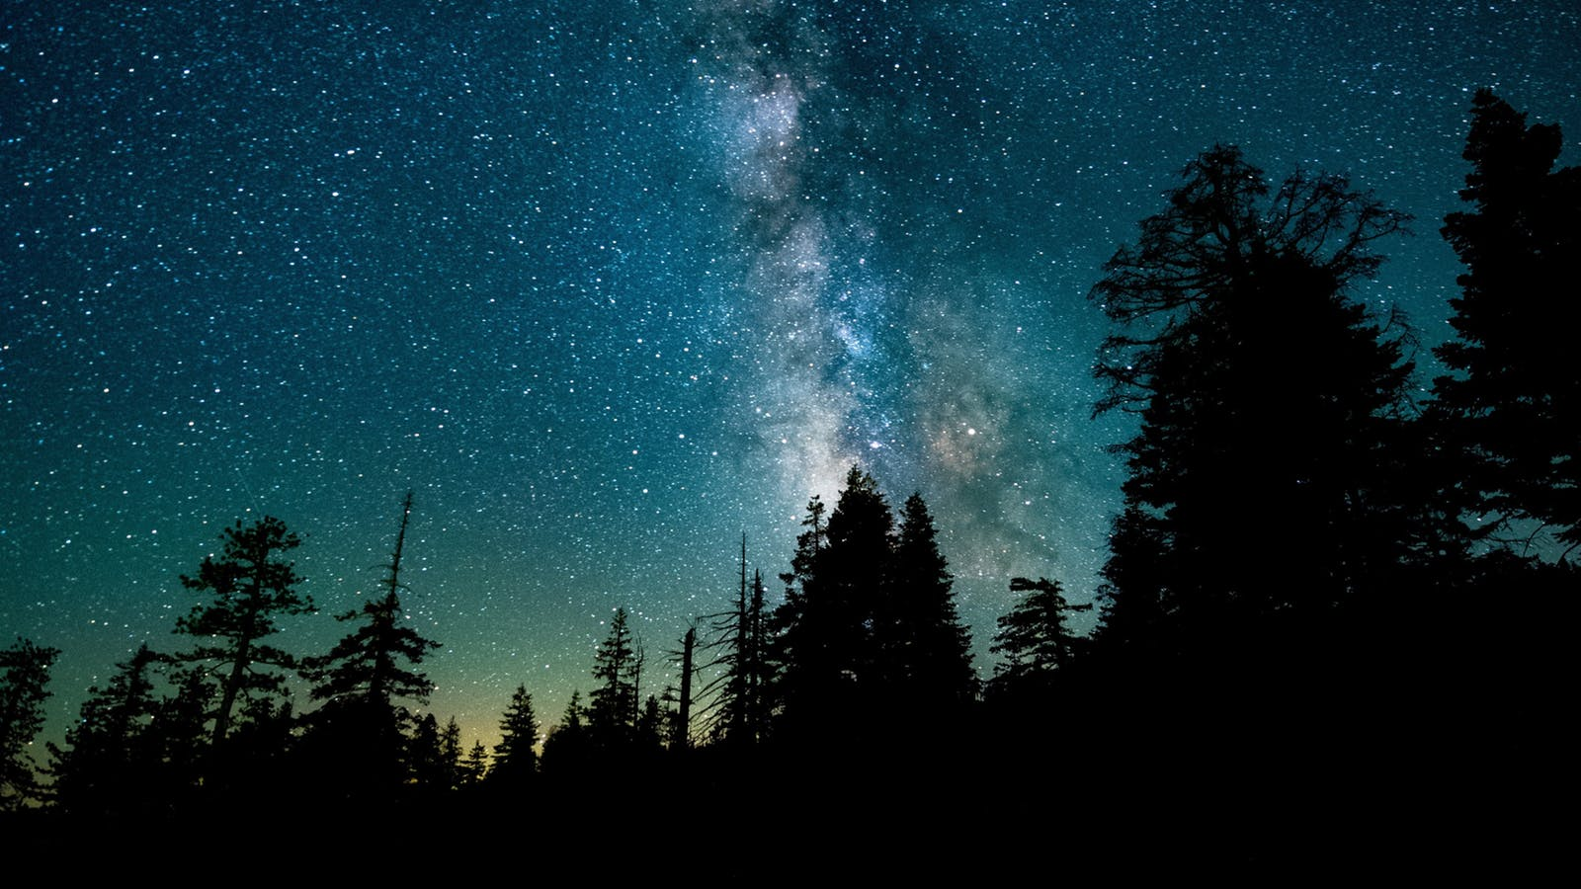
For in this we groan, earnestly desiring to be clothed with our habitation which is from heaven, — 2nd Corinthians 5:2
we groan
heaven

Slide 19
For I desire mercy and not sacrifice, And the knowledge of God more than burnt offerings. — Hosea 6:6
God
knowledge
knowledge
God

Slide 20
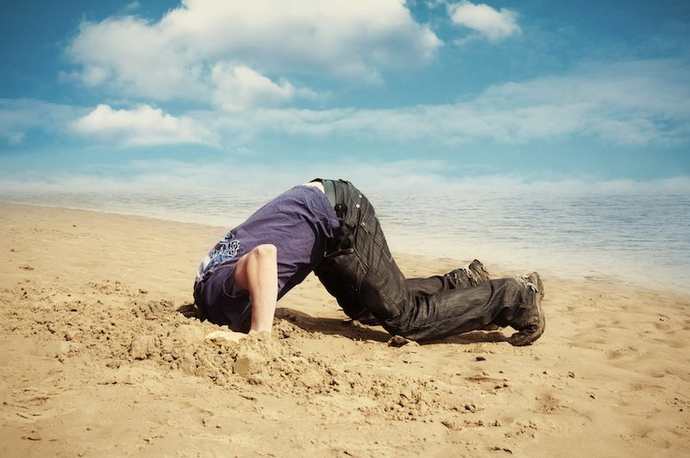
Brethren, my heart's desire and prayer to God for Israel is that they may be saved. For I bear them witness that they have a zeal for God, but not according to knowledge. For they being ignorant of God's righteousness, and seeking to establish their own righteousness, have not submitted to the righteousness of God. — Romans 10:1-3
God
zeal
God
knowledge
not according to knowledge
God
God

Slide 21
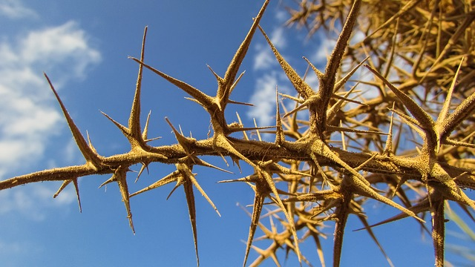
"Now these are the ones sown among thorns; they are the ones who hear the word, and the cares of this world, the deceitfulness of riches, and the desires for other things entering in choke the word, and it becomes unfruitful." — Mark 4:18-9
cares
of this world
desires
desires

Slide 22
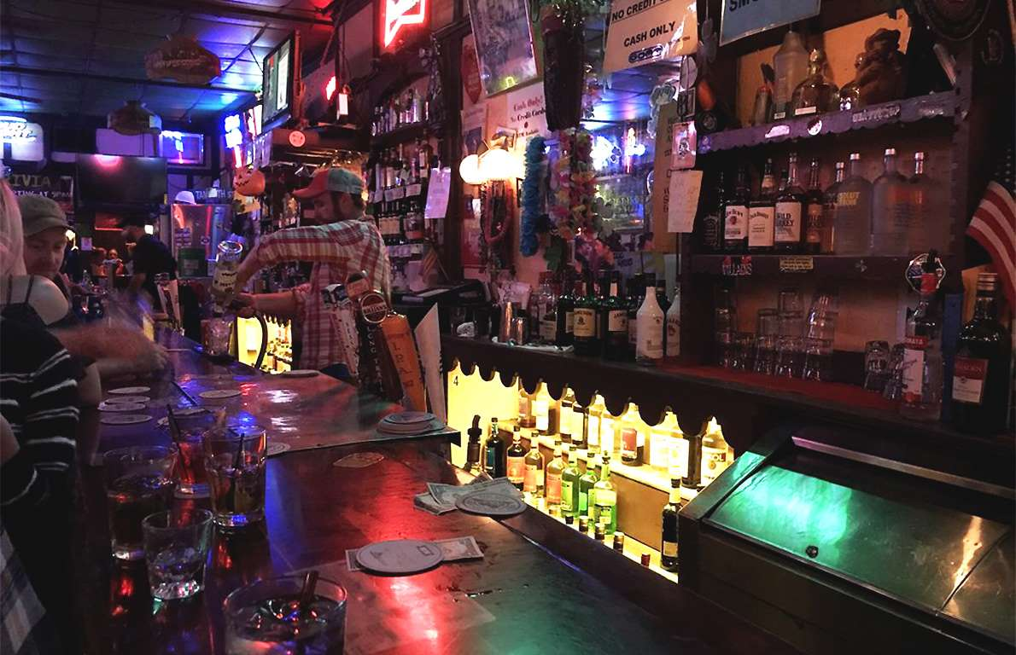
… among whom also we all once conducted ourselves in the lusts of our flesh, fulfilling the desires of the flesh and of the mind, and were by nature children of wrath, just as the others. — Ephesians 2:3
:
fulfilling the desires of lusts:
→ of the flesh
→ of the mind
by nature children of wrath
→
lusts
of
→
fulfilling the desires of
desires
the flesh
of the mind
by nature children of wrath

Slide 23
… in which you once walked according to the course of this world, according to the prince of the power of the air, the spirit who now works in the sons of disobedience, … — Ephesians 2:2
you once walked
disobedience
Satan complex
disobedience

Slide 24
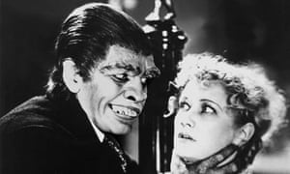
The soul of the wicked desires evil; His neighbor finds no favor in his eyes. — Proverbs 21:10
lewdness
life
Christ
Christ who is out life
jealousies
When Christ who is our life appears, then you also will appear with Him in glory. Therefore put to death your members which are on the earth: fornication, uncleanness, passion, evil desire, and covetousness, which is idolatry. — Colossians 3:4-5
hatred
soul of the wicked
EVIL
wrath
disobedience
desire
put to death
immorality
selfishness
liars
evil eye
superiority
evil desire
desire
envy
desire
drunkenness
thieving

Slide 25
For godly sorrow produces repentance leading to salvation, not to be regretted; but the sorrow of the world produces death. For observe this very thing, that you sorrowed in a godly manner: What diligence it produced in you, what clearing of yourselves, what indignation, what fear, what vehement desire, what zeal, what vindication! In all things you proved yourselves to be clear in this matter. — 2nd Corinthians 7:10-11
godly sorrow
repentance leading to salvation
not to be regretted
producing:
• diligence
• indignation
• clarity
• vehement desire
• zeal
• vindication
sorrow of the world
produces death
godly sorrow
repentance
leading to salvation
not to be regretted
saints
sorrow of the world
produces
death
ing
ty
diligence
produc
cl
ari
indignation
desire
vehement desire
zeal
vindication
wretch

Slide 28
Desire
2
Ron Bert
September 1, 2019

Slide 29
Of His own will He brought us forth by the word of truth, that we might be a kind of firstfruits of His creatures. — James 1:18
s
l
o
u
word of truth
His creatures
soul

Slide 30
Therefore lay aside all filthiness and overflow of wickedness, and receive with meekness the implanted word, which is able to save your souls. — James 1:21
lay aside
all filthiness
overflow of
wickedness
which is able to
save your souls
lay aside
all filthiness
soul
wicked
overflow of
wickedness
receive with
meekness the
receive with
meekness the
implanted word
implanted word
which is able
to
save your souls
soul
wicked
Notes:
Soul juice

Slide 31
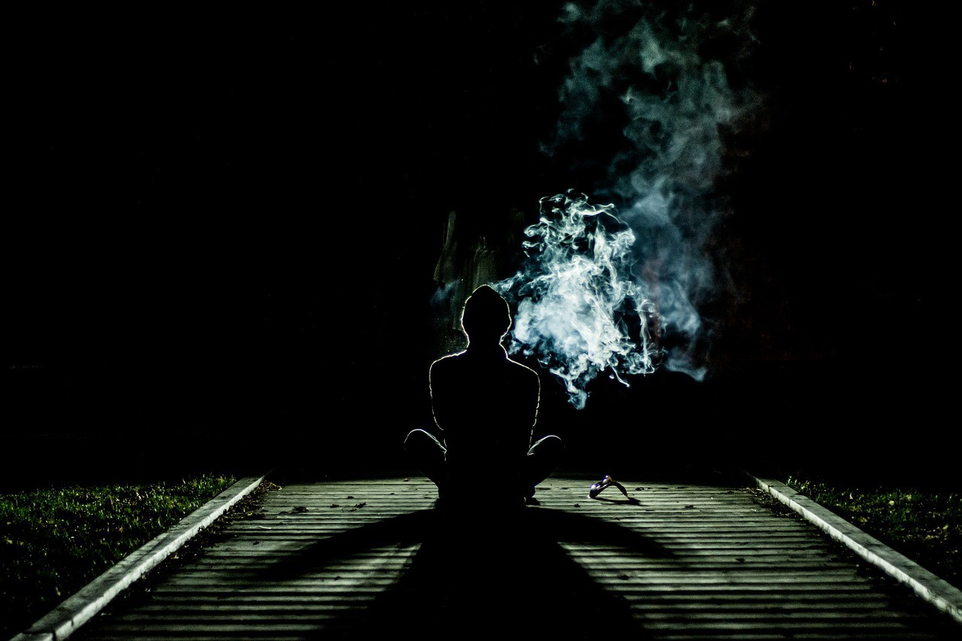
He has dispersed abroad, He has given to the poor; His righteousness endures forever; His horn will be exalted with honor. The wicked will see it and be grieved; He will gnash his teeth and melt away; The desire of the wicked shall perish. — Psalms 112:9-10
His righteousness endures forever
wicked
wicked
The desire of the
wicked
wicked shall perish

Slide 32
The desire of the righteous is only good, But the expectation of the wicked is wrath. — Proverbs 11:23
desire
good
desire
wicked
wrath
Notes:
Wickedness creates panic attacks.

Slide 33
You lust and do not have. You murder and covet and cannot obtain. You fight and war. Yet you do not have because you do not ask. — James 4:2
ask
desire
desire
ask

Slide 34
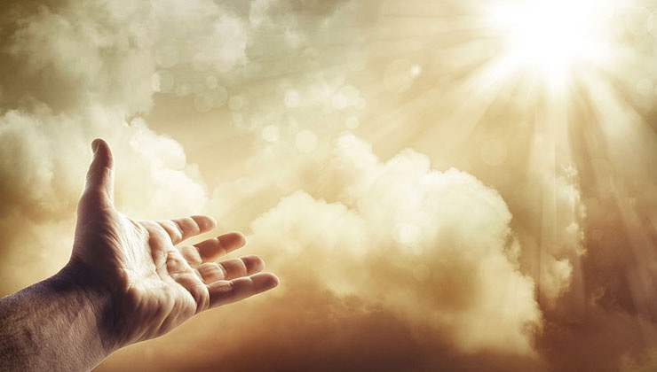
Now this is the confidence that we have in Him, that if we ask anything according to His will, He hears us. And if we know that He hears us, whatever we ask, we know that we have the petitions that we have asked of Him. — 1st John 5:14-15
ask
according to His will

Slide 35
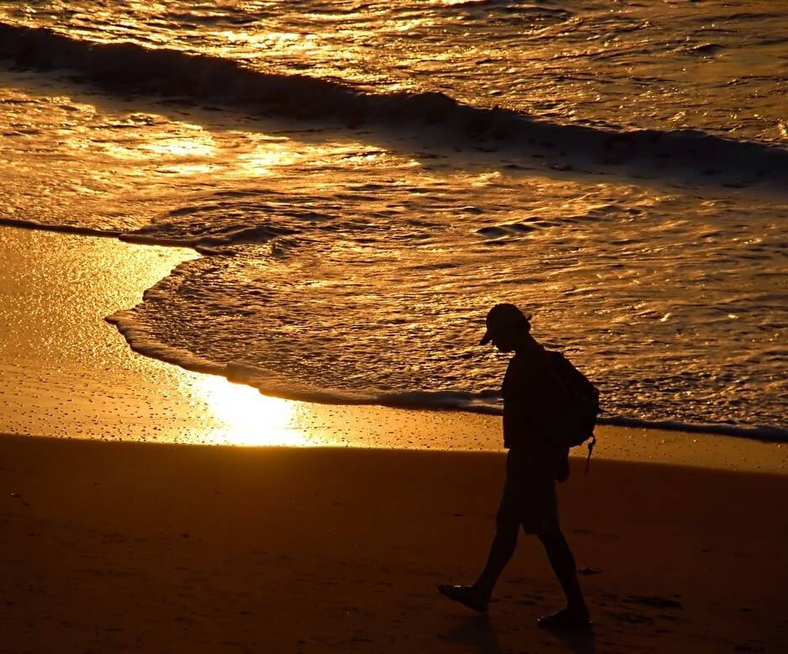
Let us walk properly, as in the day, not in revelry and drunkenness, not in lewdness and lust, not in strife and envy. But put on the Lord Jesus Christ, and make no provision for the flesh, to fulfill its lusts. — Romans 13:13-14
Let us walk properly, as in the day
not in:
• revelry and drunkenness
• lewdness and lust
• strife and envy
in
not
in
walk properly
w
Let us walk properly, as in the day
er
in
not in
revelry and drunkenness
in
w
in
lewdness and lust
strife and envy
put on
Jesus Christ
will
power
p
o
ill
Jesus Christ
Jesus Christ

Slide 36
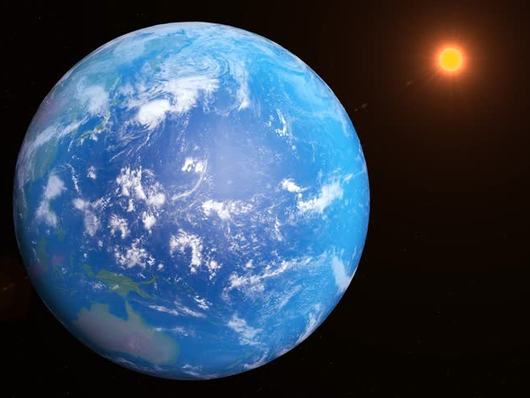
Do not love the world or the things in the world. If anyone loves the world, the love of the Father is not in him. For all that is in the world -- the lust of the flesh, the lust of the eyes, and the pride of life -- is not of the Father but is of the world. And the world is passing away, and the lust of it; but he who does the will of God abides forever. — 1st John 2:15-17
Do not love the world or the things in the world. If anyone loves the world, the love of the Father is not in him. For all that is in the world -- the lust of the flesh, the lust of the eyes, and the pride of life -- is not of the Father but is of the world. And the world is passing away, and the lust of it; but he who does the will of God abides forever. — 1st John 2:15-17
love of the Father
And the world is passing
away, and the lust of it; but he who
does the will of God abides forever

Slide 37
But each one is tempted when he is drawn away by his own desires and enticed. — James 1:14
drawn away
desires
desires

Slide 38
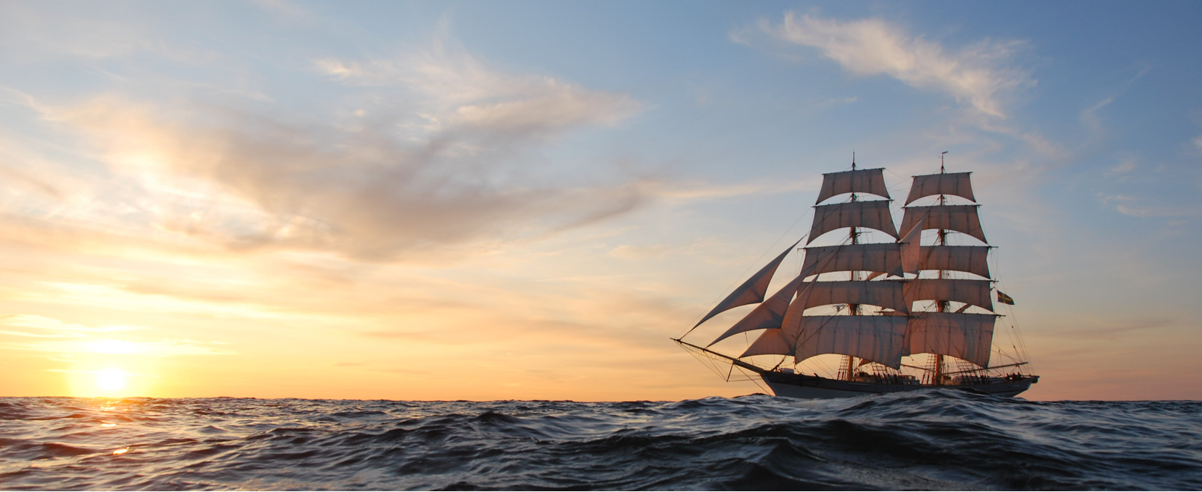
Look also at ships: although they are so large and are driven by fierce winds, they are turned by a very small rudder wherever the pilot desires. — James3:4
Look
Look
choice
wherever
desires

Slide 39
Pursue peace with all people, and holiness, without which no one will see the LORD: looking carefully lest anyone fall short of the grace of God; lest any root of bitterness springing up cause trouble, and by this many become defiled; — Hebrews 12:14-15
Pursue peace with all people, and holiness, without which no one will see the LORD: looking carefully lest anyone fall short of the grace of God; lest any root of bitterness springing up cause trouble, and by this many become defiled; — Hebrews 12:14-15
Pursue peace
all people
holiness
WARNING
LORD
looking carefully
see the LORD
Look
LORD
root of bitterness
bitterness
Notes:
The thorn of bitterness causes one more than just distress; it is a dream killer.

Slide 40
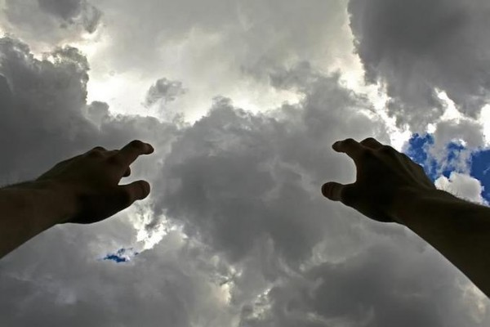
The LORD is good to those who wait for Him, To the soul who seeks Him. It is good that one should hope and wait quietly For the salvation of the LORD. — Lamentations 3:25-26
wait
LORD
LORD
seek
hope
For the salvation of the LORD
Notes:
Walking orders have been given.

Slide 41
Therefore I exhort first of all that supplications, prayers, intercessions, and giving of thanks be made for all men, for kings and all who are in authority, that we may lead a quiet and peaceable life in all godliness and reverence. For this is good and acceptable in the sight of God our Savior, who desires all men to be saved and to come to the knowledge of the truth. — 1st Timothy 2:1-4
be made for all men:
→ supplications
→ prayers
→ intercessions
→ giving of thanks
that we may lead
quiet and peaceable life
in all godliness and reverence
↑
knowledge of the truth
desires all men to be saved
desire
supplications
prayers
intercessions
giving of thanks
be made for all men
desire
that
we may lead
quiet and peaceable life
in all godliness and reverence
God
in
desires all
men to be
saved
knowledge
of the truth

Slide 42
I desire therefore that the men pray everywhere, lifting up holy hands, without wrath and doubting; — 1st Timothy 2:8
Pray
desire
Pray
pray everywhere
desire
without wrath and
doubting

Slide 43
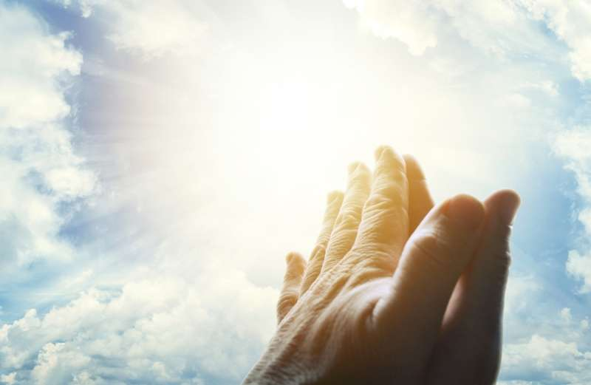
Pray for us; for we are confident that we have a good conscience, in all things desiring to live honorably. — Hebrews 13:18
Pray
a good conscience
desire
desiring to live
desire
honorably

Slide 44
For the time will come when they will not endure sound doctrine, but according to their own desires, because they have itching ears, they will heap up for themselves teachers; — 2nd Timothy 4:3
desire
desire
but according to their own desires

Slide 45
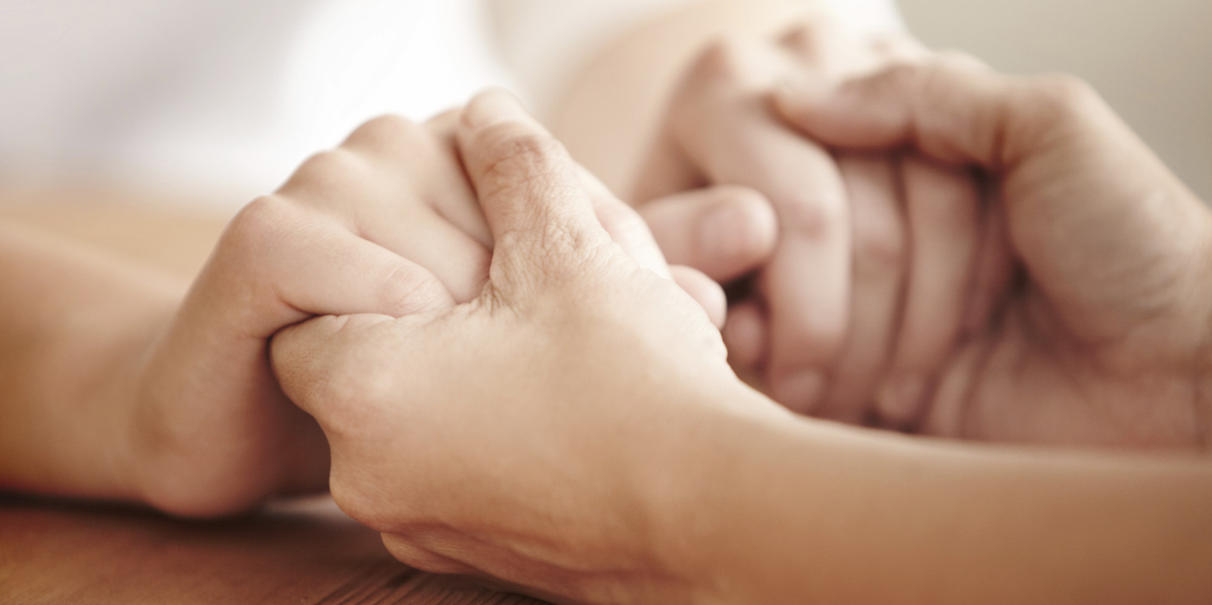
"But go and learn what this means: 'I desire mercy and not sacrifice.' For I did not come to call the righteous, but sinners, to repentance." — Matthew 9:13
desire
desire
genuine
temporary

Slide 46
Then He said to them all, "If anyone desires to come after Me, let him deny himself, and take up his cross daily, and follow Me. For whoever desires to save his life will lose it, but whoever loses his life for My sake will save it. For what profit is it to a man if he gains the whole world, and is himself destroyed or lost?" — Luke 9:23-25
whoever loses his life
for My sake will save it
one
desires
desire
come after Me
desires
deny
self
take up his cross daily
follow Me
come after Me
desires
desires
whoever
loses his life
for My sake will save it
desires
deny oneself
take up his cross daily
follow Me
follow Me

Slide 47
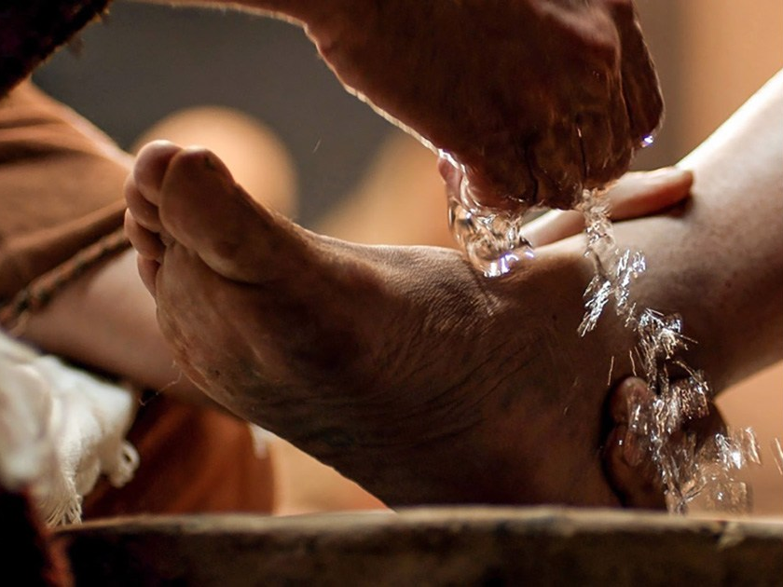
But they kept silent, for on the road they had disputed among themselves who would be the greatest. And He sat down, called the twelve, and said to them, "If anyone desires to be first, he shall be last of all and servant of all." — Mark 9:34-35
desires
servant
desires
servant
servant of all

Slide 48
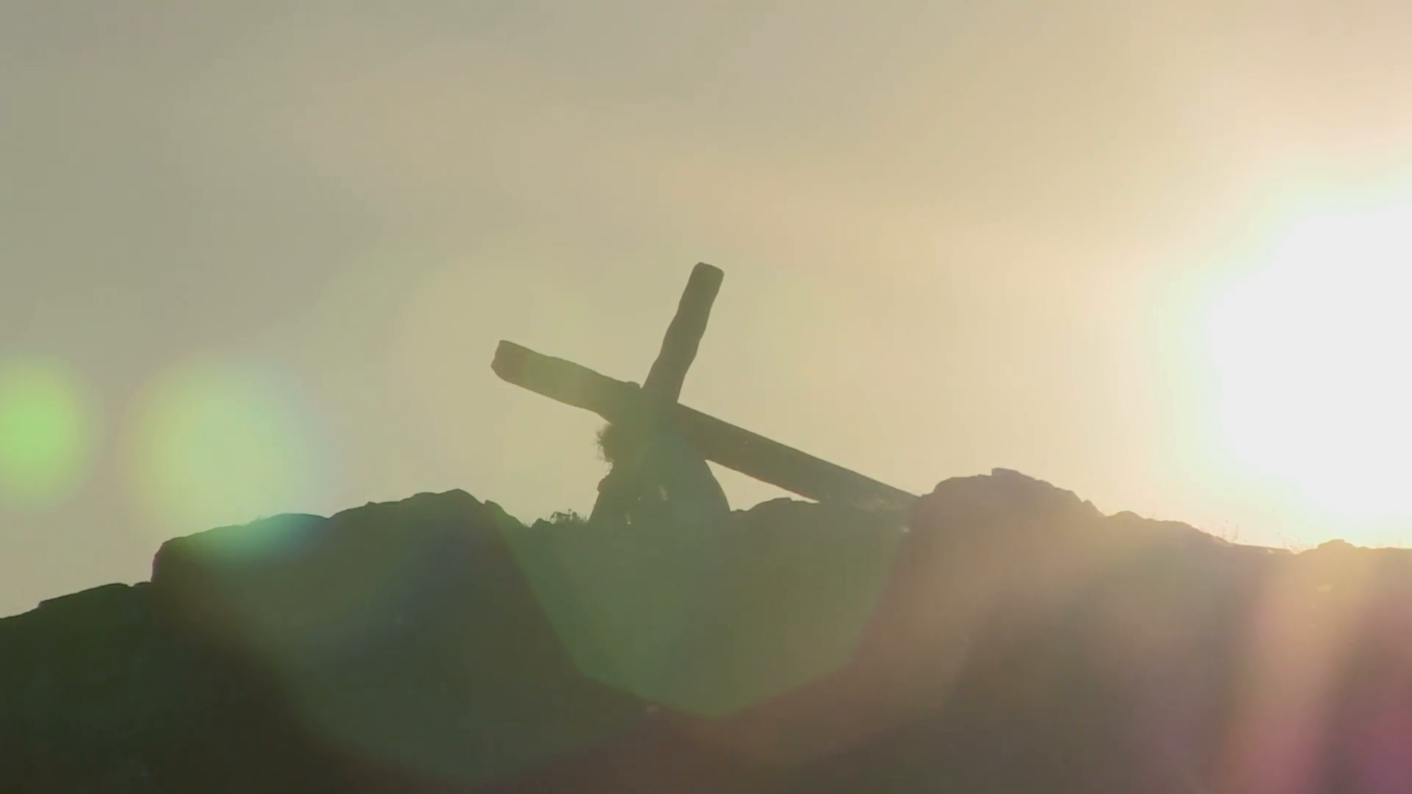
"Yet it shall not be so among you; but whoever desires to become great among you shall be your servant. And whoever of you desires to be first shall be slave of all. For even the Son of Man did not come to be served, but to serve, and to give His life a ransom for many." — Mark 10:43-45
desires
desires
servant
desires
did not come to be served
but
to serve

Slide 49
And those who are Christ's have crucified the flesh with its passions and desires. — Galatians 5:24
crucified
desires
desires
passions and desires

Slide 50
And the Spirit and the bride say, "Come!" And let him who hears say, "Come!" And let him who thirsts come. Whoever desires, let him take the water of life freely. — Revelation 22:17
desires
desires
water
of life freely

Slide 51
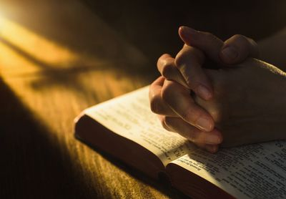
→ None of our desires are hidden from God
→ God satisfies the desire of all living things
→ Only by diligent works can true value be found
→ Better with good purpose than wandering desires
→ Desiring a heavenly home is a natural part of hope
→ Salvation comes by submitting to God’s own truths
→ Put to death evil desires & all that goes against God
→ Regrets deliver spiritual strength otherwise missing
→ Turn from evil and receive the implanted word
→ The desires of the wicked will perish
→ Desires absent of God’s will obtain nothing
→ Walking with Christ denies passions of the flesh
→ Without peace and holiness one falls short of grace
Desires of the heart create following destinies
Notes:
Desires of the heart create following destinies.

Slide 53
Please visit http://www.LoveFromGod.com to explore further
Ronald Bert Channel on
Notes:
Eternity never ends.

