Slide 1
Notes:
In absolute darkness light has no presence.

Slide 2
Denying Christ
Ron Bert
July 17, 2016
Notes:
To deny Christ is to deny the light of God Himself.

Slide 3
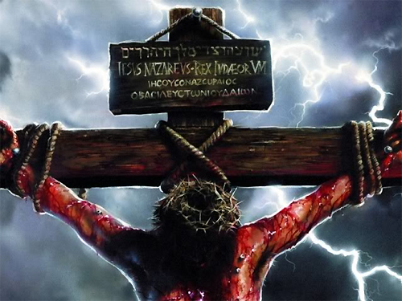
He is despised and rejected by men, A Man of sorrows and acquainted with grief. And we hid, as it were, our faces from Him; He was despised, and we did not esteem Him. — Isaiah 53:3
despised + rejected
God = + sorrows + grief
+ ( – esteemed )
despised
G
rejected
sorrows
grief
o
d
ed
esteem
Notes:
The suffering Christ endured, He carried the wicked sins of all. He did this unselfishly to enlighten all those who would choose to know the one and only true God of love and self-sacrifice.

Slide 4
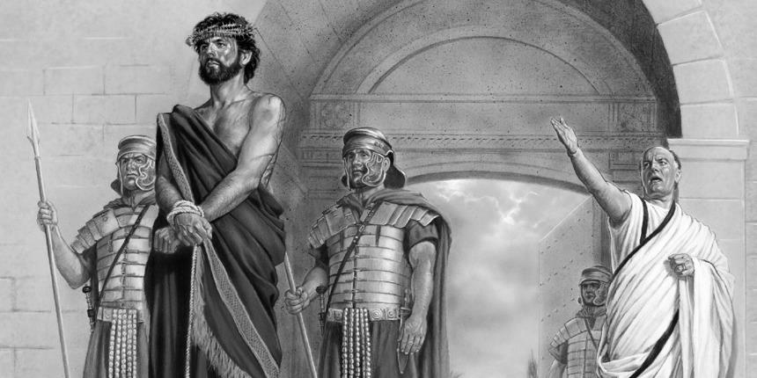
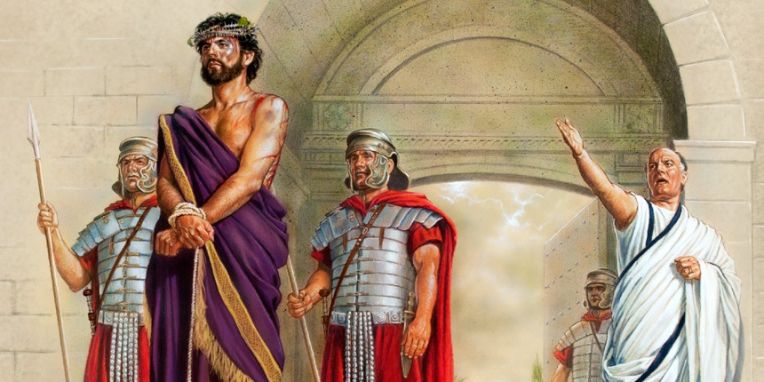
He was in the world, and the world was made through Him, and the world did not know Him. He came to His own, and His own did not receive Him. — John 1:10-11
● He was in the world
● world was made through Him
● world did not know Him
He was in the world
world was made through Him
world did not know Him
He
came to His own
His own
He came to His own +
(His own – receive Him)
=
Rejection
receive Him
Notes:
As the powers of mongering evil would have it, they reject simple truth mercilessly.

Slide 5
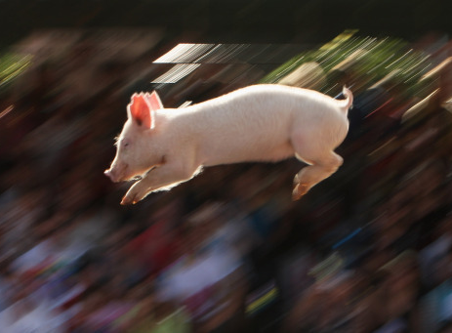
Then they began to plead with Him to depart from their region. — Mark 5:17
plead
plead
Notes:
Truth burns the ears of those who do not want to hear. One may say they will never deny God but if one unrepentantly lives, contrary to His instructions for lifestyle, the rejection remains. Though they plead, it only delays their destination with the abyss.

Slide 6
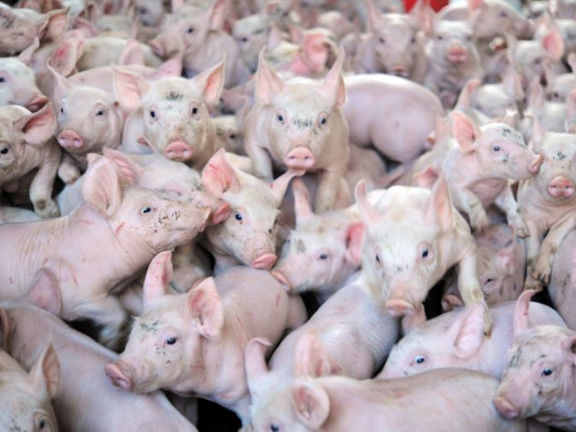
And behold, the whole city came out to meet Jesus. And when they saw Him, they begged Him to depart from their region. — Matthew 8:34
begged
begged
Notes:
As pigs race to destruction, mindless evil follows in desperation to purge that which is not understood when light attempts to change its’ darkness back to the light.

Slide 7
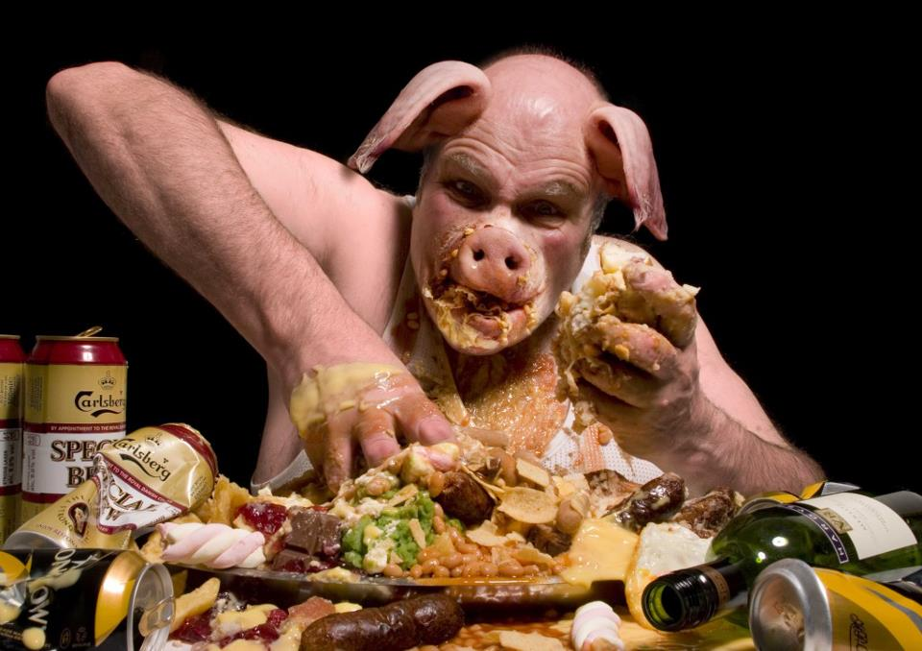
God
Yet they say to God, 'Depart from us, For we do not desire the knowledge of Your ways.' — Job 21:14
do not desire
desire
knowledge of
Notes:
Many are so comfortable in their set ways that they dare others to try and change what they believe; don’t challenge their right to be that they are. Arrogance has led families, nations, and the world to the brink of destruction again and again. It is not God that does this, it is the anger that boils in souls devoid of compassion mired in selfish perverted stubborn judgments.

Slide 8
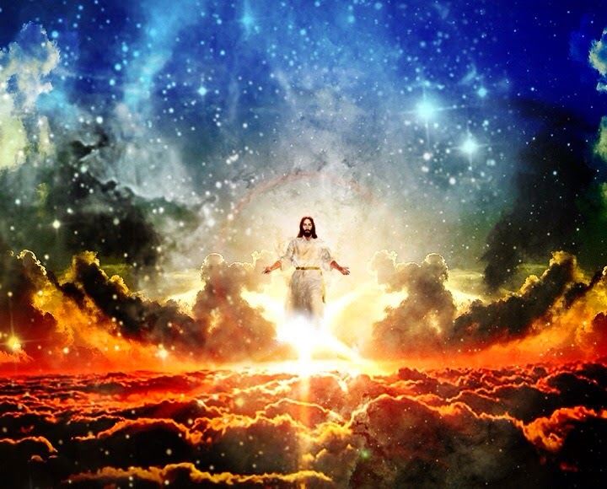
"For whoever is ashamed of Me and My words, of him the Son of Man will be ashamed when He comes in His own glory, and in His Father's, and of the holy angels." — Luke 9:26
e
ashamed of
words
m
o
of
will be
when He
ashamed
He
He will be ashamed of those when He comes
ashamed of Him + His words
comes
His
s
Hi
=
th
Notes:
His universe of life contained in the truth of His creation has a higher purpose, and especially for those destined to inherit His Grace. Those who choose to oppose Him remaining against what He has righteously called out for in His life will receive judgment, according to His will, over that of rebellion’s arrogance.

Slide 9
"For whoever is ashamed of Me and My words in this adulterous and sinful generation, of him the Son of Man also will be ashamed when He comes in the glory of His Father with the holy angels." — Mark 8:38
in
adulterous
adulterous
sinful generation
sinful generation
Notes:
Without regard for His will of ordained decency and loyalty for His justice, damnation waits for those that choose not to know God nor want to know Him, in His ways. Huge numbers of souls choose sexual promiscuity over self-control along with no reservations broadcasting sexual jestings. Appropriately, they will unsurprisingly receive His rejection.

Slide 10
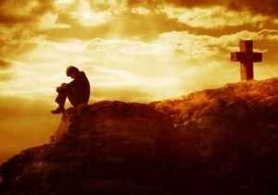
"But whoever denies Me before men, him I will also deny before My Father who is in heaven." — Matthew 10:33
whoever denies Me = I will deny
whoever denies Me
I will
deny
Notes:
It is most condemning for those who in unbelief do not regard His eternal saving Grace.

Slide 11
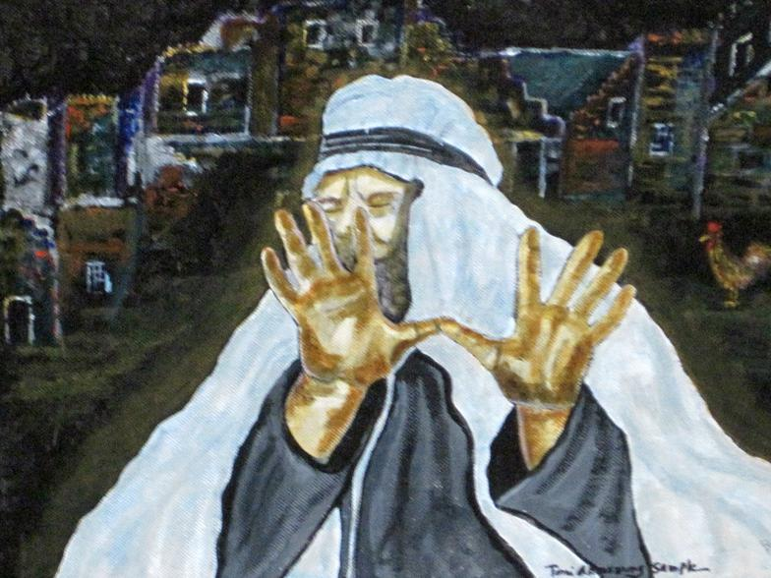
Then Paul and Barnabas grew bold and said, "It was necessary that the word of God should be spoken to you first; but since you reject it, and judge yourselves unworthy of everlasting life, behold, we turn to the Gentiles. — Acts 13:46
the word
the word
word
reject it
reject it
unworthy of
everlasting life
Notes:
There are those that deny His word is truth in the suffocating guilt that will consume them. Others give up believing they are going to hell anyway, so why try. To act on believing in God, it takes courage and a steadfast spirit.

Slide 12
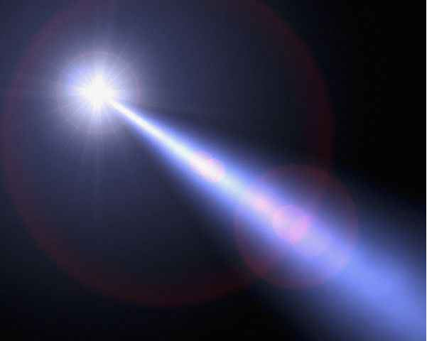
"And this is the condemnation, that the light has come into the world, and men loved darkness rather than light, because their deeds were evil." — John 3:19
darkness
evil
light
evil
Notes:
Evil methods do not truly care for the light of God where accountability drives justice.

Slide 13
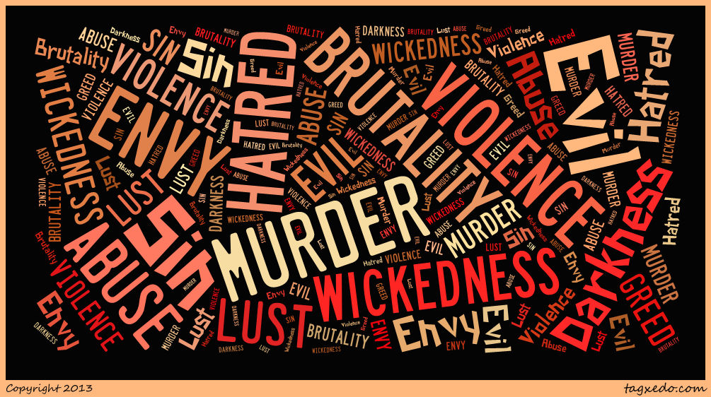
"The world cannot hate you, but it hates Me because I testify of it that its works are evil." — John 7:7
world
world
world
world
evil
its works are evil
its works are evil
Notes:
Evil hates truth’s light that exposes the secrets hidden in the shadows of darkness.

Slide 14
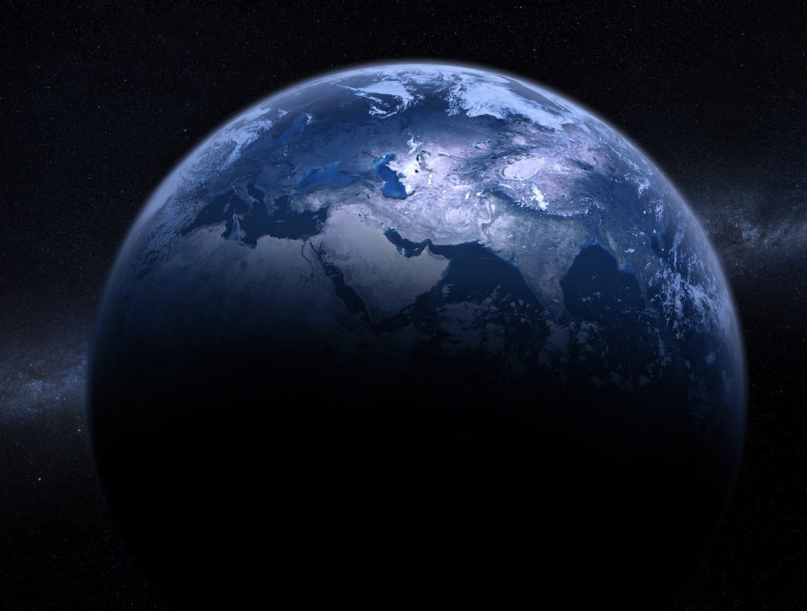
"If you were of the world, the world would love its own. Yet because you are not of the world, but I chose you out of the world, therefore the world hates you." — John 15:19
world
world
world
world
not of the world
I chose you
Notes:
The earth is an implosion of hate which God calls us to become free of. Seeking Him is greater than all the substance of time.

Slide 15
"He who hates Me hates My Father also. If I had not done among them the works which no one else did, they would have no sin; but now they have seen and also hated both Me and My Father. But this happened that the word might be fulfilled which is written in their law, 'They hated Me without a cause.'" — John 15:23-25
He who hates Me
hates
He who hates Me
without cause
=
G
hates God
o
d
without
cause
Notes:
Hate upwells from an anger of not having consumed in that which will never be had. Hate does not summit to love but excuses itself in the blur of not caring to know. He who hates Me without cause = hates God

Slide 16
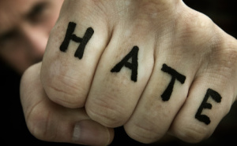
Do not marvel, my brethren, if the world hates you. We know that we have passed from death to life, because we love the brethren. He who does not love his brother abides in death. Whoever hates his brother is a murderer, and you know that no murderer has eternal life abiding in him. By this we know love, because He laid down His life for us. And we also ought to lay down our lives for the brethren. — 1st John 3:13-16
hate
death to life
because we
in
hate abides in death
love
hate abides in death
hate
He who does not love
hate
hate
hate
his brother abides in death
abides in death
. .
hates his brother is a murderer
death to life → because we love
. .
love
love
love
love
love
love
no murderer has eternal life
Selfless
laid down His life
laid down His life
Sacrifice
lay down our lives
lay down our lives
Notes:
The simple truth is love is power over hate where hate knows no sacrifice. Hate abides in the death of a soul.

Slide 17
If we endure, We shall also reign with Him. If we deny Him, He also will deny us. If we are faithless, He remains faithful; He cannot deny Himself. — 2nd Timothy 2:12-13
endure
Notes:
God remains faithful over all conditions of man waiting to find those loyally seeking to live in the light of His ways.

Slide 18
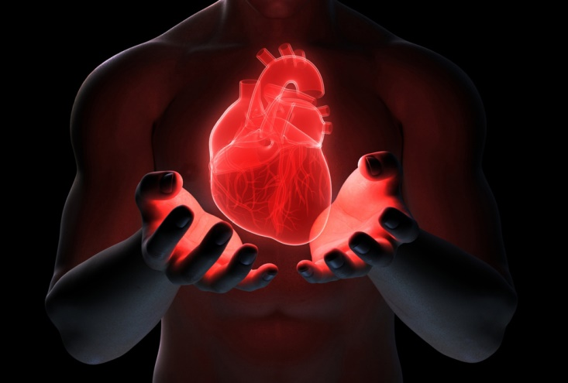
Thus says the LORD: "Cursed is the man who trusts in man And makes flesh his strength, Whose heart departs from the LORD." — Jeremiah 17:5
G
O
D
TRUST
TRUTH
TR TH
HEART
SPIRIT
f
strength
l
e
s
h
heart departs
heart departs
Notes:
The bottom line is what a heart is to itself. One can only know who one is and if not in accord with the divine calling of God Himself, oblivious despicable pursuits can lead to a soul's destruction over eternal life in Him. No crime is greater than departing from what is real beyond all that we can know. If God is not greater, then something less has been fallen in to.

Slide 19
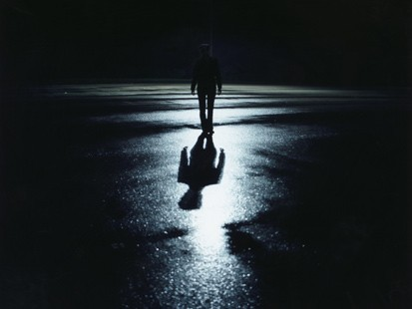
"But the sons of the kingdom will be cast out into outer darkness. There will be weeping and gnashing of teeth." — Matthew 8:12
sons of the kingdom
"But the will be cast out into outer darkness. There will be weeping and gnashing of teeth." — Matthew 8:12
. .
cast out into outer darkness
Notes:
The world is overly religious due to the bureaucracies of man’s corruption and power posturing. God is not looking for self-important people. The Jews believed they were entitled. Many believe supremacy over others and or their doctrines; “We are the best way.” It is not about one set of people but God was approaching His message for all through the stumbling’s of man. It is about awakening individual hearts over conglomerate collections of blind followers. God looks to see how one leads oneself weighing honesty over deception. Though the Jewish elite thought they were God’s own chosen, their wickedness and color of heart drew no distinction, in repeated abysmal actions, all repulsive to God. Many people who think they are upright may be in jeopardy of not knowing God over themselves. Self-righteous, if not humbled in the face of God, will find that outer darkness as light leaves them for lost.

Slide 20
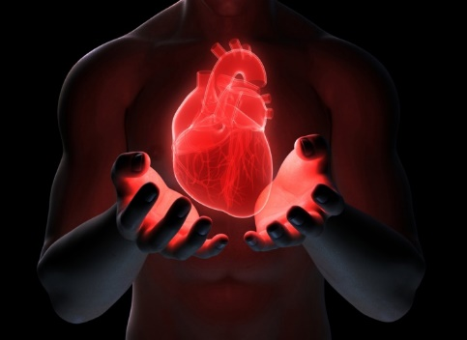

Slide 21
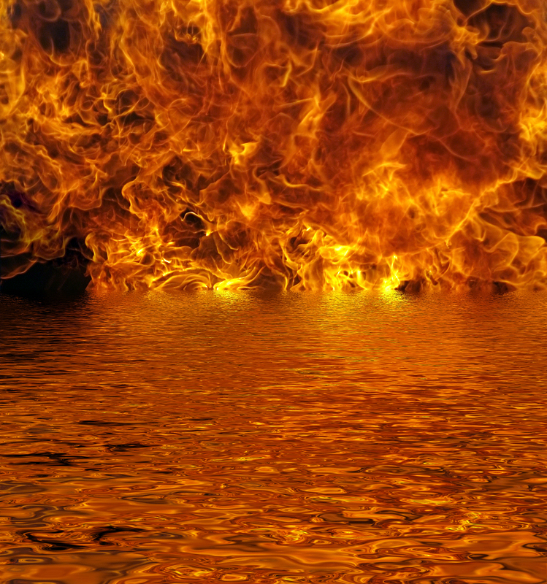
APART
→ He is despised and rejected by men
→ His own did not receive Him
→ They pleaded with Him to depart from their region
→ They begged Him to depart from their region
→ To be ashamed of Him and His words condemns one
→ To deny Him denies access to God who is in heaven
→ Rejecting the word judges one unfit for eternal life
→ Men love evil’s darkness rather than light
→ The world hates Him because He testifies of its evil
→ The world hates us for belief in more than the world
→ They hated Him without a cause
→ We have passed from death to life, because we love
→ If we endure, We shall also reign with Him
The Fire of His Truth can not be Denied
Notes:
The fire of His truth can not be denied.

Slide 22
Notes:
There is no sympathy in darkness.

Slide 23
Denying Christ
Ron Bert
Part 2
July 17, 2016
Notes:
Living is a curiosity in becoming that which is good and noble over the decent to wickedness’s abominations.

Slide 24
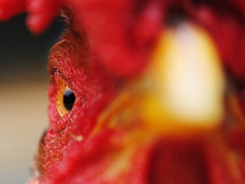
Jesus said to him, "Assuredly, I say to you that today, even this night, before the rooster crows twice, you will deny Me three times." But he spoke more vehemently, "If I have to die with You, I will not deny You!" And they all said likewise. — Mark 14:30-31
deny
three
deny
Notes:
Spiritual courage has always been challenged by the weakness of flesh. Blessed are those that follow the convictions of their beliefs. We may think we have an eye on the truth and it really comes down to the tarmac where thoughts in action are what masters the spirit of a soul.

Slide 25
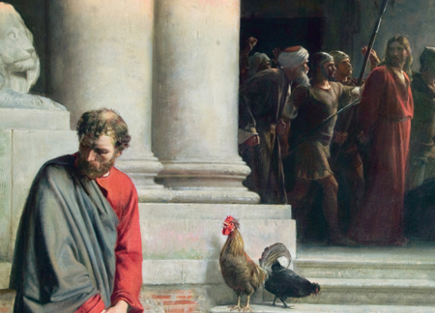
A second time the rooster crowed. Then Peter called to mind the word that Jesus had said to him, "Before the rooster crows twice, you will deny Me three times." And when he thought about it, he wept. — Mark 14:72
deny
when he thought about it = he wept
when he thought about it
he wept
Notes:
To often fear pushes people from the truth of taking a stand for what is right in His sight. If one says he has no regrets, is he not a liar? Repentance is thoughtfulness in the face of His presence.

Slide 26
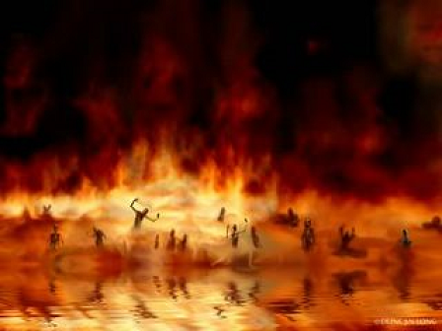
My people are destroyed for lack of knowledge. Because you have rejected knowledge, I also will reject you from being priest for Me; Because you have forgotten the law of your God, I also will forget your children. — Hosea 4:6
destroyed
of
knowledge
reject
reject knowledge of God = destroyed
God
Notes:
To the shame of our children godless truth is held higher in the absence of His righteous calling.

Slide 27
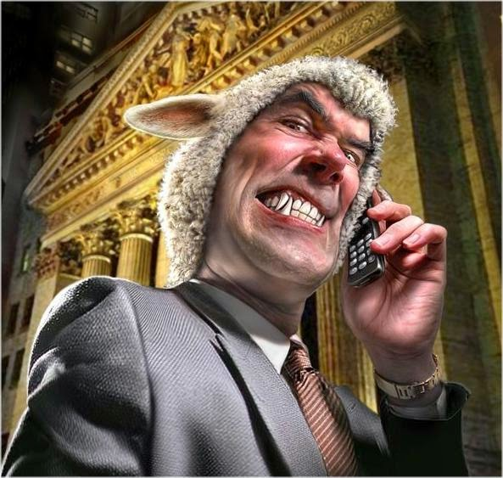
They profess to know God, but in works they deny Him, being abominable, disobedient, and disqualified for every good work. — Titus 1:16
profess
but
in works
deny Him
in
Notes:
All wickedness void of conscience devours the soul in the bite of a wolf.

Slide 28
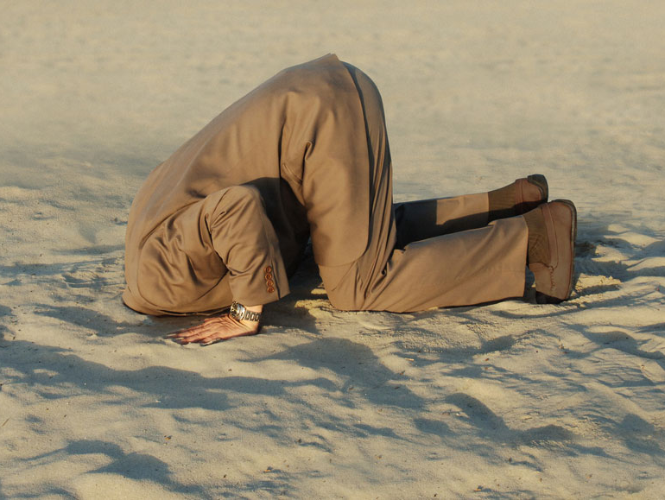
Who is a liar but he who denies that Jesus is the Christ? He is antichrist who denies the Father and the Son. Whoever denies the Son does not have the Father either; he who acknowledges the Son has the Father also. — 1st John 2:22-23
liar
denies
Christ
antichrist
antichrist
liar = denies Christ = antichrist
antichrist = does not have God
does not have
d
G
o
Notes:
One can choose not to accept His light, that will not hide, and that would be the choice of one becoming buried in searing darkness.

Slide 29
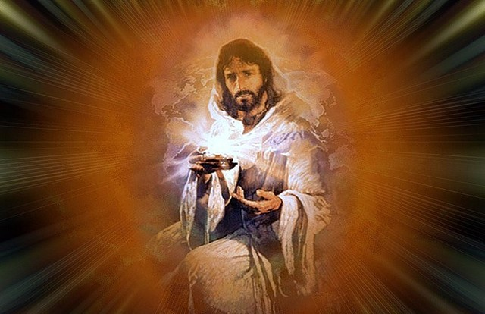
By this you know the Spirit of God: Every spirit that confesses that Jesus Christ has come in the flesh is of God, and every spirit that does not confess that Jesus Christ has come in the flesh is not of God. And this is the spirit of the Antichrist, which you have heard was coming, and is now already in the world. — 1st John 4:2-3
Spirit of God
confesses
Christ
came
es
Christ
Spirit of God = confesses Christ came
spirit of Antichrist = denies Christ came
came
spirit of
e
Antichrist
d
n
i
Notes:
One can deny Christ has come in the flesh and this would be to reject what God has offered to man in the fullest sense of divine glory. No matter how deep the darkness dug into the bottom of a soul, His rope of light simply calls for one to try in reaching up to gain reconciliation.

Slide 30
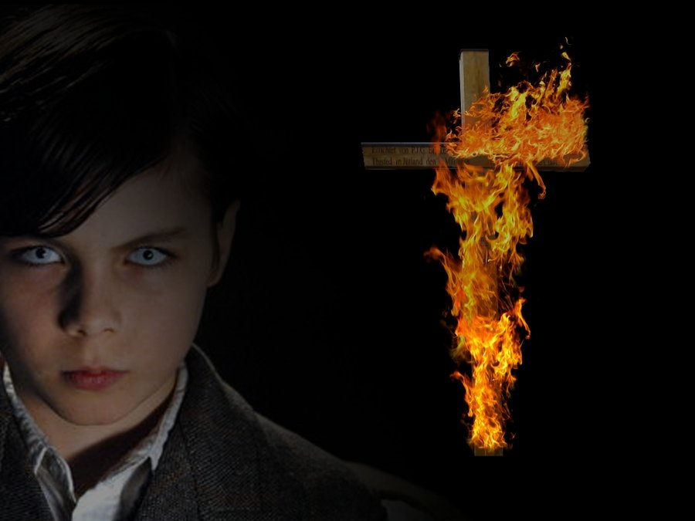
For many deceivers have gone out into the world who do not confess Jesus Christ as coming in the flesh. This is a deceiver and an antichrist. — 2nd John 1:7
. .
do not confess
Notes:
Those exclusively in pursuit of godless pleasures deny the gift God has given to all, His own image of truth in the flesh. Those that burn crosses and blame religion for the problems that currently confront civilization miss the higher message of salvation. What a man holds in his bosom declares eternal worth from above or a simpletons bickering among fellow shallow surface dwellers.

Slide 31
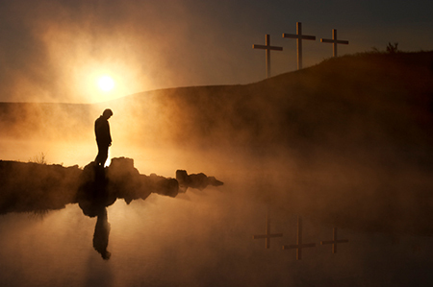
Whoever transgresses and does not abide in the doctrine of Christ does not have God. He who abides in the doctrine of Christ has both the Father and the Son. — 2nd John 1:9
does not abide
in the doctrine
of
Christ
does not
have God
=
Notes:
For God to be God, His power in what has been delivered cannot lie upon itself. Christ is His flash for reaching those lacking insight in the value of His eternal light.

Slide 32
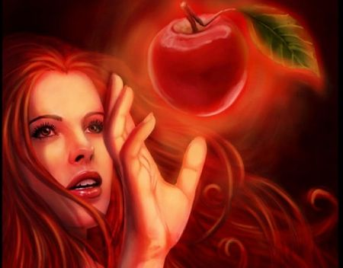
but to those who are self-seeking and do not obey the truth, but obey unrighteousness--indignation and wrath, … — Romans 2:8
self-seeking
do not
… but a certain fearful expectation of judgment, and fiery indignation which will devour the adversaries. — Hebrews 10:27
obey
Notes:
It is a choice to pursue evil, and that cannot be stopped, if one who would wish to resist a conscience in Him. One bent on evil shows no remorse in their unholiness. Regret is God’s blessing in knowing right from wrong.

Slide 33
"But the cowardly, unbelieving, abominable, murderers, sexually immoral, sorcerers, idolaters, and all liars shall have their part in the lake which burns with fire and brimstone, which is the second death." — Revelation 21:8
second death
second death
Notes:
Contrary to popular belief, the dark side has no lasting force.

Slide 34
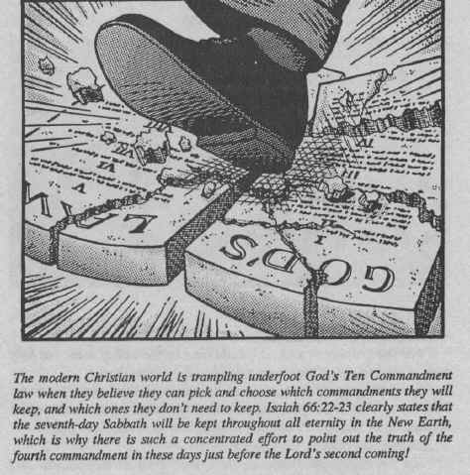
He said to them, "All too well you reject the commandment of God, that you may keep your tradition." — Mark 7:9
Habit
Inclination
Belief
Convention
reject
God
reject
Practice
God
Ritual
you
Addiction
tradition
Custom
Liking
Notes:
Stubborn human ploys relentlessly trample that which comes before them unwilling to compromise in their hardness of heart. They are a law unto themselves.

Slide 35
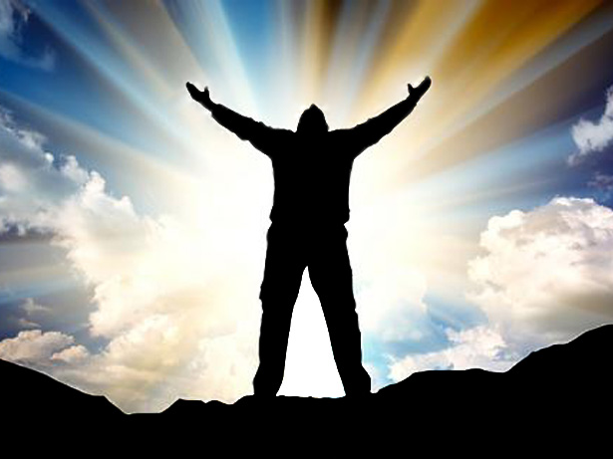
Finally then, brethren, we urge and exhort in the Lord Jesus that you should abound more and more, just as you received from us how you ought to walk and to please God; for you know what commandments we gave you through the Lord Jesus. — 1st Thessalonians 4:1-2
J
E
S
U
S
you
received
how to walk
to please God
through the Lord Jesus
you
received
LOVES
LOV S
how
to walk
to
please God
YO
YOU
through the Lord Jesus
Notes:
The word proclaims the desire of God for man’s liberty, and in submission to His love the heart sees.

Slide 36
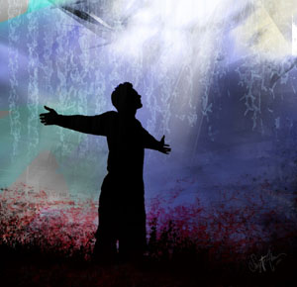
For this is the will of God, your sanctification: that you should abstain from sexual immorality; that each of you should know how to possess his own vessel in sanctification and honor, not in passion of lust, like the Gentiles who do not know God; — 1st Thessalonians 4:3-5
in
in
sanctification and honor
not in
in
passion of lust
Notes:
With a clean heart love lasts forever. In accepting the heart of Jesus one finds the truth of God’s redemption for eternal life.

Slide 37
For God did not call us to uncleanness, but in holiness. Therefore he who rejects this does not reject man, but God, who has also given us His Holy Spirit. — 1st Thessalonians 4: 7-8
us
to
in
hol
ref
e
rejects
refuse to be holy = rejects God
b
God
e
y
Notes:
To live without regarding His call to humble holiness personally rejects God Himself.

Slide 38
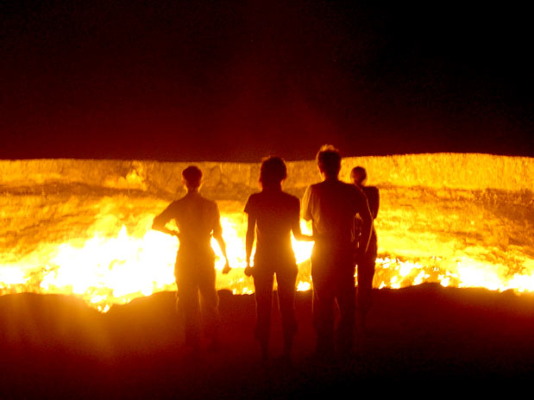
… and to give you who are troubled rest with us when the Lord Jesus is revealed from heaven with His mighty angels, in flaming fire taking vengeance on those who do not know God, and on those who do not obey the gospel of our Lord Jesus Christ. — 2nd Thessalonians 1:7-8
Lord
do not know God
do not obey the
gospel
of our Lord Jesus Christ
Notes:
There will be no forgiveness for those who purposely, or ignorantly, refuse Him and His word. God has made Himself unobtrusively available for all to know through His word. What one pursues is what one becomes. Choices of broad humanism over individual godliness define a souls destiny, and certainly, social trials under the oppressions of man include boundless afflictions. It is hard work to keep a clean heart in God. Those unable and or unwilling to ward off evil, contrary to innate goodness written upon the heart of life, will fall in to the consuming darkness prepared for all of God’s opponents. One cannot fight against God and win.

Slide 39
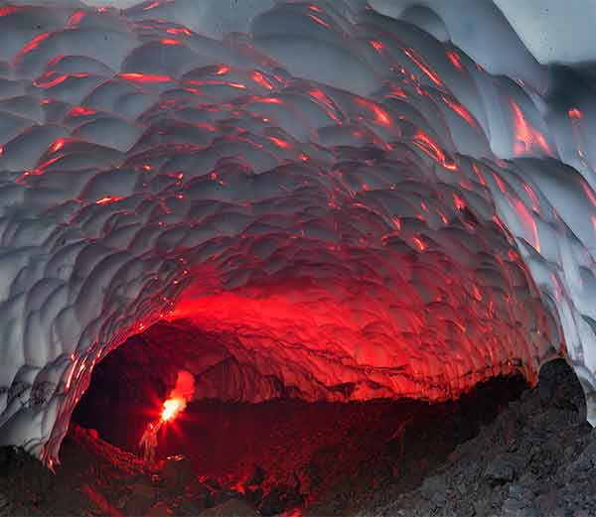
These shall be punished with everlasting destruction from the presence of the Lord and from the glory of His power, … — 2nd Thessalonians 1:9
Lord
. .
presence of the Lord
Lord
Notes:
Reserved is a place where contentment has no light for those embracing darkness's destructiveness. It is in the presence of the Lord that we live. True treasures untold await, for each of us, that wait on His mercy and grace.

Slide 41
HOPE
→ Good intensions are not always realized in action
→ What we don’t do for God should cause remorse
→ Forgetting knowledge of God is what destroys souls
→ Professing to know God is not always honorable
→ In the spirit of an antichrist a liar denies Christ
→ Not confessing Jesus Christ in the flesh is not of God
→ Not abiding in Christ’s doctrine dismisses God
→ Disobedient self-seekers invite God’s own wrath
→ Evil forever separates from God in the second death
→ People reject God’s commands in favor of tradition
→ Instructions received show how we ought to walk
→ Rejecting the call to holiness rejects God Himself
→ Not obeying the gospel or knowing God damns one
God looks for a heart
to rise back to Him
Notes:
In His light of truth all will come to see in the face of His judgment. God calls to those who have rejected Him to return. God looks for a heart to rise back to Him.

Slide 42
Notes:
Light’s last moment evaporates to darkness.

Slide 43
Please visit http://www.RonBert.com to explore further
Ronald Bert Channel on
Notes:
Eternity never ends.

