Slide 1
Notes:
Darkness oh darkness, how art thou able to see?

Slide 2
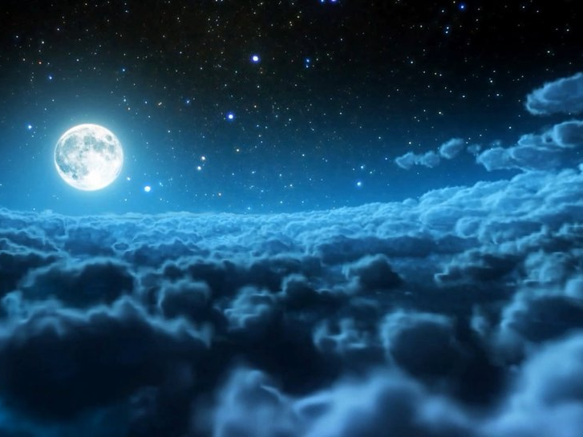
Darkness Uncovered
Ron Bert
November 19, 2017
Notes:
We are all in the light of His love.

Slide 3
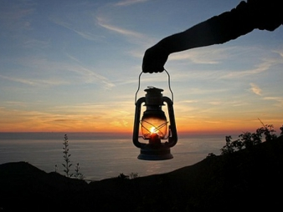
For You will light my lamp; The LORD my God will enlighten my darkness. — Psalms 18:28
lamp
Notes:
Stumbling from one day to the next, sometimes just searching to breathe, has many dumbfounded as to the reasons we are alive. Is it only to suffer? Many qualities are at play in the rising of a spirit. One cannot achieve greater understandings of why without the help of God through His explaining word. Insights for spiritual living avails one to see clearly.

Slide 4
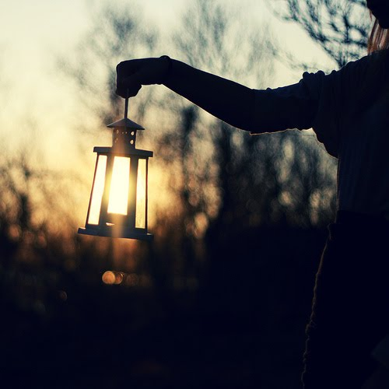
"The lamp of the body is the eye. Therefore, when your eye is good, your whole body also is full of light. But when your eye is bad, your body also is full of darkness. Therefore take heed that the light which is in you is not darkness. If then your whole body is full of light, having no part dark, the whole body will be full of light, as when the bright shining of a lamp gives you light." — Luke 11:34-36
lamp
eye is good
eye is good
t
full of light
full of light
eye is bad
o
eye is bad
darkness
darkness
take heed
darkness
in
light which is in you is not darkness
light
Notes:
Darkness is upon those who lack purpose in His brilliance. Direction in life is the light that delivers juice; it may or may not involve godly pursuits. A vague haze lingers on the spiritually blind as impulse pours out in desperation. A rat cannot see what the eagle perceives. Knowledge is the road to enlightenment upon understanding. How and what we seek establishes the good and or bad character that rules us.

Slide 5
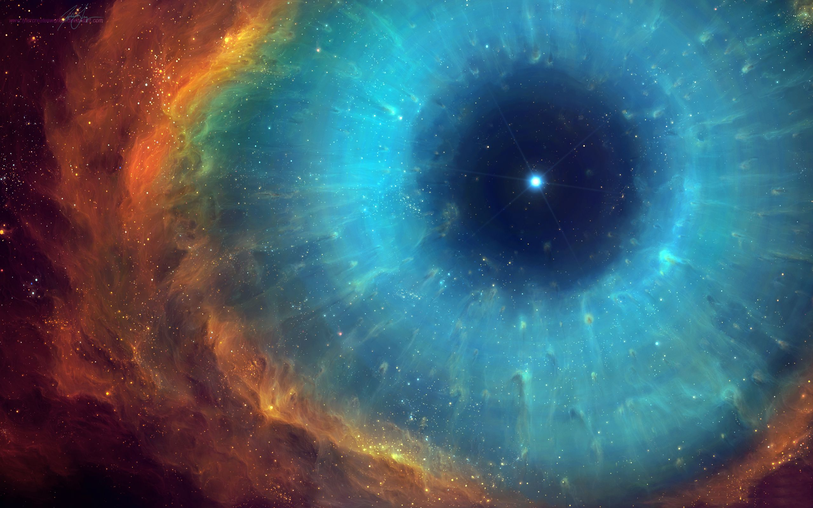
… 'to open their eyes, in order to turn them from darkness to light, and from the power of Satan to God, that they may receive forgiveness of sins and an inheritance among those who are sanctified by faith in Me.' — Acts 26:18
light
open
eyes
darkness
turn
darkness to light
light
to God
forgiveness of sins
forgiveness of sins
sanctified by faith
in
sanctified by faith
Jesus
Notes:
It is the light of God that has come, to uncover the darkness, so the blind may be able to rise from their horrible pits of disgust for self. The foundation of a soul requires love and peace if true maturity is to be achieved. Allowing His presence delivers those things unobtainable through mortal means. Light’s warmth expels the cold darkness. Come to His lifting Spirit and find what cannot be tangibly found. It is a choice to rise in His light or descend in to the darkness.

Slide 6
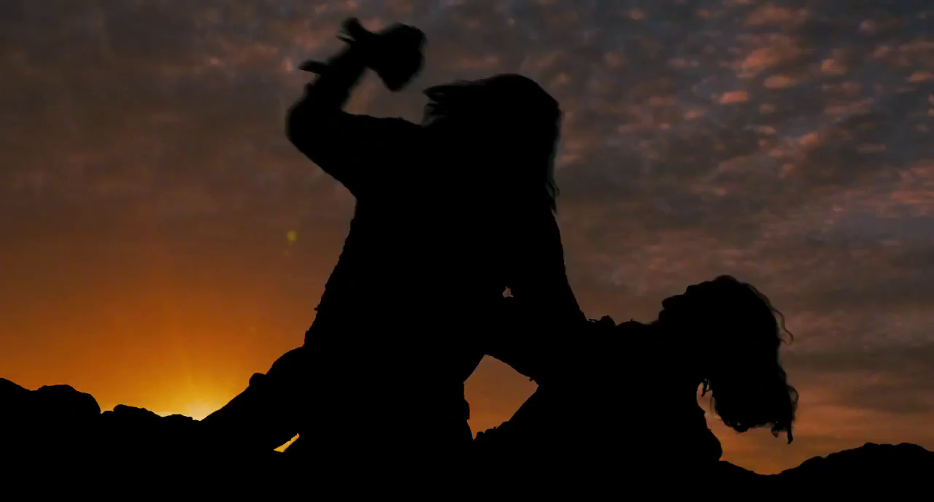
He who says he is in the light, and hates his brother, is in darkness until now. He who loves his brother abides in the light, and there is no cause for stumbling in him. But he who hates his brother is in darkness and walks in darkness, and does not know where he is going, because the darkness has blinded his eyes. — 1st John 2:9-11
light
love
darkness
darkness
darkness
does not know
does not know
Notes:
Insincerity is the plague of all genuine. A blaming soul can cling to a haughty mask which covers the darkness of a sinking heart. Hate is a fall into the pit of no return. Isolations best friend is a lone violin no one hears. Anger is heard loudest in the one who is angry. Love conquerors anger and is how one comes to possess oneself.

Slide 7
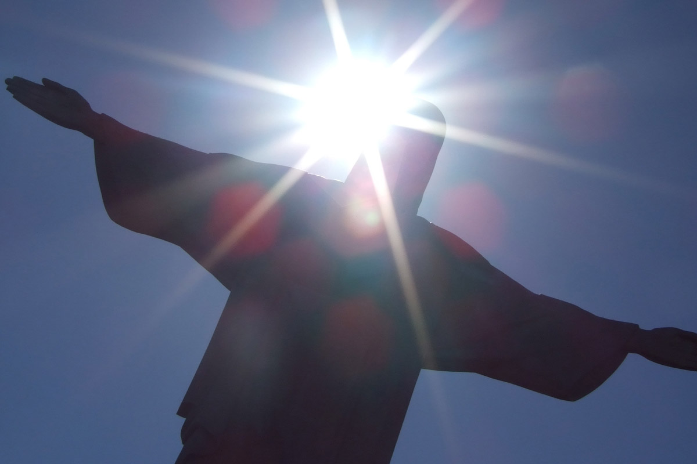
Then Jesus spoke to them again, saying, "I am the light of the world. He who follows Me shall not walk in darkness, but have the light of life." — John 8:12
light
light
follows
darkness
light
of
life
Notes:
His redemption is the escape clause from all that would destroy one. In His light we see.

Slide 8
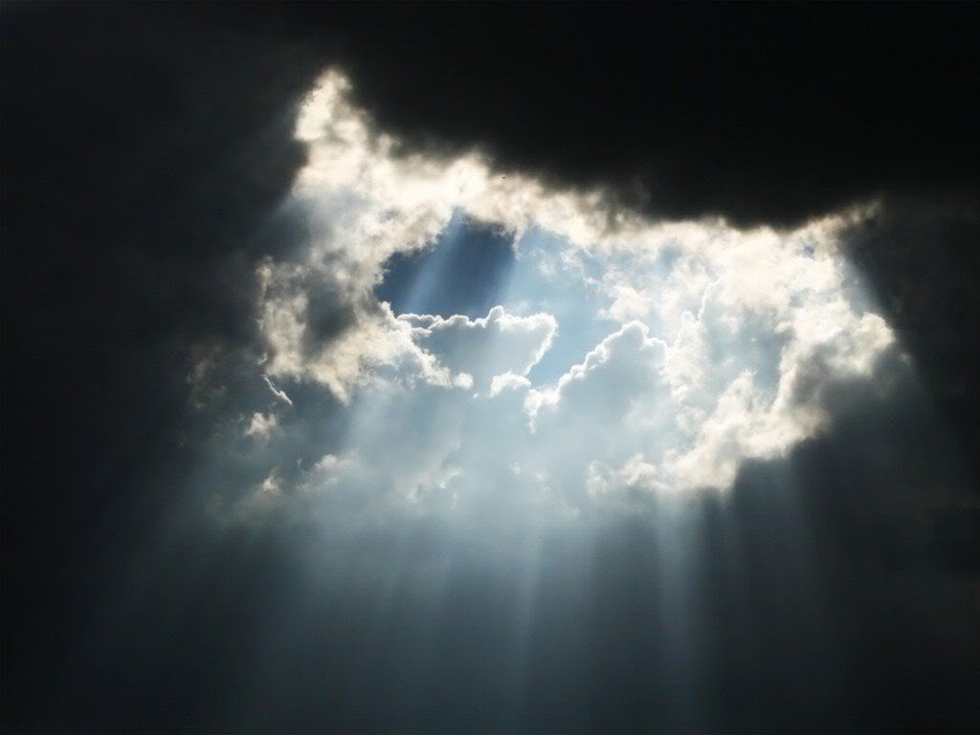
In Him was life, and the life was the light of men. And the light shines in the darkness, and the darkness did not comprehend it. — John 1:4-5
In
In Him
life
In Him
life
light
light
light of men
light of men
darkness
shines in the darkness
shines in the darkness
darkness
Notes:
One can avoid the light but it does not change the fact of light. If one wants to be truly alive, in the fullest sense, it can only be achieved in His Grace and truth.

Slide 9
"And this is the condemnation, that the light has come into the world, and men loved darkness rather than light, because their deeds were evil." — John 3:19
darkness
light
Notes:
True spiritual darkness has no flavor for open godliness in its’ self-seeking and hidden lustful venues.

Slide 10
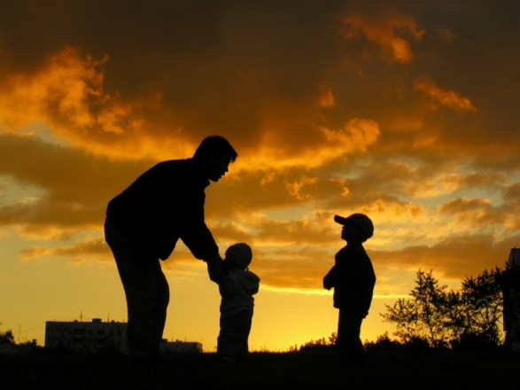
Then Jesus said to them, "A little while longer the light is with you. Walk while you have the light, lest darkness overtake you; he who walks in darkness does not know where he is going. While you have the light, believe in the light, that you may become sons of light." These things Jesus spoke, and departed, and was hidden from them. — John 12:35-36
light
darkness
light
believe in the light
in
light
believe in the light
sons of
light
Notes:
As our lives are but a fading brief moment, arrival to His doorstep, and light’s eternal entrance, is an inevitability for all. To dismiss His light is to reject life itself in a hollow demise leading to the eventuality of being left alone in the darkness.

Slide 11
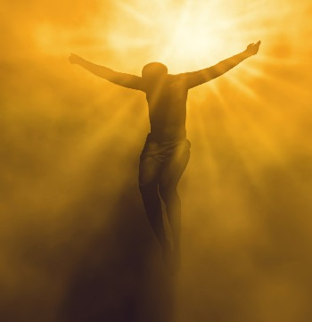
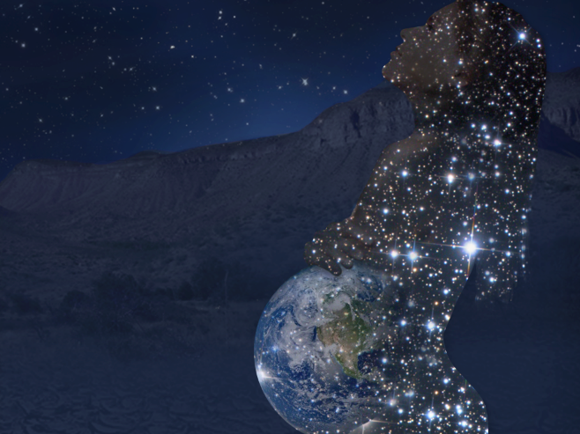
"I have come as a light into the world, that whoever believes in Me should not abide in darkness." — John 12:46
light
c
light
o
"I have come as a light into the world, that whoever believes in Me should not abide in darkness." — John 12:46
"I have come as a light into the world, that whoever believes in Me should not abide in darkness." — John 12:46
children of light
children of light
f
of God
In this the children of God and the children of the devil are manifest: Whoever does not practice righteousness is not of God, nor is he who does not love his brother. — 1st John 3:10
"Man who is born of woman Is of few days and full of trouble. He comes forth like a flower and fades away; He flees like a shadow and does not continue." — Job 14:1-2
"Man who is born of woman Is of few days and full of trouble. He comes forth like a flower and fades away; He flees like a shadow and does not continue." — Job 14:1-2
"Man who is born of woman Is of few days and full of trouble. He comes forth like a flower and fades away; He flees like a shadow and does not continue." — Job 14:1-2
h
ld
i
in
n
of the devil
few days
few days
r
e
of God → practice righteousness
of the devil → does not love
practice
righteousness
like a shadow
like a shadow
does not love
Notes:
Belief in Christ shows us how to rely on God Himself while purging the unwanted darkness. Darkness is the destiny this universe flows into. We are meant to be greater than that which we can perceive. Out of the darkness of the womb we are born in to the light. Our eternal being is developing, rising from the darkness, born in this womb of His light, for those that hear the call and see the truth of His design. As fetuses are blind to the greater extent of the outside, so we too must realize the boundaries of our spiritual awakenings as we develop inside. True Faith is by design meant to draw one into eternity. A lifetime is just a small sense of what yet can be seen.

Slide 12
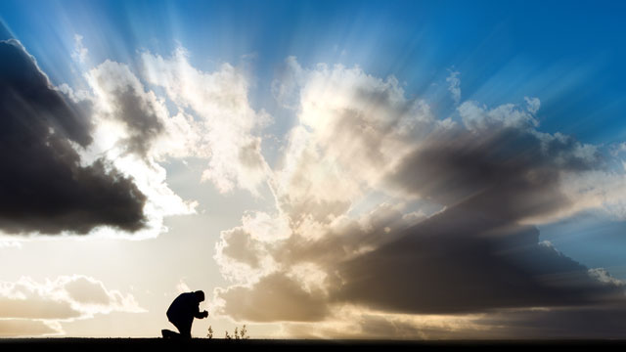
For you were once darkness, but now you are light in the Lord. Walk as children of light (for the fruit of the Spirit is in all goodness, righteousness, and truth), finding out what is acceptable to the Lord. — Ephesians 5:8-10
darkness
in
light in the Lord
light in the Lord
light
children of light
children of light
in
goodness
righteousness
truth
seeking
Notes:
Self forgiveness is often roughest when one carries evil deeds from the past or say the baggage of guilt immersed in repentance. Releasing and abandoning those evil deeds enables a better spirit to rise from that darkness left to the past. It is the present that the Lord is interested in. All carry the burdens of living, but the path is either one of rising goodness or descending oblivion. Either it is a focus on service to others or various vices of drugs and or alcohol in which self consuming misery covers a painful life in search of unreachable love. True love originates from the source in which it came. Returning to Him allows relief from self. To be secure in God one must take control of the reigns of desire. We need to bring the light of His truth near to fend off the darkness that lurks seeking to destroy all goodness. Thoughts are the power of a soul.

Slide 13
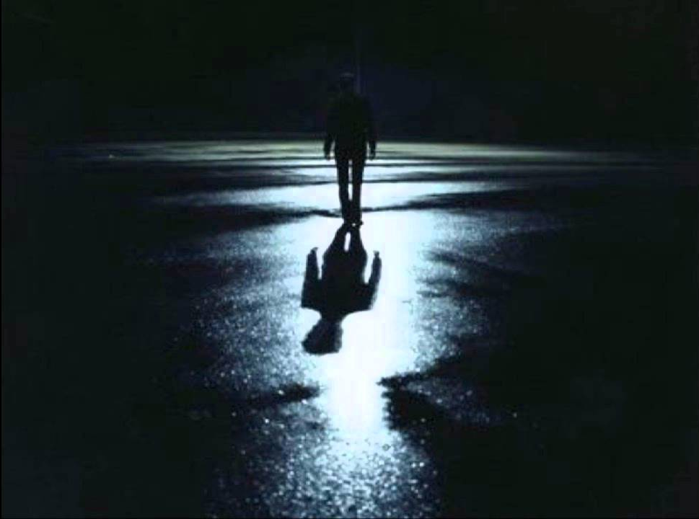
And have no fellowship with the unfruitful works of darkness, but rather expose them. For it is shameful even to speak of those things which are done by them in secret. But all things that are exposed are made manifest by the light, for whatever makes manifest is light. — Ephesians 5:11-13
darkness
unfruitful works of darkness
expose them
light
which are
in
in secret
light
light
Notes:
In an age where darkness rules the land, light is hated for the truth that it is. What is disgusting will always remain disgusting and as civilization exalts the abominations of evil, excusing them as good, our monuments of nobility and integrity crumble in the shadows of shame. Each individual must come to his or her own light, and cast off this shadow of deception for true salvation of Spirit to be had. Faith is what is sober in us.

Slide 14
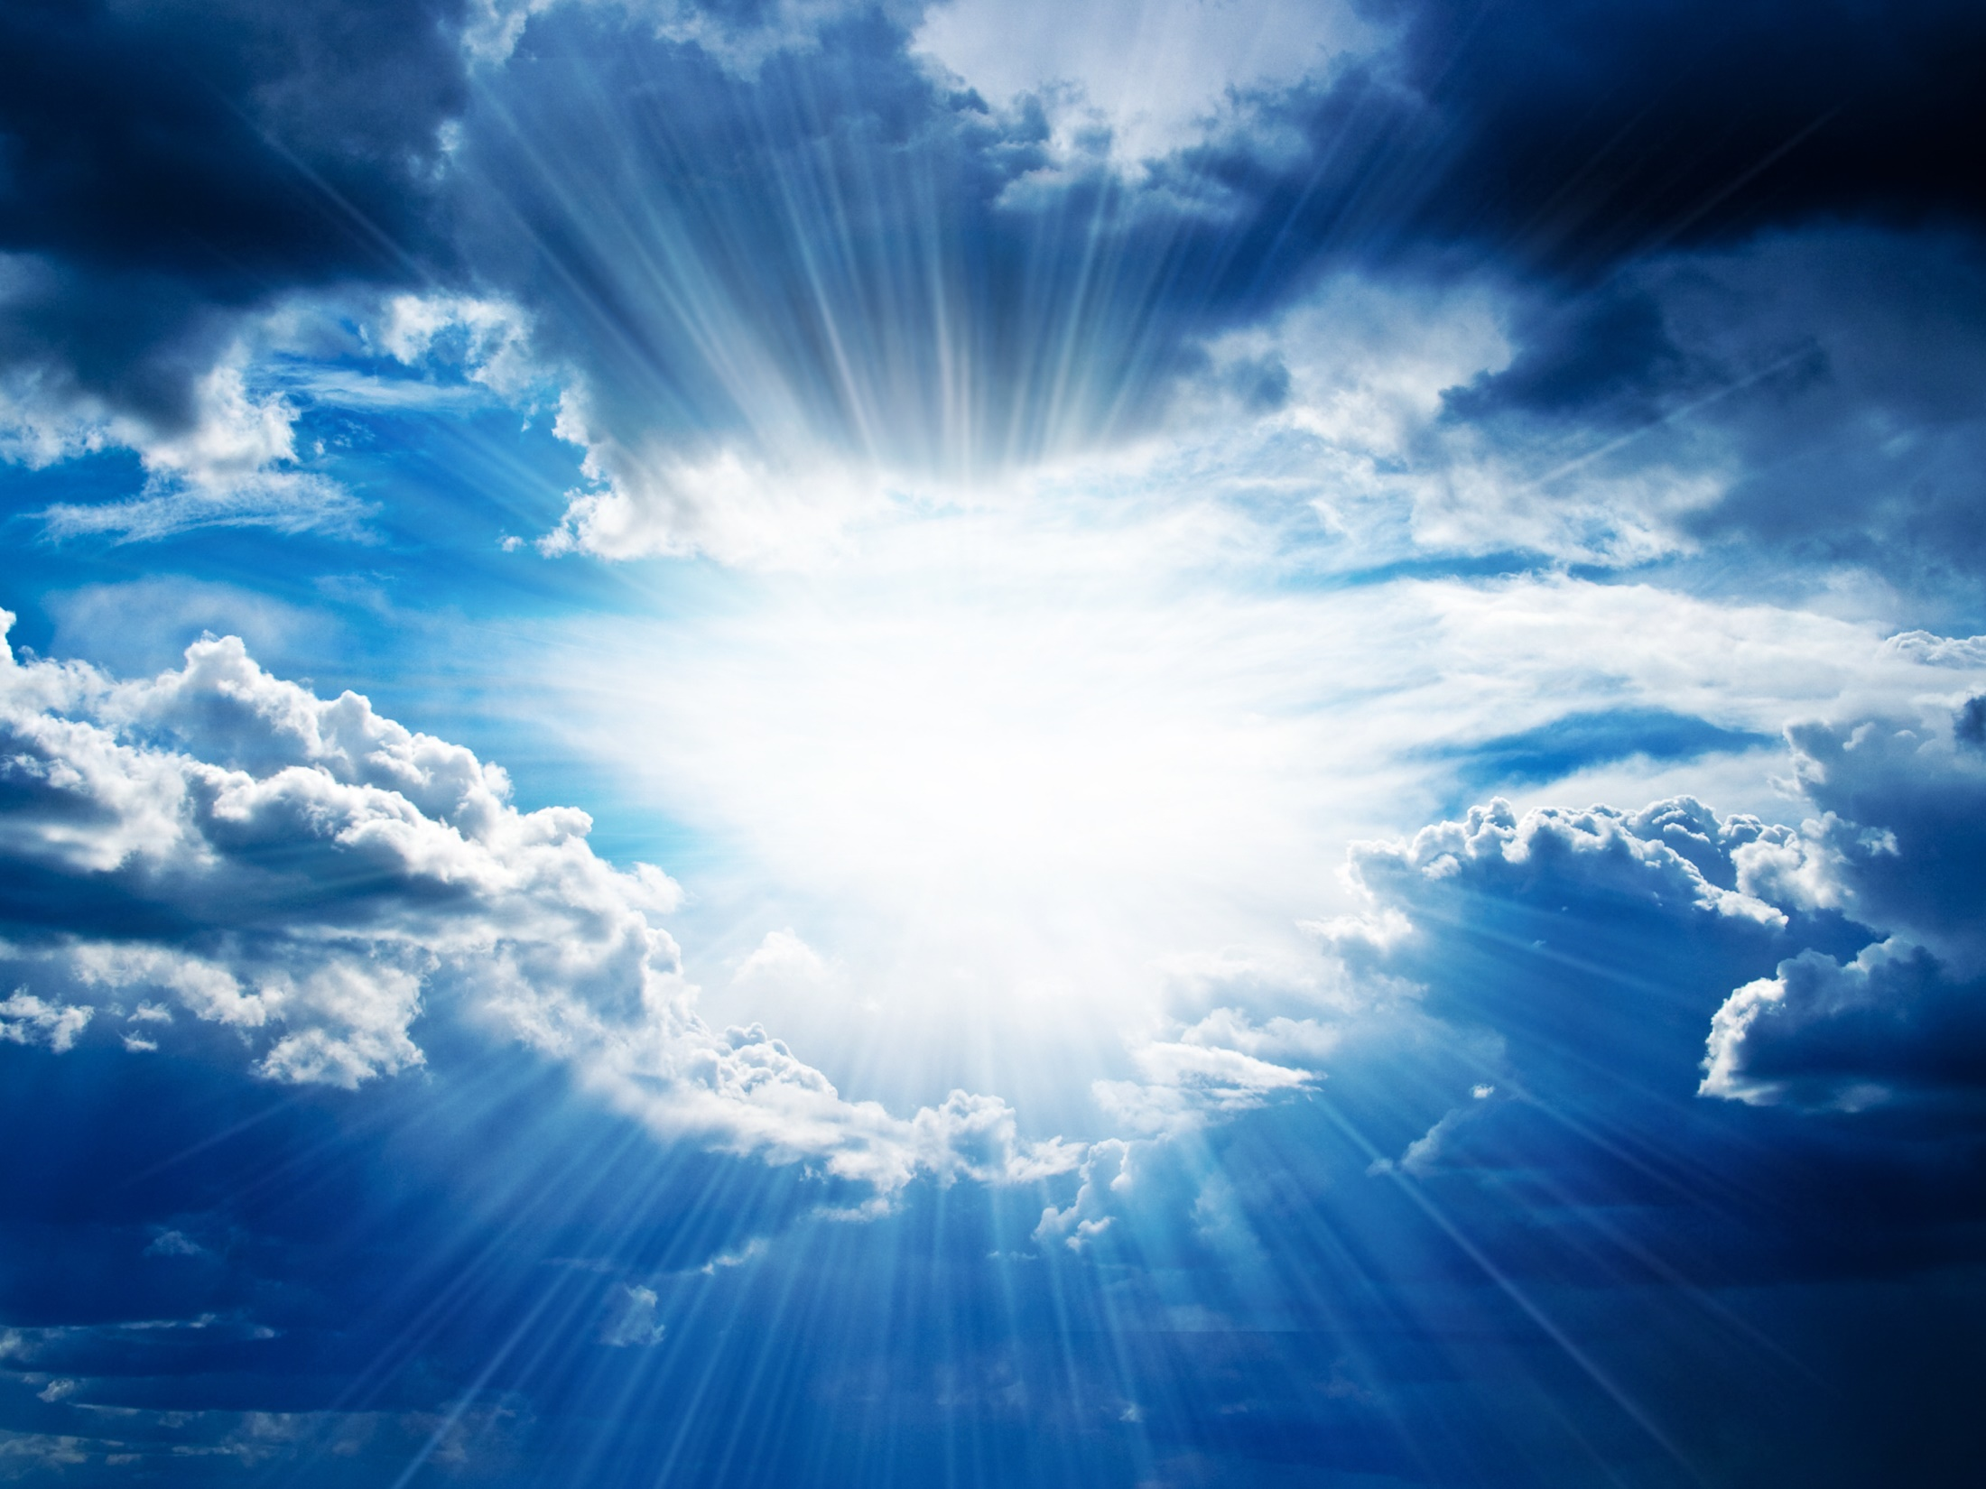
This is the message which we have heard from Him and declare to you, that God is light and in Him is no darkness at all. If we say that we have fellowship with Him, and walk in darkness, we lie and do not practice the truth. — 1st John 1:5
light
light
in
in Him
in Him
light
no darkness
all
no darkness
fellowship
fellowship
in
walk in darkness
practice the truth
practice the truth
not practice the truth
not
practice the truth
Notes:
To be in the light of God one must practice truth for a lie of any color is darkness. Fellowship in Him = Practice the Truth

Slide 15
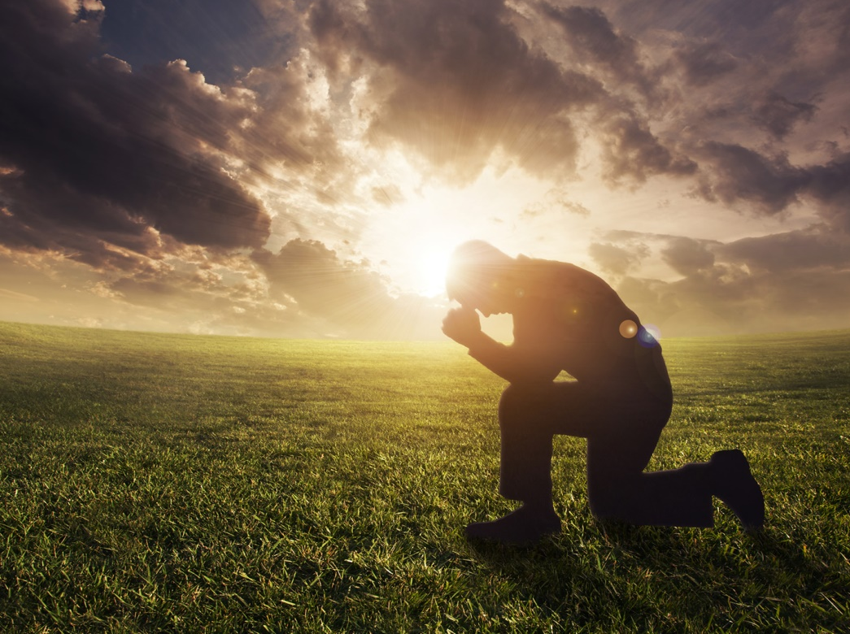
Therefore He says: "Awake, you who sleep, Arise from the dead, And Christ will give you light." See then that you walk circumspectly, not as fools but as wise, redeeming the time, because the days are evil. — Ephesians 5:14-16
Attentively
Thoughtfully
Vigilantly
Watchfully
Christ will give you light
Christ
Christ will give you light
light
Carefully
circumspectly
walk
Guardedly
Cautiously
Warily
Suspiciously
Notes:
Not coming to His unending light of truth only leaves a soul rambling in foolishness. He is serious about calling us to be serious as the times are evil. To miss His message for life in the light has the real potential of leading to death in the darkness. We need to carry our responsibility, duty if you will, or reasonable service, called out for by the Lord our God. No one or thing can replace God who is in each of us.

Slide 16
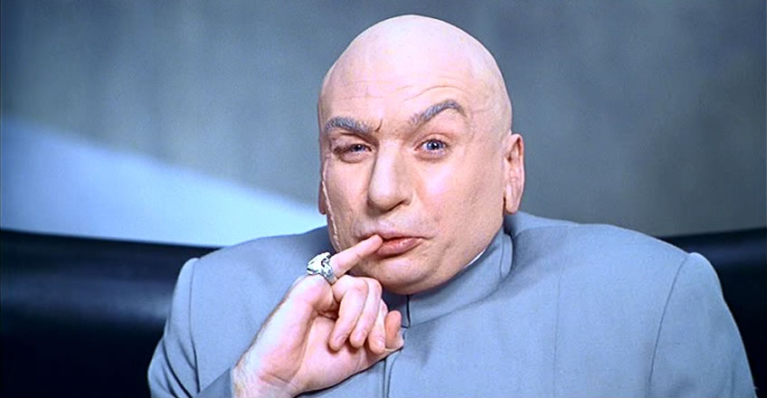
For we do not wrestle against flesh and blood, but against principalities, against powers, against the rulers of the darkness of this age, against spiritual hosts of wickedness in the heavenly places. — Ephesians 6:12
wrestle
wrestle
These are wells without water, clouds carried by a tempest, for whom is reserved the blackness of darkness forever. — 2nd Peter 2:17
against
darkness
against
darkness
darkness
reserved
blackness of
darkness
reserved
blackness of
darkness
Notes:
As individuals we are unable to purge the larger evils which have already come. There are many Mr. Evil’s. God’s rule will eventually subdue all darkness. Pray as individuals may we be found in the light, as the darkness is eternally repelled to its permanent destination of nowhere. Pray for our victory in His presence.

Slide 17
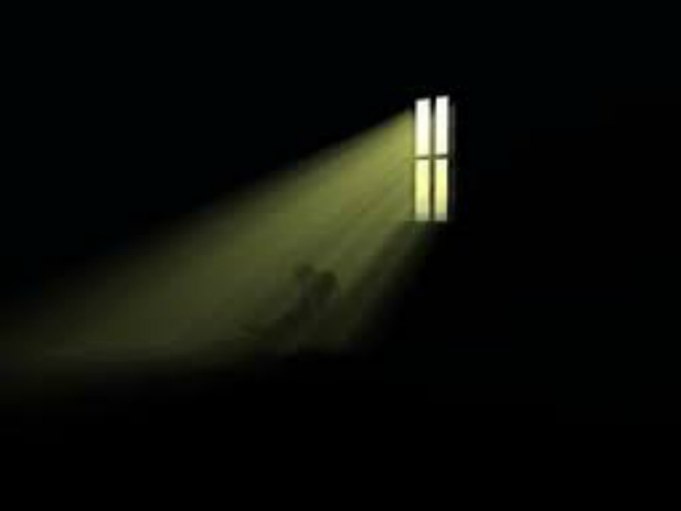
Do not be unequally yoked together with unbelievers. For what fellowship has righteousness with lawlessness? And what communion has light with darkness? — 2nd Corinthians 6:14
righteousness
lawlessness
light
darkness
Notes:
To associate with darkness only diminishes the light within. Suffocation is where the air is thick gagging the heart. Darkness has no luster and can only take away any brilliance that can be had.

Slide 18
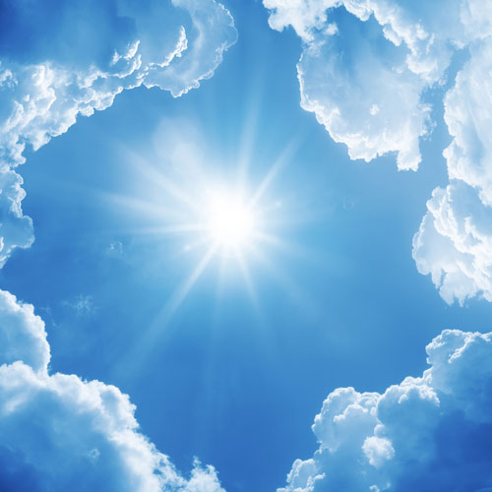
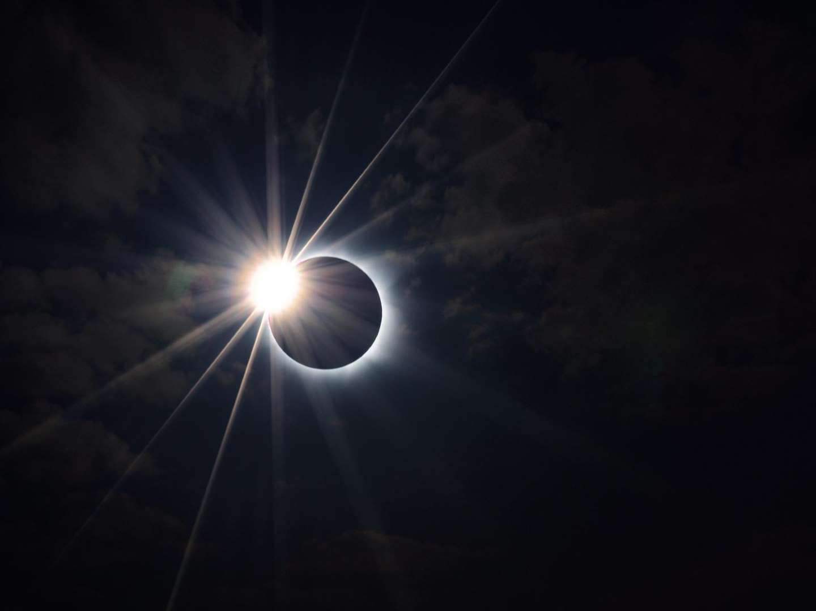
But you are a chosen generation, a royal priesthood, a holy nation, His own special people, that you may proclaim the praises of Him who called you out of darkness into His marvelous light; — 1st Peter 2:9
out of darkness
out of darkness
light
Notes:
For the true Christian His light shields us from the darkness that destroys the world.

Slide 19
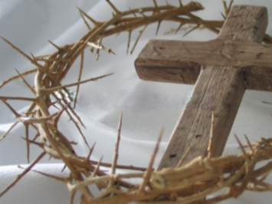
He has delivered us from the power of darkness and conveyed us into the kingdom of the Son of His love, in whom we have redemption through His blood, the forgiveness of sins. — Colossians 1:13-14
delivered us
us
delivered us
conveyed
into the kingdom
S
into the kingdom
light
of His love
Saves us
ave
of His love
through His blood
His sacrifice
the forgiveness of sins
s
His Grace
Notes:
His life prepares a path for our return where bliss is eternally upon all in Him. We are now in His kingdom where Christ has paid the sacrificial price for our redemption, if we in heart follow Him in seeking out His ways. This Grace comes to light through His sacrifice in love for all.

Slide 20
But you, brethren, are not in darkness, so that this Day should overtake you as a thief. You are all sons of light and sons of the day. We are not of the night nor of darkness. — 1st Thessalonians 5:4-5
Saves us
sons of light
of the day
sons of light
Notes:
The faithful good hearted march in beat with His will.

Slide 21
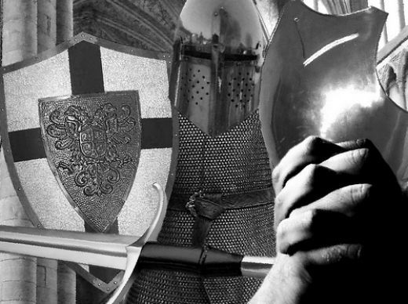
Therefore let us not sleep, as others do, but let us watch and be sober. For those who sleep, sleep at night, and those who get drunk are drunk at night. But let us who are of the day be sober, putting on the breastplate of faith and love, and as a helmet the hope of salvation. — 1st Thessalonians 5:6-8
let us not sleep
let us not sleep
at night
at night
darkness
at night
at night
of the day
faith
love
hope
Notes:
Materialism will consume itself in the dead substance that it is. Spiritual values have worth well beyond the temporal times that confine the mortal. True strength rises to the anchors He has established for our return. Is the gravity of one’s thirst for rocks of this world or that beacon call from eternity’s gates?

Slide 22
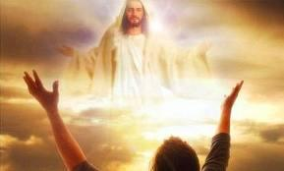
"The people who sat in darkness have seen a great light, And upon those who sat in the region and shadow of death Light has dawned." — Matthew 4:16
darkness
light
shadow of death
Notes:
His knowledge of truth has delivered us from the darkness of death, if we open our hearts to see Him for who He is, the Light of Life. Fear is the path of darkness without the torch of His courage. Light has overtaken the darkness.

Slide 23
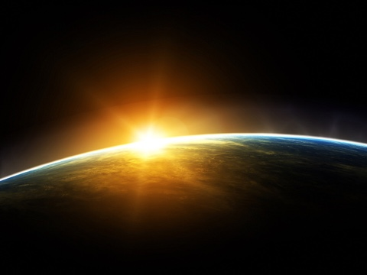
Therefore judge nothing before the time, until the Lord comes, who will both bring to light the hidden things of darkness and reveal the counsels of the hearts. Then each one's praise will come from God. — 1st Corinthians 4:5
Therefore judge nothing before the time, until the Lord comes, who will both bring to light the hidden things of darkness and reveal the counsels of the hearts. Then each one's praise will come from God. — 1st Corinthians 4:5
light
darkness
Notes:
It is best to leave it to the good way of God for He will retrieve all that is upright in Himself, rejecting all that is offensive. Pray we are found pleasing in His sight, resting our deepest hopes on His promises, and embracing grace’s protective bosom by which we are buried in the Son of His Love.

Slide 24
Pureness of His Light
Unrighteous
Hope
Respectful Angels
Liars
Light of life
Faith
Fools
Believers
Truth
Unbelievers
Outer Darkness
Wise
GOD
GOD
GOD
GOD
GOD
Righteous
Unprofitable Servant
SHEEP
GOATS
Disrespectful Angels
Jesus Christ Saves
GOATS
Falling
Unfaithful
Death
Hate
Fallen
Children of light
Rising
Faithful
SHEEP
Chained Angels
Evil Deeds
Forgiveness of sins
Reserved Darkness
Love
Notes:
In the realm of His light there are believers and unbelievers. He has revealed what is and what will be. After all is said and done, it is God that remains above all for all that is faithful in His goodness. The righteous will not witness the ultimate demise of the unrighteous, however, the wicked will witness good’s ascension. To dismiss the trumpets played for all to hear is to fall on a fools silent shock. Hearts will deposit where they have sought.

Slide 26
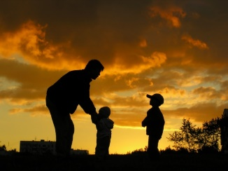
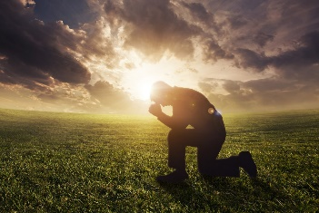
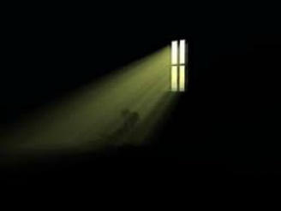
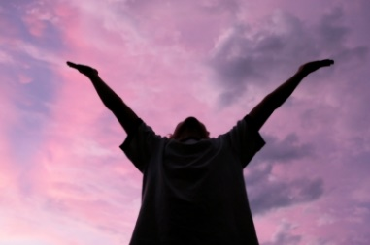
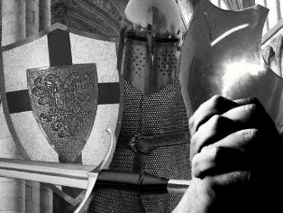

Slide 27
→ It is the Lord that brings light to a soul
→ He instructs us to shine in Him rejecting darkness
→ He who hates holds darkness over any light
→ His life turns one back to the light over the darkness
→ Pursuing Jesus allows light to purge darkness
→ Evil defines all that is darkness
→ He is the only true path with all darkness left behind
→ He orders us to find out what is acceptable to Him
→ It is Christ that gives the light of life
→ Do not associate with or pursue darkness
→ Deliverance is one breath away while He is
→ Fill one’s desires soberly in love hoping for salvation
→ God will judge the darkness in His light
God’s Light calls to the Darkness to Return
Notes:
God’s Light calls to the Darkness to Return. Have you come to the pools of His truth?

Slide 28
Notes:
Darkness only leaves emptiness in its’ wake. Darkness has no bottom.

Slide 29
Darkness Uncovered
II
Ron Bert
November 19, 2017
Notes:
Darkness is uncovered in the brilliance of His light.

Slide 30
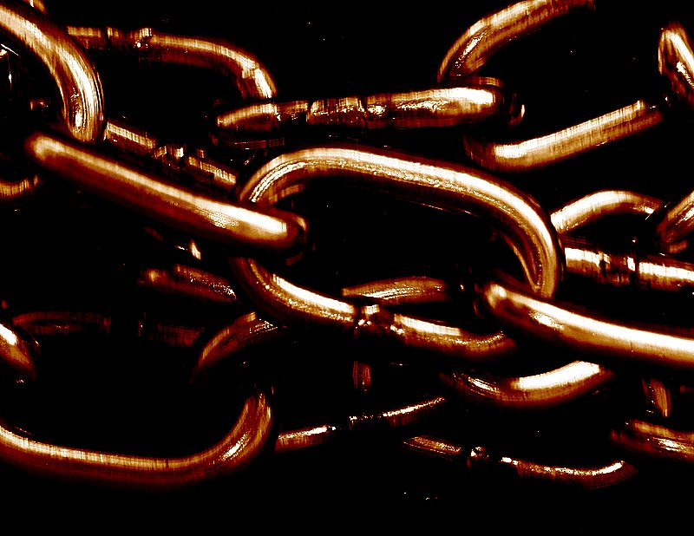
And the angels who did not keep their proper domain, but left their own abode, He has reserved in everlasting chains under darkness for the judgment of the great day; — Jude 1:6
chains
darkness
chains of darkness
of
Notes:
Condemned for abandoning loyalty to their Creator God, evil waits exposed in their own naked darkness for His final judgment. Broken from heights of their own making, reserved in the coldness of separate pain.

Slide 31
For if God did not spare the angels who sinned, but cast them down to hell and delivered them into chains of darkness, to be reserved for judgment; — 2nd Peter 2:4
chains of darkness
Wicked
Salvation is for the righteous
Notes:
Confined in their own iniquities, destruction is upon them who have turned from God. If the defiant only realized the exterminating tumultuous state we are in, as angels do, they would surely throw themselves humbly before Him. The proud rise to the deepest pits.

Slide 32
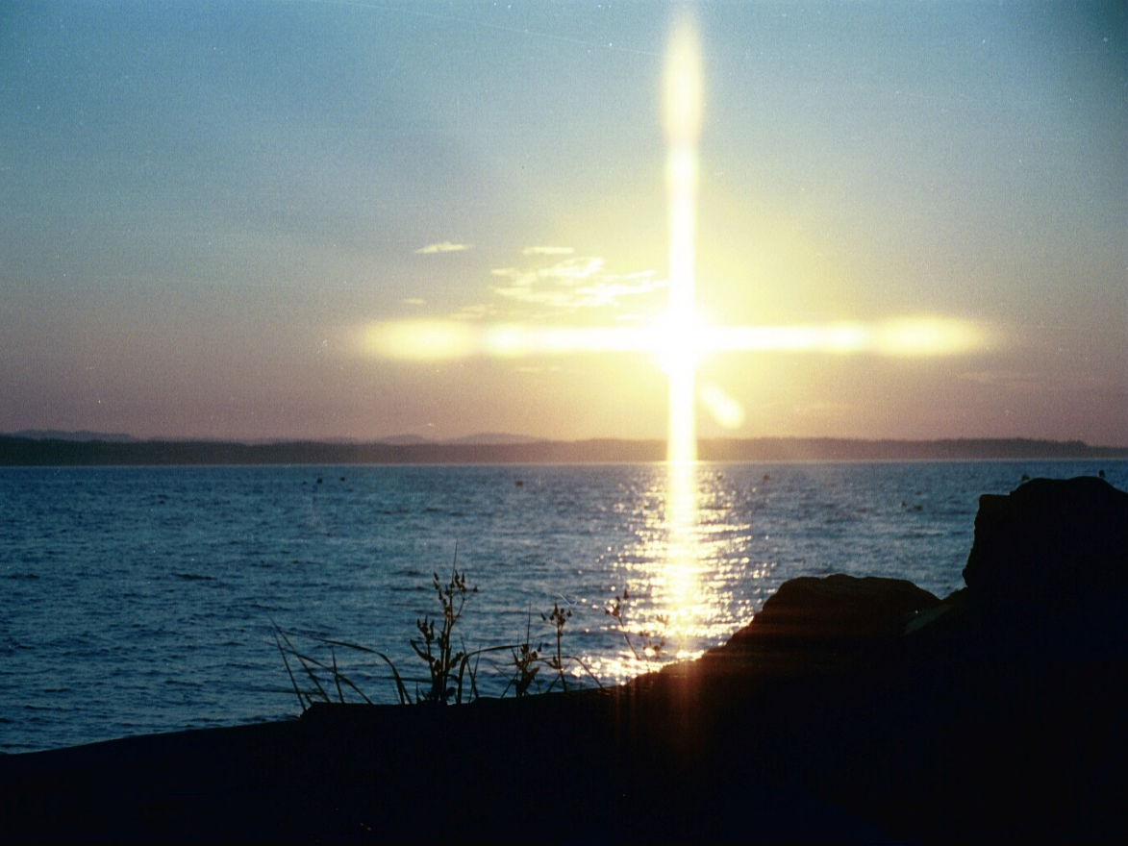
… then the Lord knows how to deliver the godly out of temptations and to reserve the unjust under punishment for the day of judgment, and especially those who walk according to the flesh in the lust of uncleanness and despise authority. They are presumptuous, self-willed. They are not afraid to speak evil of dignitaries, whereas angels, who are greater in power and might, do not bring a reviling accusation against them before the Lord. — 2nd Peter 2:9-11
reserve
reserve punishment for:
● flesh in the lust of uncleanness
● despise authority
● presumptuous
● self-willed
● speak evil of dignitaries
punishment for
flesh in the lust of
uncleanness
despise authority
disrespectful
presumptuous
self-willed
speak evil of dignitaries
respect
Notes:
For those that show no regard, for authority, invite their own demise. God delivers those that pray for an escape from evil, who possess a steadfast patience, and love for Him. It is not an easy path to remain good surrounded by the vortexes of evil’s revelry. True Christians suffer as Lot did in Sodom and Gomorrah. We wait for our awakening at our Master’s feet.

Slide 33
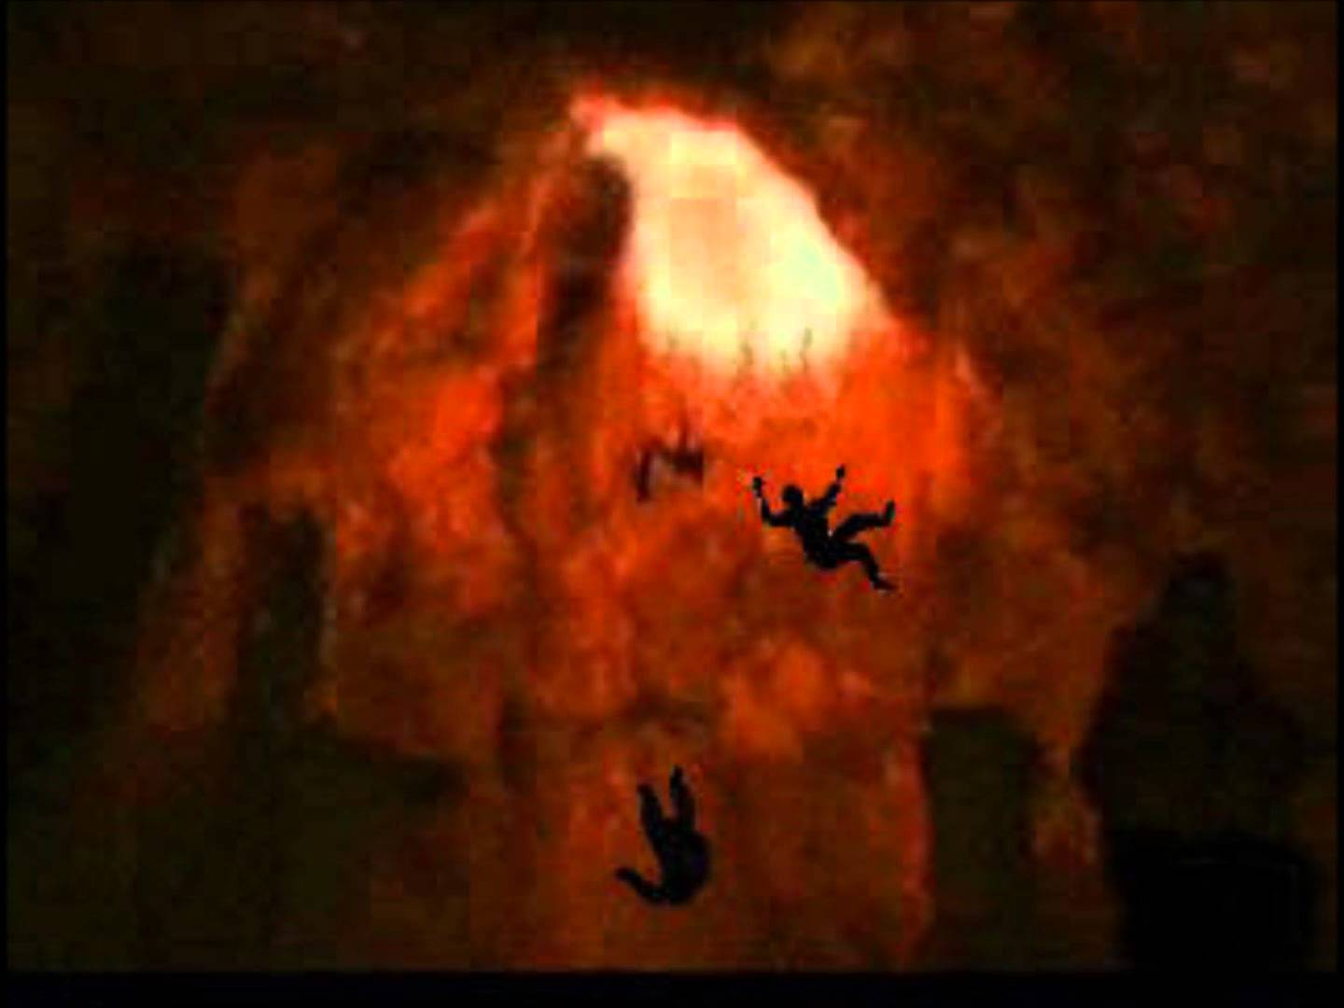
'And cast the unprofitable servant into the outer darkness. There will be weeping and gnashing of teeth.' — Matthew 25:30
outer darkness
outer darkness
Notes:
There is an outer darkness where all unrighteousness will be purged from His presence to their detriment. Casting off the spoon that feeds you has a permanent taste of death in this instance.

Slide 34
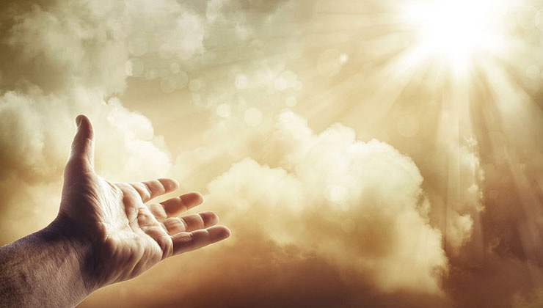
Behold, the LORD'S hand is not shortened, That it cannot save; Nor His ear heavy, That it cannot hear. But your iniquities have separated you from your God; And your sins have hidden His face from you, So that He will not hear. — Isaiah 59:1-2
Wrongs
Bias
Injustice
Inequality
Discrimination
iniquit
iniquities
iniquities
y
separated you from your God
Preconceptions
separated you from your God
Prejudices
Unfairness
iniquity
Notes:
God sees all that is evil though He separates Himself from their wicked pleas. Many broken sticks walk the land. A broken stick can only be repaired through a miraculous means. It is the stick that must call out to be healed as this upwelling prayer in belief and trust is the seed to the request. Hearts fuse where His brilliance shines.

Slide 35
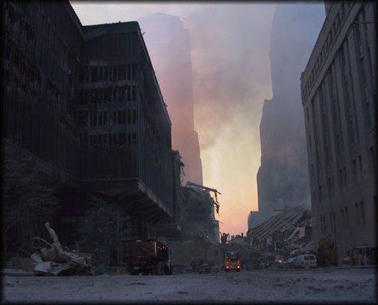
For your hands are defiled with blood, And your fingers with iniquity; Your lips have spoken lies, Your tongue has muttered perversity. No one calls for justice, Nor does any plead for truth. They trust in empty words and speak lies; They conceive evil and bring forth iniquity. — Isaiah 59:3-4
→
speak lies
conceive evil
muttered perversity
trust in empty words
No one calls for justice
Nor does any plead for truth
→
→
muttered
→
perversity
No one calls for justice
→
Nor does any plead for truth
→
trust in empty words
speak
lies
conceive evil
iniquity
Notes:
Evil in its’ bloody lies cannot lie to itself when His justice is revealed. Shame is the worst when we are conceived into death.

Slide 36
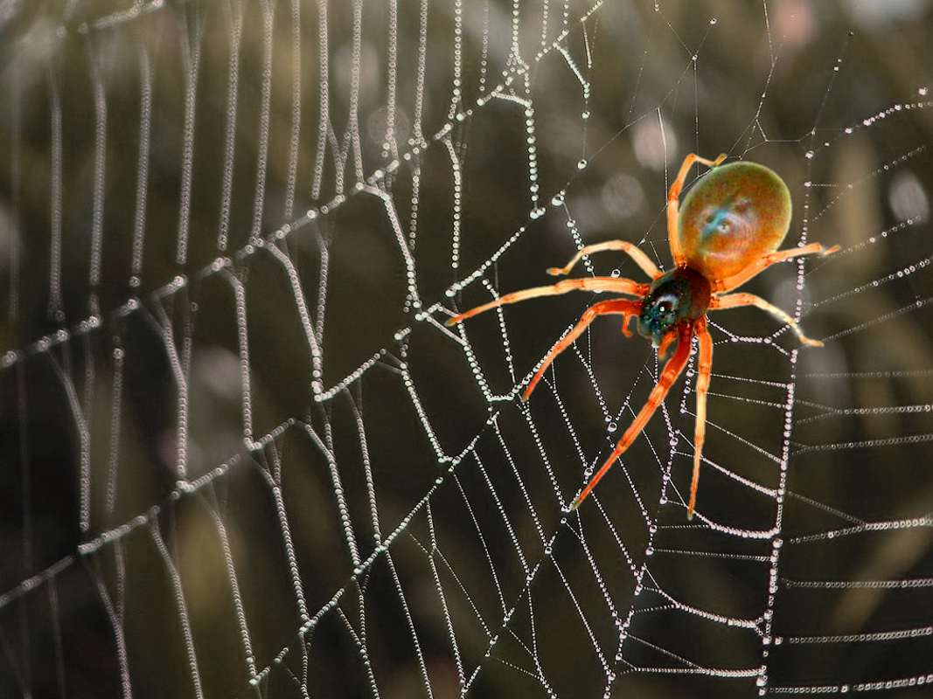
They hatch vipers' eggs and weave the spider's web; He who eats of their eggs dies, And from that which is crushed a viper breaks out. Their webs will not become garments, Nor will they cover themselves with their works; Their works are works of iniquity, And the act of violence is in their hands. — Isaiah 59:5-6
evil
e
iniquity
vi
l
Notes:
There is no refuge from the evils of man where he perpetuates upon the meek. Body’s are torn asunder in the rage of man.

Slide 37
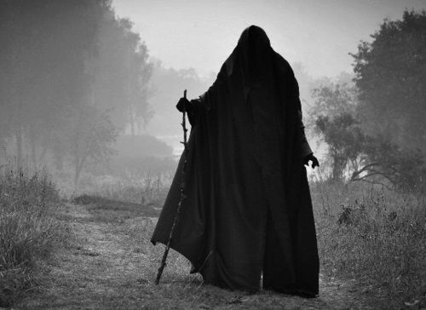
Their feet run to evil, And they make haste to shed innocent blood; Their thoughts are thoughts of iniquity; Wasting and destruction are in their paths. The way of peace they have not known, And there is no justice in their ways; They have made themselves crooked paths; Whoever takes that way shall not know peace. — Isaiah 59:7-8
evil
iniquity
crooked paths
not know peace
not know peace
Notes:
Wickedness spins in that black darkness holding calculated callousness. Oblivion is covered in the whip of ignorance.

Slide 38
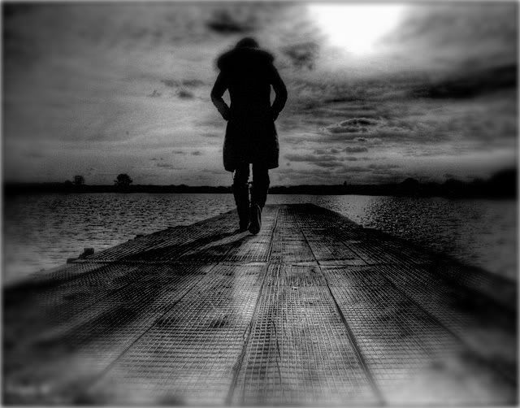
Therefore justice is far from us, Nor does righteousness overtake us; We look for light, but there is darkness! For brightness, but we walk in blackness! We grope for the wall like the blind, And we grope as if we had no eyes; We stumble at noonday as at twilight; We are as dead men in desolate places. — Isaiah 59:9-10
justice
righteousness
light
brightness
stumble
eyes
as dead men
Notes:
Blindness is a condition of darkness.

Slide 39
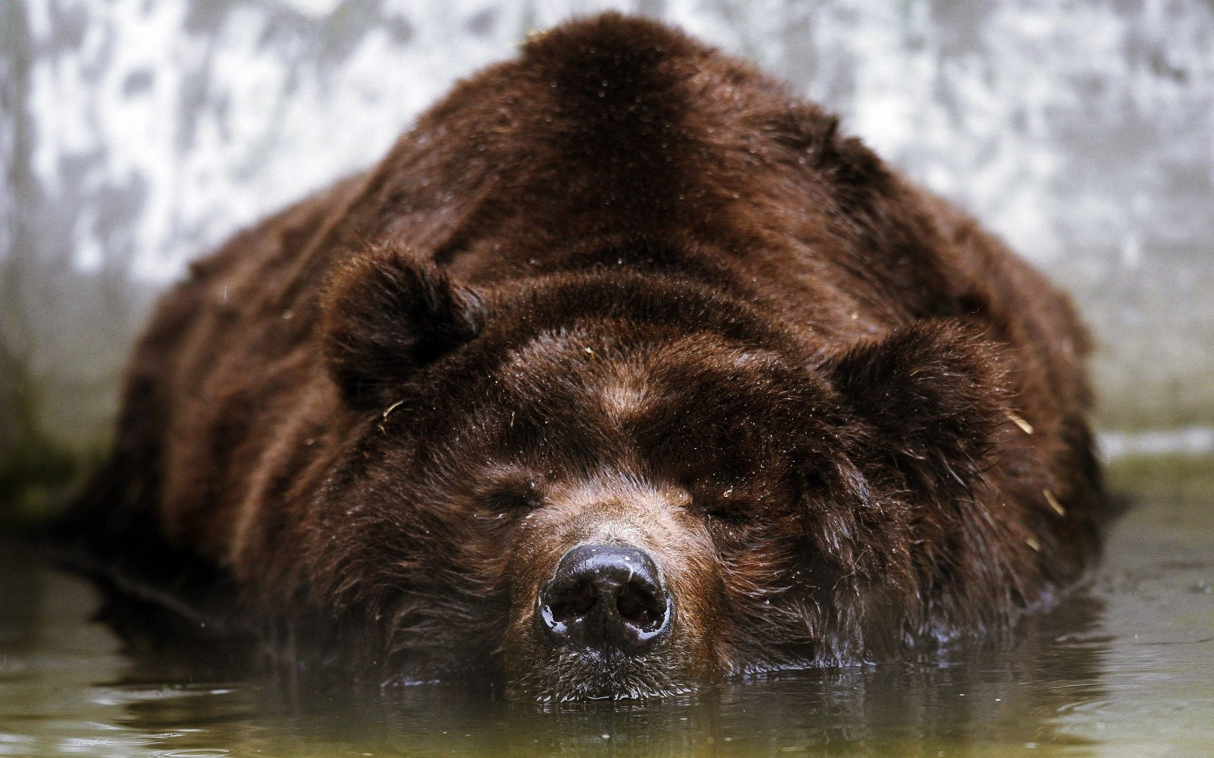
We all growl like bears, And moan sadly like doves; We look for justice, but there is none; For salvation, but it is far from us. For our transgressions are multiplied before You, And our sins testify against us; For our transgressions are with us, And as for our iniquities, we know them: — Isaiah 59:11-12
We all growl
moan
look for justice
salvation
but
our sins testify against us
our sins testify against us
stumble
Notes:
A heart cannot hide from His truth as evil is a witness to itself. There is no comfort in evil.

Slide 40
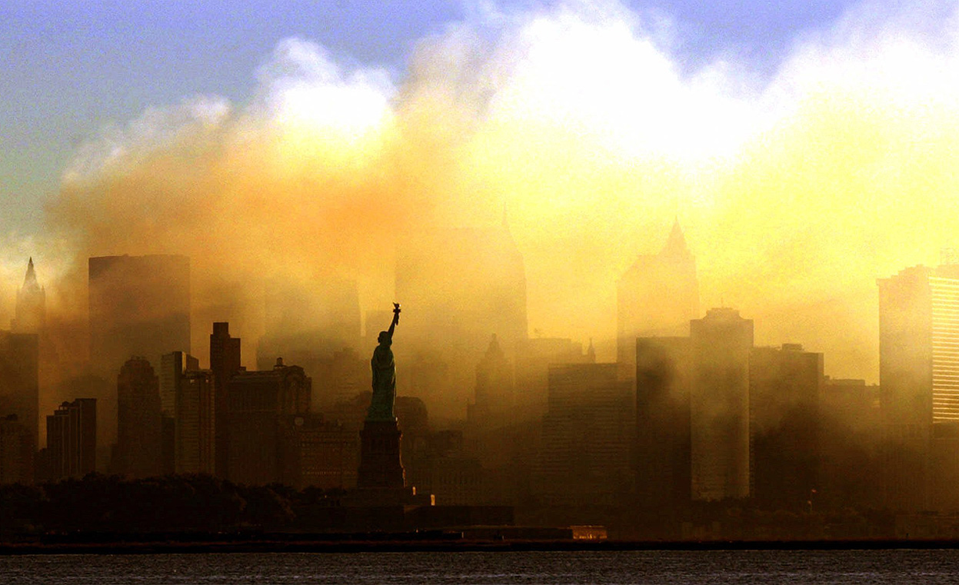
In transgressing and lying against the LORD, And departing from our God, Speaking oppression and revolt, Conceiving and uttering from the heart words of falsehood. Justice is turned back, And righteousness stands afar off; For truth is fallen in the street, And equity cannot enter. — Isaiah 59:13-14
In transgressing and lying against the LORD, And departing from our God, Speaking oppression and revolt, Conceiving and uttering from the heart words of falsehood. Justice is turned back, And righteousness stands afar off; For truth is fallen in the street, And equity cannot enter. — Isaiah 59:13-14
In transgressing and lying against the LORD, And departing from our God, Speaking oppression and revolt, Conceiving and uttering from the heart words of falsehood. Justice is turned back, And righteousness stands afar off; For truth is fallen in the street, And equity cannot enter. — Isaiah 59:13-14
walk in
darkness
They do not know, nor do they understand; They walk about in darkness; All the foundations of the earth are unstable. — Psalms 82:5
walk
in
truth is fallen in the street
truth is fallen in the street
darkness
All
earth
unstable
Notes:
Those who would cause the innocent harm are blinded from the truth of God. No man has the power to protect himself from the powers of self seeking lustful greedy envious malicious darkness without the peaceful healing light of God’s own presence. The World Trade Towers destruction, though horrific, is just a small visible outward sign for heinous acts of hate that are happening everyday across this world, where darkness pounces to stomp out the light of God’s own called out for standards of truth. Truths of decency, honor, and love that rise in those possessing true faith and hope for their children’s children crumble in the face of evil’s oppression. Adults fail in raising children if not to teach crucial and critical knowledge of how to live by the nature of all that is true, and in truth over deceptions of man’s lust over all. A disrespectful culture of eat before eaten is devouring our children in ignorance where hate and revenge in envy is magnified over caring in love. Sand consumes the proud in the unforgiving dust of time.

Slide 41
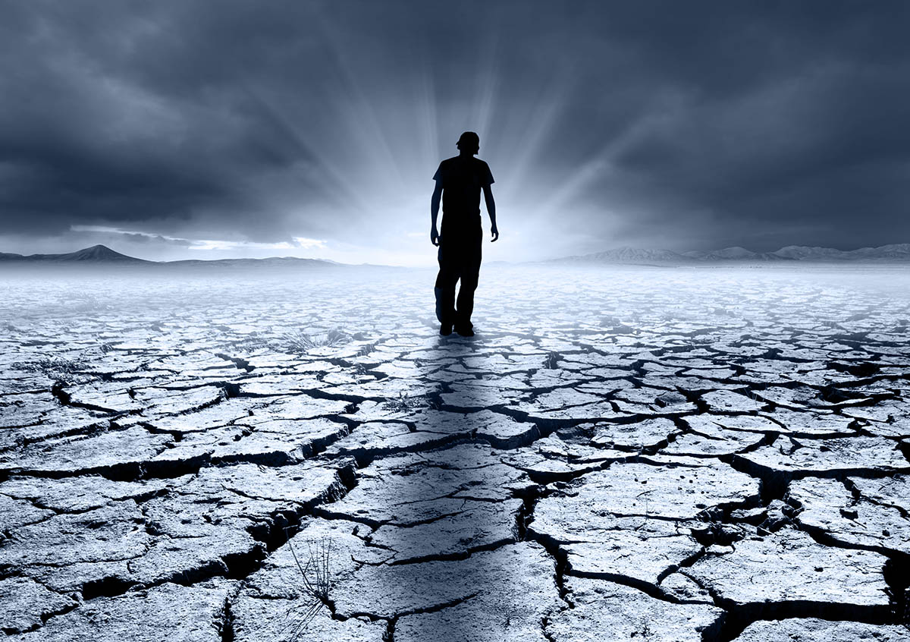
So truth fails, And he who departs from evil makes himself a prey. Then the LORD saw it, and it displeased Him That there was no justice. He saw that there was no man, And wondered that there was no intercessor; Therefore His own arm brought salvation for Him; And His own righteousness, it sustained Him. — Isaiah 59:15-16
righteousness
truth fails
truth fails
LORD
no
no
justice
justice
no intercessor
no intercessor
righteousness
Notes:
Truth emphatically fails where darkness turns from the light. The good of the earth are victims of the jaws of evil as it is the beastly that rule the world. Weapons cripple the use of tools. It is the small minded, who claim greatness as large in themselves, that plow over the poor and afflicted. The only true sanctuary is in the heart where the rich light of God reveals life. God Himself came to earth as He saw no man leading man to Him. To come to God, one has to leave the desires of this world’s wickedness and come to control self with understanding in Him. Spiritual desolation occurs when permanence is placed on that which is temporary. Freedom reaches into eternity. No one has the power to lift life from death other than the One who came to proclaim it as it is.

Slide 42
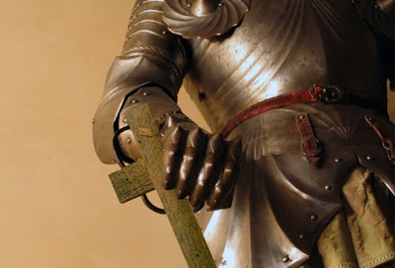
For He put on righteousness as a breastplate, And a helmet of salvation on His head; He put on the garments of vengeance for clothing, And was clad with zeal as a cloak. According to their deeds, accordingly He will repay, Fury to His adversaries, Recompense to His enemies; The coastlands He will fully repay. — Isaiah 59:17-18
He
righteousness
righteousness
He
salvation
vengeance
zeal
He
He
Notes:
Knowing man in his ignorance had not the power to bring forth justice in truth, He brought Himself to the earth to establish that standard where light would prevail over the darkness.

Slide 43
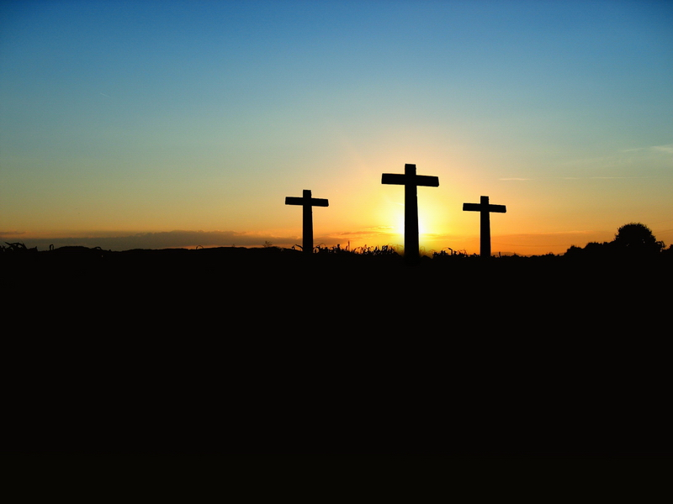
So shall they fear The name of the LORD from the west, And His glory from the rising of the sun; When the enemy comes in like a flood, The Spirit of the LORD will lift up a standard against him. "The Redeemer will come to Zion, And to those who turn from transgression in Jacob," Says the LORD. — Isaiah 59:19-20
LORD
His glory
His glory
He
LORD
Spirit of the LORD
Spirit of the LORD
The Redeemer
The Redeemer
LORD
Notes:
It is through God Himself that man is now able to return with a clean heart directly to Him.

Slide 44
"As for Me," says the LORD, "this is My covenant with them: My Spirit who is upon you, and My words which I have put in your mouth, shall not depart from your mouth, nor from the mouth of your descendants, nor from the mouth of your descendants' descendants," says the LORD, "from this time and forevermore." — Isaiah 59:21
My Spirit
My Spirit
is upon you
is upon you
shall not depart
Notes:
For all that would have Him, He is near with His revealing words.

Slide 45
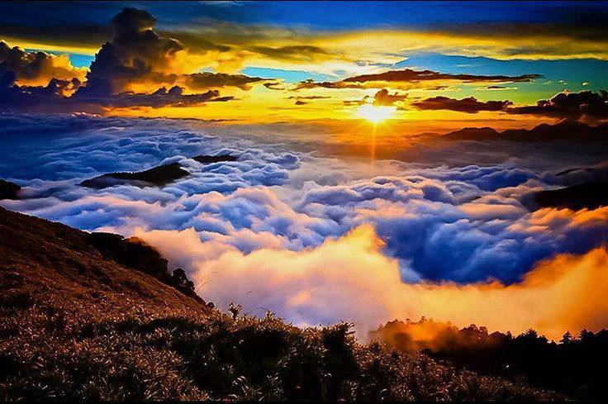
And so all Israel will be saved, as it is written: "The Deliverer will come out of Zion, And He will turn away ungodliness from Jacob; For this is My covenant with them, When I take away their sins." — Romans 11:26 -27
Then I saw that wisdom excels folly As light excels darkness. — Ecclesiastes 2:13
Then I saw that wisdom excels folly As light excels darkness. — Ecclesiastes 2:13
Then I saw that wisdom excels folly As light excels darkness. — Ecclesiastes 2:13
He reveals deep and secret things; He knows what is in the darkness, And light dwells with Him. — Daniel 2:22
He reveals deep and secret things; He knows what is in the darkness, And light dwells with Him. — Daniel 2:22
He reveals deep and secret things; He knows what is in the darkness, And light dwells with Him. — Daniel 2:22
For with You is the fountain of life; In Your light we see light. — Psalms 36:9
light excels darkness
light excels darkness
He knows
He knows
And so all Israel will be saved, as it is written: "The Deliverer will come out of Zion, And He will turn away ungodliness from Jacob; For this is My covenant with them, When I take away their sins." — Romans 11:26 -27
And so all Israel will be saved, as it is written: "The Deliverer will come out of Zion, And He will turn away ungodliness from Jacob; For this is My covenant with them, When I take away their sins." — Romans 11:26 -27
In Your light we see light
In Your light we see light
I take away their sins
I take away their sins
Notes:
It was foreordained that God would come in the flesh to reveal the darkness of man; so that man’s thoughts and heart might return to the good intent of creation, over the evil devouring and crushing of those who would hope. It is currently a narrow slice of souls that pursue Him wholly in spirit and truth. Darkness pervades the earth in all the unyielding perversions of man. As most seek to escape in their vices, Solomon reveals that understanding has more worth to a soul than unfulfilling follies. As light is ahead of darkness, so does wisdom’s advance place follies as undesirable fading whims; actual hindrances. How powerful the redemption of a soul for all. God’s promise is to save man from himself if He turns back, striving to be more Holy, too our true nature as created for, in His image.

Slide 46
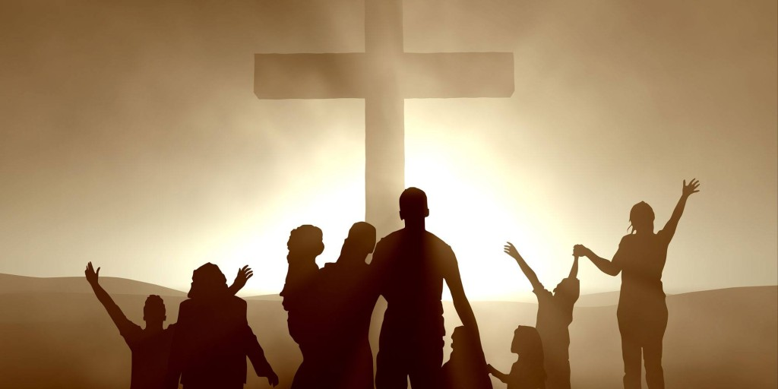
But the path of the just is like the shining sun, That shines ever brighter unto the perfect day. The way of the wicked is like darkness; They do not know what makes them stumble. — Proverbs 4:18-19
the path
the path
shining
darkness
Notes:
It is when a heart shines over the darkness that truth come to be.

Slide 47
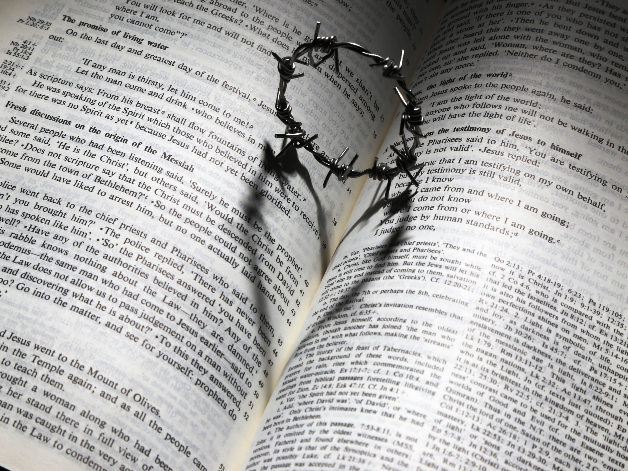
"For this is the covenant that I will make with the house of Israel after those days, says the LORD: I will put My laws in their mind and write them on their hearts; and I will be their God, and they shall be My people." — Hebrews 8:10
G
T
LIGHT
GR ACE
LIGH
O
D
GOD
G
O
D
in
in
R
U
T
H
R
U
H
. .
D
MIND
hearts
on their hearts
G
CHRIST
Notes:
In the heart of man beats the truth of God if in submission to Him. This mind of God should be deep upon each of our hearts as we cherish that which has come for us to know God Himself.

Slide 48
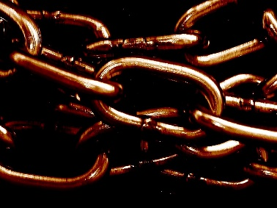
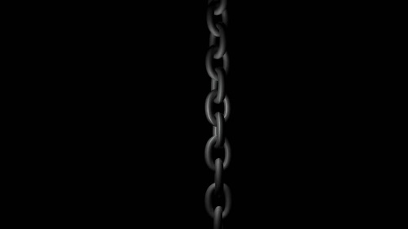
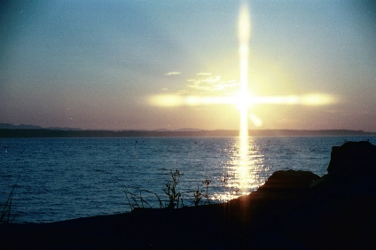
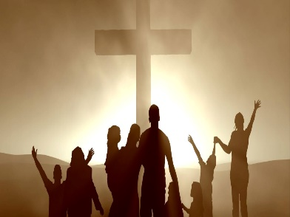
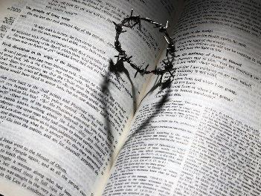

Slide 49
→ The Lord is present before all iniquities
→ The Lord sees all the evils of corruption
→ Evil spawns more evil where there is no cover
→ There is no peace in darkness
→ Darkness has no sense of light
→ The deep truth of light shames unjust darkness
→ Liars deceive themselves in honor
→ The world tortures the good
→ God brought Himself forth revealing light to mankind
→ Transgressive hearts return to God through Christ
→ The Spirit of God forever remains among us
→ Salvation will come to those loyal to God
→ Wisdom in the light is superior to follies in the dark
Hearts can
only see in His light of truth
Notes:
Hearts can only see in His light of truth.

Slide 50
Notes:
Darkness conveys all that is empty.

Slide 51
Please visit http://www.LoveFromGod.com to explore further
Ronald Bert Channel on
Notes:
Eternity never ends.

