Slide 2
Covetousness
Ron Bert
January 12, 2020

Slide 3
But fornication and all uncleanness or covetousness, let it not even be named among you, as is fitting for saints; — Ephesians 5:3
raised
X
r
X
X
not even be
ed
ai
s
Notes:
Covetousness is not part of the eternal wealth found in freedom from material bondage. The question comes in what we elevate in our hearts. Goodness leaves evil behind where priorities rise in spirit.

Slide 4
If then you were raised with Christ, seek those things which are above, where Christ is, sitting at the right hand of God. Set your mind on things above, not on things on the earth. For you died, and your life is hidden with Christ in God. When Christ who is our life appears, then you also will appear with Him in glory. — Colossians 3:1-4
raised
Christ
Christ
seek
above
Christ
Christ
God
your mind
God
Christ
God
Christ
Notes:
Closeness to God involves prayer and contemplations of ideals that cannot be bought. All fall short of the standard set by God, of what we have been shown in Christ. To follow Him is to follow God where man is a miserable example. How close is God to what you call out for?

Slide 5
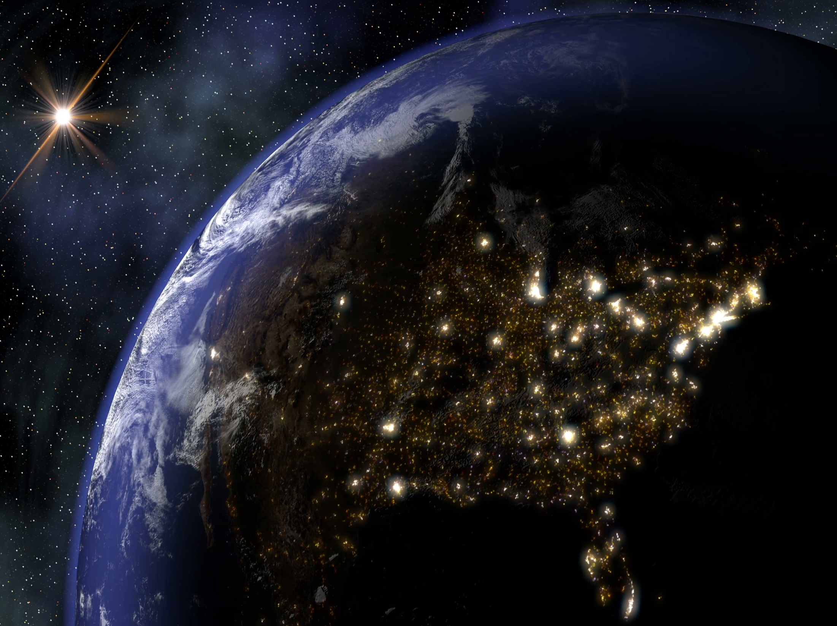
Therefore put to death your members which are on the earth: fornication, uncleanness, passion, evil desire, and covetousness, which is idolatry. Because of these things the wrath of God is coming upon the sons of disobedience, in which you yourselves once walked when you lived in them. — Colossians 3:5-7
put to death
put to death:
• fornication
• uncleanness
• passion
• evil desire
• covetousness
which is idolatry
:
covetousness
fornication
uncleanness
passion
evil desire
covetousness
which
Minneapolis
is idolatry
Cleveland
Boston
San Francisco
Denver
Chicago
New York
Kansas
City
St Louis
Philadelphia
Los Angeles
God
Washington DC
covetousness
Dallas
Atlanta
Houston
=
Jacksonville
Tampa
Miami
Notes:
When we see our heart’s for what they are, desire reveals our true purpose. Lips speak truth of want in one’s ability to be self-aware. An honest heart endures, rather than rambling off the cliff with the herd, and declares responsibility or not. Is the gift of light where God gives life less important than the rocks we buy?

Slide 6
Let your conduct be without covetousness; be content with such things as you have. For He Himself has said, "I will never leave you nor forsake you." So we may boldly say: "The LORD is my helper; I will not fear. What can man do to me?" — Hebrews 13:5-6
covetousness
. .
covetousness
covetousness
forsake
. .
fear
help
fear
WISDOM
Notes:
To lose heart for things, over true living relationships in love, what can one do, without sacred substance that cannot be seen? Does one forsake love of God for love of stuff, or does one lose love of stuff for love of God? Not only does priorities set precedence, but it defines character, which gives or takes from those around us. As it has been said, are we part of the problem or solution? It is how we interact with those we are most intimate with that frees or imprisons us. This is where our true desires and glory comes to light. Glory that radiates from within is best light, and not downtroddenly heavy.

Slide 7
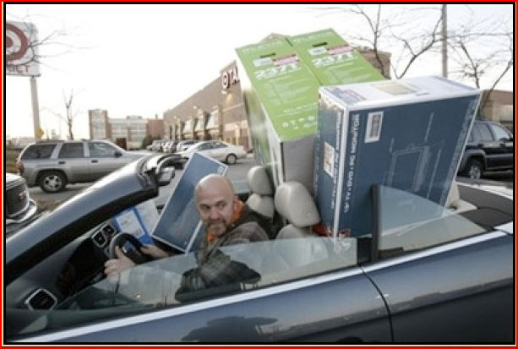
And He said to them, "Take heed and beware of covetousness, for one's life does not consist in the abundance of the things he possesses." — Luke 12:15
JESUS
covet
watchful
Take heed
beware
covetousness
covet
one's life
life
Notes:
Desperate thirst to spend and obtain causes grief beyond measure damaging any peace of heart.

Slide 8
"You shall not covet your neighbor's house; you shall not covet your neighbor's wife, nor his male servant, nor his female servant, nor his ox, nor his donkey, nor anything that is your neighbor's." — Exodus 20:17
#10
covet
Notes:
Curious how the Catholic church eliminates the 2nd commandment (no idols) in exodus, as they teach in their Catechism, and split the 10th commandant into 9 and 10? - to cover the shame of all their statues. Come out of her lest ye partake in her damnation; ditch digger religions.
True religion is not politically correct as it seeks to correct moral conduct. Politics involves appeasements and compromise, not necessarily in accordance with God given truths. Replacing murder with kill, in “Thou shall not do murder,” changes the context and actually changes truth to a lie. Truths of God aspire to instruct us to be the best we can become.

Slide 9
For the love of money is a root of all kinds of evil, for which some have strayed from the faith in their greediness, and pierced themselves through with many sorrows. — 1st Timothy 6:10
love
love
. .

Slide 10
He who loves silver will not be satisfied with silver; Nor he who loves abundance, with increase. This also is vanity. — Ecclesiastes 5:10
love
. .
satisfied

Slide 11
"For where your treasure is, there your heart will be also. The lamp of the body is the eye. If therefore your eye is good, your whole body will be full of light. But if your eye is bad, your whole body will be full of darkness. If therefore the light that is in you is darkness, how great is that darkness!" — Matthew 6:21-23
r
e
serve
↙ ↘
light darkness
serve
serve
e
v
↙ ↘
love
s
light
darkness
Notes:
What you love is what you treasure.

Slide 12
"No one can serve two masters; for either he will hate the one and love the other, or else he will be loyal to the one and despise the other. You cannot serve God and mammon. — Matthew 6:24
serve
serve
serve
serve

Slide 13
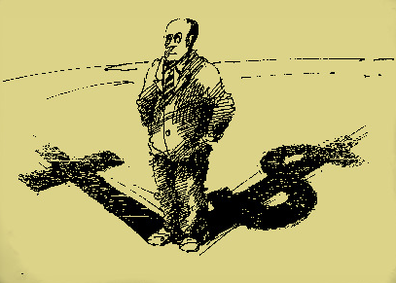
"No servant can serve two masters; for either he will hate the one and love the other, or else he will be loyal to the one and despise the other. You cannot serve God and mammon." — Luke 16:13
serve
e
t
ov
covet
c
serve
Notes:
A choice confronts all in what is sensible. Sensible in the sense of humanism as the pinnacle of existence, or in its’ temporality, heavenly truths as more tangible.

Slide 14
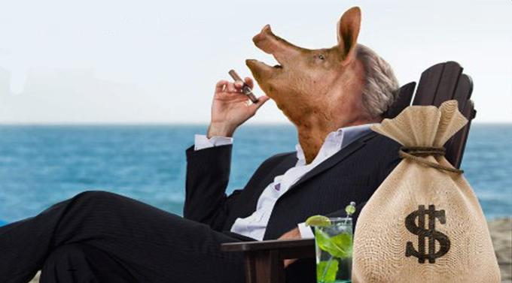
Woe to those who devise iniquity, And work out evil on their beds! At morning light they practice it, Because it is in the power of their hand. They covet fields and take them by violence, Also houses, and seize them. So they oppress a man and his house, A man and his inheritance. — Micah 2:1-2
l
in
of
in the power
A man of value
v
covet
u
e
A man
a
Notes:
Piggish usually refers to excessive desire void of spiritual sense. Evil knows no mercy. Each of us has been given power to influence one another. Do we take in greediness or are we able to cater and adjust to the needs of others?
"Try not to become a man of success but rather try to become a man of value." - Albert Einstein

Slide 15
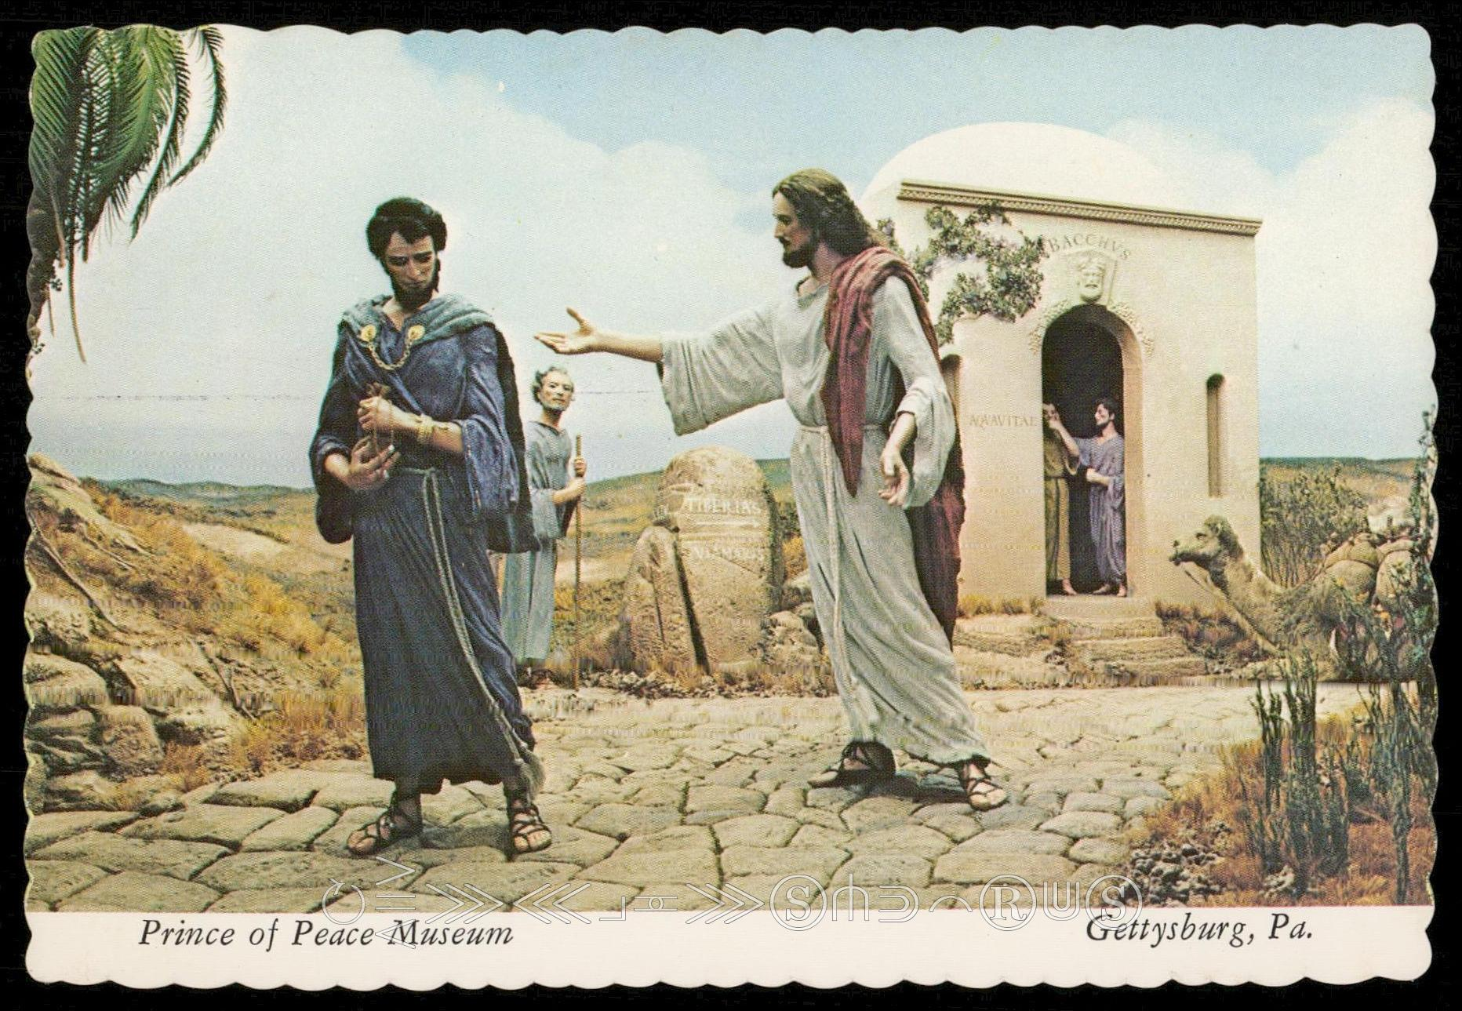
So when Jesus heard these things, He said to him, "You still lack one thing. Sell all that you have and distribute to the poor, and you will have treasure in heaven; and come, follow Me." But when he heard this, he became very sorrowful, for he was very rich. — Luke 18:22-23
Jesus
Jesus
attachment
STUFF
earth
A man of value
heaven
follow Me
Notes:
Jesus wants to know where our ultimate attachment is. It may not always be easy to follow Him, but rewards follow if one does.

Slide 16
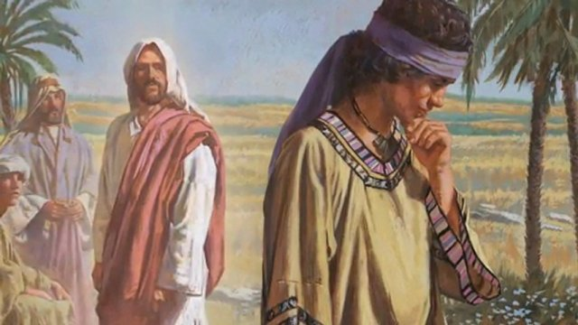
And when Jesus saw that he became very sorrowful, He said, "How hard it is for those who have riches to enter the kingdom of God! For it is easier for a camel to go through the eye of a needle than for a rich man to enter the kingdom of God." — Luke 18:24-25
Jesus
sorrowful
Joy?
riches
God
God

Slide 17
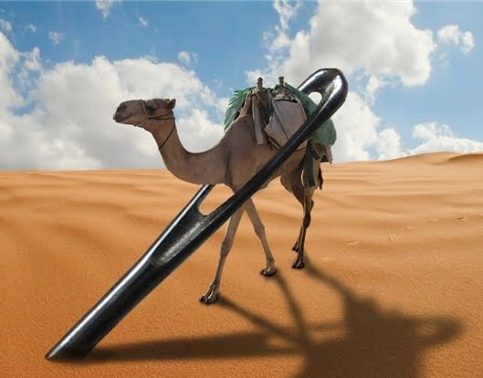
"And again I say to you, it is easier for a camel to go through the eye of a needle than for a rich man to enter the kingdom of God." — Matthew 19:24
Creator
Creation
God
covetous
. .
God
Notes:
What one chooses to be one’s God, either material or supernal, will declare the outcome deserved. True value transcends time and creates an infinite space in Him. Upon the sands we walk, do we find thought simple, in love of God, or do we resist clinging to the material which He has given?

Slide 18
Command those who are rich in this present age not to be haughty, nor to trust in uncertain riches but in the living God, who gives us richly all things to enjoy. Let them do good, that they be rich in good works, ready to give, willing to share, storing up for themselves a good foundation for the time to come, that they may lay hold on eternal life. — 1st Timothy 6:17-19
trust in God who gives all things to enjoy ● do good be rich in good works ● ready to give ● willing to share ҉ a good foundation for eternal life
. .
trust in
. .
God
God
who gives
all things to enjoy
do good
be rich in good works
ready
to give
willing to share
a good foundation for
eternal life
eternal life
Notes:
So, where does your God reside? Fortune is found in contentment. As winding storms of life assault us, we all seek clarity from those we hope in, or for a simple hand of mercy. Only God offers eternal life where all man does is fade on the shadows of self.

Slide 19
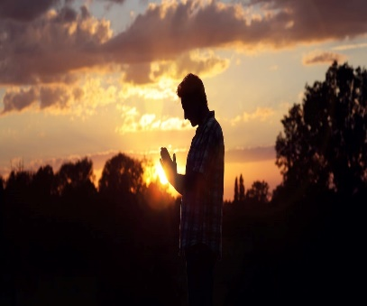
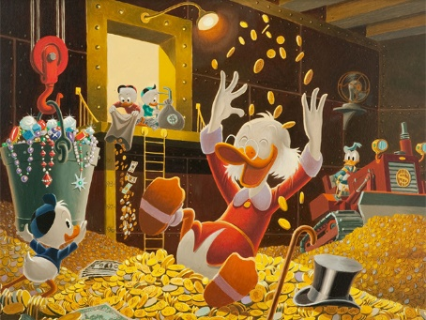
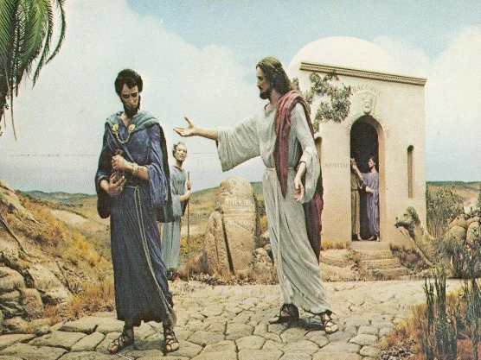

Slide 20
→ Covetousness is not a fitting quality for the saints
→ Seek what comes from above given by Christ
→ Put to death wickedness before God’s wrath comes
→ Be content with such things as you have
→ Life does not consist in the abundance of goods
→ The love of money pierces a heart with sorrows
→ Compulsively seeking wealth is a disease of greed
→ Treasure is found in the desires of one’s heart
→ One cannot serve God and insatiable desires
→ Covetous men ruin good people stealing their lives
→ No attachment is worth more than eternal life
→ Placing possessions above God nullifies faith
→ Trust in God the giver and not material possessions
Hands that selfishly grab have little ability to build
Notes:
Hands that selfishly grab have little ability to build

Slide 22
Covetousness
2
Ron Bert
January 12, 2020

Slide 23
"So they come to you as people do, they sit before you as My people, and they hear your words, but they do not do them; for with their mouth they show much love, but their hearts pursue their own gain. — Ezekiel 33:31
hypocrites
do not do them
schemers
pursue their
own gain

Slide 24
For this you know, that no fornicator, unclean person, nor covetous man, who is an idolater, has any inheritance in the kingdom of Christ and God. — Ephesians 5:5
Worship stuff
covetous man, who is an idolater
=
inheritance
Notes:
A fire baptism is coming for each of us that will strip us bare before God, exposing all that we are. Will you or we be found in self absorption, or assisting others where we can?

Slide 25
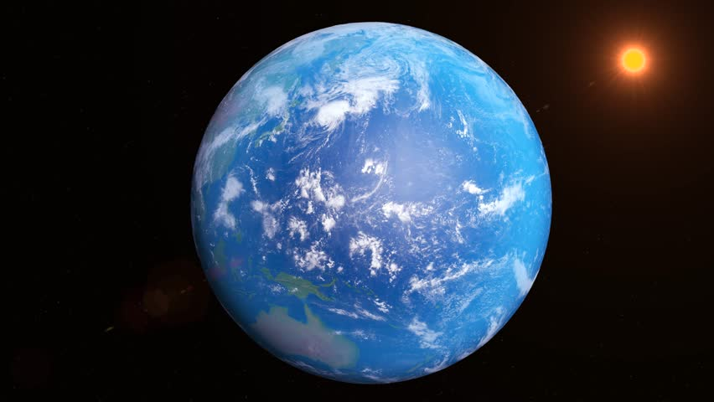
"For whoever desires to save his life will lose it, but whoever loses his life for My sake will find it. For what profit is it to a man if he gains the whole world, and loses his own soul? Or what will a man give in exchange for his soul?" — Matthew 16:25
world
world
. .
Notes:
Think of your life, what could pay for one moment of thought, experience of warmth, if for all the molecules on and of the sun, and beyond, could exchange for one breath of life?

Slide 26
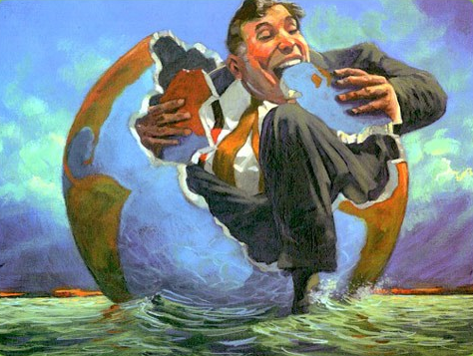
Do not love the world or the things in the world. If anyone loves the world, the love of the Father is not in him. For all that is in the world -- the lust of the flesh, the lust of the eyes, and the pride of life -- is not of the Father but is of the world. And the world is passing away, and the lust of it; but he who does the will of God abides forever. — 1st John 2:15-17
. .
love
love
world
world
world
world
world
world
world
Notes:
Habitual consumption of those inert things of the earth will never deliver eternal satisfaction. Material obsessions lead to compulsive behaviors, often neurotic, in acquiring more of what one fixates upon, and will always remain empty, especially after obtaining. The search for unquenching more is the dangerous passion that can steal peace and contentment, in the moment of life’s revealing.

Slide 27
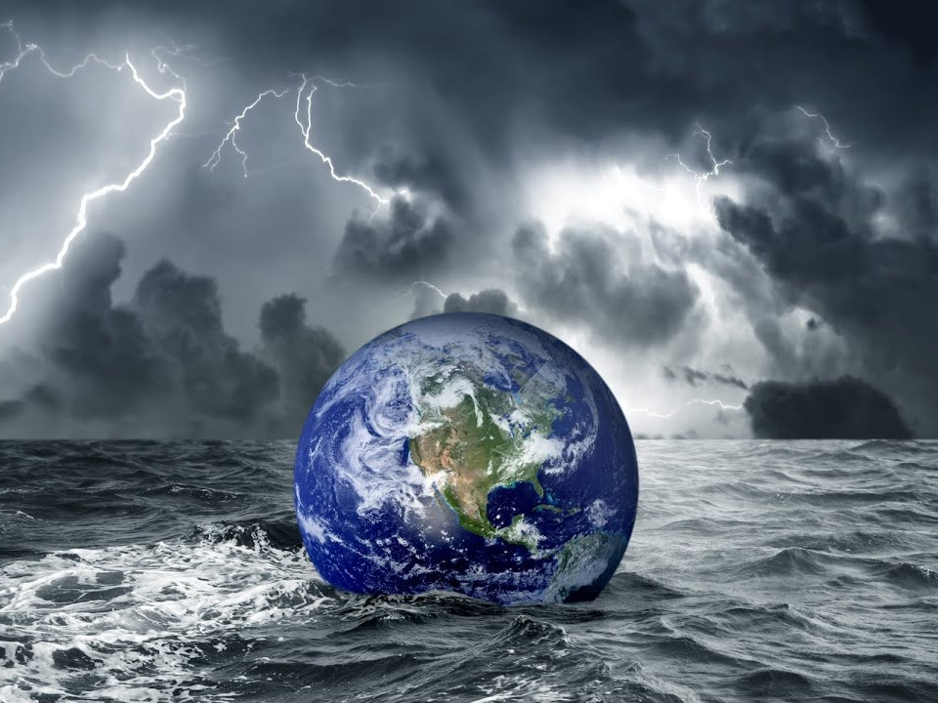
You lust and do not have. You murder and covet and cannot obtain. You fight and war. Yet you do not have because you do not ask. You ask and do not receive, because you ask amiss, that you may spend it on your pleasures. Adulterers and adulteresses! Do you not know that friendship with the world is enmity with God? Whoever therefore wants to be a friend of the world makes himself an enemy of God. — James 4:2-4
covet and cannot obtain
a
l
your pleasures
all
hostility
hatred
resentment
bitterness
world
disgust
l
friend of the world
enemy of God
Notes:
When the things of the world cause one to dismiss or forget God, tragically this spiritual death oppresses all those that would be thankful for His creation, and His continuing support of life within tests of character, upon the shadows of what is temporary. The earth is a garden where God is weeding out character finding those with true flowers. In a sea of confusion, all seek truth that would enable security. Truth of God supplies what is never ended.

Slide 28
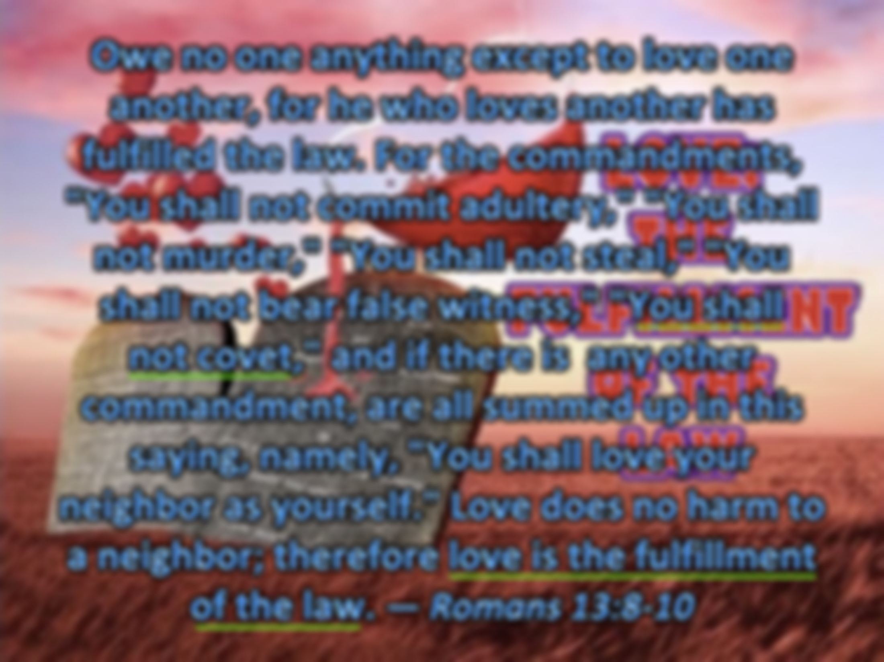
Owe no one anything except to love one another, for he who loves another has fulfilled the law. For the commandments, "You shall not commit adultery," "You shall not murder," "You shall not steal," "You shall not bear false witness," "You shall not covet," and if there is any other commandment, are all summed up in this saying, namely, "You shall love your neighbor as yourself." Love does no harm to a neighbor; therefore love is the fulfillment of the law. — Romans 13:8-10
LOVE:
THE
FULFILLMENT
OF THE
LAW
. .
. .
all
Love
. .
. .
Notes:
Requests in the form of commands have been imposed that will judge each soul on their line of death. Jesus showed us what was most important, to love one another to death. This is the window to glory and the best all can achieve, love. If God is love, then He looks for the same.

Slide 29
LOVE:
THE
FULFILLMENT
OF THE
LAW

Slide 30
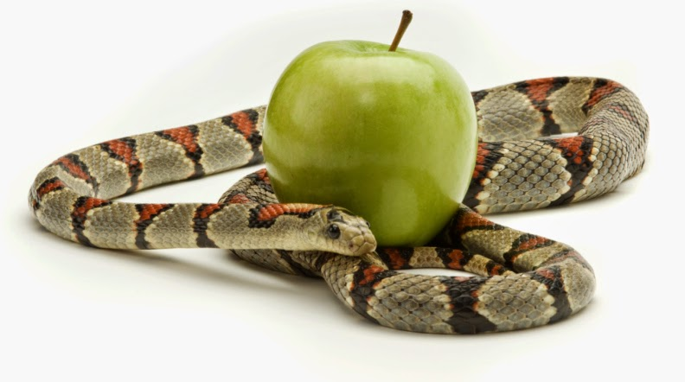
Now the works of the flesh are evident, which are: adultery, fornication, uncleanness, lewdness, idolatry, sorcery, hatred, contentions, jealousies, outbursts of wrath, selfish ambitions, dissensions, heresies, envy, murders, drunkenness, revelries, and the like; of which I tell you beforehand, just as I also told you in time past, that those who practice such things will not inherit the kingdom of God. — Galatians 5:19-21
will not inherit the kingdom of God:
● adultery
● fornication
● uncleanness
● lewdness
● idolatry
● sorcery
● hatred
● contentions
● jealousies
● outbursts of wrath
● selfish ambitions
● dissensions
● heresies
● envy
● murders
● drunkenness
● revelries, and the like
adultery
fornication
uncleanness
lewdness
idolatry
sorcery
hatred
contentions
jealousies
outbursts
of wrath
selfish ambitions
dissensions
heresies
envy
murders
drunkenness
revelries, and the like
selfish ambitions
will not inherit the kingdom of God
Notes:
In such a world as this, one would be hard pressed to avoid sin as it stirs in each of us.

Slide 31
I wrote to you in my epistle not to keep company with sexually immoral people. Yet I certainly did not mean with the sexually immoral people of this world, or with the covetous, or extortioners, or idolaters, since then you would need to go out of the world. — 1st Corinthians 5:9-10
not to keep company
?
immoral people
covetous
covetous
covetous
extortioners
idolaters
out of
the world
Notes:
Surrounded by sinners, it is impossible to completely extract oneself from its’ influence, unless one is regulated to the misery of solitary confinement.

Slide 32
But now I have written to you not to keep company with anyone named a brother, who is sexually immoral, or covetous, or an idolater, or a reviler, or a drunkard, or an extortioner -- not even to eat with such a person. — 1st Corinthians 5:11
w
anyone named a brother
d
word
X
X
or
or
Greediness
covetous
or
X
or
X
or
X
X
or
or
Notes:
God instructs us to assemble with like minded souls exalting His ways of goodness. Obvious practicing sinners, unrepentful of their actions, should be avoided inside true worship gatherings. One can worship sin, and this is not of what God commands in His holy call.

Slide 33
"Now these are the ones sown among thorns; they are the ones who hear the word, and the cares of this world, the deceitfulness of riches, and the desires for other things entering in choke the word, and it becomes unfruitful." — Mark 4:18-19
word
cares
of this world
riches
things
unfruitful
Notes:
Cares for the world can mislead one into not caring for others, be it family or would be friends. Self-seeking isolates a soul from seeing whole-seeking.

Slide 34
For there are many insubordinate, both idle talkers and deceivers, especially those of the circumcision, whose mouths must be stopped, who subvert whole households, teaching things which they ought not, for the sake of dishonest gain. — Titus 1:10-11
dishonest gain
Kenneth Copeland 760 million
Jesse Duplantis 50 million
Creflo
Dollar 27 million
takers
dishonest gain
dishonest gain
Notes:
Many will lie to gain advantage in achieving wealth through unethical manipulations. Opulence in church leaders is what the young despise and results in what is repulsive. For all that are sensible, misuse of power is offensive.
1. Jesse Duplantis (Oral Roberts University) – 50 million 2. Creflo Dollar – 27 million 3. Kenneth Copeland - 760 million

Slide 35
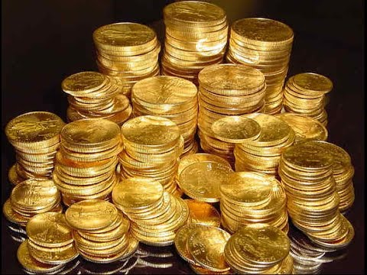
"I have coveted no one's silver or gold or apparel. Yes, you yourselves know that these hands have provided for my necessities, and for those who were with me. I have shown you in every way, by laboring like this, that you must support the weak. And remember the words of the Lord Jesus, that He said, 'It is more blessed to give than to receive.'" — Acts 20:33-35
dishonest gain
support the weak
more blessed to give
give
takers
Notes:
Those that only take are ugly in the sight of God.

Slide 36
"Therefore, whatever you want men to do to you, do also to them, for this is the Law and the Prophets." — Matthew 7:12
do
Old Testament
Notes:
The measure of love has no length. The golden rule of treating others as you would want to be treated is one of the main messages of the Bible. Are we eager to be with one another or oppositely, eager to avoid social interactions with pre-conceived notions of contempt and mistrust? If one wants to be trusted, he or she must also have a trusting heart. Covetous hearts do not extend in this way as they are more apt to be untrusting and suspicious, as they prowl for more. Coming to God is not just understanding what He asks, but allowing His word to lift us to something more than most are, genuinely caring. To be doers of His will, and not just hearers only, is key to inheriting the gifts He offers.

Slide 37
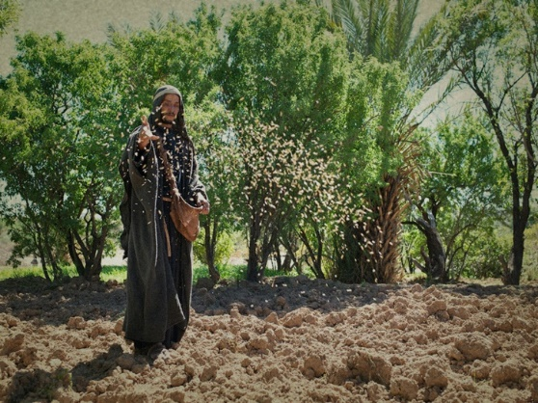
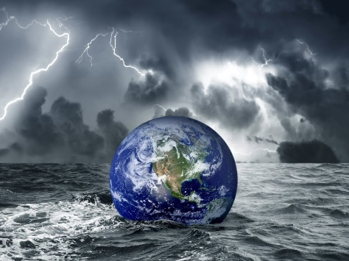

Slide 38
→ Hypocrites will lie in pursuit of their own gain
→ No covetous man will inherit God’s kingdom
→ To lose one’s life for God will find it
→ The whole world is not enough to pay for one soul
→ Love of the world is not the love of the Father
→ To be a friend of the world is an enemy of God
→ Love for another fulfills the law of God
→ You shall not covet is a commandment
→ Selfish ambitions deny entry into God’s kingdom
→ No one can avoid encounters with worldly evils
→ Material wealth only can be a spider web of misery
→ Many smooth operators are out for dishonest gain
→ It is more blessed to give than to receive
One chooses to be filled or empty of spiritual values
Notes:
One chooses to be filled or empty of spiritual values

Slide 40
Please visit http://www.LoveFromGod.com to explore further
Ronald Bert Channel on
Notes:
Eternity never ends.

