Slide 1
Notes:
Darkness has no depth of distance.

Slide 2
BAPTISM
Ron Bert
1
March 18, 2018
Notes:
Our Lord God calls for the return of His children.

Slide 3
Baptism of Moses
Baptism of John
Baptism of Jesus by John
Baptism of Suffering
Great Commission Water Baptism
Baptism into His death/life
Baptism of the Holy Spirit
Baptism of Fire
Baptism ø for the Dead
Baptism of Moses
Baptism of John
Baptism of Jesus by John
Baptism of Suffering
Great Commission Water Baptism
Baptism into His death/life
Baptism of the Holy Spirit
Baptism of Fire
Baptism ø for the Dead
1
3
2
Notes:
There are various types of baptism. The baptism of Moses through the Red Sea. John’s baptism of repentance for the remission of sins. The baptism of suffering Christ and His apostles endured. The great commission water baptism remains and has come as a command of God. The baptism of the Holy Spirit, as God finalized His anointing upon the earth where men live, has blessed us all in the knowledge of Him. A fire baptism cleansing the evils of creation is yet to occur as all rise back to His Spirit. There can be no substitute for an individuals accountability directly to God, and the dead rise no more, making it impossible for choices, made or not made, to be altered or changed once mortal death has occurred.

Slide 4
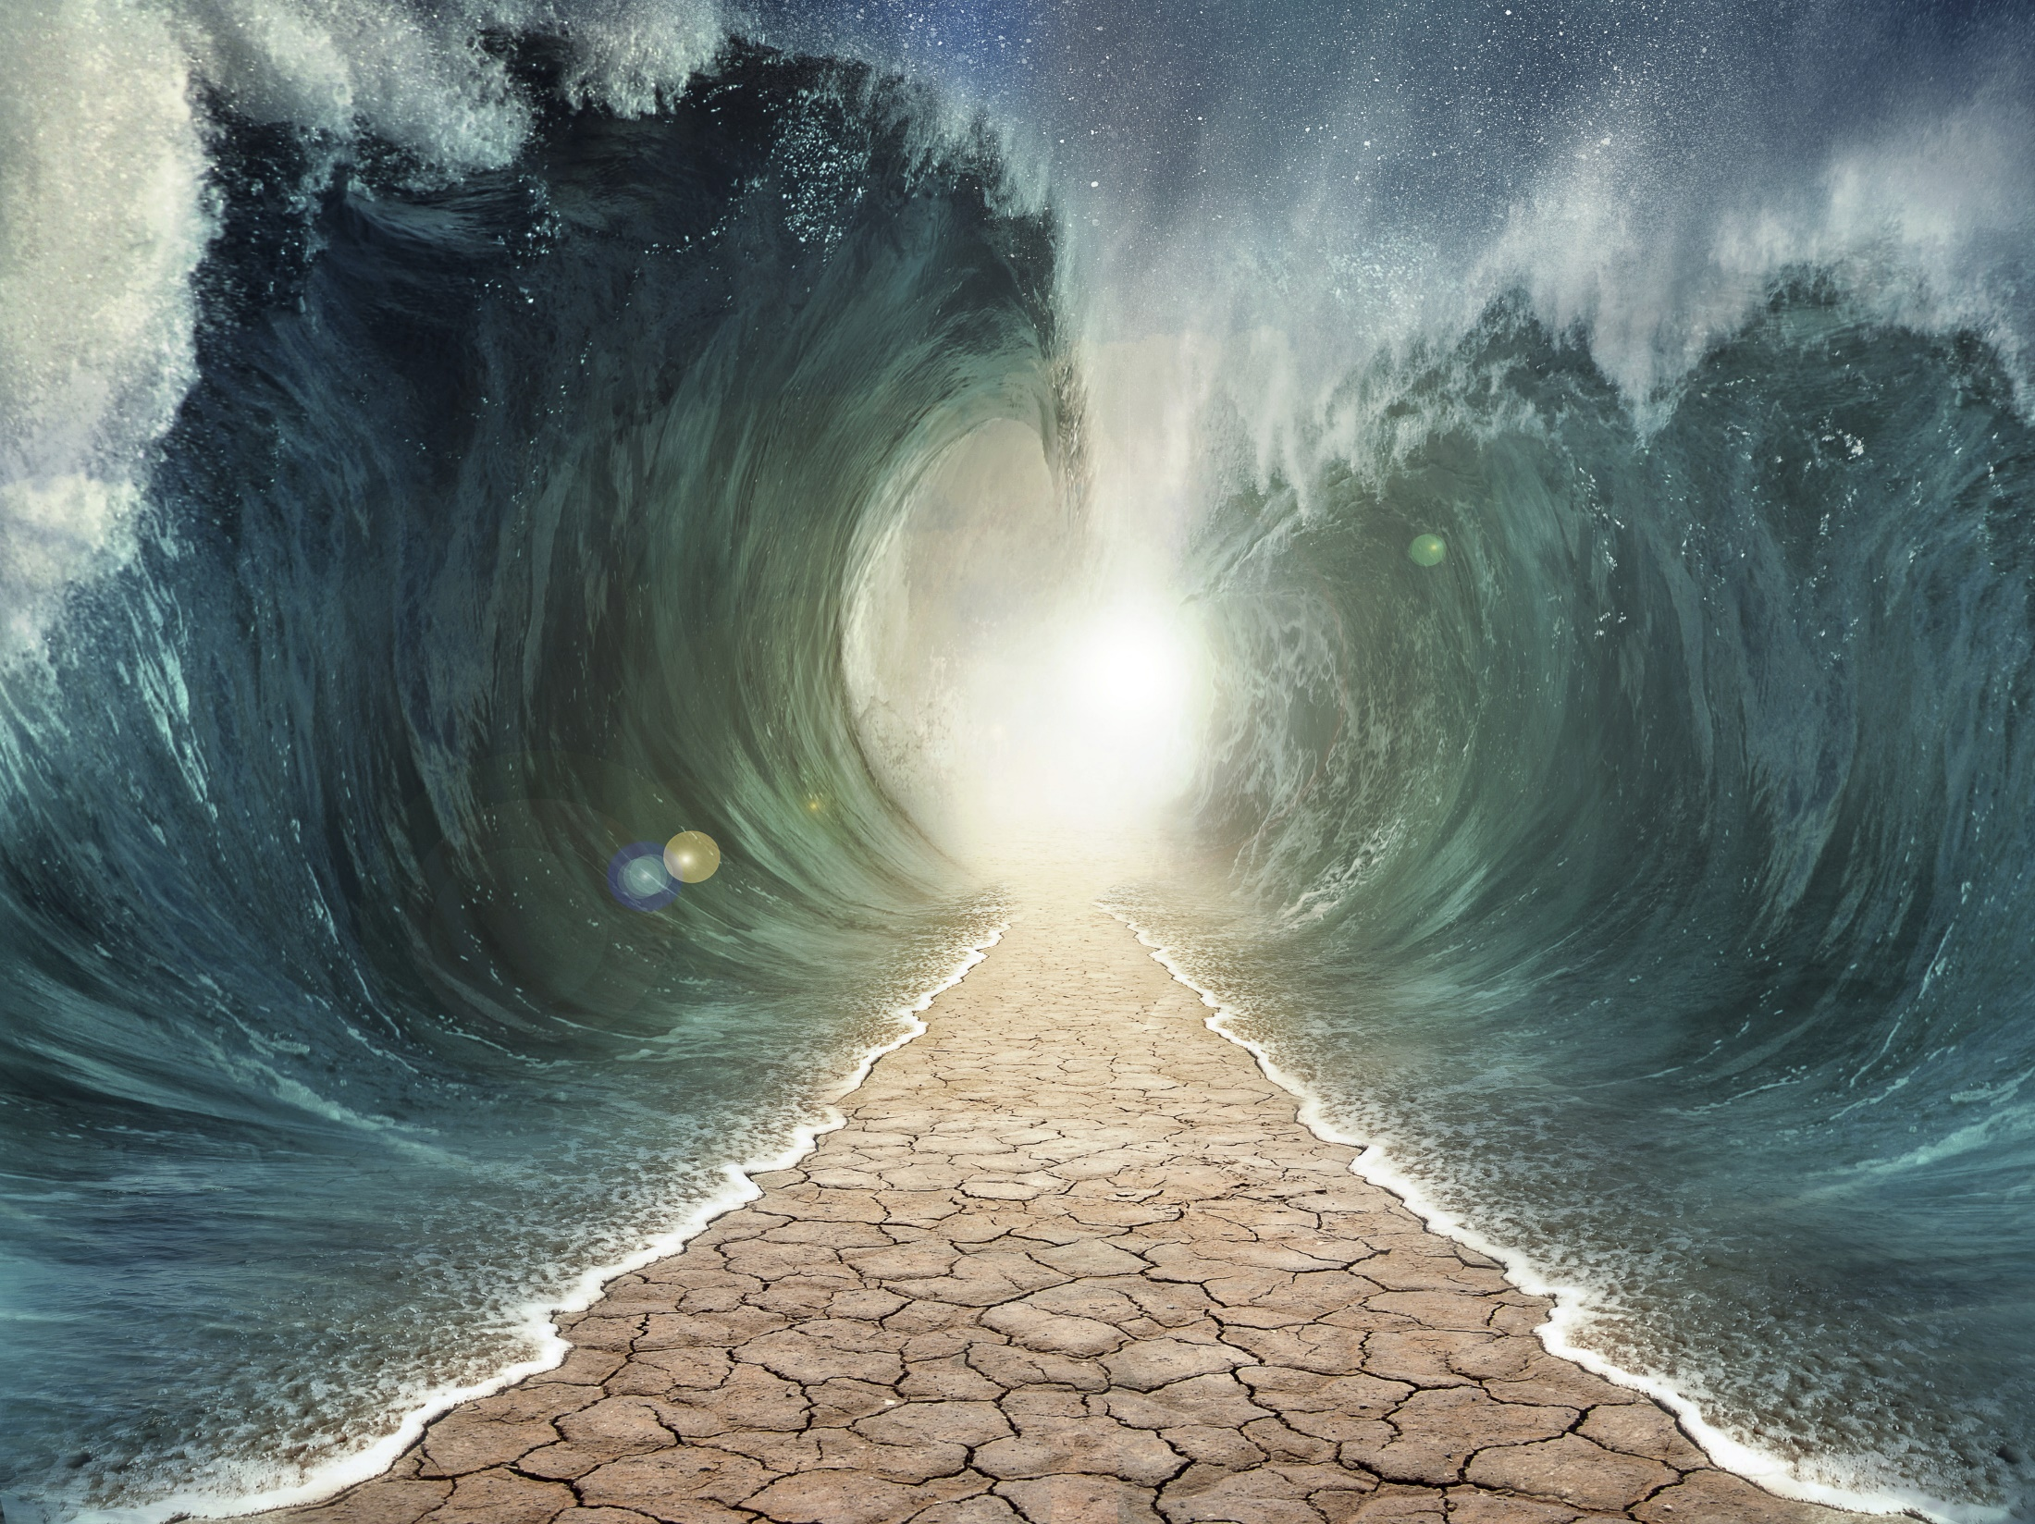
Moreover, brethren, I do not want you to be unaware that all our fathers were under the cloud, all passed through the sea, all were baptized into Moses in the cloud and in the sea, all ate the same spiritual food, and all drank the same spiritual drink. For they drank of that spiritual Rock that followed them, and that Rock was Christ. — 1st Corinthians 10:1-4
all
through the sea
baptized
all
baptized
into Moses
into Moses
in
in
all
all
drank of
drank of
Assurance
that Rock
that Rock
Christ
Notes:
It is the truth of Christ that washes us clean.

Slide 5
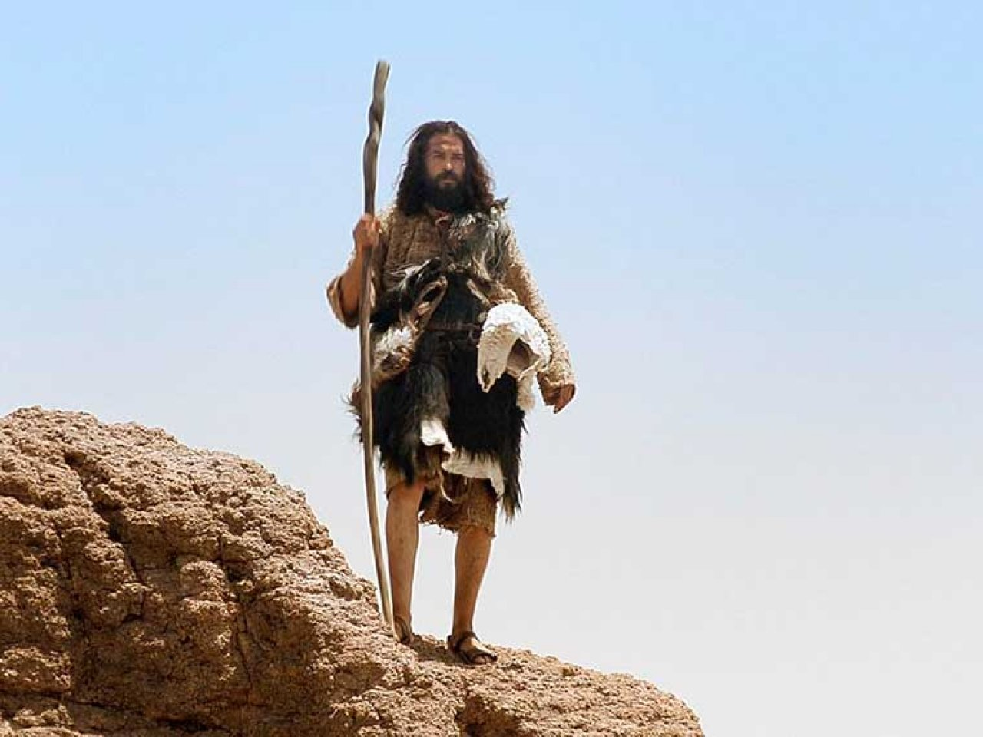
John came baptizing in the wilderness and preaching a baptism of repentance for the remission of sins. — Mark 1:4
John came baptizing in the wilderness and preaching a baptism of repentance for the remission of sins. — Mark 1:4
John came baptizing
baptiz
John came baptizing
baptized
e
for
for
decrease
cutback
reduction
lessening
Notes:
John prepared the way for Christ’s arrival.

Slide 6
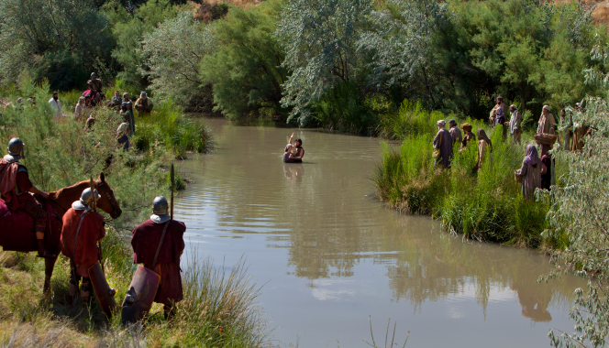
Then all the land of Judea, and those from Jerusalem, went out to him and were all baptized by him in the Jordan River, confessing their sins. — Mark 1:5
all
all
land
baptized
all
baptize
baptized
Notes:
Many took heed to the truth John announced being baptized in the Jordan river.

Slide 7
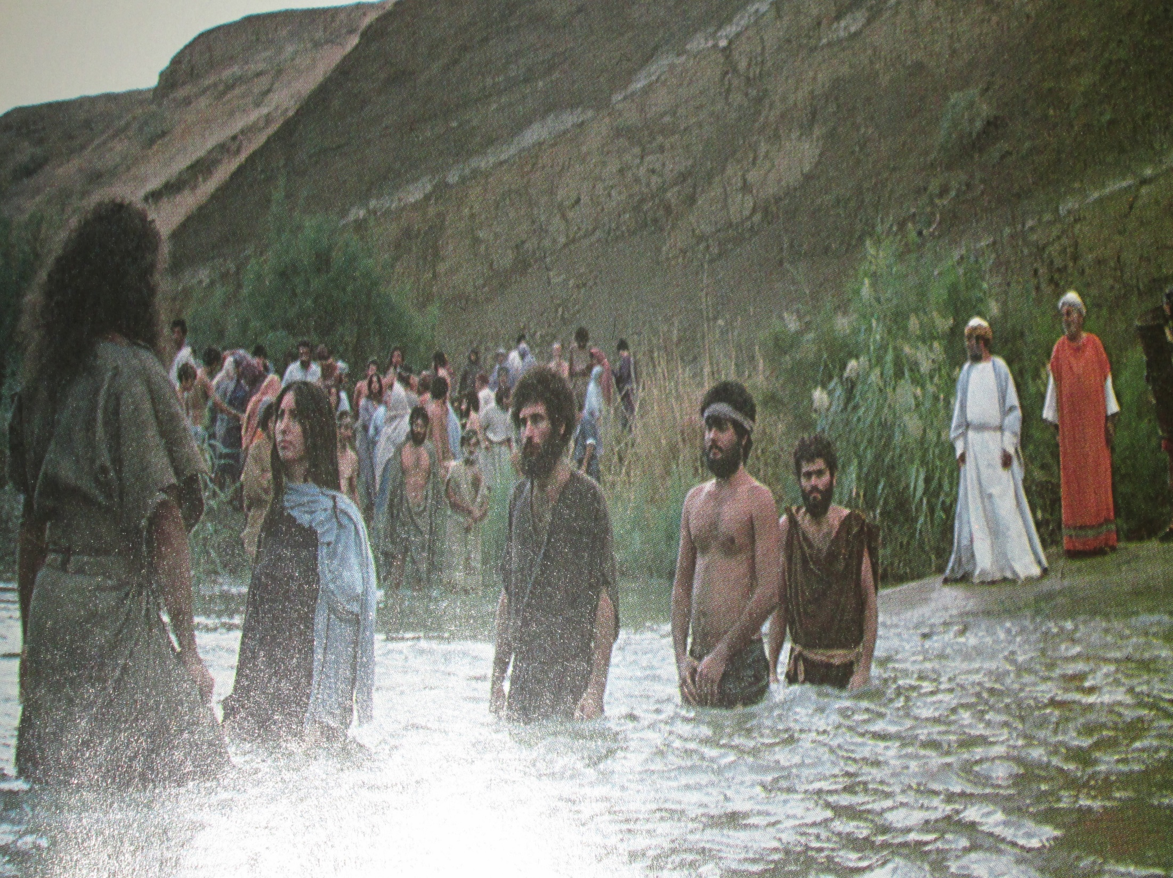
Then Jerusalem, all Judea, and all the region around the Jordan went out to him and were baptized by him in the Jordan, confessing their sins. — Matthew 3:5-6
all
all
baptized
confessing
their sins
Notes:
Countless disciples came to the call of John.

Slide 8
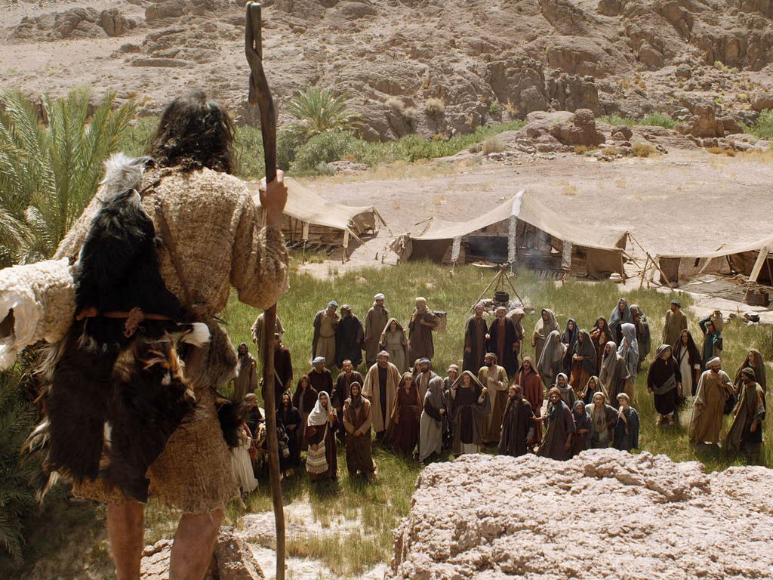
And he went into all the region around the Jordan, preaching a baptism of repentance for the remission of sins, … — Luke 3:3
baptism
baptism
repentance for
repentance for
remission of sins
remission of sins
Notes:
John traveled throughout the region to preach the message he was ordained to present.

Slide 9
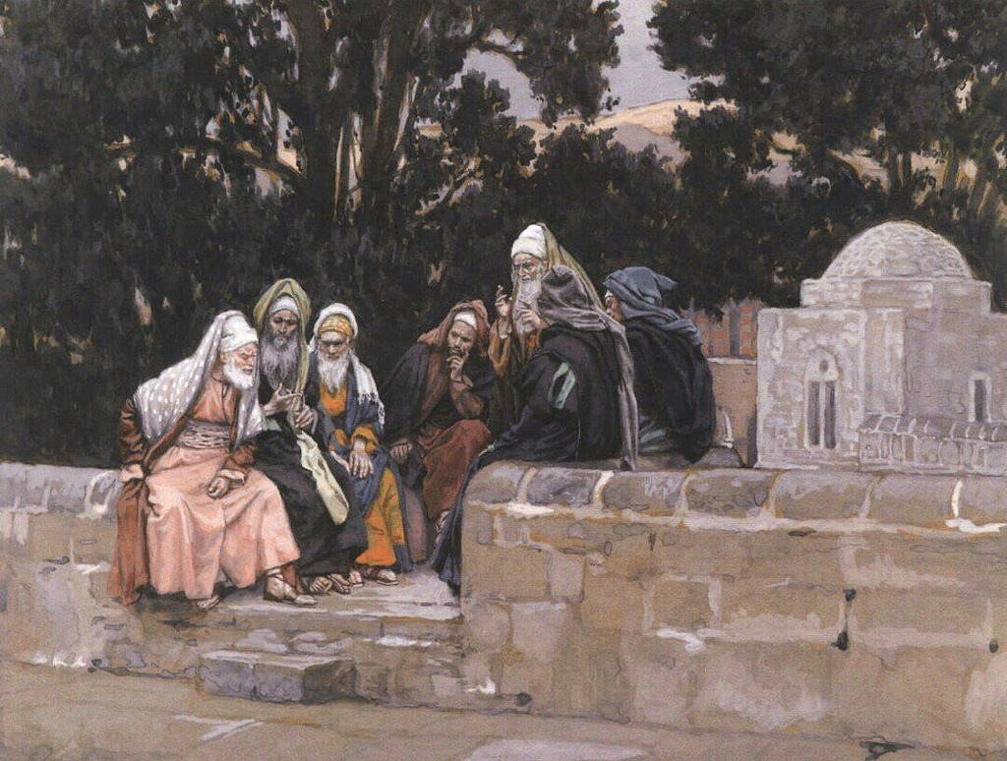
But when he saw many of the Pharisees and Sadducees coming to his baptism, he said to them, "Brood of vipers! Who warned you to flee from the wrath to come? — Matthew 3:7
Power Mongers
baptism
flee
wrath
flee
wrath
to come
. .
Accountability
Notes:
There were those elite who wanted forgiveness in secret or privately where John rebuked them. Many were angered and turned from repentance enraged in their own scorn. Standing in the light of God is not something done reclusely.

Slide 10
baptize

Slide 11
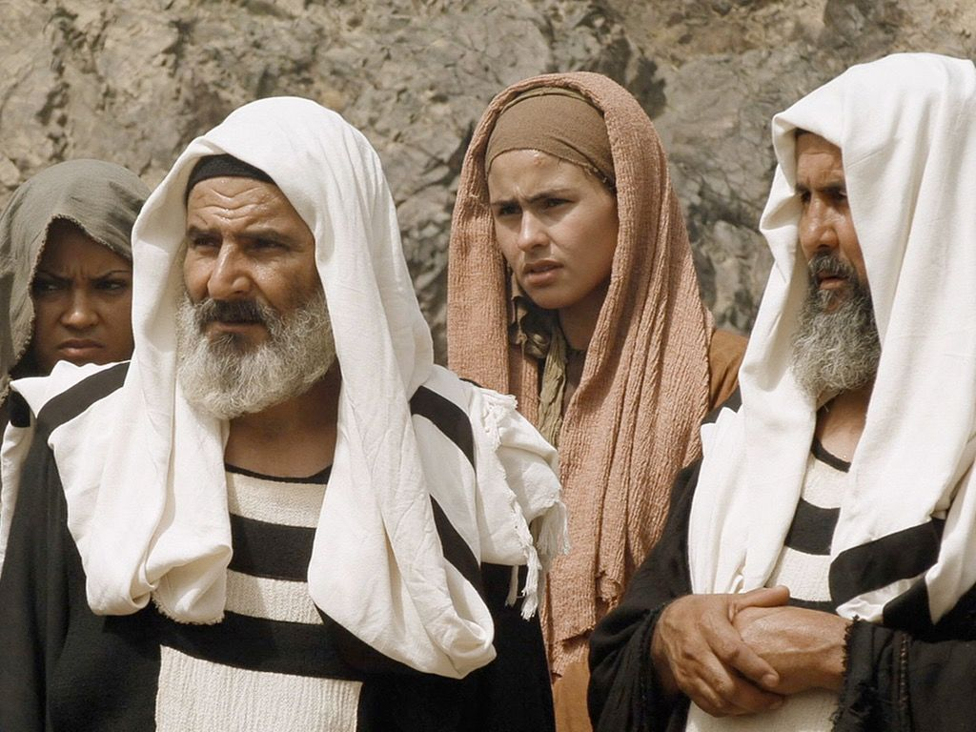
And they asked him, saying, "Why then do you baptize if you are not the Christ, nor Elijah, nor the Prophet?" John answered them, saying, "I baptize with water, but there stands One among you whom you do not know." — John 1:25-26
Why
baptize
Why
baptize
baptize
baptize
Notes:
The pride of the Jewish elite refused to believe John had the authority cause such a happening that he had created. John humbly and boastfully proclaimed the coming of the Great One was at hand.

Slide 12
"I did not know Him, but He who sent me to baptize with water said to me, 'Upon whom you see the Spirit descending, and remaining on Him, this is He who baptizes with the Holy Spirit.'" — John 1:33
baptize
baptize
Holy Spirit
Hope
Notes:
John, as many who have followed, are obedient servants of God Almighty, in view of not directly seeing Him obey His call.

Slide 13
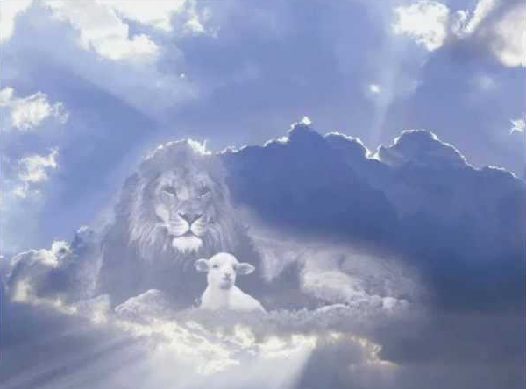
"It is He who, coming after me, is preferred before me, whose sandal strap I am not worthy to loose." These things were done in Bethabara beyond the Jordan, where John was baptizing. The next day John saw Jesus coming toward him, and said, "Behold! The Lamb of God who takes away the sin of the world!" — John 1:27-29
coming after me
"It is He who, coming after me, is preferred before me, whose sandal strap I am not worthy to loose." These things were done in Bethabara beyond the Jordan, where John was baptizing. The next day John saw Jesus coming toward him, and said, "Behold! The Lamb of God who takes away the sin of the world!" — John 1:27-29
He
coming after me
Jesus
Notes:
It came that John saw Jesus for who He truly was.

Slide 14
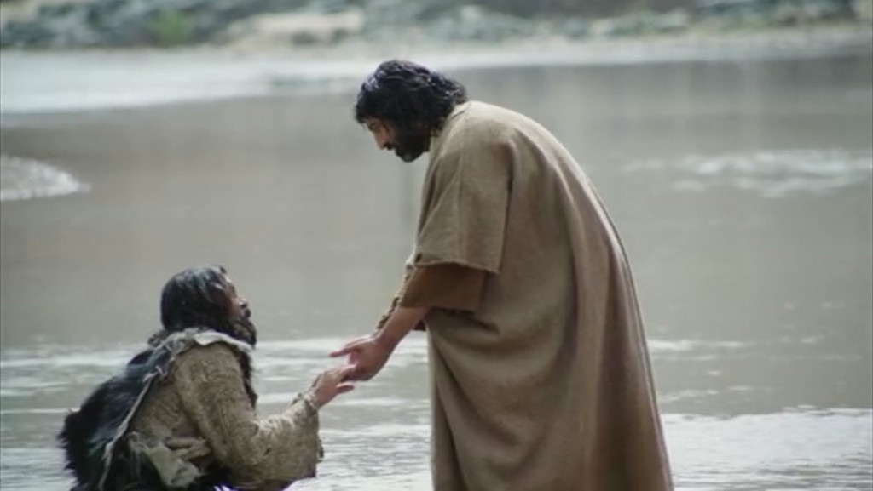
Then Jesus came from Galilee to John at the Jordan to be baptized by him. And John tried to prevent Him, saying, "I need to be baptized by You, and are You coming to me?" — Matthew 3:13-14
Compassion
baptized
baptized
I need
I need
baptized
You
You
You
Notes:
John fell before his Great God and Savior pleading for mercy.

Slide 15
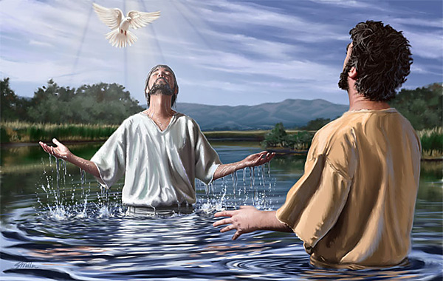
When He had been baptized, Jesus came up immediately from the water; and behold, the heavens were opened to Him, and He saw the Spirit of God descending like a dove and alighting upon Him. — Matthew 3:16
baptized
Spirit of God
God
Spirit of God
Notes:
John was witness to the blessing God Himself wrought upon the earth.

Slide 16
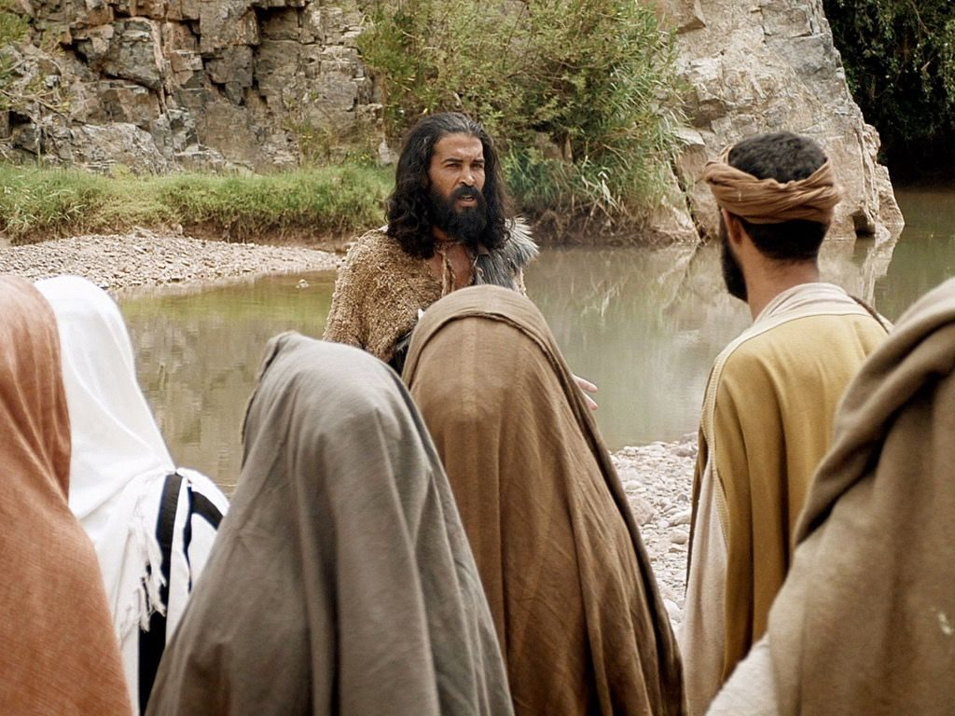
"This is He of whom I said, 'After me comes a Man who is preferred before me, for He was before me.' I did not know Him; but that He should be revealed to Israel, therefore I came baptizing with water." And John bore witness, saying, "I saw the Spirit descending from heaven like a dove, and He remained upon Him." — John 1:30-32
After me
After me
He was before me
He
He was before me
ed
baptiz
baptized
Notes:
John proclaimed Jesus’ superiority, to his preaching, as Jesus was set to establish what God had planned before time began, in the plan of salvation for man.

Slide 17
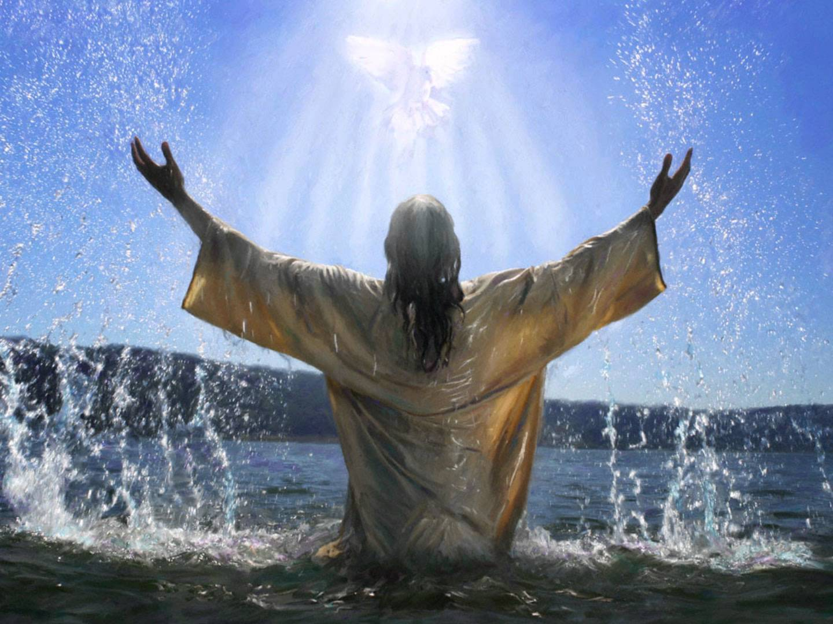
It came to pass in those days that Jesus came from Nazareth of Galilee, and was baptized by John in the Jordan. — Mark 1:9
baptized
Jesus
baptized
was baptized by John
was baptized by John
Notes:
It has occurred as it is.

Slide 18
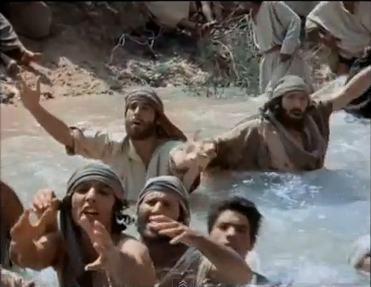
After these things Jesus and His disciples came into the land of Judea, and there He remained with them and baptized. Now John also was baptizing in Aenon near Salim, because there was much water there. And they came and were baptized. For John had not yet been thrown into prison. — John 3:22-24
Jesus and His
Jesus
Jesus and His
disciples
disciples
baptized
baptized
baptized
baptized
much water
much water
baptized
John
prison
Notes:
After the baptism of Jesus, the advance of baptisms overtook the land.

Slide 19
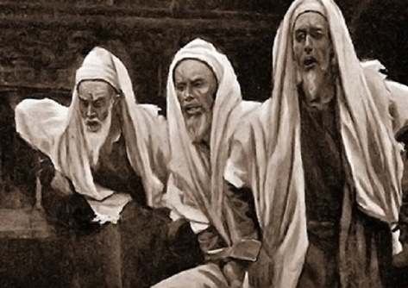
Therefore, when the Lord knew that the Pharisees had heard that Jesus made and baptized more disciples than John (though Jesus Himself did not baptize, but His disciples), He left Judea and departed again to Galilee. — John 4:1-3
Jesus
baptized
Jesus
Jesus
Jesus Himself did not baptize
Jesus
Jesus Himself did not baptize
Notes:
The Pharisees, seeing the loss of influence and power, sought to belittle this baptism movement, seeking for Jesus Himself.

Slide 20
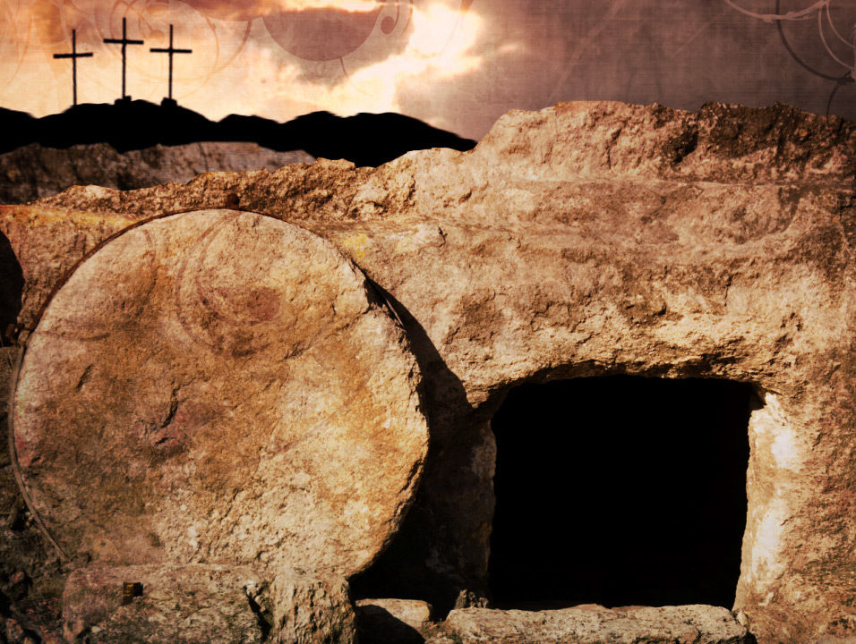
"From this man's seed, according to the promise, God raised up for Israel a Savior -- Jesus -- after John had first preached, before His coming, the baptism of repentance to all the people of Israel." — Acts 13:23-24
Holy Spirit
Jesus
John
John
before
baptism of
His
baptism of
His coming
repentance
repentance
Notes:
Through John’s ministry, Jesus rose to prominence. Our faith is all about the life, death, and resurrection of Christ and how God wants us to know Him.

Slide 21
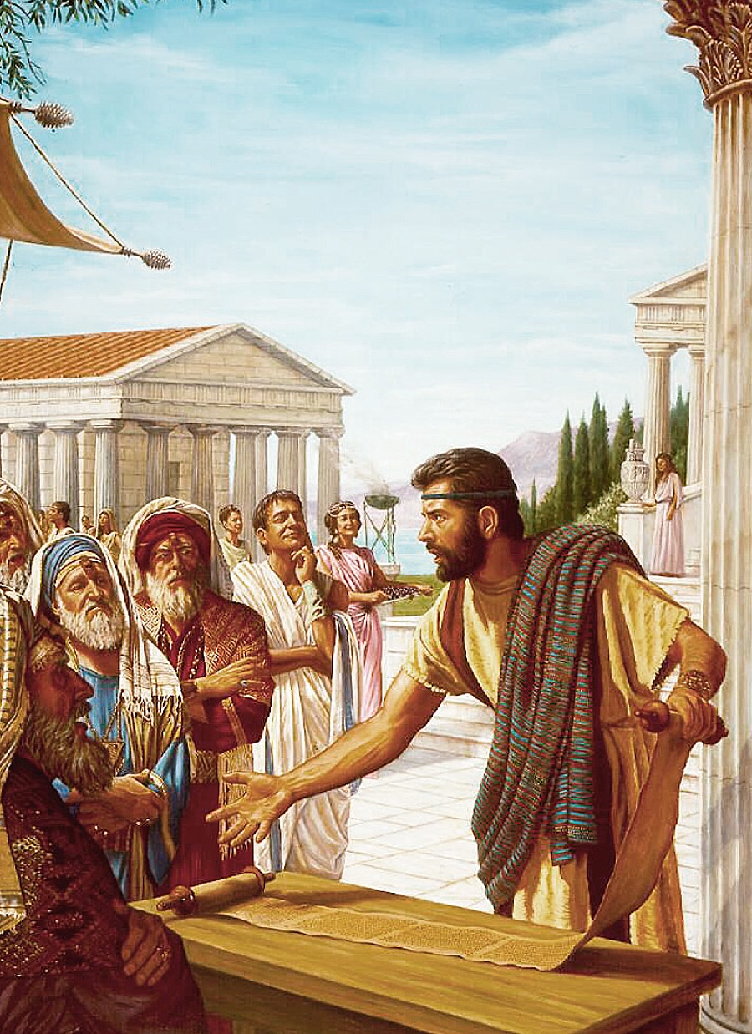
Now a certain Jew named Apollos, born at Alexandria, an eloquent man and mighty in the Scriptures, came to Ephesus. This man had been instructed in the way of the Lord; and being fervent in spirit, he spoke and taught accurately the things of the Lord, though he knew only the baptism of John. — Acts 18:24-25
the way
the way
knew only
knew only
baptism of John
baptism of John
Notes:
As the church of Christ settled, the baptism of John was only meant to be a prelude to introduce our now famous baptism into Him.

Slide 22
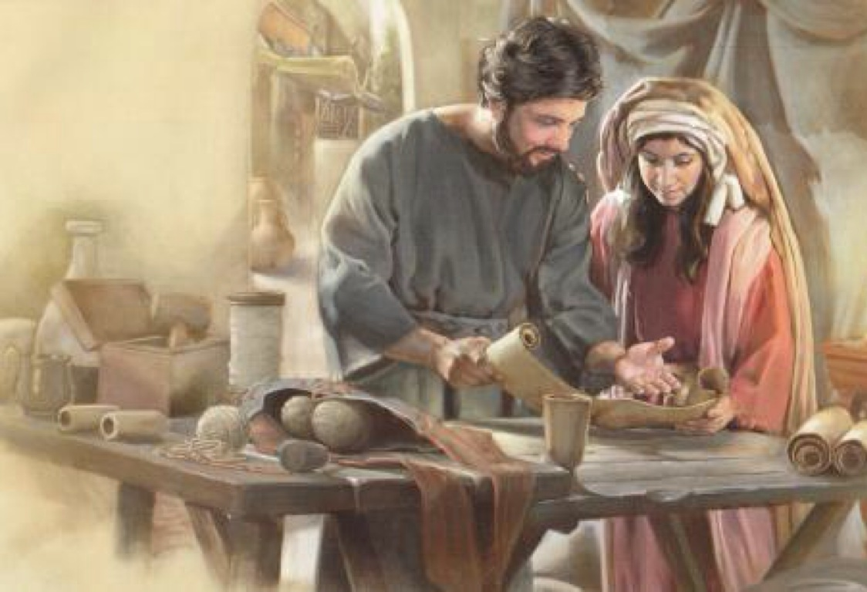
So he began to speak boldly in the synagogue. When Aquila and Priscilla heard him, they took him aside and explained to him the way of God more accurately. — Acts 18:26
way of God
the way
way of God
God
Notes:
The early church made it clear Jesus was our Savior, and John’s baptism was replaced by baptism into Jesus Himself.

Slide 23
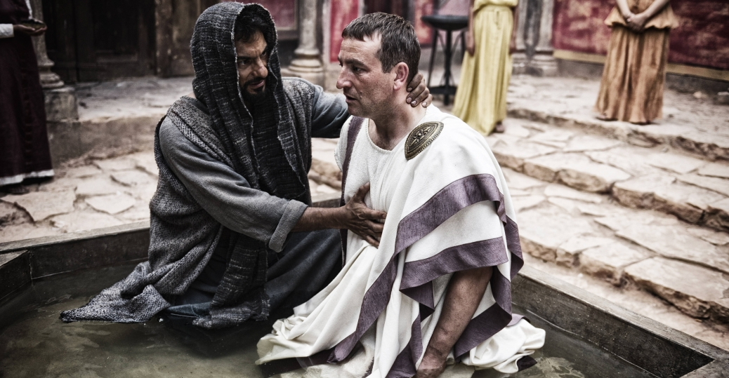
Then Paul said, "John indeed baptized with a baptism of repentance, saying to the people that they should believe on Him who would come after him, that is, on Christ Jesus." When they heard this, they were baptized in the name of the Lord Jesus. — Acts 19:4-5
baptism
baptism
believe
on Christ Jesus
in
Notes:
In Christ is the fulfilment of all things God would have us to know. Baptism is not just an act of obedience or casual fulfilment to the word, but an act of genuine belief.

Slide 24
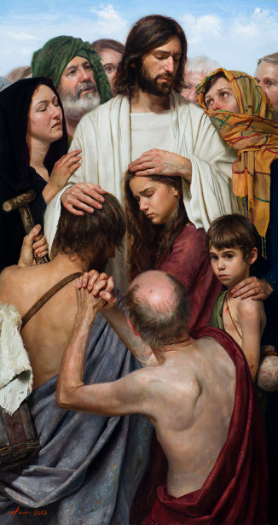
"... that word you know, which was proclaimed throughout all Judea, and began from Galilee after the baptism which John preached: how God anointed Jesus of Nazareth with the Holy Spirit and with power, who went about doing good and healing all who were oppressed by the devil, for God was with Him." — Acts 10:37-38
baptism
God anointed Jesus of Nazareth with the Holy Spirit and with power
doing good
. .
God was with Him
God
. .
Notes:
It is in fact that God takes precedence.

Slide 25
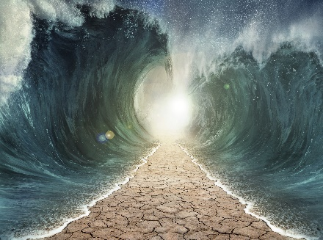
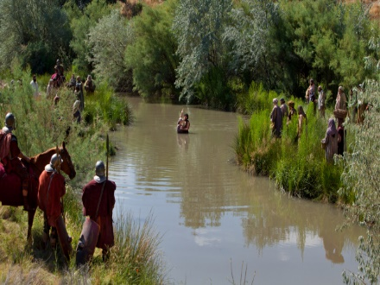
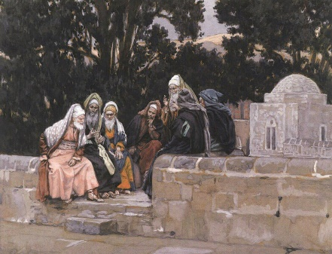
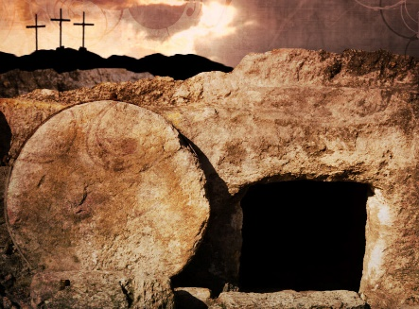
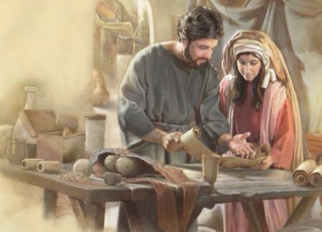

Slide 26
→ All passed through the sea / baptized into Moses
→ John spoke baptism of repentance/remission of sins
→ Jerusalem, all Judea, etc., were baptized by John
→ John baptized with water in view of Christ’s coming
→ Jesus was baptized by John in the Jordan
→ John saw Spirit descending from heaven on Christ
→ Jesus baptizes with the Holy Spirit
→ After Christ baptized/John & Jesus’ disciples baptize
→ Jesus’ disciples then baptized more than John
→ As promised, God raised up for Israel a Savior--Jesus
→ Baptism in Christ supersedes John’s baptism
→ John said we should believe on Christ after him
→ God anointed Jesus with the Holy Spirit & power
Baptism is a cleansing of a soul from all previous sin
Notes:
Baptism is a cleansing of a soul from all previous sin

Slide 27
Notes:
Darkness has only the clarity of nothing.

Slide 28
BAPTISM
Ron Bert
2
April 15, 2018
Notes:
Baptism is the answer of a good conscience to His call.

Slide 29
Baptism of Moses
Baptism of John
Baptism of Jesus by John
Baptism of Suffering
Great Commission Water Baptism
Baptism into His death/life
Baptism of the Holy Spirit
Baptism of Fire
Baptism ø for the Dead
Baptism of Moses
Baptism of John
Baptism of Jesus by John
Baptism of Suffering
Great Commission Water Baptism
Baptism into His death/life
Baptism of the Holy Spirit
Baptism of Fire
Baptism ø for the Dead
1
3
2
Notes:
There are various types of baptism. The baptism of Moses through the Red Sea. John’s baptism of repentance for the remission of sins. The baptism of suffering Christ and His apostles endured. The great commission water baptism remains and has come as a command of God. The baptism of the Holy Spirit, as God finalized His anointing upon the earth where men live, has blessed us all in the knowledge of Him. A fire baptism cleansing the evils of creation is yet to occur as all rise back to His Spirit. There can be no substitute for an individuals accountability directly to God, and the dead rise no more, making it impossible for choices, made or not made, to be altered or changed once mortal death has occurred.

Slide 30
"Wash yourselves, make yourselves clean; Put away the evil of your doings from before My eyes. Cease to do evil, …" — Isaiah 1:16
clean
clean
Cease to do evil
Cease to do evil
Notes:
It is God who calls us to cease from evil and wash ourselves in the truth of His light.

Slide 31
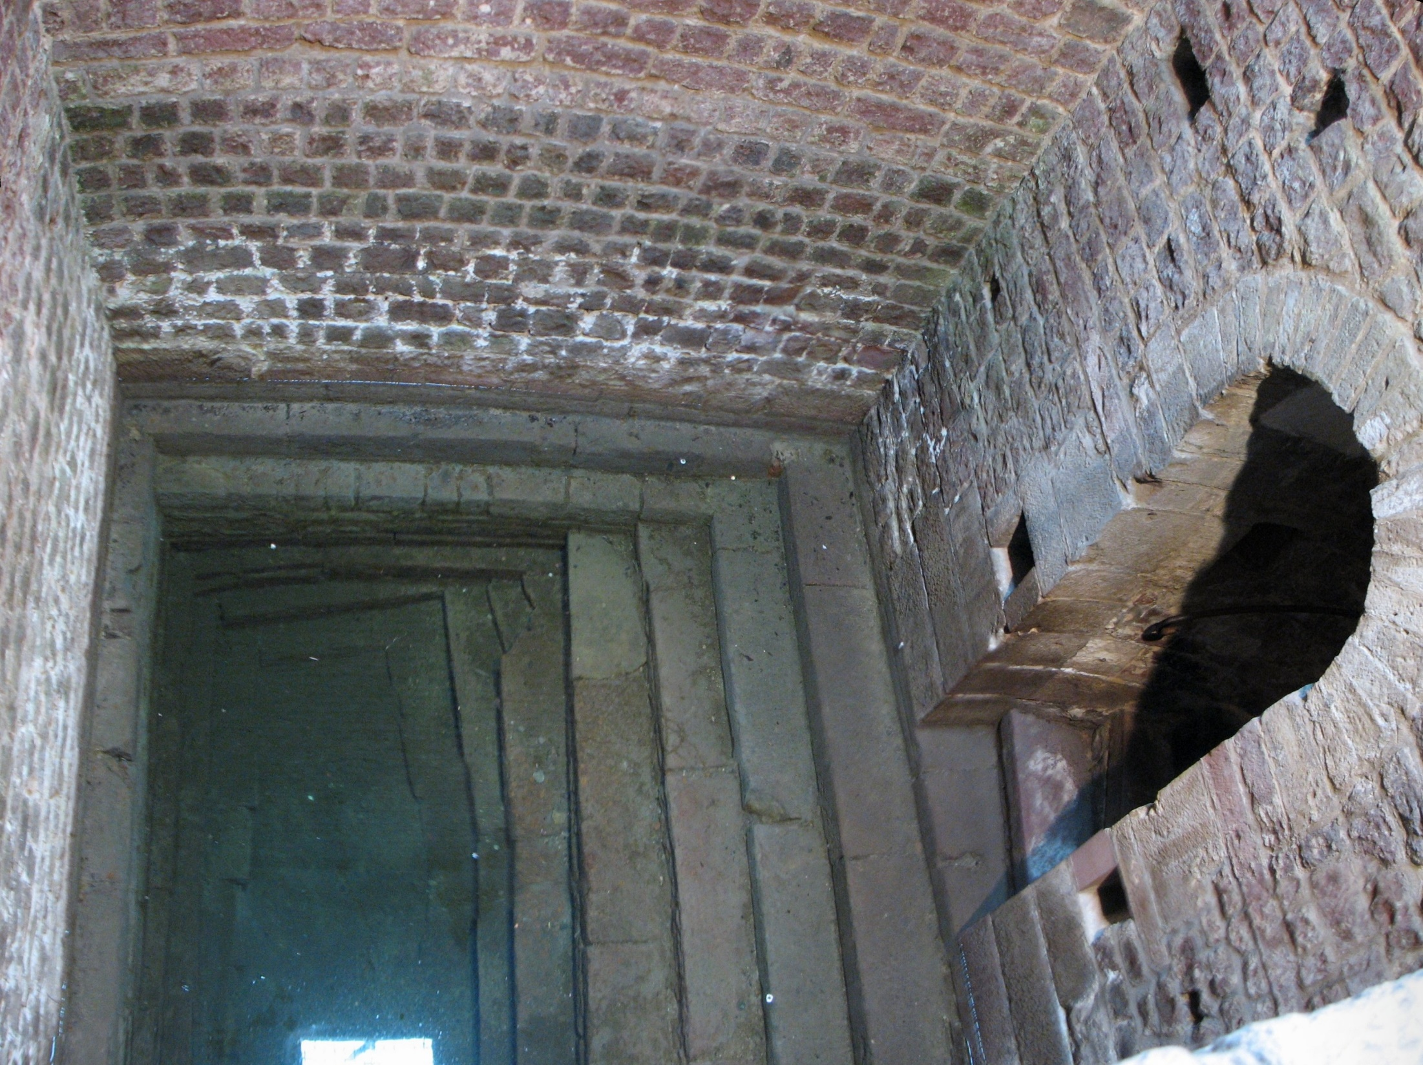
"Woe to you, scribes and Pharisees, hypocrites! For you cleanse the outside of the cup and dish, but inside they are full of extortion and self-indulgence. Blind Pharisee, first cleanse the inside of the cup and dish, that the outside of them may be clean also." — Matthew 23:25-26
hypocrites
outside
outside
inside
inside
intimidation
blackmail
extortion
threats
bullying
coercion
self-indulgence
clean
inside
inside
outside
also
Notes:
One can only find spiritual cleanness from the inside where the heart dwells. The outside mask more often conceals hidden agendas of self seeking.

Slide 32
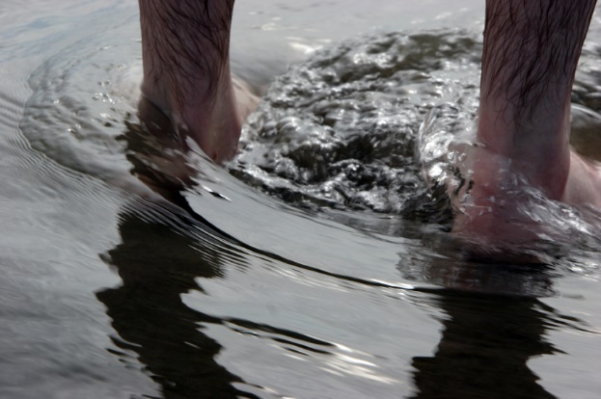
And such were some of you. But you were washed, but you were sanctified, but you were justified in the name of the Lord Jesus and by the Spirit of our God. — 1st Corinthians 6:11
washed
● washed
● sanctified
● justified
sanctified
justified
Notes:
It is a call to be transparent purging the hypocrisy that blinds a soul in lies.

Slide 33
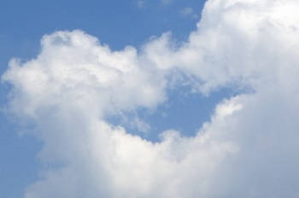
"I indeed baptized you with water, but He will baptize you with the Holy Spirit." — Mark 1:8
● washed
● sanctified
● justified
baptize
baptize
Holy Spirit
Holy Spirit
Notes:
It is through Jesus that we received the blessings, showered upon us all, by the Holy Spirit. To be immersed in the Holy Spirt is to be open to the very truth of God Himself.

Slide 34
"I indeed baptize you with water unto repentance, but He who is coming after me is mightier than I, whose sandals I am not worthy to carry. He will baptize you with the Holy Spirit and fire. — Matthew 3:11
baptize
baptize
baptize
baptize
Holy Spirit
baptize
Holy Spirit
and fire
and fire
Notes:
It is through Jesus that salvation is offered with the definite expectation of judgment.

Slide 35
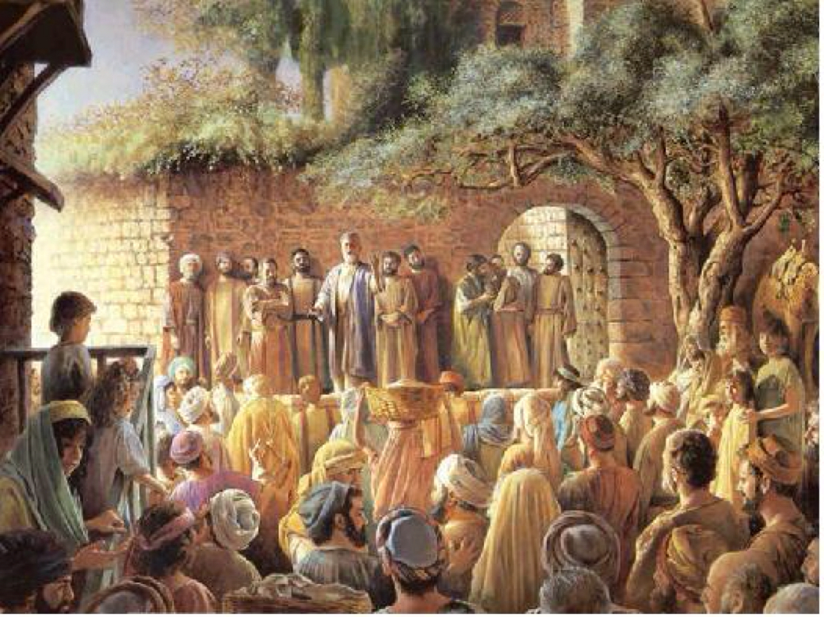
"... for John truly baptized with water, but you shall be baptized with the Holy Spirit not many days from now." — Acts 1:5
baptize
Holy Spirit
Notes:
Jesus Himself told the Apostles of the coming of His kingdom through the Holy Spirit of truth.

Slide 36
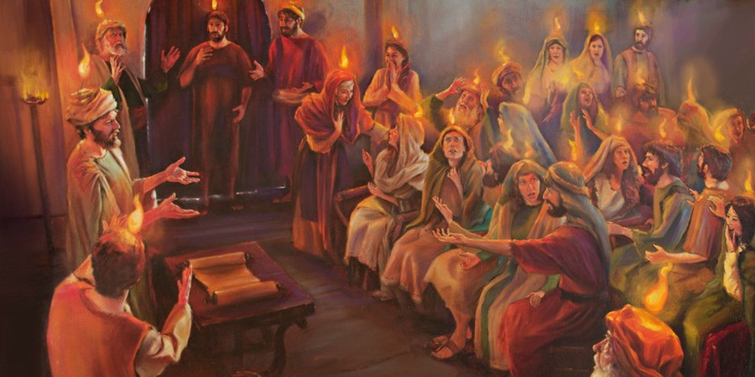
When the Day of Pentecost had fully come, they were all with one accord in one place. And suddenly there came a sound from heaven, as of a rushing mighty wind, and it filled the whole house where they were sitting. — Acts 2:1-2
Day of Pentecost
Day of Pentecost
● sound from heaven
● rushing mighty wind
● filled the whole house
sound from heaven
rushing mighty wind
filled the whole house
Notes:
On the Day of Pentecost, Jesus ascended and the Holy Spirit descended upon those present as they became immersed in Him, His Spirit.

Slide 37
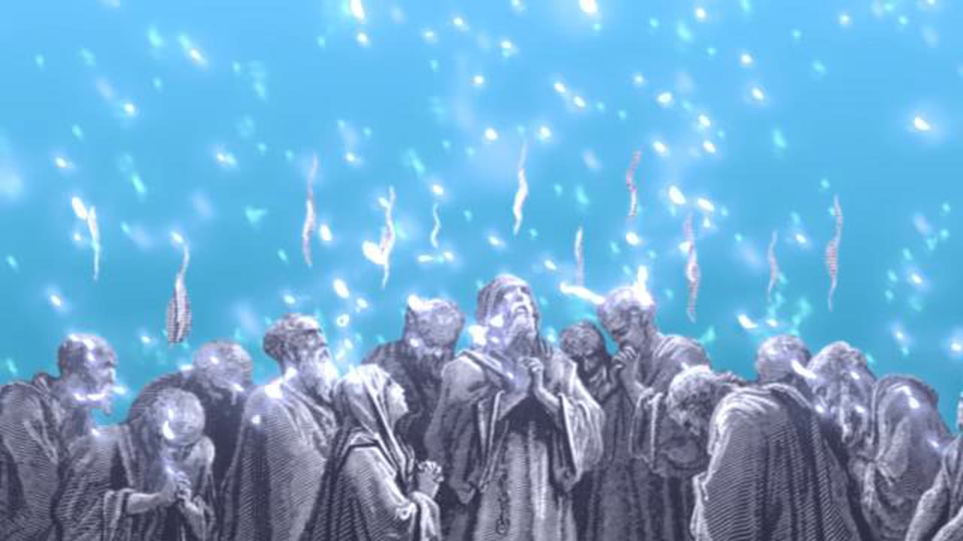
Then there appeared to them divided tongues, as of fire, and one sat upon each of them. And they were all filled with the Holy Spirit and began to speak with other tongues, as the Spirit gave them utterance. — Acts 2:3-4
Holy Spirit
as of fire
as of fire
Holy Spirit
gave them
Notes:
Miraculous happens occurred as the Holy Spirit moved the mere flesh of man.

Slide 38
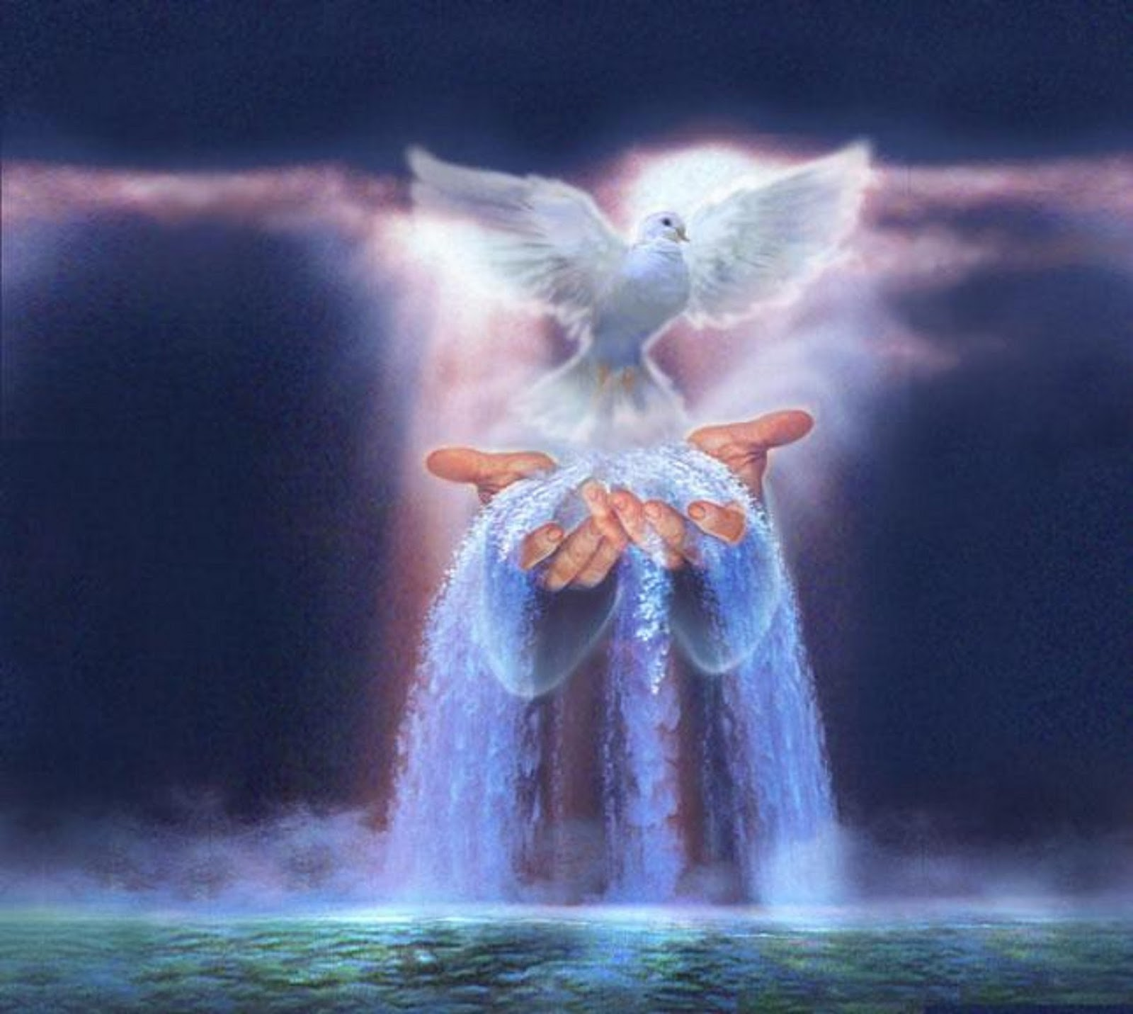
While Peter was still speaking these words, the Holy Spirit fell upon all those who heard the word. And those of the circumcision who believed were astonished, as many as came with Peter, because the gift of the Holy Spirit had been poured out on the Gentiles also. — Acts 10:44-45
Holy Spirit
All
Holy Spirit
Gentiles also
Gentiles also
Notes:
The Holy Spirit continued to be poured out upon the Gentiles, as God’s call to all is now abundantly clear.

Slide 39
For they heard them speak with tongues and magnify God. Then Peter answered, "Can anyone forbid water, that these should not be baptized who have received the Holy Spirit just as we have?" — Acts 10:46-47
Holy Spirit
received Holy Spirit
not be baptized?
not be baptized
received
Holy Spirit
?
Notes:
God refuses none who come asking for His mercy and grace, if in accordance with His will.

Slide 40
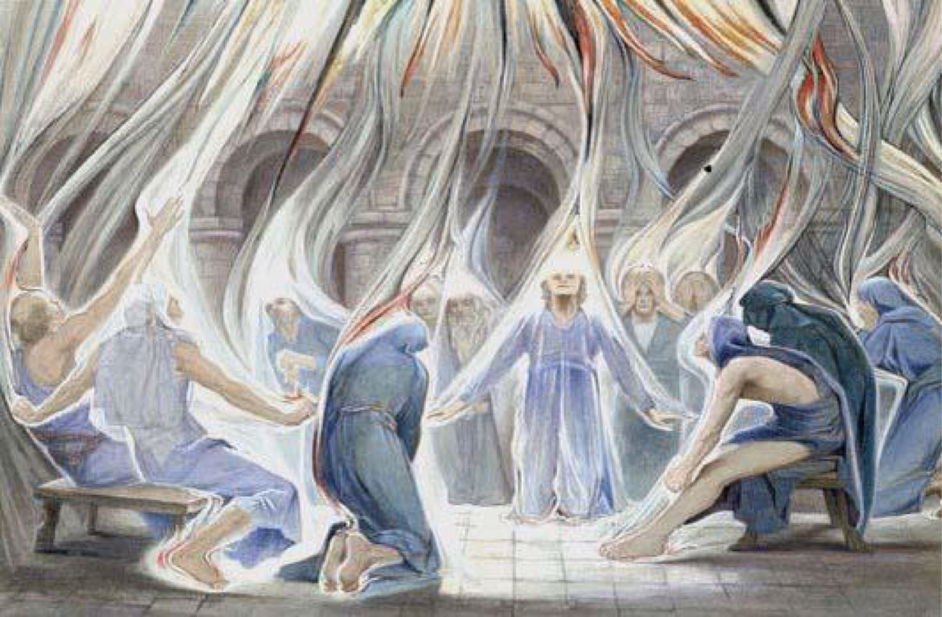
"And as I began to speak, the Holy Spirit fell upon them, as upon us at the beginning." — Acts 11:15
Holy Spirit
Holy Spirit
as upon us at the beginning
as upon us at the beginning
Pentecost
Notes:
The blessing of the Holy Spirit is to reveal the power in truth.

Slide 41
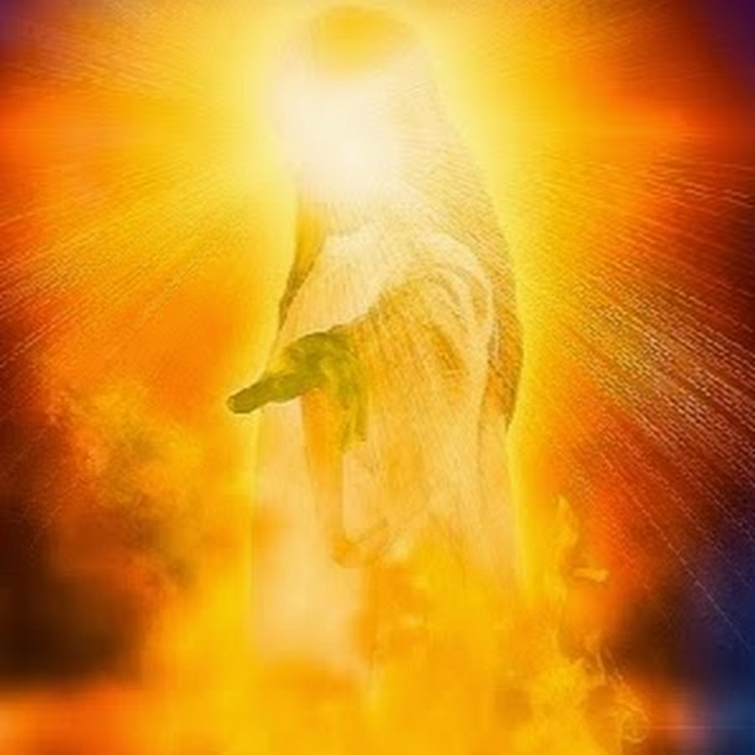
"I indeed baptize you with water unto repentance, but He who is coming after me is mightier than I, whose sandals I am not worthy to carry. He will baptize you with the Holy Spirit and fire. His winnowing fan is in His hand, and He will thoroughly clean out His threshing floor, and gather His wheat into the barn; but He will burn up the chaff with unquenchable fire." — Matthew 3:11-12
Holy Spirit
truth
tares
fire
chaff
fire
fire
judgment
chaff
fire
worthless
fire
husk
fire
Notes:
In view of the Holy Spirit of truth now being upon us all, judgment is a warning call to all as well.

Slide 42
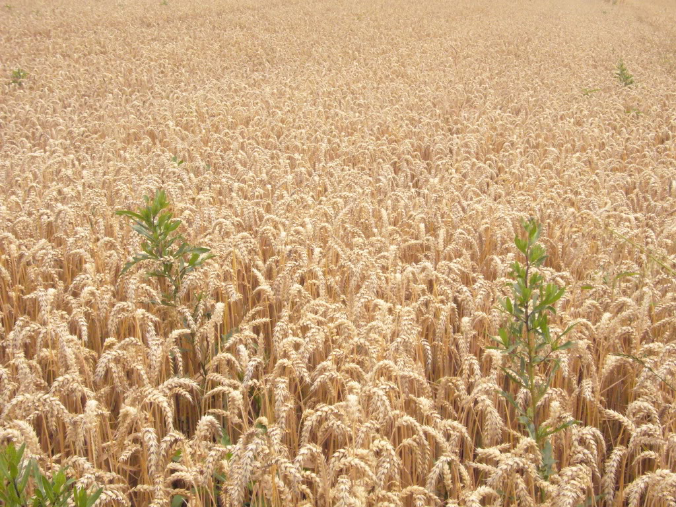
"'Let both grow together until the harvest, and at the time of harvest I will say to the reapers, "First gather together the tares and bind them in bundles to burn them, but gather the wheat into my barn."'" — Matthew 13:30
burn
tares
chaff
reject
burn
gather
gather
accepted
Notes:
God has a plan and those that do not abide in His ways will be discarded.

Slide 43
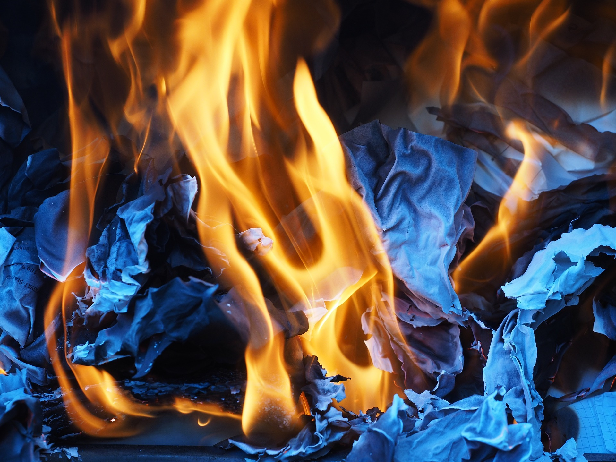
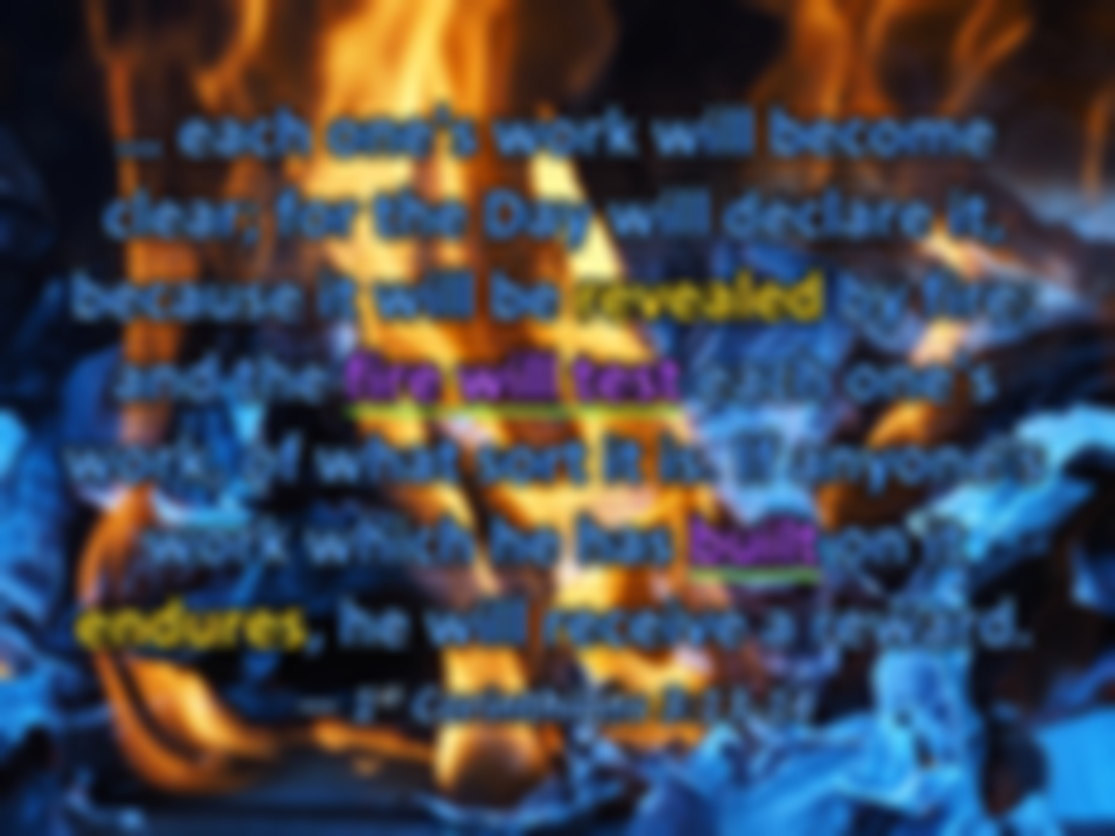
… each one's work will become clear; for the Day will declare it, because it will be revealed by fire; and the fire will test each one's work, of what sort it is. If anyone's work which he has built on it endures, he will receive a reward. — 1st Corinthians 3:13-14
work
fire
fire will test
fire
fire will test
burn
desires
work
truth
work
built
built
love
commitment
Notes:
It will be the brightness of God Himself that will burn away all pretentiousness revealing the naked soul. Our works will divulge our character either be they godly or demonic.

Slide 44
If anyone's work is burned, he will suffer loss; but he himself will be saved, yet so as through fire. Do you not know that you are the temple of God and that the Spirit of God dwells in you? If anyone defiles the temple of God, God will destroy him. For the temple of God is holy, which temple you are. — 1st Corinthians 3:15-17
work
fire
.
God
God
God
God
God
fire
in you?
in
in you?
God
God
Notes:
Only through assimilating in His Spirit, and the calling of His ways, will bring a spirit into the presence and fullness of His commanding light.

Slide 45
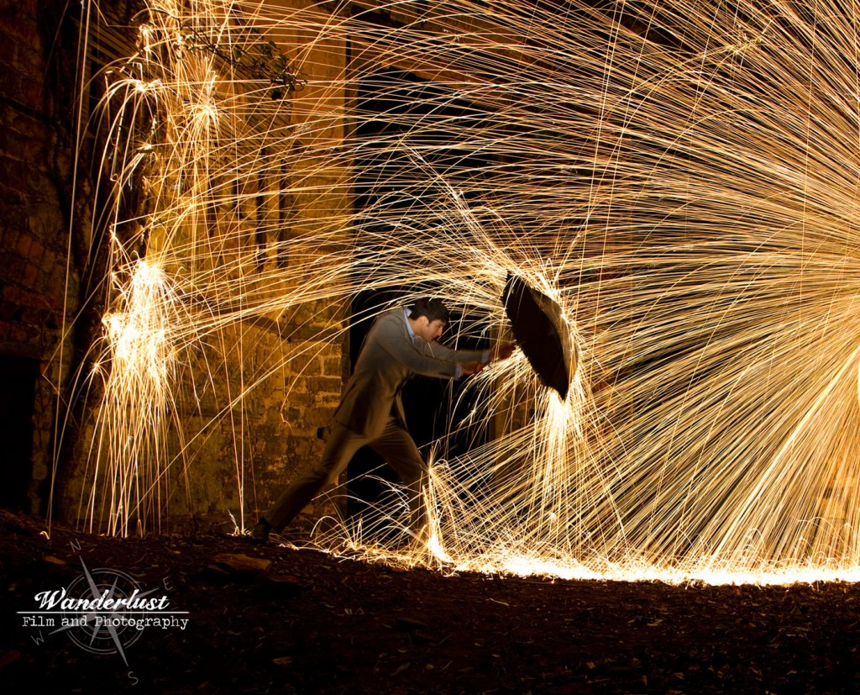
… that the genuineness of your faith, being much more precious than gold that perishes, though it is tested by fire, may be found to praise, honor, and glory at the revelation of Jesus Christ, … — 1st Peter 1:7
genuineness
genuineness
judgment
tested by fire
test
fire
fire
praise, honor, and glory
Jesus Christ
truth
Notes:
Each one will either awake in glory or dread upon His coming. There is no inbetween.

Slide 46
But the day of the Lord will come as a thief in the night, in which the heavens will pass away with a great noise, and the elements will melt with fervent heat; both the earth and the works that are in it will be burned up. — 2nd Peter 3:10
Lord
fire
melt
fervent heat
fervent heat
Lord
Notes:
A washing of all material is coming whereby the only spirits of goodness will survive.

Slide 47
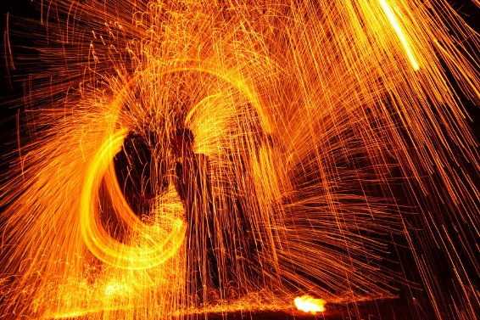
… in flaming fire taking vengeance on those who do not know God, and on those who do not obey the gospel of our Lord Jesus Christ. — 2nd Thessalonians 1:8
in
flaming fire
flaming fire
fire
do not know God
do not know God
God
do not obey
do not obey
fire
Lord
Notes:
God has declared for all to know, and for those that refuse to hear the significance of His coming, and announced commands, only damnation awaits for the disobedient.

Slide 48
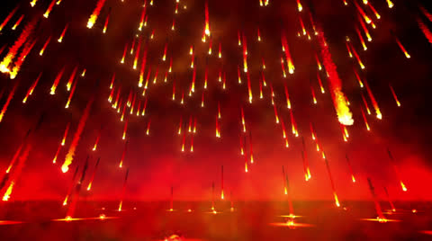
Then Death and Hades were cast into the lake of fire. This is the second death. And anyone not found written in the Book of Life was cast into the lake of fire. — Revelation 20:14-15
lake of fire
lake of fire
fire
cast
second death
second death
fire
Absence from God
cast
fire
cast into
Notes:
The lake of fire is synonymous with destruction. It is again where the fire burns all evil away from His presence.

Slide 49
And as it is appointed for men to die once, but after this the judgment, so Christ was offered once to bear the sins of many. To those who eagerly wait for Him He will appear a second time, apart from sin, for salvation. — Hebrews 9:27-28
die once
die once
die
Christ
die
cast
bear the sins of many
eagerly wait
apart from sin, for salvation
Notes:
Reincarnation is not part of God’s eternal plan. Reincarnation is a coward’s excuse for giving sin precedence over obedience to God. Once dead, and then resurrection to final judgment is what He has announced.

Slide 50
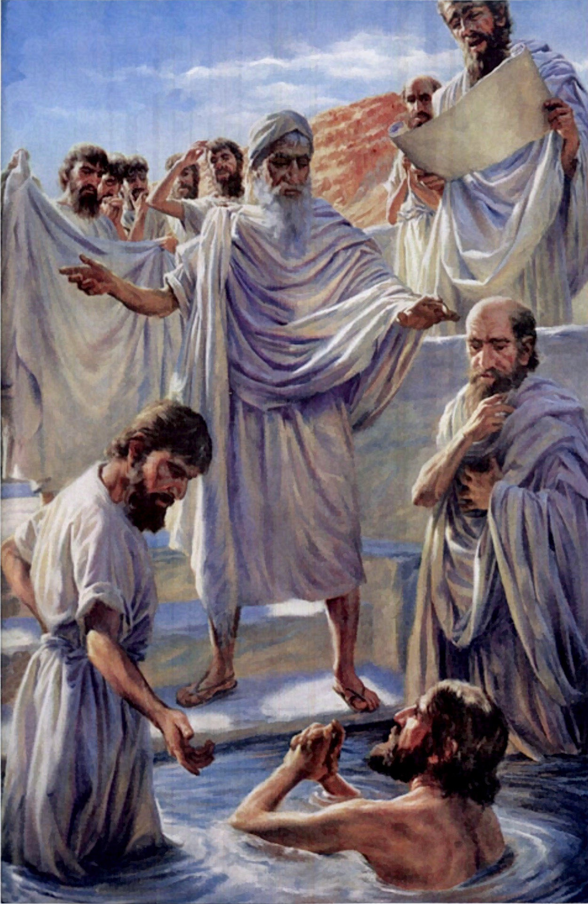
Otherwise, what will they do who are baptized for the dead, if the dead do not rise at all? Why then are they baptized for the dead? —1st Corinthians 15:29
X
. .
dead
baptized for the dead
die
dead do not rise
Notes:
One cannot substitute for the real thing. No one can be baptized for another. The dead who await judgment are sealed in the fate of their own works, and by His fiery breath all will bare all.

Slide 51
individual call to rise

Slide 52
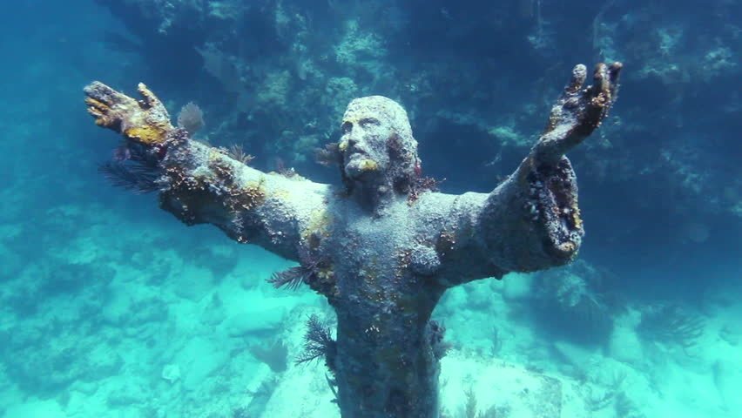
Therefore, leaving the discussion of the elementary principles of Christ, let us go on to perfection, not laying again the foundation of repentance from dead works and of faith toward God, of the doctrine of baptisms, of laying on of hands, of resurrection of the dead, and of eternal judgment. — Hebrews 6:1-2
→
Milk → Meat
Milk
Meat
individual call to rise
love
let us go on to perfection
Habitual sin
Contentious augmentation
Notes:
Contention has no place where love takes precedence.

Slide 53
For we ourselves were also once foolish, disobedient, deceived, serving various lusts and pleasures, living in malice and envy, hateful and hating one another. But when the kindness and the love of God our Savior toward man appeared, … — Titus 3:3-4
sinners
love of God
love of God
God
appeared
appeared
Notes:
To rise past our sin we must first acknowledge our sin. In view of our sin, we can then be humbled by the mercy of His love.

Slide 54
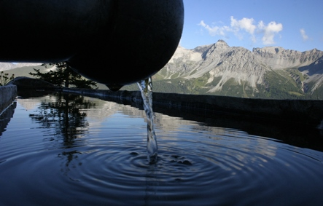
… not by works of righteousness which we have done, but according to His mercy He saved us, through the washing of regeneration and renewing of the Holy Spirit, whom He poured out on us abundantly through Jesus Christ our Savior, that having been justified by His grace we should become heirs according to the hope of eternal life. — Titus 3:5-7
His mercy
saved us
through
Holy Spirit
. .
justified by His grace
Notes:
Be baptized and receive the gift of the Holy Spirit, for those obedient to the faith, once delivered. One cannot argue with what God has done. Acceptance is part of salvation.

Slide 55
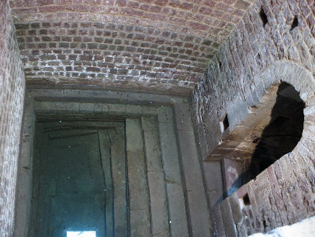
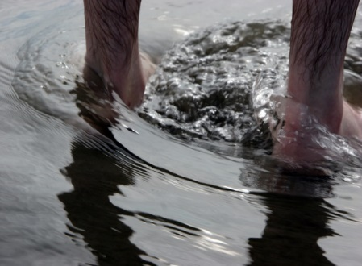
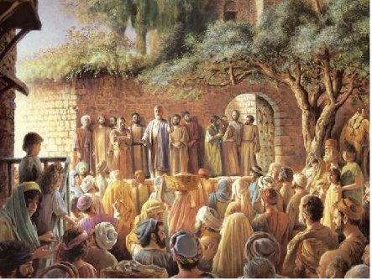
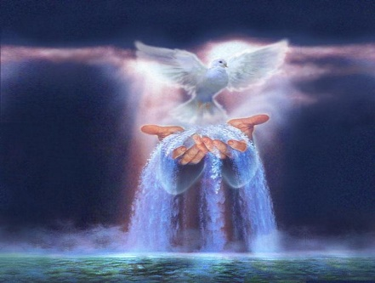
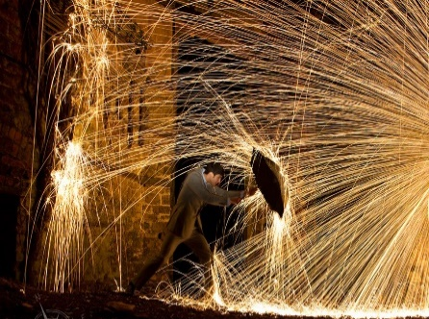
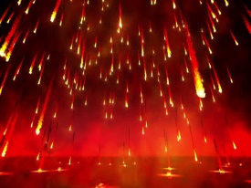
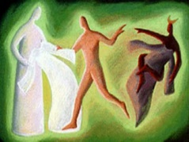
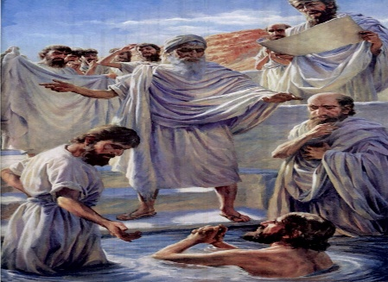

Slide 56
→ God calls for us to cease to do evil
→ Jesus says only an inner cleanness makes one clean
→ John said Jesus would baptize / Holy Spirit and fire
→ Pentecost / Holy Spirit miraculously filled disciples
→ Holy Spirit fell upon Gentiles in Joppa as at the start
→ Individuals are called to be holy as temples of God
→ Fire reveals our praise, honor, & glory at His coming
→ Earth and the works that are in it will be burned up
→ Fire of vengeance on who do not know God or obey
→ Not written in Book of Life is cast into lake of fire
→ Christ comes 2nd time, apart from sin, for salvation
→ One cannot be baptized for the dead or another
→ Decree/not to ponder various doctrines of baptisms
Beyond the tangible God remains eternal
Notes:
Beyond the tangible God remains eternal

Slide 57
Notes:
Darkness hides in the emptiness of itself.

Slide 58
BAPTISM
Ron Bert
3
April 29, 2018
Notes:
Baptism is to be immersed in all that one is.

Slide 59
Baptism of Moses
Baptism of John
Baptism of Jesus by John
Baptism of Suffering
Great Commission Water Baptism
Baptism into His death/life
Baptism of the Holy Spirit
Baptism of Fire
Baptism ø for the Dead
Baptism of Moses
Baptism of John
Baptism of Jesus by John
Baptism of Suffering
Great Commission Water Baptism
Baptism into His death/life
Baptism of the Holy Spirit
Baptism of Fire
Baptism ø for the Dead
1
3
2
Notes:
There are various types of baptism. The baptism of Moses through the Red Sea. John’s baptism of repentance for the remission of sins. The baptism of suffering Christ and His apostles endured. The great commission water baptism remains and has come as a command of God. The baptism of the Holy Spirit, as God finalized His anointing upon the earth where men live, has blessed us all in the knowledge of Him. A fire baptism cleansing the evils of creation is yet to occur as all rise back to His Spirit. There can be no substitute for an individuals accountability directly to God, and the dead rise no more, making it impossible for choices, made or not made, to be altered or changed once mortal death has occurred.

Slide 60
"I came to send fire on the earth, and how I wish it were already kindled! But I have a baptism to be baptized with, and how distressed I am till it is accomplished!" — Luke 12:49-50
I have a baptism
distressed
distressed
Notes:
Jesus ignited a battle of wills between that of God, and the arrogance of man.

Slide 61
They said to Him, "Grant us that we may sit, one on Your right hand and the other on Your left, in Your glory." — Mark 10:37
Grant us
Grant us
in Your glory
in
in Y our glory
Notes:
It is by the will of God who He chooses to remain and where. The Apostles falsely assumed Jesus would conquer the Roman Empire and dominated the physical kingdoms of man. God is interested in souls more than kingdoms.

Slide 62
But Jesus said to them, "You do not know what you ask. Are you able to drink the cup that I drink, and be baptized with the baptism that I am baptized with?" They said to Him, "We are able." So Jesus said to them, "You will indeed drink the cup that I drink, and with the baptism I am baptized with you will be baptized;" — Mark 10:38-39
baptized
baptized
suffering
baptized
baptized
Notes:
Jesus knew the pain He was to suffer and He felt it prior to it actually occurring. The Apostles could hardly know what was to befall them in such a wicked world where the venomous nature of man rules over the smallest of compassion. Baptism is surely an immersion into that which is total.

Slide 63
"He who believes and is baptized will be saved; but he who does not believe will be condemned. — Mark 16:16
believes
baptized
baptized
believes + baptized = saved
not believe = condemned
saved
not believe
condemned
Notes:
There should be no doubt as to what Jesus Himself has said. Arguing semantics will not absolve one from the simple command He demands. Simplicity is best found in compliance.

Slide 64
Jesus answered, "Most assuredly, I say to you, unless one is born of water and the Spirit, he cannot enter the kingdom of God." — John 3:5
Spirit
unless
unless
Spirit
water
Spirit
Commitment
Acceptance
Notes:
Again, Jesus undeniably states the importance of obedience as well as a fervent spirit to achieve final salvation.

Slide 65
For by one Spirit we were all baptized into one body -- whether Jews or Greeks, whether slaves or free -- and have all been made to drink into one Spirit. — 1st Corinthians 12:13
one
Spirit
baptized into one body
baptized into one body
one
one Spirit
one
one Spirit
Notes:
There is no division in God, and He calls for unity in Him. His is not a Spirit that can be divided as He calls for us to be in the oneness of His proclaimed faith.

Slide 66
… one Lord, one faith, one baptism; — Ephesians 4:5
one
one
one
baptism
one baptism
one baptism
baptism
Notes:
Currently, there is only the Great Water Baptism that God waits on souls to embrace.

Slide 67
There is also an antitype which now saves us -- baptism (not the removal of the filth of the flesh, but the answer of a good conscience toward God), through the resurrection of Jesus Christ, … — 1st Peter 3:21
baptism saves us:
● not removal of filth of the flesh
● answer of a good conscience/God ↘
through resurrection of Christ
saves us
baptism
not
saves us
saves us
removal of
filth of the flesh
answer of a good
conscience
God
through
resurrection of
Christ
Notes:
It is written that baptism is a requirement unto salvation. It is an essential ingredient of a hearts continuing commitment to God.

Slide 68
… that if you confess with your mouth the Lord Jesus and believe in your heart that God has raised Him from the dead, you will be saved. For with the heart one believes unto righteousness, and with the mouth confession is made unto salvation. — Romans 10:9-10
Jesus
in
heart
heart
Jesus
saved
with the heart
one
with the heart
one believes
unto righteousness
believes
unto righteousness
and
mouth
and
mouth
Notes:
And it is by wholehearted open confession in belief that salvation is had.

Slide 69
Therefore, brethren, having boldness to enter the Holiest by the blood of Jesus, by a new and living way which He consecrated for us, through the veil, that is, His flesh, and having a High Priest over the house of God, … — Hebrews 10:19-21
Jesus
blood of Jesus
Jesus
living way
living
living
living way
through the veil
through the veil
Notes:
We now have a direct connection to God through Christ Jesus our Savior.

Slide 70
… let us draw near with a true heart in full assurance of faith, having our hearts sprinkled from an evil conscience and our bodies washed with pure water. Let us hold fast the confession of our hope without wavering, for He who promised is faithful. — Hebrews 10:22-23
ving
i
l
living
living
living
washed
washed
hold fast
hold fast
hope
hope
Notes:
Baptism is just a beginning of plunging into God. Growth in all aspects of improvement, learning and loving, reaching for, and honing spiritual discernment, climbs the ladder to heaven. It is recognizing the removal of the veil between man and God.

Slide 71
For as many of you as were baptized into Christ have put on Christ. — Galatians 3:27
living
baptized into Christ
Christ
baptized into Christ
have put on Christ
Christ
have put on Christ
Notes:
It is rising into the character of Christ that we are made whole.

Slide 72
… buried with Him in baptism, in which you also were raised with Him through faith in the working of God, who raised Him from the dead. And you, being dead in your trespasses and the uncircumcision of your flesh, He has made alive together with Him, having forgiven you all trespasses, … — Colossians 2:12-13
in
buried with Him in baptism
raised with Him
in
buried with Him in baptism
in raised with Him through faith
in the working of God
dead in your trespasses
alive together with Him
forgiven you all trespasses
through faith in the working of God
through faith in the working of God
faith
in the working of God
through faith
God
in
with Him
in
dead in your trespasses
in
with Him
alive together
i
n
with Him
forgiven you all
trespasses
Notes:
The symbolism is undeniable that through baptism we rise to be alive in Him. It is written that it is a working of God as per His promise to bring salvation to man.

Slide 73
"Go therefore and make disciples of all the nations, baptizing them in the name of the Father and of the Son and of the Holy Spirit, …" — Matthew 28:19
Followers
make disciples
make disciples
all the nations
baptizing them
baptizing them
in
Father
in
Holy Spirit
Son
Holy Spirit
Holy Spirit
Notes:
As instructed, God calls for His children to take part in the great retrieval of souls, in returning to His truth, in Spirit.

Slide 74
Then Peter said to them, "Repent, and let every one of you be baptized in the name of Jesus Christ for the remission of sins; and you shall receive the gift of the Holy Spirit." — Acts 2:38
1)
Repent
baptized
2)
baptized
baptized
for the remission of sins
for the remission of sins
+
receive the gift
Holy Spirit
Promise of eternal life
Promise of eternal life
Notes:
It can be made no clearer than in Acts 2:38. The gift is the promise of eternal life to all those remaining faithful until the end.

Slide 75
Then those who gladly received his word were baptized; and that day about three thousand souls were added to them. — Acts 2:41
received his word
were baptized
baptized
baptized
received his word
were baptized
baptized
baptized
Notes:
The church of Christ began as many were baptized upon hearing the command.

Slide 76
But when they believed Philip as he preached the things concerning the kingdom of God and the name of Jesus Christ, both men and women were baptized. Then Simon himself also believed; and when he was baptized he continued with Philip, and was amazed, seeing the miracles and signs which were done. — Acts 8:12-13
when they believed
when they believed
were baptized
baptized
were baptized
baptized
baptized
Notes:
The message went out and touched the curious of heart, seekers in the ways of God. One can only wonder of the amazements witnessed by those first century Christians.

Slide 77
Then Philip opened his mouth, and beginning at this Scripture, preached Jesus to him. Now as they went down the road, they came to some water. And the eunuch said, "See, here is water. What hinders me from being baptized?" Then Philip said, "If you believe with all your heart, you may." And he answered and said, "I believe that Jesus Christ is the Son of God." — Acts 8:35-37
baptized
What hinders me
What hinders me
baptized
I believe
I believe
Notes:
In full knowledge of God’s plan of salvation, a rational decision can be made. It is to either want God with one’s all or not. To hesitate is to hold doubt in one’s heart with other possible extraneous agendas.

Slide 78
So he commanded the chariot to stand still. And both Philip and the eunuch went down into the water, and he baptized him. Now when they came up out of the water, the Spirit of the Lord caught Philip away, so that the eunuch saw him no more; and he went on his way rejoicing. — Acts 8:38-39
No Hesitation
baptized
action
baptized
Notes:
Surely, only rejoicing comes in total submission to God.

Slide 79
'And now why are you waiting? Arise and be baptized, and wash away your sins, calling on the name of the Lord.' — Acts 22:16
why are you waiting
why are you waiting
baptized
wash away your sins
baptized
Notes:
Only a fool denies what God has requested and commanded.

Slide 80
Then Crispus, the ruler of the synagogue, believed on the Lord with all his household. And many of the Corinthians, hearing, believed and were baptized. — Acts 18:8
baptized
hearing
↘
believed
↘
baptized
↘
hearing
↘
believed
baptized
baptized
Notes:
Upon believing what has been told to us by God Himself, no other decision can be made but to obey. It is a choice each of has to make, or deny. Our actions in accordance to His word will declare where our motives lie.

Slide 81
Or do you not know that as many of us as were baptized into Christ Jesus were baptized into His death? Therefore we were buried with Him through baptism into death, that just as Christ was raised from the dead by the glory of the Father, even so we also should walk in newness of life. — Romans 6:3-4
know
know
know
RESURRECTED TO NEW LIFE
DEAD IN
SIN
baptized into Christ
Christ
. .
baptized
with Him
through baptism
raised
BURIED WITH CHRIST JESUS
in
in newness of life
Notes:
Baptism is not a casual or flippant event. To treat it as such nullifies the significance of its importance. Many have suggested that infant baptism is a valid means of salvation. This does not hold up as infants do not have the cognitive power to realize the magnitude of the event itself. As the living can not be baptized for the dead, so infant baptism cannot sooth the conscience of any parent or family member fooled into its worthiness.

Slide 82
know
know
know
know
know
know
know
know
know
know
Notes:
To know or not to know reveals the truth.

Slide 83
know

Slide 84
→ Jesus bore a baptism of suffering as did His Apostles
→ He who believes and is baptized will be saved
→ Unless one is born of water & the Spirit, no entry
→ By one Spirit we were all baptized into one body
→ … one Lord, one faith, one baptism, …
→ Antitype / now saves us — baptism through Christ
→ Confess/mouth & believe in heart God raised Jesus
→ Baptized into Christ has put on Christ
→ Make disciples of all the nations, baptizing them
→ Repent & be baptized in Christ for/remission of sins
→ Knowing His sacrifice, don’t put off His offered gift
→ Be baptized and wash away your sins
→ Baptized / Christ / His death - rise in newness of life
Salvation calls from the rising waters of baptism
Notes:
Salvation calls from the rising waters of baptism

Slide 85
Notes:
Darkness has no place where something is.

Slide 86
Please visit http://ronbert.com/baptism4u.htm to explore further
Ronald Bert Channel on
Notes:
Eternity never ends.

Slide 87
Part 4 future development
Extensive Utilization of diagrams
Conversions in the Book of Acts
http://ronbert.com/tablebaptism.htm

Slide 88
Not all washings cleanse the soul
If not approved by God

