Slide 1
Notes:
Darkness embraces the thrust of nothing.

Slide 2
Ron Bert
ARROGANCE
November 15, 2015
Notes:
Arrogance emboldens a defiant heart of perceived no fault.

Slide 3
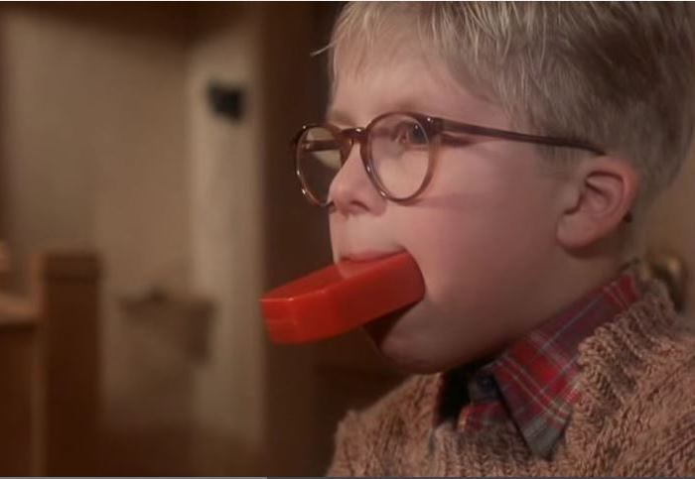
"Talk no more so very proudly; Let no arrogance come from your mouth, For the LORD is the God of knowledge; And by Him actions are weighed." — 1st Samuel 2:3
proud
actions
weighed
Notes:
Pride acts upon the mouth unprepared for the consequences.

Slide 4
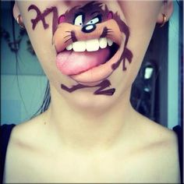
They utter speech, and speak insolent things; All the workers of iniquity boast in themselves. — Psalm 94:4
boast
boast
Notes:
In self-boasting one falls spewing gagging words upon others.

Slide 5
Do not boast about tomorrow, For you do not know what a day may bring forth. — Proverbs 27:1
boast
do not know
Notes:
Sunlight is an unguaranteed moment as life jumps forward.

Slide 6
Come now, you who say, "Today or tomorrow we will go to such and such a city, spend a year there, buy and sell, and make a profit"; whereas you do not know what will happen tomorrow. For what is your life? It is even a vapor that appears for a little time and then vanishes away. Instead you ought to say, "If the Lord wills, we shall live and do this or that." But now you boast in your arrogance. All such boasting is evil. — James 4:13-16
do not know
boast in your arrogance
boast in your arrogance
evil
Notes:
Raging envy and jealousy is the food of a defiant bitter heart. Thankfulness in Him is the keel that drives a rudder home.

Slide 7
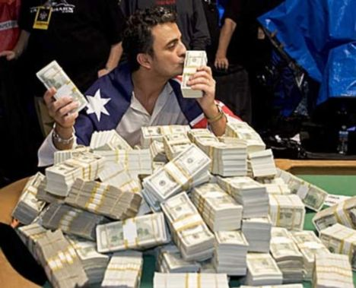
'And I will say to my soul, "Soul, you have many goods laid up for many years; take your ease; eat, drink, and be merry."' "But God said to him, 'Fool! This night your soul will be required of you; then whose will those things be which you have provided?' So is he who lays up treasure for himself, and is not rich toward God." — Luke 12:19-21
A
Fool
is not rich toward God
Notes:
Over confidence without mortal regard for the uncertainty of time can leave one empty deprived of intuitive spiritual rewards.

Slide 8
The fear of the LORD is to hate evil; Pride and arrogance and the evil way And the perverse mouth I hate. — Proverbs 8:13
Superiority
Snobbery
Egotism
Overconfidence
Narcissism
Self-importance
arrogance
Haughtiness
Conceit
Notes:
Haughty hearts have no place in God’s accepted way. Arrogance is a disease of heart.

Slide 9
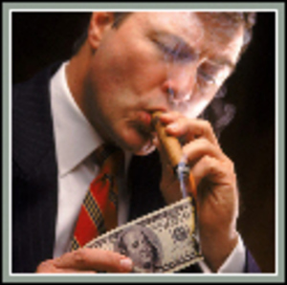
But know this, that in the last days perilous times will come: For men will be lovers of themselves, lovers of money, boasters, proud, blasphemers, disobedient to parents, unthankful, unholy, unloving, unforgiving, slanderers, without self-control, brutal, despisers of good, traitors, headstrong, haughty, lovers of pleasure rather than lovers of God, having a form of godliness but denying its power. And from such people turn away! — 2nd Timothy 3:1-5
X
lovers of God
lovers of God
turn away
turn away
Notes:
Swirling evil suffocates decency appallingly cold.

Slide 10
If anyone teaches otherwise and does not consent to wholesome words, even the words of our Lord Jesus Christ, and to the doctrine which accords with godliness, he is proud, knowing nothing, but is obsessed with disputes and arguments over words, from which come envy, strife, reviling, evil suspicions, useless wranglings of men of corrupt minds and destitute of the truth, who suppose that godliness is a means of gain. From such withdraw yourself. — 1st Timothy 6:3-5
the word
word
the word
proud, knowing nothing, but is obsessed with disputes and arguments over words, from which come envy, strife, reviling, evil suspicions, useless wranglings of men of corrupt minds and destitute of the truth, who suppose that godliness is a means of gain. From such withdraw yourself. — 1st Timothy 6:3-5
doctrine
doctrine
accords with godliness
accords with godliness
turn away
Notes:
Without actions reflecting the true knowledge of God humbly in Jesus, argumentative spirits often skew from Him cloaked in self-seeking agendas.

Slide 11
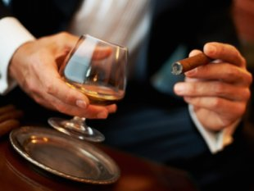
Woe to those who are wise in their own eyes, And prudent in their own sight! — Isaiah 5:21
Who
W
ho
Notes:
A snob has no room for merciful ears all puffed up acting tuff while often huffing.

Slide 12
Who say, 'Keep to yourself, Do not come near me, For I am holier than you!' These are smoke in My nostrils, A fire that burns all the day. — Isaiah 65:5
Who
Notes:
The pompous reserve their eternal fire in a smokeless realm.

Slide 13
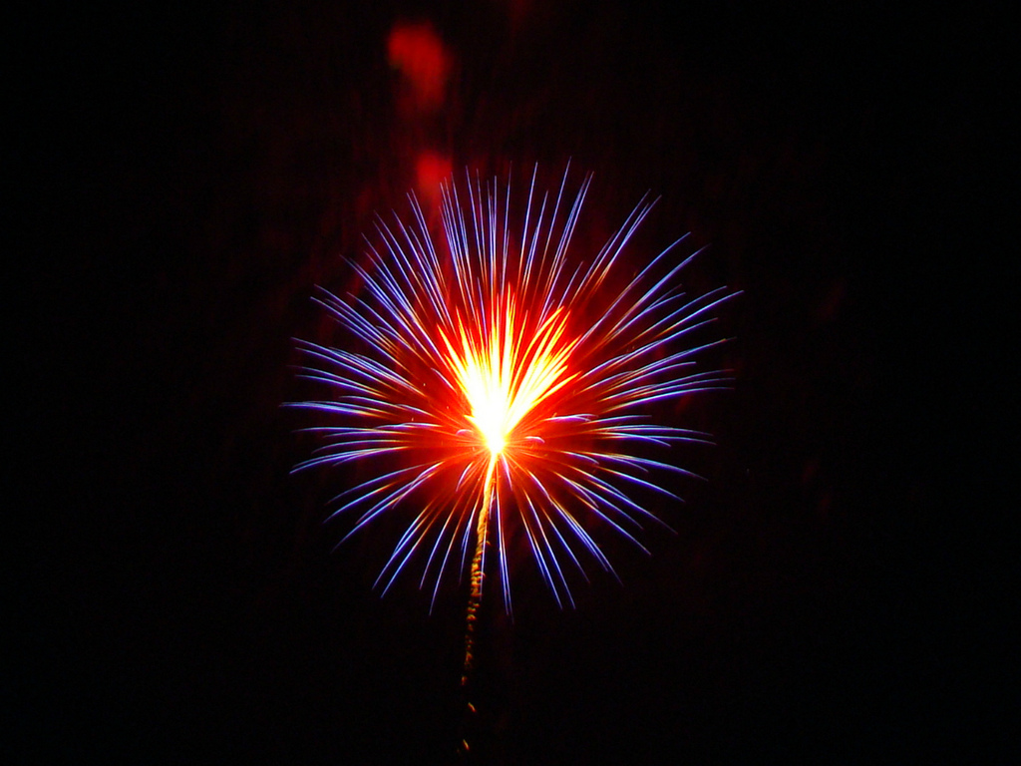
He who is of a proud heart stirs up strife, But he who trusts in the LORD will be prospered. He who trusts in his own heart is a fool, But whoever walks wisely will be delivered. — Proverbs 28:25-26
wise
trust
trust
in
walks wisely
wise
Notes:
Trusting in self has deeper deceptions of insecurities’ hardship.

Slide 14
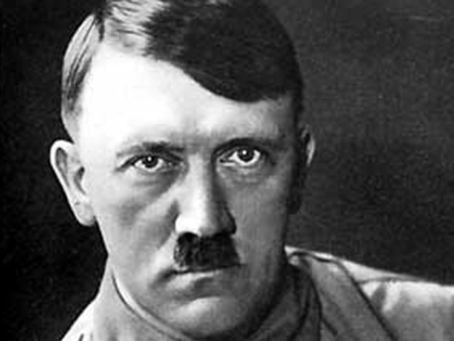
Do you see a man wise in his own eyes? There is more hope for a fool than for him. — Proverbs 26:12
wise
wise in his own
in
wise in his own
wise
wise
Notes:
Without a humble heart, wisdom is forever out of reach.

Slide 15
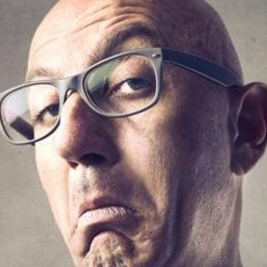
Do not be wise in your own eyes; Fear the LORD and depart from evil. — Proverbs 3:7
①
wise
wise
②
③
Notes:
The deepest wisdom can only be had by the seeking ignorant.

Slide 16
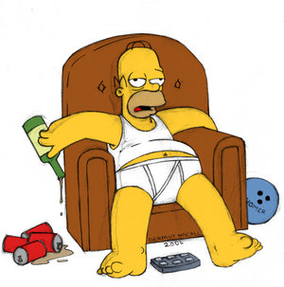
The lazy man is wiser in his own eyes Than seven men who can answer sensibly. — Proverbs 26:6
wise
eyes
eyes
Notes:
There is no sensibility in a lazy man’s cockiness.

Slide 17
By pride comes nothing but strife, But with the well-advised is wisdom. — Proverbs 13:10
conflict
strife
fighting
rivalry
friction
eyes
contention
trouble
Notes:
Pride eventually leads to the poverty of loneliness.

Slide 18
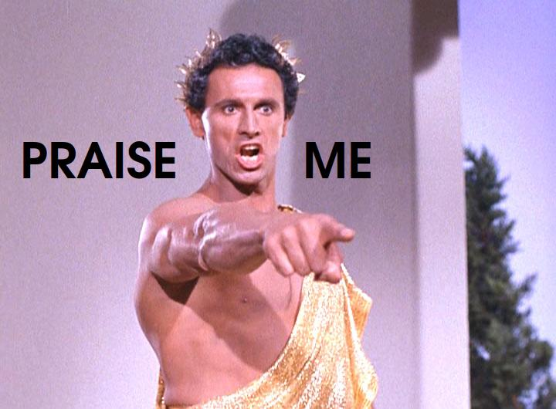
Pride goes before destruction, And a haughty spirit before a fall. — Proverbs 16:18
Notes:
The demands of the haughty shall fall to the height of the bottom.

Slide 19
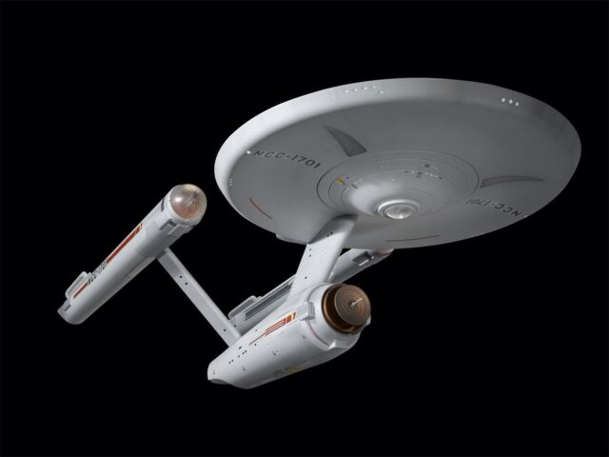
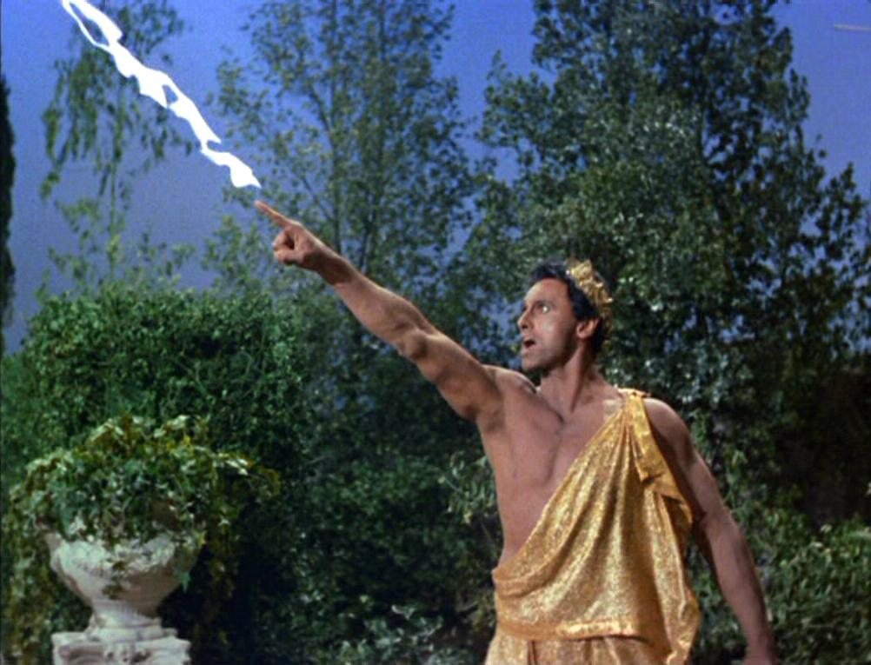
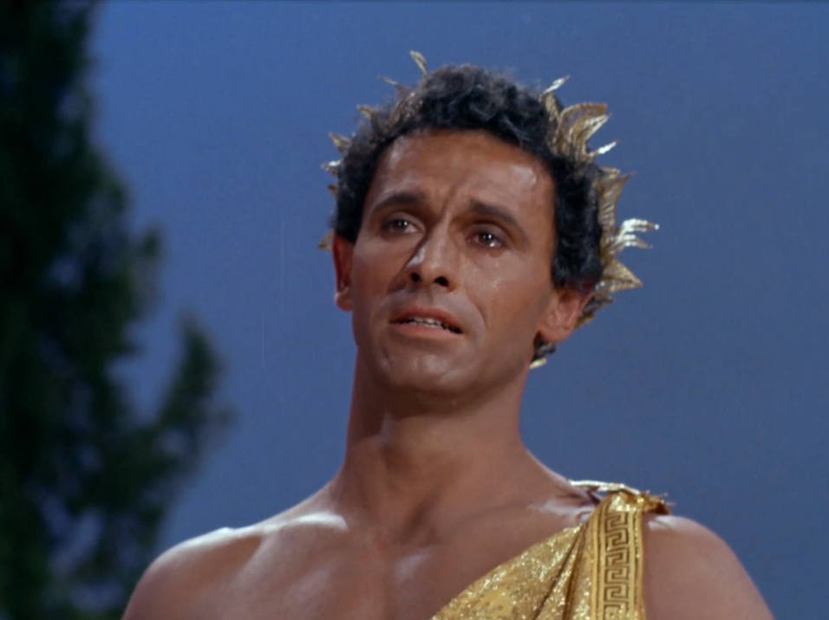
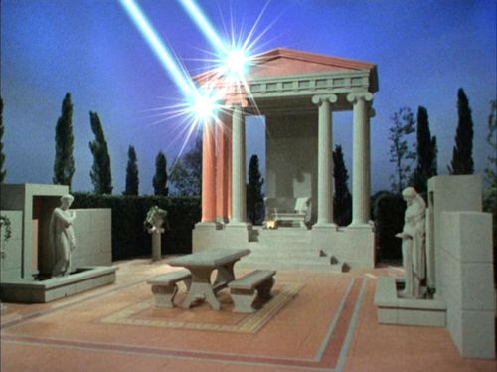
Before destruction the heart of a man is haughty, And before honor is humility. — Proverbs 18:12
Notes:
Humility humbles a peaceable heart whereas arrogance destroys a fitful fighting one.

Slide 20
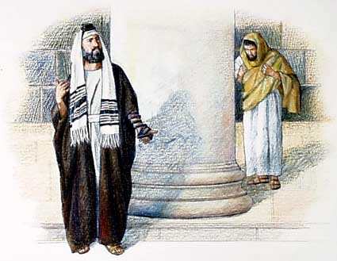
Also He spoke this parable to some who trusted in themselves that they were righteous, and despised others:— Luke 18:9
loathe
hate
scorn
ridicule
despise
disgust
Notes:
Despising others can lead to the deception of being above accountability.

Slide 21
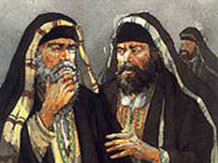
"Beware of the scribes, who desire to go around in long robes, love greetings in the marketplaces, the best seats in the synagogues, and the best places at feasts," — Luke 20:46
Beware
Proud
Beware
Notes:
Desire to be over others as entitled maintains a destructive heart.

Slide 22
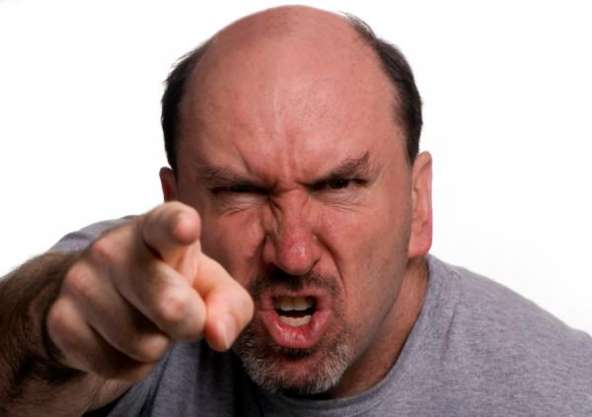
For if anyone thinks himself to be something, when he is nothing, he deceives himself. But let each one examine his own work, and then he will have rejoicing in himself alone, and not in another. For each one shall bear his own load. — Galatians 6:3-5
each one shall bear his own load
each one shall bear his own load
Notes:
Fools fail to examine truth of self.

Slide 23
And if anyone thinks that he knows anything, he knows nothing yet as he ought to know. But if anyone loves God, this one is known by Him. — 1st Corinthians 8:2-3
loves God
Notes:
To know is to know one knows not. Only a humble contrite heart can truly love God.

Slide 24
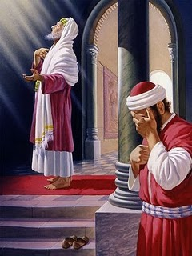
"I tell you, this man went down to his house justified rather than the other; for everyone who exalts himself will be humbled, and he who humbles himself will be exalted." — Luke 18:14
ll
u
d
full of
himself
f
e
o
f
t
himself
m
himself
i
emptied
himself
ed
Notes:
Full of self fails to empty out before God.

Slide 25
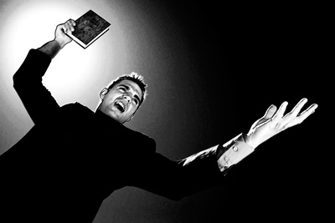
"And whoever exalts himself will be humbled, and he who humbles himself will be exalted." — Matthew 23:12
A man's pride will bring him low, But the humble in spirit will retain honor. — Proverbs 29:23
humble
Notes:
Superiority invites condemnation while the meek find honor.

Slide 26
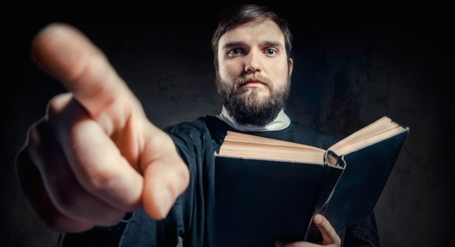
A man's pride will bring him low, But the humble in spirit will retain honor. — Proverbs 29:23
A man's pride will bring him low, But the humble in spirit will retain honor. — Proverbs 29:23
Notes:
To be more is to be less.

Slide 27
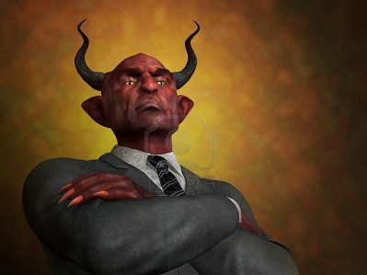
… not a novice, lest being puffed up with pride he fall into the same condemnation as the devil. — 1st Timothy 3:6
puffed up
puffed up
with pride
with pride
condemnation as the devil
Notes:
Pride is the root that rots a soul away from God inheriting the devils residence.

Slide 28
Be of the same mind toward one another. Do not set your mind on high things, but associate with the humble. Do not be wise in your own opinion. — Romans 12:16
same mind
same mind
associate
associate
humble
humble
Notes:
Truth associates in unity with the humble where superiority alienates the wise.

Slide 29
For we dare not class ourselves or compare ourselves with those who commend themselves. But they, measuring themselves by themselves, and comparing themselves among themselves, are not wise. — 2nd Corinthians 10:12
commend themselves
commend themselves
are not wise
are not wise
Notes:
Those entangled in jealous and envious competitions ruin themselves in disgust.

Slide 30
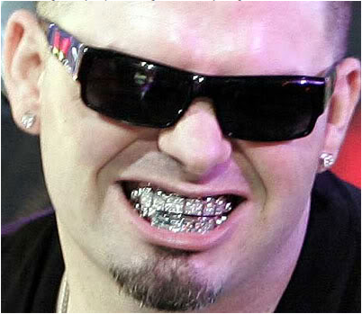
For all that is in the world – the lust of the flesh, the lust of the eyes, and the pride of life – is not of the Father but is of the world. — 1st John 2:16
①
②
③
Notes:
Consumed in self blinds one from all higher truths.

Slide 31
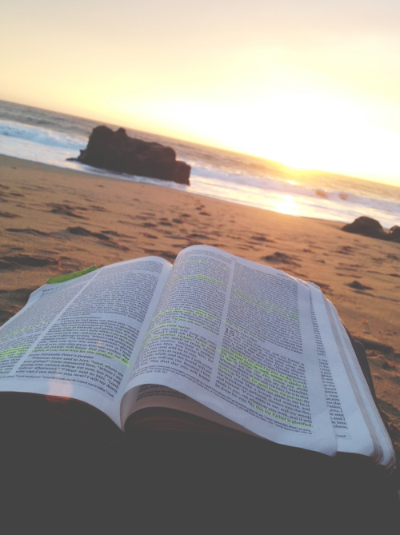
Not that we are sufficient of ourselves to think of anything as being from ourselves, but our sufficiency is from God, … — 2nd Corinthians 3:5
We exist because of God
is from God
is from God
Notes:
To realize we are but parts of God in the gift of His love awakens truth.

Slide 32
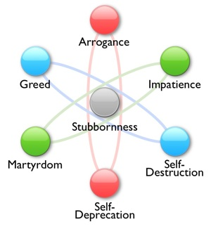
But He gives more grace. Therefore He says: "God resists the proud, But gives grace to the humble." Therefore submit to God. Resist the devil and he will flee from you." — James 4:6-7
grace to the
humble
submit to
God
Resist the devil
Suffering
Self-
Contempt
Notes:
Grace is a gift given to the humble who submit to God while resisting the devil’s stubborn ways.

Slide 33
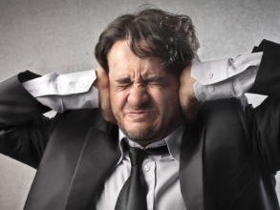
"But they refused to heed, shrugged their shoulders, and stopped their ears so that they could not hear." — Zechariah 7:11
pride
pride
spirit
Notes:
It all comes down to spiritual insights over pride’s obliviousness.
Are we custodians of what befalls us or do we haughtily claim ownership.

Slide 34
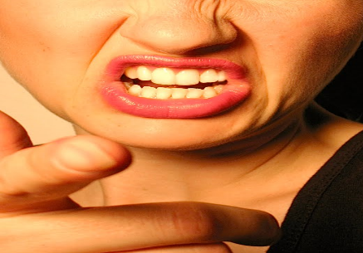
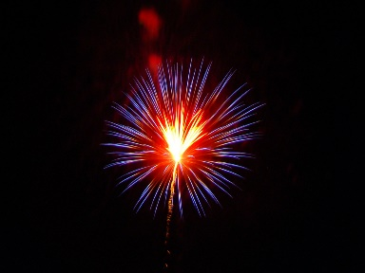
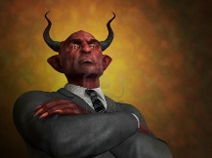
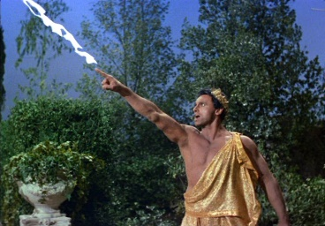
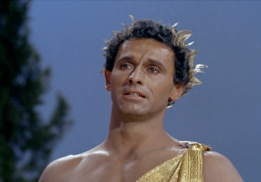
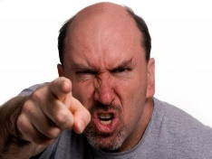
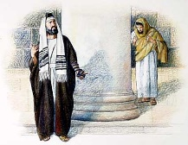
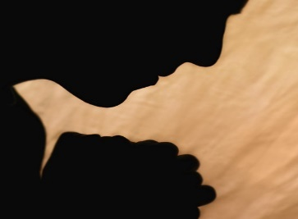
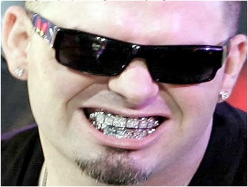
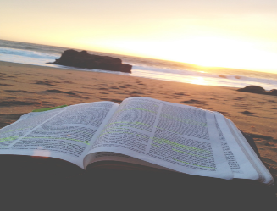
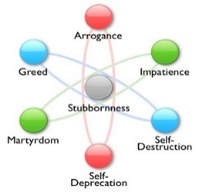

Slide 35
→ Do not talk proudly or speak arrogantly
→ Do not boast arrogantly which is evil
→ Be rich toward the ways of God and hate evil
→ Turn away and withdraw from the ungodly
→ Do not have a holier than thou attitude
→ Trust in the Lord walking wisely as well-advised
→ Do not be wise in your own eyes or opinion
→ Do not despise others with a haughty heart
→ Do not commend oneself among comparisons
→ Pride gets the same condemnation the devil has
→ Examine your own works humbly
→ Associate with the humble
→ Our sufficiency is from God; Submit to God
Command your spirit over your pride
Notes:
Command your spirit over your pride.

Slide 36
Notes:
Below explosive darkness stills listless motion unable to orient.

Slide 37
Please visit http://www.RonBert.com to explore further
Ronald Bert Channel on
Notes:
Eternity never ends.

