Slide 2
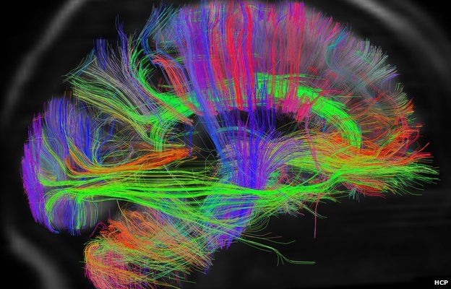
Anxiety
Ron Bert
March 8, 2020

Slide 3
Anxiety in the heart of man causes depression, But a good word makes it glad. — Proverbs 12:25
A
the heart
A good word makes the heart glad
good word
makes
glad
Notes:
No matter who, encouragement builds the band-aids of heaven.

Slide 4
indeed
Notes:
No matter who, encouragement builds the band-aids of heaven.

Slide 5
I have seen all the works that are done under the sun; and indeed, all is vanity and grasping for the wind. What is crooked cannot be made straight, And what is lacking cannot be numbered. — Ecclesiastes 1:14-15
I have seen all the works that are done under the sun; and indeed, all is vanity and grasping for the wind. What is crooked cannot be made straight, And what is lacking cannot be numbered. — Ecclesiastes 1:14-15
indeed
conceit
egotism
self-importance
arrogance
pride
all is vanity
. .
What is crooked cannot
be made straight, And what is
lacking cannot be numbered
Notes:
All the unreachable escapes from earth’s turmoil rest upon the shoulders which bear upon a heart.

Slide 6
crooked cannot be made straight ● what is lacking cannot be numbered ●
man is born
man is born
Notes:
All the unreachable escapes from earth’s turmoil rest upon the shoulders which bear upon a heart.

Slide 7
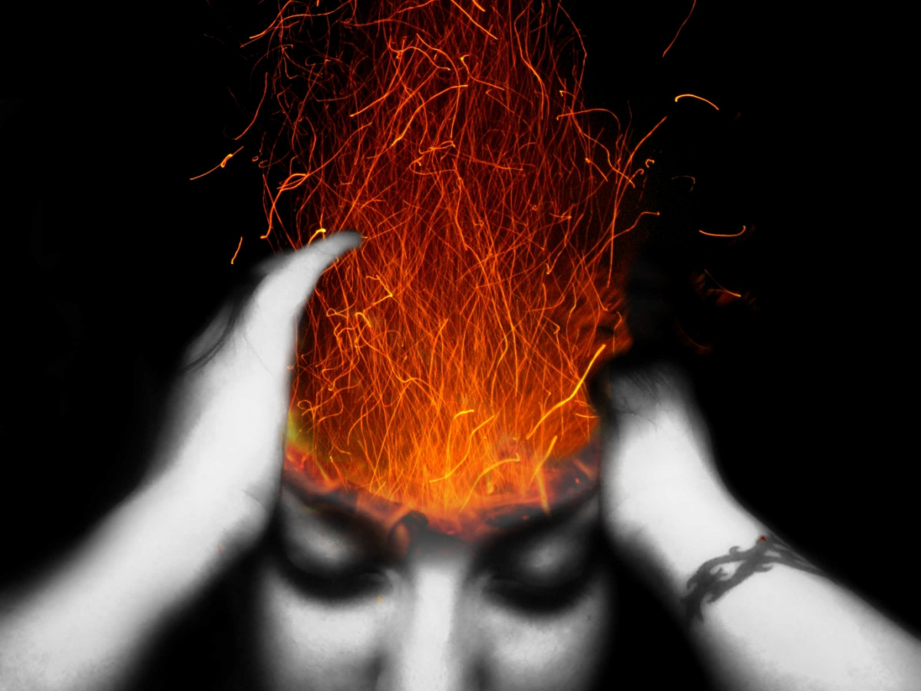
Yet man is born to trouble, As the sparks fly upward. — Job 5:7
man is born
Notes:
Explosions needle the plights of mankind.

Slide 8
Have mercy on me, O LORD, for I am weak; O LORD, heal me, for my bones are troubled. My soul also is greatly troubled; But You, O LORD-how long? Return, O LORD, deliver me! Oh, save me for Your mercies' sake! For in death there is no remembrance of You; In the grave who will give You thanks? I am weary with my groaning; All night I make my bed swim; I drench my couch with my tears. — Psalms 6:2-6
O LORD
O LORD
O LORD
O LORD, deliver me!
O LORD
O LORD, deliver me!
Many sorrows
Notes:
Weariness drains the soul when the flesh finds no pleasure. No doubt most, if not all, have at some point reduced to helplessness bequeathing the Lord, if be, for reprieve.

Slide 9
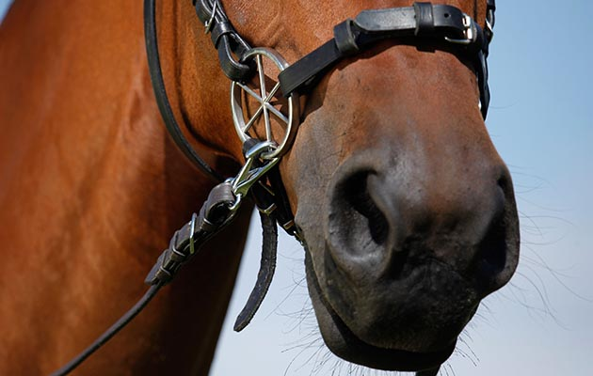
Do not be like the horse or like the mule, Which have no understanding, Which must be harnessed with bit and bridle, Else they will not come near you. Many sorrows shall be to the wicked; But he who trusts in the LORD, mercy shall surround him. Be glad in the LORD and rejoice, you righteous; And shout for joy, all you upright in heart! — Psalms 32:9-11
have
understanding
have
understanding
Many sorrows
sorrow
sorrow
Notes:
Key to all that is upright is our joy in trusting His truths.

Slide 10
A merry heart makes a cheerful countenance, But by sorrow of the heart the spirit is broken. — Proverbs 15:13
bearing
presence
Gods mercy
face
. .
air
countenance
sorrow
features
demeanor
expression
appearance
Notes:
Shadows of heart shatter peace where the kiss of love releases the spirit.

Slide 11
Depart from evil and do good
Notes:
Shadows of heart shatter peace where the kiss of love releases the spirit.

Slide 12
Keep your tongue from evil, And your lips from speaking deceit. Depart from evil and do good; Seek peace and pursue it. The eyes of the LORD are on the righteous, And His ears are open to their cry. — Psalms 34:13-15
LORD
Depart from evil and do good
Depart from evil and do good
Depart from evil and do good
Seek peace and pursue it
Seek peace and pursue it
LORD
Notes:
It is in all that we pursue that delivers able flight or crushing defeat. God want us to rise in the knowledge of Him, but this can be a challenge when we put emphasis on all that is other than Him.

Slide 13
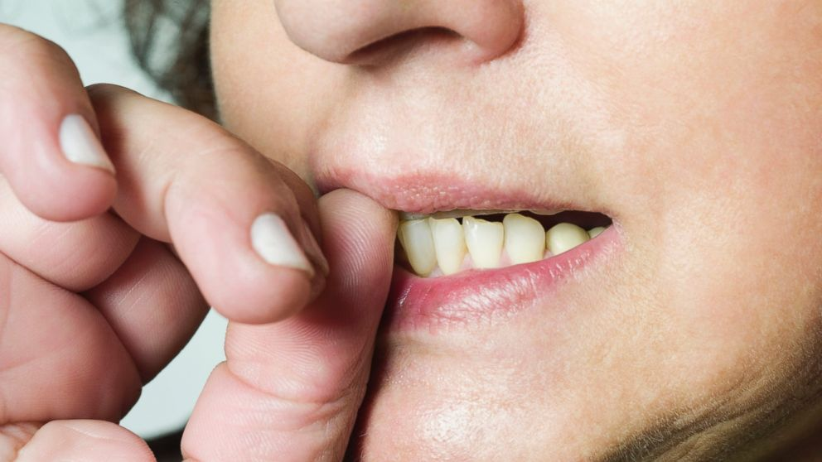
Rest in the LORD, and wait patiently for Him; Do not fret because of him who prospers in his way, Because of the man who brings wicked schemes to pass. Cease from anger, and forsake wrath; Do not fret - it only causes harm. — Psalms 37:7-8
in
Rest in the LORD, and wait patiently for Him; Do not fret because of him who prospers in his way, Because of the man who brings wicked schemes to pass. Cease from anger, and forsake wrath; Do not fret - it only causes harm. — Psalms 37:7-8
LORD
Cease from anger
Cease from anger
Do not fret
Do not fret
Notes:
Patient faith and trust in God is the immunity medicine that causes worries and troubles to fade. God does not desire we bite our teeth while we wait for Him.

Slide 14
Be anxious for nothing, but in everything by prayer and supplication, with thanksgiving, let your requests be made known to God; and the peace of God, which surpasses all understanding, will guard your hearts and minds through Christ Jesus. — Philippians 4:6-7
in everything by prayer
and supplication, with thanksgiving
in everything by prayer
and
thanksgiving
supplication, with
thanksgiving
self
let your requests be made known
. .
the peace of God
surpasses all understanding
will guard your hearts
to God
the peace of God
. .
surpasses all understanding
will guard your hearts
through Christ Jesus
Christ Jesus
. .
Notes:
Prayer is the highway rising past all the heights of heaven.

Slide 15
His
word
His word
Notes:
Prayer is the highway rising past all the heights of heaven.

Slide 16
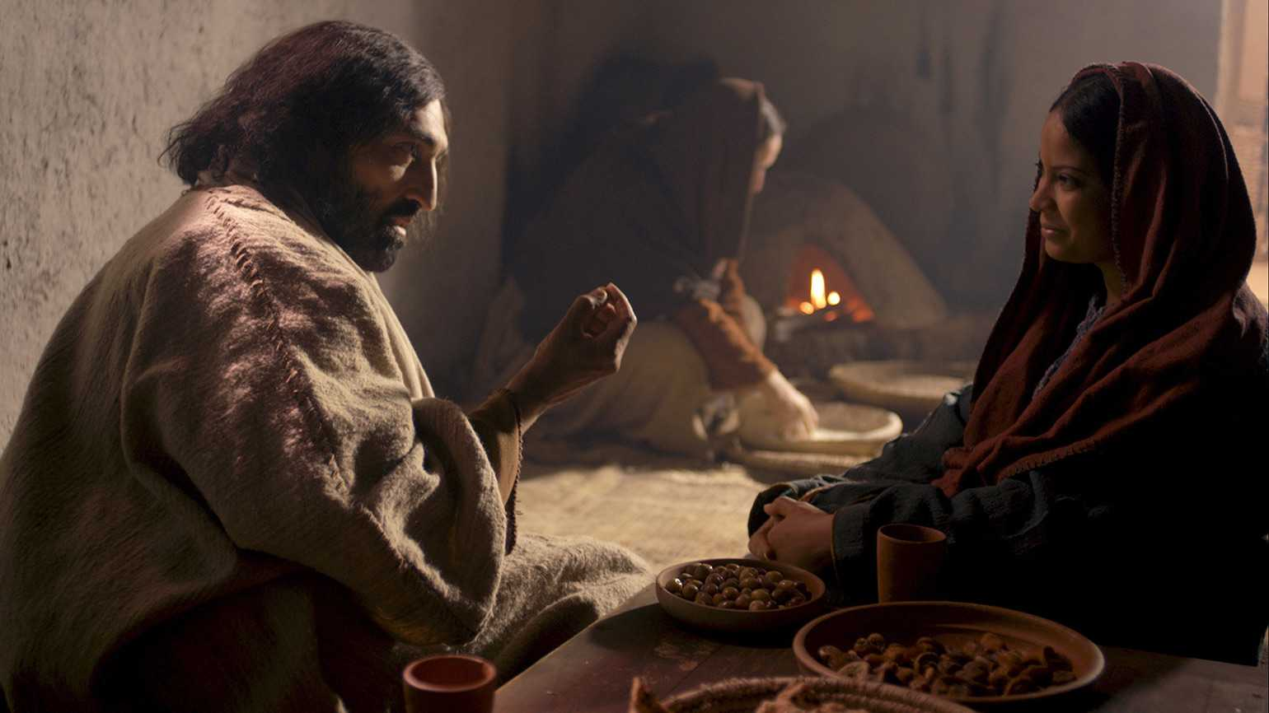
Now it happened as they went that He entered a certain village; and a certain woman named Martha welcomed Him into her house. And she had a sister called Mary, who also sat at Jesus' feet and heard His word. — Luke 10:38-39
Martha
Martha
Martha welcomed Him
Martha welcomed Him
His word
Notes:
His word is food indeed that heals the soul.

Slide 17
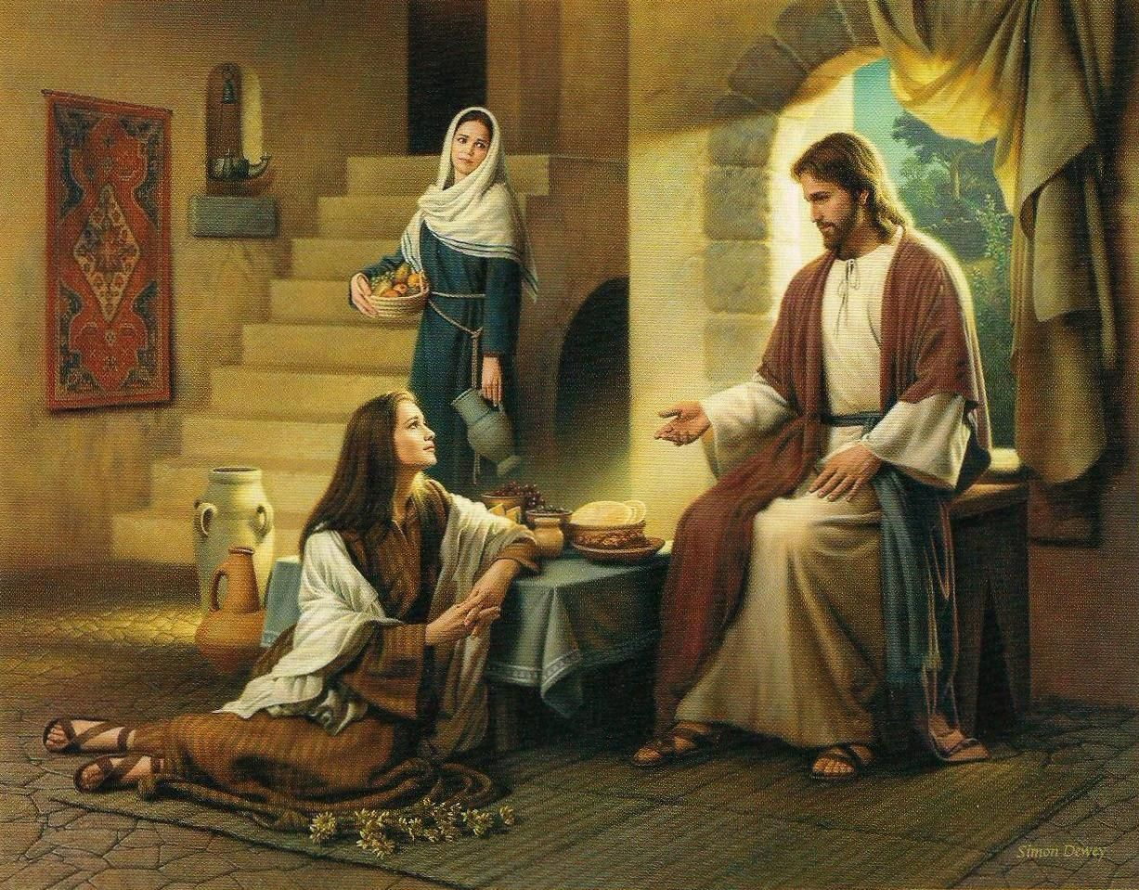
But Martha was distracted with much serving, and she approached Him and said, "Lord, do You not care that my sister has left me to serve alone? Therefore tell her to help me." — Luke 10:40
Martha
Martha
tell her
tell her
Notes:
Anxiety is caused when we judge others and are annoyed at what we are not receiving; Instead of focusing on opportunities to serve, one looks to be served. When the Bible tells us the least shall be the greatest, it is for a heart of service without demands on others to do for you. The greatest treasure is to find contentment.

Slide 18
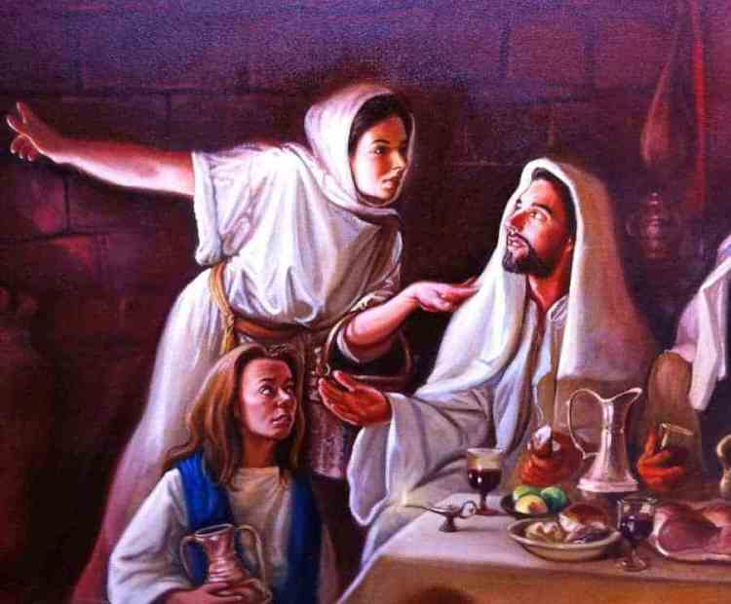
And Jesus answered and said to her, "Martha, Martha, you are worried and troubled about many things. "But one thing is needed, and Mary has chosen that good part, which will not be taken away from her." — Luke 10:41-42
Martha
Martha
Notes:
What one centers on has the focus of welcomed calm or disquieted turmoil. Life is a choice and if one condemns others, what is missed is self-awareness in the moment over outward complaining. To obtain peace, a thankful heart under God’s own grace has nothing comparable.

Slide 19
Therefore humble yourselves under the mighty hand of God, that He may exalt you in due time, casting all your care upon Him, for He cares for you. — 1st Peter 5:6-7
casting all your care upon Him
casting all your care upon Him
Notes:
Overly wrought cares consume the sanctuary of a peaceful mind.

Slide 20
"And which of you by worrying can add one cubit to his stature? If you then are not able to do the least, why are you anxious for the rest? Consider the lilies, how they grow: they neither toil nor spin; and yet I say to you, even Solomon in all his glory was not arrayed like one of these." — Luke 12:25-27
worry
anxious
anxious
Notes:
Beauty is found in what is most simple torn from the bonds of confusion. The shear moment of a naked blade of grass in simple blowing fields has great magnificence when seen. Wonder and awe lift a soul above the petty mundane. Anxiety does not reveal the true nature God intended for mankind.

Slide 21
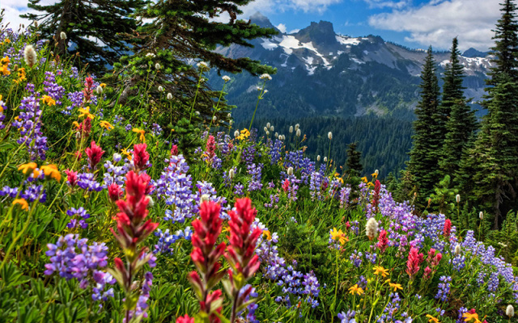
"If then God so clothes the grass, which today is in the field and tomorrow is thrown into the oven, how much more will He clothe you, O you of little faith? And do not seek what you should eat or what you should drink, nor have an anxious mind." — Luke 12:28-29
clothe
clothe
little
faith
little faith
. .
eat
eat
drink
drink
anxious
mind
anxious mind
anxious
. .
Notes:
Escape comes to those who find His love in more than what could ever be returned. desire

Slide 22
d
e
i
e
s
desires
r
s
Notes:
Escape comes to those who find His love in more than what could ever be returned. Usually, unfulfilled desires leave one empty asking for more; discontent with what one already has.

Slide 23
"Now these are the ones sown among thorns; they are the ones who hear the word, and the cares of this world, the deceitfulness of riches, and the desires for other things entering in choke the word, and it becomes unfruitful." — Mark 4:18-19
thorns
cares of
this world
deceitfulness
of riches
desires for
other things
thorns
care
cares
care
of
this world
deceitfulness
of
desires
other
riches
desires for
things
Notes:
All that is seen is destined to the decay of yesterday.

Slide 24
Be sober, be vigilant; because your adversary the devil walks about like a roaring lion, seeking whom he may devour. Resist him, steadfast in the faith, knowing that the same sufferings are experienced by your brotherhood in the world. But may the God of all grace, who called us to His eternal glory by Christ Jesus, after you have suffered a while, perfect, establish, strengthen, and settle you. — 1st Peter 5:8-10
Be sober
be vigilant
Be sober, be vigilant:
Resist the devouring devil
● steadfast in the faith
same sufferings
by your brotherhood
in the world
● after you have suffered a while
perfect, establish, strengthen
settle you
Be sober, be vigilant:
Be sober
be vigilant
thorns
cares of
this world
deceitfulness
of riches
desires for
other things
the
devil
ing
devour
Resist
steadfast in the faith
same sufferings
by your brotherhood
in the
world
after you have suffered a while
perfect, establish, strengthen
settle you
Notes:
We all have walls to conquer in front of us. One block at a time lifts us to that higher vantage.

Slide 25
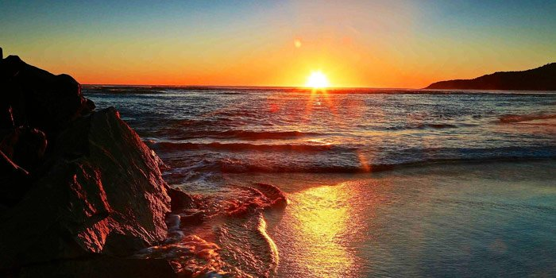
"But seek first the kingdom of God and His righteousness, and all these things shall be added to you. Therefore do not worry about tomorrow, for tomorrow will worry about its own things. Sufficient for the day is its own trouble." — Matthew 6:33-34
"By your patience possess your souls." — Luke 21:19
seek
seek
His righteousness
His righteousness
do not worry about tomorrow
do not worry
about tomorrow
trouble
trouble
Notes:
Worry is mostly those delusions that cause unnecessary panic to envelop stolen peace. Concern is reasonable, where worry can be debilitating and needless. The more one knows of Jesus, and the ways of God, troubles become lessened.

Slide 26
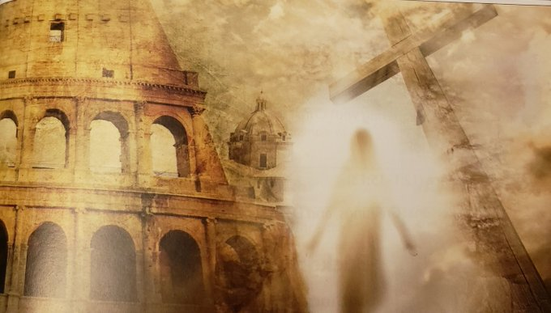
Now as they said these things, Jesus Himself stood in the midst of them, and said to them, "Peace to you." But they were terrified and frightened, and supposed they had seen a spirit. And He said to them, "Why are you troubled? And why do doubts arise in your hearts?" — Luke 24:36-38
Now as they said these things, Jesus Himself stood in the midst of them, and said to them, "Peace to you." But they were terrified and frightened, and supposed they had seen a spirit. And He said to them, "Why are you troubled? And why do doubts arise in your hearts?" — Luke 24:36-38
FEAR
a spirit
trouble
Notes:
God, creator of all, can never be seen in His totality. This fear of either His knowing or our not knowing builds or destroys the sanity of a soul. If we allow our fears to overwhelm our courage, we surely have lost the purpose of life.

Slide 27
"Let not your heart be troubled; you believe in God, believe also in Me." — John 14:1
Let not your heart be troubled
. .
Notes:
Dreams can never fill the light He has already given.

Slide 28
For our light affliction, which is but for a moment, is working for us a far more exceeding and eternal weight of glory, … — 2nd Corinthians 4:17
eternal weight of glory
. .
Notes:
That which is ahead holds more substance than all created before.

Slide 29
God
Lord Jesus Christ
God
Lord Jesus Christ
Lord Jesus Christ

Slide 30
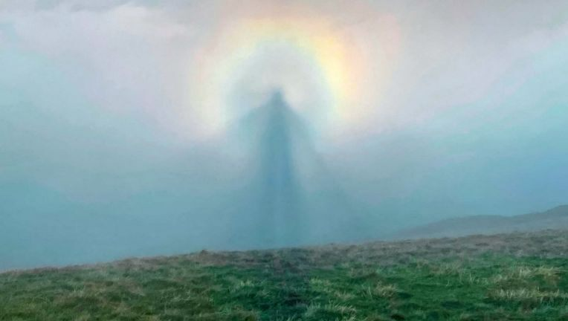
Blessed be the God and Father of our Lord Jesus Christ, the Father of mercies and God of all comfort, who comforts us in all our tribulation, that we may be able to comfort those who are in any trouble, with the comfort with which we ourselves are comforted by God. — 2nd Corinthians 1:3-4
God
Lord Jesus Christ
God
God of all comfort:
→ comforts us in all our tribulation
↓
we may be able to comfort
who are in any trouble
↕
with the comfort we
are comforted by God
God of all comfort
comforts us in all our
tribulation
we may be able
to comfort
who are in any
trouble
with the comfort
we
are comforted
by God
Notes:
When our faith stands for all to see, collectively, we strengthen each other.
Pain is the heart of consciousness we all endure

Slide 31
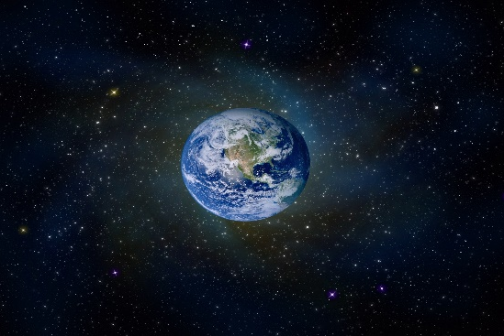
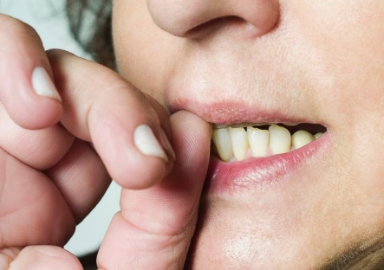
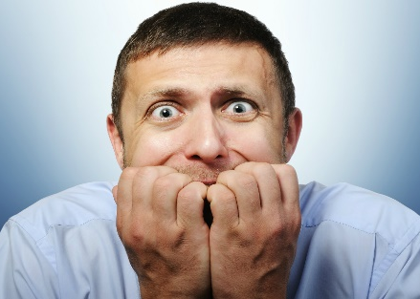
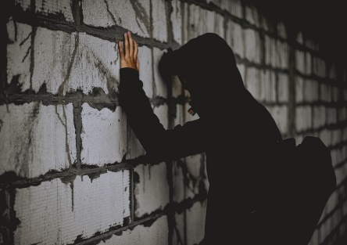
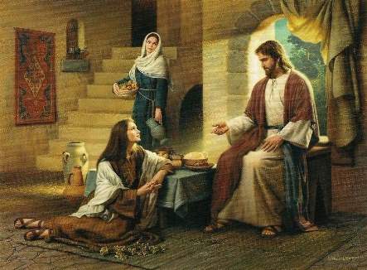

Slide 32
→ Anxiety causes depression while a good word heals
→ The corruption in the world remains among all
→ Understanding with trusting God is what draws joy
→ Depart from evil and do good knowing God watches
→ Forsake wrath, do not fret – it only causes harm
→ Sober prayer & thanksgiving guards peace of heart
→ Overly spent by busy woes misses His simple truths
→ Undue worries avalanche on those with little faith
→ The cares of the world blur higher spiritual truths
→ We are not alone in the challenges all face
→ Troubles and doubts fade when we see Christ’s love
→ Unbounded glory rises on the horizon of our faith
→ Together we are able to comfort one another
Welcome the crutch of God rather than the broken cane of man
Notes:
Welcome the crutch of God rather than the broken cane of man.

Slide 34
Please visit http://www.RonBert.com to explore further
Ronald Bert Channel on
Notes:
Eternity never ends.

