Slide 1
Notes:
Darkness carries nothing to see.

Slide 2
Ron Bert
ANGER
October 16, 2016
Notes:
Anger is the cancer of peace.

Slide 3
"Be angry, and do not sin": do not let the sun go down on your wrath, … — Ephesians 4:26
angry
Notes:
Too many have split over trifles that escalate past the softness of forgiveness. One should choose to be upset with what causes one to fall away from the peace of a true relationship with God first, and then too earnestly carry more peace with others. Anger is the plague of all times and especially for us today as it tragically infests the roadways across our land. Arrogance has it that no one is going to do me wrong, too often attacking without reason. And what damage has been done from the extremely poor selfish leadership we are all stricken with. Without respect for a higher source, hate freely swims in its’ misery biting all in its’ raging path.

Slide 4
Be angry, and do not sin. Meditate within your heart on your bed, and be still. Selah Offer the sacrifices of righteousness, And put your trust in the LORD. — Psalms 4:4-5
angry
within
peace
trust
Notes:
Our anger should be focused upon a riled heart not controlling self in the spirit of love. We need to pray for His will to help bring about what is best in us. Lack of trust in God only exacerbates desperation and agitates the heart unnecessarily.

Slide 5
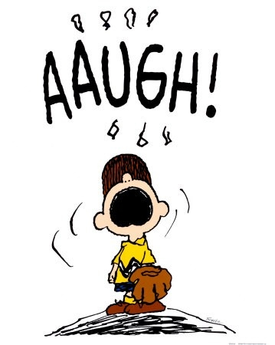
Cease from anger, and forsake wrath; Do not fret-it only causes harm. — Psalm 37:8
Cease
wrath
harm
Notes:
It is a command of God not to be irrationally angry. Not only does headaches over agony steal any bliss, it diverges from the deep gifts of spirit He offers to each of us who are able to fully trust in Him.

Slide 6
He who is slow to wrath has great understanding, But he who is impulsive exalts folly. A sound heart is life to the body, But envy is rottenness to the bones. — Proverbs 14:29-30
wrath
impulsive
envy
Notes:
Contention is the order of our times. How rotten have we become lacking the spiritual life that inspires our children to achieve more. Our leadership is compromised by the animosities we hold from the top down. It all but appears that Godly fear is far from those who tyrannically claim the answers to our social diseases rest with them.

Slide 7
Where do wars and fights come from among you? Do they not come from your desires for pleasure that war in your members? You lust and do not have. You murder and covet and cannot obtain. You fight and war. Yet you do not have because you do not ask. You ask and do not receive, because you ask amiss, that you may spend it on your pleasures. — James 4:1-3
desires for pleasure
You
peace
ask amiss
Notes:
Without clear calm thinking our children are being raised to naturally revolt. The anger from the top trickles down invading the peace of the simple.

Slide 8
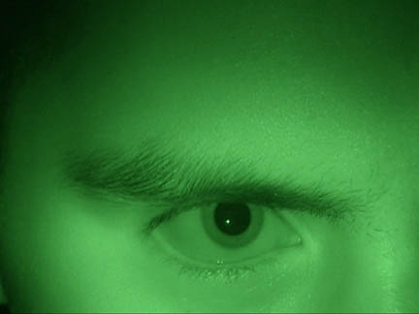
For wrath kills a foolish man, And envy slays a simple one. — Job 5:2
wrath kills
t
envy
a simple
on
Notes:
Envy swirls in an unsettled soul.

Slide 9
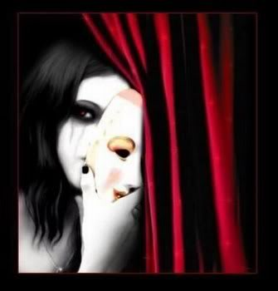
"But the hypocrites in heart store up wrath; They do not cry for help when He binds them. They die in youth, And their life ends among the perverted persons." — Job 36:13-14
fester
do not cry for help
Notes:
Often the young ignorantly die before true maturity and wisdom takes a turn to higher order thinking. The self can consumes one in isolation.

Slide 10
The merciful man does good for his own soul, But he who is cruel troubles his own flesh. — Proverbs 11:17
cruel
troubles
cruelty
troubles
Notes:
Cruelty destroys what little peace may be had leaving the heart disturbed in constant turmoil.

Slide 11
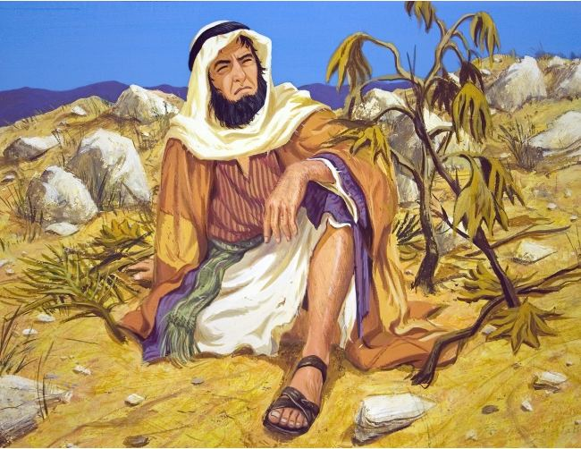
"Therefore now, O LORD, please take my life from me, for it is better for me to die than to live!" Then the LORD said, "Is it right for you to be angry?" — Jonah 4:3-4
suicide
not appoint
For God did not appoint us to wrath, but to obtain salvation through our Lord Jesus Christ, … — 1st Thessalonians 5:9
wrath
obtain salvation
Is it right for you to be angry
Jesus Christ
Notes:
Wrath is reserved for God against those that turn from His ways. We are instructed to resign to sorrow and pleas for help, but not to leap over to senseless anger.

Slide 12
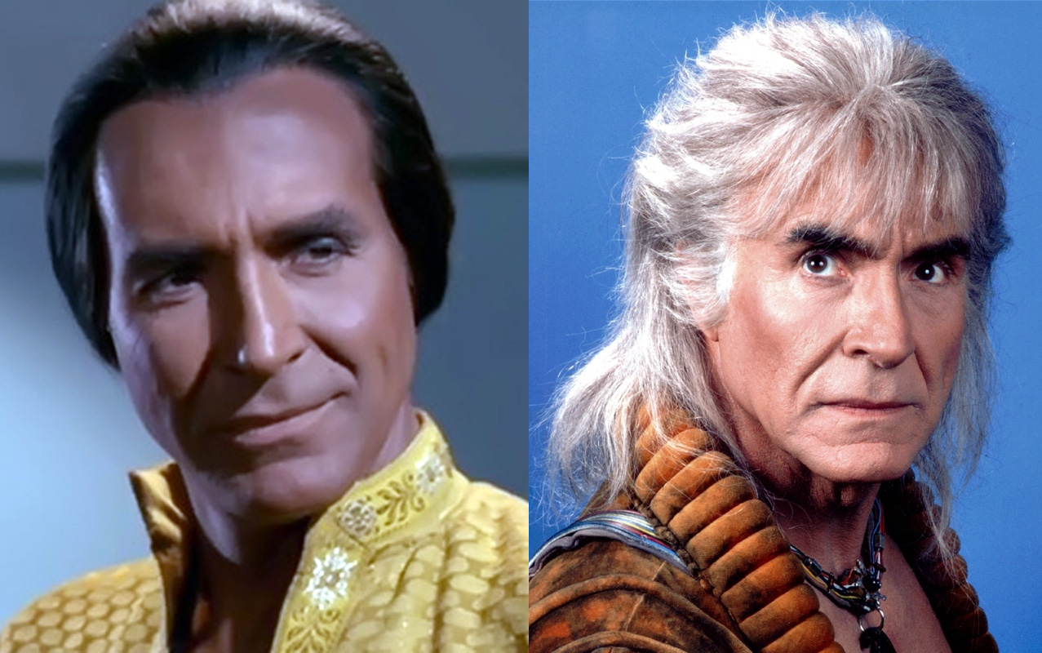
A man of great wrath will suffer punishment; For if you rescue him, you will have to do it again. — Proverbs 19:19
repeat offenders
Notes:
There is repeat offenders that live to hate all others. The truth of one who continually chooses evil over good is very condemning indeed.

Slide 13
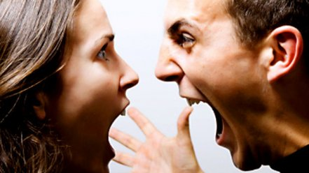
Make no friendship with an angry man, And with a furious man do not go, Lest you learn his ways And set a snare for your soul. — Proverbs 22:24-25
anger begets anger
Notes:
Anger begets anger and it is advised to avoid those who are unable to exercise self control. A wild man cures no one.

Slide 14
An angry man stirs up strife, And a furious man abounds in transgression. — Proverbs 29:22
A wrathful man stirs up strife, But he who is slow to anger allays contention. — Proverbs 15:18
hot head
cool head
Notes:
Hot heads alienate the meek while cool collected heads inspire all they encounter.

Slide 15
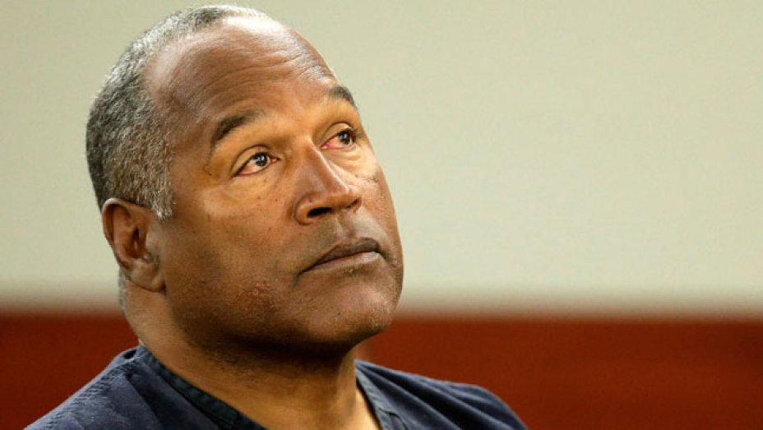
A quick-tempered man acts foolishly, And a man of wicked intentions is hated. — Proverbs 14:17
Notes:
Truly those that defy decency and courtesy earn the public contempt they deserve.

Slide 16
Wrath is cruel and anger a torrent, But who is able to stand before jealousy? — Proverbs 27:4
For jealousy is a husband's fury; Therefore he will not spare in the day of vengeance. — Proverbs 6:34
Notes:
Obsessive possession of others enrages those engulfed in the claws of loss. Jealousy is vain sickness.

Slide 17
Better to dwell in the wilderness, Than with a contentious and angry woman. — Proverbs 21:19
Argumentative
Hot-blooded
Combative
Antagonistic
Hostile
Belligerent
contentious
Quarrelsome
Touchy
Aggressive
Confrontational
Notes:
Wickedness is found in the needles disgust throws in its’ unsatisfied spew.

Slide 18
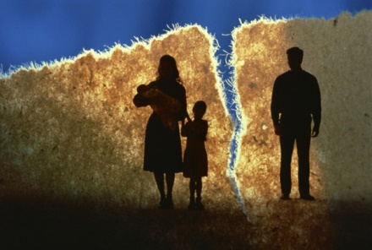
"For the LORD God of Israel says That He hates divorce, For it covers one's garment with violence," Says the LORD of hosts. "Therefore take heed to your spirit, That you do not deal treacherously." — Malachi 2:16
with
violence
take heed
do not deal
treacherously
Notes:
Without love understanding is all but void where the treacherous prowl.

Slide 19
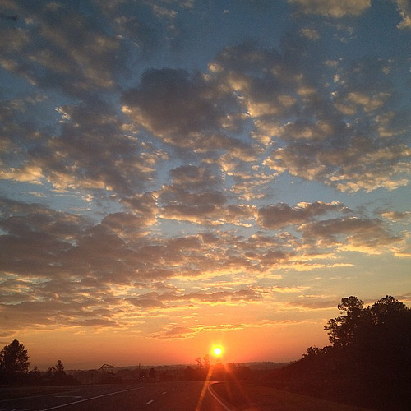
→ Do not rest on your anger
→ Be angry with sin and trust in the Lord
→ Fretting or anger only does harm: cease from wrath
→ Slow to anger shows great understanding
→ Greed and envy is notorious for breeding anger
→ Anger troubles the soul – find His salvation
→ The Lord instructs us to carry sorrow over anger
→ Some are unable to fend off anger and obtain peace
→ Avoid the angry as they stir up strife
→ A quick-tempered man acts foolishly inviting hatred
→ Jealousy is an extreme form of anger
→ Suffering goes hand and hand with an angry partner
→ Treachery involves the intent to do violence
Anger Steals the Love God intended for us
Notes:
Anger steals the love God intended for us.

Slide 20
Notes:
Darkness has no regard for light.

Slide 21
Ron Bert
II
ANGER
October 16, 2016
Notes:
For one to rise past anger, love has to overpower contempt.

Slide 22
So the LORD said to Cain, "Why are you angry? And why has your countenance fallen? If you do well, will you not be accepted? And if you do not do well, sin lies at the door. And its desire is for you, but you should rule over it." — Genesis 4:6-7
angry
rule over
Notes:
In rage madness can cause one to bark unkindly. It is the command of God that we should rule over this weakness to pounce upon others unjustly. We must rule over our emotions rather than having our emotions rule over us.

Slide 23
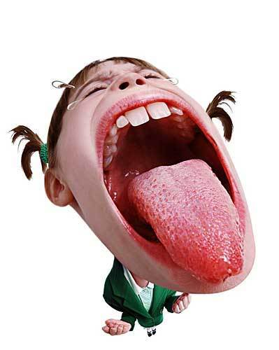
A fool vents all his feelings, But a wise man holds them back. — Proverbs 29:11
fool
vents
Notes:
Fools lack the wisdom to restrain uncontrolled emotional outbursts.

Slide 24
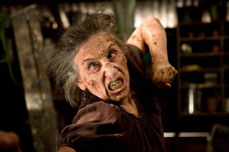
Do not hasten in your spirit to be angry, For anger rests in the bosom of fools. — Ecclesiastes 7:9
"By your patience possess your souls." — Luke 21:19
anger
in
fool
fool
Notes:
Again, God instructs us to take command of our spirit and possess our souls.

Slide 25
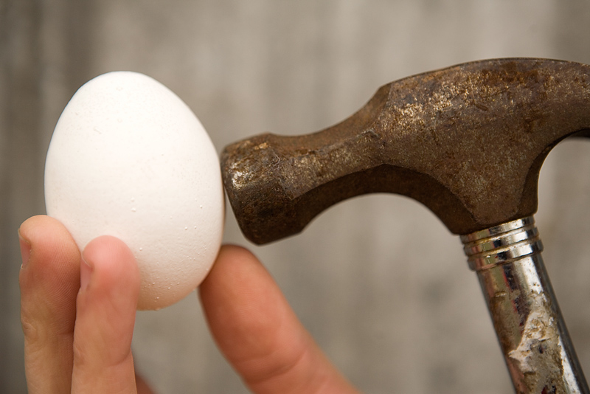
Wisdom is too lofty for a fool; He does not open his mouth in the gate. He who plots to do evil Will be called a schemer. — Proverbs 24:7-8
fool
plots
schemer
Notes:
Fools lack character and stumble as they plot the demise of others in the perception of lifting themselves. Instead of asking God for guidance and forgiveness, a fool will arrogantly plot his way through destructive anger excusing behavior rather than wisely accessing character improvements.

Slide 26
He who is slow to anger is better than the mighty, And he who rules his spirit than he who takes a city. — Proverbs 16:32
slow to anger
rule
Notes:
Self-control is one of the highest premiums in living a life to the fullest potential that it can offer; in the utmost evaluation it reaps spiritual rewards that transcend the eternal.

Slide 27
Whoever has no rule over his own spirit Is like a city broken down, without walls. — Proverbs 25:28
rule
Notes:
There is no defense for an angry fool.

Slide 28
He who has knowledge spares his words, And a man of understanding is of a calm spirit. — Proverbs 17:27
Notes:
Knowledge is key in reaching understanding which directly influences spirit over the lower cardinal desires of flesh.

Slide 29
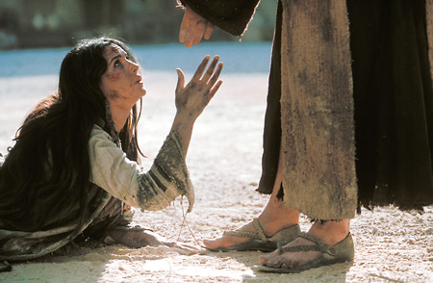
The discretion of a man makes him slow to anger, And his glory is to overlook a transgression. — Proverbs 19:11
thoughtfulness
mercy
Notes:
Thoughtfulness inspires mercy.

Slide 30
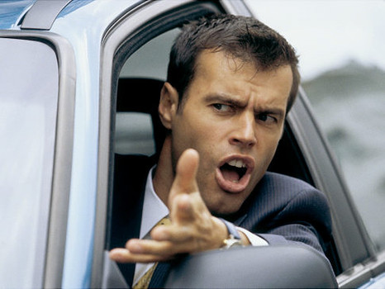
But avoid foolish and ignorant disputes, knowing that they generate strife. — 2nd Timothy 2:23
Notes:
Too often festering anger fuels more than is reasonable. Road rage for instance terrorizes the land leaving carnage upon all hearts. Enraged irritable hearts scorn others without the calm compassion God created for us to be, and to passionately show love for one another. A land without God is surely to be pitied.

Slide 31
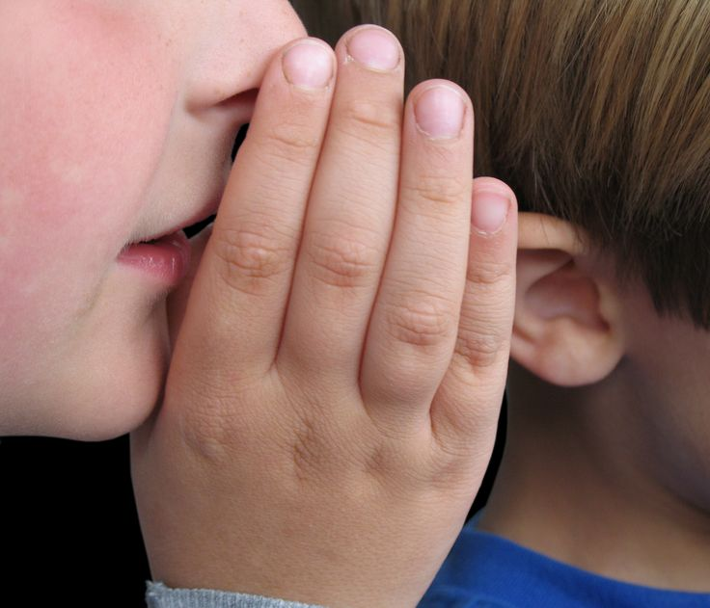
A soft answer turns away wrath, But a harsh word stirs up anger. — Proverbs 15:1
soft
ot
harsh
n
Notes:
Caring hearts are the medicine most mothers preserve for their children. Anger is rebellion away from the unity we seek, for in our families, and generally, among our fellow countrymen.

Slide 32
Let no corrupt word proceed out of your mouth, but what is good for necessary edification, that it may impart grace to the hearers. — Ephesians 4:29
mouth
Notes:
Anger is often associated with vulgar speech as it rips into the pain contempt holds.

Slide 33
"But I say to you that whoever is angry with his brother without a cause shall be in danger of the judgment. And whoever says to his brother, 'Raca!' shall be in danger of the council. But whoever says, 'You fool!' shall be in danger of hell fire. — Matthew 5:22
angry
without
cause
Raca
mouth
Understanding over condemnation
You fool
Notes:
To have understanding over condemnation frees a soul to soar reaching truly unlimited heights. Flat anger shunts the vertical connection with the eternal. Some people live to complain about just everything, including their own lives. This is not living but suffering a slow death. To be upset just for the sake of being upset severs the heart from the joy God wants us to embrace. Anger seems to have different extents or depths. Simply, one could be a compulsive complainer. More severe would be judging another as stupid. The greatest depth would be to actual hate or loathe a specific individual.

Slide 34
A gift in secret pacifies anger, And a bribe behind the back, strong wrath. — Proverbs 21:14
Notes:
Tender gifts in love draws smiles from even dragons.

Slide 35
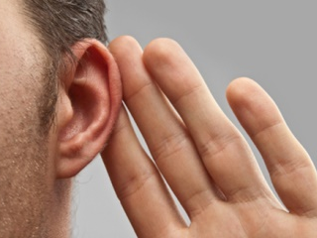
So then, my beloved brethren, let every man be swift to hear, slow to speak, slow to wrath; for the wrath of man does not produce the righteousness of God. — James 1:19-20
wrath
wrath of man
Notes:
Classic to His word is to listen patiently avoiding petty wrath. Knowledge again is key and instrumental in producing a sound soul, or for that matter, a civilization built upon decency and respect. Without knowledge the wisdom of righteousness is trampled by the wrathful ignorant. What is wrapped around one’s little finger owns one’s moment; patience or impatience.

Slide 36
But now you yourselves are to put off all these: anger, wrath, malice, blasphemy, filthy language out of your mouth. — Colossians 3:8
wrath
Notes:
A clean heart is a controlled heart. More often than not it our mouth that expresses our anger. Relentless at times, we have all heard zip it.

Slide 37
Fathers, do not provoke your children, lest they become discouraged. — Colossians 3:21
Notes:
Anger is a vicious cycle destroying the hearts of the young advancing rebellion and disrespect for all. There is no love where children are abandoned to the wolves of their own making. Social diseases can only be cured by a return to God sincerely beseeching His mercy.

Slide 38
… to speak evil of no one, to be peaceable, gentle, showing all humility to all men. — Titus 3:2
Notes:
We are all just single fragile souls. His call reaches out for all true believers to humble themselves, releasing despicable anger and adopting a gracious nature.

Slide 39
Let all bitterness, wrath, anger, clamor, and evil speaking be put away from you, with all malice. And be kind to one another, tenderhearted, forgiving one another, just as God in Christ forgave you. — Ephesians 4:31-32
e
ness
a
s
away from you
al
heart
forgiv
he
Notes:
It is not hard to understand what God desires. It is in the application that we find the challenge; to leave the beast behind one must take on those attributes He declares.

Slide 40
→ Anger is buried deep in the spirit of a fool
→ Fools do not seek understanding
→ Control over the spirit refines the mighty
→ A calm knowledgeable man is cautious in his words
→ Willpower is what brings forgiveness of others
→ Avoid foolish and ignorant disputes
→ Answer softly rather than harshly
→ In all you say, may it impart grace to the hearers
→ Gifts given privately heal anger
→ Swift to hear, slow to speak, slow to wrath
→ Do not provoke your children
→ Find peace and be gentle in all humility to all
→ Forgive one another as God in Christ forgave you
Kindness
Overcomes Anger
Notes:
Kindness overcomes anger.

Slide 41
Notes:
Darkness holds only numbness.

Slide 42
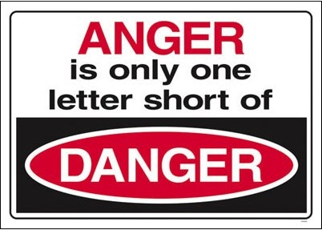
Notes:
It is a fact that anger is one letter short of danger.

Slide 43
Ron Bert
III
ANGER
November 20, 2016
Notes:
Light is an opportunity to shine while in the fading darkness.

Slide 44
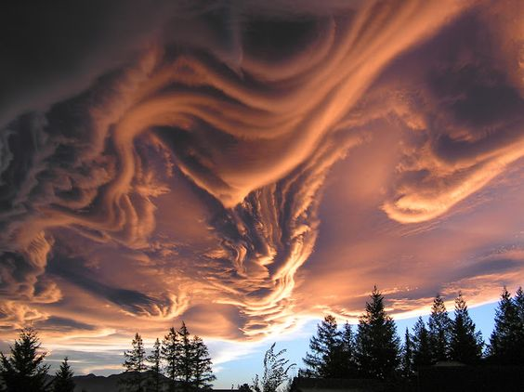
God is a just judge, And God is angry with the wicked every day. — Psalms 7:11
angry
wicked
Notes:
Patiently God waits for souls to gain a sense of right and wrong. His anger will condemn all that is wicked.

Slide 45
God is jealous, and the LORD avenges; The LORD avenges and is furious. The LORD will take vengeance on His adversaries, And He reserves wrath for His enemies; The LORD is slow to anger and great in power, And will not at all acquit the wicked. The LORD has His way In the whirlwind and in the storm, And the clouds are the dust of His feet. — Nahum 1:2-3
He reserves wrath
anger
wicked
Notes:
There will be no mercy for those that show no mercy and are against His called for ways.

Slide 46
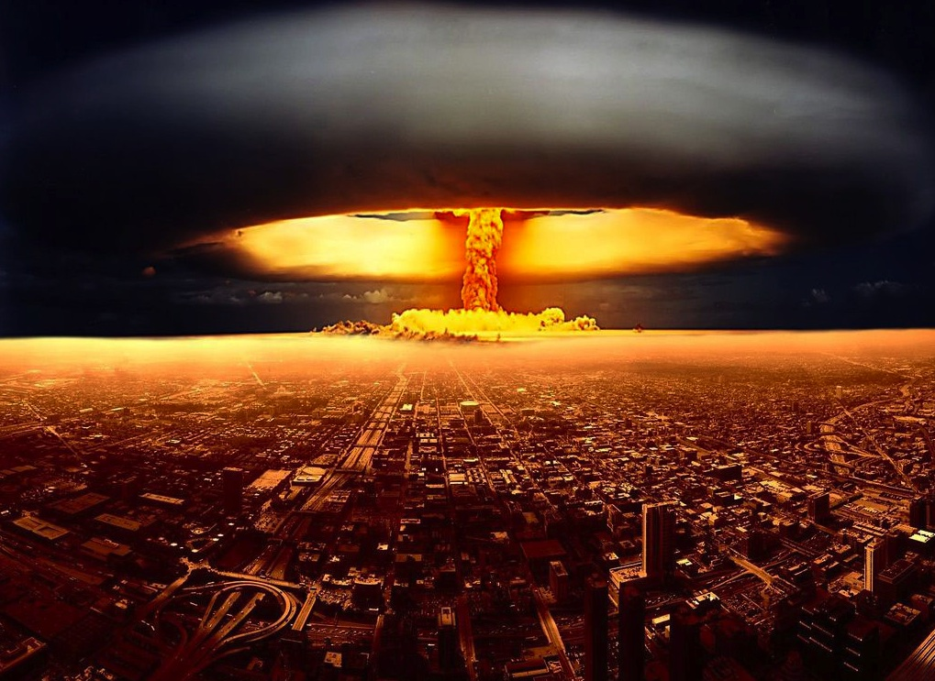
Why do the nations rage, And the people plot a vain thing? — Psalms 2:1
Why
And even as they did not like to retain God in their knowledge, God gave them over to a debased mind, to do those things which are not fitting; being filled with all unrighteousness, sexual immorality, wickedness, covetousness, maliciousness; full of envy, murder, strife, deceit, evil-mindedness; they are whisperers, backbiters, haters of God, violent, proud, boasters, inventors of evil things, disobedient to parents, undiscerning, untrustworthy, unloving, unforgiving, unmerciful; — Romans 1:28-31
Notes:
Foolish ones claim superiority in their wrath as destiny will claim them to the ungodly pit they sow.

Slide 47
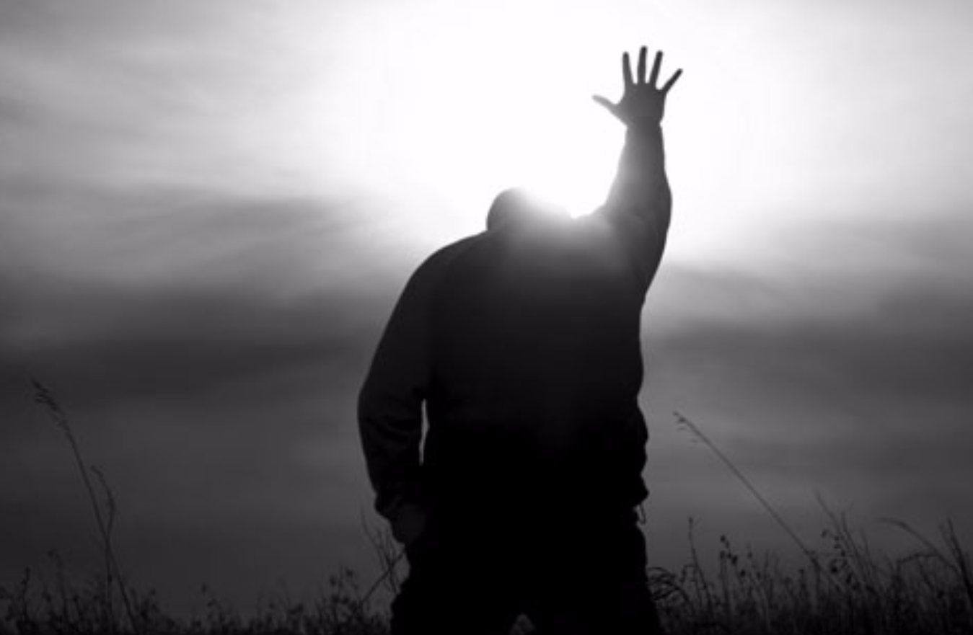
Serve the LORD with fear, And rejoice with trembling. Kiss the Son, lest He be angry, And you perish in the way, When His wrath is kindled but a little. Blessed are all those who put their trust in Him. — Psalms 2:11-12
Serve the LORD
honor
angry
authority
perish
trust in Him
in
Notes:
Unless the rage is silenced and trust put in God, unending turmoil will devour souls in darkness.

Slide 48
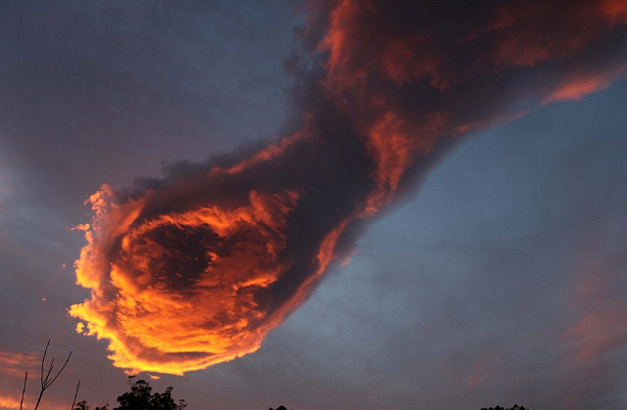
"For I know that after my death you will become utterly corrupt, and turn aside from the way which I have commanded you; and evil will befall you in the latter days, because you will do evil in the sight of the LORD, to provoke Him to anger through the work of your hands." — Deuteronomy 31:29
turn aside
do evil
provoke Him
Notes:
There are those that plot seeking their own gain over glorifying God. Selfish self-seeking souls will not gain His favor.

Slide 49
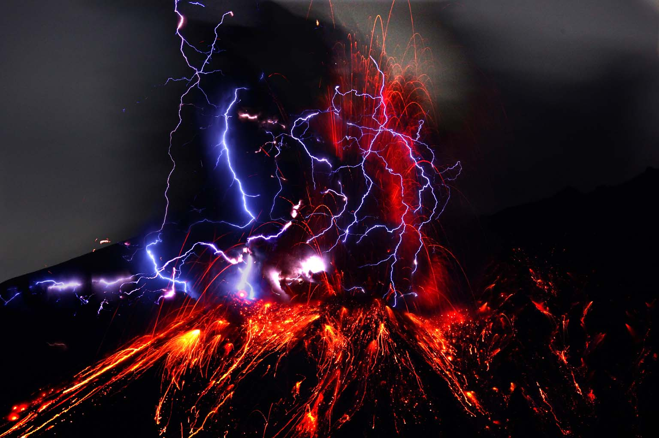
They have provoked Me to jealousy by what is not God; They have moved Me to anger by their foolish idols. But I will provoke them to jealousy by those who are not a nation; I will move them to anger by a foolish nation. For a fire is kindled by my anger, And shall burn to the lowest hell; It shall consume the earth with her increase, And set on fire the foundations of the mountains. —Deuteronomy 32:21-22
moved Me
anger
anger
anger
Notes:
As worship skews to become entertaining for the privileged, He will not recognize the proud heights they will fall from.

Slide 50
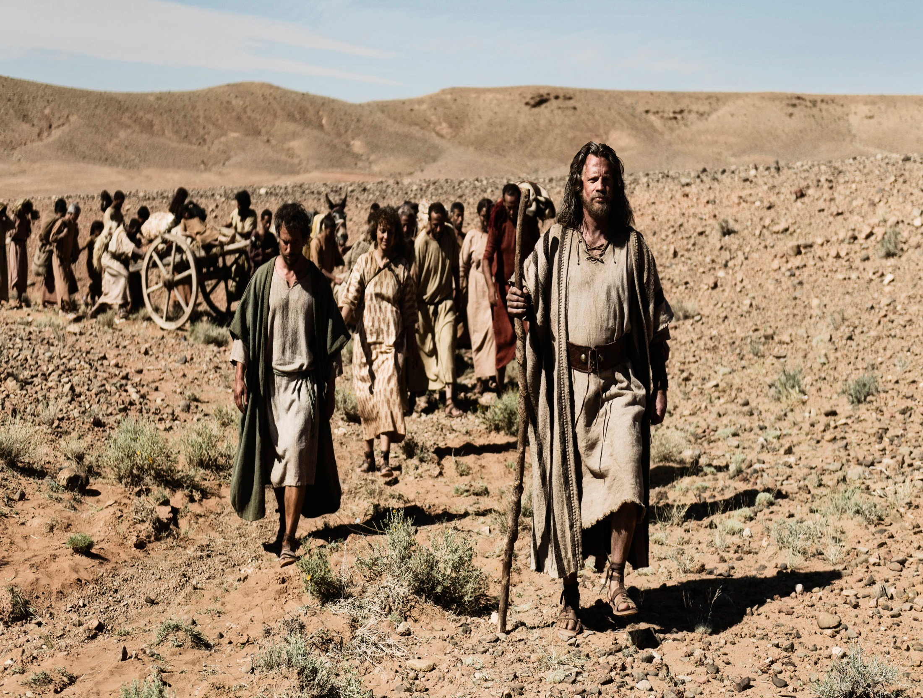
"So the LORD'S anger was aroused against Israel, and He made them wander in the wilderness forty years, until all the generation that had done evil in the sight of the LORD was gone." — Numbers 32:13
anger
aroused
Notes:
Messages have been given to submit in thankful prayer to Him over the arrogance of self-seeking complainers. To be content in that He is is to possess value beyond compare.

Slide 51
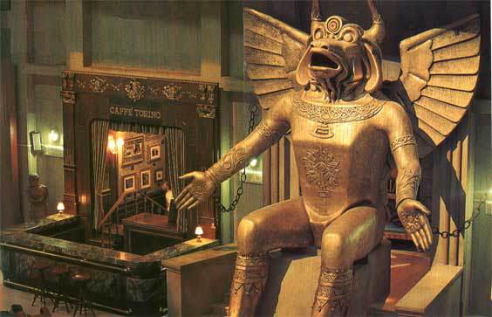
So the LORD became angry with Solomon, because his heart had turned from the LORD God of Israel, who had appeared to him twice, and had commanded him concerning this thing, that he should not go after other gods; but he did not keep what the LORD had commanded. — 1st Kings 11:9-10
his heart
turned from the LORD God
did not keep
Notes:
To turn to one’s own ways against the will of God will invite His fierce wrath upon His revealing.

Slide 52
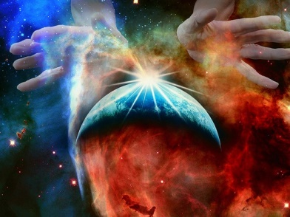
If you say, "Surely we did not know this," Does not He who weighs the hearts consider it? He who keeps your soul, does He not know it? And will He not render to each man according to his deeds? — Proverbs 24:12
weighs the hearts
Notes:
Ignorance may not be enough as goodness is a form of eternal truth. One must seek deeply asking His divine inspiration to expose the truth humbly. There are fundamental truths that can not be changed as a soul approaches the supreme of all deities.

Slide 53
Let no one deceive you with empty words, for because of these things the wrath of God comes upon the sons of disobedience. — Ephesians 5:6
love
wrath
Notes:
Excuses are water in the sand. People try to justify why it is okay to ignore His commands while embracing the desires of flesh. The flesh is a test that reveals the character of the soul. If our wrath is greater than our love we are in serious jeopardy of eternal damnation. He who has an ear let that one hear what the spirit has to say to the souls that would know.

Slide 54
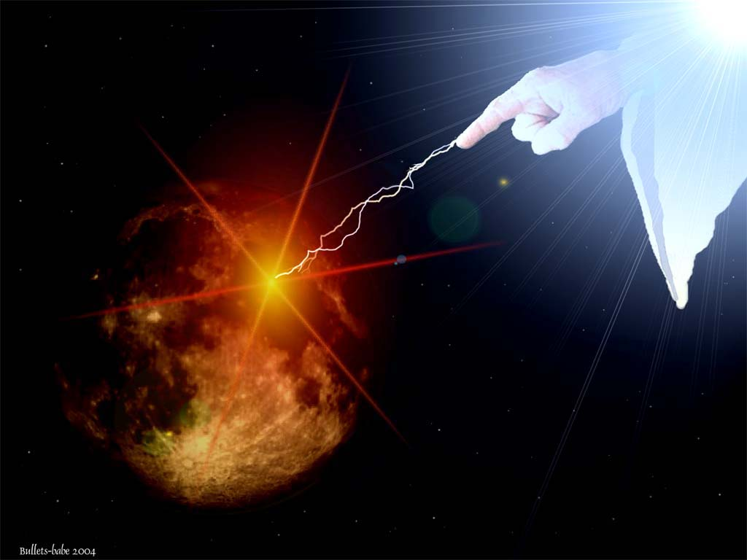
For the wrath of God is revealed from heaven against all ungodliness and unrighteousness of men, who suppress the truth in unrighteousness, … — Romans 1:18
wrath
suppress the truth
HIDE
Notes:
Truth is truth and that can not be changed. Lies have no enduring power.

Slide 55
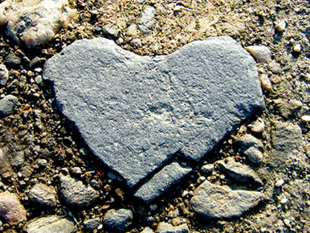
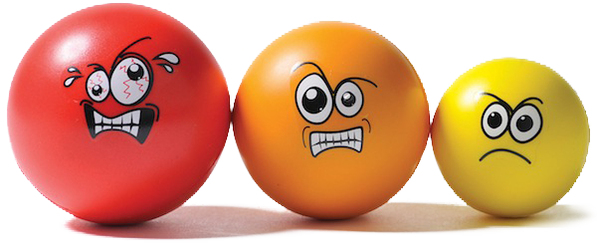
But in accordance with your hardness and your impenitent heart you are treasuring up for yourself wrath in the day of wrath and revelation of the righteous judgment of God, who "will render to each one according to his deeds": — Romans 2:5-6
hardness
unrepentant
unremorseful
unapologetic
defiant
treasuring up
wrath
Notes:
For those that deny or choose to ignore His ways will engage in the most horrific and terrible of all realizations, upon His appearing. It is our deeds that the Lord watches very closely. How genuine is a soul who turns from considering the will of the Almighty? Wrath can often be associated with a broken heart. No one else can pick a soul up off the carpet, that muster must come from within as in a commitment to stand for something greater.

Slide 56
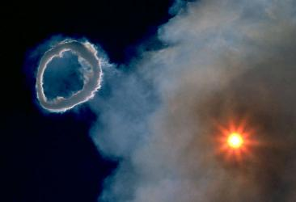
… eternal life to those who by patient continuance in doing good seek for glory, honor, and immortality; but to those who are self-seeking and do not obey the truth, but obey unrighteousness -- indignation and wrath, tribulation and anguish, on every soul of man who does evil, of the Jew first and also of the Greek; — Romans 2:7-9
self-seeking
wrath
wrath
who does evil
Notes:
An inheritance of blessing and or condemnation is coming for each soul rising from the earth’s incubator in the womb of His creation.

Slide 57
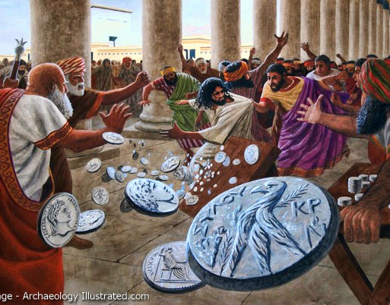
Then Jesus went into the temple of God and drove out all those who bought and sold in the temple, and overturned the tables of the money changers and the seats of those who sold doves. And He said to them, "It is written, 'My house shall be called a house of prayer,' but you have made it a 'den of thieves.'" — Mathew 21:12-13
de
When He had made a whip of cords, He drove them all out of the temple, with the sheep and the oxen, and poured out the changers' money and overturned the tables. And He said to those who sold doves, "Take these things away! Do not make My Father's house a house of merchandise!" — John 2:15-16
self-seeking
ed
greed
ang
money
y
indeed angry
in
r
thieves
house of merchandise
Notes:
God has shown His wrath is for those that take, especially advantage taken of His truth to pursue rewards of self interest. Oppression is a construction of man not condoned by God. The self-seeking will not find God.

Slide 58
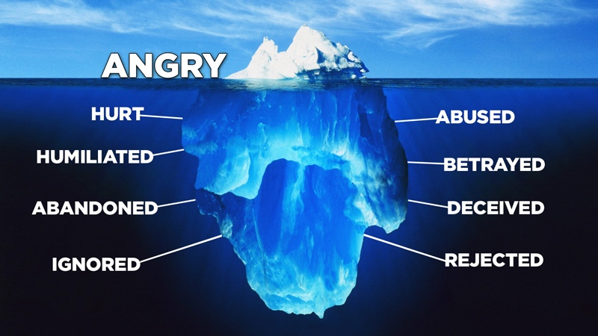
You meet him who rejoices and does righteousness, Who remembers You in Your ways. You are indeed angry, for we have sinned - In these ways we continue; And we need to be saved. — Isaiah 64:5
rejoices
does
righteousness
"And these will go away into everlasting punishment, but the righteous into eternal life." — Matthew 25:46
you
y
remembers You
in
indeed angry
u
o
-
these ways
we
continue
Notes:
Salvation is to be desired. What will be will be. To remember His ways possesses great value beyond measure. Jesus was ignored, abandoned, humiliated, hurt, abused, betrayed, deceived, and rejected. Although we too experience all of these things, He instructs us to seek His salvation in a spirit of joy. Rejoicing in the ways of the Lord frees one from the guilt of evil deeds gone past.

Slide 59
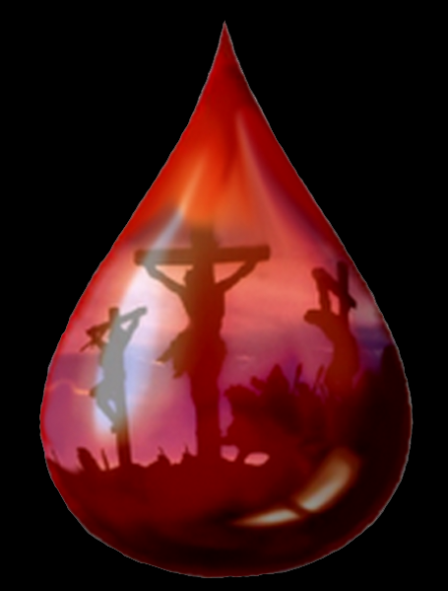
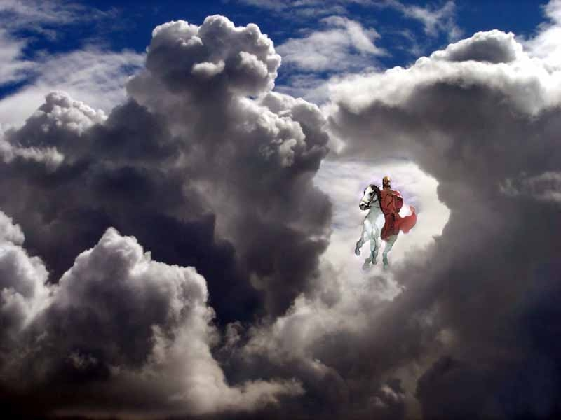
Now upon you I will soon pour out My fury, And spend My anger upon you; I will judge you according to your ways, And I will repay you for all your abominations. — Ezekiel 7:8
Much more then, having now been justified by His blood, we shall be saved from wrath through Him. — Romans 5:9
anger
you
Notes:
For all the suffering inflicted by the cold hearted, their fate is worse than if they had never known. Humbled under Jesus, His sacrifice is our salvation.

Slide 60
By the blast of God they perish, And by the breath of His anger they are consumed. — Job 4:9
You, Yourself, are to be feared; And who may stand in Your presence When once You are angry? You caused judgment to be heard from heaven; The earth feared and was still, When God arose to judgment, To deliver all the oppressed of the earth. Selah — Psalms 76:7-9
God
anger
Notes:
God’s righteous anger will repel the heartless from His healing presence. If we are found to be oppressors, where then do we stand with God who saves the oppressed?

Slide 61
Repay no one evil for evil. Have regard for good things in the sight of all men. If it is possible, as much as depends on you, live peaceably with all men. Beloved, do not avenge yourselves, but rather give place to wrath; for it is written, "Vengeance is Mine, I will repay," says the Lord. — Romans 12:17-19
A N G E R
Have
A N G E R
A
WRATH
regard for good things in the sight
of all men
N
MADNESS
live peaceably
UNFORGIVING
G
V
O
L
E
E
VIOLENCE
R
HARSH
Notes:
While we live waiting for His revealing, He calls us to stay under His care. He desires that we put off anger as it will be His final judgment that will take precedence over all that is wicked. Anger needs to be seen for what it is, an illness of spirit. Spiritual wealth is found in peace.

Slide 62
→ God is angry with the wicked every day
→ God is jealous and will avenge those wicked
→ Blessed are all those who serve and trust in Him
→ Evil provokes the LORD to anger
→ Worshipping things made by God infuriates Him
→ God became angry with Solomon as he turned away
→ The LORD considers all in His wisdom of judgment
→ Let no one deceive you with empty untruthful words
→ Hard hearts will not find His mercy
→ Worshipping God is not of the tangible but in spirit
→ Judgment will come according to our ways
→ In a moment God will extinguish evil
→ "Vengeance is Mine, I will repay," says the Lord
God’s Anger will reveal the truth of all lies
Notes:
God’s Anger will reveal the truth of all lies.

Slide 63
Notes:
Darkness holds the shame of nothing.

Slide 64
Please visit http://www.LoveFromGod.com to explore further
Ronald Bert Channel on
Notes:
Eternity never ends.

