Slide 1
Notes:
Darkness hides in the dark as darkness does.

Slide 2
All Your heart, soul, mind and spirit
Ron Bert
heart
heart
heart
soul
soul
soul
spirit
spirit
mind
spirit
mind
mind
MARCH 15, 2015
Notes:
God calls all to come into His light of truth with one’s all.

Slide 3
\ | / – GOD – / | \
"Remember the former things of old, For I am God, and there is no other; I am God, and there is none like Me, Declaring the end from the beginning, And from ancient times things that are not yet done, Saying, 'My counsel shall stand, And I will do all My pleasure,' " – Isaiah 46:9-10
I am God
Declaring the end
from the beginning
I will
do all My pleasure
Notes:
He has left a treasure trove of knowledge for us to know good from evil. He is larger than any of our pettiness's. Small minded people have always complained impatiently demanding action over caution. The Lord watches and waits to find those in His service holding fast to what He has called out for. As He declares the end from the beginning, it has all been created for His pleasure. In God’s counsel, He finds no pleasure in rebellion or the evils that turn away from the goodness He intended for the autonomous life that He created. God’s plan is for life to live and as such He has begotten His Son, His Spirit, for our redemption, to save us from ourselves that we may grasp eternal life nobly.

Slide 4
\ | / – GOD – / | \
Heart
Mind
The LORD is in His holy temple, The LORD'S throne is in heaven; His eyes behold, His eyelids test the sons of men. The LORD tests the righteous, But the wicked and the one who loves violence His soul hates. – Psalms 11:4-5
'Yes, I will rejoice over them to do them good, and I will assuredly plant them in this land, with all My heart and with all My soul.' – Jeremiah 32:41
For "who has known the mind of the LORD that he may instruct Him?" But we have the mind of Christ. – 1st Corinthians 2:16
"God is Spirit, and those who worship Him must worship in spirit and truth." – John 4:24
Spirit
\ | / – GOD – / | \
mind
heart
mind of Christ
soul
Soul
Spirit
Notes:
Created in His image, qualities of heart, mind, spirit, and soul are gifts freely given to all who consciously live.

Slide 5
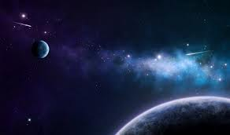
liberty
liberty
Now the Lord is the Spirit; and where the Spirit of the Lord is, there is liberty. – 2nd Corinthians 3:17
Notes:
Freedom is rendered to the deepest reaches of space, both extremely close and vastly distant. Stewardship has gone astray as men have fallen away from the blessings He offers more often engaging in harmful pursuits reaching across suffering generations so detrimental to the meek.

Slide 6
For you, brethren, have been called to liberty; only do not use liberty as an opportunity for the flesh, but through love serve one another. - Galatians 5:13
For you, brethren, have been called to liberty; only do not use liberty as an opportunity for the flesh, but through love serve one another. - Galatians 5:13
called
liberty
love
love
Notes:
His truth is not hard to understand as serving each other takes on high precedence. His nature of love renders service, and in His image, He calls us out to do the same.

Slide 7
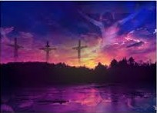
"Behold! My Servant whom I have chosen, My Beloved in whom My soul is well pleased! I will put My Spirit upon Him, And He will declare justice to the Gentiles." - Matthew 12:18
"Behold! My Servant whom I have chosen, My Beloved in whom My soul is well pleased! I will put My Spirit upon Him, And He will declare justice to the Gentiles." - Matthew 12:18
love
love
But God demonstrates His own love toward us, in that while we were still sinners, Christ died for us. - Romans 5:8
But God demonstrates His own love toward us, in that while we were still sinners, Christ died for us. - Romans 5:8
declare
justice
Notes:
God’s service through Jesus brings us all to know how great His love is for us. That our lives are more important than our deaths. His wisdom remains for all that will have it.

Slide 8
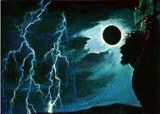
"The heart is deceitful above all things, And desperately wicked; Who can know it?" - Jeremiah 17:9
"If you do well, will you not be accepted? And if you do not do well, sin lies at the door. And its desire is for you, but you should rule over it." - Genesis 4:7
declare
Heart
Heart
Mind
Mind
The coming of the lawless one is according to the working of Satan, with all power, signs, and lying wonders, and with all unrighteous deception among those who perish, because they did not receive the love of the truth, that they might be saved. And for this reason God will send them strong delusion, that they should believe the lie, that they all may be condemned who did not believe the truth but had pleasure in unrighteousness. – 2nd Thessalonians 2:9-12
justice
"Behold, all souls are Mine; The soul of the father As well as the soul of the son is Mine; The soul who sins shall die." - Ezekiel 18:4
Pride goes before destruction, And a haughty spirit before a fall. - Proverbs 16:18
\ | / – SELF – / | \
\ | / – SELF – / | \
For Christ also suffered once for sins, the just for the unjust, that He might bring us to God, being put to death in the flesh but made alive by the Spirit, … -1st Peter 3:18
heart
once for sins
sin
spirit
soul
i
bring us to God
rule over it
n
m
d
Soul
Spirit
Notes:
In the depths of the caldron called humanity, dark clouds more often cover the light God would want us to have. He sacrificed that we might live in Him having the knowledge of creation in His battle to regain eternally loyal souls. Purging self reveals the true spirit of God.

Slide 9
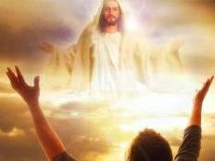
Therefore, since Christ suffered for us in the flesh, arm yourselves also with the same mind, for he who has suffered in the flesh has ceased from sin, that he no longer should live the rest of his time in the flesh for the lusts of men, but for the will of God. – 1st Peter 4:1-2
in
consolation
→ consolation in Christ
→ comfort of love
→ fellowship of the Spirit
→ affection and mercy
↘
joy by being
↘
● like-minded
● having the same love
● of one accord
● of one mind
↑
be in you
Therefore if there is any consolation in Christ, if any comfort of love, if any fellowship of the Spirit, if any affection and mercy, fulfill my joy by being like-minded, having the same love, being of one accord, of one mind. Let nothing be done through selfish ambition or conceit, but in lowliness of mind let each esteem others better than himself. Let each of you look out not only for his own interests, but also for the interests of others. Let this mind be in you which was also in Christ Jesus, … – Philippians 2:1-5
in Christ
comfort of love
fellowship of the Spirit
affection and
mercy
joy by being
like-minded
having the same love
of one accord
of one mind
selfish ambition or conceit
selfish ambition or conceit
look out
live
live
own interests
interests of others
be in
you
God
for the will of God
Therefore
for the will of God
in

Slide 10
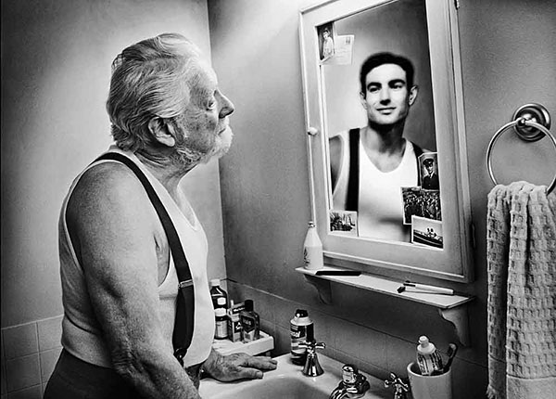
But the natural man does not receive the things of the Spirit of God, for they are foolishness to him; nor can he know them, because they are spiritually discerned. – 1st Corinthians 2:14
man
Thus says the LORD: "Cursed is the man who trusts in man And makes flesh his strength, Whose heart departs from the LORD. – Jeremiah 17:5
"Truly, this only I have found: That God made man upright, But they have sought out many schemes." – Ecclesiastes 7:29
The spirit of a man is the lamp of the LORD, Searching all the inner depths of his heart. – Proverbs 20:27
God
LORD
Notes:
Man in his self-serving demise has turned away from the true God. Does one’s mirror reflect the beast or the man?

Slide 11
"But from there you will seek the LORD your God, and you will find Him if you seek Him with all your heart and with all your soul." – Deuteronomy 4:29
LORD
LORD
find Him
find Him
Notes:
In liberty, sanctuary is present for each heart to fathom His revealing truth.

Slide 12
"You shall love the LORD your God with all your heart, with all your soul, and with all your strength." – Deuteronomy 6:5
LORD
with all
with all
with all
with all
with all
with all
Notes:
Dedication delivers an honest soul if bias does not cloud ones convictions to serve the master rather than a mere servant of one of man’s many delusional facades. Loving God with one’s all pursues God, not man.

Slide 13
"And now, Israel, what does the LORD your God require of you, but to fear the LORD your God, to walk in all His ways and to love Him, to serve the LORD your God with all your heart and with all your soul, and to keep the commandments of the LORD and His statutes which I command you today for your good?" – Deuteronomy 10:12-13
LORD
to fear the LORD
LORD
to walk
to
to
to
to love Him
in all His ways
to
to
LORD
serve the LORD
LORD
to keep the commandments
to
LORD
for your good
Notes:
He has delivered the keys to enter His vault of truth. To fear Him with great regard, to walk in His ways as announced, to serve Him in this through obedience as it has all been established for our good.

Slide 14
He has shown you, O man, what is good; And what does the LORD require of you But to do justly, To love mercy, And to walk humbly with your God? – Micah 6:8
"And the LORD your God will circumcise your heart and the heart of your descendants, to love the LORD your God with all your heart and with all your soul, that you may live." – Deuteronomy 30:6
LORD
to do
to do
that you may live
Notes:
God desires a heart full of passion in seeking His truth. Those indifferent or actually cold will literally have hell to pay in their avoidance of the All Mighty Supreme Creator of All. All reduces back to the one and only true God where all will bow.

Slide 15
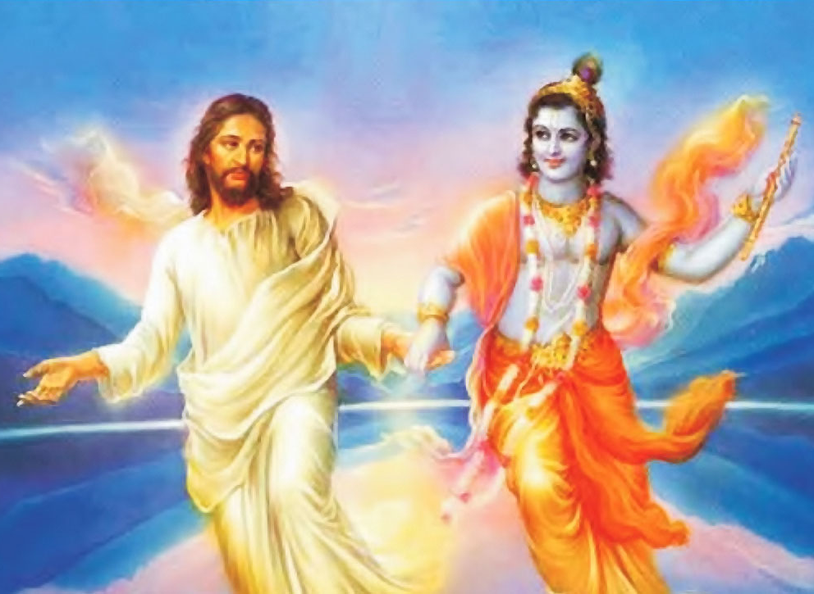
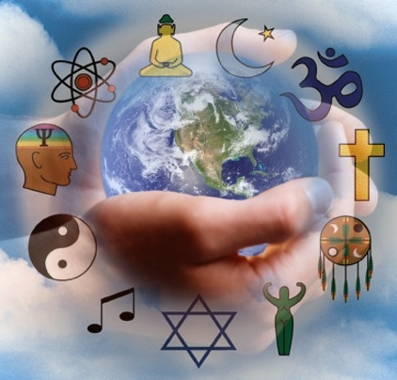
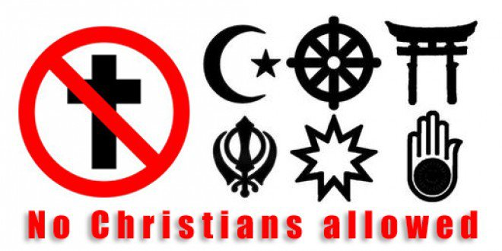
"... you shall not listen to the words of that prophet or that dreamer of dreams, for the LORD your God is testing you to know whether you love the LORD your God with all your heart and with all your soul." – Deuteronomy 13:3
LORD
God is testing you
God is testing you
Notes:
Many religions divide the truth of God delusionally choosing fantasy over reality. Even atheism has a god of disbelief. To worship in truth is a pursuit in discovering His will as laid forth for all to witness through His Son, given to us, so that we may know God Himself and not just a mere construction of man. Many well intended maintain the goodness He calls out for but if done absent in regarding His will for return, vanity delivers nothing. Swinging a rifle praising God does little for the betterment He calls out for in each of us. Written on the heart where no gun can pierce, truth can be known by those willing to know.

Slide 16
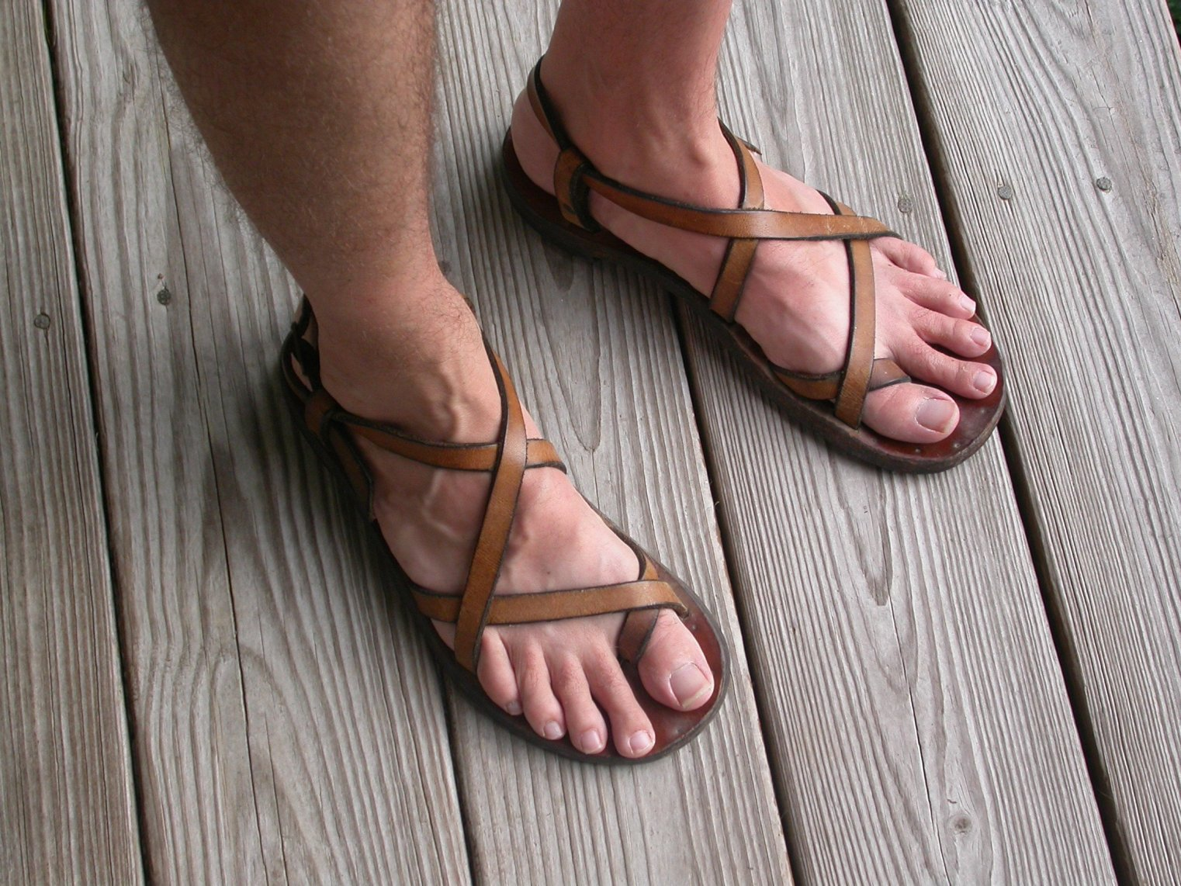
"But take careful heed to do the commandment and the law which Moses the servant of the LORD commanded you, to love the LORD your God, to walk in all His ways, to keep His commandments, to hold fast to Him, and to serve Him with all your heart and with all your soul." – Joshua 22:5
careful
take careful heed to do
to do
to do
This is a faithful saying, and these things I want you to affirm constantly, that those who have believed in God should be careful to maintain good works. These things are good and profitable to men. – Titus 3:8
LORD
careful to maintain good works
careful to maintain good works
heart
Notes:
He instructs us as individuals to carefully heed His word as to what drives our lives.

Slide 17
"And to love Him with all the heart, with all the understanding, with all the soul, and with all the strength, and to love one's neighbor as oneself, is more than all the whole burnt offerings and sacrifices." – Mark 12:33
love
love
love Him
love Him
heart
all
all
all
all
more than all
Notes:
In the gymnasium of emotions, our fitness in loving Him and others forms the character He himself searches for in us.

Slide 18
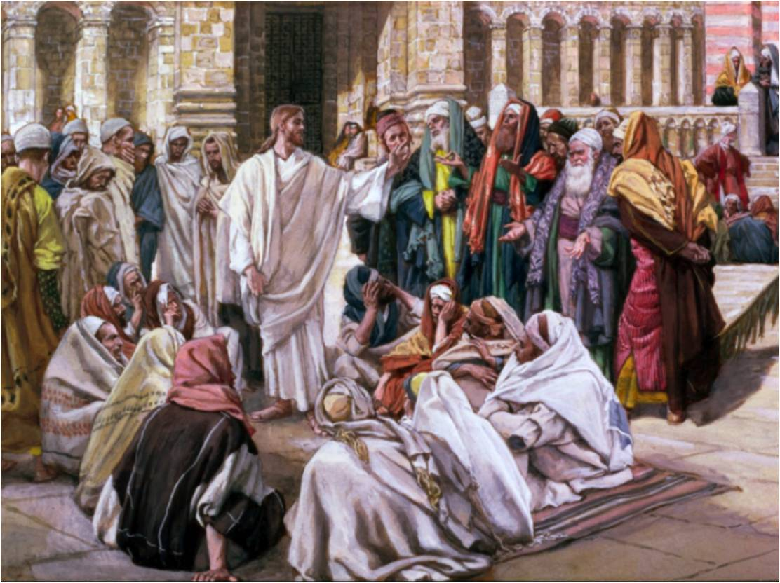
Jesus said to him," 'You shall love the LORD your God with all your heart, with all your soul, and with all your mind.' This is the first and great commandment. And the second is like it: 'You shall love your neighbor as yourself.' On these two commandments hang all the Law and the Prophets." – Matthew 22:37-40
love
all
all
all
↓
Entire Old Testament
hang
all the Law
and the Prophets
Notes:
Jesus himself proclaimed that fundamental to all truth is loving God supremely, along with loving all others including self within His creation. Peace is a moment often passed by within the recklessness of man and the oppression we all bear.

Slide 19
The LORD preserves all who love Him, But all the wicked He will destroy. – Psalm 145:20
love
love Him
Notes:
Commitment to God surpasses the evils shed to the past as one awakens in Him.

Slide 20
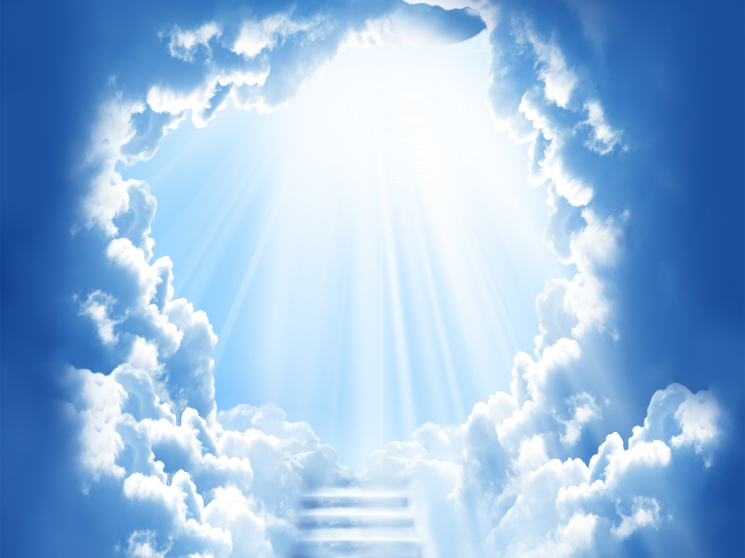
But as it is written: Eye has not seen, nor ear heard, Nor have entered into the heart of man The things which God has prepared for those who love Him." – 1st Corinthians 2:9
love Him
Notes:
More than the imaginations dust of no more, heaven sparkles truths unrevealed beyond splendor.

Slide 21
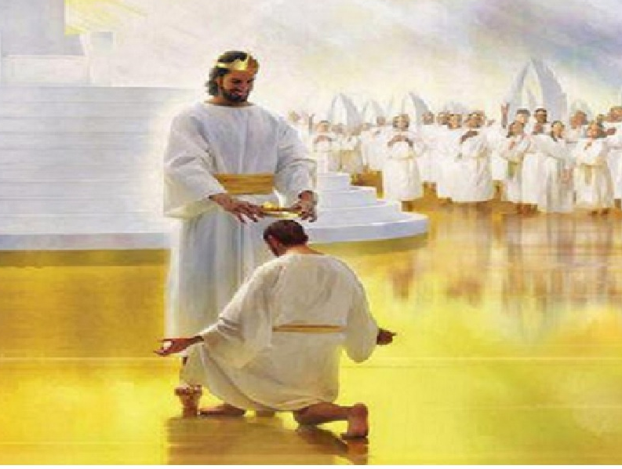
Blessed is the man who endures temptation; for when he has been approved, he will receive the crown of life which the Lord has promised to those who love Him. – James 1:12
love Him
Notes:
We do not have to wait until arriving in heaven to find blessings in the promise the crown of life holds, as it delivers eternally, which includes now.

Slide 22
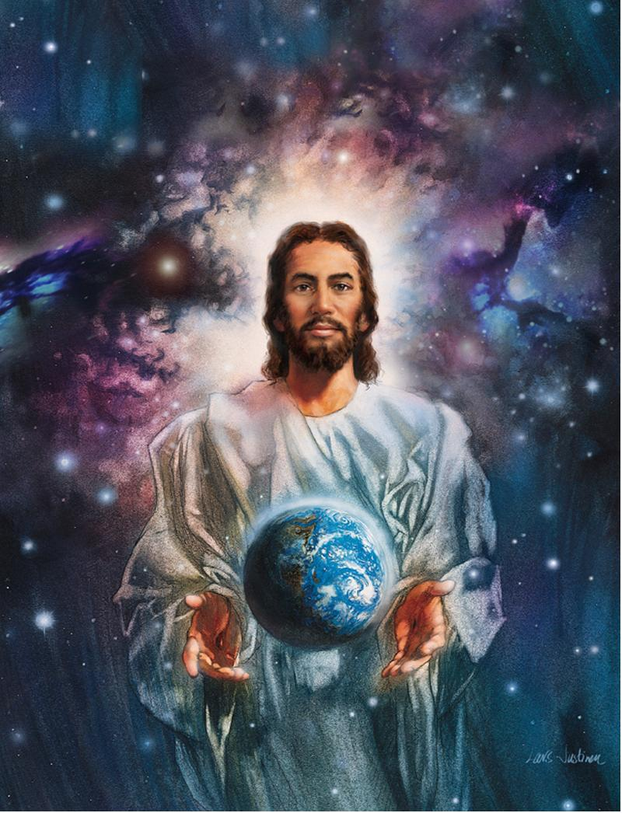
We love Him because He first loved us. – 1st John 4:19
love Him
Notes:
God’s love extends much further than the earth where He seeks for each one of us across all the ages of man. This humbling beyond imaginable love is why so many hear His steadfast call. His love remains as He calls to us.

Slide 23
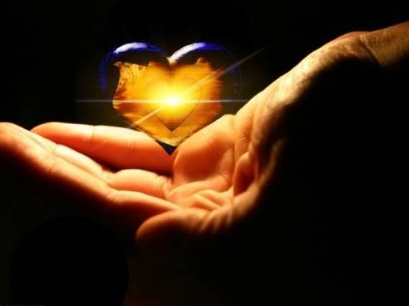
"He who has My commandments and keeps them, it is he who loves Me. And he who loves Me will be loved by My Father, and I will love him and manifest Myself to him." – John 14:21
love him
love Him
Notes:
The brightness of love beholds the reflection of God. As two way streets intersect, it is mutual love that is nurtured and cherished by God.

Slide 24
Jesus answered and said to him, "If anyone loves Me, he will keep My word; and My Father will love him, and We will come to him and make Our home with him. – John 14:23
love
love him
come to
come to
Notes:
One’s life becomes an open book as He refreshes life that can be had, as no mortal friend could provide. Loving God is where the light of man ignites to become the child He loves.

Slide 25
But whoever keeps His word, truly the love of God is perfected in him. By this we know that we are in Him. – 1st John 2:5
keeps His word
keeps His word
love
God
Notes:
Our own test of obedience reveals our spiritual heath and unity in Him.

Slide 26
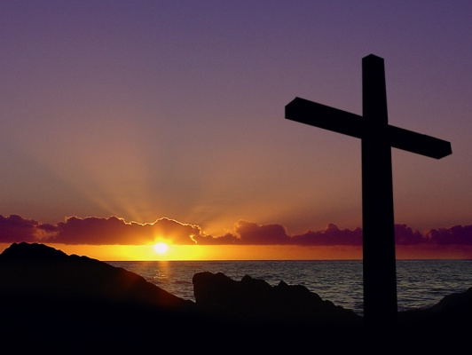
Whoever believes that Jesus is the Christ is born of God, and everyone who loves Him who begot also loves him who is begotten of Him. By this we know that we love the children of God, when we love God and keep His commandments. For this is the love of God, that we keep His commandments. And His commandments are not burdensome. – 1st John 5:1-3
love
God
love
Notes:
Love contains all of the colors of light both visible and invisible. His truth remains over the mere babblings of man.

Slide 27
"If you love Me, keep My commandments." – John 14:15
Hatred stirs up strife, But love covers all sins. – Proverbs 10:12
love
Notes:
Knowing good and evil is essential in obeying the will of God over the whims of man. Regret heals the penitent heart to stand strong.

Slide 28
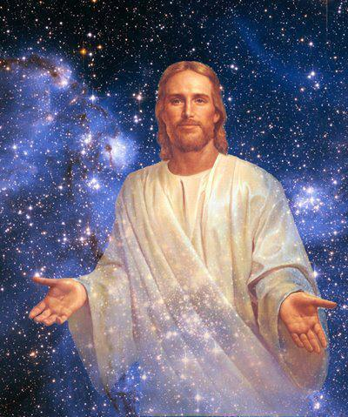
"… for the Father Himself loves you, because you have loved Me, and have believed that I came forth from God." – John 16:27
love
love
because
love
loved Me
believed
Notes:
Belief in God and His Son is God’s choice to deliver truth to those who live upon the earth.

Slide 29
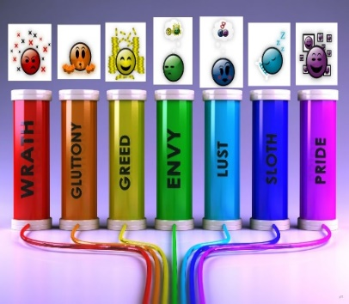
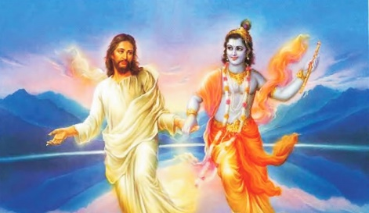
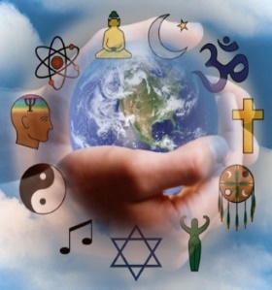
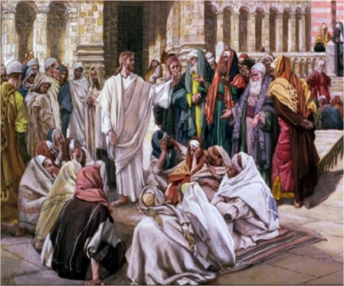
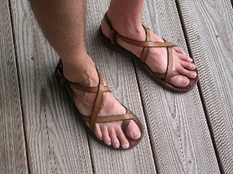
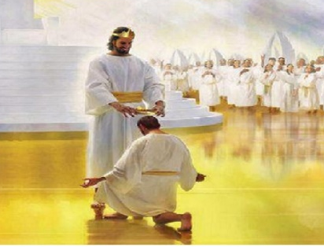

Slide 30
① Through love serve one another
② To seek Him with all one’s heart and soul
③ To love Him with all one’s heart, soul, and strength
④ To fear the Lord
⑤ To walk in all His ways
⑥ To serve Him
⑦ To keep the commandments
⑧ To do justly – stand on honesty
⑨ To love mercy – hold a forgiving heart
⑩ To walk humbly with your God
⑪ To not listen to the words of falsehoods
⑫ To hold fast to Him
⑬ Take careful heed to do
⑭ To love God with all one’s mind and understanding
⑮ To love one's neighbor as oneself
God calls
to each heart
To come
Notes:
God’s call to return with knowledge of Him is universal. The spokes of His truth remain exposed for the discerning heart.

Slide 31
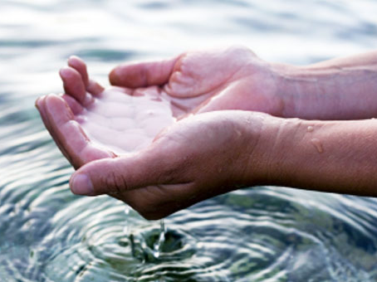
And the Spirit and the bride say, "Come!" And let him who hears say, "Come!" And let him who thirsts come. Whoever desires, let him take the water of life freely. – Revelation 22:17
Notes:
He desires that we all drink freely in the life He offers. No force can persuade a man that has already decided one way or another. His law has been given. It is our decisions that guide our actions that we will account to God for.

Slide 32
Notes:
Darkness, somewhere below empty, has less than nothing.

Slide 33
Please visit http://www.RonBert.com to explore further
Ronald Bert Channel on
Notes:
Eternity never ends.

